Slide 1


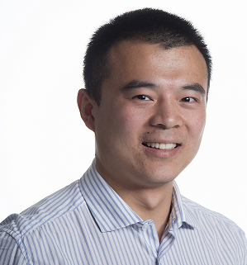
FactorBase: Multi-Relational Structure Learning with SQL All the Way
School of Computing Science
Simon Fraser University
Vancouver, Canada
Zhensong Qian | Oliver Schulte
Notes:
http://dsaa2015.lip6.fr/?page_id=692
(L) for Long Presentation for 20 minutes
Tuesday 20th Oct 2015
S7R1 Databases
15:00 FACTORBASE: Multi-Relational Structure Learning with SQL All The Way (L) Zhensong Qian and Oliver Schulte

Slide 2
Introduction

Slide 3
Statistical-Relational Learning (SRL)
Recent growing field.
Intersection of Machine Learning, Artificial Intelligence and Database Systems.
Applications for structured/linked/relational data.
Link-based Classification
Relational Query Optimization.
Information Extraction
Outlier Detection
....
ML
AI
SRL
DB
FactorBase Qian, Schulte DSAA 2015 @ Paris, France
Notes:
Statistical relational learning is a recent growing field. It’s the intersection of machine learning, artificial intelligence and database systems as shown below.
There’re lots of applications for structured/linked/relational data. Such as link-based classification, outlier detection, relational query optimization, and so on.

Slide 4

Statistical-Relational Model Learning
Extends traditional machine learning from single-table to multiple interrelated tables.
Provides integrated statistical analysis of data sources.
Typically a log-linear model = product of factors.
Our work:
provides database system support for learning a generative log-linear model of the entire input database.
Traditional Machine Learning | Relational Learning
FactorBase Qian, Schulte DSAA 2015 @ Paris, France
Notes:
Statistical relational model learning extends traditional machine learning from single-table to multiple inter-related tables.
It aims to provide integrated statistical analysis of the data sources. Typically as a log-linear model (product of factors).
Our work provides the database system support for learning a generative log-linear model of the entire input database.

Slide 5
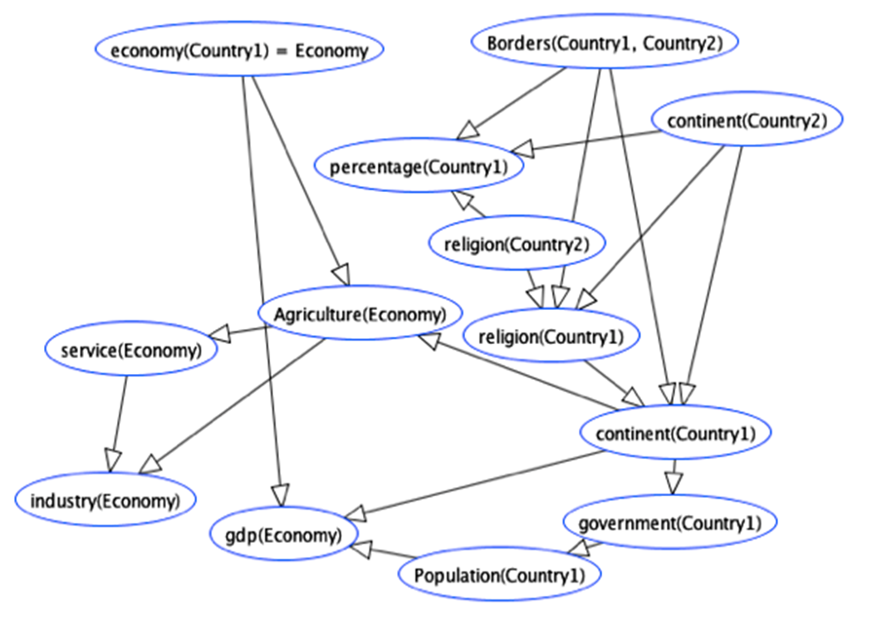
Challenges for Programming Model Structure Learning
Programming graphical model learning for relational data is hard.
Multi-relational data is NOT self-describing.
Need to query metadata.
Structured models with structured components.
Event counts across multiple tables.
expensive and error-prone.
Large parameter space.
> 1M sometimes.
FactorBase Qian, Schulte DSAA 2015 @ Paris, France
Notes:
Is not self-describing:

Slide 6
The Solution: SQL Scripts All the Way
Store relational model inside the database*.
[As well as relational data.]
SQL for creating, transforming, storing sets of models.
SQL for querying metadata from DB catalog.
Native SQL support for complex counts [count(*)].
SQL for computing and storing parameter values.
>1M parameters no problem.
SQL is standardized
system is portable, works out of the box.
*Daisy W, Eirinaios M, Garofalakis, M and Hellerstein, M. BayesStore: Managing Large, Uncertain Data Repositories with Probabilistic Graphical Models, Proc. VLDB 2008
Notes:
Following the philosophy of Bayestore , by considering both the structured model and the relational data as first-class citizen of the database management system.

Slide 7
Contributions
Identifying new system requirements for multi-relational model learning that go beyond single table machine learning.
An integrated set of SQL-based solutions for providing these system capabilities.
SQL can do more than we think!
All code and datasets are available online*.
*Qian, Z.; Schulte, O. The BayesBase System. http://www.cs.sfu.ca/~oschulte/BayesBase

Slide 8
Related Works
BayesStore, Tuffy: complementary
push model inside the database too
leverage database techniques for inference/parameter learning,
not model learning.
Madlib, MLBase, Bismarck, MauveDB, Unipivot...
leverage database techniques for single-table learning.
Data Type
Single-Table
Multi-Relational
Data Management
Data Management
Database
Files+
Main Memory
Database
Files+
Main Memory
MADLib
MLBase
Bismarck
Unipivot
MauveDB
Weka
R
Task
Alchemy PSL
Boostr
ProbLog
Structure Learning
Parameter
Learning
Inference
FactorBase
Tuffy
Felix
BayesStore
Tuffy
Felix
FactorBase Qian, Schulte DSAA 2015 @ Paris, France
Notes:
Related works in the field.

Slide 9
System Overview
Each component is stored, constructed and managed using database tables and SQL.
Components are integrated using SQL as well.
Input DataBase
Variable Manager
Random Variable
DataBase: VDB
Count Manager
Count Database:
CDB
Model Manager
Models Database: MDB
Contingency Table
Parameters
Model Structure
analyzes schema
MetaData about random variables
computes sufficient statistics
cross-table counts/
sufficient statistics
Learns Model Structure
Graphical Model +
Parameter Values
relational data
FactorBase Qian, Schulte DSAA 2015 @ Paris, France
Notes:
Integration is an important advantage.
Variable Manager: analyzes the information in the DB system catalog to define a default set of random variables.
Count Manager: uses the meta data in the VDB database to compute multi-relational sufficient statistics for a set of random variables.
Model Manager: supports the construction and querying of large structured statistical models.

Slide 10
Running Example
grade
satisfaction
registration
diff
rating
course_id
course
ranking
student
intelligence
student_id
professor
RA
prof_id
popularity
teachingability
salary
capability
Entity-Relationship Diagram for University Domain
FactorBase Qian, Schulte DSAA 2015 @ Paris, France
Notes:
Running example using Entity relationship diagram from university domain.
RA and registration are relationship tables, both have two descriptive attributes
student, professor and course are entity tables.

Slide 11
The Model Manager
Goal: Learn First-Order Bayesian Network Structure*.
Nodes = Random Variables
Edges are stored in Database tables
Model selection scores are also stored
not shown (BIC, AIC, BDeu)
Capability(P,S)
Child | Parent
Capability(P,S) | RA(P,S)
Capability(P,S) | Salary(P,S)
Teachingability(P) | Popularity(P)
Teachingability(P) | RA(P,S)
… | …
Salary(P,S)
RA(P,S)
intelligence(S)
Popularity(P)
Teachingability(P)
Ranking(S)
*Russell, S. & Norvig, P. Artificial Intelligence: A Modern Approach Prentice Hall, 2010.
Notes:
Given the sufficient statistics, and the random variables, the goal of the model manager is to learn the first-order Bayesian Network Structure.
The partial structure of the learned BN for university domain.
Color code for different type of nodes: green for relationship node, red for descriptive attributes for relationship node and blue for attributes of entity tables.
Lattice based learning algorithm

Slide 12
The Random Variable Database
Metadata about random variables stored in database tables.
Domain of possible values.
Pointer to corresponding data table/column.
...
Table Name | Column Headers in Random Variable Database
Pvariables | Pvid | TABLE_NAME
 | C | course
 | P | prof
 | S | student
1Variables | 1VarID | COLUMN_NAME |  |  | Pvid
 | diff(C) | diff |  |  | C
 | intelligence(S) | intelligence |  |  | S
 | popularity(P) | popularity |  |  | P
2Variables | 2VarID | COLUMN_NAME1 | COLUMN_NAME2 |  | Pvid1 | Pvid2
 | capability(P,S) | p_id | s_id |  | P | S
 | grade(C,S) | c_id | s_id |  | C | S
Relationship | RVarID | TABLE_NAME | COLUMN_NAME1 | COLUMN_NAME2 | Pvid1 | Pvid2
 | RA(P,S) | RA | p_id | s_id | P | S
 | Registered(C,S) | Registered | c_id | s_id | C | S
FactorBase Qian, Schulte DSAA 2015 @ Paris, France
Notes:
For the random variable database, it stores the metadata of the random variables extracted from the system catalog.
Pvariables: corresponds to entity tables
1variables: corresponds to attributes of entity tables
2variables: descriptive attributes of relational tables
Relationship: stands for relationship tables
Nodes in BN.

Slide 13
The Count Manager
Goal: for a conjunctive query, compute the instantiation count = result set size.
Stored in Contingency Table.
Main computational cost in learning.
Problem: need to generate SQL queries for arbitrary variable lists.
Solution: use Meta Data + Meta Queries
General Form of Count Query:
SELECT COUNT(*) AS Count, <VARIABLE-LIST> FROM <TABLE-LIST>
GROUP BY <VARIABLE-LIST> WHERE <Join-Conditions>
Meta-Queries | Entries
CREATE VIEW Select_List AS SELECT RVarID, CONCAT(‘COUNT(*)',' as "count"') AS Entries FROM VDB.Relationship UNION DISTINCT SELECT RVarID, AVarID AS Entries FROM VDB.Relationship_Attributes; | COUNT(*) as “count"
 | `Popularity(P)`
 | `Teachingability(P)`
 | `Intelligence(S)`
 | `Ranking(S)`
CREATE VIEW From_List AS SELECT RVarID, CONCAT('@database@.',TABLE_NAME) AS Entries FROM VDB.Relationship_FOvariables UNION DISTINCT SELECT RVarID, CONCAT('@database@.',TABLE_NAME) AS Entries FROM VDB.Relationship; | @database@.prof AS P
 | @database@.student AS S
 | @database@.RA AS `RA`

Slide 14
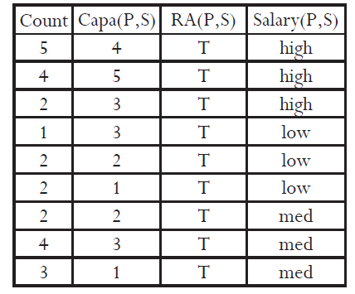
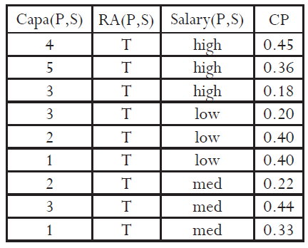
The Parameter Manager
Goal: Learn Bayesian Network Parameters
Stored in Conditional Probability (CP) database table.
Maximum Likelihood Estimates: easy SQL given Contingency Table.
CT_Table JOIN CT_Table
Group By
CT Table (from Count Manager)
CP table
FactorBase Qian, Schulte DSAA 2015 @ Paris, France
Notes:
SELECT COUNT(*) AS Count, Capability as `Capa(P,S)`, 'T' as `RA(P,S)`, Salary as `Salary(P,S)`
FROM `RA`;
Color coding, replace with real table?

Slide 15
Results and Summary

Slide 16
Results
Task: learning a multi-relational Bayesian network
Database and performance statistics for FactorBase
FactorBase Qian, Schulte DSAA 2015 @ Paris, France
Notes:
Can you make plots out of these somehow? Bar charts would be great. Like in our ILP paper.
Replace with real table?

Slide 17
Orders of magnitude improvements in speed and scalability.
FactorBase Qian, Schulte DSAA 2015 @ Paris, France
Notes:
Can you make plots out of these somehow? Bar charts would be great. Like in our ILP paper.
Replace with real table?

Slide 18
Other Tasks
Use Natural Join + Group By for evaluating log-linear expressions.
Compute Log-likelihood, compute Class Label Distribution.
Block Access for Test Instance Predictions ➔ scales to >1M instances.
Counts
Parameters
Test Set
Log-likelihood
Predictive Accuracy
FactorBase Qian, Schulte DSAA 2015 @ Paris, France
Notes:
Speedup on other tasks: compute model selection score, test models, cross-validation. Not shown.
For further details, please refer to our paper.

Slide 19
Other Tasks
Task: Block Access for Test Instance Predictions ➔ scales to >1M instances.
??
FactorBase Qian, Schulte DSAA 2015 @ Paris, France
Notes:
Speedup on other tasks: compute model selection score, test models, cross-validation. Not shown.
For further details, please refer to our paper.

Slide 20
Summary and Conclusions
Multi-relational model discovery requires new system capabilities.
BayesStore Design Philosophy: Store data and models inside the database system.
SQL is used to build and transform statistical objects inside the database
Structured Graphical Model.
Parameter Estimates.
Sufficient Statistics (counts).
Empirical evaluation: leveraging the RDBMS capabilities achieves scalable learning and fast model testing.
Future Direction:
Integrate with relational inference systems (BayesStore, Tuffy).
Distributed processing, in-memory computing (SparkSQL)
FactorBase Qian, Schulte DSAA 2015 @ Paris, France
Notes:
Empirical evaluation: leveraging the RDBMS capabilities achieves scalable learning and fast model testing.
SQL can do more than we think!
General comments:
Still a problem with dangling lines.
We should try to have more pictures.
How about colour coding for different components? E.g. CP tables have a colour for parameters, CT tables a colour for counts, Model Tables a colour for models etc.

Slide 21

Thanks for your attention.

Slide 22
Multi-Relational Sufficient Statistics
Why
Find correlations involving relationships. e.g.
Compactness: summarize original data by counts.
user searches for item
user watches video about item.
?
user does not search for item
user does not watch video about item
Previous Approaches
Single-table data: row counts (σ selection only).
Multiple tables: Table joins ⋈.
Notes:
relationships are underlined
To our knowledge, no system does this.
Positive only: join, relatively more straightforward
Negative : enumerate, cross product of primary keys → grows exponentially with the number of involved entity sets → too expensive

Slide 23
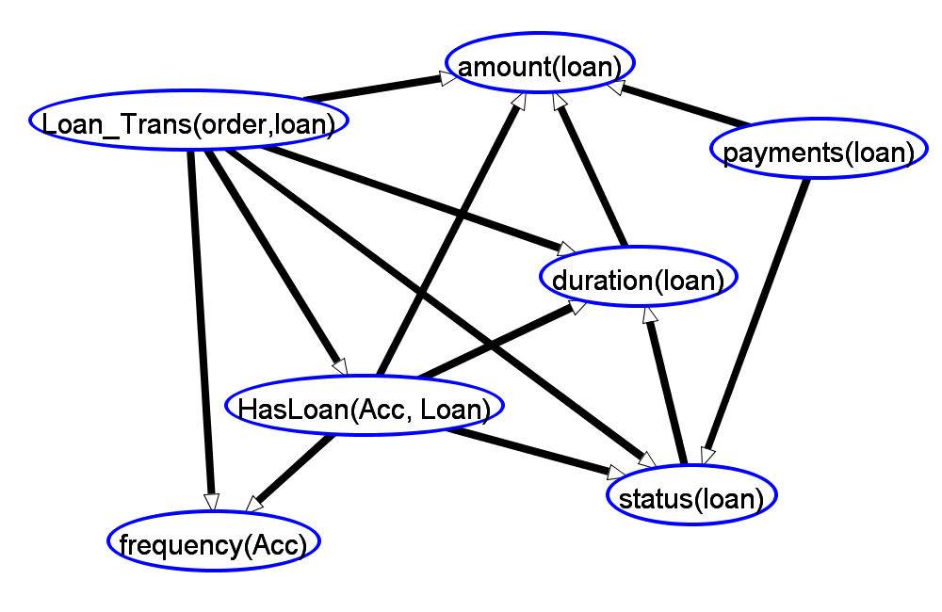
Applications
Feature Selection.
Does frequency of bank statement predict whether customer has loan?
Association Rules.
statement freq.(Acc) = monthly → HasLoan(Acc, Loan) = ? .
Bayesian Network Learning.
...
Notes:
Why choose these three applications? decision-making
Feature/information → convert to knowledge, remove the redundant information
Rule based model→ intuitive/natural/easy to understand
Examples are from Financial Dataset. BN show Markov blanket of HasLoan.

Slide 24
Contingency Tables (ct-table)
Counts for conjunctive queries:
capability = value1, intelligence = value2.
capability = n/a: wasn’t RA.
Conditional ct-table :
e.g. given capability = 1.
capability | intelligence | count
1 | 2 | 3
1 | 3 | 2
2 | 2 | 3
2 | 3 | 1
3 | 1 | 2
3 | 2 | 4
3 | 3 | 1
4 | 1 | 1
4 | 3 | 4
5 | 1 | 1
5 | 2 | 3
N/A | 1 | 80
N/A | 2 | 65
N/A | 3 | 58
Sum(count) : |  | 228
Total Tuples : |  | 14
Entity Table | Primary Key | # Tuples
Professor | p_id | 6
Student | s_id | 38
Cross Product | 228
Notes:
To do : use RA;
select sum(`MULT`) as Count, `capability(prof0,student0)`as capability,`intelligence(student0)` as intel from `a_CT` group by intel,capability;
total number of students, professors, and size of cross product.

Slide 25
Count | Diff. | Rat. | Pop. | Teach. | Intel. | Rank. | Cap. | Sal. | Grade | Sat. | RA | Reg.
1 | 1 | 1 | 1 | 2 | 3 | 1 | 3 | High | 1 | 1 | T | T
1 | 1 | 2 | 1 | 2 | 2 | 2 | n/a | n/a | 2 | 2 | F | T
3 | 1 | 2 | 1 | 2 | 2 | 2 | 1 | Med | n/a | n/a | T | F
24 | 2 | 1 | 1 | 2 | 1 | 5 | n/a | n/a | n/a | n/a | F | F
… | … | … | … | … | … | … | … | … | … | … | … | …
1 | 2 | 1 | 2 | 2 | 1 | 4 | n/a | n/a | 3 | 2 | F | T
Notes:
uni-ct-table.pdf

Slide 26
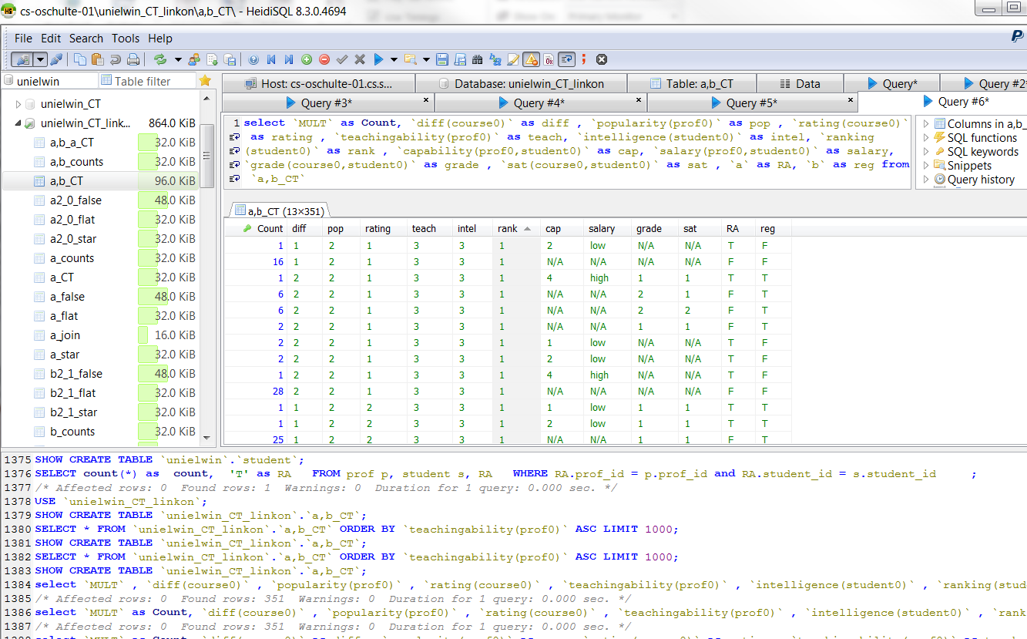
Storing Sufficient Statistics in Database Tables
New: large contingency table stored as database table.
Manipulate using SQL, Index, ...
Notes:
new thing:
store the ct table in the database
Motivate: ct-tables can be large.
Can manipulate using SQL.
Can index them.

Slide 27
Computing Sufficient Statistics: positive relationships only (e.g.RA=True)
CREATE TABLE ct_{T}(RA) AS
SELECT count(*) as count, pop, teach, intel, rank, cap, salary, 'T' as RA
FROM Professor P, Student S, RA
WHERE RA.p_id = P.p_id AND RA.s_id = S.s_id
GROUP BY pop, teach, intel, rank, cap, salary
cross-table count
count | pop | teach | intel | rank | cap | salary | RA
2 | 2 | 2 | 3 | 1 | 4 | high | T
2 | 2 | 3 | 1 | 4 | 3 | med | T
1 | 1 | 2 | 2 | 2 | 1 | med | T
1 | 1 | 2 | 2 | 2 | 2 | med | T
1 | 1 | 2 | 2 | 2 | 3 | low | T
1 | 1 | 2 | 3 | 1 | 3 | high | T
... | ... | ... | ... | ... | ... | ... | ...
Notes:
could mention tuple ID propagation;
Mention that this is a single RA relationship.
Real query for table a-counts:
Select count(*) as "Count" , prof0.popularity AS `pop` , prof0.teachingability AS `teach` , student0.intelligence AS `intel` , student0.ranking AS `rank` , `a`.capability AS `cap` , `a`.salary AS `salary` , 'T' as `a` from unielwin.prof AS prof0 , unielwin.student AS student0 , unielwin.RA AS `a` where `a`.prof_id = prof0.prof_id and `a`.student_id = student0.student_id group by `pop` , `teach` , `intel` , `rank` , `cap` , `salary` ;

Slide 28
Step 1: Contingency Table Cross Product
x
Example: ct(Professor) ct(Student)
→ ct*(RA)
Count | pop | teach
2 | 1 | 2
1 | 2 | 2
3 | 2 | 3
ct(Professor)
Count | pop | teach | intel | rank
12 | 1 | 2 | 1 | 4
16 | 1 | 2 | 1 | 5
10 | 1 | 2 | 2 | 2
14 | 1 | 2 | 2 | 3
2 | 1 | 2 | 2 | 4
16 | 1 | 2 | 3 | 1
6 | 1 | 2 | 3 | 2
6 | 2 | 2 | 1 | 4
8 | 2 | 2 | 1 | 5
5 | 2 | 2 | 2 | 2
7 | 2 | 2 | 2 | 3
... | ... | ... | ... | ...
x
ct*(RA)
ct(Student)
Count | intel | rank
6 | 1 | 4
8 | 1 | 5
5 | 2 | 2
7 | 2 | 3
1 | 2 | 4
8 | 3 | 1
3 | 3 | 2
Notes:
Cross product of sufficient statistics, not the primary keys.
Add animation, to show tables in order ct(s) → ct(p) → ct*(ra)

Slide 29
Step 2: Contingency Table Subtraction
Count | Pop | Teach | Intel | Rank
16 | 1 | 2 | 3 | 1
15 | 2 | 3 | 2 | 2
18 | 2 | 3 | 1 | 4
… | … | … | … | …
Count | Pop | Teach | Intel | Rank
1 | 1 | 2 | 3 | 1
1 | 1 | 2 | 2 | 2
1 | 2 | 2 | 2 | 4
… | … | … | … | …
RA
T
ct*(RA)
ct_{T}(RA)
Count | Pop | Teach | Intel | Rank
15 | 1 | 2 | 3 | 1
16 | 2 | 3 | 2 | 3
21 | 2 | 3 | 3 | 1
… | … | … | … | …
RA
F
∪
Count | Pop | Teach | Intel | Rank | RA
15 | 1 | 2 | 3 | 1 | F
1 | 1 | 2 | 3 | 1 | T
1 | 1 | 2 | 2 | 2 | T
... | ... | ... | ... | ... | ...
ct(RA)
Final Result: Contingency Table for RA relationship
Notes:
Mention slide no. for ct* and ctT
Emphasize: no joins of data tables, no cross product.
drop last two intermediate tables.

Slide 30
Datasets for Evaluation
7 Real-world Datasets (over 1M rows).
Dataset | #Relationship Tables/ Total | # Columns | # Rows
UW-CSE | 2/4 | 14 | 712
Mondial | 2/4 | 18 | 870
Hepatitis | 3/7 | 19 | 12,927
Mutagenesis | 2/4 | 11 | 14,540
Financial | 3/7 | 15 | 225,932
Movielens | 1/3 | 7 | 1,010,051
IMDB | 3/7 | 17 | 1,354,134
Computing Sufficient Statistics Qian, Schulte, Sun CIKM 2014 @ Shanghai, China
Notes:
To do:
Self-relationship example: Borders(Country1, Country2).
Tuples = rows
Attributes = columns
maybe order by #Tuples
Drop self-relationship

Slide 31
Computation Time
Never enumerates cross product of primary keys.
Complexity: nearly linear in size of the required output.
(non-trivial) #ct_operation = O(#SS * log (#SS))
Dataset | #Sufficient Statistics (SS) | Cross Product Time | Our Dynamic Program Time
Movielens | 252 | 703.99 | 2.70
Mutagenesis | 1,631 | 1,096.00 | 1.67
UW-CSE | 2,828 | 350.30 | 3.84
Mondial | 1,746,870 | 132.13 | 1,112.84
Financial | 3,013,011 | N.T. | 1,421.87
Hepatitis | 12,374,892 | N.T. | 3,536.76
IMDB | 15,538,430 | N.T. | 7,467.85
Notes:
MJ -> our dynamic program
CP -> corss product.
#sufficient stastistics computed
bold better numbers.
r -> #Counts.
In other words, nearly linear in the size of the required output.
Optimal. Upper bound is not trivial.
N.T. indicates Not Terminated

