Slide 1

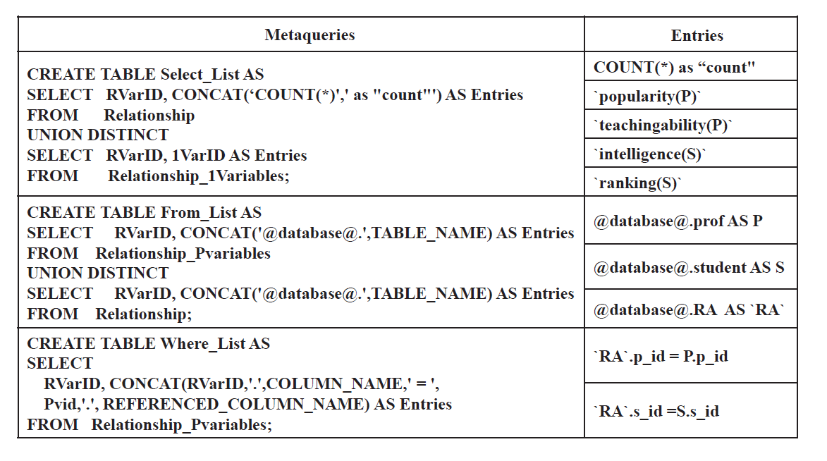
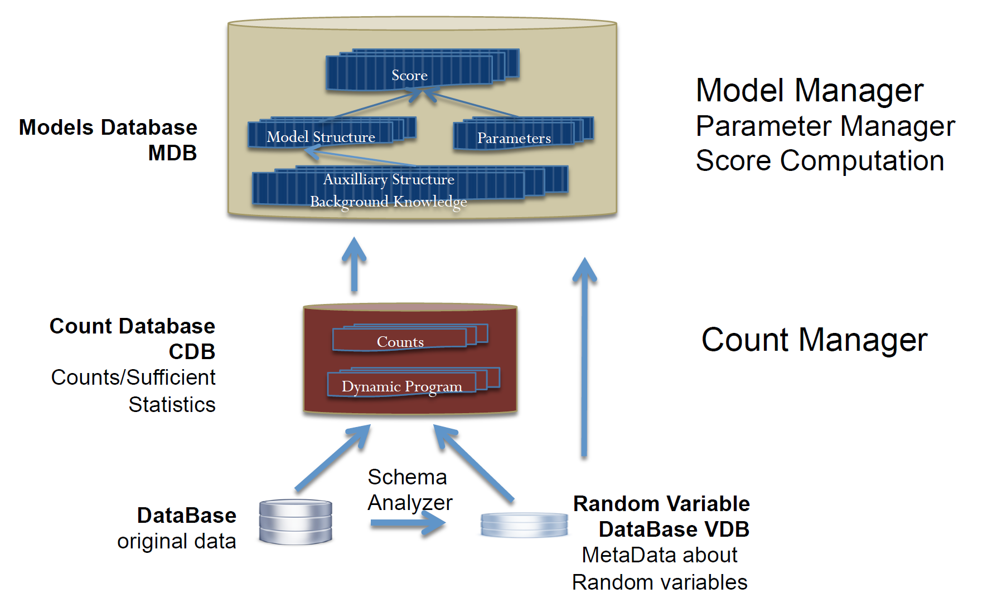
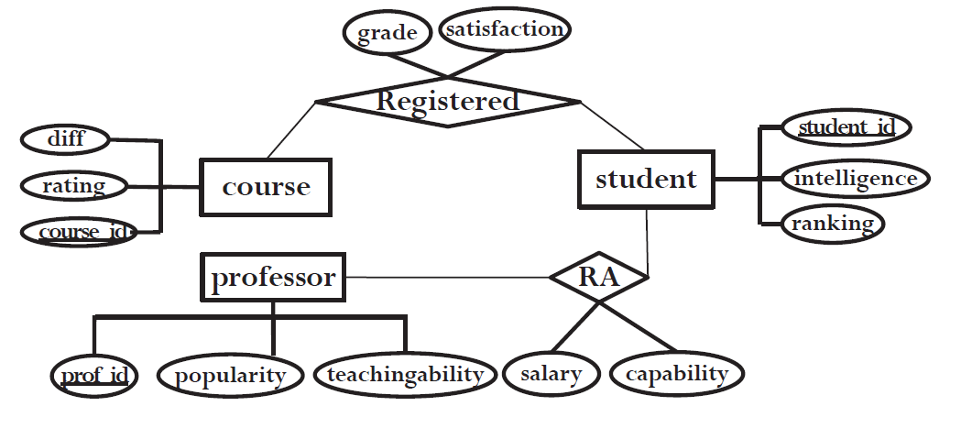
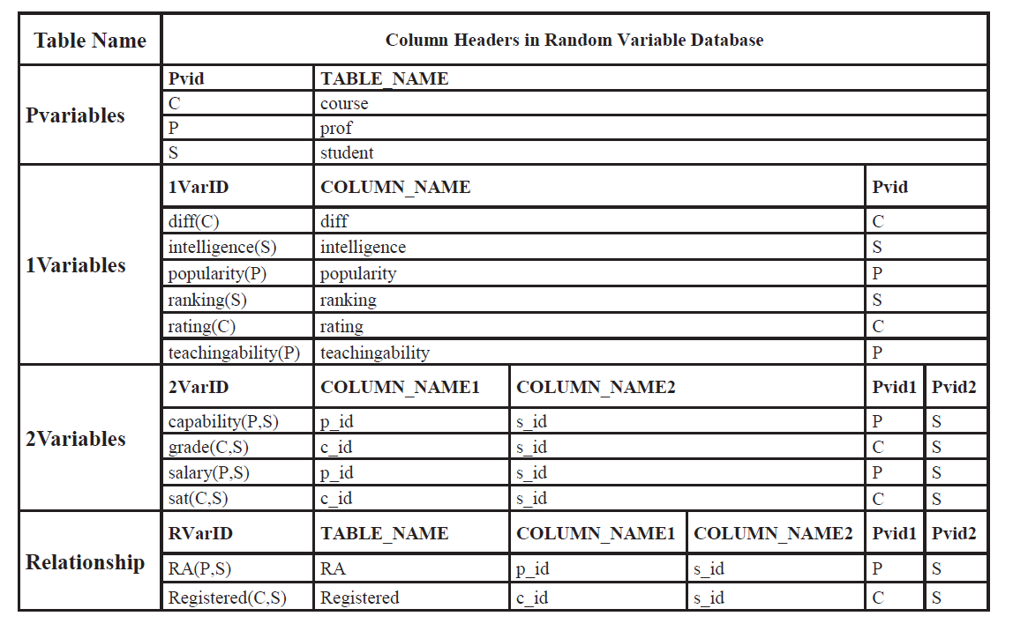
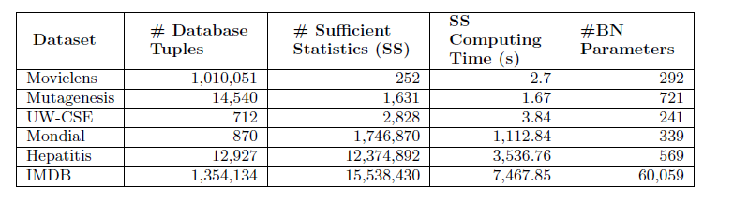
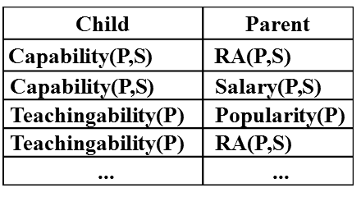
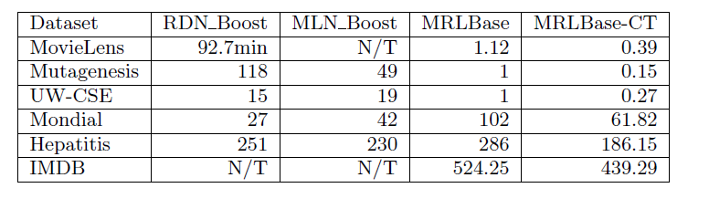
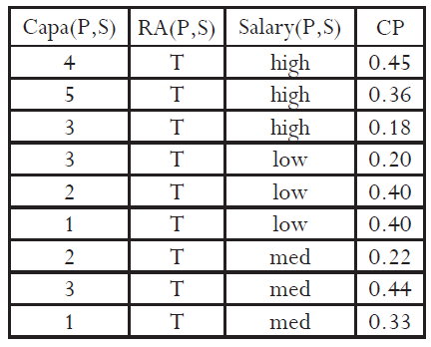
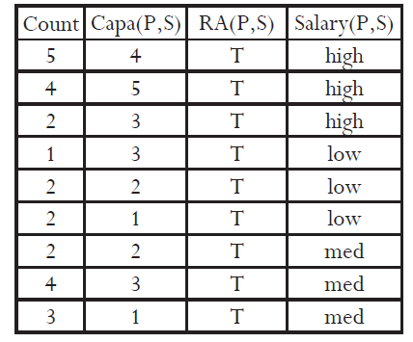
FACTORBASE: SQL for Multi-Relational Model Learning
Zhensong Qian and Oliver Schulte, Simon Fraser University, Canada
Introduction
The Count Manager
Statistical-Relational Learning: Learn a joint statistical model for all tables in the input database.
New approach to SRL system building:
The RDBMS stores structured objects for statistical analysis as first-class citizens in the database.
SQL is used to build and transform statistical objects:
Structured Model (Bayesian network, Markov Logic Network).
Parameter Estimates.
Sufficient Statistics.
Empirical evaluation: leveraging the RDBMS capabilities achieves scalable learning and fast model testing.
All code and datasets are available online [1].
Goal: for a conjunctive query, compute the instantiation count = result set size.
Stored in Contingency (CT) Table [4].
Main computational cost in learning.
Problem: need to generate SQL queries for arbitrary variable lists.
Solution: use Meta Data + Meta Queries
General Form of SQL Count Query:
SELECT COUNT(*) AS Count, <VARIABLE-LIST> FROM TABLE-LIST
GROUP BY <VARIABLE-LIST> WHERE <Join-Conditions>
Variable List
Contributions
Meta Query
Identifying new system requirements for multi-relational machine learning that go beyond single table machine learning.
An integrated set of SQL-based solutions for providing these system capabilities.
Count(*) Query
System Overview
The Random Variable Database
Meta data about random variables stored in database tables.
Domain of possible values.
Pointer to corresponding data table/column.
...
ER-Design for University Domain
Schema Analyzer: examines the information in the DB system catalog to define a default set of random variables.
Count Manager: uses the meta data in the VDB database to compute multi-relational sufficient statistics for a set of random variables [4].
Model Manager: supports the construction and querying of large structured statistical models.
Results
Task: learning a multi-relational Bayesian network
Database and performance statistics for FactorBase
The Model Manager
Comparison with other statistical-relational learning (Markov Logic Networks)
Capability(P,S)
S in Student
The RDBMS support for multi-relational learning translates into orders of magnitude improvements in speed and scalability.
Salary(P,S)
RA(P,S)
Intelligence(S)
Popularity(P)
Ranking(S)
P in Professor
Teachingability(P)
Speedup on other tasks: compute model selection score, test models, cross-validation. Not shown.
Goal: Learn First-Order Bayesian Network [2].
Bayesian Network Structure Learning [6].
Nodes = Random Variables
Edges are stored in Database tables
Model selection scores are also stored, not shown (BIC, AIC, BDeu)
Related Works
BayesStore [3]: all statistical objects are first-class citizens in a relational database. Inference, no learning.
MadLib [5]: leverages SQL for single-relational data table analysis.
Tuffy [7]: reliable and scalable inference and parameter learning for Markov Logic Networks with an RDBMS. No structure learning.
The Parameter Manager
SELECT COUNT(*) AS Count, Capability as `Capa(P,S)`, 'T' as `RA(P,S)`, Salary as `Salary(P,S)`
FROM `RA`;
Conclusions
Multi-relational learning requires new system capabilities.
leverage SQL, RDBMS.
Fast system development through high-level SQL constructs.
Manage large statistical objects: parameters, sufficient statistics.
Fast native support for counting (count(*)).
Future Directions:
distributed processing, in-memory computing (SparkSQL)
Integrate with inference systems (BayesStore, Tuffy)
CP table
Contingency Table
Specific SQL Query
Goal: Learn Bayesian Network Parameters
Stored in Conditional Probability (CP) table.
Maximum Likelihood Estimate are easy to compute from database counts.
References
References
Qian, Z.; Schulte, O. The BayesBase System. www.cs.sfu.ca/~oschulte/BayesBase
Russell, S. & Norvig, P. Artificial Intelligence: A Modern Approach Prentice Hall, 2010.
Wang, D. Z.; Michelakis, E.; & et al. BayesStore: managing large, uncertain data repositories with probabilistic graphical models, PVLDB, 2008, 1, 340-351.
Qian, Z.; Schulte, O. & Sun, Y. Computing Multi-Relational Sufficient Statistics for Large Databases, CIKM 2014, 1249-1258.
Hellerstein, J. M.; Ré, C.; Schoppmann, F.; & et al, The MADlib Analytics Library: Or MAD Skills, the SQL, PVLDB, 2012, 5, 1700-1711
Schulte, O. & Khosravi, H. Learning graphical models for relational data via lattice search Machine Learning, 2012, 88, 331-368
Niu, F.; Ré, C.; Doan, A. & Shavlik, J. W. Tuffy: Scaling up Statistical Inference in Markov Logic Networks using an RDBMS PVLDB, 2011, 4, 373-384
Notes:
Created on Nov 30, 2015. NIPS Learning System workshop, 36in wide and 48 in tall
Dec.12. Montreal

