Slide 1

SQL for SRL: Structure Learning Inside a Database System Structure Learning Made Easy
Oliver Schulte and Zhensong Qian
Simon Fraser University
Vancouver, Canada

Slide 2
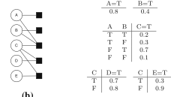
Big Databases for Big Models
SRL models put together large structured statistical objects.
First-order random variables.
Graphs.
Parameter tables, factor tables.
Design Philosophy: store structured statistical objects as tables in database.
Tuffy, BayesStore: in-database multi-relational probabilistic inference.
Our FACTORBASE system: in-database multi-relational probabilistic model learning.
Kimmig, Mihalkova, Getoor 2014
Notes:
Not storing data! SRL Programming is hard.

Slide 3
Benefits
SQL as scripting language.
As much fun as Python!
Native support for counting groundings/instantiations.
Big jump in scalability for free.
Same portable high-level language for creating/manipulating/transforming graphs, parameters, factors, counts, model prediction scores…
Easy programming.
Works out of the box database.
Details in poster.
Notes:
No need for user declarations.

