Slide 1

SQL for SRL: Model Structure Learning Inside a Database System or, Structure Learning Made Easy
Oliver Schulte and Zhensong Qian
Simon Fraser University, Vancouver, Canada.

Slide 2
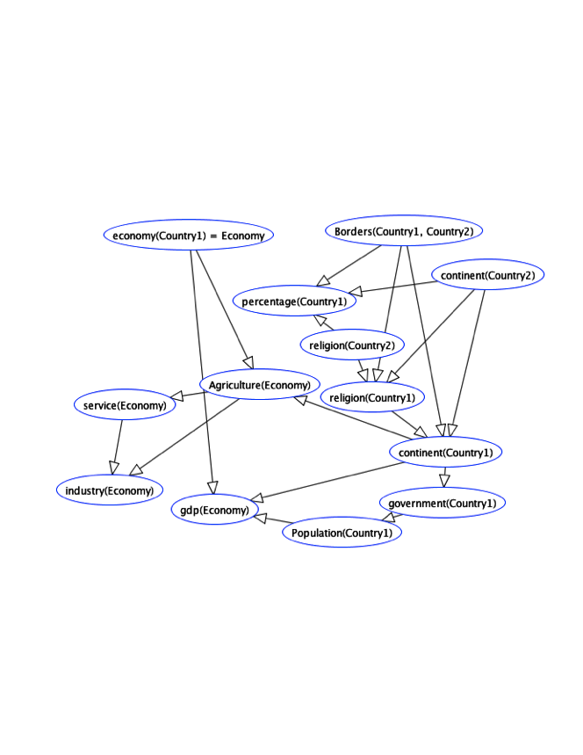

SQL for Programming Model Structure Learning
Programming graphical model search for relational data is hard.
Multi-relational data is not self-describing.
Need to query metadata. e.g. DB schema/mode declarations.
Structured Models (Graphs) with structured components (terms, predicates, first-order variables, constants).
Computing event counts across multiple tables is expensive and error-prone.
Large Parameter space, > 1M sometimes.

Slide 3
The Solution: SQL Scripts All the Way
Store relational model inside the database. (As well as relational data.) Tuffy, Felix, BayesStore, Wang et al. 1995.
Use SQL to query metadata from DB catalog.
Native SQL support for complex counts (count(*)).
SQL for creating, transforming, storing sets of models.
SQL for computing and storing parameter values. >1M parameters no problem.
SQL is standardized: system is portable, works out of the box.

Slide 4
Related Work
Tuffy, BayesStore: complementary
push model inside the database as well.
leverage database techniques for inference/parameter learning, not structure learning.
Madlib, MLBase, Bismarck, MauveDB, Unipivot...
leverage database techniques for single-table learning.
Notes:
for Sindbad see poster.

