Slide 1
CMPT 354: Database System I
Lecture 7. Basics of Query Optimization

Slide 2

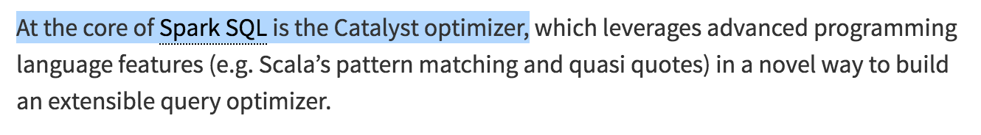

Why should you care?
https://databricks.com/glossary/catalyst-optimizer
https://sigmod.org/sigmod-awards/people/goetz-graefe-2017-sigmod-edgar-f-codd-innovations-award/

Slide 3
Query Processing Steps
SQL query
SQL Parser
Logical Optimization
Query
optimization
Physical Optimization
Query Execution
Disk

Slide 4
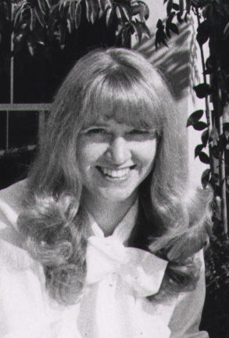
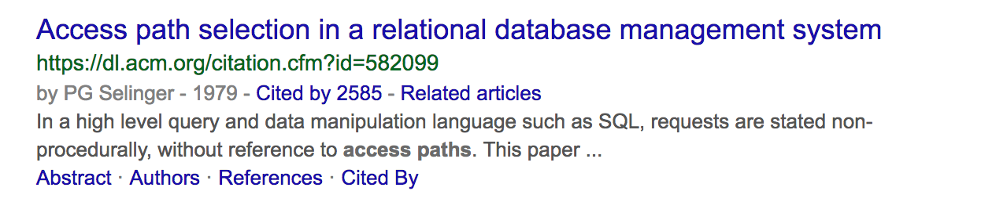
IBM System R Optimizer
First implementation of a query optimizer
Make people believe that the DBMS can beat a human developer
A lot of the concepts are still used today

Slide 5
How to build a query optimization?
Plan Space
Figure out all possible query plans
Cost Estimation
Estimate the cost of each plan
Search Algorithm
Find the best plan
Too large, must be pruned
CPU + I/O
don’t go for best plan, go for least worst plan

Slide 6
Outline
Recap of Logical Optimization
Selection Pushdown
Projection Pushdown
Physical Optimization
Join Algorithms
Selectivity Estimation

Slide 7

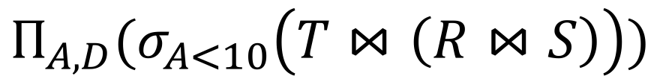
Translating to RA
R(A,B) S(B,C) T(C,D)
$$Π_{A,D}$$
SELECT R.A,S.D
FROM R,S,T
WHERE R.B = S.B
AND S.C = T.C
AND R.A < 10;
σ_{Α<10}
T(C,D)
R(A,B)
S(B,C)
$$Π_{A,D}(σ_{A<10}\left(T⋈\left(R⋈S\right)\right))$$

Slide 8
Optimizing RA Plan
R(A,B) S(B,C) T(C,D)
Push down selection on A so it occurs earlier
$$Π_{A,D}$$
SELECT R.A,S.D
FROM R,S,T
WHERE R.B = S.B
AND S.C = T.C
AND R.A < 10;
σ_{Α<10}
T(C,D)
R(A,B)
S(B,C)
$$Π_{A,D}(σ_{A<10}\left(T⋈\left(R⋈S\right)\right))$$

Slide 9

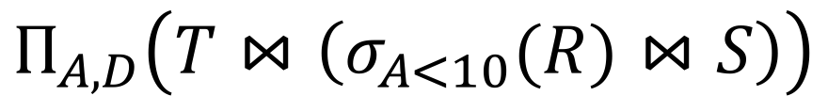
Optimizing RA Plan
R(A,B) S(B,C) T(C,D)
Push down selection on A so it occurs earlier
SELECT R.A,S.D
FROM R,S,T
WHERE R.B = S.B
AND S.C = T.C
AND R.A < 10;
$$Π_{A,D}$$
T(C,D)
σ_{Α<10}
S(B,C)
$$Π_{A,D}\left(T⋈\left(σ_{A<10}(R)⋈S\right)\right)$$
R(A,B)

Slide 10
Optimizing RA Plan
R(A,B) S(B,C) T(C,D)
Push down projection so it occurs earlier
SELECT R.A,S.D
FROM R,S,T
WHERE R.B = S.B
AND S.C = T.C
AND R.A < 10;
$$Π_{A,D}$$
T(C,D)
σ_{Α<10}
S(B,C)
$$Π_{A,D}\left(T⋈\left(σ_{A<10}(R)⋈S\right)\right)$$
R(A,B)

Slide 11
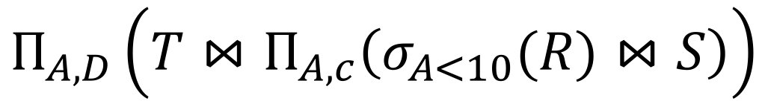


Optimizing RA Plan
We eliminate B earlier!
R(A,B) S(B,C) T(C,D)
$$Π_{A,D}$$
SELECT R.A,S.D
FROM R,S,T
WHERE R.B = S.B
AND S.C = T.C
AND R.A < 10;
$$Π_{A,C}$$
T(C,D)
$$Π_{A,D}\left(T⋈Π_{A,c}\left(σ_{A<10}(R)⋈S\right)\right)$$
σ_{Α<10}
S(B,C)
R(A,B)

Slide 12
Outline
Recap of Logical Optimization
Selection Pushdown
Projection Pushdown
Physical Optimization
Join Algorithms
Histogram

Slide 13

Join Algorithms
Nested loop Join
Hash Join
Sort-merge join
Student
University
sname | uID
Mike | 0
Joe | 1
Alice | 0
Marry | 1
Bob | 0
Tim | 2
uID | uname
0 | SFU
1 | UBC
2 | UT
Student $⋈$University

Slide 14
Dive into Nested Loop Joins

Slide 15
Notes
Cost = I/O + CPU + Network
“IO aware” algorithms
We will focus on I/O
Given a relation R, let:
T(R) = # of tuples in R
P(R) = # of pages in R
10 | CMPT | 345 | SP 2018 | Jiannan
20 | CMPT | 454 | FA 2018 | Martin
Page 1
30 | … | … | … | …
40 | …
Page 2
50
60
Page 3
70
80
Page 4

Slide 16
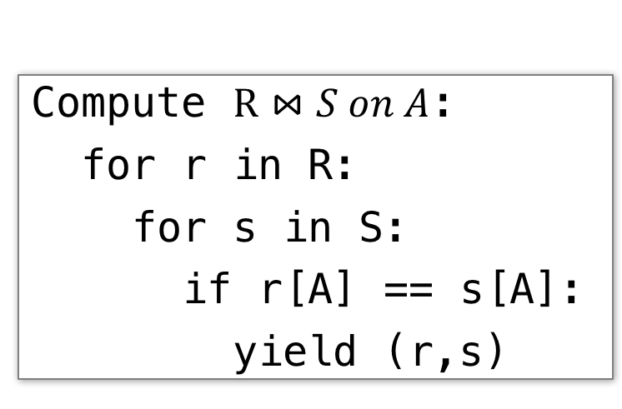
Nested Loop Join (NLJ)
Compute $R⋈S on A$:
for r in R:
for s in S:
if r[A] == s[A]:
yield (r,s)

Slide 17
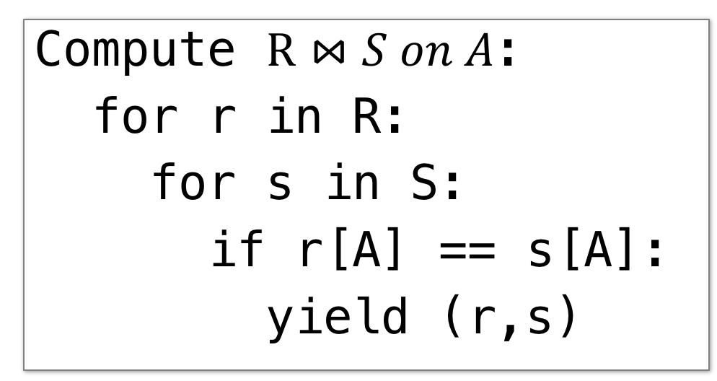
Nested Loop Join (NLJ)
Cost:
Compute $R⋈S on A$:
for r in R:
for s in S:
if r[A] == s[A]:
yield (r,s)
P(R)
Loop over the tuples in R
Note that our IO cost is based on the number of pages loaded, not the number of tuples!

Slide 18
Nested Loop Join (NLJ)
Cost:
Compute $R⋈S on A$:
for r in R:
for s in S:
if r[A] == s[A]:
yield (r,s)
P(R) + T(R)*P(S)
Loop over the tuples in R
For every tuple in R, loop over all the tuples in S
Have to read all of S from disk for every tuple in R!

Slide 19
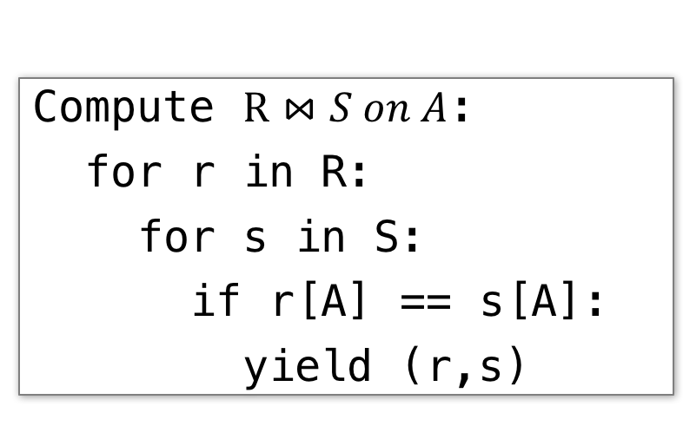
Nested Loop Join (NLJ)
Cost:
Compute $R⋈S on A$:
for r in R:
for s in S:
if r[A] == s[A]:
yield (r,s)
P(R) + T(R)*P(S)
Loop over the tuples in R
For every tuple in R, loop over all the tuples in S
Check against join conditions
Note that NLJ can handle things other than equality constraints… just check in the if statement!

Slide 20
Nested Loop Join (NLJ)
Cost:
Compute $R⋈S on A$:
for r in R:
for s in S:
if r[A] == s[A]:
yield (r,s)
P(R) + T(R)*P(S) + OUT
Loop over the tuples in R
For every tuple in R, loop over all the tuples in S
Check against join conditions
Write out (to page, then when page full, to disk)
Is this the same as a cross product?

Slide 21
Nested Loop Join (NLJ)
Cost:
Compute $R⋈S on A$:
for r in R:
for s in S:
if r[A] == s[A]:
yield (r,s)
P(R) + T(R)*P(S) + OUT
What if R (“outer”) and S (“inner”) switched?
P(S) + T(S)*P(R) + OUT
Outer vs. inner selection could make a huge difference- DBMS needs to know which relation is smaller!

Slide 22
IO-Aware Approach

Slide 23
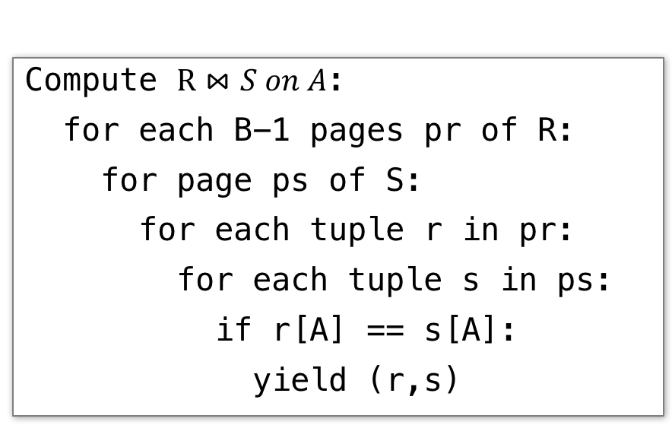
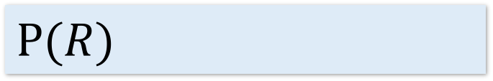
Block Nested Loop Join (BNLJ)
Given B+1 pages of memory
Cost:
Compute $R⋈S on A$:
for each B-1 pages pr of R:
for page ps of S:
for each tuple r in pr:
for each tuple s in ps:
if r[A] == s[A]:
yield (r,s)
$$P(R)$$
Load in B-1 pages of R at a time (leaving 1 page each free for S & output)
Note: There could be some speedup here due to the fact that we’re reading in multiple pages sequentially however we’ll ignore this here!

Slide 24

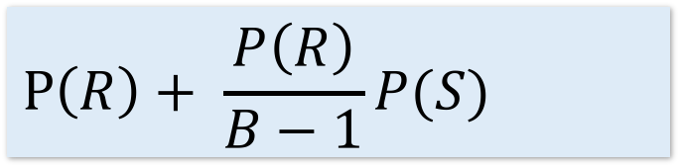
Block Nested Loop Join (BNLJ)
Given B+1 pages of memory
Cost:
Compute $R⋈S on A$:
for each B-1 pages pr of R:
for page ps of S:
for each tuple r in pr:
for each tuple s in ps:
if r[A] == s[A]:
yield (r,s)
$$P\left(R\right)+ \frac{P\left(R\right)}{B−1}P(S)$$
Load in B-1 pages of R at a time (leaving 1 page each free for S & output)
For each (B-1)-page segment of R, load each page of S
Note: Faster to iterate over the smaller relation first!

Slide 25

Block Nested Loop Join (BNLJ)
Given B+1 pages of memory
Cost:
Compute $R⋈S on A$:
for each B-1 pages pr of R:
for page ps of S:
for each tuple r in pr:
for each tuple s in ps:
if r[A] == s[A]:
yield (r,s)
$$P\left(R\right)+ \frac{P\left(R\right)}{B−1}P(S)$$
Load in B-1 pages of R at a time (leaving 1 page each free for S & output)
For each (B-1)-page segment of R, load each page of S
Check against the join conditions
BNLJ can also handle non-equality constraints

Slide 26
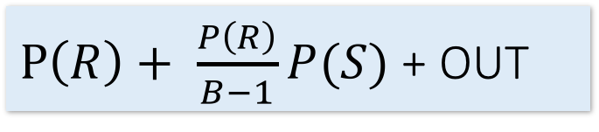
Block Nested Loop Join (BNLJ)
Given B+1 pages of memory
Cost:
Compute $R⋈S on A$:
for each B-1 pages pr of R:
for page ps of S:
for each tuple r in pr:
for each tuple s in ps:
if r[A] == s[A]:
yield (r,s)
$P\left(R\right)+ \frac{P\left(R\right)}{B−1}P(S)$ + OUT
Load in B-1 pages of R at a time (leaving 1 page each free for S & output)
For each (B-1)-page segment of R, load each page of S
Check against the join conditions
Write out

Slide 27
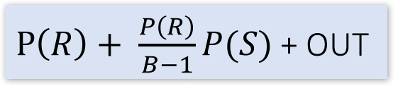
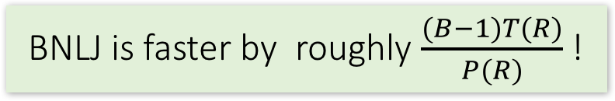
BNLJ vs. NLJ: Benefits of IO Aware
NLJ
Read all of S from disk for every page of R
BNLJ
Read all of S from disk for every (B-1)-page segment of R
NLJ
BNLJ
P(R) + T(R)*P(S) + OUT
$P\left(R\right)+ \frac{P\left(R\right)}{B−1}P(S)$ + OUT
BNLJ is faster by roughly $\frac{(B−1)T(R)}{P(R)}$ !

Slide 28
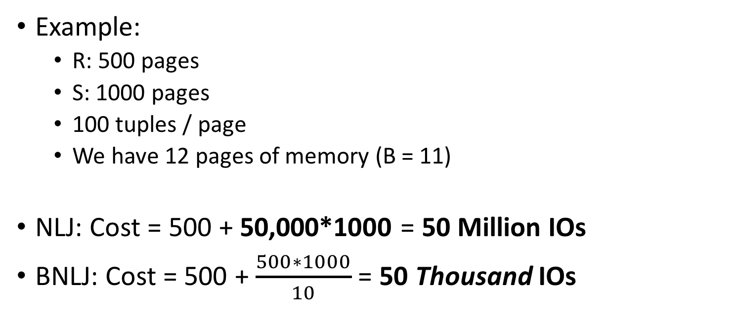
BNLJ vs. NLJ: Benefits of IO Aware
Example:
R: 500 pages
S: 1000 pages
100 tuples / page
We have 12 pages of memory (B = 11)
NLJ: Cost = 500 + 50,000*1000 = 50 Million IOs
BNLJ: Cost = 500 + $\frac{500∗1000}{10}$ = 50 Thousand IOs
Ignoring OUT here…
A very real difference from a small change in the algorithm!

Slide 29
Outline
Recap of Logical Optimization
Selection Pushdown
Projection Pushdown
Physical Optimization
Join Algorithms
Histogram

Slide 30
Motivation
Imagine you build an index on name, and then run the following queries
Imagine you build an index on gender, and then run the following queries
SELECT sID
FROM Student
WHERE name = ?
Will query optimizer use the index?
Yes!
SELECT sID
FROM Student
WHERE gender = ?
Will query optimizer use the index?
No!
How does query optimizer figure these out?

Slide 31
Histograms
A histogram is a set of value ranges (“buckets”) and the frequencies of values in those buckets occurring
How to choose the buckets?
Equiwidth & Equidepth
Turns out high-frequency values are very important

Slide 32
Example
Frequency
How do we compute how many values between 8 and 10?
(Yes, it’s obvious)
Values
Problem: counts take up too much space!

Slide 33
Full vs. Uniform Counts
How much space do the full counts (bucket_size=1) take?
How much space do the uniform counts (bucket_size=ALL) take?

Slide 34
Fundamental Tradeoffs
Want high resolution (like the full counts)
Want low space (like uniform)
Histograms are a compromise!
So how do we compute the “bucket” sizes?

Slide 35
Equi-width
All buckets roughly the same width

Slide 36
Equidepth
All buckets contain roughly the same number of items (total frequency)

Slide 37
Histograms
Simple, intuitive and popular
Parameters: # of buckets and type
Can extend to many attributes (multidimensional)

Slide 38
Maintaining Histograms
Histograms require that we update them!
Typically, you must run/schedule a command to update statistics on the database
Out of date histograms can be terrible!
There is research work on self-tuning histograms and the use of query feedback
Oracle 11g

Slide 39
Nasty example
1. we insert many tuples with value > 16
2. we do not update the histogram
3. we ask for values > 20?

Slide 40
Compressed Histograms
One popular approach:
Store the most frequent values and their counts explicitly
Keep an equiwidth or equidepth one for the rest of the values
People continue to try all manner of fanciness here wavelets, graphical models, entropy models,…

Slide 41
Summary
Logical Optimization
SQL -- > RA → RA Tree
Selection Pushdown
Projection Pushdown
Physical Optimization
Nested Loop Join / Hash Join / Sort-Merge Join
I/O Aware Algorithm
Histogram

Slide 42
Acknowledge
Some lecture slides were copied from or inspired by the following course materials
“W4111: Introduction to databases” by Eugene Wu at Columbia University
“CSE344: Introduction to Data Management” by Dan Suciu at University of Washington
“CMPT354: Database System I” by John Edgar at Simon Fraser University
“CS186: Introduction to Database Systems” by Joe Hellerstein at UC Berkeley
“CS145: Introduction to Databases” by Peter Bailis at Stanford
“CS 348: Introduction to Database Management” by Grant Weddell at University of Waterloo

