Slide 1
CMPT 354: Database System I
Lecture 10. Application Programming

Slide 2
Why this lecture
DB designer: establishes schema
DB administrator: tunes systems and keeps whole things running
Data scientist: manipulates data to extract insights
Data engineer: builds a data-processing pipeline
DB application developer: writes programs that query and modify a database

Slide 3
Outline
Database Programming
Application Architecture

Slide 4
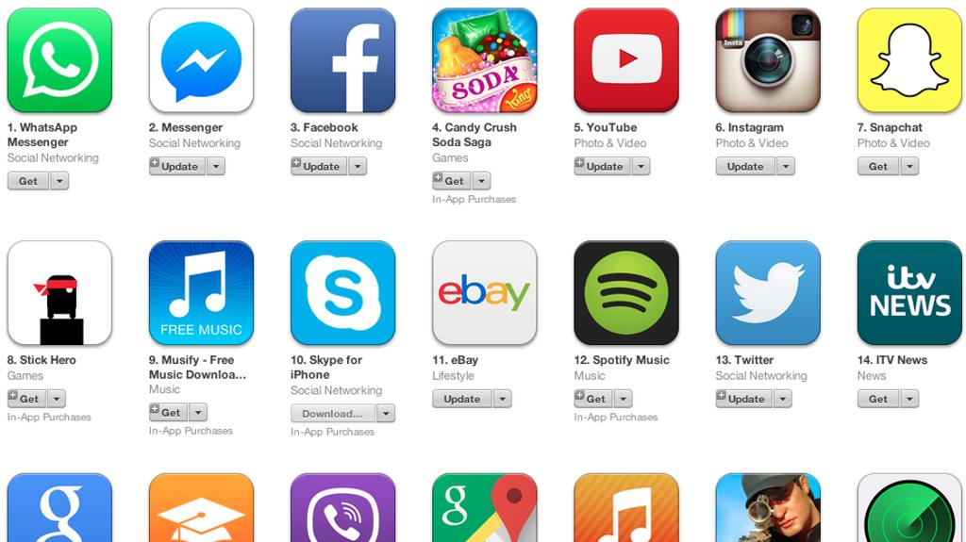
Programming Environment
?
Program
(C++, Java, Python, Ruby)
SQL
database
DBMS

Slide 5
Many Database API options
Fully embed into language (embedded SQL)
Low-level library with core database calls (DB API)
Object-relational mapping (ORM)
Ruby on rails, django, etc
define database-backed classes
magically maps between database rows & objects
magic is a double edged sword

Slide 6
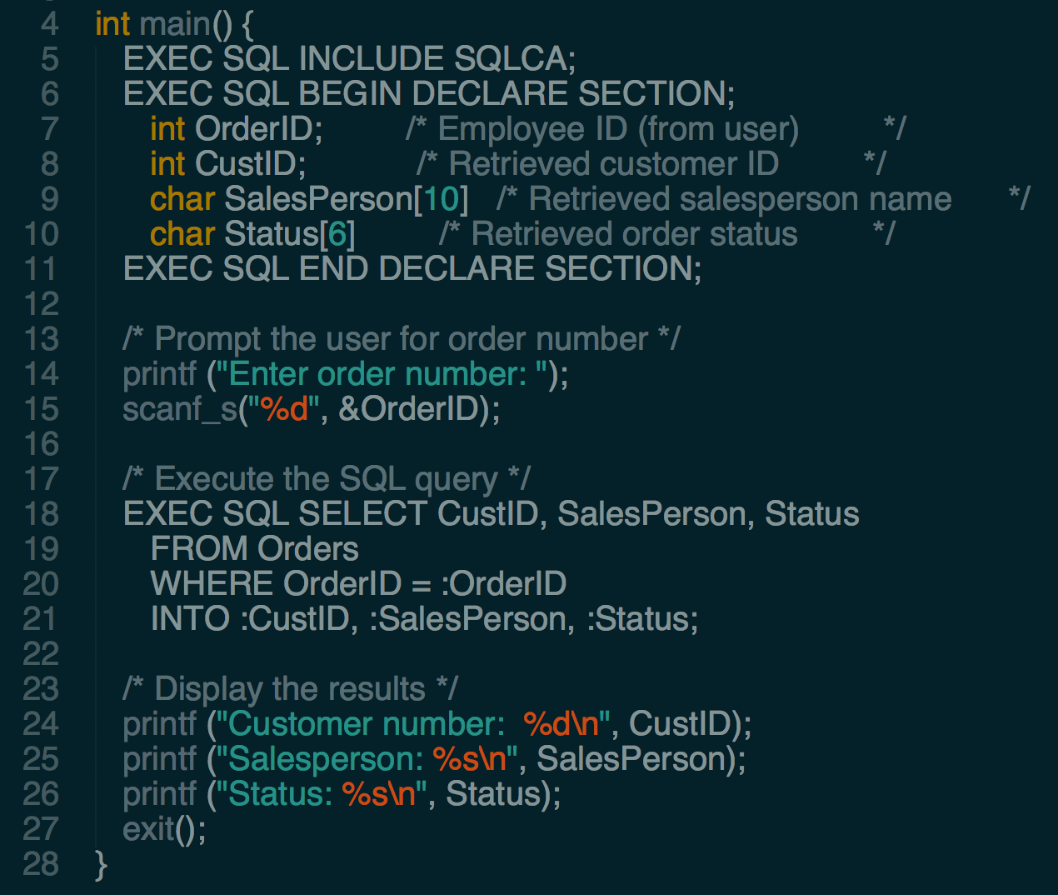
Embedded SQL
Extend host language (CPP) with SQL syntax
Declaring Variables
Embedded SQL Query

Slide 7
Embedded SQL
CPP + embedded SQL
Hard to maintain
What if SQL evolves?
What if Compiler evolves?
Preprocessor
CPP + DB library calls
CPP Compiler
DBMS library
Executable
DBMS

Slide 8
Many Database API options
Fully embed into language (embedded SQL)
Low-level library with core database calls (DB API)
Object-relational mapping (ORM)
Ruby on rails, django, Hibernate, sqlalchemy, etc
define database-backed classes
magically maps between database rows & objects
magic is a double edged sword

Slide 9
What does a library need to do?
Single interface to possibly multiple DBMS engines
Connect to a database
Map objects between host language and DBMS
Manage query results
Ads
Program
DBMS
Library
Users
Billing
API calls
Connection

Slide 10

ODBC and JDBC
ODBC (Open DataBase Connectivity)
JDBC (Java DataBase Connectivity)
Sun developed as set of Java interfaces
javax.sql.*

Slide 11
Connections
Create a connection
Allocate resources for the connection
Relatively expensive to set up, libraries often cache connections for future use
conn = connect(sfu.db)
Should close connections when done! Otherwise resource leak.

Slide 12
Query Execution
foo = conn.execute(“select * from student”)
Challenges
Type Mismatch
What is the return type of execute()?
How to pass data between DBMS and host language?

Slide 13
Type Mismatch
SQL standard defines mappings between SQL and several languages
SQL types
CHAR(20)
INTEGER
SMALLINT
REAL
C types
char[20]
int
short
float
Python types
str
int
int
float

Slide 14
Cursor
SQL relations and results are sets of records
What is the type of foo?
Cursor over the Result Set
similar to an iterator interface
Note: relations are unordered!
Cursors have no ordering guarantees
Use ORDER BY to ensure an ordering
foo = conn1.execute(“select * from student”)

Slide 15
student1
student2
student3
student4
student1
student5
cursor
student6
student7
student8
student9
Program
DBMS
student10
student11

Slide 16
student1
student2
student3
student4
student2
student5
cursor
student6
student7
student8
student9
Program
DBMS
student10
student11

Slide 17
Cursor
Cursor similar to an iterator
cursor = conn.execute(“SELECT * FROM student”)
Cursor methods
fetchone()
fetchall()

Slide 18
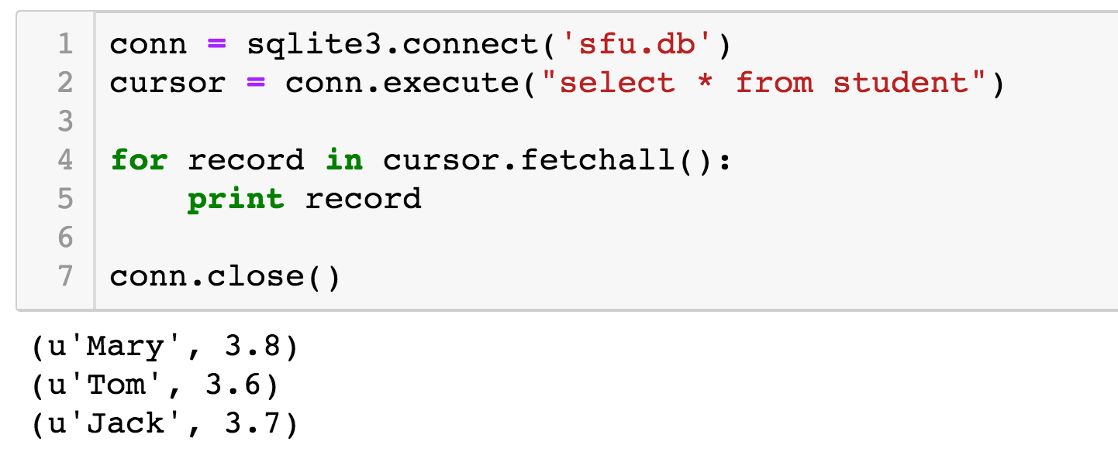
Cursor
Cursor similar to an iterator

Slide 19
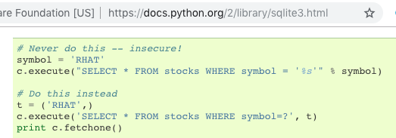
SQL Injection!!
symbol = “RHAT’ OR True -- ”
SELECT * FROM stocks WHERE symbol = 'RHAT' OR True -- '
SELECT * FROM stocks WHERE symbol = 'RHAT'' OR True -- '

Slide 20
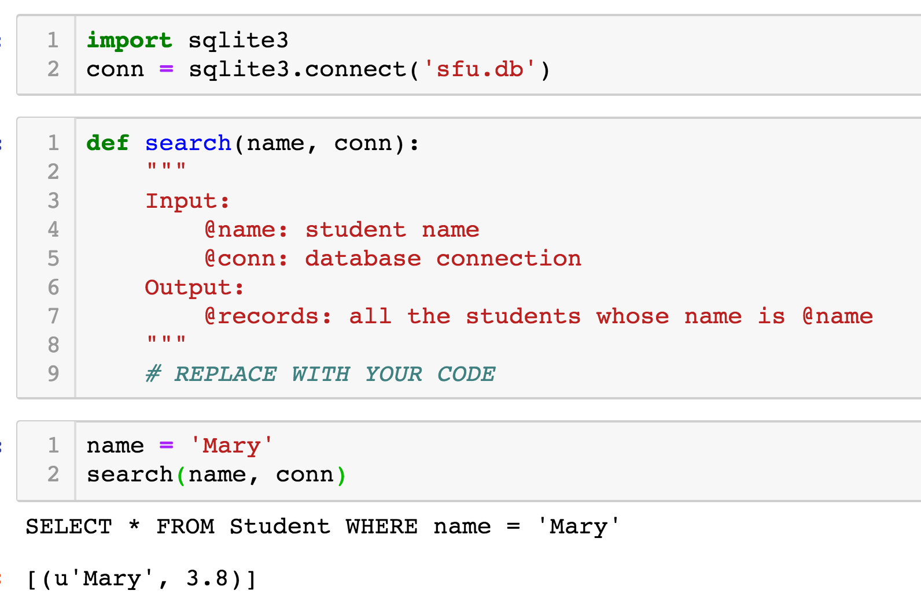
Exercise
Notes:
def search(name, conn):
sql = "SELECT * FROM Student WHERE name = ?"
cursor = conn.execute(sql, (name,))
return cursor.fetchall()

Slide 21
Outline
Database Programming
Application Architecture

Slide 22
Architectures
Single tier
How things used to be …
Two tier
Client-server architecture
Three tier (and multi-tier)
Used for many web systems
Very scalable

Slide 23
Single Tier Architecture
Historically, data intensive applications ran on a single tier which contained
The DBMS,
Application logic and business rules, and
User interface

Slide 24
Two-Tier Architecture
Client/ server architecture
The server implements the business logic and data management
Separate presentation from the rest of the application
Client
Application Logic
network
…
DBMS
Client

Slide 25
Presentation Layer
Responsible for handling the user's interaction with the middle tier
One application may have multiple versions that correspond to different interfaces
Web browsers, mobile phones, …
Style sheets can assist in controlling versions

Slide 26
Three-Tier Architecture
Separate presentation from the rest of the application
Separate the application logic from the data management
Client
network
Application Logic
network
…
DBMS
Data Management Layer
Middle Layer
Client
Presentation Layer

Slide 27
Business logic Layer
The middle layer is responsible for running the business logic of the application which controls
What data is required before an action is performed
The control flow of multi-stage actions
Access to the database layer
Multi-stage actions performed by the middle tier may require database access
But will not usually make permanent changes until the end of the process
e.g. adding items to a shopping basket in an Internet shopping site

Slide 28
Data Management Layer
The data management tier contains one, or more databases
Which may be running on different DBMSs
Data needs to be exchanged between the middle tier and the database servers
This task is not required if a single data source is used but,
May be required if multiple data sources are to be integrated
XML is a language which can be used as a data exchange format between database servers and the middle tier

Slide 29
Example: Airline reservations
Consider the three tiers in a system for airline reservations
Database System
Airline info, available seats, customer info, etc.
Application Server
Logic to make reservations, cancel reservations, add new airlines, etc.
Client Program
Log in different users, display forms and human-readable output

Slide 30
Example: Course Enrollment
Student enrollment system tiers
Database System
Student information, course information, instructor information, course availability, pre-requisites, etc.
Application Server
Logic to add a course, drop a course, create a new course, etc.
Client Program
Log in different users (students, staff, faculty), display forms and human-readable output

Slide 31
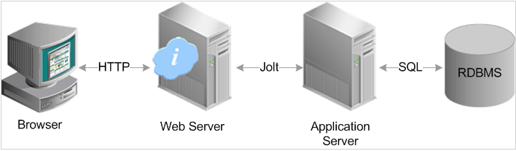
3 Tier Architecture and the Web
In the domain of web applications three tier architecture usually refers to
Web server
Application server
Database server
HTTP

Slide 32
Summary
Database Programming
Embedded SQL
DB API
Application Architecture
Three Tier Architecture

Slide 33
Acknowledge
Some lecture slides were copied from or inspired by the following course materials
“W4111: Introduction to databases” by Eugene Wu at Columbia University
“CSE344: Introduction to Data Management” by Dan Suciu at University of Washington
“CMPT354: Database System I” by John Edgar at Simon Fraser University
“CS186: Introduction to Database Systems” by Joe Hellerstein at UC Berkeley
“CS145: Introduction to Databases” by Peter Bailis at Stanford
“CS 348: Introduction to Database Management” by Grant Weddell at University of Waterloo

