Slide 1
CMPT 354: Database System I
Lecture 11. Transaction Management

Slide 2
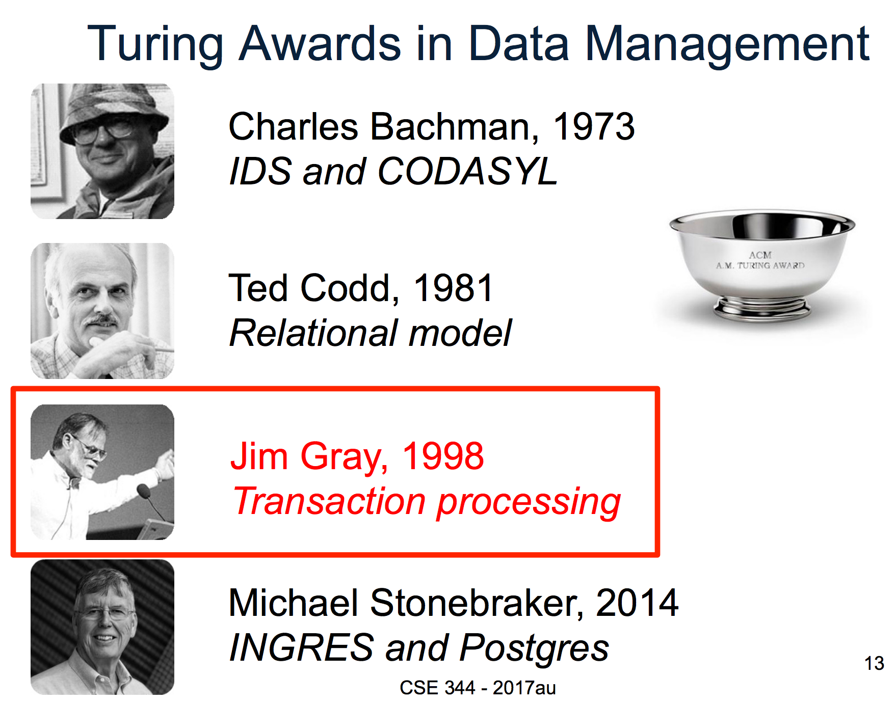
Why this lecture
DB application developer
What if crash occurs, power goes out, etc?
Single user → Multiple users

Slide 3
Outline
Transaction Basics
Definition
Motivation for Transaction
ACID Properties
Concurrency Control
Scheduling
Anomaly Types
Conflict Serializability

Slide 4
Transactions: Basic Definition
A transaction (“TXN”) is a sequence of one or more operations (reads or writes) which reflects a single real-world transition.
In the real world, a TXN either happened completely or not at all
Examples:
Transfer money between accounts
Purchase a group of products
Register for a class (either waitlist or allocated)

Slide 5
Transactions in SQL
In “ad-hoc” SQL:
Default: each statement = one transaction
In a program, multiple statements can be grouped together as a transaction:
START TRANSACTION
UPDATE Bank SET amount = amount – 100
WHERE name = ‘Bob’
UPDATE Bank SET amount = amount + 100
WHERE name = ‘Joe’
COMMIT

Slide 6
Motivation for Transactions
Grouping user actions (reads & writes) into transactions helps with two goals:
Recovery & Durability: Keeping the DBMS data consistent and durable in the face of crashes, aborts, system shutdowns, etc.
Concurrency: Achieving better performance by parallelizing TXNs without creating anomalies

Slide 7
Motivation
1. Recovery & Durability of user data is essential for reliable DBMS usage
The DBMS may experience crashes (e.g. power outages, etc.)
Individual TXNs may be aborted (e.g. by the user)
Idea: Make sure that TXNs are either durably stored in full, or not at all; keep log to be able to “roll-back” TXNs

Slide 8
Protection against crashes / aborts
Client 1:
INSERT INTO SmallProduct(name, price) SELECT pname, price FROM Product
WHERE price <= 0.99
DELETE Product WHERE price <=0.99
Crash / abort!
What goes wrong?

Slide 9
Protection against crashes / aborts
Client 1:
START TRANSACTION
INSERT INTO SmallProduct(name, price) SELECT pname, price FROM Product
WHERE price <= 0.99
DELETE Product WHERE price <=0.99
COMMIT OR ROLLBACK
Now we’d be fine!

Slide 10
Motivation
2. Concurrent execution of user programs is essential for good DBMS performance.
Disk accesses may be frequent and slow- optimize for throughput (# of TXNs), trade for latency (time for any one TXN)
Users should still be able to execute TXNs as if in isolation and such that consistency is maintained
Idea: Have the DBMS handle running several user TXNs concurrently, in order to keep CPUs humming…

Slide 11
Multiple users: single statements
Client 1: UPDATE Employee SET Salary = Salary + 1000 Client 2: UPDATE Product
SET Salary = Salary * 2
Two managers attempt to increase employee salary concurrently- What could go wrong?

Slide 12
Multiple users: single statements
Client 1: START TRANSACTION
UPDATE Employee SET Salary = Salary + 1000
COMMIT Client 2: START TRANSACTION
UPDATE Employee SET Salary = Salary * 2
COMMIT
Now works like a charm- we’ll see how / why later…

Slide 13
Transaction Properties: ACID
Atomic
State shows either all the effects of txn, or none of them
Consistent
Txn moves from a state where integrity holds, to another where integrity holds
Isolated
Effect of txns is the same as txns running one after another (ie looks like batch mode)
Durable
Once a txn has committed, its effects remain in the database
ACID continues to be a source of great debate!

Slide 14
ACID: Atomic
TXN’s activities are atomic: all or nothing
Intuitively: in the real world, a transaction is something that would either occur completely or not at all
Two possible outcomes for a TXN
It commits: all the changes are made
It aborts: no changes are made

Slide 15
ACID: Consistent
The tables must always satisfy user-specified constraints
Examples:
Account number is unique
Stock amount can’t be negative
Sum of debits and of credits is 0
How consistency is achieved:
Programmer makes sure a txn takes a consistent state to a consistent state
System makes sure that the txn is atomic

Slide 16
ACID: Isolated
A transaction executes concurrently with other transactions
Isolation: the effect is as if each transaction executes in isolation of the others.
E.g. Should not be able to observe changes from other transactions during the run

Slide 17
ACID: Durable
The effect of a TXN must continue to exist (“persist”) after the TXN
And after the whole program has terminated
And even if there are power failures, crashes, etc.
And etc…
Means: Write data to disk

Slide 18
A Note: ACID is contentious!
Many debates over ACID, both historically and currently
Many newer “NoSQL” DBMSs relax ACID
In turn, now “NewSQL” reintroduces ACID compliance to NoSQL-style DBMSs…
ACID is an extremely important & successful paradigm, but still debated!

Slide 19
Transaction Management (Big Picture)
Definition
Two Big Problems
Techniques
Properties
Write
Read
1. Support multiple transaction at the same time
Atomicity
1. Concurrency Control
Storage
Consistency
2. Make sure the data stored is reliable
2. Database Recovery
Isolation
Transaction = A list of writes and reads
Durability
For example: {Read, Read, Write}

Slide 20
Outline
Transaction Basics
Definition
Motivation for Transaction
ACID Properties
Concurrency Control
Scheduling
Anomaly types
Conflict serializability

Slide 21
Concurrency: Isolation & Consistency
The DBMS must handle concurrency such that…
Isolation is maintained: Users must be able to execute each TXN as if they were the only user
DBMS handles the details of interleaving various TXNs
Consistency is maintained: TXNs must leave the DB in a consistent state
DBMS handles the details of enforcing integrity constraints
ACID
ACID

Slide 22
Example- consider two TXNs:
T1: START TRANSACTION
UPDATE Accounts SET Amt = Amt + 100
WHERE Name = ‘A’
UPDATE Accounts SET Amt = Amt - 100
WHERE Name = ‘B’
COMMIT
T2: START TRANSACTION
UPDATE Accounts SET Amt = Amt * 1.06
COMMIT
T1 transfers $100 from B’s account to A’s account
T2 credits both accounts with a 6% interest payment

Slide 23
Example- consider two TXNs:
We can look at the TXNs in a timeline view- serial execution:
T₁
A += 100
B -= 100
T₂
A *= 1.06
B *= 1.06
Time
T1 transfers $100 from B’s account to A’s account
T2 credits both accounts with a 6% interest payment

Slide 24
Example- consider two TXNs:
The TXNs could occur in either order… DBMS allows!
T₁
A += 100
B -= 100
T₂
A *= 1.06
B *= 1.06
Time
T2 credits both accounts with a 6% interest payment
T1 transfers $100 from B’s account to A’s account

Slide 25
Example- consider two TXNs:
The DBMS can also interleave the TXNs
T₁
A += 100
B -= 100
T₂
A *= 1.06
B *= 1.06
Time
T2 credits A’s account with 6% interest payment, then T1 transfers $100 to A’s account…
T2 credits B’s account with a 6% interest payment, then T1 transfers $100 from B’s account…

Slide 26
Example- consider two TXNs:
The DBMS can also interleave the TXNs
T₁
A += 100
B -= 100
T₂
A *= 1.06
B *= 1.06
Time
Is it correct?

Slide 27
Why Interleave TXNs?
Interleaving TXNs might lead to anomalous outcomes… why do it?
Several important reasons:
Individual TXNs might be slow- don’t want to block other users during!
Disk access may be slow- let some TXNs use CPUs while others accessing disk!
All concern large differences in performance

Slide 28
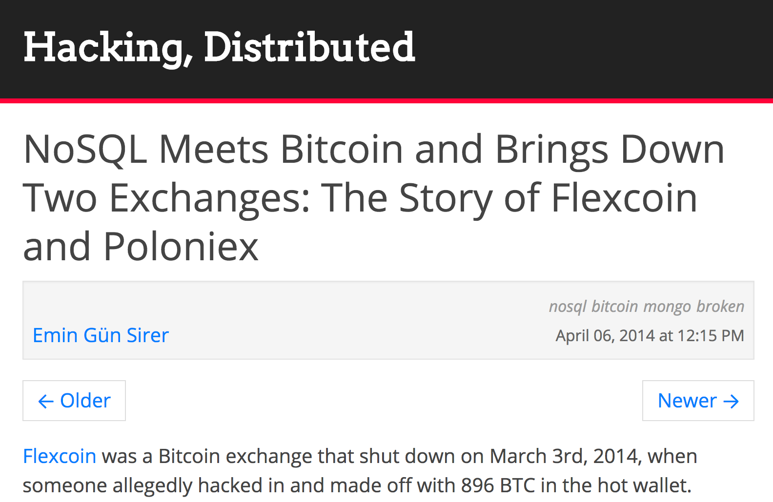
Ignore all issues?
At Facebook, only 0.0004% of results returned are inconsistent
But,

Slide 29
Interleaving & Isolation
The DBMS has freedom to interleave TXNs
However, it must pick an interleaving or schedule such that isolation and consistency are maintained
Must be as if the TXNs had executed serially!
“With great power comes great responsibility”
ACID
DBMS must pick a schedule which maintains isolation & consistency

Slide 30
Scheduling examples
Starting Balance
A | B
$50 | $200
Serial schedule T₁,T₂:
T₁
A += 100
B -= 100
T₂
A *= 1.06
B *= 1.06
A | B
$159 | $106
Interleaved schedule 1:
Same result!
T₁
A += 100
B -= 100
T₂
A *= 1.06
B *= 1.06
A | B
$159 | $106

Slide 31
Scheduling examples
Starting Balance
A | B
$50 | $200
Serial schedule T₁,T₂:
T₁
A += 100
B -= 100
T₂
A *= 1.06
B *= 1.06
A | B
$159 | $106
Different result than serial T₁,T₂!
Interleaved schedule 2:
T₁
A += 100
B -= 100
T₂
A *= 1.06
B *= 1.06
A | B
$159 | $112

Slide 32
Scheduling examples
Starting Balance
A | B
$50 | $200
Serial schedule T₂,T₁:
T₁
A += 100
B -= 100
T₂
A *= 1.06
B *= 1.06
A | B
$153 | $112
Different result than serial T₂,T₁ ALSO!
Interleaved schedule 2:
T₁
A += 100
B -= 100
T₂
A *= 1.06
B *= 1.06
A | B
$159 | $112

Slide 33
Scheduling examples
Interleaved schedule B:
T₁
A += 100
B -= 100
T₂
A *= 1.06
B *= 1.06
This schedule is different than any serial order! We say that it is not serializable

Slide 34
Scheduling Definitions
A serial schedule is one that does not interleave the actions of different transactions
A serializable schedule is a schedule that is equivalent to some serial schedule.
Schedule 1 and Schedule 2 are equivalent if, for any database state, the effect on DB of executing Schedule 1 is identical to the effect of Schedule 2

Slide 35
Serializable?
Serial schedules:
 | A | B
T₁,T₂ | 1.06*(A+100) | 1.06*(B-100)
T₂,T₁ | 1.06*A + 100 | 1.06*B - 100
T₁
A += 100
B -= 100
A | B
1.06*(A+100) | 1.06*(B-100)
T₂
A *= 1.06
B *= 1.06
Same as a serial schedule for all possible values of A, B = serializable

Slide 36
Serializable?
Serial schedules:
 | A | B
T₁,T₂ | 1.06*(A+100) | 1.06*(B-100)
T₂,T₁ | 1.06*A + 100 | 1.06*B - 100
T₁
A += 100
B -= 100
A | B
1.06*(A+100) | 1.06*B - 100
T₂
A *= 1.06
B *= 1.06
Not equivalent to any serializable schedule = not serializable

Slide 37
Outline
Transaction Basics
Definition
Motivation for Transaction
ACID Properties
Concurrency Control
Scheduling
Anomaly types
Conflict Serializability

Slide 38
What else can go wrong with interleaving?
Various anomalies which break isolation / serializability
Often referred to by name…
Occur because of / with certain “conflicts” between interleaved TXNs

Slide 39
The DBMS’s view of the schedule
T₁
A += 100
B -= 100
Each action in the TXNs reads a value from global memory and then writes one back to it
Scheduling order matters!
T₂
A *= 1.06
B *= 1.06
T₁
R(A)
W(A)
R(B)
W(B)
T₂
R(A)
W(A)
R(B)
W(B)

Slide 40
Conflict Types
Two actions conflict if they are part of different TXNs, involve the same variable, and at least one of them is a write
Thus, there are three types of conflicts:
Read-Write conflicts (RW)
Write-Read conflicts (WR)
Write-Write conflicts (WW)
Why no “RR Conflict”?
Interleaving anomalies occur with / because of these conflicts between TXNs (but these conflicts can occur without causing anomalies!)

Slide 41
Classic Anomalies with Interleaved Execution
“Unrepeatable read”:
Example:
T₁ reads some data from A
T₂ writes to A
Then, T₁ reads from A again and now gets a different / inconsistent value
T₁
R(A)
R(A)
T₂
R(A)
W(A)
C
Occurring with / because of a RW conflict

Slide 42
Classic Anomalies with Interleaved Execution
“Dirty read” / Reading uncommitted data:
Example:
T₁ writes some data to A
T₂ reads from A, then writes back to A & commits
T₁ then aborts- now T₂’s result is based on an obsolete / inconsistent value
T₁
W(A)
A
T₂
R(A)
W(A)
C
Occurring with / because of a WR conflict

Slide 43
Classic Anomalies with Interleaved Execution
“Lost update”:
Example:
T₁ blind writes some data to A
T₂ blind writes to A and B
T₁ then blind writes to B; now we have T₂’s value for B and T₁’s value for A- not equivalent to any serial schedule!
T₁
W(A)
W(B)
C
T₂
W(A)
W(B)
C
Occurring because of a WW conflict

Slide 44
Outline
Transaction Basics
Definition
Motivation for Transaction
ACID Properties
Concurrency Control
Scheduling
Anomaly Types
Conflict Serializability

Slide 45
Schedules
Serial Schedule:
T₁
R(A)
W(A)
R(B)
W(B)
T₂
R(A)
W(A)
R(B)
W(B)
Serializable Schedule:
T₁
R(A)
W(A)
R(B)
W(B)
T₂
R(A)
W(A)
R(B)
W(B)

Slide 46
Conflict Serializable Schedule
All Schedules
Serializable Schedule
Conflict Serializable Schedule
Serial Schedule

Slide 47
Conflicts
Two actions conflict if all the conditions hold
i) they are part of different TXNs,
ii) they involve the same variable,
iii) at least one of them is a write
T₁
R(A)
W(A)
R(B)
W(B)
T₂
R(A)
W(A)
R(B)
W(B)

Slide 48
Exercise
Two actions conflict if all the conditions hold
i) they are part of different TXNs,
ii) they involve the same variable,
iii) at least one of them is a write
T₁
R(A)
W(A)
R(B)
W(B)
T₂
R(A)
W(A)
R(B)
W(B)
Find all the other conflicts

Slide 49
Exercise: Answer
Two actions conflict if all the conditions hold
i) they are part of different TXNs,
ii) they involve the same variable,
iii) at least one of them is a write
T₁
R(A)
W(A)
R(B)
W(B)
T₂
R(A)
W(A)
R(B)
W(B)

Slide 50
Conflict serializable
Schedule S is conflict serializable if S is conflict equivalent to some serial schedule
Two schedules are conflict equivalent if:
They involve the same actions of the same TXNs
Every pair of conflicting actions of two TXNs are ordered in the same way

Slide 51
Are they conflict equivalent?
“They involve the same actions of the same TXNs” does not hold
T₁
R(A)
W(A)
R(B)
W(B)
T₂
R(A)
W(A)
R(B)
NO
T₁
R(A)
W(A)
R(B)
W(B)
T₂
R(A)
W(A)
R(B)
W(B)

Slide 52
Are they conflict equivalent?
“Every pair of conflicting actions of two TXNs are ordered in the same way” does not hold
T₁
R(A)
W(A)
R(B)
W(B)
T₂
R(A)
W(A)
R(B)
W(B)
NO
T₁
R(A)
W(A)
R(B)
W(B)
T₂
R(A)
W(A)
R(B)
W(B)

Slide 53
Are they conflict equivalent?
They involve the same actions of the same TXNs
Every pair of conflicting actions of two TXNs are ordered in the same way
T₁
R(A)
W(A)
R(B)
W(B)
T₂
R(A)
W(A)
R(B)
W(B)
YES
T₁
R(A)
W(A)
R(B)
W(B)
T₂
R(A)
W(A)
R(B)
W(B)

Slide 54
The Conflict Graph
Consider a graph where the nodes are TXNs, and there is an edge from T_{i} →T_{j} if any actions in T_{i} precede and conflict with any actions in T_{j}
T₁
R(A)
W(A)
R(B)
W(B)
T₂
T₁
T₂
R(A)
W(A)
R(B)
W(B)
Theorem: Schedule is conflict serializable if and only if its conflict graph is acyclic

Slide 55
Is this schedule conflict serializable ?
T₁
R(A)
W(A)
R(B)
W(B)
T₂
T₁
T₂
R(A)
W(A)
R(B)
W(B)
Find all conflicts
Model the schedule as a conflict graph
Check whether the graph has a cycle
Yes → not conflict serializable
No → conflict serializable
NO

Slide 56
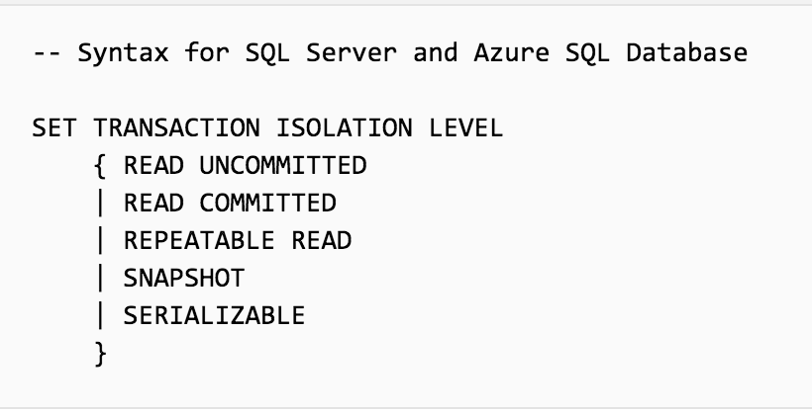
Isolation Levels
Transactions in SQLite are serializable (https://www.sqlite.org/isolation.html)
Isolation Levels in SQL Server (https://docs.microsoft.com/en-us/sql/t-sql/statements/set-transaction-isolation-level-transact-sql?view=sql-server-2017)
ACID
Check out CMPT 454

Slide 57
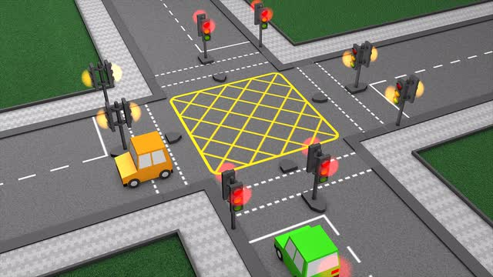

Concurrency Control Algorithms
Locking
Timestamp Ordering
2-phase locking
Multi-version concurrency control (MVCC)
Check out CMPT 454

Slide 58
Summary
Transaction Basics
Definition
Motivation for Transaction
ACID Properties
Concurrency Control
Scheduling
Anomaly Types
Conflict Serializability
58

Slide 59
Acknowledge
Some lecture slides were copied from or inspired by the following course materials
“W4111: Introduction to databases” by Eugene Wu at Columbia University
“CSE344: Introduction to Data Management” by Dan Suciu at University of Washington
“CMPT354: Database System I” by John Edgar at Simon Fraser University
“CS186: Introduction to Database Systems” by Joe Hellerstein at UC Berkeley
“CS145: Introduction to Databases” by Peter Bailis at Stanford
“CS 348: Introduction to Database Management” by Grant Weddell at University of Waterloo

