Slide 1
CMPT 354: Database System I
Lecture 2. Relational Model

Slide 2
Outline
An overview of data models
Basics of the Relational Model
Define a relational schema in SQL

Slide 3
Outline
An overview of data models
Basics of the Relational Model
Define a relational schema in SQL

Slide 4
Review
What is a database?
A collection of files that store related data
What is a DBMS?
A piece of software designed to store and manage databases

Slide 5
Data Storage with DBMS
File 1
Application Program 1
File 2
DBMS
Application Program 2
.
.
.
File n
Application Program m

Slide 6
Data Model
Data Model
mathematical formalism (or conceptual way) for describing the data
The description generally consists of three parts:
Structure of the data
Operations on the data
Constraints on the data

Slide 7
Structure of the data
Schema (e.g., table names, attribute names)
Describe the conceptual structure of the data
Different from data structure (e.g., list, array)
Data structure can be seen as a physical data model

Slide 8
Operations on the data
Query language (e.g., SQL)
Describe what operations that can be performed on data
Two kinds of operations
operations that retrieve information
operations that change the database
Different from programming languages (e.g., C, Java)
Support a set of limited operations
Allow for query optimizations

Slide 9
Constraints on the data.
Constraints (e.g., age > 0, student# is unique)
describe limitations on what the data can be.
Different kinds of constraints
Domain constraints
Integrity constraints
Why does it matter?
Ensure the correctness of data

Slide 10
Commonly Used Data Models
Relational Data Model
Key-Value Data Model
Semi-structured Data Model (e.g., Json, XML)

Slide 11
The Relational Model in Brief
Id | Name | Age | GPA
1000 | Mike | 21 | 3.8
1001 | Bill | 19 | 3.4
1002 | Alice | 20 | 3.6
Structure of the Data
Table structure
Query language
SQL
Constraints on the data
E.g., id is unique, age > 10, name is not NULL

Slide 12
The Key-Value Model in Brief
Key → Value
1000 → (Mike, 21, 3.8)
1001 → (Bill, 19, 3.4)
1002 → (Alice, 20, 3.6)
Structure of the Data
(Key, Value) pairs
Key is an integer/string, value can be any object
Query language
get(key), put(key, value)
Constraints on the data
E.g., key is unique, value is not NULL

Slide 13
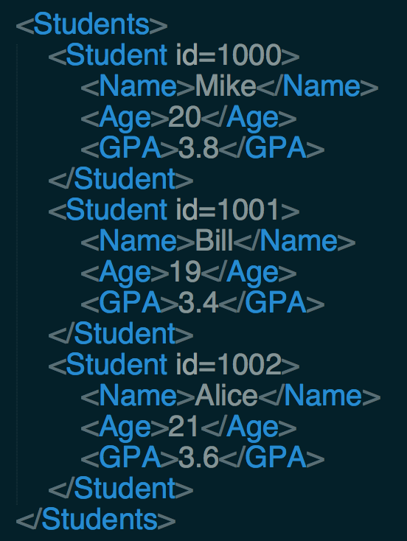
The Semistructured Model in Brief
Structure of the Data
Tree structure
Query language
XPath
Constraints
E.g., <Age> has to be integer, each <Student> has a <Name> element nested within in

Slide 14
Outline
An overview of data models
Basics of the Relational Model
Define a relational schema in SQL

Slide 15
Terminology
Relations/Tables
Columns/Attributes/Fields
Rows/Tuples/Records
Degree (arity) of a relation = #attributes
Cardinality of a relation = #tuples
Columns/
Attributes/
Fields
Id | Name | Age | GPA
1000 | Mike | 21 | 3.8
1001 | Bill | 19 | 3.4
1002 | Alice | 20 | 3.6
Rows/
Tuples/
Records

Slide 16
Schema
Relation schema
The name of a relation + The set of attributes for a relation
Database schema
The set of schemas for the relations of a database
Student(id, sname, age, gpa)
Student (sid, sname, age, gpa)
Take (sid, cid)
Course (cid, cname, credit)

Slide 17
Domains
Each attribute has a domain (date type)
Examples
Text: CHAR(20), VARCHAR(50), TEXT
Integer: INT, SMALLINT
Real: DOUBLE, FLOAT
Few more that are vendor specific
Student(id:INT, sname:VARCHAR(50), age:INT, gpa:FLOAT)

Slide 18
Equivalent Representations of a Relation
Order does not matter!
Id | Name | GPA | Age
1000 | Mike | 3.8 | 21
1001 | Bill | 3.4 | 19
1002 | Alice | 3.6 | 20
Id | Name | Age | GPA
1000 | Mike | 21 | 3.8
1001 | Bill | 19 | 3.4
1002 | Alice | 20 | 3.6
Id | Name | Age | GPA
1000 | Mike | 21 | 3.8
1002 | Alice | 20 | 3.6
1001 | Bill | 19 | 3.4

Slide 19
Exercise-1: Terminology
Accounts
AcctNo | Type | Balance
12345 | savings | 12000
23456 | checking | 1000
34567 | savings | 25
List two other sayings of “rows”
List two other sayings of “columns”
List another saying of “table”
Customers
fname | lname | idNo | account
Robbie | Banks | 901-222 | 12345
Lena | Hand | 805-333 | 12345
Lena | Hand | 805-333 | 23456
Notes:
tuples, records
fields, attributes
relation

Slide 20
Exercise-2: Terminology
Accounts
Indicate the attributes of each relation
Indicate the tuples of each relation
Indicate the degree of each relation
Indicate the cardinality of each relation
AcctNo | Type | Balance
12345 | savings | 12000
23456 | checking | 1000
34567 | savings | 25
Customers
fname | lname | idNo | account
Robbie | Banks | 901-222 | 12345
Lena | Hand | 805-333 | 12345
Lena | Hand | 805-333 | 23456
Notes:
4. Accounts: AcctNo, Type, Balance
Customers: fname, lname, idNo, account
5. Accounts: (12345, “savings”, 12000), (23456, “checking”, 1000), (34567, ”savings”, 25)
Customers: (“Robbie”, “Banks”, 901-222, 12345), (“Lena”, “Hand”, 805-333, 12345), (“Lena”, “Hand”, 805-333, 23456)
6. Accounts: 3
Customers: 4
7. Accounts 3
Customers: 3

Slide 21
Exercise-3: Terminology
Accounts
AcctNo | Type | Balance
12345 | savings | 12000
23456 | checking | 1000
34567 | savings | 25
Indicate the schema for each relation
Indicate the database schema
Specify a suitable domain for each attribute
Customers
fname | lname | idNo | account
Robbie | Banks | 901-222 | 12345
Lena | Hand | 805-333 | 12345
Lena | Hand | 805-333 | 23456
Notes:
8. Accounts(AcctNo, Type, Balance)
Customers(fname, lname, idNo, account)
9. Accounts(AcctNo, Type, Balance), Customers(fname, lname, idNo, account)
10. AcctNo: INT, Type: CHAR(8), Balance: INT, fname: VARCHAR(32), lname: VARCHAR(32), idNO: INT, account: INT

Slide 22
Exercise-4: Terminology
Customers
Indicate another equivalent way to represent this relation
How many different ways to represent this relation?
fname | lname | idNo | account
Robbie | Banks | 901-222 | 12345
Lena | Hand | 805-333 | 12345
Lena | Hand | 805-333 | 23456
Notes:
11. For example, swap the 2nd and 3rd rows
12. 3! * 4! = 144

Slide 23
Keys
Key = one (or multiple) attributes that uniquely identify a record
AcctNo | Type | Balance
12345 | savings | 12000
23456 | checking | 1000
34567 | savings | 25

Slide 24
Keys
Key = one (or multiple) attributes that uniquely identify a record
Key
Not a key
Not a key
AcctNo | Type | Balance
12345 | savings | 12000
23456 | checking | 1000
34567 | savings | 25

Slide 25
Multiple-attribute Key
Multiple-attribute Key = multiple attributes that uniquely identify a record
Key = fname, lname
fname | lname | age | salary
Robbie | Banks | 20 | 10k
Alice | Banks | 30 | 8k
Alice | Smith | 25 | 12k

Slide 26
Multiple Keys
Key
Another Key
SIN | fname | lname | age | salary
123-456-789 | Robbie | Banks | 20 | 10k
222-111-709 | Alice | Banks | 30 | 8k
345-498-712 | Alice | Smith | 25 | 12k
We can choose one key as primary key (e.g., SSN)

Slide 27
Foreign Key
Attribute(s) whose value is a key of a record in some other relation
Accounts
Customers
acctNo | type | balance
12345 | savings | 12000
23456 | checking | 1000
34567 | savings | 25
fname | lname | idNo | account
Robbie | Banks | 901-222 | 12345
Lena | Hand | 805-333 | 12345
Lena | Hand | 805-333 | 23456
Foreign key to Accounts.acctNo

Slide 28
Discussions
Tables are NOT ordered
They are sets or multisets (bags)
Tables DO NOT prescribe how they are implemented/stored on disk
This is called physical data independence

Slide 29
Outline
An overview of data models
Basics of the Relational Model
Define a relational schema in SQL

Slide 30
SQL DDL
SQL stands for Structured Query Language
SQL is divided into two parts
Data Manipulation Language (DML) which allows users to create, modify and query data
Data Definition Language (DDL) which is used to define external and conceptual schemas
The DDL supports the creation, deletion and modification of tables
Including the specification of domain constraints and other constraints

Slide 31
Creating Tables
To create a table use the CREATE TABLE statement
Specify the table name, field names and domains
CREATE TABLE Customer (
sin CHAR(11),
firstName CHAR(20),
lastName CHAR(20),
age INTEGER,
income REAL)
Question – is SQL case sensitive?
Answer – SQL keywords (create and table for example) are not case sensitive.
Named objects (tables, columns etc.) may be.

Slide 32
Inserting Records
To insert a record into an existing table use the INSERT statement
The list of column names is optional
If omitted the values must be in the same order as the columns
INSERT INTO Customer(sin, firstName, lastName, age, income)
VALUES ('111', 'Sam', 'Spade', 23, 65234)

Slide 33
Deleting Records
To delete a record use the DELETE statement
The WHERE clause specifies the record(s) to be deleted
Be careful, the following SQL query deletes all the records in a table
DELETE
FROM Customer
WHERE sin = '111'
DELETE
FROM Customer

Slide 34
Modifying Records
Use the UPDATE statement to modify a record, or records, in a table
Note that the WHERE statement is evaluated before the SET statement
Like DELETE the WHERE clause specifies which records are to be updated
UPDATE Customer
SET age = 37
WHERE sin = '111'

Slide 35
Deleting Tables
To delete a table use the DROP TABLE statement
This not only deletes all of the records but also deletes the table schema
DROP TABLE Customer

Slide 36
Modifying Tables
Columns can be added or removed to tables using the ALTER TABLE statement
ADD to add a column and
DROP to remove a column
ALTER TABLE Customer
ADD height INTEGER
ALTER TABLE Customer
DROP height

Slide 37
Acknowledge
Some lecture slides were copied from or inspired by the following course materials
“W4111: Introduction to databases” by Eugene Wu at Columbia University
“CSE344: Introduction to Data Management” by Dan Suciu at University of Washington
“CMPT354: Database System I” by John Edgar at Simon Fraser University
“CS186: Introduction to Database Systems” by Joe Hellerstein at UC Berkeley
“CS145: Introduction to Databases” by Peter Bailis at Stanford
“CS 348: Introduction to Database Management” by Grant Weddell at University of Waterloo

