Slide 1
CMPT 354: Database System I
Lecture 6. Basics of Query Processing and Indexing

Slide 2
Outline
Query Processing
What happens when an SQL query is issued?
Indexing
How to speed up query performance?

Slide 3
Query Processing Steps
SQL query
SQL Parser
Logical Optimization
Query
optimization
Physical Optimization
Query Execution
Disk

Slide 4
Example
Offering (oID, dept, cNum, term, instructor)
Took (sID, oID, grade)
Q: Student number of all students who have taken CMPT 354
SELECT sID
FROM Offering O, Took T
WHERE O.oID = T.oID
AND O.dept = ‘CMPT’
AND O.cNum = ‘354’

Slide 5
SQL Parser
Offering (oID, dept, cNum, term, instructor)
Took (sID, oID, grade)
From the input SQL text to a logical plan
π_{sID}
SELECT sID
FROM Offering O, Took T
WHERE O.oID = T.oID
AND O.dept = ‘CMPT’
AND O.cNum = ‘354’
σ_{dept = ‘CMPT’ ∧ cNum = 354}
⨝
π_{sID} (σ_{dept = ‘CMPT’ ∧ cNum = 354} (Offering ⨝ Took))
Offering
Took
Relational algebra expression is also called the “logical query plan”

Slide 6
Logical Optimization
Find the optimal logical plan
π_{sID}
π_{sID}
σ_{dept = ‘CMPT’ ∧ cNum = 354}
⨝
⨝
σ_{dept = ‘CMPT’ ∧ cNum = 354}
Offering
Took
Offering
Took

Slide 7
Physical Optimization
Find the optimal physical plan
π_{sID}
π_{sID}
(Nested loop)
⨝
(Hash Join)
⨝
V.S.
(Scan & write to T)
(Scan & write to T)
σ_{dept = ‘CMPT’ ∧ cNum = 354}
σ_{dept = ‘CMPT’ ∧ cNum = 354}
Offering
Took
Offering
Took
(File Scan)
(File Scan)
(File Scan)
(File Scan)

Slide 8
Query Execution
From a physical plan to actual machine code
π_{sID}
(Hash Join)
⨝
“Volcano Iterator Model”
Machine Code (e.g., C++)
(Scan & write to T)
σ_{dept = ‘CMPT’ ∧ cNum = 354}
Offering
Took
(File Scan)
(File Scan)

Slide 9
Summary
Logical plans:
Created by the parser from the input SQL text
Expressed as a relational algebra tree
Each SQL query has many possible logical plans
Physical plans:
Goal is to choose an efficient implementation for each operator in the RA
Each logical plan has many possible physical plans
Query Optimization:
Find the optimal logical plan
Find the optimal physical plan

Slide 10
Outline
Query Processing
What happens when an SQL query is issued?
Indexing
How to speed up query performance?

Slide 11
Query Performance
My database application is too slow… why?
One of the queries is very slow… why?
To address these problems, we need to understand:
How is data organized on disk
What is an index
How to select indexes

Slide 12
Data Storage
sID | dept | cNum | Term | instructor
10 | CMPT | 345 | SP 2018 | Jiannan
20 | CMPT | 454 | FA 2018 | Martin
… | … | … | … | …
DBMSs store data in files
Most common organization is row-wise storage
On disk, a file is split into blocks
Each block contains a set of tuples
10 | CMPT | 345 | SP 2018 | Jiannan
20 | CMPT | 454 | FA 2018 | Martin
Block 1
30 | … | … | … | …
40 | …
Block 2
50
60
Block 3
70
80
Block 4
In the example, we have 4 blocks with 2 tuples each

Slide 13
Scanning a Data File
Data file is stored on Disk
Consequence: Sequential IO is MUCH FASTER than random IO
Good: read blocks 1, 2, 3, 4, 5
Bad: read blocks 2342, 11, 321, 9
Rule of thumb:
Random reading 1-2% of the file ≈ sequential scanning the entire file

Slide 14
Data File Types
Heap file
Unsorted
Sequential file
Sorted according to some attribute(s) called key
Note: key here means something different from primary key: it just means that we order the file according to that attribute. In our example we ordered by sID. Might as well order by instructor, if that seems a better idea for the applications running on our database.

Slide 15
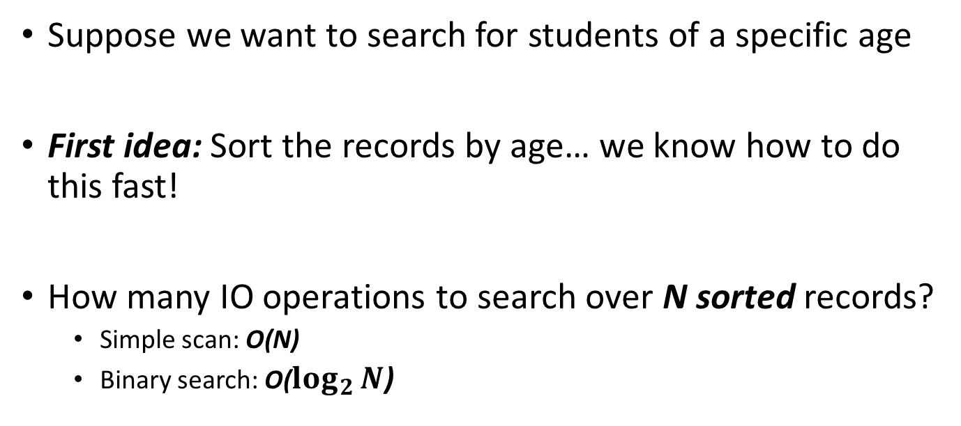
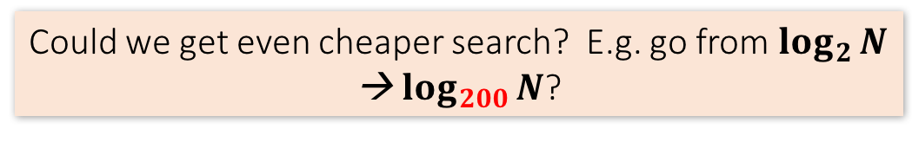
Index Motivation
Student(name, age)
Suppose we want to search for students of a specific age
First idea: Sort the records by age… we know how to do this fast!
How many IO operations to search over N sorted records?
Simple scan: O(N)
Binary search: O($\log_{2}{N}$)
Could we get even cheaper search? E.g. go from $\log_{2}{N}$ → $\log_{200}{N}$?

Slide 16
Index Motivation
What about if we want to insert a new student, but keep the list sorted?
We would have to potentially shift N records, requiring up to ~ 2*N/P IO operations (where P = # of records per page)!
2
1,3
4,5
6,7
1,2
3,4
5,6
7,
Could we get faster insertions?

Slide 17
Index Motivation
What about if we want to be able to search quickly along multiple attributes (e.g. not just age)?
We could keep multiple copies of the records, each sorted by one attribute set… this would take a lot of space
Can we get fast search over multiple attribute sets without taking too much space?
We’ll create separate data structures called indexes to address all these points

Slide 18
Index
An additional file, that allows fast access to records in the data file given a search key
The index contains (key, value) pairs:
The key = an attribute value (e.g., student ID or name)
The value = a pointer to the record
An index can store the full rows it points to (primary index) or pointers to those rows (secondary index)
We’ll mainly consider secondary indexes
Could have many indexes for one table

Slide 19
Different Keys
Primary key
uniquely identifies a tuple
Key of the sequential file
how the data file is sorted
Index key
how the index is organized

Slide 20
Example 1: Index on sID
Data File
Index
10 | CMPT | 345 | SP 2018 | Jiannan
20 | CMPT | 454 | FA 2018 | Martin
10
20
30
40
50
60
70
80
30 | … | … | … | …
40 | …
50
60
70
80

Slide 21
Example 2: Index on cNum
Data File
Index
10 | CMPT | 345 | SP 2018 | Jiannan
20 | CMPT | 454 | FA 2018 | Martin
102
110
225
276
354
383
454
470
30 | … | 110 | … | …
40 | … | 276
50 |  | 225
60 |  | 383
70 |  | 102
80 |  | 470

Slide 22
Index Organization
Common indexes:
Hash tables
B+ trees
Specialized indexes
R-trees
Inverted index
…

Slide 23
B+ Tree Example
K = 30?
30 < 80
80
30 in [20,60)
20 |  | 60
100 |  | 120 |  | 140
30 in [30,40)
10 |  | 15 |  | 18
20 |  | 30 |  | 40 |  | 50
60 |  | 65
80 |  | 85 |  | 90
Not all nodes pictured
To the data!
10
12
15
20
28
30
40
60
63
80
84
89

Slide 24
Clustered vs. Unclustered Index
30
30
Index File
22 |  | 25 |  | 28 |  | 29
32 |  | 34 |  | 37 |  | 38
22 |  | 25 |  | 28 |  | 29
32 |  | 34 |  | 37 |  | 38
19
22
27
28
30
33
35
37
Data file
19
33
27
22
37
28
35
30
Clustered
Unclustered

Slide 25
Clustered vs. Unclustered Index
Recall that for a disk with block access, sequential IO is much faster than random IO
For exact search, no difference between clustered / unclustered
For range search over R values: difference between 1 random IO + R sequential IO, and R random IO

Slide 26
SELECT *
FROM R WHERE R.K > ? And R.K < ?
Unclustered Index
Sequential Scan
Cost
Clustered Index
0
Percentage tuples retrieved
100

Slide 27
Summary
Logical plans:
Created by the parser from the input SQL text
Expressed as a relational algebra tree
Each SQL query has many possible logical plans
Physical plans:
Goal is to choose an efficient implementation for each operator in the RA
Each logical plan has many possible physical plans
Query Optimization:
Find the optimal logical plan
Find the optimal physical plan

Slide 28
Summary
Index = a file that enables direct access to records in another data file
B+ tree / Hash table
Clustered/unclustered
Data resides on disk
Organized in blocks
Sequential IO is more efficient than random IO
Random read 1-2% of data worse than sequential scan of the entire file

Slide 29
Creating Indexes in SQL
Offering (oID, dept, cNum, term, instructor)
CREATE INDEX IDX1 ON Offering(dept)
Which query(s) could be affected by IDX1?
SELECT oID FROM Offering
WHERE dept = ‘CMPT’
(A)
SELECT oID FROM Offering
WHERE cNum = ‘354’
(B)
SELECT oID FROM Offering
WHERE dept = ‘CMPT’ AND cNum = ‘354’
(C)
Notes:
A, C

Slide 30
Creating Indexes in SQL
Offering (oID, dept, cNum, term, instructor)
CREATE INDEX IDX2 ON Offering(dept, cNum)
Which query(s) could be affected by IDX2?
SELECT oID FROM Offering
WHERE dept = ‘CMPT’
(A)
SELECT oID FROM Offering
WHERE cNum = ‘354’
(B)
SELECT oID FROM Offering
WHERE dept = ‘CMPT’ AND cNum = ‘354’
(C)
Notes:
A, C

Slide 31
Which Indexes?
How many indexes could we create?
Which indexes should we create?

Slide 32
Which Indexes?
The index selection problem
Given a table, and a “workload” (SFU CourSys application with lots of SQL queries), decide which indexes to create (and which ones NOT to create!)
Who does index selection:
The database administrator DBA
Semi-automatically, using a database administration tool

Slide 33
Index Selection: Which Search Key
Make some attribute K a search key if the WHERE clause contains:
An exact match on K
A range predicate on K
A join on K

Slide 34
The Index Selection Problem 1
Your workload is
100000 queries
100000 queries
SELECT sID
FROM Student
WHERE name = ?
SELECT sID
FROM Student
WHERE gender = ?
Which one is better?
A. Index on name
B. Index on gender
Notes:
A

Slide 35
The Index Selection Problem 2
Your workload is
100000 queries
100000 queries
SELECT sID
FROM Student
WHERE name like ?
SELECT sID
FROM Student
WHERE age = ?
Which one is better?
A. Index on name
B. Index on age
Notes:
It depends.
If we assume the percentage of tuples that satisfy “age = ?” is relatively small, then B.

Slide 36
The Index Selection Problem 3
Your workload is
100000 queries
100 queries
SELECT sID
FROM Student
WHERE name = ?
SELECT sID
FROM Student
WHERE age = ?
Which one(s) are useful?
A. Index on name
B. Index on age
C. Index on name, age
D. Index on age, name
Notes:
It depends
If we assume the percentage of tuples that satisfy “age = ?” is small, then A, B, C, D

Slide 37
The Index Selection Problem 4
Your workload is
100000 queries
100000 queries
SELECT sID
FROM Student
WHERE fname = ?
SELECT sID
FROM Student
WHERE fname = ? AND age > ?
Which one is better?
A. Index on (fname, age)
B. Index on (age, fname)
Notes:
A

Slide 38
The Index Selection Problem 5
Your workload:
100000 queries
100 queries
100000 queries
SELECT sID
FROM Student
WHERE name = ?
SELECT sID
FROM Student
WHERE age = ?
INSERT INTO Student
VALUES (?, …, ?)
Which one(s) are useful?
A. Index on name
B. Index on age
C. Index on name, age
D. Index on age, name
Notes:
A, C

Slide 39
Basic Index Selection Guidelines
Consider queries in workload in order of importance
Consider relations accessed by query
No point indexing other relations
Look at WHERE clause for possible search key
Try to choose indexes that speed up multiple queries

Slide 40
Summary
Query Processing
SQL Parser
Logical Optimization
Physical Optimization
Query Execution
Indexing
Data Storage
Index motivation
Index Selection

Slide 41
Acknowledge
Some lecture slides were copied from or inspired by the following course materials
“W4111: Introduction to databases” by Eugene Wu at Columbia University
“CSE344: Introduction to Data Management” by Dan Suciu at University of Washington
“CMPT354: Database System I” by John Edgar at Simon Fraser University
“CS186: Introduction to Database Systems” by Joe Hellerstein at UC Berkeley
“CS145: Introduction to Databases” by Peter Bailis at Stanford
“CS 348: Introduction to Database Management” by Grant Weddell at University of Waterloo

