Slide 1
CMPT 354: Database System I
Lecture 8. The E/R Model

Slide 2
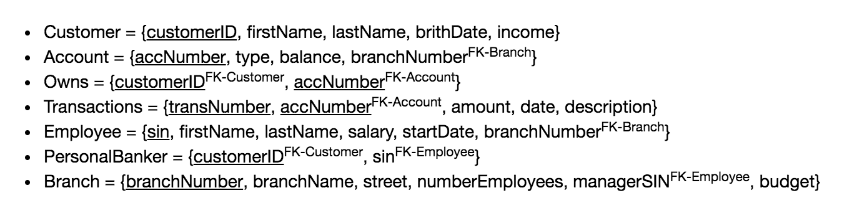
Motivation
How to figure out this database design?
What tables to create?
Which attributes should be added to each table?
What are the relationships between the tables?

Slide 3
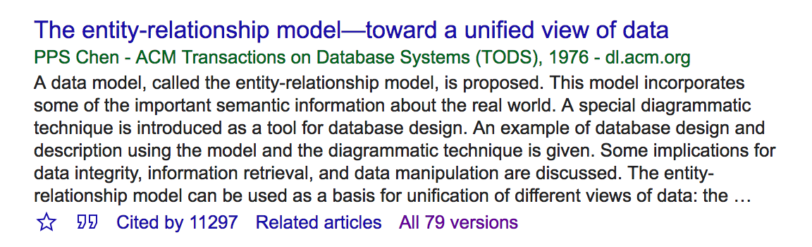

History of E/R Model
E/R Model (Entity-Relationship Modeling)
Codd wrote a long letter criticizing paper
Many people suggested him to give up this idea
Why not build RDBMS based on E/R Model?
No query language proposed
Relational DBMS in the 1970’s
Dr. Peter Chen

Slide 4
Outline
E/R Basics: Entities & Relationships
E/R Design considerations
Advanced E/R Concepts

Slide 5
Outline
E/R Basics: Entities & Relationships
Database Design
Entities/Entity sets/Keys/Relationships
E/R Design considerations
Advanced E/R Concepts

Slide 6
Database Design
Database design: Why do we need it?
Agree on structure of the database before deciding on a particular implementation
Consider issues such as:
What entities to model
How entities are related
What constraints exist in the domain
How to achieve good designs
Several formalisms exist
We discuss one flavor of E/R diagrams

Slide 7
Database Design Process
1. Requirements Analysis
2. Conceptual Design
3. Logical, Physical, Security, etc.
Requirements analysis
What data is going to be stored?
What are we going to do with the data?
Who should access the data?
Technical and non-technical people are involved

Slide 8
Database Design Process
1. Requirements Analysis
2. Conceptual Design
3. Logical, Physical, Security, etc.
2. Conceptual Design
A high-level description of the database
Sufficiently precise that technical people can understand it
But, not so precise that non-technical people can’t participate
This is where E/R fits in.

Slide 9
Database Design Process
1. Requirements Analysis
2. Conceptual Design
3. Logical, Physical, Security, etc.
3. More:
Logical Database Design
Physical Database Design
Security Design

Slide 10
Database Design Process
1. Requirements Analysis
2. Conceptual Design
3. Logical, Physical, Security, etc.
E/R Model & Diagrams used
name
name
category
price
Product
Makes
Company
E/R is a visual syntax for DB design which is precise enough for technical points, but abstracted enough for non-technical people

Slide 11
Entities and Entity Sets
An entity is an individual object
Eg: A specific person or product
An entity set is a collection of entities of the same type
These are what is shown in E/R diagrams - as rectangles
Eg: Person, Product
Person
Product

Slide 12
Attributes
An entity set has attributes
Represented by ovals attached to an entity set
name
category
price
Product

Slide 13
Example
Entities are not explicitly represented in E/R diagrams!
Entity
name
category
price
Name: Xbox
Category: Total Multimedia System
Price: $250
Entity Attribute
Name: My Little Pony Doll
Category: Toy
Price: $25
Product
Product
Entity Set

Slide 14
Keys
A key is a set of attributes that uniquely identifies an entity.
Every entity set must have a key
Denote elements of the primary key by underlining.
name
category
price
Product

Slide 15
The R in E/R: Relationships
A relationship is between two entities
name
category
name
price
Product
Makes
Company

Slide 16
name
category
name
price
makes
Company
Product
stockprice
buys
employs
Person
address
name
ssn

Slide 17
What is a Relationship?
A mathematical definition:
Let A, B be sets
A={1,2,3}, B={a,b,c,d}
B=
A=
1
a
2
b
3
c
d

Slide 18
What is a Relationship?
A mathematical definition:
Let A, B be sets
A={1,2,3}, B={a,b,c,d}
A x B (the cross-product) is the set of all pairs (a,b)
A × B = {(1,a), (1,b), (1,c), (1,d), (2,a), (2,b), (2,c), (2,d), (3,a), (3,b), (3,c), (3,d)}
B=
A=
1
a
2
b
3
c
d

Slide 19
What is a Relationship?
A mathematical definition:
Let A, B be sets
A={1,2,3}, B={a,b,c,d},
A x B (the cross-product) is the set of all pairs (a,b)
A × B = {(1,a), (1,b), (1,c), (1,d), (2,a), (2,b), (2,c), (2,d), (3,a), (3,b), (3,c), (3,d)}
We define a relationship to be a subset of A x B
R = {(1,a), (2,c), (2,d), (3,b)}
B=
A=
1
a
2
b
3
c
d

Slide 20
What is a Relationship?
Company
Product
name
Apple
Microsoft
name | category | price
iPhone 8 | Electronics | $700
iPad 4 | Electronics | $300
Office | Software | $120
name
category
name
price
Product
Makes
Company
A relationship between entity sets P and C is a subset of all possible pairs of entities in P and C, with tuples uniquely identified by P and C’s keys

Slide 21

What is a Relationship?
Company
Product
Company C $×$Product P
name
Apple
Microsoft
name | category | price
iPhone 8 | Electronics | $700
iPad 4 | Electronics | $300
Office | Software | $120
C.name | P.name | P.category | P.price
Apple | iPhone 8 | Electronics | $700
Apple | iPad 4 | Electronics | $300
Apple | Office | Toys | $120
Microsoft | iPhone 8 | Electronics | $700
Microsoft | iPad 4 | Electronics | $300
Microsoft | Office | Toys | $120
name
category
name
price
Product
Makes
Company
A relationship between entity sets P and C is a subset of all possible pairs of entities in P and C, with tuples uniquely identified by P and C’s keys

Slide 22
What is a Relationship?
Company
Product
Company C $×$Product P
name
Apple
Microsoft
name | category | price
iPhone 8 | Electronics | $700
iPad 4 | Electronics | $300
Office | Software | $120
C.name | P.name | P.category | P.price
Apple | iPhone 8 | Electronics | $700
Apple | iPad 4 | Electronics | $300
Apple | Office | Software | $120
Microsoft | iPhone 8 | Electronics | $700
Microsoft | iPad 4 | Electronics | $300
Microsoft | Office | Software | $120
name
category
name
price
Product
Makes
Company
Makes
C.name | P.name
Apple | iPhone 8
Apple | iPad 4
Microsoft | Office
A relationship between entity sets P and C is a subset of all possible pairs of entities in P and C, with tuples uniquely identified by P and C’s keys

Slide 23
What is a Relationship?
There can only be one relationship for every unique combination of entities
This also means that the relationship is uniquely determined by the keys of its entities
Example: the “key” for Makes (to right) is {Product.name, Company.name}
This follows from our mathematical definition of a relationship- it’s a SET!
name
name
category
price
Product
Makes
Company

Slide 24
Relationships and Attributes
Relationships may have attributes as well.
since
name
name
category
price
Product
Makes
Company
For example: “since” records when company started making a product
Makes
C.name | P.name | Since
Apple | iPhone 8 | 2018.09.01
Apple | iPhone 8 | 2017.09.01

Slide 25
Decision: Relationship vs. Entity?
Q: What does this say?
A: A person can only buy a specific product once
date
name
category
name
price
Product
Purchased
Person
Purchase
Person.name | Product.name | Date
Jiannan | iPhone 8 | 2018.10.01
Jiannan | iPhone 8 | 2018.12.01

Slide 26
Decision: Relationship vs. Entity?
What about this way?
Now we can have multiple purchases per product, person pair!
date
PID#
quantity
name
name
category
Purchase
price
ProductOf
BuyerOf
Product
Person
We can always use a new entity instead of a relationship. For example, to permit multiple instances of each entity combination!

Slide 27
Exercise -1

Slide 28
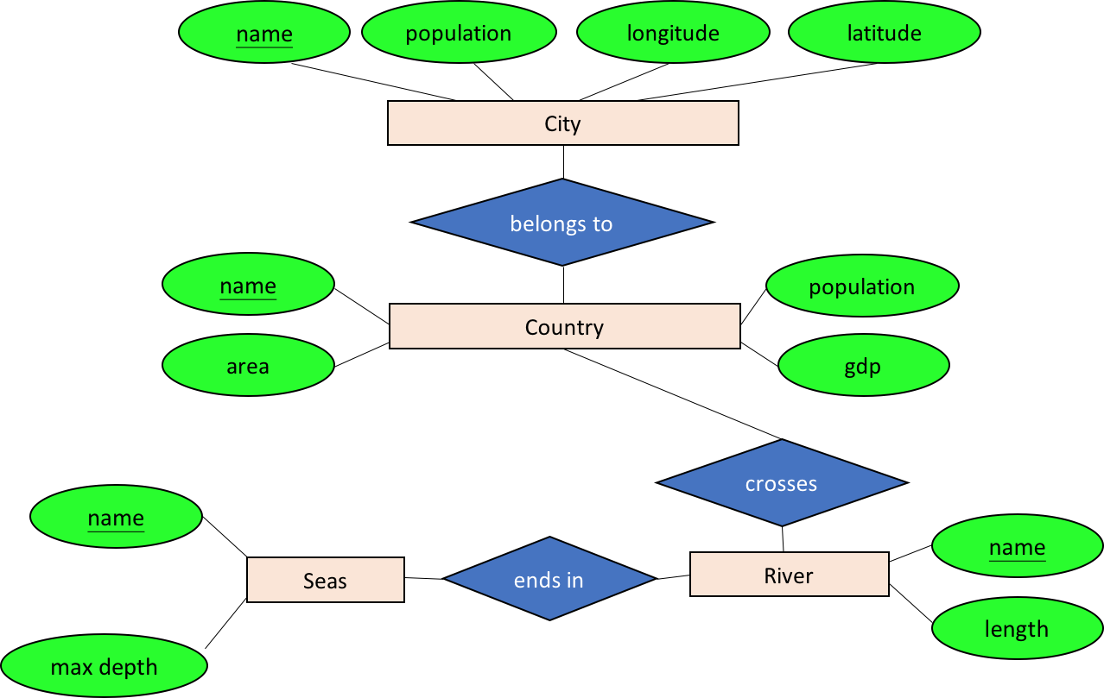
Draw an E/R diagram for geography
Entities
Country: name, area, population, gdp
City: name, population, longitude, latitude
River: name, length
Sea: name, max depth
Relationships
City belongs to Country
River crosses Country
River ends in Sea

Slide 29
Outline
E/R Basics: Entities & Relationships
Database Design
Entities/Entity sets/Keys/Relationships
E/R Design considerations
Relationships cond’s: multiplicity, multi-way
Design considerations
Conversion to SQL
Advanced E/R Concepts

Slide 30
Multiplicity of E/R Relationships
One-to-one:
1
2
3
a
b
c
d
Indicated using arrows
1
2
3
a
b
c
d
Many-to-one:
X -> Y means there exists a function mapping from X to Y (recall the definition of a function)
1
2
3
a
b
c
d
One-to-many:
Many-to-many:
1
2
3
a
b
c
d

Slide 31
name
category
name
price
makes
Company
Product
stockprice
buys
What does this say?
employs
Person
address
name
ssn
Notes:
a person may be employed by at most one company
a product may be made by at most one company

Slide 32
Multi-way Relationships
How do we model a purchase relationship between buyers,
products and stores?
Product
Purchase
Store
Person
Notes:
need to identify purchases by all three keys

Slide 33
Arrows in Multiway Relationships
Q: What does the arrow mean ?
Product
Purchase
Store
Person
given a person, can determine what they bought and the store where they bought it
Notes:
given a person, can determine what they bought and the store where they bought it

Slide 34
Arrows in Multiway Relationships
Q: What does the arrow mean ?
Product
Purchase
Store
Person
given a store, can determine who shopped there and the product they bought
each store sells one product and to one person, ever
Notes:
given a store, can determine who shopped there and the product they bought
each store sells one product and to one person, ever

Slide 35
Arrows in Multiway Relationships
Q: How do we say that every person shops in at most one store ?
Product
Purchase
Store
Person
A: Cannot. This is the best approximation. (Why only approximation ?)
Notes:
our representation is not complete! trade-off between complexity and abstraction

Slide 36
Converting Multi-way Relationships to Binary
date
ProductOf
From what we had on previous slide to this - what did we do?
Product
Purchase
StoreOf
Store
BuyerOf
Person

Slide 37
Decision: Multi-way or New Entity + Binary?
Multi-way Relationship
Entity + Binary
ProductOf
Product
Product
date
Purchase
StoreOf
Store
Purchase
Store
Person
BuyerOf
Person
(B) is also useful when we want to add details (constraints or attributes) to the relationship
“A person who shops in at most one store”
“How long a person has been shopping at a store”
(A) is useful when a relationship really is between multiple entities
- Ex: A three-party legal contract

Slide 38
Design Principles
What’s wrong with these examples?
Purchase
Product
Person
product buys only one product, then out
President
Country
Person
multiple presidents, also may want to require country to have president
Notes:
product buys only one product, then out
multiple presidents, also may want to require country to have president

Slide 39
Design Principles: What’s Wrong?
date
Product
Purchase
Store
personAddr
personName
maybe people should be entities!
Notes:
maybe people should be entities!

Slide 40
Design Principles: What’s Wrong?
Dates
date
Product
Purchase
Store
Person
dates don’t need to be an entity by themselves
Notes:
dates don’t need to be an entity by themselves

Slide 41
Examples: Entity vs. Attribute
Should address (A) be an attribute?
Or (B) be an entity?
Addr 1
Addr 2
Street Addr
ZIP
Address
Employee
AddrOf
Employee
Notes:
every employee has _exactly_ two addresses!

Slide 42
Examples: Entity vs. Attribute
Should address (A) be an attribute?
How do we handle employees with multiple addresses here?
How do we handle addresses where internal structure of the address (e.g. zip code, state) is useful?
Addr 1
Addr 2
Employee

Slide 43
Examples: Entity vs. Attribute
Should address (A) be an attribute?
Or (B) be an entity?
Addr 1
Addr 2
Street Addr
ZIP
Address
Employee
AddrOf
Employee
In general, when we want to record several values, we choose new entity
Notes:
every employee has _exactly_ two addresses!

Slide 44
Exercise -2

Slide 45

Draw an E/R diagram for geography
Entities
Country: name, area, population, gdp
City: name, population, longitude, latitude
River: name, length
Sea: name, max depth
Relationships
Each city belongs to a single country
Each river crosses one or several countries
Each river ends in a single sea
Notes:
City(name, population, longitude, latitude, countryName)
Country(name, population, area, gdb)
Cross(countryName, riverName)
River(name, length, seaName)
Sea(name, max depth)

Slide 46
From E/R Diagrams to Relational Schema
Key concept:
Both Entity sets and Relationships become relations (tables in RDBMS)

Slide 47
From E/R Diagrams to Relational Schema
price
category
An entity set becomes a table
Each row is one entity
Each row is composed of the entity’s attributes, and has the same primary key
name
Product
Product
name | price | category
iPhone | 700 | Electronics
Office | 150 | Software
CREATE TABLE Product(
name CHAR(50) PRIMARY KEY,
price DOUBLE,
category VARCHAR(30)
)

Slide 48
From E/R Diagrams to Relational Schema
date
firstname
lastname
A relationship also becomes a table
Add Primary Key
Add Foreign Key
name
category
price
Product
Purchased
Person
CREATE TABLE Purchased(
name CHAR(50),
firstname CHAR(50),
lastname CHAR(50),
date DATE,
PRIMARY KEY (name, firstname, lastname),
FOREIGN KEY (name)
REFERENCES Product,
FOREIGN KEY (firstname, lastname)
REFERENCES Person
)
Purchased
name | firstname | lastname | date
iPhone | Mike | Jordan | 01/01/18
iPhone | Jiannan | Wang | 01/03/18
iPad | John | Smith | 01/05/18

Slide 49
Exercise -3

Slide 50
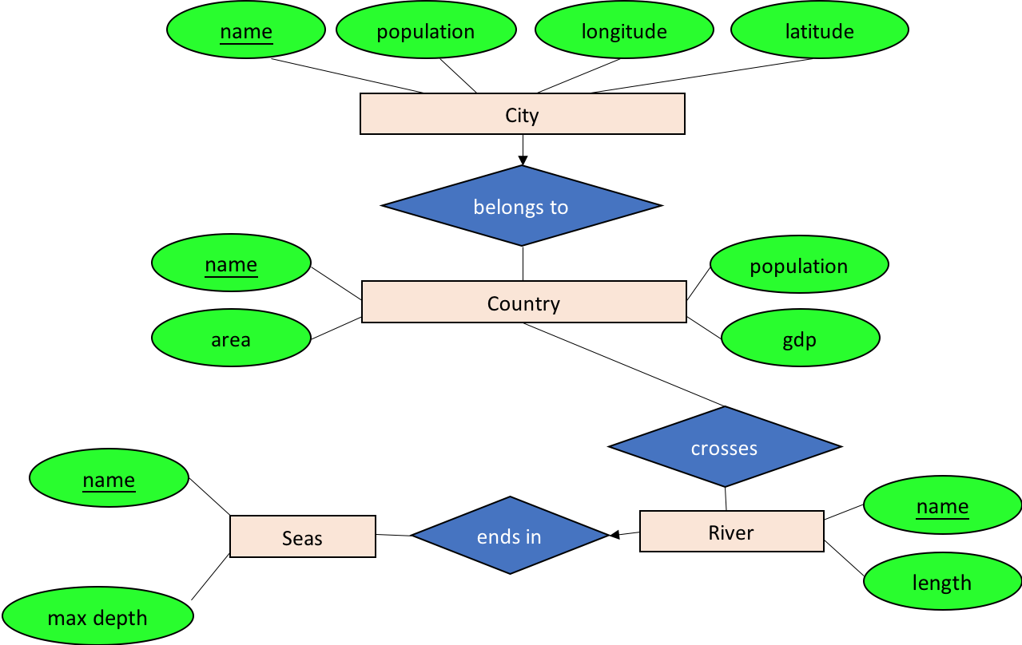
From E/R Diagram to Relational Schema
How do we represent this as a relational schema?

Slide 51
Outline
E/R Basics: Entities & Relationships
Database Design
Entities/Entity sets/Keys/Relationships
E/R Design considerations
Relationships cond’s: multiplicity, multi-way
Design considerations
Conversion to SQL
name
category
name
price
makes
Company
Product
country

Slide 52
Outline
E/R Basics: Entities & Relationships
Database Design
Entities/Entity sets/Keys/Relationships
E/R Design considerations
Relationships cond’s: multiplicity, multi-way
Design considerations
Conversion to SQL
Advanced E/R Concepts
Combing Relations
Constraints
Subclass
Weak Entity Sets

Slide 53
Combing Relations
For many-to-one relationships
name
category
name
price
makes
Company
Product
Product
country
Make
name | category | price
iPhone 8 | Electronics | $700
iPad 4 | Electronics | $300
Office | Software | $120
Company
P.name | C.name
iPhone 8 | Apple
iPad 4 | Apple
Office | Microsoft
name | country
Apple | US
Microsoft | US

Slide 54
Combing Relations
Product
Make
name | category | price
iPhone 8 | Electronics | $700
iPad 4 | Electronics | $300
Office | Software | $120
Company
P.name | C.name
iPhone 8 | Apple
iPad 4 | Apple
Office | Microsoft
name | country
Apple | US
Microsoft | US
P.name | C.name | category | price
iPhone 8 | Apple | Electronics | $700
iPad 4 | Apple | Electronics | $300
Office | Microsoft | Software | $120
name | country
Apple | US
Microsoft | US
Remember: no separate relations for many-one relationship

Slide 55
Constraints in E/R Diagrams
Finding constraints is part of the E/R modeling process. Commonly used constraints are:
Keys
Ex: A product name uniquely identifies a product
Single-value constraints:
Ex: a product made by exactly one company
Participation constraints:
Ex: all products are made by a company

Slide 56
Keys in E/R Diagrams
Underline keys:
name
category
price
Note: no formal way to specify multiple keys in E/R diagrams…
Product
Person
address
name
ssn

Slide 57
Single-Value Constraints
makes
Product
Company
Each product made by at most one company.
Some products made by no company?
makes
Product
Company
Each product made by exactly one company.

Slide 58
Participation Constraints: Partial v. Total
makes
Product
Company
Are there products made by no company? Companies that don’t make a product?
makes
Product
Company
Bold line indicates total participation (i.e. here: all products are made by a company)

Slide 59
Modeling Subclasses
Some objects in a class may be special
Define a new class?
But what if we want to maintain connection to current class?
Better: define a subclass
Ex:
Products
Software
products
Hardware
products
We can define subclasses in E/R!

Slide 60
Modeling Subclasses
name
price
Child subclasses contain all the attributes of all of their parent classes plus the new attributes shown attached to them in the E/R diagram
Product
isA
Software Product
Hardware Product
platforms
weight

Slide 61
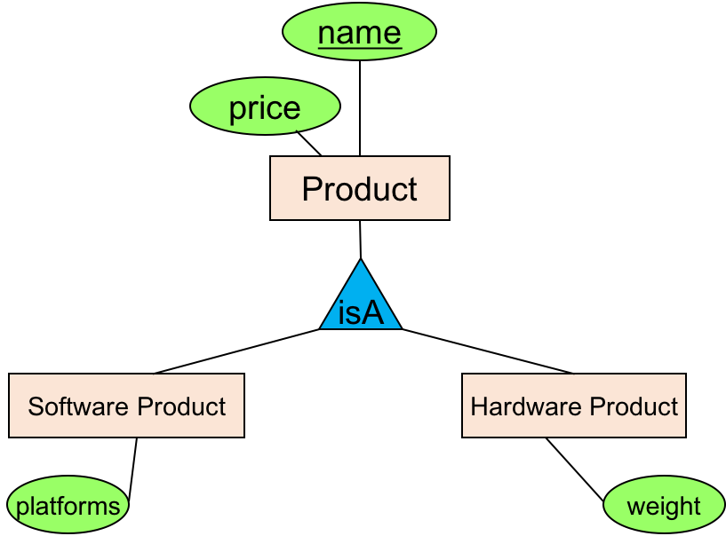
Understanding Subclasses
Think in terms of records; ex:
Product
SoftwareProduct
HardwareProduct
name
price
name
price
platforms
name
price
weight

Slide 62
Subclasses to Relations
Product
name | price
iphone 8 | 700
iPad 4 | 300
office | 100
SoftwareProduct
name | platforms
office | windows
HardwareProduct
name | weight
iphone 8 | 148 g
ipad 4 | 650 g

Slide 63
IsA Review
If we declare A IsA B then every A is a B
We use IsA to
Add descriptive attributes to a subclass
To identify entities that participate in a relationship

Slide 64
Modeling UnionTypes With Subclasses
Person
FurniturePiece
Company
Say: each piece of furniture is owned either by a person, or by a company

Slide 65
Modeling UnionTypes With Subclasses
Say: each piece of furniture is owned either by a person or by a company
Solution 1. Acceptable, but imperfect (What’s wrong?)
Person
FurniturePiece
Company
ownedByPerson
ownedByComp

Slide 66
Modeling UnionTypes With Subclasses
Solution 2: better (though more laborious)
FurniturePiece
ownedBy
Person
Owner
Company
isa

Slide 67
Weak Entity Sets
Entity sets are weak when their key comes from other
classes to which they are related.
Offer
Course
University
textbook
cname
uname
“Introduction to database” vs. “The SFU introduction to database”

Slide 68
Weak Entity Sets
Entity sets are weak when their key comes from other
classes to which they are related.
Offer
Course
University
textbook
cname
uname
cname is a partial key (denote with dashed underline).
University is called the supporting entity set
Offer is called the supporting relationship

Slide 69
Weak Entity Sets to Relations
Offer
Course
University
textbook
cname
uname
Course(cname, uname, textbook)
University(uname)
Offering(cname, Course.uname, University.uname)

Slide 70
E/R Summary
E/R Basics: Entities & Relationships
Database Design
Entities/Entity Sets/Keys/Relationships
E/R Design considerations
Relationships cond’s: multiplicity, multi-way
Design considerations
Conversion to SQL
Advanced E/R Concepts
Combing Relations
Constraints
Subclass
Weak Entity Sets

Slide 71
Acknowledge
Some lecture slides were copied from or inspired by the following course materials
“W4111: Introduction to databases” by Eugene Wu at Columbia University
“CSE344: Introduction to Data Management” by Dan Suciu at University of Washington
“CMPT354: Database System I” by John Edgar at Simon Fraser University
“CS186: Introduction to Database Systems” by Joe Hellerstein at UC Berkeley
“CS145: Introduction to Databases” by Peter Bailis at Stanford
“CS 348: Introduction to Database Management” by Grant Weddell at University of Waterloo

