Slide 1
CMPT 354: Database System I
Lecture 9. Design Theory

Slide 2
Design Theory
Design theory is about how to represent your data to avoid anomalies.
Design 1
Design 2
Student | Course | Room
Mike | 354 | AQ3149
Mary | 354 | AQ3149
Sam | 354 | AQ3149
.. | .. | ..
Student | Course
Mike | 354
Mary | 354
Sam | 354
.. | ..
Course | Room
354 | AQ3149
454 | T9204

Slide 3
Four Types of Anomalies - 1
What’s wrong?
Student | Course | Room
Mike | 354 | AQ3149
Mary | 354 | AQ3149
Sam | 354 | AQ3149
.. | .. | ..
If every course is in only one room, contains redundant information!

Slide 4
Four Types of Anomalies - 2
What’s wrong?
Student | Course | Room
Mike | 354 | AQ3149
Mary | 354 | T9204
Sam | 354 | AQ3149
.. | .. | ..
If we update the room number for one tuple, we get inconsistent data = an update anomaly

Slide 5
Four Types of Anomalies - 3
What’s wrong?
Student | Course | Room
.. | .. | ..
If everyone drops the class, we lose what room the class is in! = a delete anomaly

Slide 6
Four Types of Anomalies - 4
What’s wrong?
Student | Course | Room
Mike | 354 | AQ3149
Mary | 354 | AQ3149
Sam | 354 | AQ3149
.. | .. | ..
… | 454 | T9204
Similarly, we can’t reserve a room without students = an insert anomaly

Slide 7
Elimination of Anomalies
Is it better?
Student | Course
Mike | 354
Mary | 354
Sam | 354
.. | ..
Course | Room
354 | AQ3149
454 | T9204
Redundancy?
Update anomaly?
Delete anomaly?
Insert anomaly?
Why this design may be better?
How to find this decomposition?

Slide 8
Normal Forms
1st Normal Form (1NF) = All tables are flat
2nd Normal Form = disused
Boyce-Codd Normal Form (BCNF) = no bad FDs
3rd , 4th , and 5th Normal Forms = see text books

Slide 9
1st Normal Form (1NF)
Student | Courses
Mary | CS145
Mary | CS229
Joe | CS145
Joe | CS106
Student | Courses
Mary | {CS145,CS229}
Joe | {CS145,CS106}
… | …
Violates 1NF.
In 1st NF
1NF Constraint: Types must be atomic!

Slide 10
Normal Forms
1st Normal Form (1NF) = All tables are flat
2nd Normal Form = disused
Boyce-Codd Normal Form (BCNF) = no bad FDs
3rd , 4th , and 5th Normal Forms = see text books
What’s this?

Slide 11
Outline
Functional Dependency (FD)
Inference Problem
Closure Algorithm

Slide 12
Functional Dependency
Def: Let A,B be sets of attributes
We write A → B or say A functionally determines B if, for any tuples t₁ and t₂:
t₁[A] = t₂[A] implies t₁[B] = t₂[B]
and we call A → B a functional dependency
A->B means that
“whenever two tuples agree on A then they agree on B.”

Slide 13
A Picture Of FDs
Defn (again):
Given attribute sets A={A₁,…,A_{m}} and B = {B₁,…B_{n}} in R,
 | A₁ | … | A_{m} |  | B₁ | … | B_{n}

Slide 14
A Picture Of FDs
Defn (again):
Given attribute sets A={A₁,…,A_{m}} and B = {B₁,…B_{n}} in R,
The functional dependency A→ B on R holds if for any t_{i},t_{j} in R:
 | A₁ | … | A_{m} |  | B₁ | … | B_{n}
t_{i}
t_{j}

Slide 15
A Picture Of FDs
Defn (again):
Given attribute sets A={A₁,…,A_{m}} and B = {B₁,…B_{n}} in R,
The functional dependency A→ B on R holds if for any t_{i},t_{j} in R:
t_{i}[A₁] = t_{j}[A₁] AND t_{i}[A₂]=t_{j}[A₂] AND … AND t_{i}[A_{m}] = t_{j}[A_{m}]
 | A₁ | … | A_{m} |  | B₁ | … | B_{n}
t_{i}
t_{j}
If t1,t2 agree here..

Slide 16
A Picture Of FDs
Defn (again):
Given attribute sets A={A₁,…,A_{m}} and B = {B₁,…B_{n}} in R,
The functional dependency A→ B on R holds if for any t_{i},t_{j} in R:
if t_{i}[A₁] = t_{j}[A₁] AND t_{i}[A₂]=t_{j}[A₂] AND … AND t_{i}[A_{m}] = t_{j}[A_{m}]
then t_{i}[B₁] = t_{j}[B₁] AND t_{i}[B₂]=t_{j}[B₂] AND … AND t_{i}[B_{n}] = t_{j}[B_{n}]
 | A₁ | … | A_{m} |  | B₁ | … | B_{n}
t_{i}
t_{j}
If t1,t2 agree here..
…they also agree here!

Slide 17
Example
An FD holds, or does not hold on a table:
EmpID | Name | Phone | Position
E0045 | Smith | 1234 | Clerk
E3542 | Mike | 9876 | Salesrep
E1111 | Smith | 9876 | Salesrep
E9999 | Mary | 1234 | Lawyer
Position → Phone
Phone → Position
Phone, Name → Position

Slide 18
Exercise - 1
An FD holds, or does not hold on a table:
Name | Category | Color | Department | Price
Gizmo | Gadget | Green | Toys | 49
Tweaker | Gadget | Green | Toys | 49
Gizmo | Stationary | Green | Office-supply | 59
Name → Color
Category → Department
Color, Category → Color

Slide 19
Exercise - 2
Find at least three FDs which do not hold on this table:
A | B | C | D | E
1 | 2 | 4 | 3 | 6
3 | 2 | 5 | 1 | 8
1 | 4 | 4 | 5 | 7
1 | 2 | 4 | 3 | 6
3 | 2 | 5 | 1 | 8
{ } → { }
{ } → { }
{ } → { }
Notes:
A -> D, B→ C, C->D

Slide 20
Outline
Functional Dependency (FD)
Inference Problem
Closure Algorithm

Slide 21
An Interesting Observation
Provided FDs:
1. Name → Color
2. Category → Department
3. Color, Category → Price
Does it always hold? Name, Category → Price
If we find out from application domain that a relation satisfies some FDs, it doesn’t mean that we found all the FDs that it satisfies! There could be more FDs implied by the ones we have

Slide 22
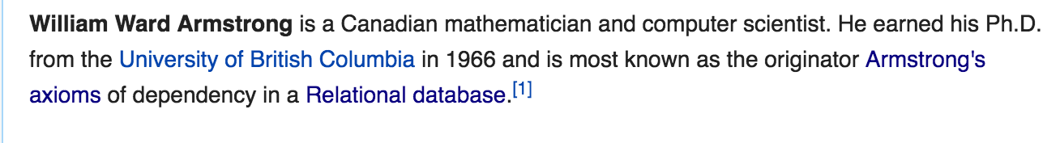
Inference Problem
Whether or not a set of FDs imply another FD?
This is called Inference problem
Answer: Three simple rules called Armstrong’s Rules.
Split/Combine,
Reduction, and
Transitivity

Slide 23
1. Split/Combine
 | A₁ | … | A_{m} |  | B₁ | … | B_{n}
A₁, …, A_{m} → B₁,…,B_{n}

Slide 24
1. Split/Combine
 | A₁ | … | A_{m} |  | B₁ | … | B_{n}
A₁, …, A_{m} → B₁,…,B_{n}
… is equivalent to the following n FDs…
A₁,…,A_{m} → B_{i} for i=1,…,n

Slide 25
1. Split/Combine
 | A₁ | … | A_{m} |  | B₁ | … | B_{n}
And vice-versa, A₁,…,A_{m} → B_{i} for i=1,…,n
… is equivalent to …
A₁, …, A_{m} → B₁,…,B_{n}

Slide 26
2. Reduction/Trivial
 | A₁ | … | A_{m}
A₁,…,A_{m} → A_{j} for any j=1,…,m

Slide 27
3. Transitive
 | A₁ | … | A_{m} |  | B₁ | … | B_{n} |  | C₁ | … | C_{k}
A₁, …, A_{m} → B₁,…,B_{n} and
B₁,…,B_{n} → C₁,…,C_{k}

Slide 28
3. Transitive
 | A₁ | … | A_{m} |  | B₁ | … | B_{n} |  | C₁ | … | C_{k}
A₁, …, A_{m} → B₁,…,B_{n} and
B₁,…,B_{n} → C₁,…,C_{k}
implies
A₁,…,A_{m} → C₁,…,C_{k}

Slide 29
Inferred FDs
Example:
Inferred FDs:
Provided FDs:
Inferred FD | Rule used
4. Name, Category → Name | ?
5. Name, Category → Color | ?
6. Name, Category → Category | ?
7. Name, Category → Color, Category | ?
8. Name, Category → Price | ?
1. {Name} → {Color}
2. {Category} → {Dept.}
3. {Color, Category} → {Price}
Which / how many other FDs hold?

Slide 30
Inferred FDs
Example:
Inferred FDs:
Provided FDs:
Inferred FD | Rule used
4. Name, Category → Name | Trivial
5. Name, Category → Color | Transitive (4 -> 1)
6. Name, Category → Category | Trivial
7. Name, Category → Color, Category | Split/combine (5 + 6)
8. Name, Category → Price | Transitive (7 -> 3)
1. {Name} → {Color}
2. {Category} → {Dept.}
3. {Color, Category} → {Price}
Can we find an algorithmic way to do this?

Slide 31
Outline
Functional Dependency (FD)
Inference Problem
Closure Algorithm

Slide 32
Closure of a set of Attributes
Given a set of attributes A₁, …, A_{n} and a set of FDs F:
Then the closure, {A₁, …, A_{n}}⁺ is the set of attributes B s.t. {A₁, …, A_{n}} → B
Example: F =
name → color
category → department
color, category → price
Closures:
{name}⁺ = {name, color}
{name, category}⁺ = {name, category, color, dept, price}
{color}⁺ = {color}

Slide 33
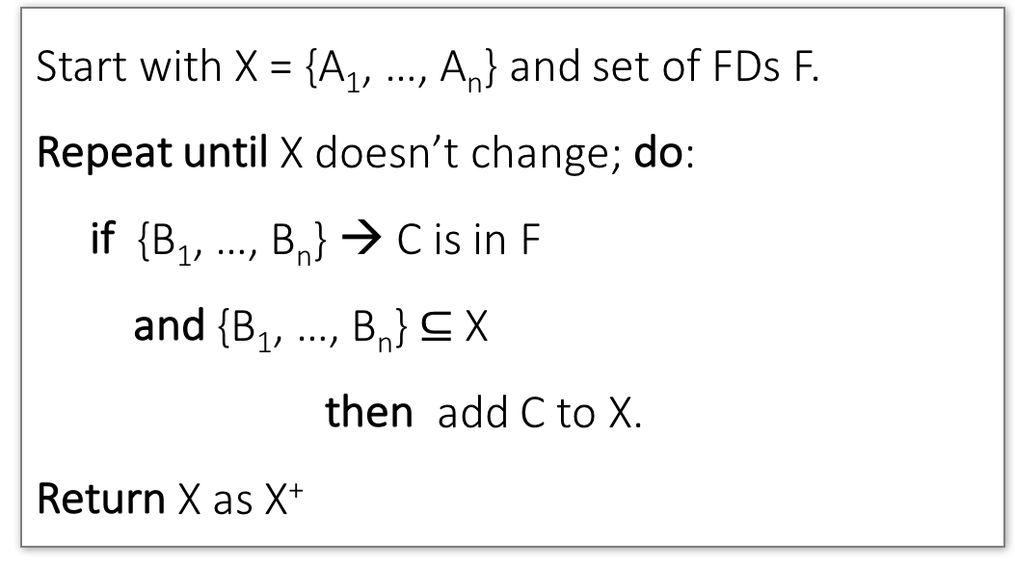
Closure Algorithm
Start with X = {A₁, …, A_{n}} and set of FDs F.
Repeat until X doesn’t change; do:
if {B₁, …, B_{n}} → C is in F
and {B₁, …, B_{n}} $⊆$ X
then add C to X.
Return X as X⁺

Slide 34
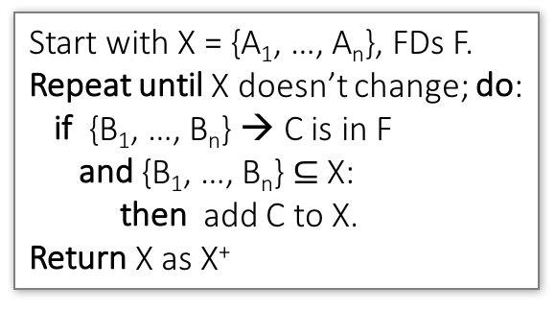
Closure Algorithm
Start with X = {A₁, …, A_{n}}, FDs F.
Repeat until X doesn’t change; do:
if {B₁, …, B_{n}} → C is in F
and {B₁, …, B_{n}} $⊆$ X:
then add C to X.
Return X as X⁺
{name, category}⁺ =
{name, category}
F =
name → color
category → dept
color, category → price

Slide 35
Closure Algorithm
Start with X = {A₁, …, A_{n}}, FDs F.
Repeat until X doesn’t change; do:
if {B₁, …, B_{n}} → C is in F
and {B₁, …, B_{n}} $⊆$ X:
then add C to X.
Return X as X⁺
{name, category}⁺ =
{name, category}
{name, category}⁺ =
{name, category, color}
F =
name → color
category → dept
color, category → price

Slide 36
Closure Algorithm
Start with X = {A₁, …, A_{n}}, FDs F.
Repeat until X doesn’t change; do:
if {B₁, …, B_{n}} → C is in F
and {B₁, …, B_{n}} $⊆$ X:
then add C to X.
Return X as X⁺
{name, category}⁺ =
{name, category}
{name, category}⁺ =
{name, category, color}
F =
{name, category}⁺ =
{name, category, color, dept}
name → color
category → dept
color, category → price

Slide 37
Closure Algorithm
Start with X = {A₁, …, A_{n}}, FDs F.
Repeat until X doesn’t change; do:
if {B₁, …, B_{n}} → C is in F
and {B₁, …, B_{n}} $⊆$ X:
then add C to X.
Return X as X⁺
{name, category}⁺ =
{name, category}
{name, category}⁺ =
{name, category, color}
{name, category}⁺ =
{name, category, color, dept}
F =
name → color
category → dept
color, category → price
{name, category}⁺ =
{name, category, color, dept, price}

Slide 38
Exercise - 3
R(A,B,C,D,E,F)
A,B → C
A,D → E
B → D
A,F → B
Compute {A,B}⁺ = {A, B, }
Compute {A, F}⁺ = {A, F, }

Slide 39
Exercise - 3
R(A,B,C,D,E,F)
A,B → C
A,D → E
B → D
A,F → B
Compute {A,B}⁺ = {A, B, C, D }
Compute {A, F}⁺ = {A, F, B }

Slide 40
Exercise - 3
R(A,B,C,D,E,F)
A,B → C
A,D → E
B → D
A,F → B
Compute {A,B}⁺ = {A, B, C, D, E}
Compute {A, F}⁺ = {A, B, C, D, E, F}

Slide 41
Exercise - 4
Find all FD’s implied by
A,B → C A,D → B
B → D
Requirements
Non-trivial FD (i.e., no need to return A, B → A)
The right-hand side contains a single attribute (i.e., no need to return A, B → C, D)

Slide 42
Exercise - 4
A,B → C A,D → B
B → D
Given F =
Step 1: Compute X⁺, for every set of attributes X:
{A}⁺ = ?
{B}⁺ = ?
{C}⁺ = ?
{D}⁺ = ?
{A,B}⁺ = ?
{A,C}⁺ = ?
{A,D}⁺ = ?
{B,C}⁺ = ?
{B,D}⁺ = ?
{C,D}⁺ = ?
{A,B,C}⁺ = ?
{A,B,D}⁺ = ?
{A,C,D}⁺ = ?
{B,C,D}⁺ = ?
{A,B,C,D}⁺ = ?

Slide 43
Exercise - 4
A,B → C A,D → B
B → D
Given F =
Step 1: Compute X⁺, for every set of attributes X:
{A}⁺ = {A}
{B}⁺ = {B,D}
{C}⁺ = {C}
{D}⁺ = {D}
{A,B}⁺ = {A,B,C,D}
{A,C}⁺ = {A,C}
{A,D}⁺ = {A,B,C,D}
{B,C}⁺ = {B,C,D}
{B,D}⁺ = {B,D}
{C,D}⁺ = {C,D}
{A,B,C}⁺ = {A,B,C,D}
{A,B,D}⁺ = {A,B,C,D}
{A,C,D}⁺ = {A,B,C,D}
{B,C,D}⁺ = {B,C,D}
{A,B,C,D}⁺ = {A,B,C,D}

Slide 44
Exercise - 4
A,B → C A,D → B
B → D
Given F =
Step 2: Enumerate all FDs X → Y, s.t. Y ⊆ X⁺ and X ∩ Y = ∅:
{A}⁺ = {A}
{B}⁺ = {B,D}
{C}⁺ = {C}
{D}⁺ = {D}
{A,B}⁺ = {A,B,C,D}
{A,C}⁺ = {A,C}
{A,D}⁺ = {A,B,C,D}
{B,C}⁺ = {B,C,D}
{B,D}⁺ = {B,D}
{C,D}⁺ = {C,D}
{A,B,C}⁺ = {A,B,C,D}
{A,B,D}⁺ = {A,B,C,D}
{A,C,D}⁺ = {A,B,C,D}
{B,C,D}⁺ = {B,C,D}
{A,B,C,D}⁺ = {A,B,C,D}
B → D
A,B → C
A,B → D
A,D → B
A,D → C
A,B,C → D
A,B,D → C
A,C,D → B

Slide 45
Review
Functional Dependency (FD)
What is an FD?
Inference Problem
Whether or not a set of FDs imply another FD?
Closure
How to compute the closure of attributes?

Slide 46
High-level Idea
Student | Course | Room
Mike | 354 | AQ3149
Mary | 354 | AQ3149
Sam | 354 | AQ3149
.. | .. | ..
Two Steps
Search for “bad” FDs in the table
Keep decomposing the table into sub-tables until no more bad FDs
Student | Course
Mike | 354
Mary | 354
Sam | 354
.. | ..
Course | Room
354 | AQ3149
454 | T9204
Like a debugging process ☺

Slide 47
Outline
“Good” vs. “Bad” FDs
Boyce-Codd Normal Form
Decompositions

Slide 48
“Good” vs. “Bad” FDs
EmpID | Name | Phone | Position
E0045 | Smith | 1234 | Clerk
E3542 | Mike | 9876 | Salesrep
E1111 | Smith | 9876 | Salesrep
E9999 | Mary | 1234 | Lawyer
EmpID → Name, Phone, Position
Good FD since EmpID can determine everything
EmpID is a Key
Phone → Position
Bad FD since Phone cannot determine everything

Slide 49
Exercise - 1
Student | Course | Room
Mike | 354 | AQ3149
Mary | 354 | AQ3149
Sam | 354 | AQ3149
.. | .. | ..
Student, Course → Room
Good FD!
Course → Room
Bad FD!

Slide 50
What’s wrong with “Bad” FDs
If X →Y is a Bad FD, then X functionally determines some of the attributes; therefore, those other attributes can be duplicated
Recall: this means there is redundancy
And redundancy like this can lead to data anomalies!
Student | Course | Room
Mike | 354 | AQ3149
Mary | 354 | AQ3149
Sam | 354 | AQ3149
.. | .. | ..

Slide 51
Outline
“Good” vs. “Bad” FDs
Boyce-Codd Normal Form
Decompositions

Slide 52
Boyce-Codd Normal Form (BCNF)
Main idea is that we define “good” and “bad” FDs as follows:
X → A is a “good FD” if X is a key
In other words, if A is the set of all attributes
X → A is a “bad FD” otherwise
We will try to eliminate the “bad” FDs!

Slide 53
Boyce-Codd Normal Form (BCNF)
A relation R is in BCNF if:
there are no “bad” FDs
A relation R is in BCNF if:
if {A₁, ..., A_{n}} → B is a non-trivial FD in R
then {A₁, ..., A_{n}} is a key for R
Equivalently: $∀$ sets of attributes X, either (X⁺ = X) or (X⁺ = all attributes)

Slide 54
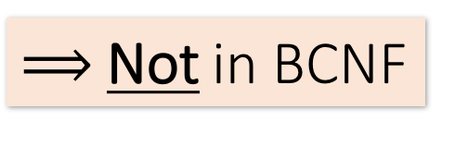
Example
Is this table in BCNF?
Name | SIN | PhoneNumber | City
Fred | 123-45-6789 | 604-555-1234 | Vancouver
Fred | 123-45-6789 | 604-555-6543 | Vancouver
Joe | 987-65-4321 | 908-555-2121 | Burnaby
Joe | 987-65-4321 | 908-555-1234 | Burnaby
{SIN} → {Name,City}
This FD is bad because it is not a key
What is the key?
{SIN, PhoneNumber}
$⟹$Not in BCNF

Slide 55
Example
Name | SIN | City
Fred | 123-45-6789 | Vancouver
Joe | 987-65-4321 | Burnaby
{SIN} → {Name,City}
This FD is now good because it is the key
SIN | PhoneNumber
123-45-6789 | 604-555-1234
123-45-6789 | 604-555-6543
987-65-4321 | 908-555-2121
987-65-4321 | 908-555-1234
Now in BCNF!

Slide 56
BCNF Decomposition Algorithm
BCNFDecomp(R): Find X s.t.: X⁺ ≠ X and X⁺ ≠ [all attributes]
if (not found) then Return R
let Y = X⁺ - X, Z = (X⁺)^{C} decompose R into R1(X ∪ Y) and R2(X ∪ Z)
Return BCNFDecomp(R1), BCNFDecomp(R2)

Slide 57
BCNF Decomposition Algorithm
BCNFDecomp(R): Find a non-trivial bad FD: X → Y
if (not found) then Return R
let Y = X⁺ - X, Z = (X⁺)^{C} decompose R into R1(X ∪ Y) and R2(X ∪ Z)
Return BCNFDecomp(R1), BCNFDecomp(R2)
X is not a key, i.e.,
X⁺ ≠ [all attributes]

Slide 58
BCNF Decomposition Algorithm
BCNFDecomp(R): Find a non-trivial bad FD: X → Y
if (not found) then Return R
let Y = X⁺ - X, Z = (X⁺)^{C} decompose R into R1(X ∪ Y) and R2(X ∪ Z)
Return BCNFDecomp(R1), BCNFDecomp(R2)
If no “bad” FDs found, in BCNF!

Slide 59
BCNF Decomposition Algorithm
BCNFDecomp(R): Find a non-trivial bad FD: X → Y
if (not found) then Return R
Split R into X⁺ and X+[rest attributes] decompose R into R1(X ∪ Y) and R2(X ∪ Z)
Return BCNFDecomp(R1), BCNFDecomp(R2)
Intersection is X
X

Slide 60
BCNF Decomposition Algorithm
BCNFDecomp(R): Find a non-trivial bad FD: X → Y
if (not found) then Return R
Split R into X⁺ and X+[rest attributes] decompose R into R1(X ∪ Y) and R2(X ∪ Z)
Return BCNFDecomp(R1), BCNFDecomp(R2)
One table is X⁺
X⁺

Slide 61
BCNF Decomposition Algorithm
BCNFDecomp(R): Find a non-trivial bad FD: X → Y
if (not found) then Return R
Split R into X⁺ and X+[rest attributes] decompose R into R1(X ∪ Y) and R2(X ∪ Z)
Return BCNFDecomp(R1), BCNFDecomp(R2)
The other table is
X + (R – X⁺)

Slide 62
BCNF Decomposition Algorithm
BCNFDecomp(R): Find a non-trivial bad FD: X → Y
if (not found) then Return R
Split R into X⁺ and X+[rest attributes]
Return BCNFDecomp(R₁), BCNFDecomp(R₂)
Proceed recursively until no more “bad” FDs!

Slide 63
BCNF Decomposition Algorithm
BCNFDecomp(R): Find a non-trivial bad FD: X → Y
if (not found) then Return R
Split R into X⁺ and X+[rest attributes]
Return BCNFDecomp(R₁), BCNFDecomp(R₂)
Only look at the FD in the given set
Need to imply all FDs for R₁ and R₂

Slide 64
Example
Student | Course | Room
Mike | 354 | AQ3149
Mary | 354 | AQ3149
Sam | 354 | AQ3149
.. | .. | ..
Course → Room
Student | Course
Mike | 354
Mary | 354
Sam | 354
.. | ..
Course | Room
354 | AQ3149
454 | T9204

Slide 65
Exercise - 2
BCNFDecomp(R): Find a non-trivial bad FD: X → Y
if (not found) then Return R
Split R into X⁺ and X+[rest attributes]
Return BCNFDecomp(R₁), BCNFDecomp(R₂)
R(A,B,C,D,E)
{A} → {B,C}
{C} → {D}

Slide 66
Exercise - 2
R(A,B,C,D,E)
R(A,B,C,D,E)
{A}⁺ = {A,B,C,D} ≠ {A,B,C,D,E}
{A} → {B,C}
{C} → {D}
R₁(A,B,C,D) {C}⁺ = {C,D} ≠ {A,B,C,D}
R₁₁(C,D)
R₁₂(A,B,C)
R₂(A,E)

Slide 67
Outline
“Good” vs. “Bad” FDs
Boyce-Codd Normal Form
Decompositions

Slide 68
Decompositions in General
R(A₁,...,A_{n},B₁,...,B_{m},C₁,...,C_{p})
R₁(A₁,...,A_{n},B₁,...,B_{m})
R₂(A₁,...,A_{n},C₁,...,C_{p})
R₁ = the projection of R on A₁, ..., A_{n}, B₁, ..., B_{m}
R₂ = the projection of R on A₁, ..., A_{n}, C₁, ..., C_{p}

Slide 69
Lossless Decompositions
Name | Price | Category
Gizmo | 19.99 | Gadget
OneClick | 24.99 | Camera
Gizmo | 19.99 | Camera
It is a Lossless decomposition
Name | Price
Gizmo | 19.99
OneClick | 24.99
Gizmo | 19.99
Name | Category
Gizmo | Gadget
OneClick | Camera
Gizmo | Camera

Slide 70
Lossless Decompositions
R(A₁,...,A_{n},B₁,...,B_{m},C₁,...,C_{p})
R₁(A₁,...,A_{n},B₁,...,B_{m})
R₂(A₁,...,A_{n},C₁,...,C_{p})
A decomposition R to (R1, R2) is lossless if R = R1 Join R2

Slide 71
Lossy Decomposition
Name | Price | Category
Gizmo | 19.99 | Gadget
OneClick | 24.99 | Camera
Gizmo | 19.99 | Camera
However sometimes it isn’t
What’s wrong here?
Name | Category
Gizmo | Gadget
OneClick | Camera
Gizmo | Camera
Price | Category
19.99 | Gadget
24.99 | Camera
19.99 | Camera

Slide 72
Lossless Decompositions
R(A₁,...,A_{n},B₁,...,B_{m},C₁,...,C_{p})
R₁(A₁,...,A_{n},B₁,...,B_{m})
R₂(A₁,...,A_{n},C₁,...,C_{p})
If {A₁, ..., A_{n}} → {B₁, ..., B_{m}}
Then the decomposition is lossless
Note: don’t need
{A₁, ..., A_{n}} → {C₁, ..., C_{p}}
BCNF decomposition is always lossless. Why?
Notes:
don’t need the FD on R2 because A1-An is effecitvely a superkey, so when you join with R2, you append the single unique value
in BCNF, the left side is the closure

Slide 73
A Problem with BCNF
Unit | Company | Product
… | … | …
{Unit} → {Company} {Company,Product} → {Unit}
We do a BCNF decomposition on a “bad” FD:
{Unit}⁺ = {Unit, Company}
Unit | Company
… | …
Unit | Product
… | …
{Unit} → {Company}
We lose the FD {Company,Product} → {Unit}!!

Slide 74
The Problem
We started with a table R and FDs F
We decomposed R into BCNF tables R₁, R₂, … with their own FDs F₁, F₂, …
We insert some tuples into each of the relations—which satisfy their local FDs but when reconstruct it violates some FD across tables!
Practical Problem: To enforce FD, must reconstruct R—on each insert!

Slide 75
Trade-offs
Different Normal Forms
Prevent Decomposition Problems
VS
Remove Redundancy
BCNF still most common- with additional steps to keep track of lost FDs…

Slide 76
Summary
“Good” vs. “Bad” FDs
Boyce-Codd Normal Form
Decompositions

Slide 77
Acknowledge
Some lecture slides were copied from or inspired by the following course materials
“W4111: Introduction to databases” by Eugene Wu at Columbia University
“CSE344: Introduction to Data Management” by Dan Suciu at University of Washington
“CMPT354: Database System I” by John Edgar at Simon Fraser University
“CS186: Introduction to Database Systems” by Joe Hellerstein at UC Berkeley
“CS145: Introduction to Databases” by Peter Bailis at Stanford
“CS 348: Introduction to Database Management” by Grant Weddell at University of Waterloo

