Slide 1
CMPT 354: Database System I
Lecture 1. Course Introduction

Slide 2
Outline
Course admin and set up (Who and How)
Motivation for studying DBs (Why)
Overview of course topics (What)

Slide 3
Staff
Instructor:
Prof. Jiannan Wang (jnwang@sfu.ca)
Office hours: Wednesday 11:30-12:30 (noon), Zoom
TA:
Chunyu Chen (cca387@sfu.ca)
Obumneme Dukor (osd@sfu.ca)
Danrui Qi (dqi@sfu.ca)
Office hours: Monday 12:30 – 2:30, Zoom
Office hours start from Jan 17

Slide 4
Course Format
Lectures
Mon 10:30 - 12:20 (Zoom → SWH10041)
Wed 10:30 - 11:20 (Zoom → EDB7618)
PLEASE ATTEND!
Five homework assignments
Midterm and final

Slide 5
Grading
Homework: 5 * 6% = 30%
Midterm: 25%
Final: 45%
This is all subject to change

Slide 6
Communications
Web page
Link: https://sfu-db.github.io/cmpt354
Course information, lecture notes, and assignments
Piazza
Sign up: https://piazza.com/sfu.ca/spring2022/cmpt354
The place to ask course-related questions
Log in today and enable notifications
Class mailing list
You are automatically subscribed
Low traffic, only important announcements
Google form
Link: https://goo.gl/forms/UH0nvxKGAFNMkCtr1
Provide anonymous feedback to improve courses

Slide 7
Textbooks
[GUW] Database Systems: The Complete Book (2nd Edition)
Hector Garcia-Molina,
Jeffrey Ullman,
Jennifer Widom
[RG] Database Management Systems (optional)
Raghu Ramakrishnan
Johannes Gehrke

Slide 8
Five Assignments
A1. Basic SQL Queries
A2. Advanced SQL Queries
A3. Relational Algebra & Indexing
A4. Schema Design
A5. Transactional Application

Slide 9
Policy
Don’t be late
You have up to 4 late days
No more than 2 on any one assignment
Once it is used up, 20% per day for each late day
Don’t Cheat
We will do plagiarism check at the end of semester
If you got caught, your final mark would be deducted by 40%

Slide 10
Outline
Course admin and set up (Who and How)
Motivation for studying this course (Why)
Overview of course topics (What)

Slide 11
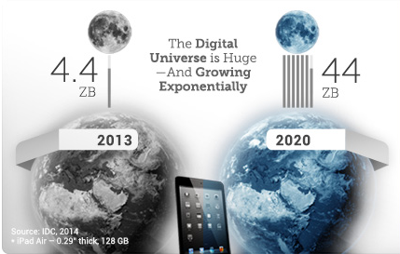
Trend 1: Data grows exponentially
1 ZB = 1, 000, 000, 000, 000 GB

Slide 12
Why Trend 1?
Human Generated Data
Social Media
Camera/Microphones
Activity Trackers
…
Machine Generated Data
Software Logs
Smart Home
Self-driving Car
…

Slide 13
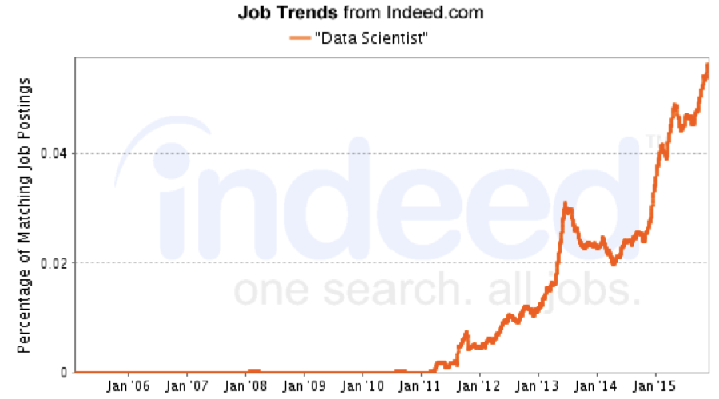
Trend 2: Data skills are in increasingly high demand

Slide 14
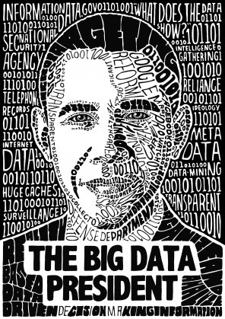


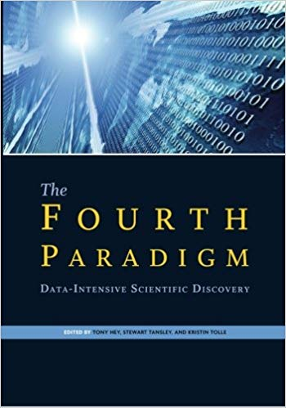
Why Trend 2?
everything
Data is at the center of many things

Slide 15


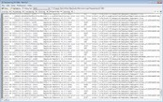
Database
What is a database?
A collection of files that store related data
We will mainly focus on relational databases (i.e., data is stored in tables)
Text Data
Photos & Videos
Name | Gender | GPA
Mike | Male | 4.0
Bob | Male | 3.6
Alice | Female | 3.8
Notes:
Example

Slide 16
Databases in Real Life
Examples
Amazon: Online Bookstore
SFU: Course Management System
RBC: Banking System
Air Canada: Airline Reservation System
Answer two questions
What data do they need?
What applications do they need to build?

Slide 17
Amazon: Online Bookstore
Database
Data about books, customers, orders, etc.
Data about sessions (clicks, pages, searches)
Applications
Book Search System
Recommender System
Payment System
Order System
….

Slide 18
Database Management Systems (DBMSs)
What is a DBMS?
A piece of software designed to store and manage databases
Examples
Commercial: Oracle, IBM DB2, Microsoft SQL Server
Open source: MySQL (Sun/Oracle), PostgreSQL, SQLite

Slide 19
Data Storage without DBMS
Data would be collected in many different files and
Used by many application programs
File 1
Application Program 1
File 2
Application Program 2
.
.
.
.
.
.
File n
Application Program m

Slide 20
What happens if
Several programs need to access and modify the same record at the same time?
An attribute is added to one of the files?
We need to repeatedly access a single record out of millions of records?
We need to retrieve data stored in multiple files?
The system crashes while one of the application programs is running?

Slide 21
Data Storage with DBMS
File 1
Application Program 1
File 2
DBMS
Application Program 2
.
.
.
File n
Application Program m

Slide 22
DBMS Functions
All access to data is centralized and managed by the DBMS
Usage advantages
Efficient access
Data integrity and security
Concurrent access and concurrency control
Crash recovery
Design and implementation advantages
Logical data independence
Physical data independence
Reduced application development time

Slide 23
Current Market
Relational database still anchor the software industry
Elephants: Oracle, IBM, Microsoft, Teradata, EMC, …
Open source: MySQL, PostgreSQL
Emerging variants: In-memory, Column-oriented
Open source “NoSQL” is growing
Analytics: Hadoop MapReduce, Spark
Key-value Stores: MongoDB, Cassandra, Couchbase
Cloud services are expanding quickly
Amazon Redshift/Aurora, Microsoft Cosmos DB, Google BigQuery, Snowflake

Slide 24
Course Objectives
Master skills to query a database
Master skills to design a database
Understand how a DBMS works

Slide 25
Who needs this course?
DB designer: establishes schema
DB application developer: writes programs that query and modify a database
DB administrator: tunes systems and keeps whole things running
Data scientist: manipulates data to extract insights
Data engineer: builds a data-processing pipeline

Slide 26
Outline
Course admin and set up (Who and How)
Motivation for studying DBs (Why)
Overview of course topics (What)

Slide 27
CMPT 354 Topics
Week 1. Introduction
Week 2. Relational Data Model
Week 3-4. SQL
Week 5. Relational Algebra
Week 6. Data Storage and Indexing
Week 7. Midterm
Week 8. Query Processing
Week 9-11. Database Design
Week 12. Transaction Processing
Week 13. NoSQL & SQL over Hadoop & Cloud Databases
Week 15. Final Exam

Slide 28
CMPT 354 and 454
CMPT 354
How to query a database
How to design a database
How DBMSs work (basics)
CMPT 454
How DBMSs work (advance)
How to implement DBMSs

Slide 29
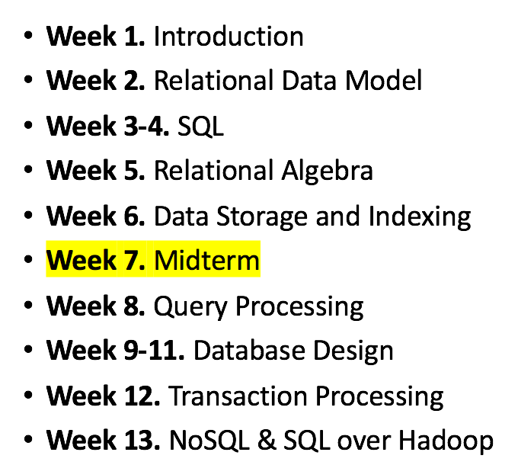
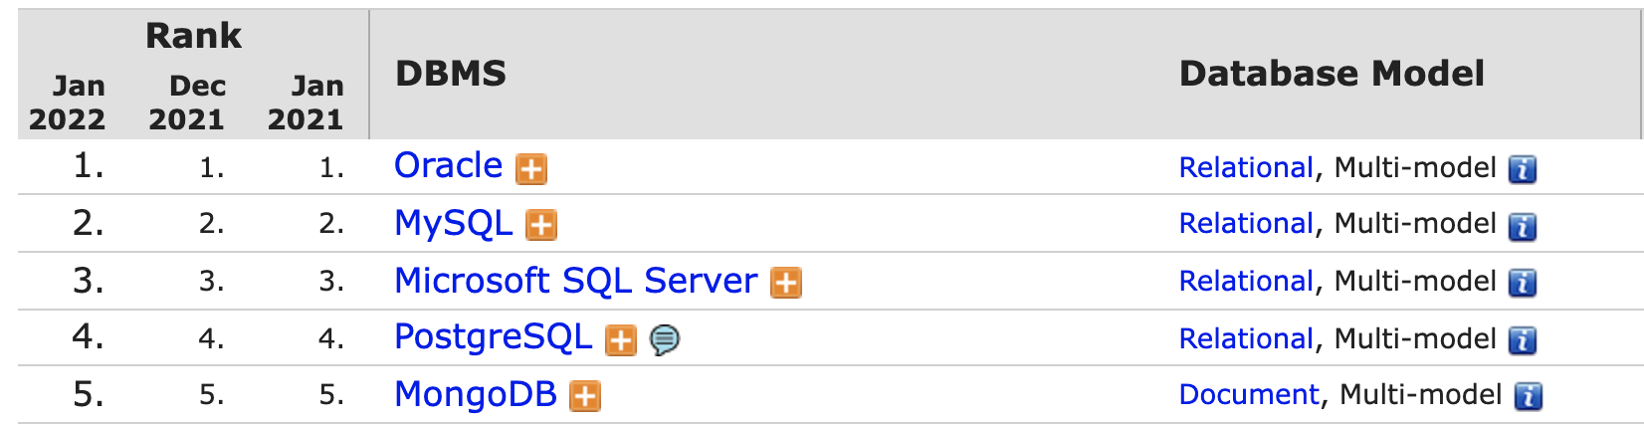
Why should you care?
Week 2. Relational Model
Ted Codd won a Turing Award by proposing the relational model
4 out of 5 top database engines are relational databases

Slide 30

Why should you care?
Week 3-4. Structured Query Language (SQL)
Enable you to communicate with a DBMS
Declarative language (i.e., say what you want not how to do it)
Sorry, I can only understand SQL…
Find names of all students
with GPA > 3.5
SELECT name
FROM Student
WHERE GPA > 3.5
DBMS

Slide 31

Why should you care?
Week 5. Relational Algebra
SQL: What you want
Relational Algebra: How to get it
Find names of all students
with GPA > 3.5
SELECT name
FROM Student
WHERE gpa > 3.5
$$Π_{name}(σ_{gpa>3.5}(Students))$$

Slide 32
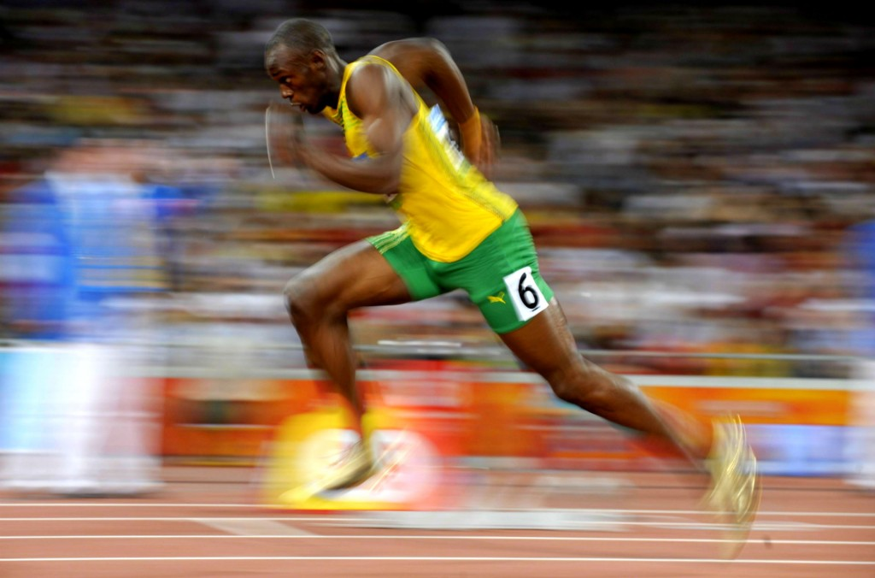
Why should you care?
Week 6. Storage and Indexing
My database application is too slow … Why?
One of the queries is very slow … Why?

Slide 33
Why should you care?
Week 8. Query Optimization and Execution
Understand how an SQL query is processed
How to execute a query plan?
SQL → → Result
Relational Algebra → Query Optimization → Execution
????????
What is the best query plan?

Slide 34
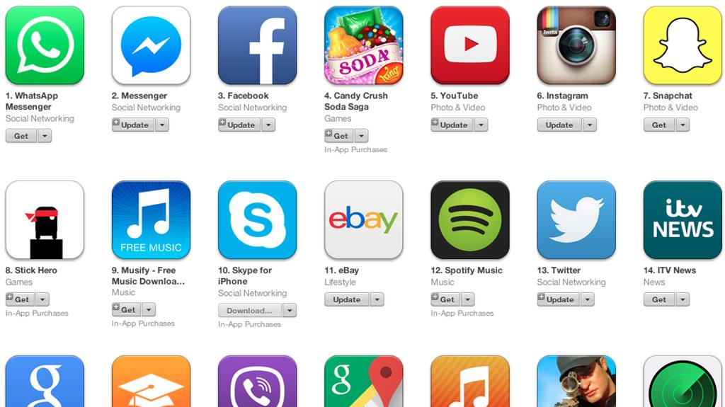
Why should you care?
Week 9-11. Database Design
How to design a database for an application (e.g. an iPhone APP)

Slide 35

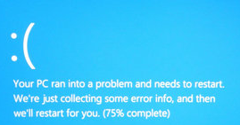
Why should you care?
Week 12. Transaction Processing
What if multiple users access the same data
What if your computer crashes

Slide 36
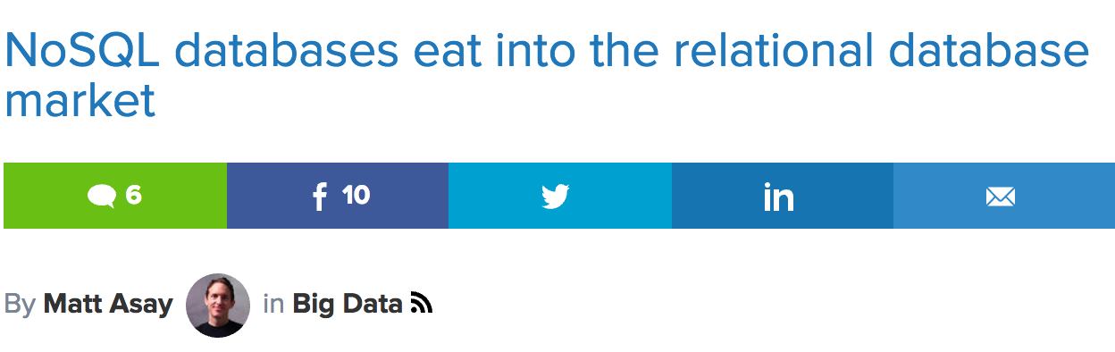
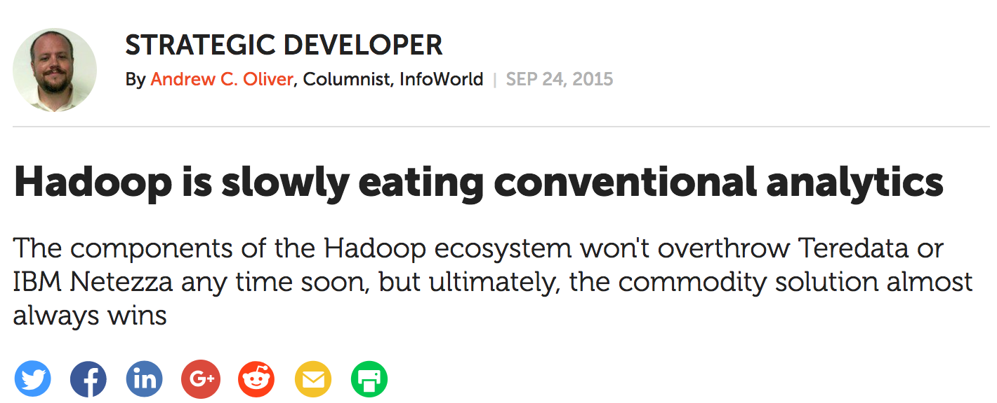

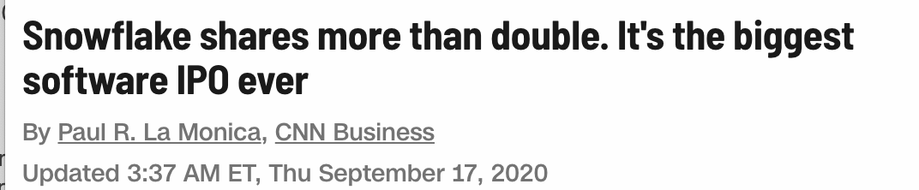
Why should you care?
Week 13. NoSQL & Big Data & Cloud Databases

Slide 37
What to do next?
Decide whether this is the right course for you
Sign up Piazza and enable notifications
https://piazza.com/sfu.ca/spring2022/cmpt354
Check out the course website
https://sfu-db.github.io/cmpt354/

Slide 38
Acknowledgements
Some lecture slides were copied from or inspired by the following course materials
“W4111: Introduction to databases” by Eugene Wu at Columbia University
“CSE344: Introduction to Data Management” by Dan Suciu at University of Washington
“CMPT354: Database System I” by John Edgar at Simon Fraser University
“CS186: Introduction to Database Systems” by Joe Hellerstein at UC Berkeley
“CS145: Introduction to Databases” by Peter Bailis at Stanford
“CS 348: Introduction to Database Management” by Grant Weddell at University of Waterloo

