Slide 1
CMPT 354: Database System I
Lecture 5. Relational Algebra

Slide 2
What have we learned
Lec 1. Database History
Lec 2. Relational Model
Lec 3-4. SQL

Slide 3
Why Relational Algebra matter?
An essential topic to understand how query processing and optimization work
What happened when an SQL is issued to a database?
Help you master the kills to quickly learn a new query language
How to quickly learn XML QL and MangoDB QL?

Slide 4
Relational Query Languages
Query languages allow the manipulation and retrieval of data from a database
Traditionally: QL != programming language
Doesn’t need to be turing complete
Not designed for computation
Supports easy, efficient access to large databases
Recent Years:
Everything interesting involves a large data set
QLs are quite powerful for expressing algorithms at scale

Slide 5
Formal Query Languages
Relational Algebra
Procedural query language
used to represent execution plans
Relational Calculus
Non-procedural (declarative) query language
Describe what you want, rather than how to compute it
Foundation for SQL

Slide 6
Results of a Query
Query is a function over relations
The schema of the result relation is determined by the input relation and the query
Because the result of a query is a relation, it can be used as input to another query
Q(R1,...,Rn) = Rresult
Q(
) =
,Q(
) =
, …

Slide 7
Sets v.s. Bags
Sets: {a, b, c}, {a, d, e, f}, {}, …
Bags: {a, a, b, c}, {b, b, b, b, b}, …
Relational Algebra has two flavors:
Set semantics = standard Relational Algebra
Bag semantics = extended Relational Algebra
DB systems implement bag semantics (Why?)

Slide 8
Sets v.s. Bags
Sets: {a, b, c}, {a, d, e, f}, {}, …
Bags: {a, a, b, c}, {b, b, b, b, b}, …
Relational Algebra has two flavors:
Set semantics = standard Relational Algebra
Bag semantics = extended Relational Algebra
DB systems implement bag semantics (Why?)

Slide 9
Relational Algebra Operators
Core 5 operators
Selection (σ)
Projection (π)
Union (∪)
Set Difference (-)
Cross product (X)
Additional operators
Rename (ρ)
join (⨝)
Intersect (∩)

Slide 10
Selection
The selection operator, σ (sigma), specifies the rows to be retained from the input relation
A selection has the form: σ_{condition}(relation), where condition is a Boolean expression
Terms in the condition are comparisons between two fields (or a field and a constant)
Using one of the comparison operators: <, ≤, =, ≠, ≥, >
Terms may be connected by ∧ (and), or ∨ (or),
Terms may be negated using ¬ (not)

Slide 11
Selection Example
σ_{birth < 1981}(Customer)
sin | firstName | lastName | birth
333 | Cordelia | Chase | 1980
444 | Rupert | Giles | 1955
Customer
sin | firstName | lastName | birth
111 | Buffy | Summers | 1981
222 | Xander | Harris | 1981
333 | Cordelia | Chase | 1980
444 | Rupert | Giles | 1955
555 | Dawn | Summers | 1984
sin | firstName | lastName | birth
111 | Buffy | Summers | 1981
555 | Dawn | Summers | 1984
σ_{lastName = "Summers"}(Customer)

Slide 12
Projection
The projection operator, π (pi), specifies the columns to be retained from the input relation
A selection has the form: π _{columns}(relation)
Where columns is a comma separated list of column names
The list contains the names of the columns to be retained in the result relation

Slide 13
Projection Example
π_{firstName,lastName}(Customer)
firstName | lastName
Buffy | Summers
Xander | Harris
Cordelia | Chase
Rupert | Giles
Dawn | Summers
Customer
sin | firstName | lastName | birth
111 | Buffy | Summers | 1981
222 | Xander | Harris | 1981
333 | Cordelia | Chase | 1980
444 | Rupert | Giles | 1955
555 | Dawn | Summers | 1984
birth
1981
1980
1955
1984
π_{birth}(Customer)

Slide 14
Selection and Projection Notes
Selection and projection eliminate duplicates
Since relations are sets
Both operations require one input relation
The schema of the result of a selection is the same as the schema of the input relation
The schema of the result of a projection contains just those attributes in the projection list

Slide 15
Composing Selection and Projection
π_{sin, firstName}(σbirth < 1982 ∧ lastName = "Summers"(Customer))
Customer
intermediate relation
sin | firstName | lastName | birth
111 | Buffy | Summers | 1981
222 | Xander | Harris | 1981
333 | Cordelia | Chase | 1980
444 | Rupert | Giles | 1955
555 | Dawn | Summers | 1984
sin | firstName | lastName | birth
111 | Buffy | Summers | 1981
sin | firstName
111 | Buffy

Slide 16
Composing Selection and Projection
π _{birth} (σ_{birth < 1981}(Customer))
birth
1980
1955
Customer
sin | firstName | lastName | birth
111 | Buffy | Summers | 1981
222 | Xander | Harris | 1981
333 | Cordelia | Chase | 1980
444 | Rupert | Giles | 1955
555 | Dawn | Summers | 1984
birth
1980
1955
σ_{birth < 1981} (π _{birth} (Customer))

Slide 17
Commutative property
For example:
x + y = y + x
x * y = y * x
Does it hold for projection and selection?
What about
π _{columns}(σ_{condition}(R)) = π _{condition} (σ_{columns}(R)) ?
π _{firstName}(σ_{birth < 1981} (Customer))?

Slide 18
Commutative property
π _{firstName} (σ_{birth < 1981}(Customer))
firstName
Cordelia
Rupert
Customer
sin | firstName | lastName | birth
111 | Buffy | Summers | 1981
222 | Xander | Harris | 1981
333 | Cordelia | Chase | 1980
444 | Rupert | Giles | 1955
555 | Dawn | Summers | 1984
firstName
Cordelia
Rupert
σ_{birth < 1981} (π _{firstName} (Customer))
π _{firstName} (σ_{birth < 1981} (π _{firstName, birth} (Customer)))
σ_{birth < 1981} (π _{firstName, birth} (Customer))

Slide 19
Set Operations Review
A = {1, 3, 6}
B = {1, 2, 5, 6}
Union (∪)
A ∪ B ≡ B ∪ A
A ∪ B = {1, 2, 3, 5, 6}
Intersection(∩)
A ∩ B ≡ B ∩ A
A ∩ B = {1, 6}
Set Difference(−)
A − B ≠ B − A
A − B = {3}
B − A = {2, 5}

Slide 20
Union Compatible Relations
where op = ∪, ∩, or -
A and B must be union compatible
Same number of fields
Field i in each schema have the same type
A op B = R_{result}

Slide 21
Union Compatible Relations
Intersection of the Employee and Customer relations
Customer
Employee
sin | firstName | lastName | birth
111 | Buffy | Summers | 1981
222 | Xander | Harris | 1981
333 | Cordelia | Chase | 1980
444 | Rupert | Giles | 1955
555 | Dawn | Summers | 1984
sin | firstName | lastName | salary
208 | Clark | Kent | 80000.55
111 | Buffy | Summers | 22000.78
412 | Carol | Danvers | 64000.00
The two relations are not union compatible as birth is a DATE and salary is a REAL
We can carry out preliminary operations to make the relations union compatible
π_{sin, firstName, lastName}(Customer) ∩ π_{sin, firstName, lastName}(Employee)

Slide 22
Union Compatible Relations
where op = ∪, ∩, or -
A and B must be union compatible
Same number of fields
Field I in each schema have the same type
Result schema borrowed from A
A op B = R_{result}
A(age int) ∪ B(num int) = ?
R_{result} (age int)

Slide 23
Union
A
sin | firstName | lastName
111 | Buffy | Summers
222 | Xander | Harris
333 | Cordelia | Chase
444 | Rupert | Giles
555 | Dawn | Summers
sin | firstName | lastName
111 | Buffy | Summers
222 | Xander | Harris
333 | Cordelia | Chase
444 | Rupert | Giles
555 | Dawn | Summers
208 | Clark | Kent
412 | Carol | Danvers
B
A ∪ B
sin | firstName | lastName
208 | Clark | Kent
111 | Buffy | Summers
412 | Carol | Danvers

Slide 24
Set Difference
A
sin | firstName | lastName
111 | Buffy | Summers
222 | Xander | Harris
333 | Cordelia | Chase
444 | Rupert | Giles
555 | Dawn | Summers
A − B
sin | firstName | lastName
222 | Xander | Harris
333 | Cordelia | Chase
444 | Rupert | Giles
555 | Dawn | Summers
B
sin | firstName | lastName
208 | Clark | Kent
111 | Buffy | Summers
412 | Carol | Danvers
B − A
sin | firstName | lastName
208 | Clark | Kent
412 | Carol | Danvers

Slide 25
Note on Set Difference
Notice that most operators are monotonic
Increasing size of inputs → outputs grow
Set Difference is non-monotonic
Example: A – B
Increasing the size of B could decrease output size
Set difference is blocking:
For A – B, must wait for all B tuples before any results

Slide 26
Intersection
A
sin | firstName | lastName
111 | Buffy | Summers
222 | Xander | Harris
333 | Cordelia | Chase
444 | Rupert | Giles
555 | Dawn | Summers
sin | firstName | lastName
111 | Buffy | Summers
B
A ∩ B
sin | firstName | lastName
208 | Clark | Kent
111 | Buffy | Summers
412 | Carol | Danvers

Slide 27
Note on Intersect
A ∩ B = R_{result}
Can we express using other operators?
A ∩ B = ?
A
B

Slide 28
Note on Intersect
A ∩ B = R_{result}
Can we express using other operators?
A ∩ B = A - ?
A
B
(A– B)
A – B =
A
B

Slide 29
Cartesian Product
A(a₁, …, a_{n}) x B(a_{n+1} , …,a_{m}) = R_{result}(a₁ , …,a_{m})
Each row of A paired with each row of B
Result schema concats A and B’s fields
Names are inherited if possible (i.e. if not duplicated)
If two field names are the same (i.e., a naming conflict occurs) and the affected columns are referred to by position
If R contains m records, and S contains n records, the result relation will contain m * n records

Slide 30
Cartesian Product Example
σ_{lastName = "Summers"}(Customer)
Account
sin | firstName | lastName | birth
111 | Buffy | Summers | 1981
555 | Dawn | Summers | 1984
acc | type | balance | sin
01 | CHQ | 2101.76 | 111
02 | SAV | 11300.03 | 333
03 | CHQ | 20621.00 | 444
σ_{lastName = "Summers"}(Customer) × Account
1 | firstName | lastName | birth | acc | type | balance | 8
111 | Buffy | Summers | 1981 | 01 | CHQ | 2101.76 | 111
111 | Buffy | Summers | 1981 | 02 | SAV | 11300.03 | 333
111 | Buffy | Summers | 1981 | 03 | CHQ | 20621.00 | 444
555 | Dawn | Summers | 1984 | 01 | CHQ | 2101.76 | 111
555 | Dawn | Summers | 1984 | 02 | SAV | 11300.03 | 333
555 | Dawn | Summers | 1984 | 03 | CHQ | 20621.00 | 444

Slide 31
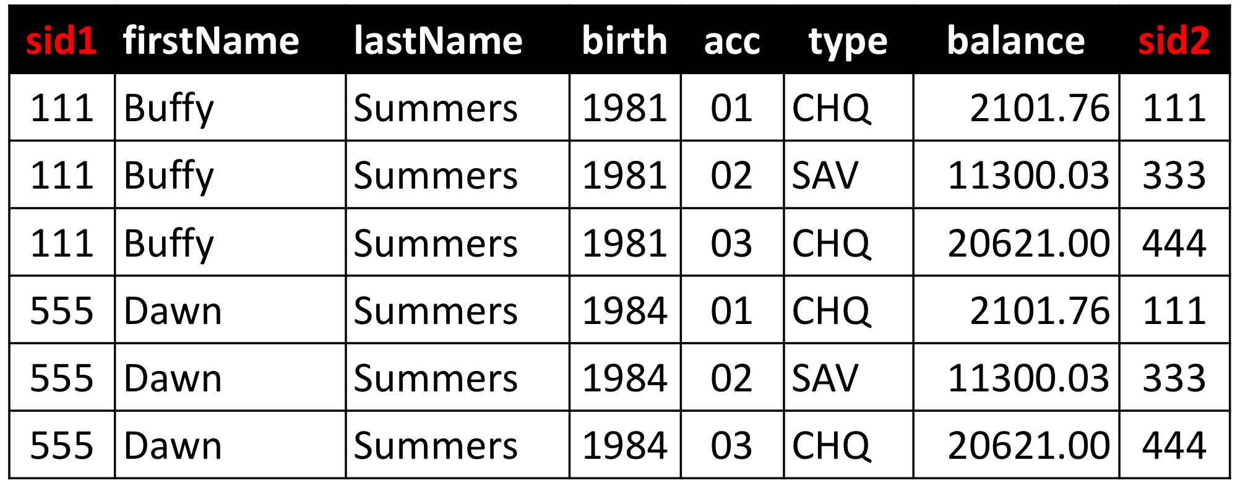
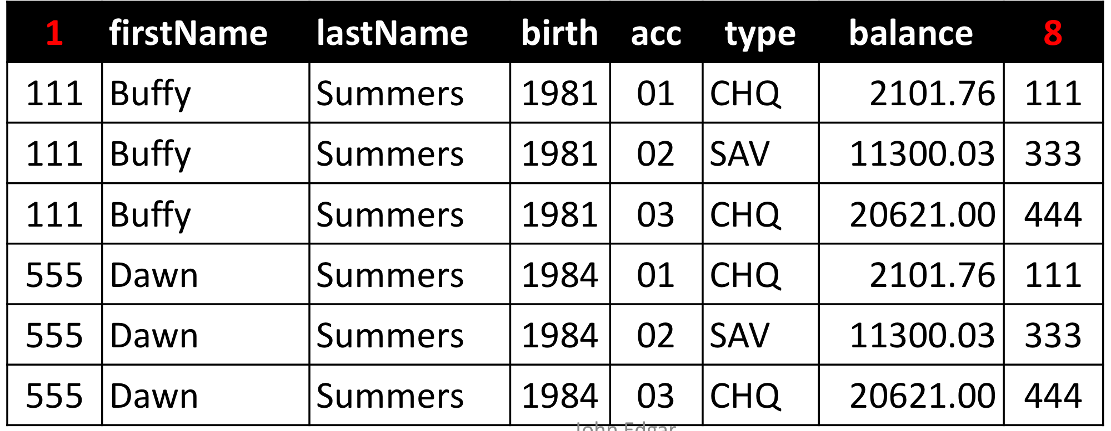
Renaming
It is sometimes useful to assign names to the results of a relational algebra query
The rename operator, ρ (rho)
ρ_{S}(R) renames a relation
ρ_{S(a1,a2,…,an)}(R) renames a relation and its attributes
ρ_{new/old}(R) renames specified attributes
R
ρ_{sid1/1, sid2/8}(R)

Slide 32
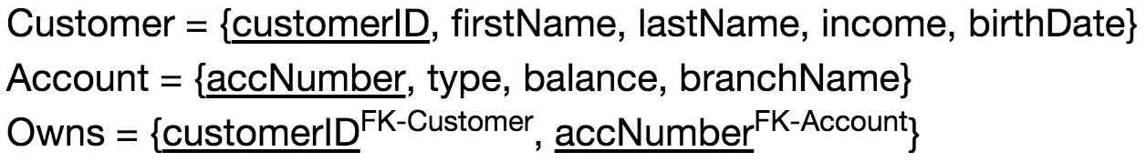
Largest Balance
Find the account with the largest balance; return accNumber
Find accounts which are less than some other account
Use set difference to find the account with the largest balance
σ_{account.balance < d.balance} (Account × ρ_{d} (Account))
π_{accNumber} (Account) –
π_{account.accNumber}(σ_{account.balance < d.balance} (Account × ρ_{d} (Account)))

Slide 33
Relational Algebra Operators
Core 5 operations
Selection (σ)
Projection (π)
Union (∪)
Set Difference (-)
Cross product (X)
Additional operations
Rename (ρ)
Intersect (∩)
Join (⨝ )

Slide 34
Relational Algebra Exercises
Student (sID, lastName, firstName, cgpa)
101, Jordan, Michael, 3.8
Offering (oID, dept, cNum, term, instructor)
abc, CMPT, 354, Fall 2018, Jiannan
Took (sID, oID, grade)
101, abc, 95
1. sID of all students who have earned some grade over 80 and some grade below 50.
π_{sID} (σ_{grade > 80} (Took)) ∩ π_{sID}(σ_{grade < 50} (Took))

Slide 35

Relational Algebra Exercises
Student (sID, lastName, firstName, cgpa)
101, Jordan, Michael, 3.8
Offering (oID, dept, cNum, term, instructor)
abc, CMPT, 354, Fall 2018, Jiannan
Took (sID, oID, grade)
101, abc, 95
$$∧$$
2. Student number of all students who have taken CMPT 354
π_{sID} (σOffering.oID = Took.oID ∧ dept = ‘CMPT’ ∧ cNum = 354 (Offering x Took))

Slide 36
(Inner) Joins
Motivation
Simplify some queries that require a Cartesian product
Natural Join: R ⨝ S = π_{A} (σ_{θ}(R × S))
Theta Join: R ⨝_{θ} S = σ_{θ} (R × S)
Equijoin: R ⨝_{θ} S = σ_{θ} (R × S)
Join condition θ consists only of equalities

Slide 37
Natural Join
There is often a natural way to join two relations
Join based on common attributes
Eliminate duplicate common attributes from the result
Customer
Employee
sin | firstName | lastName | birth
111 | Buffy | Summers | 1981
222 | Xander | Harris | 1981
333 | Cordelia | Chase | 1980
444 | Rupert | Giles | 1955
sin | firstName | lastName | salary
208 | Clark | Kent | 80000.55
111 | Buffy | Summers | 22000.78
396 | Dawn | Allen | 41000.21
Customer ⋈ Employee
sin | firstName | lastName | birth | salary
111 | Buffy | Summers | 1981 | 22000.78

Slide 38
Natural Join
R ⋈ S
Meaning:
Where:
Selection σ_{θ} checks equality of all common attributes (i.e., attributes with same names)
Projection π_{A} eliminates duplicate common attributes
The natural join of two tables with no fields in common is the Cartesian product
Not the empty set
R ⋈ S = π_{A}(σ_{θ} (R × S))

Slide 39
Natural Join Example
R
S
A | B | C | D
111 | Buffy | Summers | 1981
222 | Xander | Harris | 1981
333 | Cordelia | Chase | 1980
444 | Rupert | Giles | 1955
A | B | C | E
208 | Clark | Kent | 80000.55
111 | Buffy | Summers | 22000.78
396 | Dawn | Allen | 41000.21
R ⋈ S
= π_{A,B,C,D,E}(σ_{R.A=S.A ∧ R.B=S.B ∧} _{R.C=S.C} (R × S))
A | B | C | D | E
111 | Buffy | Summers | 1981 | 22000.78

Slide 40
Theta Join
R ⋈ _{θ} S = σ _{θ} (R x S)
Most general form
θ can be any condition
No projection in this case!
Result schema same as cross product

Slide 41
Theta Join Example
Customer
Employee
sin | firstName | lastName | birth
111 | Buffy | Summers | 1981
222 | Xander | Harris | 1981
333 | Cordelia | Chase | 1980
444 | Rupert | Giles | 1955
555 | Dawn | Summers | 1984
sin | firstName | lastName | salary
208 | Clark | Kent | 80000.55
111 | Buffy | Summers | 22000.78
412 | Carol | Danvers | 64000.00
Customer ⋈_{Customer.sin < Employee.sin} Employee
1 | 2 | 3 | birth | 5 | 6 | 7 | salary
111 | Buffy | Summers | 1981 | 208 | Clark | Kent | 80000.55
111 | Buffy | Summers | 1981 | 412 | Carol | Danvers | 64000.00
222 | Xander | Harris | 1981 | 412 | Carol | Danvers | 64000.00
333 | Cordelia | Chase | 1980 | 412 | Carol | Danvers | 64000.00

Slide 42
Equi-Joins
R ⋈ _{θ} S = σ _{θ} (R x S)
A theta join where θ is an equality predicate
Customer
Employee
sin | firstName | lastName | birth
111 | Buffy | Summers | 1981
222 | Xander | Harris | 1981
333 | Cordelia | Chase | 1980
444 | Rupert | Giles | 1955
sin | firstName | lastName | salary
208 | Clark | Kent | 80000.55
111 | Buffy | Summers | 22000.78
396 | Dawn | Allen | 41000.21
Customer ⋈_{Customer.sin = Employee.sin} Employee
1 | 2 | 3 | birth | 5 | 6 | 7 | salary
111 | Buffy | Summers | 1981 | 111 | Buffy | Summers | 22000.78

Slide 43
(Inner) Joins Summary
Natural Join: R ⨝ S = π_{A} (σ_{θ}(R × S))
Equality on all fields with same name in R and in S
Projection π_{A} drops all redundant attributes
Theta Join: R ⨝_{θ} S = σ_{θ} (R × S)
Join of R and S with a join condition θ
Cross-product followed by selection θ
No projection
Equijoin: R ⨝_{θ} S = σ_{θ} (R × S)
Join condition θ consists only of equalities
No projection

Slide 44
Relational Algebra Exercises
Student (sID, lastName, firstName, cgpa)
101, Jordan, Michael, 3.8
Course (dept, cNum, name, breadth)
CMPT, 354, DB, True
Offering (oID, dept, cNum, term, instructor)
abc, CMPT, 354, Fall 2018, Jiannan
Took (sID, oID, grade)
101, abc, 95
The names of all students who have passed a breadth course (grade >= 60 and breadth = True) with Martin
π_{lastName, firstName} (σbreadth = True ∧ grade > 60 ∧ instructor _{= ‘Martin’} (Student ⨝ Took ⨝ Offering ⨝ Course))

Slide 45
Different Plans, Same Results
Semantic equivalence: results are always the same
Are they equivalent?
Which one is more efficient?
Can you make it even more efficient?
π_{name}(σ_{cNum=354} (R ⨝ S))
π_{name}(σ_{cNum=354} (R) ⨝ S)

Slide 46
Other Operators
There are additional relational algebra operators
Usually used in the context of query optimization
Duplicate elimination – δ
Used to turn a bag into a set
Aggregation operators
e.g. sum, average
Grouping – γ
Used to partition tuples into groups
Typically used with aggregation

Slide 47
Summary
Relational Algebra (RA) operators
Five core operators: selection, projection, cross-product, union and set difference
Additional operators are defined in terms of the core operators: rename, intersection, join
Theorem: SQL and RA can express exactly the same class of queries
Multiple RA queries can be equivalent
Same semantics but difference performance
Form basis for optimizations
RDBMS translate SQL → RA, then optimize RA

Slide 48
Acknowledge
Some lecture slides were copied from or inspired by the following course materials
“W4111: Introduction to databases” by Eugene Wu at Columbia University
“CSE344: Introduction to Data Management” by Dan Suciu at University of Washington
“CMPT354: Database System I” by John Edgar at Simon Fraser University
“CS186: Introduction to Database Systems” by Joe Hellerstein at UC Berkeley
“CS145: Introduction to Databases” by Peter Bailis at Stanford
“CS 348: Introduction to Database Management” by Grant Weddell at University of Waterloo

