Slide 1
CMPT 354: Database System I
About Midterm

Slide 2
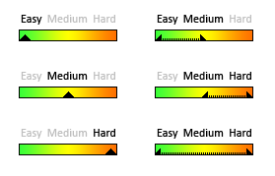
Midterm Coverage
Database History (10%)
Relational Model (10%)
SQL (45%)
Relational Algebra (25%)
Query Processing and Indexing (10%)

Slide 3
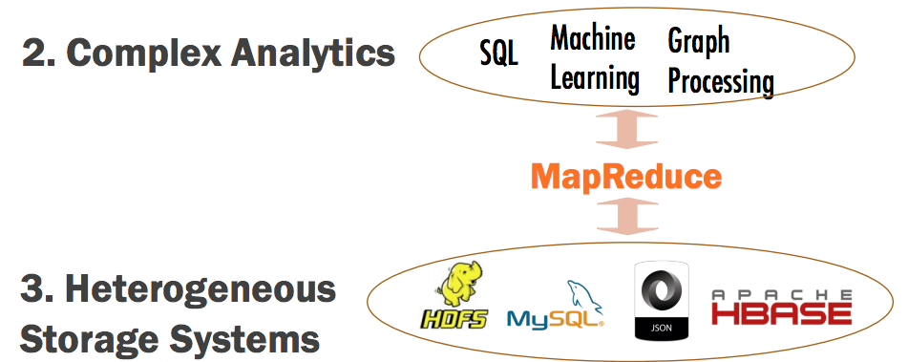
Database History (10%)
You need to understand
Why Relational Model
Why MapReduce
Why NoSQL
Example
F T It is possible to implement SQL using MapReduce

Slide 4
Relational Model (10%)
You need to understand
Basics of Data Models
Terminologies
Keys
Example
F T A primary key is a single column that uniquely identifies a record in a relation

Slide 5
SQL (45%)
You need to be familiar with
SQL DDL
Create/Insert/Alter
Constraints
SQL DML
Selection, Projection
Set Operators (UNION, INTERSECT, EXCEPT)
Joins (INNER, OUTER)
Aggregation, Group By, Having
Order By, Distinct, NULL
Subqueries
Example
Similar to A1 and A2

Slide 6
Relational Algebra
You need to know
How to write an RA query
How to optimize an RA query
How to convert an SQL query to an RA query
Examples
All students whose birth is larger than 1995
σ_{birth > 1995}(Student)
Optimize this query σ_{cNum=354} (R ⨝ S)
σ_{cNum=354} (R) ⨝ S
Convert “SELECT name FROM student” to an RA query
π_{name} (Student)

Slide 7
Query Processing and Indexing
You need to know
Query Processing Steps
Which index is better/useful?
Examples
What does SQL Parser do?
Convert the input SQL text to a logical plan
Can the following index speed up this SQL query: SELECT * FROM Student WHERE id = ?
Index on Student(id) YES NO

Slide 8

Notes
Midterm
Thursday 2:30 – 3:20 pm
AQ3149
Don’t be late
Bring your Student IDs
Please budget your time so you get to all questions
Relax. You are here to learn

