Slide 1
A Clustering Approach for the Nearly Unsupervised Recognition of Nonliteral Language
Julia Birke & Anoop Sarkar
SIMON FRASER UNIVERSITY
Burnaby BC Canada
Presented at EACL ’06, April 7, 2006

Slide 2
The Problem
She hit the ceiling.
ACCIDENT?
(as in “she banged her hand on the ceiling”)
OUTRAGE?
(as in “she got really angry”)
or
The Goal
Nonliteral Language Recognition

Slide 3
Outline
Motivation
Hypothesis
Task
Method
Results
TroFi Example Base
Conclusion

Slide 4
Motivation
“She broke her thumb while she was cheering for the Patriots and, in her excitement, she hit the ceiling.” [from Axonwave Claim Recovery Management System]
“Kerry hit Bush hard on his conduct on the war in Iraq.” → “Kerry shot Bush.” [from RTE-1 challenge of 2005]
Cannot just look up idioms/metaphors in a list
Should be able to handle using same method
ACCIDENT
FALSE
Notes:
If just went by the fact that “hit the ceiling” is in list of idioms, you’d get it wrong. To determine that the idiom shouldn’t fire in this case, you’d have to have set up – manually or automatically – some sort of set of phrases or terms to determine the context of firing or not firing. And if you’re going to do this, you might as well use something that’s going to work on either types of nonliteral language as well.

Slide 5



Motivation (cont)
Literal/Nonliteral language recognition is a “natural task” as evidenced by high inter-annotator agreement
(Cohen) and (S&C) on a random sample of 200 annotated examples annotated by two different annotators: 0.77
As per ((Di Eugenio & Glass, 2004), cf. refs therein), standard assessment for values is that tentative conclusions on agreement exists when ; definite conclusion on agreement exists when .

Slide 6
Hypothesis
It is possible to look at a sentence and classify it as literal or nonliteral
One way to implement this is to use similarity of usage to recognize the literal/nonliteral distinction
The classification can be done without building a dictionary

Slide 7
Hypothesis (cont)
Problem: New task = No data
Solution: Use nearly unsupervised algorithm to create feedback sets; use these to create usage clusters
Output: An expandable database of literal/nonliteral usage examples for use by the nonliteral language research community

Slide 8
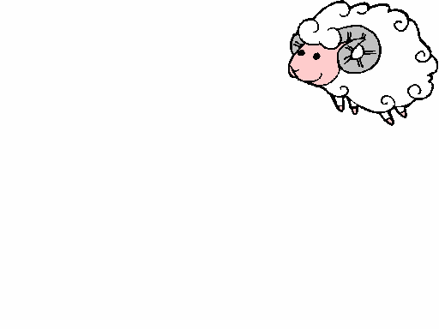
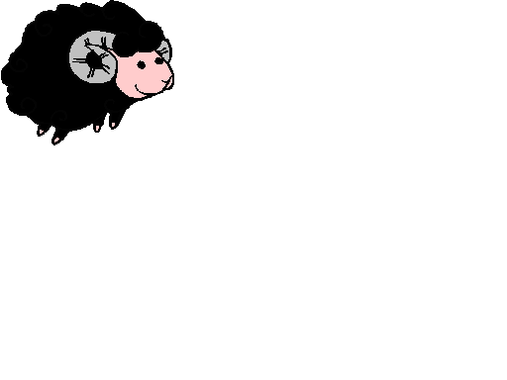
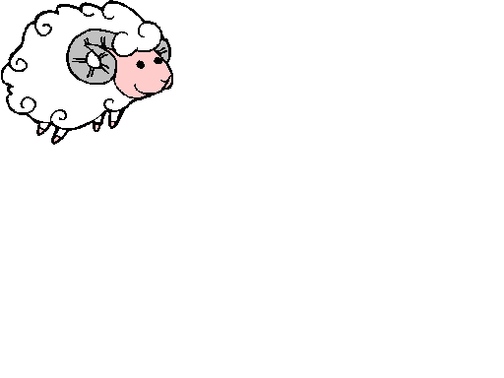
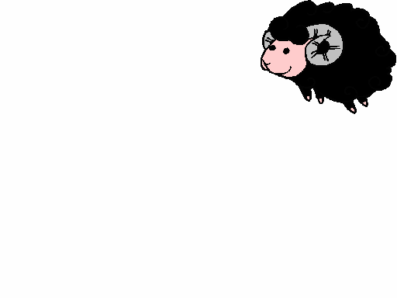
Task
Cluster usages of arbitrary verbs into literal and nonliteral by attracting them to sets of similar sentences
Mixed
Nonliteral
Literal

Slide 9
Task (cont)
TroFi Example Base
***absorb***
*nonliteral cluster*
wsj02:2251 U Another option will be to try to curb the growth in education and
other local assistance , which absorbs 66 % of the state 's budget ./.
wsj03:2839 N “ But in the short-term it will absorb a lot of top management 's
energy and attention , '' says Philippe Haspeslagh , a business
professor at the European management school , Insead , in Paris ./.
*literal cluster*
wsj11:1363 L An Energy Department spokesman says the sulfur dioxide might be simultaneously recoverable through the use of powdered
limestone , which tends to absorb the sulfur ./.
ABSORB
EAT
I want to eat chocolate.
This sponge absorbs water.
I had to eat my words.
This company absorbs cash.
Literal
Nonliteral
Notes:
Example 1 – Selectional constraint violation
Example 2 – World knowledge

Slide 10
Method
TroFi
  uses a known word-sense disambiguation algorithm (Yael Karov & Shimon Edelman, 1998)
  adapts algorithm to task of nonliteral language recognition by regarding literal and nonliteral as two senses of a word and by adding various enhancements

Slide 11
Data Sources
Wall Street Journal Corpus (WSJ)
WordNet
Database of known metaphors, idioms, and expressions (DoKMIE)
  Wayne Magnuson English Idioms Sayings & Slang
  Conceptual Metaphor WWW Server
Notes:
Mention that these provide the information for constructing our target and feedback sets and we will see how these are constructed on the next slide.

Slide 12
Input Data
Target Word
WSJ Sentences
→ Feature Sets
roll off the tongue . .
natural to say, easy to pronounce . .
Podnzilowicz is a name that doesn't roll off the tongue.
In this environment, it's pretty easy to get the ball rolling.
In this environment, it's pretty easy to get the ball rolling.
In this environment, it's pretty easy to get the ball rolling.
roll off the tongue . .
natural to say, easy to pronounce . .
Podnzilowicz is a name that doesn't roll off the tongue.
In this environment, it's pretty easy to get the ball rolling.
roll off the tongue . .
natural to say, easy to pronounce . .
Podnzilowicz is a name that doesn't roll off the tongue.
roll, revolve, turn over –
(to rotate or cause to rotate;
"The child rolled down the hill";
"She rolled the ball";
"They rolled their eyes at his words";
"turn over to your left side";
"Ballet dancers can rotate their legs outward")
2. wheel, roll –
(move along on or as if on wheels or a wheeled vehicle;
"The President's convoy rolled past the crowds")
1. roll, revolve, turn over –
(to rotate or cause to rotate;
"The child rolled down the hill";
"She rolled the ball";
"They rolled their eyes at his words";
"turn over to your left side";
"Ballet dancers can rotate their legs outward")
2. wheel, roll –
(move along on or as if on wheels or a wheeled vehicle;
"The President's convoy rolled past the crowds")
1. roll, revolve, turn over –
(to rotate or cause to rotate;
"The child rolled down the hill";
"She rolled the ball";
"They rolled their eyes at his words";
"turn over to your left side";
"Ballet dancers can rotate their legs outward")
2. wheel, roll –
(move along on or as if on wheels or a wheeled vehicle;
"The President's convoi rolled past the crowds")
General
  Feature sets of stemmed nouns and verbs;
  remove target words, seed words, and frequent words
Target Set
  WSJ sentences containing target word
Nonliteral Feedback Set
  WSJ sentences containing DoKMIE seeds
  DoKMIE examples
Literal Feedback Set
  WSJ sentences containing WordNet seeds
  WordNet examples
Target Word
Examples
→ Feature Sets
Def’ns
→ Seed Words
Target Word
Synonyms
→ Seed Words
Def’ns & Examples
→ Feature Sets
Notes:
Emphasize – The data sources are the source of information for building – without supervision – the feedback sets. The WSJ is also the source of the target sentences to be clustered into literal/nonliteral. Mention that neither the feedback nor the target set sentences are in any way hand-selected. We are trying to mimic a real-world situation, and you cannot be hand-picking your data sets in the real world.

Slide 13
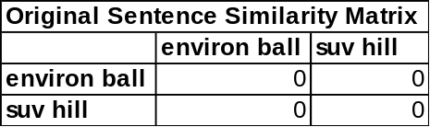
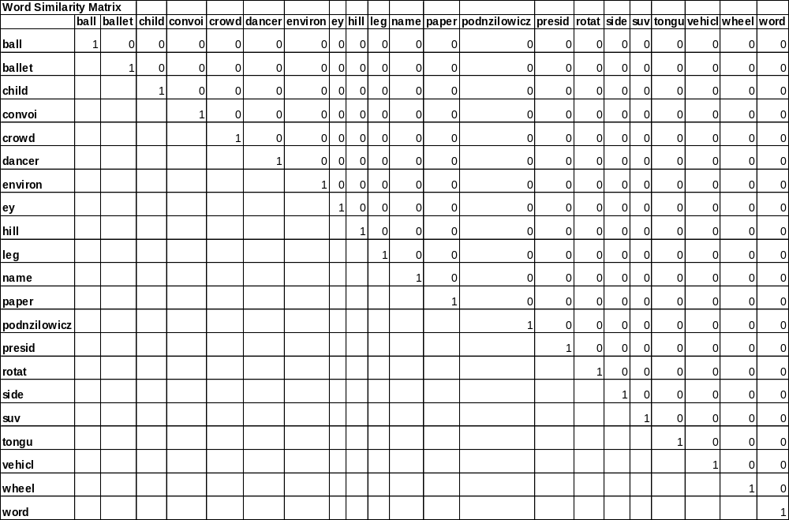
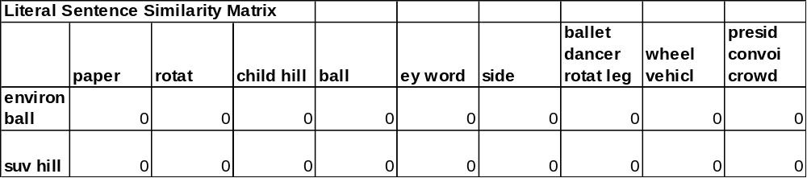
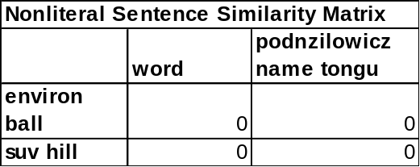
Input Data (cont)
Target
Target Set
environ ball
suv hill
The SUV rolled down the hill.
Literal Feedback Set
paper
rotat
child hill
ball
ey word
side
ballet dancer rotat leg
wheel vehicl
presid convoi crowd
Nonliteral Feedback Set
word
podnzilowicz name tongu
She turned the paper over.
I can’t pronounce that word.
Notes:
Point out that the “can’t pronounce that word” example is an actual example for “roll off the tongue”, not a joke.

Slide 14
Similarity-based Clustering
Principles
  Sentences containing similar words are similar; words contained in similar sentences are similar
  Similarity is transitive: if A is similar to B and B is similar to C, then A is similar to C
  Mutually iterative updating between matrices; stop when
  changes in similarity values < threshold
Target SSM
WSM
Literal SSM
Nonliteral SSM

Slide 15
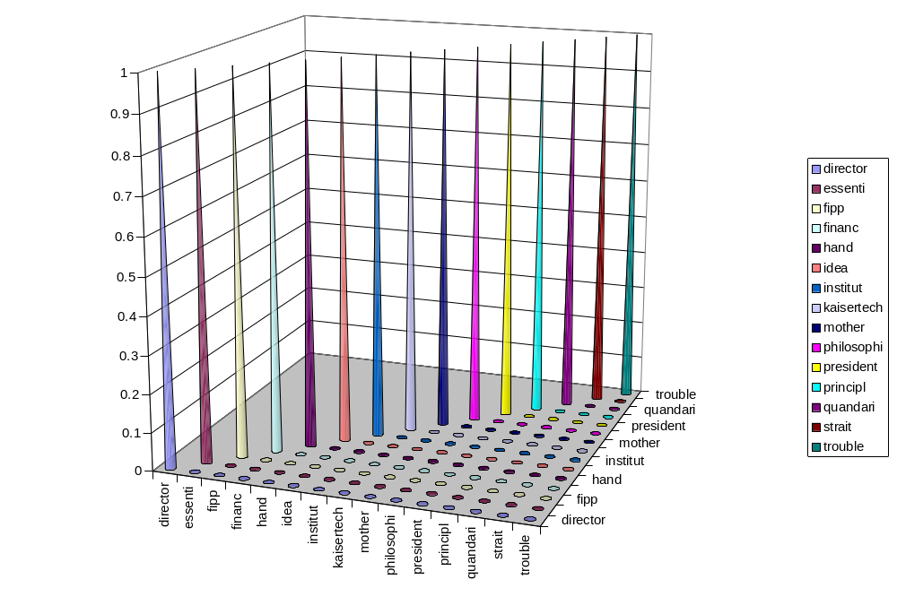
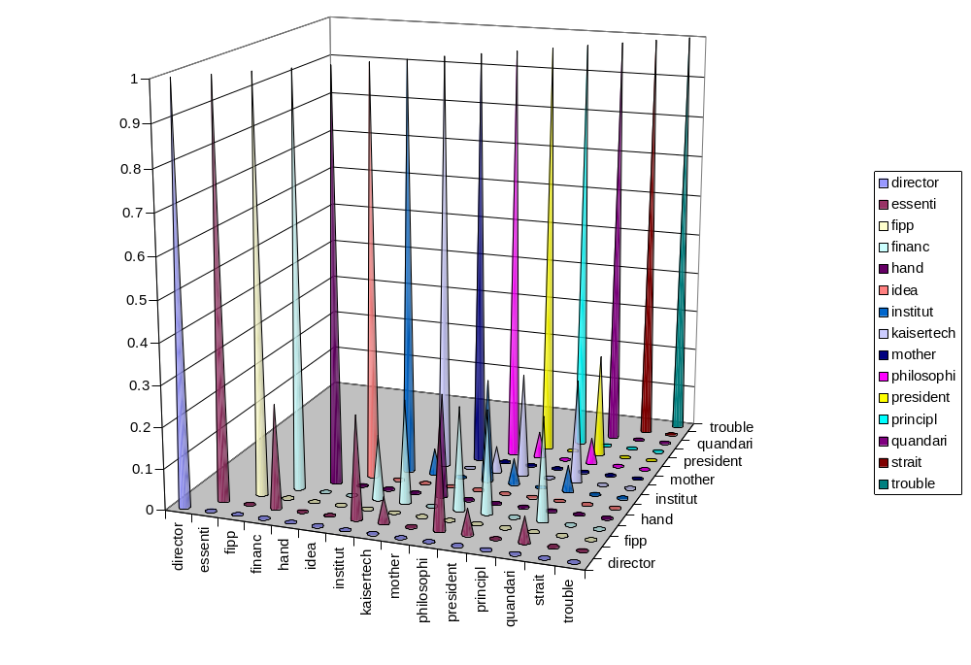
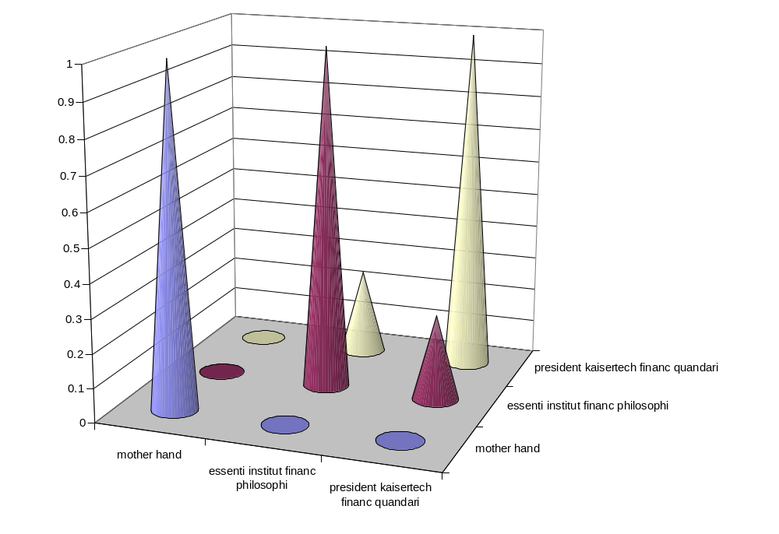
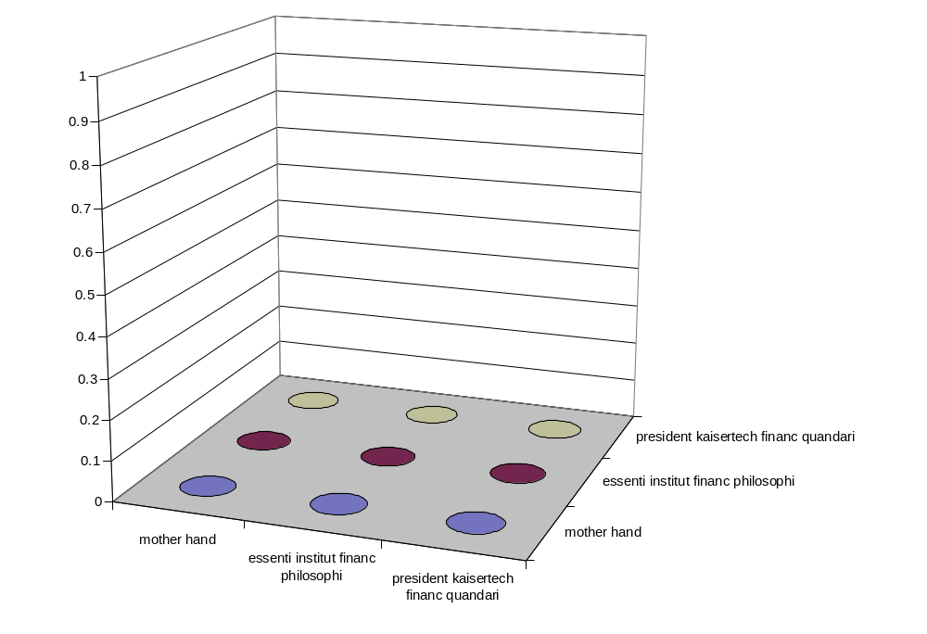
1 She grasped her mother's hand.
2 He thinks he has grasped the essentials of the
institute's finance philosophies.
3 The president failed to grasp KaiserTech's
finance quandary.
3
3
2
2
1
15
1
1
1
2
2
3
3

Slide 16
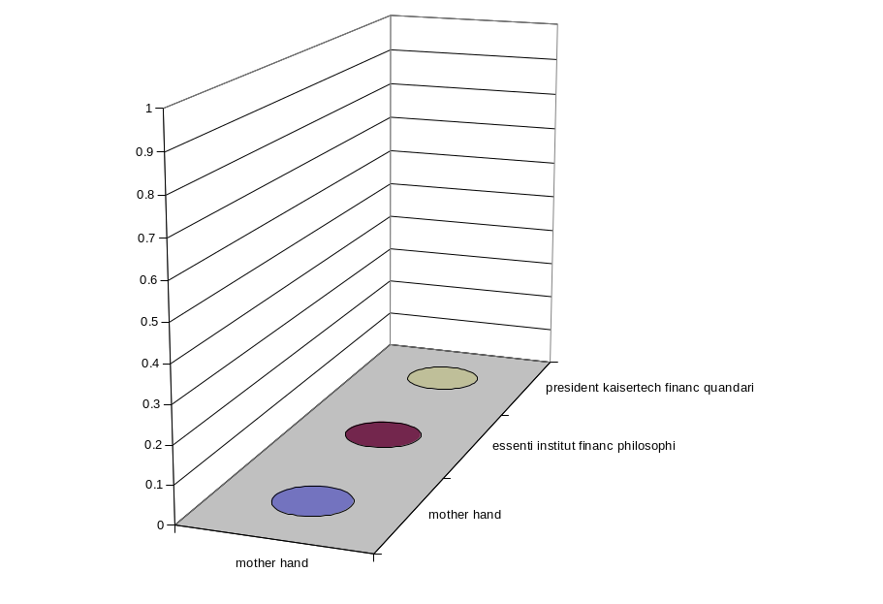
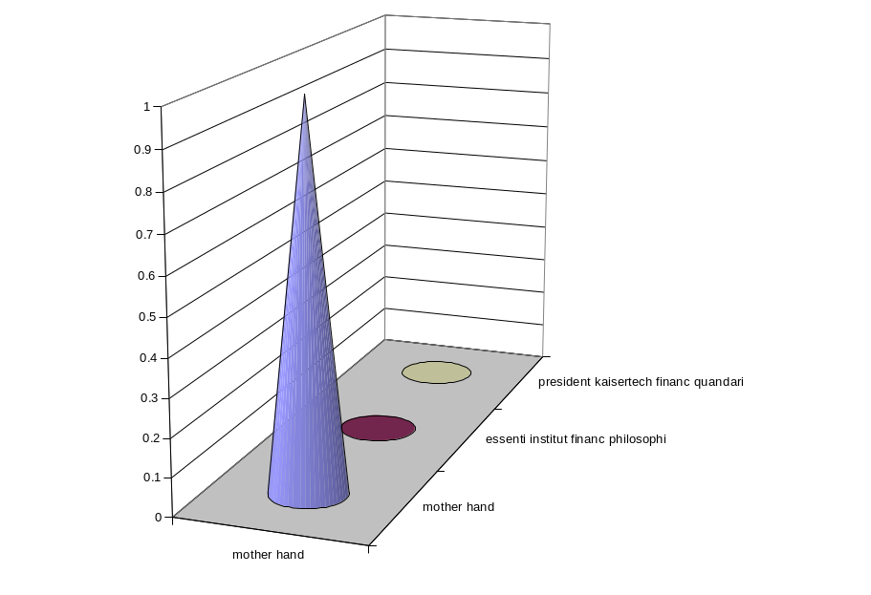
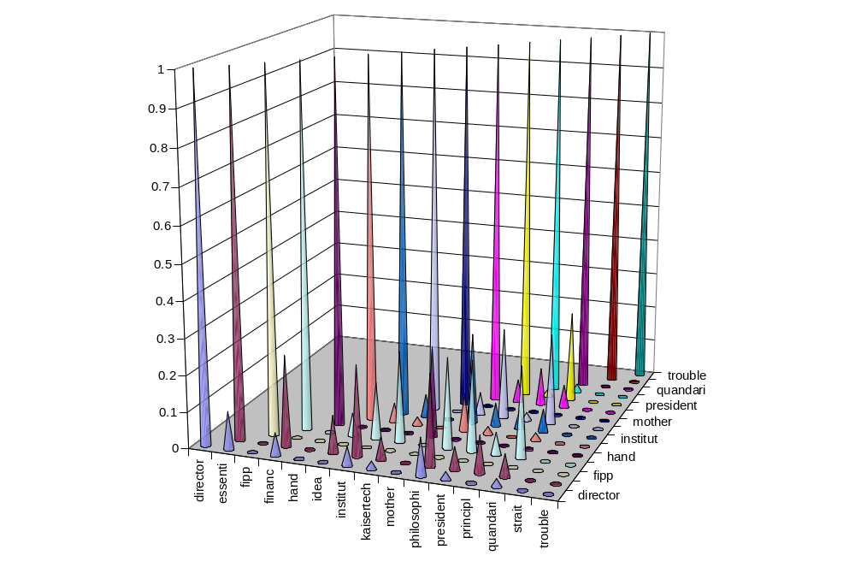
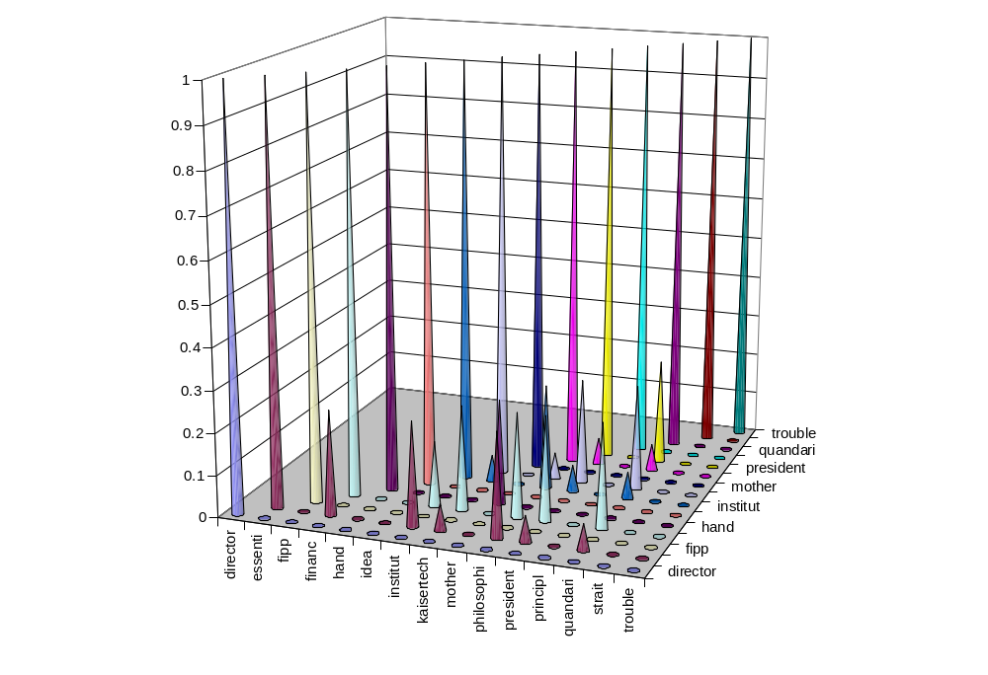
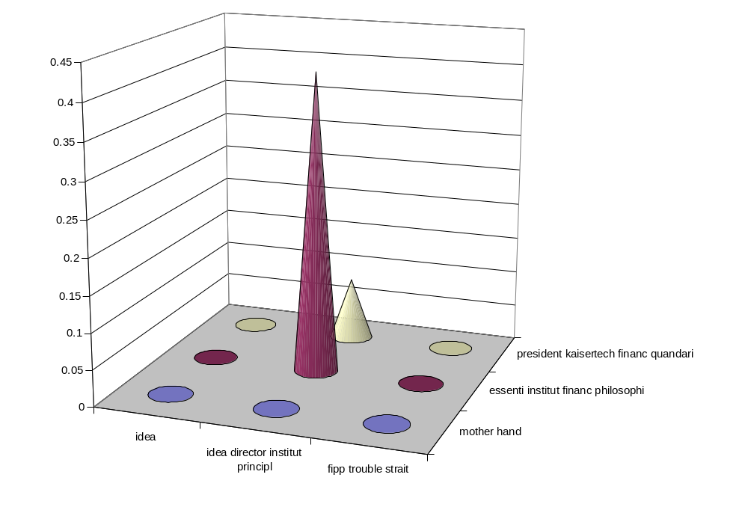
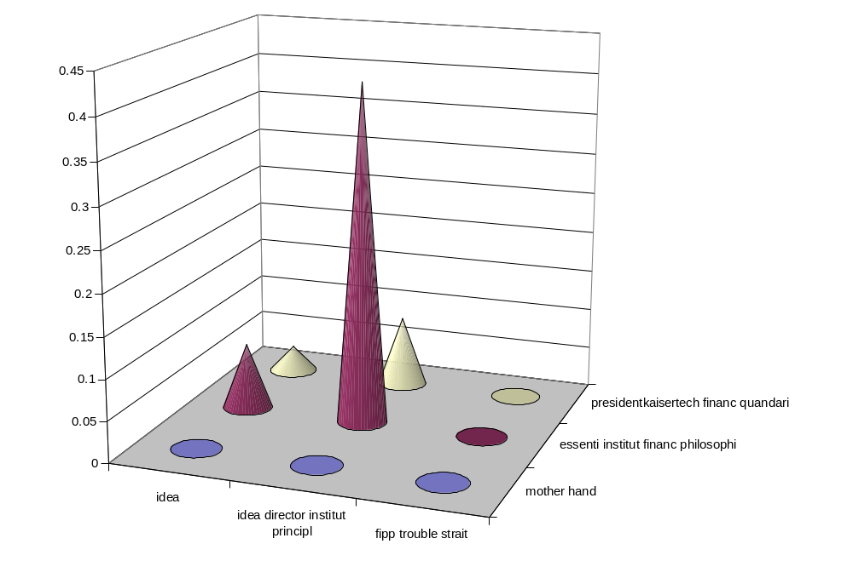
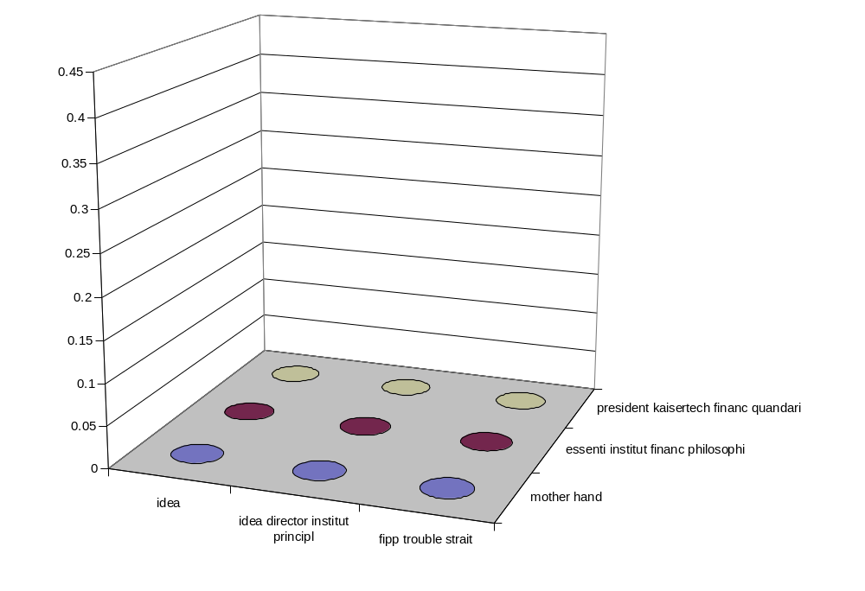
president k. financ quandari
president k. financ quandari
president k. financ quandari
essenti institut financ philosophi
essenti institut financ philosophi
essenti institut financ philosophi
mother hand
mother hand
mother hand
L1
L1
L1
His aging mother gripped his hands tightly.
N1 After much thought, he finally grasped
the idea.
N2 This idea is risky, but it looks like the
director of the institute has finally
comprehended the basic principles behind it.
N3 Mrs. Fipps is having trouble comprehending
the legal straits.
3
3
3
2
2
2
1
16
1
N1
1
N1
N1
N2
N2
N2
N3
N3
N3

Slide 17
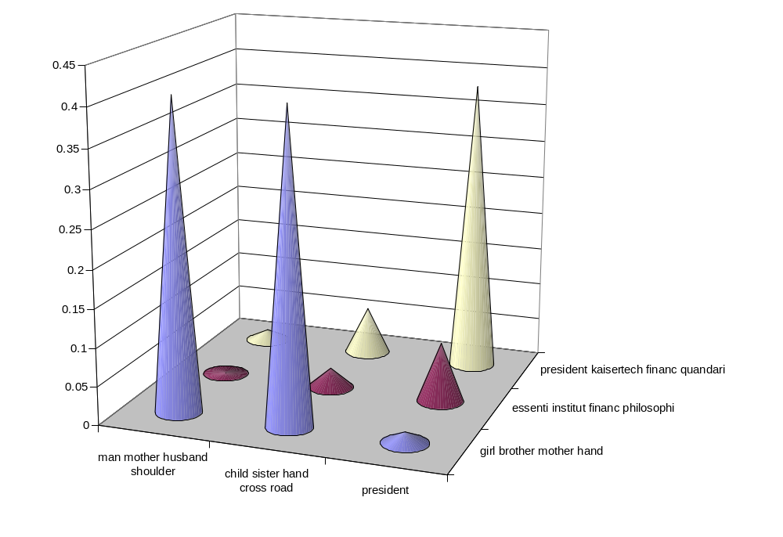
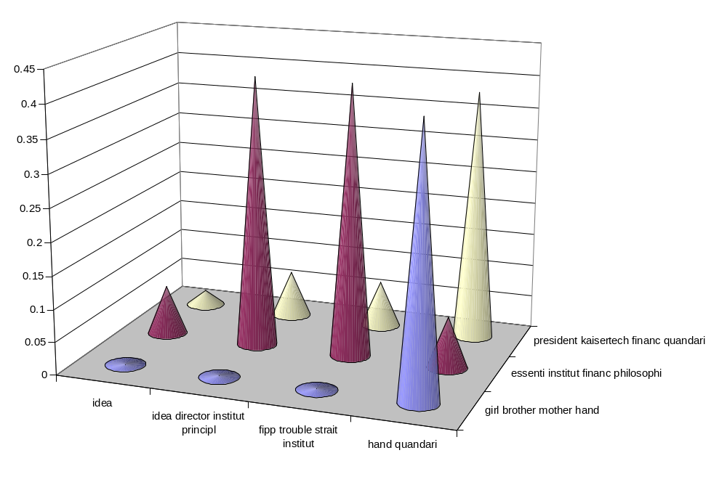
1 The girl and her brother grasped their mother's
hand.
2 He thinks he has grasped the essentials of the
institute's finance philosophies.
3 The president failed to grasp KaiserTech's
finance quandary.
L1 The man's aging mother gripped her husband's
shoulders tightly.
L2 The child gripped her sister's hand to cross
the road.
L3 The president just doesn't get the picture,
does he?
3
2
L1
1
L2
L3
N1 After much thought, he finally
grasped the idea.
N2 This idea is risky, but it looks like
the director of the institute has
finally comprehended
the basic principles behind it.
N3 Mrs. Fipps is having trouble
comprehending the legal straits
of the institute.
N4 She had a hand in his finally fully
comprehending their quandary.
3
2
N1
N2
1
N3
N4
Notes:
Point out that going by highest similarity, we’d get ties for 1 and 3, because the highest cones in each case are the same height; however, point out that looking collectively at the attraction to all the feedback set sentences, it looks like 1 should be more attracted to the literal set, and 3 more to the nonliteral set.
Transition – This prompted us to examine the way similarity is determined by the algorithm. In the basic algorithm, attraction is based on highest similarity to any one sentence in the set. Let’s see what happens if we take the sum of all the similarities instead.

Slide 18
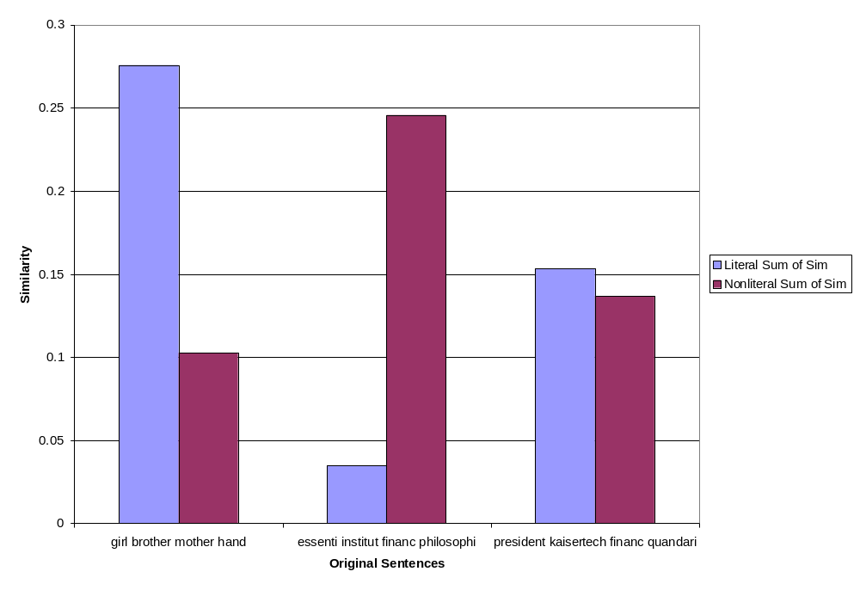
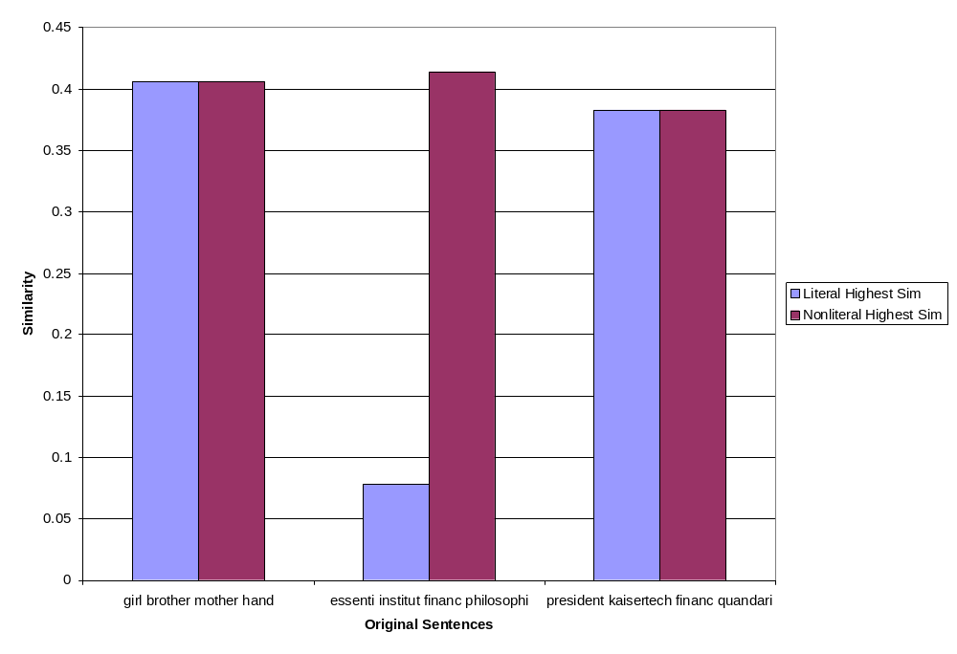
High Similarity vs. Sum of Similarities
Notes:
Note that this is still part of the demonstration of the method. We will be seeing actual experimental results later.
Point out that we broke the tie on the last sentence, but in the wrong direction. Note that false attraction is caused by noise in the feedback sets. Remind the audience that we collected the feedback sets without human intervention and that we have created a method for cleaning the up without human intervention, namely scrubbing.

Slide 19
Scrubbing & Learners
LEARNER A
INDICATOR : phrasal/expression words AND overlap
TYPE : synset
ACTION : move
LEARNER C
INDICATOR : overlap
TYPE : feature set
ACTION : remove
LEARNER B
INDICATOR : phrasal/expression words AND overlap
TYPE : synset
ACTION : remove
LEARNER D
INDICATOR : n/a
TYPE : n/a
ACTION : n/a
Scrubbing
  cleaning noise out of the feedback sets
  Scrubbing Profile
    INDICATOR
    the linguistic phenomenon that triggers the scrubbing
    phrasal/expression verbs, overlap
    TYPE
    the kind of item to be scrubbed
    word, synset, feature set
    ACTION
    the action to be taken with the scrubbed item
    move, remove
1. grasp, grip, hold on -- (hold firmly)
child sister hand cross road
2. get the picture, comprehend, savvy, dig, grasp,
compass, apprehend -- (get the meaning of something;
"Do you comprehend the meaning of this letter?")
hand quandari
Notes:
Explain scrubbing.
When get to phrasal verbs, mention that aware that not all phrasal verbs are idiomatic, but that enough of them are that it is a useful generalization to make (similar to the one-sense-per-document generalization made by word sense disambiguation people – it’s easily refuted but true often enough that it’s useful).
Mention that although scrubbing can remove elements causing false attraction, it can also remove elements causing correct attraction and it can introduce noise into the other feedback set. To balance this out, we introduced Learners, each of which gets scrubbed slightly differently.
Learner C – Emphasize that dropping whole feature set based on overlap, not just word
Transition – The way was get the greatest benefits from the learners is allow them to vote.

Slide 20
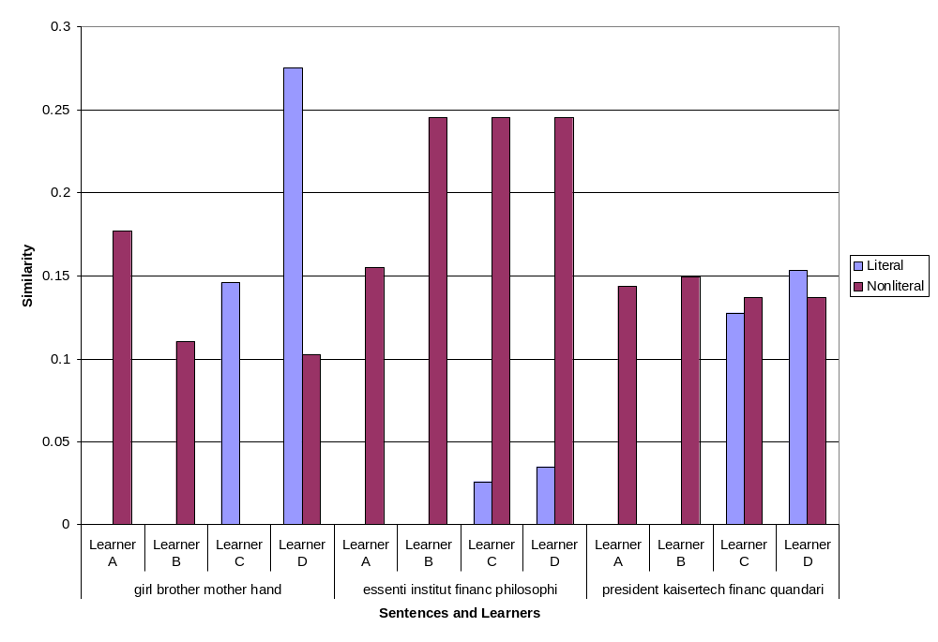
Voting
Notes:
Transition – Still haven’t get quite the results we want, so add additional features to improve the results.

Slide 21
SuperTags and Context
SuperTags
  A/B_Dnx person/A_NXN needs/B_nx0Vs1 discipline/A_NXN to/B_Vvx kick/B_nx0Vpls1 a/B_Dnx habit/A_NXN like/B_nxPnx drinking/A_Gnx0Vnx1 ./B_sPU
  →
  disciplin habit drink kick/B_nx0Vpls1_habit/A_NXN
Context
  foot drag/A_Gnx0Vnx1_foot/A_NXN
  →
  foot everyon mcdonnel dougla commod anyon paul nisbet aerospac
  analyst prudentialbach secur mcdonnel propfan model spring count order delta drag/A_Gnx0Vnx1_foot/A_NXN
Notes:
Differentiation example: “She has a habit of kicking him when she’s been drinking.”
Really could add all sorts of features that other researchers have thought of.
Transition – Now that we’ve seen how TroFi works, let’s look at how well it works.

Slide 22
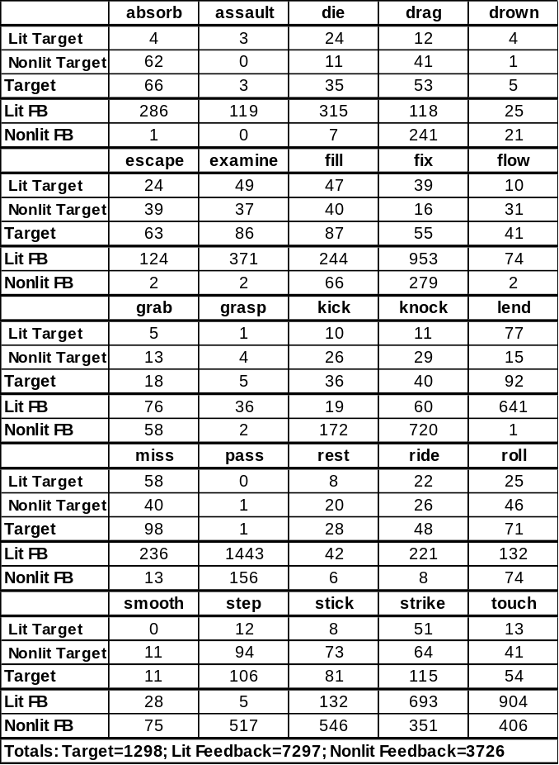
Results – Evaluation Criteria 1
25 target words
Target sets:
1 to 115 sentences each
Feedback sets:
1 to ~1500 sentences each
Total target sentences:
1298
Total literal FB sentences:
7297
Total nonliteral FB sentences:
3726
Notes:
Point out that we purposely selected target words with target and feedback sets of different sizes and qualities (natural results of unseen selection; not manually manipulated).
Purposely did not select words typically used by researchers in nonliteral language research. A collection of such words has been added later for the Example Base.

Slide 23
Results – Evaluation Criteria 2
Target set sentences hand-annotated for testing
Unknowns sent to cluster opposite to manual label
Literal Recall = correct literals in literal cluster / total correct literals
Literal Precision = correct literals in literal cluster
/ size of literal cluster
If no literals: Literal Recall = 100%;
Literal Precision = 100% if no nonliterals in literal cluster, else 0%
f-score = (2*precision*recall) / (precision+recall)
Nonliteral scores calculated in same way
Overall Performance = f-score of averaged literal/nonliteral
precision scores and averaged literal/nonliteral recall scores

Slide 24
Baseline
Baseline – Simple Attraction
  Target sentence attracted to feedback set containing sentence with which it has the most words in common
  Unknowns sent to cluster opposite to manual label
  Attempts to distinguish between literal and nonliteral
  Uses all data used by TroFi
Notes:
Mention that there are other types of baselines as well and tell people to ask about it later if interested.
In paper, with maj for each word, perf = 63.6; for Lit maj, perf = 57.5 (nolit perf = 0 vs. TroFi’s 42.3); for Nonlit maj, perf = 61.3 (but nonlit perf very high (72.1 vs 58.6 for mixed))

Slide 25
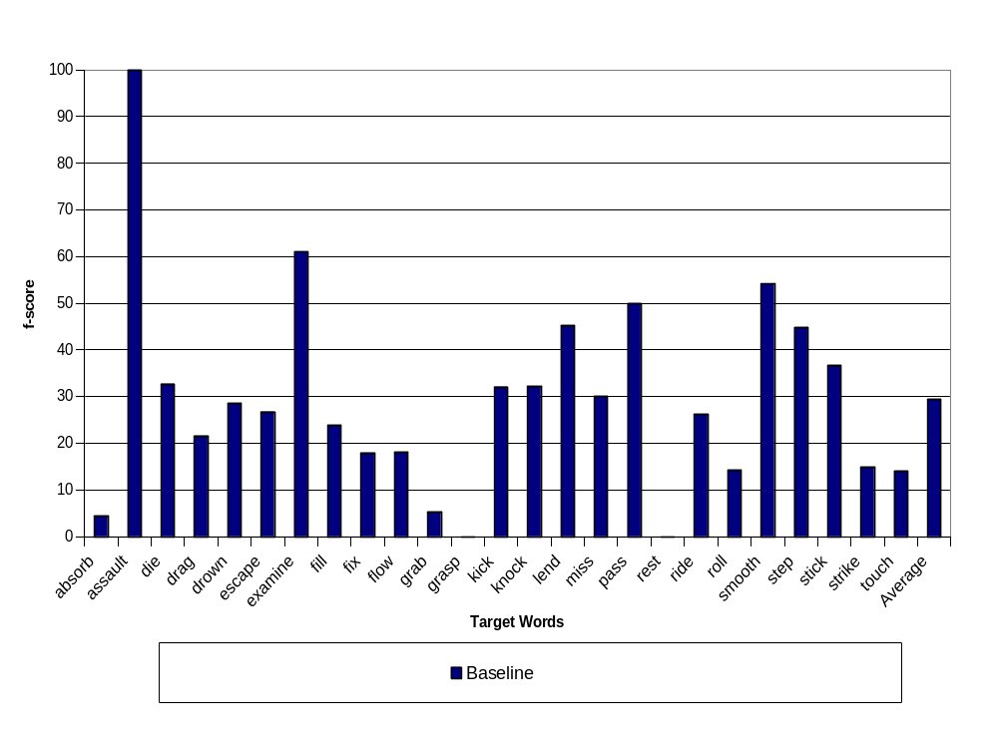
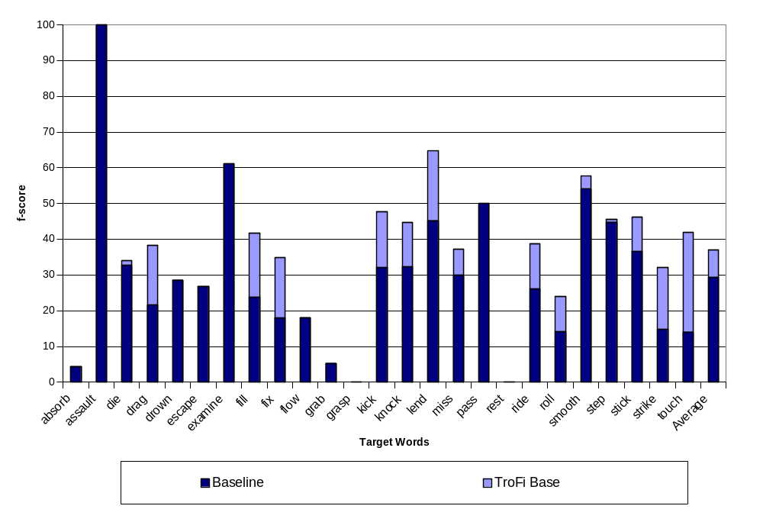
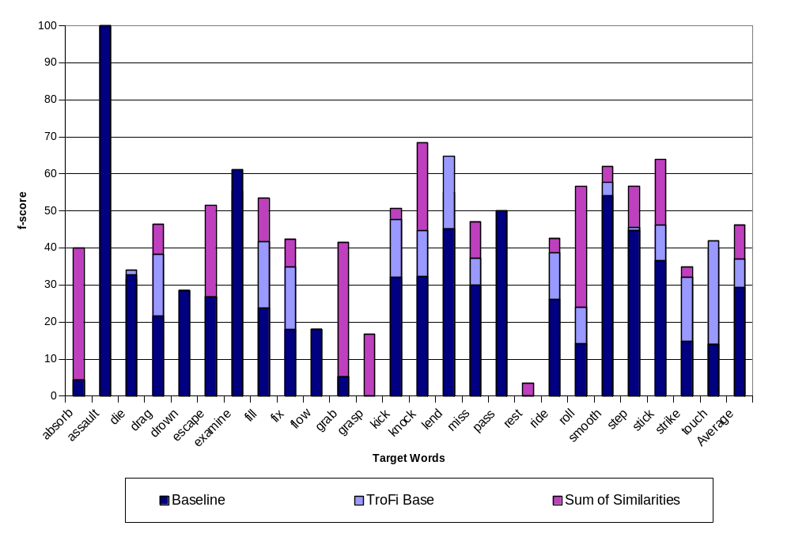
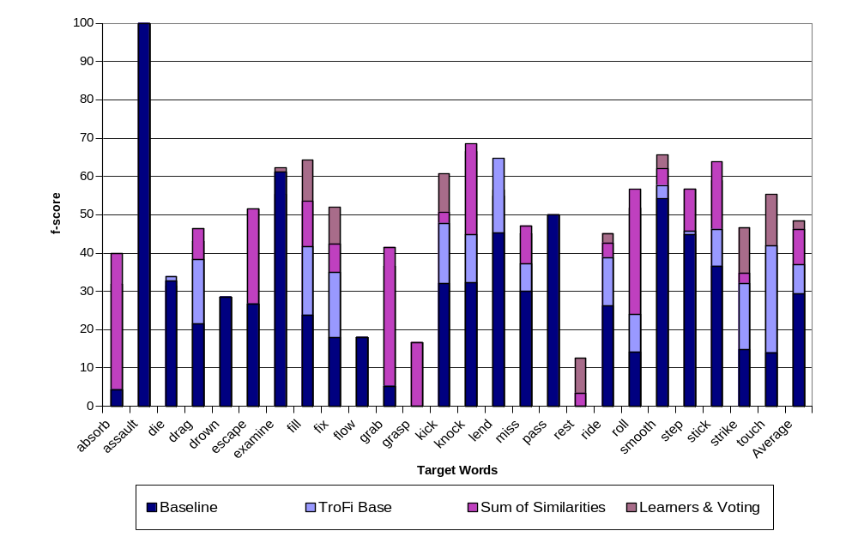
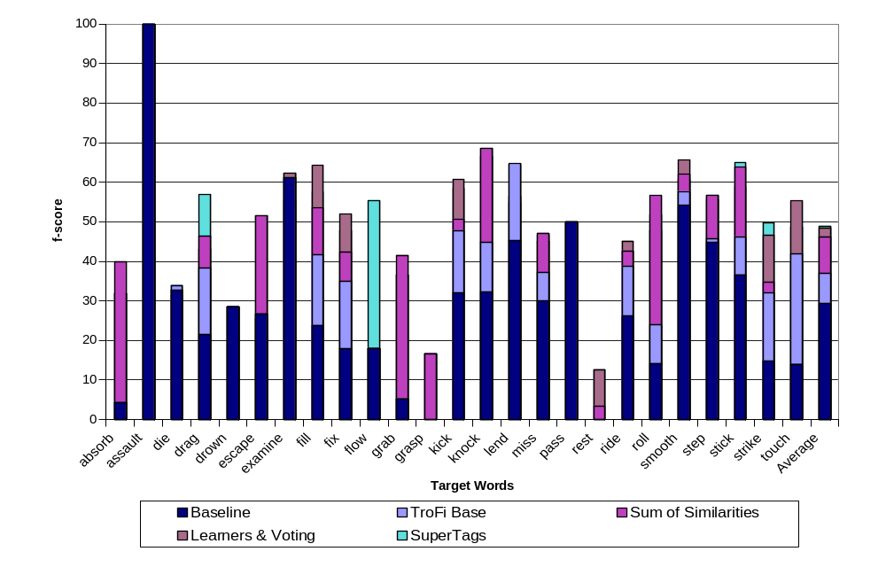
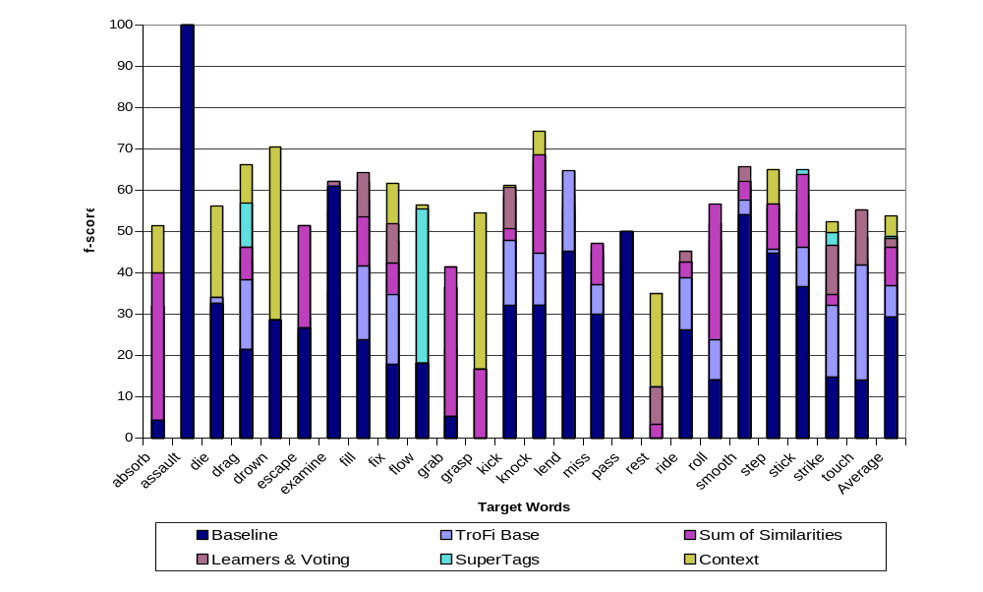
53.8%
48.9%
48.4%
46.3%
36.9%
29.4%
25

Slide 26
TroFi Example Base –
Iterative Augmentation
Purpose
  cluster more target sentences for given target word after initial run using knowledge gained during initial run
  improve accuracy over time
Method
  use TroFi with Active Learning
  after each run, save weight of each feedback set sentence
  for each feedback set sentence,
  weight = highest similarity to any target sentence
  newly clustered sentences added to feedback sets with weight = 1
  in subsequent runs for same target word, use saved weighted feedback sets instead of building new ones
Notes:
Example?

Slide 27
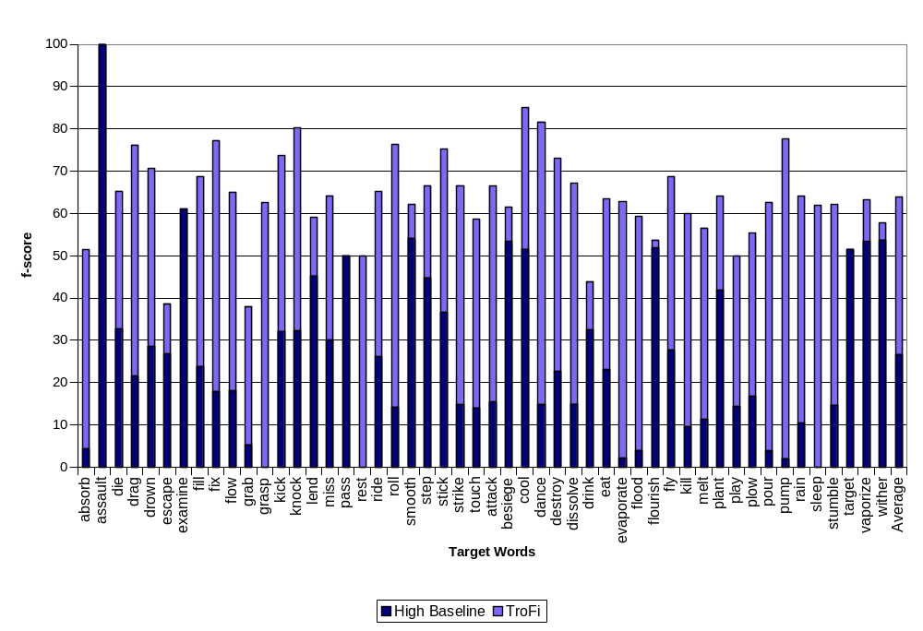
TroFi Example Base
absorb
assault
attack
besiege
cool
dance
destroy
die
dissolve
drag
drink
drown
eat
escape
evaporate
examine
fill
fix
flood
flourish
flow
fly
grab
grasp
kick
kill
knock
lend
melt
miss
pass
plant
play
plow
pour
pump
rain
rest
ride
roll
sleep
smooth
step
stick
strike
stumble
target
touch
vaporize
wither
Two runs, one regular, one iterative augmentation, for 50 target words
Uses optimal Active Learning model
Easy to expand clusters for current target words further using iterative augmentation
Also possible to add new target words, but requires new feedback sets
63.9%
26.6%

Slide 28
TroFi Example Base
Literal and nonliteral clusters of WSJ sentences
Resource for nonliteral language research
***pour***
*nonliteral cluster*
wsj04:7878 N As manufacturers get bigger , they are likely to pour more money into the battle for shelf space , raising the ante for new players ./.
wsj25:3283 N Salsa and rap music pour out of the windows ./.
wsj06:300 U Investors hungering for safety and high yields are pouring record sums into single-premium , interest-earning annuities ./.
*literal cluster*
wsj59:3286 L Custom demands that cognac be poured from a freshly opened bottle ./.
Ref back to WSJ files
Nonliteral label –
either testing legacy
or active learning
Literal label –
either testing legacy
or active learning
Unannotated –
from iterative augmentation run

Slide 29
Conclusion
TroFi – a system for nonliteral language recognition
TroFi Example Base – an expandable resource
of literal/nonliteral usage examples for the nonliteral language research community
Challenges
  Improve the algorithm for greater speed and accuracy
  Find ways of using TroFi and TroFi EB for interpretation
TroFi – a first step towards an unsupervised, scalable, widely applicable approach to nonliteral language processing that works on real-world data for any domain in any language
Notes:
Before Challenges, mention that TroFi not a standard task, like tagging for example, resulting in a lot of initial overhead, like corpora building. This means that there are still challenges ahead and many ways for TroFi to improve and grow.

Slide 30
Questions?

Slide 31
Extras
Not part of defense

Slide 32
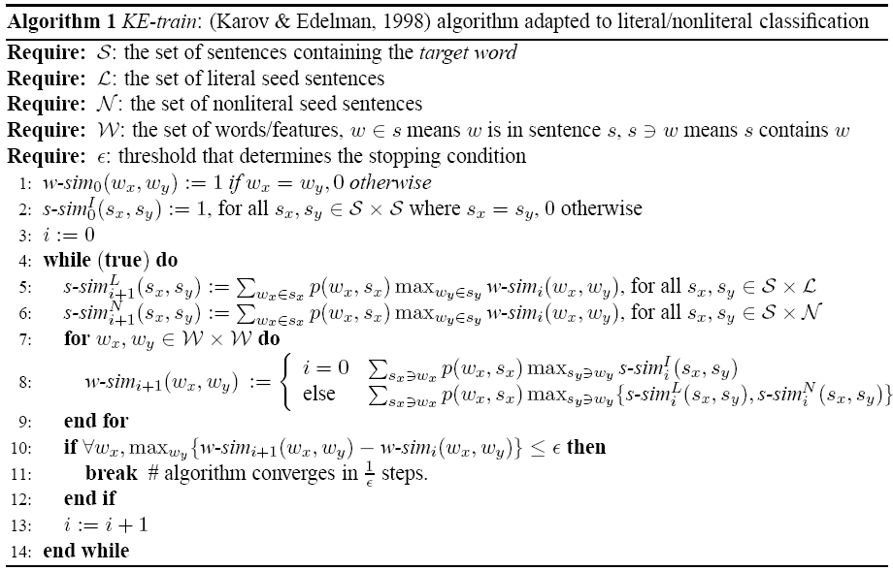
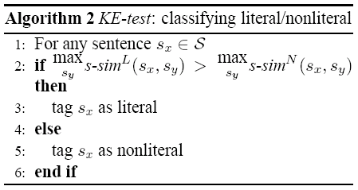
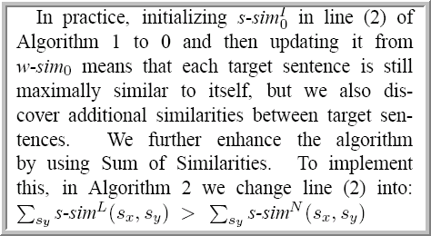

Slide 33
The Long-Awaited Formulas
aff_{n}(W, S) = max_{Wi ∈ S} sim_{n}(W, W_{i})
aff_{n}(S, W) = max_{Sj ∋ W} sim_{n}(S, S_{j})
sim_{n+1}(S₁, S₂) = ∑_{W ∈ S1} weight(W, S₁) · aff_{n}(W, S₂)
sim_{n+1}(W₁, W₂) = ∑_{S ∋ W1} weight(S, W₁) · aff_{n}(S, W₂)

Slide 34
Types of Metaphor
dead (fossilized)
  ‘the eye of a needle’; ‘the are transplanting the community’
cliché
  ‘filthy lucre’; ‘they left me high and dry’; ‘we must leverage our assets’
standard (stock; idioms)
  ‘plant a kiss’; ‘lose heart’; ‘drown one’s sorrows’
recent
  ‘kill a program’; ‘he was head-hunted’; ‘she’s all that and a bag of chips’; ‘spaghetti code’
original (creative)
  ‘A coil of cord, a colleen coy, a blush on a bush turned first men’s laughter into wailful mother’ (Joyce)
  ‘I ran a lawnmower over his flowering poetry’

Slide 35
Conceptual Metaphor
‘in the course of my life’
‘make a life’
‘build a life’
‘put together a life’
‘shape a life’
‘shatter a life’
‘rebuild a future’
(Lakoff & Johnson 1980)

Slide 36
Anatomy of a Metaphor
metaphor
object
target
source
a sunny smile
sense (tenor)
= ‘cheerful’, ‘happy’, ‘bright’, ‘warm’
image (vehicle) = ‘sun’

Slide 37
Traditional Methods
Metaphor Maps
  a type of semantic network linking sources to targets
Metaphor Databases
  large collections of metaphors organized around sources, targets, and psychologically motivated categories

Slide 38
Metaphor Maps
Action
Event
Actor
Kill
Result
Killing
Death Event
Patient
Killer
Kill
Victim
Dier
Animate
Living-Thing
Killing (Martin 1990)

Slide 39
Metaphor Databases
  PROPERTIES ARE POSSESSIONS
  She has a pleasant disposition.
  CHANGE IS GETTING/LOSING
  CAUSATION IS CONTROL OVER AN OBJECT RELATIVE TO A POSSESSOR
  ATTRIBUTES ARE ENTITIES
  STATES ARE LOCATIONS and PROPERTIES ARE POSSESSION.
  STATES ARE LOCATIONS
  He is in love.
  What kind of a state was he in when you saw him?
  She can stay/remain silent for days.
  He is at rest/at play.
  He remained standing.
  He is at a certain stage in his studies.
  What state is the project in?
  It took him hours to reach a state of perfect concentation.
  STATES ARE SHAPES
  What shape is the car in?
  His prison stay failed to reform him.
  This metaphor may actually be more narrow:
  STATES THAT ARE IMPORTANT TO PURPOSES ARE SHAPES.
  Thus one can be 'fit for service' or 'in no shape to drive'
  It may not be a way to talk about states IN GENERAL.
  This metaphor is often used transitively with SHAPES ARE CONTAINERS.
  He doesn't fit in
  She's a square peg

Slide 40
Attempts to Automate
Using surrounding context to interpret metaphor
  James H. Martin and KODIAK
Using word relationships to interpret metaphor
  William B. Dolan and the LKB

Slide 41
Metaphor Interpretation as an Example-based System
kick the bucket
bite the dust
pass on
croak
cross over to
the other side
go the way of
the dodo
ins Grass
beissen
entweichen
hinueber treten
dem Jenseits
entgegentreten
abkratzen
kick the bucket
ins Grass beissen
die
decease
perish
sterben

Slide 42
Word-Sense Disambiguation #1
An unsupervised bootstrapping algorithm for word-sense disambiguation (Yarowsky 1995)
  Start with set of seed collocations for each sense
  Tag sentences accordingly
  Train supervised decision list learner on the tagged set -- learn additional collocations
  Retag corpus with above learner; add any tagged sentences to the training set
  Add extra examples according to ‘one sense per discourse constraint’
  Repeat

Slide 43
Problems with Algorithm #1
Hard to define for Metaphor vs Literal
Difficult to determine what those features should be since many metaphors are unique
People will often mix literal and metaphorical uses of a word
Need clearly defined collocation seed sets
Need to be able to extract other features from training examples
Need to be able to trust the one sense per discourse constraint

Slide 44
Similarity-based Word-Sense Disambiguation
Uses machine-readable dictionary definitions as input
Creates clusters of similar contexts for each sense using iterative similarity calculations
Disambiguates according to the level of attraction shown by a new sentence containing the target word to a given sense cluster

