Slide 1

The Ultimate Holiday Destinations
Your top 15 bucket list…

Slide 2
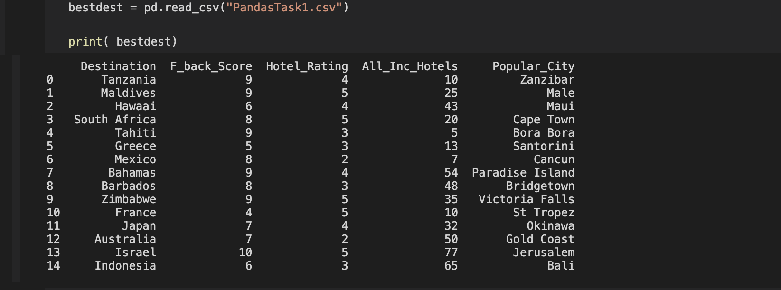
An overview of our Destinations Data

Slide 3

More on our Destinations Data
Our Data file has 15 rows and 5 columns as per below

Slide 4
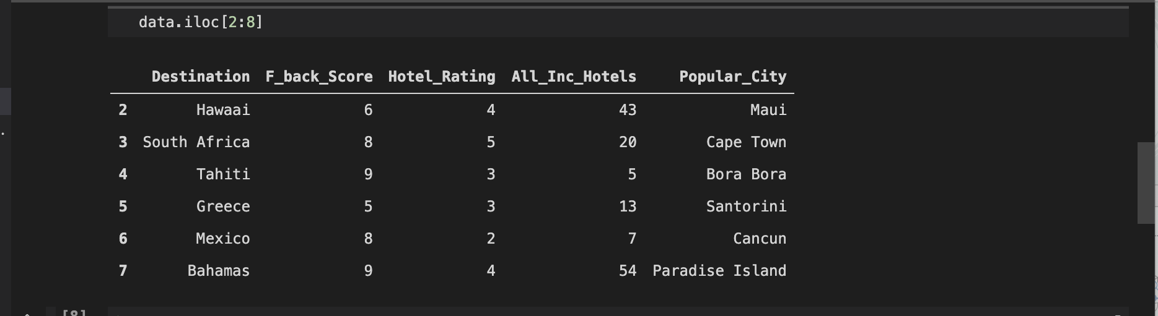
Here’s a snippet of rows 3-8

Slide 5
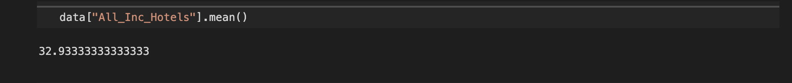
Mean number of all-inclusive hotels:

Slide 6
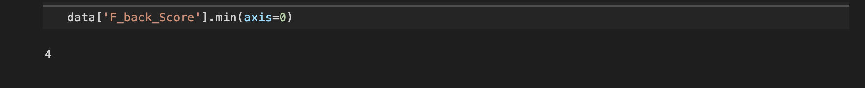
The Lowest Scoring Destination:

Slide 7
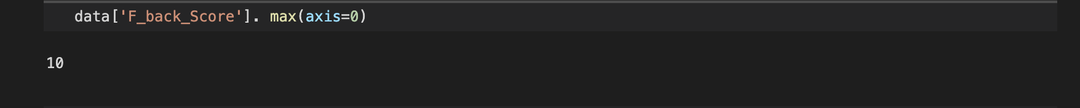
The Highest Scoring Destination:

Slide 8
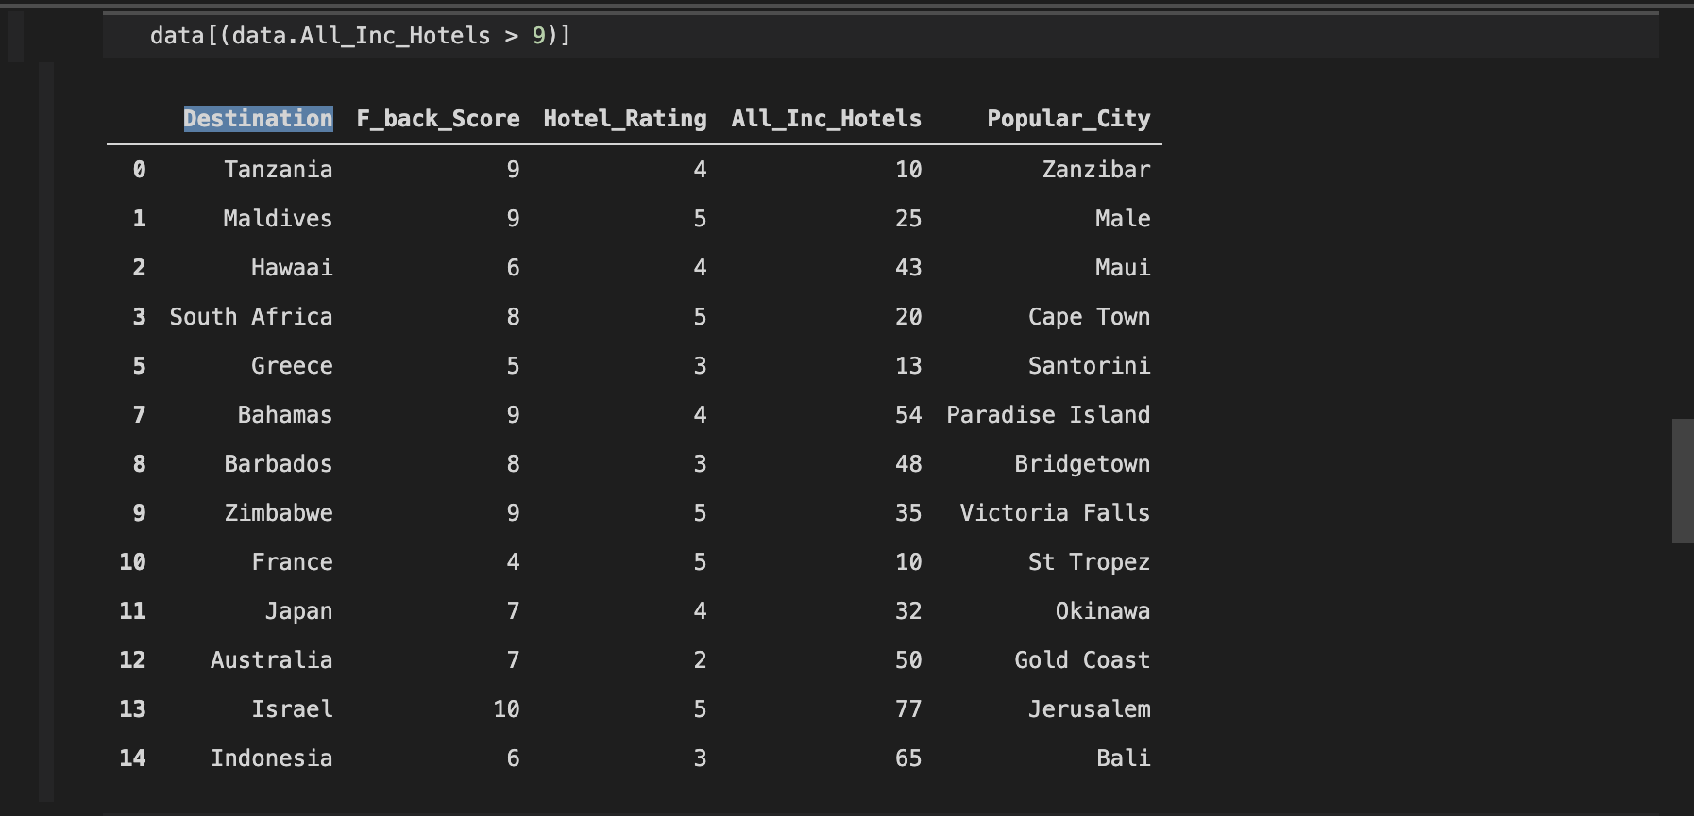
Destinations with more than 9 all inclusive hotels:

Slide 9
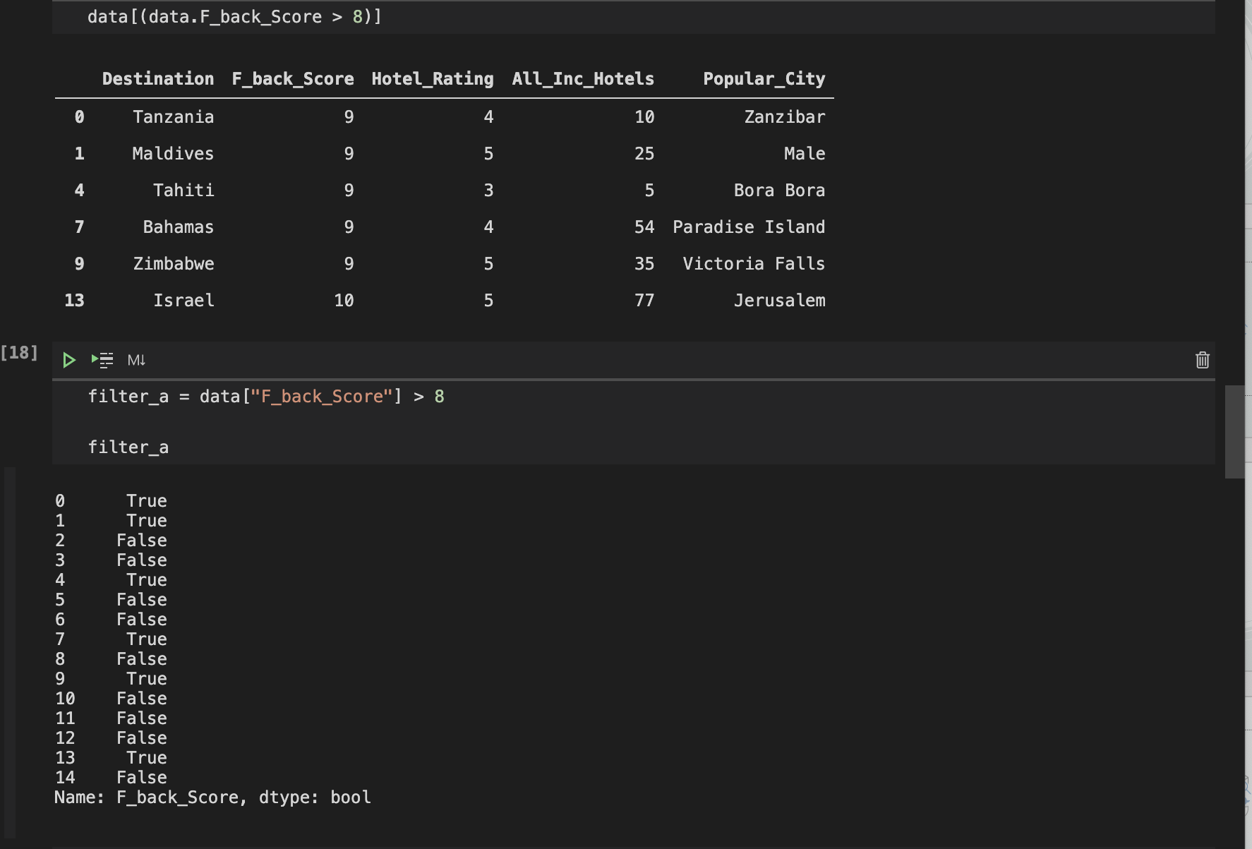
Destinations with a score above 8:

Slide 10
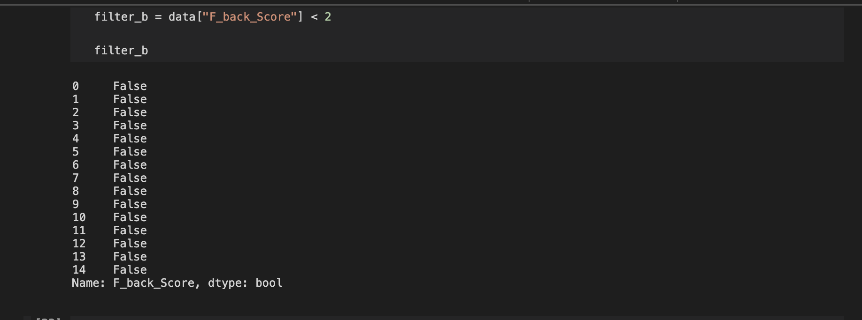
Destinations with scores below 2:
None of our recommended destinations has a score below 2

Slide 11
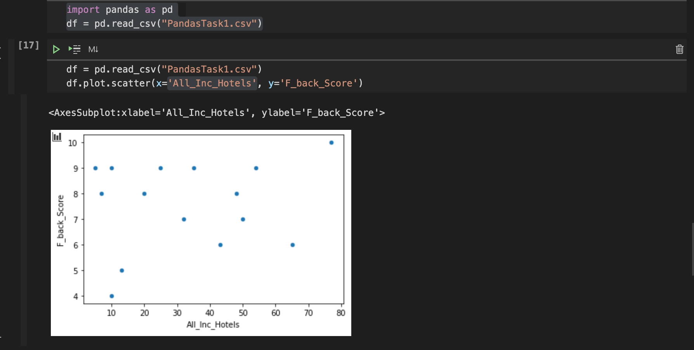
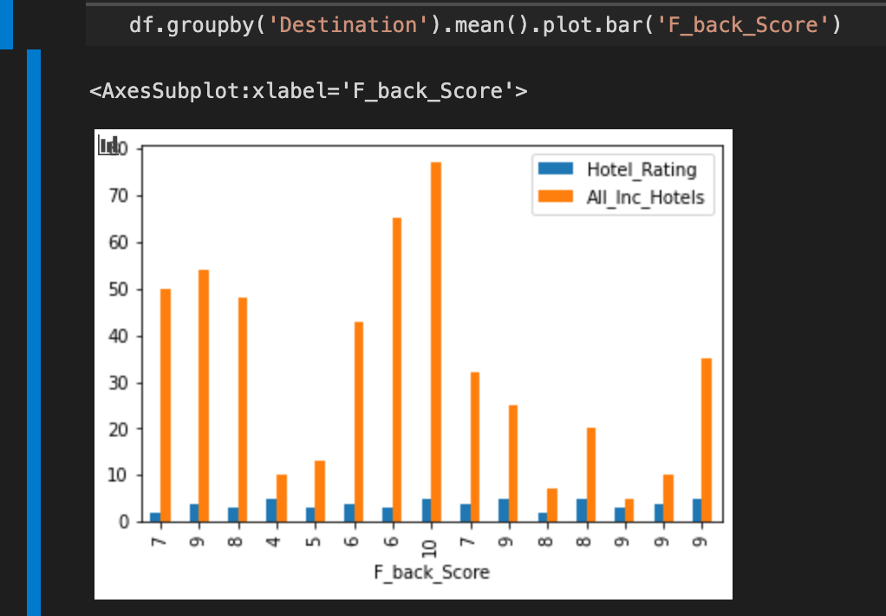
All-Inclusive Hotels vs Score Comparison

Slide 12
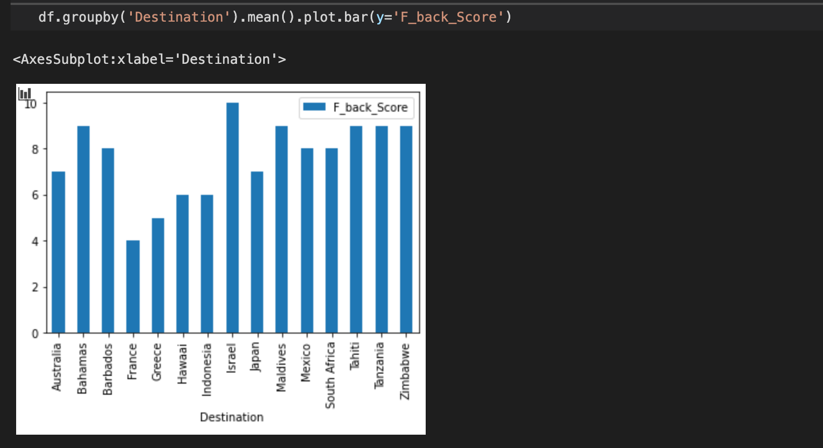
Destination Feedback Scores in a nutshell:

