Slide 1
Serverless Web Application Using Amazon Web Services
Notes:
Intro
Name
Research serverless architectures
Building app using AWS
Quick intro to AWS and serverless
Components of app
Finish with demo

Slide 2
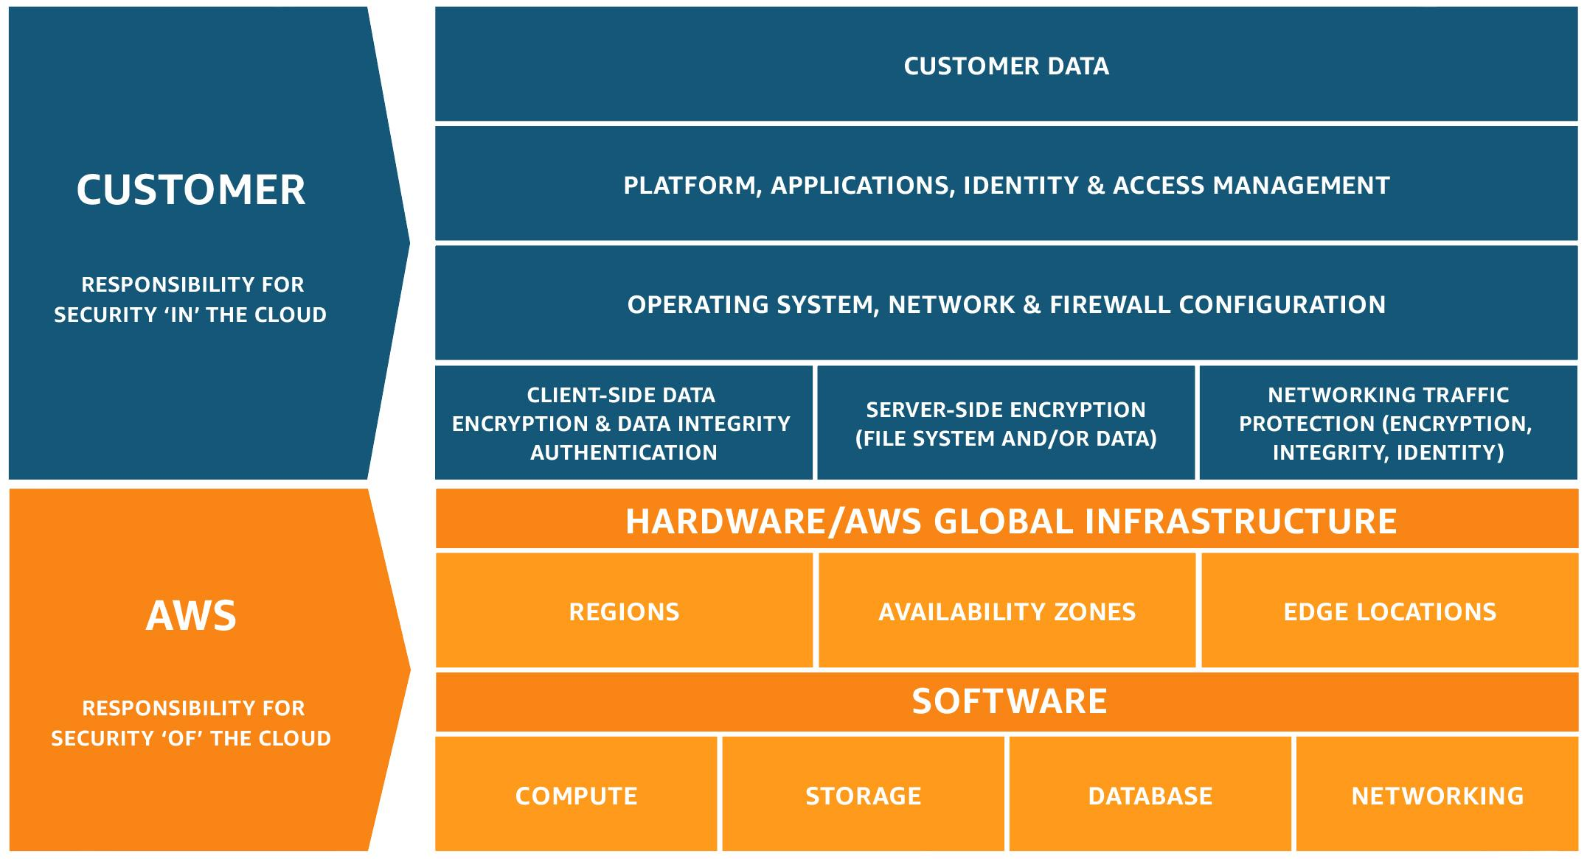
AWS and Serverless
Amazon Web Services (AWS)
Cloud computing services
Pro: Free tier, documentation
Con: UI
“Serverless”
Cloud provider manages →
Pro: Trend, scalable
Con: Difficult to migrate
Serverless Framework
Serverless Application Model (SAM)
Shared Responsibility Model - (AWS).
Notes:
AWS
Amazon Web Services
Wide range of using their infrastructure
Build anything
Free tier, with boundaries
Serverless
Model where the cloud provider manages servers
Servers still required, term serverless is a misnomer.
Cost, pay for what you use
Scalable, adjust capacity depending on needs
Infrequently used code:
greater response latency,
code is spun down when not in use,
at runtime it takes time to start up
Now look at application

Slide 3




Major components
API Gateway
Front door for client to backend services
Free: 1 million calls/month
Lambda
Code executed on demand
Free: 1 million requests/month
S3 (Simple Storage Service)
Object storage, store and retrieve
Free: 5 GB, 20k Get, 2k Put/month
ETS (Elastic Transcoder)
Converts media to other encodings
Free: 10 minutes of HD transcoding/month
Notes:
App is essentially a Youtube clone, user uploads a video
API gateway
Access backend services
Endpoints
Get URLS to send requests which handles
Endpoints are a combination of resources, paths, and HTTP methods
Lambda
Lets your run code on demand
No charge when not in use
Supports Java, Node.js, C#, and Python
Event sources
API Gateway
Schedule
S3
S3
The videos to be transcoded will be uploaded to an S3 bucket. S3 stands for Simple Storage Service.
ETS
Convert media files into other formats
Supports popular media formats
Easiest to go over
$2 over semester
Side note:
Select same region for each service
Charges for transferring between regions

Slide 4

AWS infrastructure & flow
1.Upload file
2.Trigger Lambda
3.Submit job
4.Save video
S3
Lambda
ETS
S3
5.Request video list
6.List of videos returned
API Gateway
Notes:
Application uploads file to S3 bucket using HTTP POST
S3 detects an object has been created
This S3 bucket has been configured to invoke a Lambda function when a file has been uploaded
The Lambda function prepares a job for the Elastic transcoder by specifying the input file and possible outputs
Transcode job is submitted to Elastic transcoder
Once the video is transcoded
It is saved to a separate S3 bucket
To retrieve the files that have been transcoded
App sends HTTP GET request to API Gateway
Gateway handles request
Lambda function is invoked
List of videos in S3 bucket is returned
API Gateway sends a response back

Slide 5
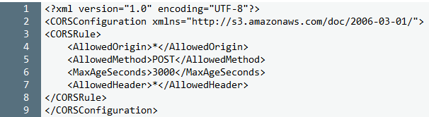
Uploading to S3
Request header:
POST /<BUCKET> HTTP/1.1
Host: s3.amazonaws.com
Form fields:
Required:
Key
File
Optional:
AWSAccessKeyID
acl
policy
Cross Origin Resource Sharing (CORS)
Connecting to Lambda:
Type of event
Specify Lambda
Event object
Notes:
An HTTP POST operation adds the file to the specified S3 bucket.
Header:
Name of the bucket, globally unique
Host
Requests do not need to be signed. They can be anonymous
Payload:
Key & File are required
There are some optional form fields as well
S3 CORS configuration doesn’t allow POST uploads
CORS
Allows app in one domain to interact with resources in different domain
Browser will send preflight request to determine if they have permission
XML
Allowed Origin: * enables all origins to send requests
Allowed method: POST
MaxAgeSeconds: time browser can cache response for preflight request
Allowed header: which headers are allowed in a preflight request
Connect to Lambda
Event property of S3
Type of event, ObjectCreated
Where to send, Lambda function
Specify Lambda, transcode-video function
Event object, JSON, includes:
Bucket name and ARN
Owner ID
key

Slide 6
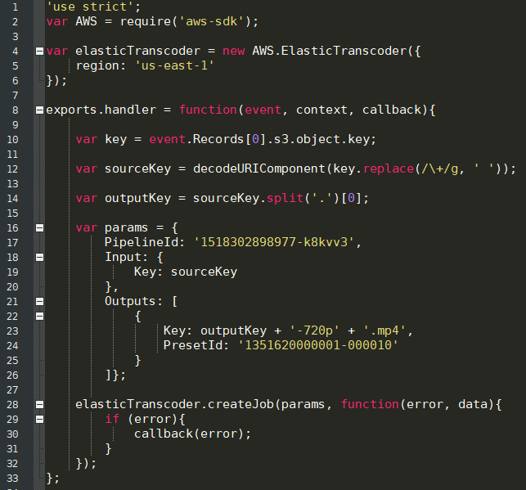
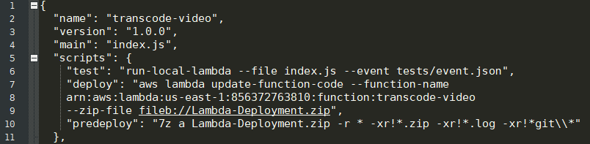

Lambda function
index.js
package.json
ARN of Lambda
Permissions:
Get objects from S3
Submit jobs to ETS
Identity Access Management (IAM) Role
Elastic Transcoder ID
Notes:
Lambda invoked when object created in S3
Submits jobs to ETS
Index.js
Line 8:
Function handler invoked by Lambda at runtime
Event, Pass event data
Context, while running we can get info about
Time remaining before timeout
CloudWatch logs
Line 10: Key identifies the object in the bucket, it is the original file name.
Line 12: S3 key names are URL-encoded. Decodes and replaces + with spaces to get original name.
Line 14: Removes the extension of the original key
Line 17: This is the pipeline ID for the Elastic Transcoder. It is available after it has been created in AWS
Line 21: System presets are used to specify the output of the Elastic transcoder. The premade presets are available in the AWS docs.
Line 30: If the Elastic transcoder fails, it writes an error to CloudWatch via the callback function
Deploying to AWS
Package.json in same directory, predeploy and deploy scripts
Predeploy creates zip file
Deploy sends zip file to AWS
Two main params, ARN of Lambda, and name of zip
ARN is unique ID when Lambda is made
Permissions
To get objects from S3
Submit jobs to ETS
IAM Role, a way to grant permissions
If service needs same permissions, give role
ETS

Slide 7
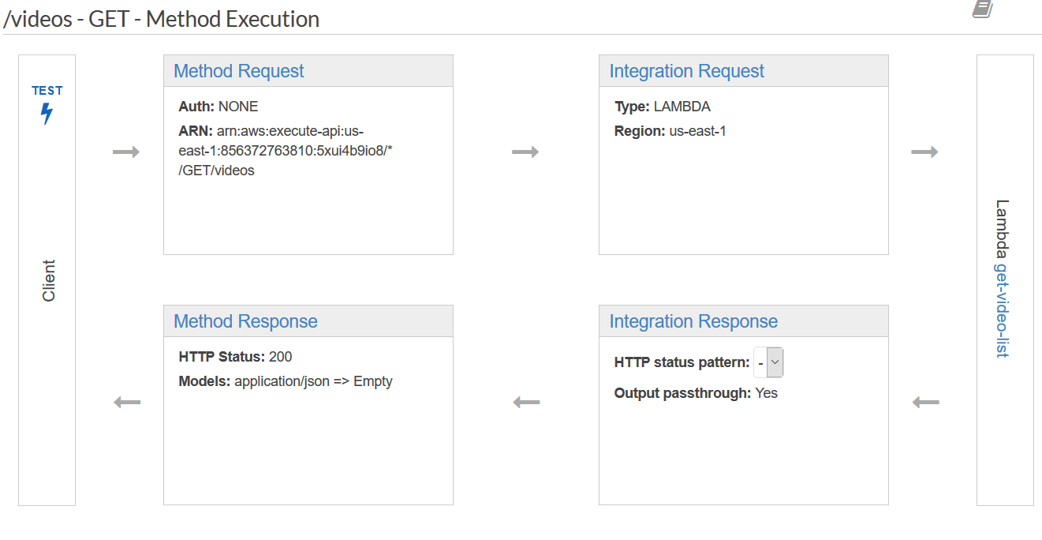
API Gateway
Authorization
Validator
Query String Parameters
Headers
Body
Type:
Lambda, HTTP, AWS, VPC
Region: us-east-1
Timeout
Map data
Like method request
Define headers and body
Shape of response
200 OK
Header
Body
Lambda result
Notes:
API Gateway, interface between backend and application
Endpoint, resource (path) &method (type), HTTPS only
Path is appended to general URL of API.
Client sends request, request must be signed
Sign with AWS access key
Method execution
Flow of data in API.
Method Request, how requests should look like, the gatekeeper
Defines header and body
Authorization
Validation
Query string parameters
Integration request
Integration type
HTTP endpoint existing
AWS Service
Lambda function
Lambda function to invoke
Region
Pass HTTP request data to lambda
Integration response
Defines how data is mapped into a format expected by the caller of the API
Returning result from Lambda function
JSON
Method response
Defines public interface that includes headers and body of the request
CORS header

Slide 8
Demonstration

Slide 9
Q & A
Notes:
Q: Why can’t you invoke Lambda directly? Why use an API Gateway?
A: There are two ways of invoking Lambda functions. One is to use the SDK, the other is to go through the API Gateway. If I use the SDK approach then the user would need to download a portion of the AWS SDK. The API Gateway also makes it harder for a stranger to abuse the system. However, I have it configured so only my user account has permissions.
S3 policy
Signature,

Slide 10
Sources
API Gateways on AWS | Manning. (n.d.). Retrieved April 12, 2018, from http://freecontent.manning.com/api-gateways-on-aws/
AWS Simple Icons. (n.d.). Retrieved April 11, 2018, from https://aws.amazon.com/architecture/icons/
Cross-Origin Resource Sharing (CORS). (n.d.). Retrieved April 13, 2018, from https://docs.aws.amazon.com/AmazonS3/latest/dev/cors.html
POST Object. (n.d.). Retrieved April 13, 2018, from https://docs.aws.amazon.com/AmazonS3/latest/API/RESTObjectPOST.html
Shared Responsibility Model - Amazon Web Services (AWS). (n.d.). Retrieved April 14, 2018, from https://aws.amazon.com/compliance/shared-responsibility-model/
What Is IAM? (n.d.). Retrieved April 13, 2018, from https://docs.aws.amazon.com/IAM/latest/UserGuide/introduction.html

