Slide 1
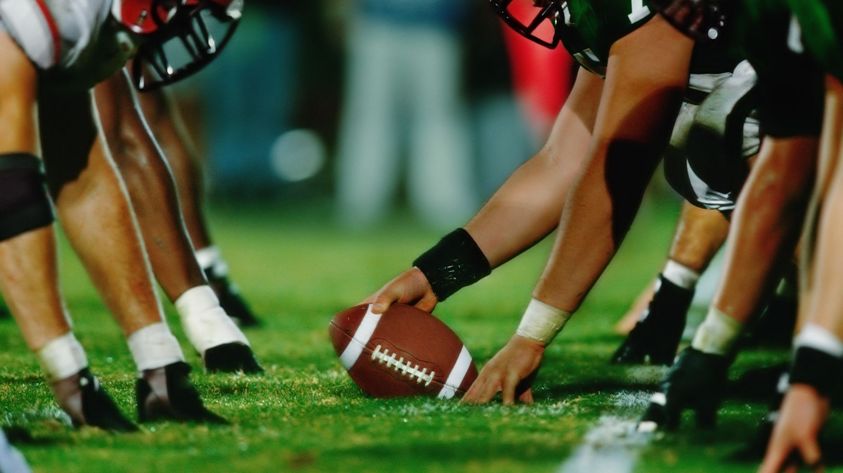
NFL Concussions Data 2012-16
By: Patrick Connell, Skylar Furey, and Zack Licursi
Notes:
Patrick

Slide 2

Overview
We are looking at how concussions impact players playtime after their injury
We are also interested in seeing if there is a clear difference for different teams and positions
Notes:
Patrick

Slide 3
Background
2016 NFL Concussion Protocol Update
Before update players would play through injuries
Notes:
Patrick

Slide 4
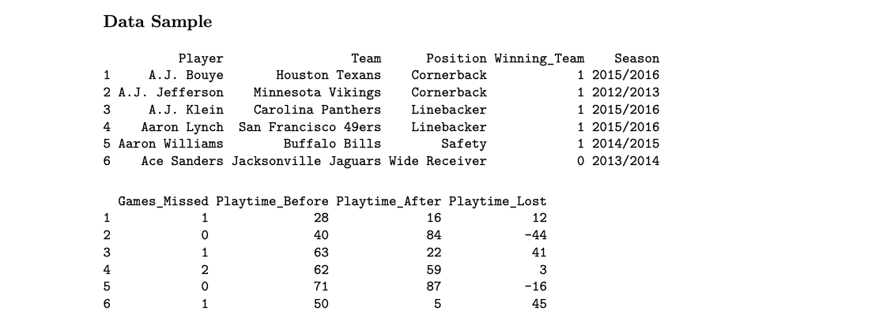
Data Preview
Notes:
Me

Slide 5
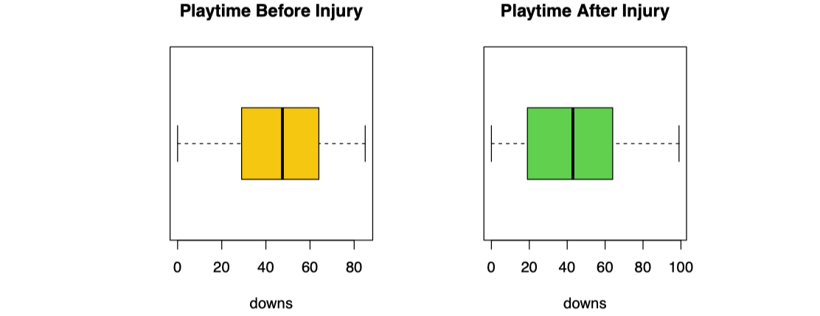
Playtime Before vs After Injury
Notes:
Zack

Slide 6
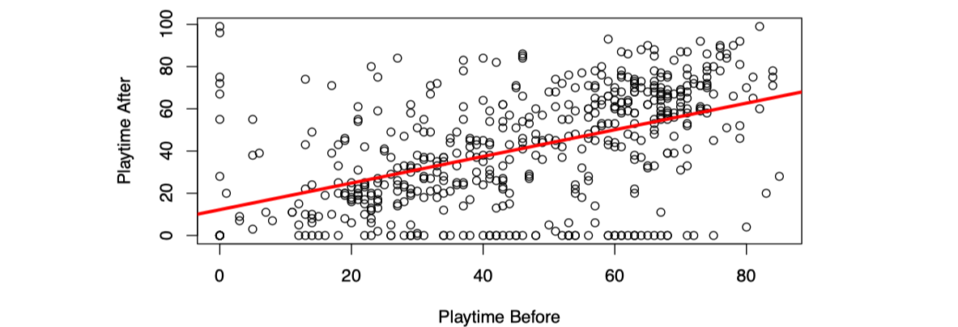
Playtime Before vs After Injury Cont.
Notes:
Me

Slide 7
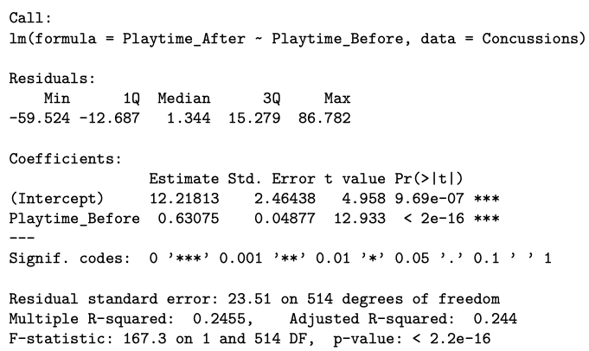
Simple Regression Model
Notes:
Patrick

Slide 8
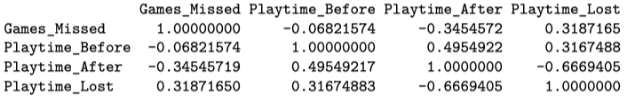
Correlation
Notes:
Zack

Slide 9
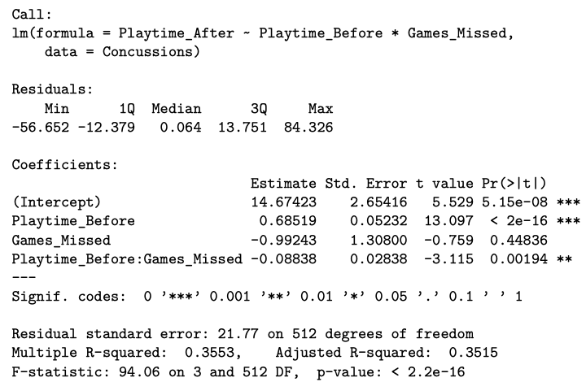
Interaction Terms
Notes:
Patrick

Slide 10
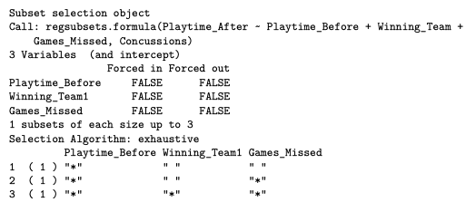
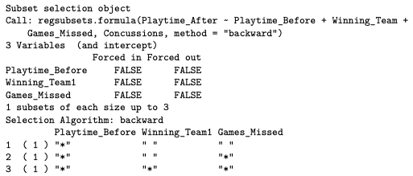

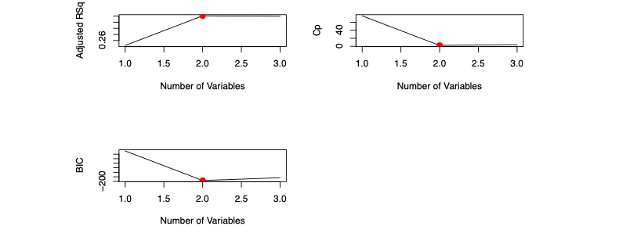
Variable Selection
Notes:
Me

Slide 11
Conclusion
Best regression model for playtime after based on playtime before and games missed
Interested to see which categorical variables have biggest impact on playtime after
Notes:
Zack

