Slide 1
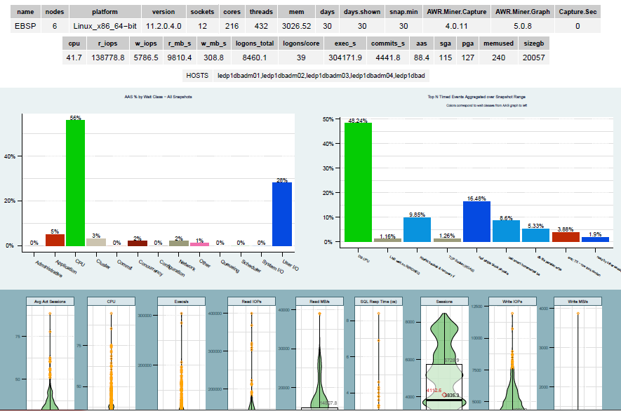
AWRMiner Metrics Explained
AWR Miner Metric | Description | Example: Exadata X5 - Xeon® E5-2699 v3
Name | Database Name | EBSP
Nodes | Number of RAC instances for this DB | 6 Hosts (3/4 Rack) X5
Platform | Operation System
Version | Oracle Database Version
Sockets | CPU sockets per host | X5 has 2 Sockets/host * 6 hosts = 12 Sockets
Cores | CPU cores per host | X5 has 18 cores per Socket (2 sockets * 18 cores) * 6 hosts = 216 cores
Threads | Total threads per host (equates to CPUs seen by OS) | X5 has 2 threads per core 216 cores * 2 threads = 432 Threads
Mem | Total physical memory for all hosts in GB | Physical mem per host is 504.42 * 6 hosts = 3026.52 GB
Days | How many days they AWR report reflects
Days Shown | Same as Days
Snap Min | Number of mins between snapshots
Capture Sec

Slide 2
AWRMiner Metrics Explained (Cont…)
AWR Miner Metric | Description | Example: Exadata X5 - Xeon® E5-2699 v3
CPU | This metric represents the highest of the average cpu% across all hosts.
r_iops | Represents the max of the average read iops across all hosts
w_iops | Represents the max of the average write iops across all hosts
r_mb_s
w_mb_s
logons_total
logons/core
exec_s
commits_s
aas
sga | SGA size in GB used across all hosts
pga | PGA size in GB used across all hosts
memused | The total physical memory in GB used across all hosts
sizegb | Total database size GB on disk

