Slide 1
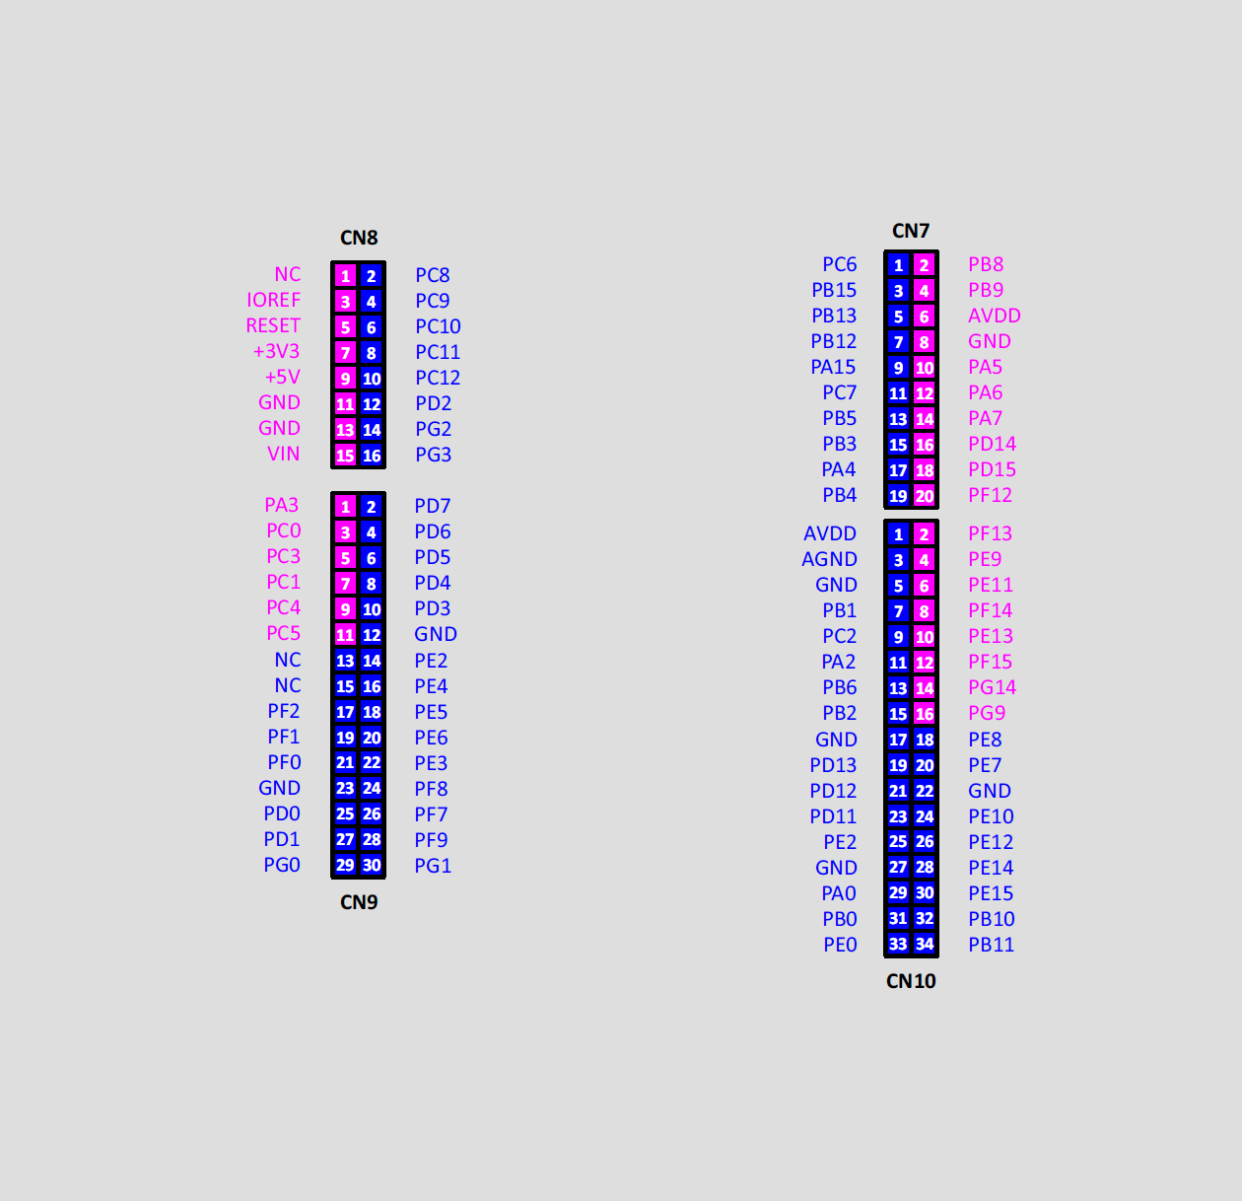
ADC [ch5]
GPIO [out 2]
ADC [ch6]
ADC [ch7]
DAC
ADC [ch3]
GPIO [out 7]
ADC [ch10]
GPIO [out 6]
ADC [ch13]
GPIO [out 5]
ADC [trig. out]
ADC [ch11]
GPIO [out 4]
ADC [ch14]
GPIO [out 3]
ADC [ch9]
ADC [ch15]
ADC [ch12]
ADC [ch2]
GPIO [in 3]
GPIO [out 0]
GPIO [out 1]
GPIO [in 2]
ADC [ch0]
GPIO [in 0]

