Slide 1
Experiments
Experimenter: Shaofeng Wu
Mentor: Jingyu Lin
College of electrical engineering, Guangxi University

Slide 2

1. Algorithms and programs used in comparative experiments
1. ICP1992: “A method for registration of 3-D shapes”
Program: Registration_of_ 2D_LIDAR_Data\01_ICP\IcpAlgorithm.m（Matlab）
2. TrICP2002: “The Trimmed Iterative Closest Point Algorithm”
Program: Registration_of_ 2D_LIDAR_Data\02_TrICP\TrIcpAlgorithm.m （Matlab）
3. PSM2005: “Laser scan matching in polar coordinates with application”
Program: Registration_of_ 2D_LIDAR_Data\06_PSM\02_PSM_SourceCode\test\example.cpp （C++）
4. SICP2013: “Sparse Iterative Closest Point”
Program: Registration_of_ 2D_LIDAR_Data\03_SICP_IterativeReweighting\SicpAlgorithm.m （Matlab）
5. Holy2018: “Registration of Lines in 2D LIDAR Scans via Functions of Angles”
Program: Registration_of_ 2D_LIDAR_Data\04_Holy2018-adam\Holy2018Algorithm.m （Matlab）
6. MyMethod
Program: Registration_of_ 2D_LIDAR_Data\05_MyMethod\MyAlgorithm.m （Matlab）

Slide 3
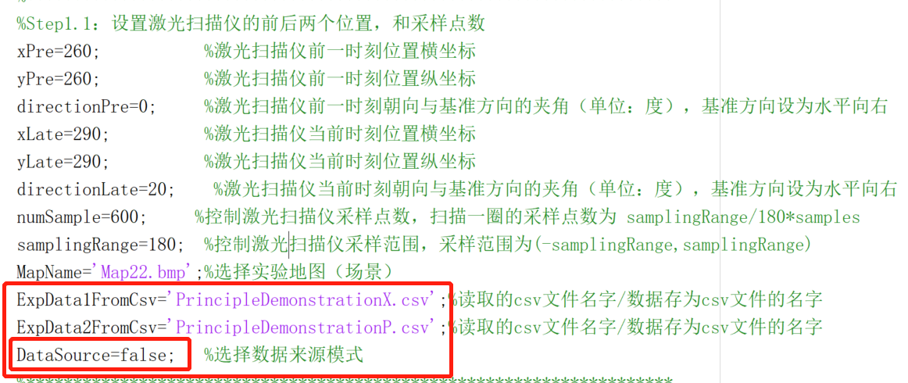
2. Demonstration of our algorithm principle
sampling range:-180~+180 (No Gaussian noise)

Slide 4
2. Demonstration of our algorithm principle
sampling range:-180~+180 (No Gaussian noise)

Slide 5
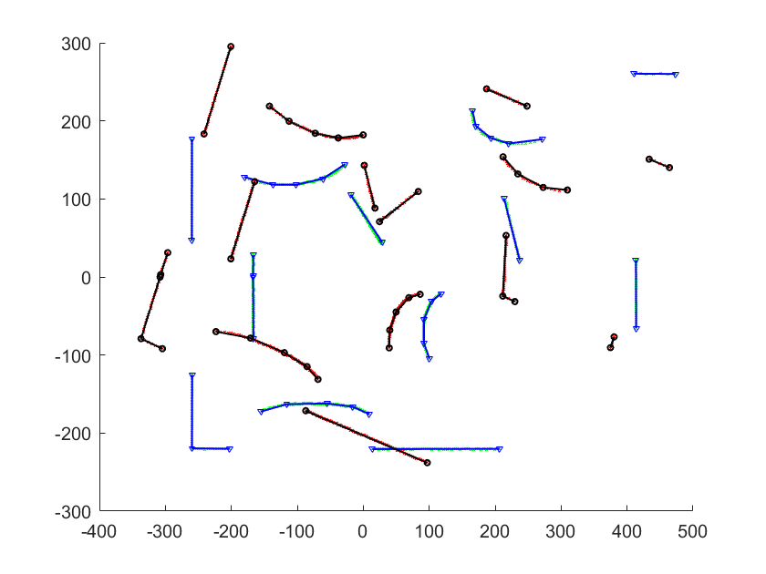
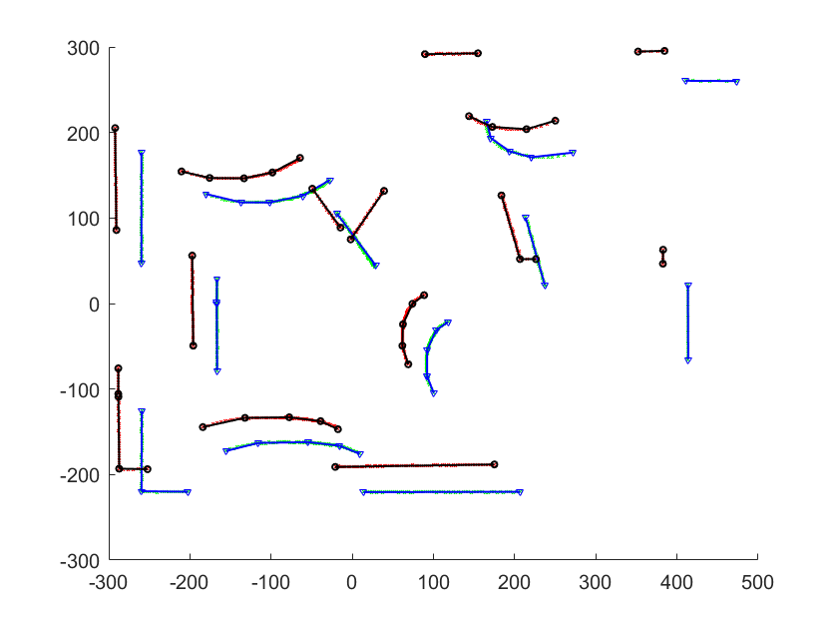
2. Demonstration of our algorithm principle
sampling range:-180~+180 (No Gaussian noise)

Slide 6
2. Demonstration of our algorithm principle
sampling range:-180~+180 (No Gaussian noise)

Slide 7
2. Demonstration of our algorithm principle
sampling range:-180~+180 (No Gaussian noise)

Slide 8
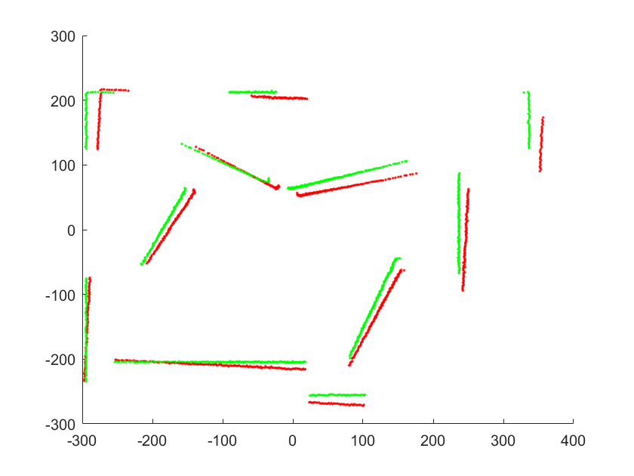
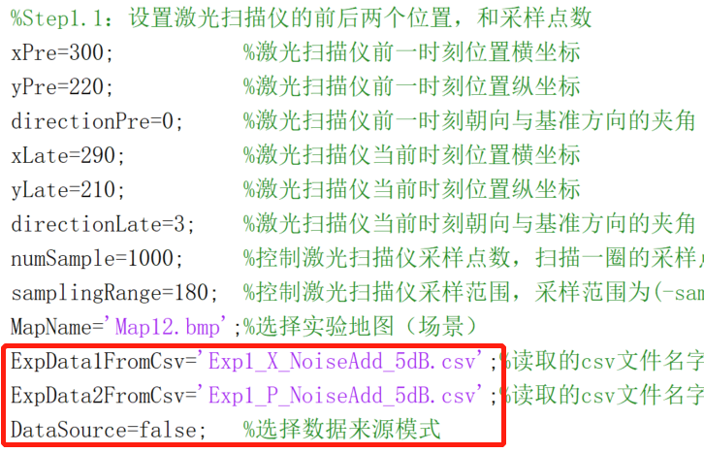
3.1 Contrast experiment based on point feature: small motion
sampling range:-180~+180 (add 5dB Gaussian noise)

Slide 9
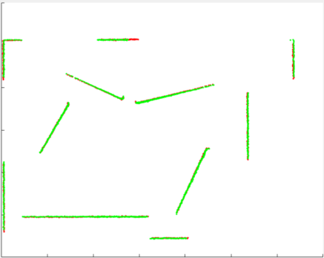
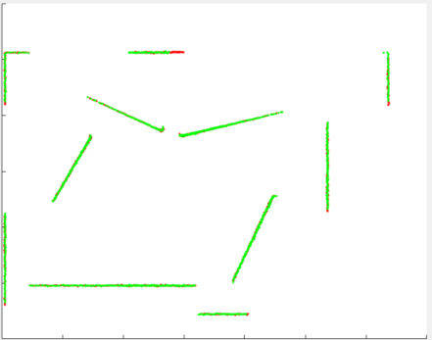
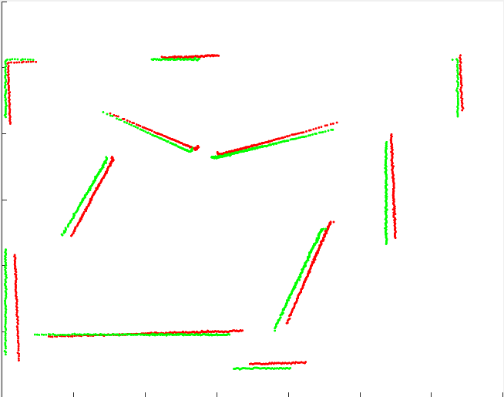
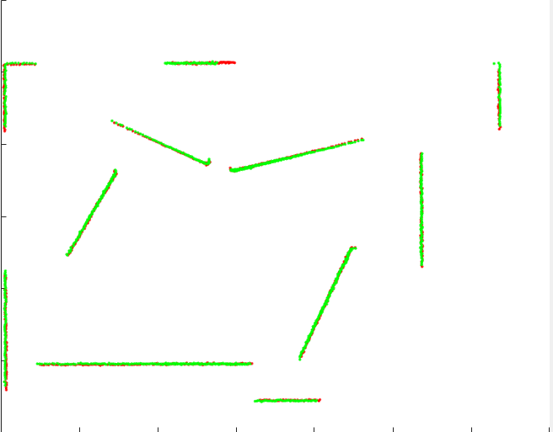
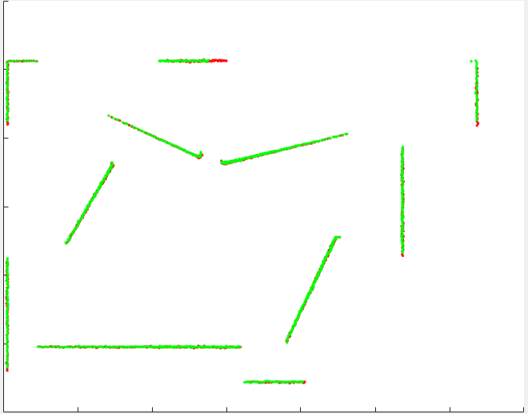
3.1 Contrast experiment based on point feature: small motion
ICP
TrICP
PSM
SICP
MyMethod
真实值 | θ=3 | 真实值 | θ=3 | 真实值 | θ=3 | 真实值 | θ=3 | 真实值 | θ=3
 | T= [-10,10] |  | T= [-10,10] |  | T= [-10,10] |  | T= [-10,10] |  | T= [-10,10]
实验值 | θ=3.3063 | 实验值 | θ=3.0069 | 实验值 | θ=4.9513 | 实验值 | θ=3.3697 | 实验值 | θ=2.9712
 | T=[ -10.2346, 10.6858] MSE=1.1440 MSE1=1.1375 |  | T=[ -9.6947,10.3881] MSE=1.0030 MSE1=0.9980 |  | T=[0.0300, 15.0029] MSE=6.9767 MSE1=6.9009 |  | T=[-9.7349,10.4288] MSE=1.1392 MSE1=1.1334 |  | T= [-9.7959;9.6398] MSE=1.0637 MSE1=1.0611

Slide 10
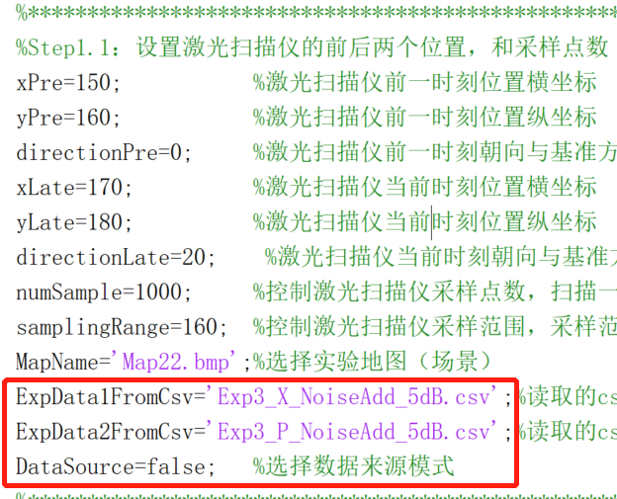
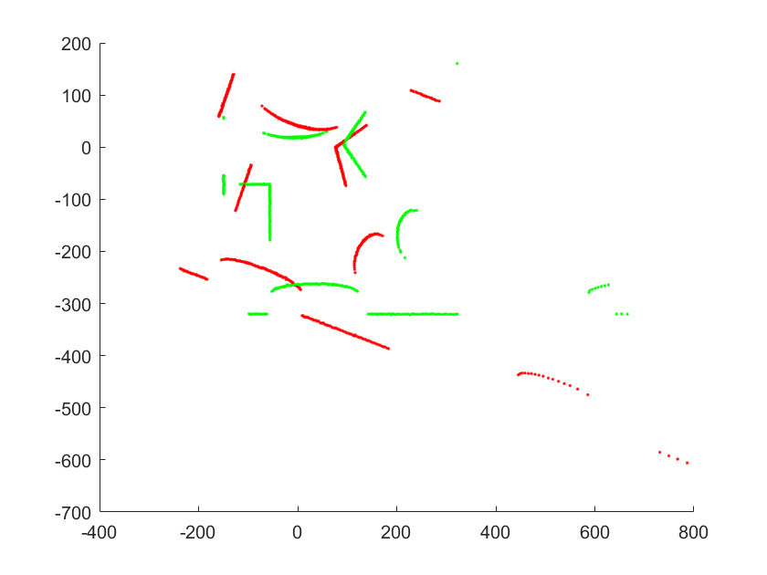
3.2 Contrast experiment based on point feature: medium motion
sampling range:-160~+160 (add 5dB Gaussian noise)

Slide 11
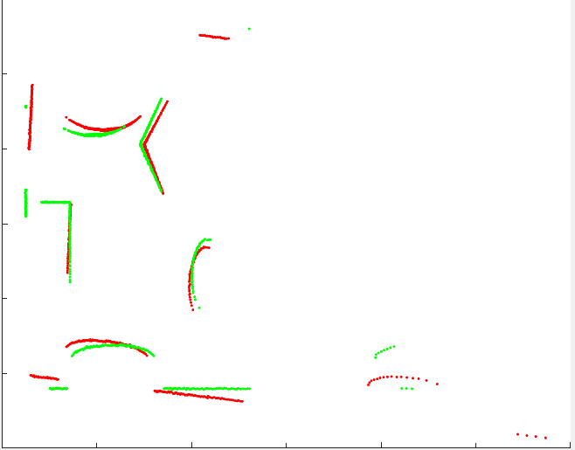
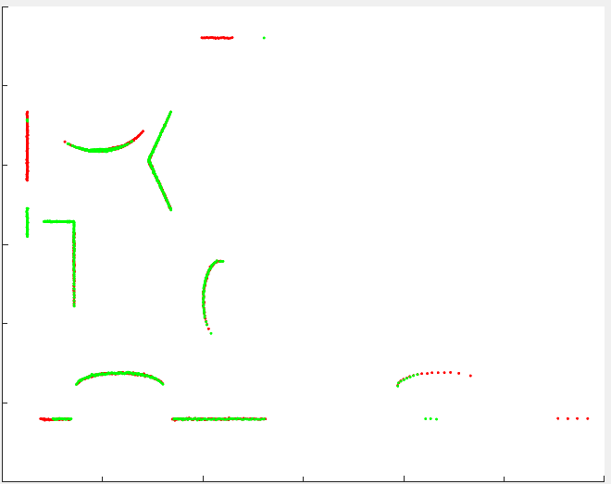
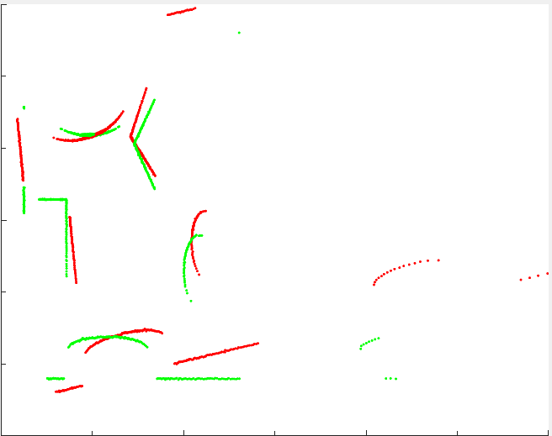
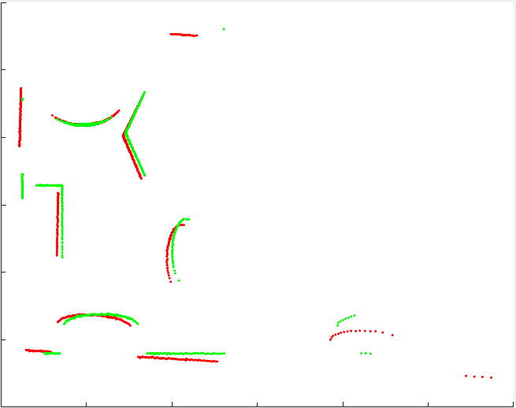
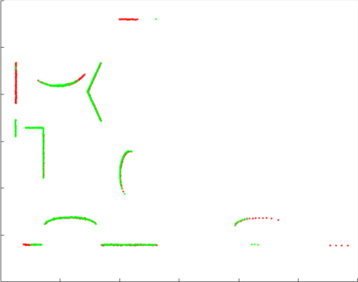
3.2 Contrast experiment based on point feature: medium motion
ICP
TrICP
PSM
SICP
MyMethod
真实值 | θ=20 | 真实值 | θ=20 | 真实值 | θ=20 | 真实值 | θ=20 | 真实值 | θ=20
 | T= [20,-20] |  | T= [20,-20] |  | T= [20,-20] |  | T= [20,-20] |  | T= [20,-20]
实验值 | θ=15.6204 | 实验值 | θ=20.0308 | 实验值 | θ=28.6800 | 实验值 | θ=17.8556 | 实验值 | θ=19.8845
 | T= [25.6342, -15.3828 ] MSE=12.0347 MSE1=11.6087 |  | T= [15.5083, -23.6705] MSE=7.7733 MSE1=7.6807 |  | T=[16.8803,-20.3247] MSE=23.1434 MSE1=19.4191 |  | T= [10.1494,-22.1969] MSE=11.2193 MSE1=10.7960 |  | T= [21.1075, -20.2802] MSE=7.8652 MSE1=7.7568

Slide 12
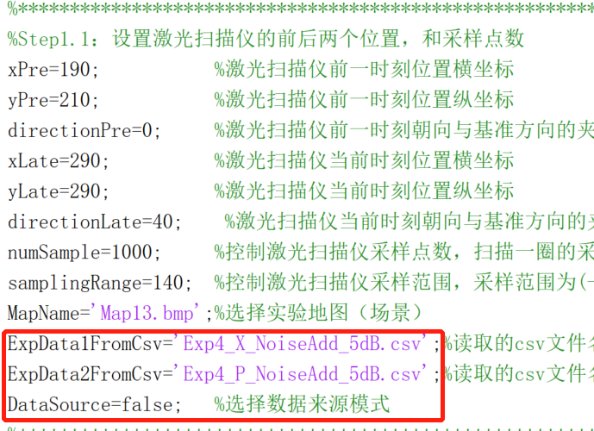
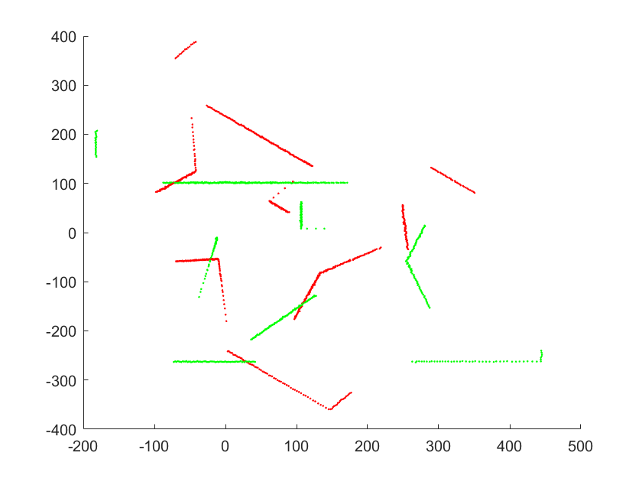
3.3 Contrast experiment based on point feature: large motion
sampling range:-140~+140 (add 5dB Gaussian noise)

Slide 13
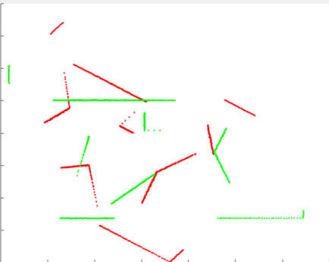
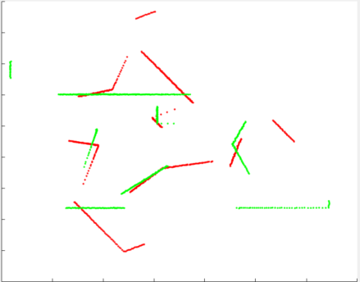
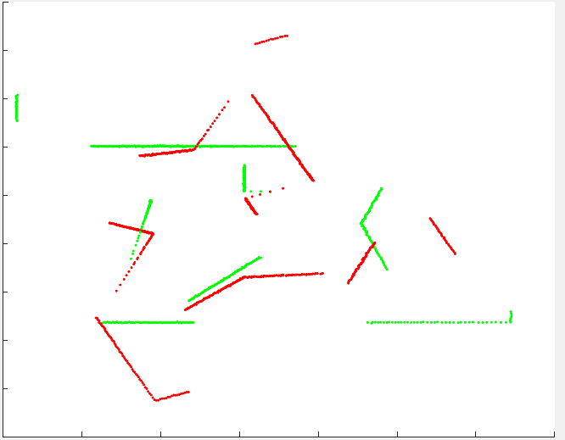
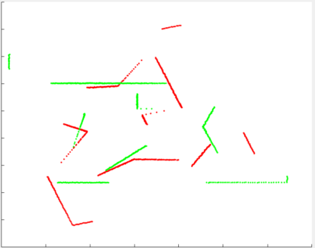
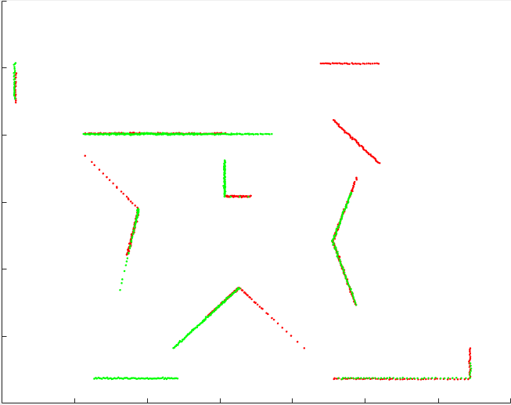
3.3 Contrast experiment based on point feature: large motion
ICP
TrICP
PSM
SICP
MyMethod
真实值 | θ=40 | 真实值 | θ=40 | 真实值 | θ=40 | 真实值 | θ=40 | 真实值 | θ=40
 | T= [100,-80] |  | T= [100,-80] |  | T= [100,-80] |  | T= [100,-80] |  | T= [100,-80]
实验值 | θ=2.9666 | 实验值 | θ=-18.6891 | 实验值 | θ=--26.6738 | 实验值 | θ=-32.5221 | 实验值 | θ=39.6623
 | T= [-5.7047, -44.6992] MSE1=43.4074 MSE=43.1136 |  | T= [21.0076, -10.4911] MSE=33.4350 MSE1=33.3143 |  | T=[24.0180, -35.7921] MSE=38.7239 MSE1=38.1414 |  | T= [44.6342,-25.3775] MSE=40.2091 MSE1=39.3166 |  | T= [100.0009, -79.7839] MSE=15.5032 MSE1=15.4944

Slide 14
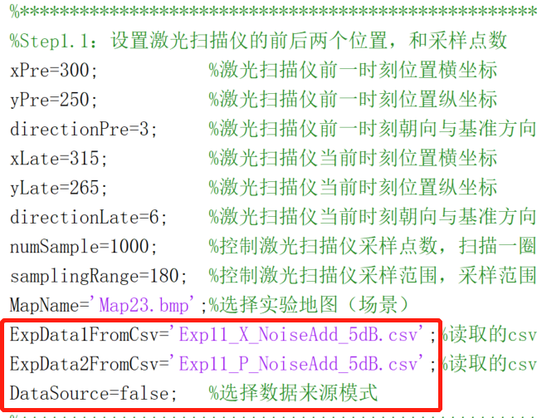
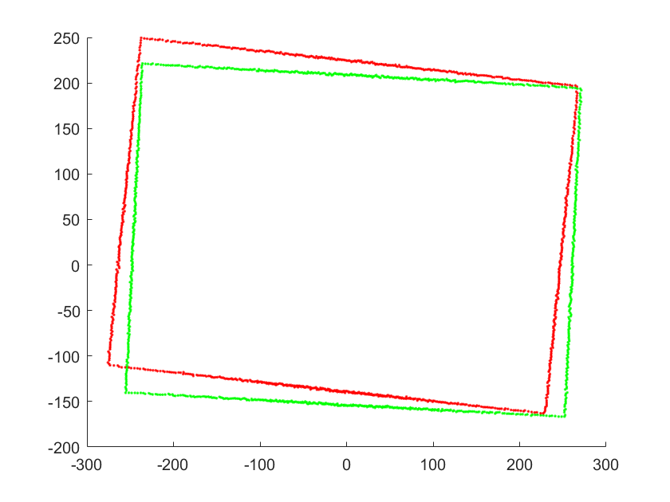
4.1 Contrast experiment based on line feature: simple environment
small motion
sampling range:-180~+180 (add 5dB Gaussian noise)

Slide 15
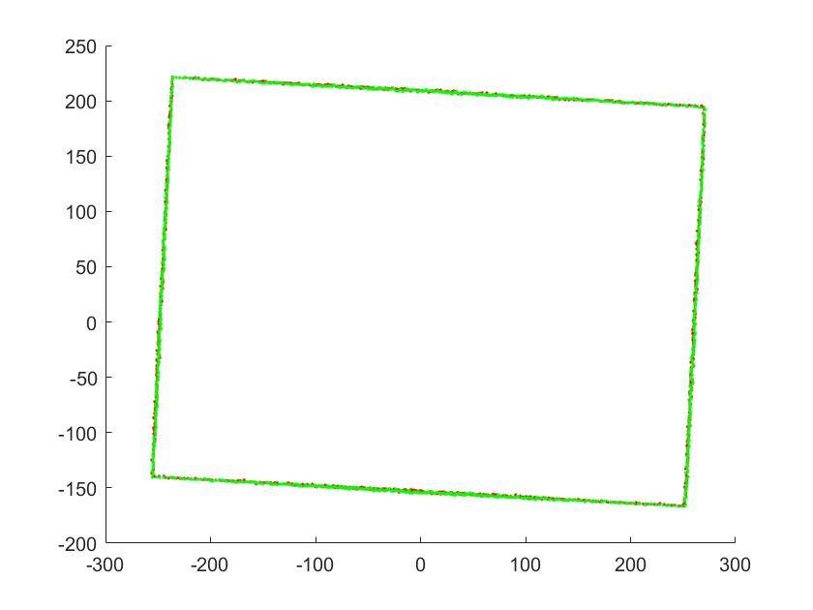
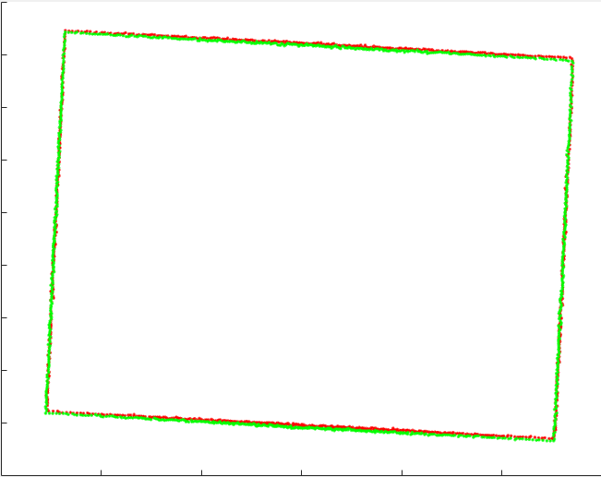
4.1 Contrast experiment based on line feature: simple environment
Holy2018 converges after about 400 iterations, and the result is the value of 500 iterations
真实值 | θ=3
 | T= [15,-15]
实验值 | θ=2.9967
 | T= [13.9895,-15.3759] MSE=0.8627 MSE1=0.8591
真实值 | θ=3
 | T= [15,-15]
实验值 | θ=3.0655
 | T= [14.6741,-13.8144] MSE=1.4847 MSE1=1.4837

Slide 16
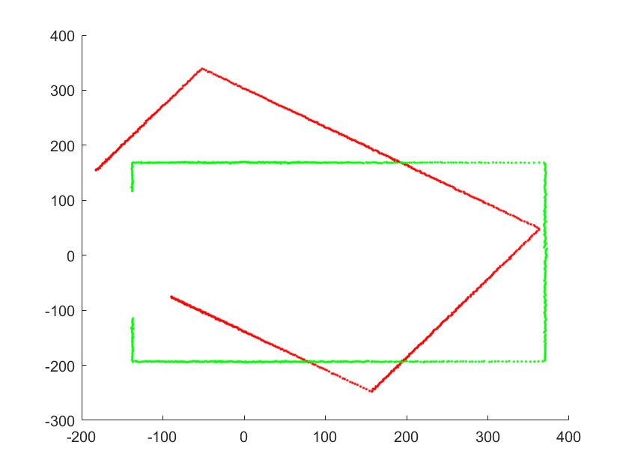
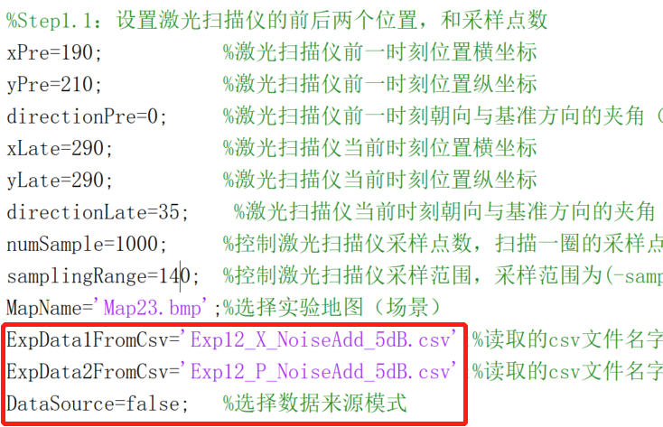
4.2 Contrast experiment based on line feature: simple environment
large motion
sampling range:-140~+140 (add 5dB Gaussian noise)

Slide 17
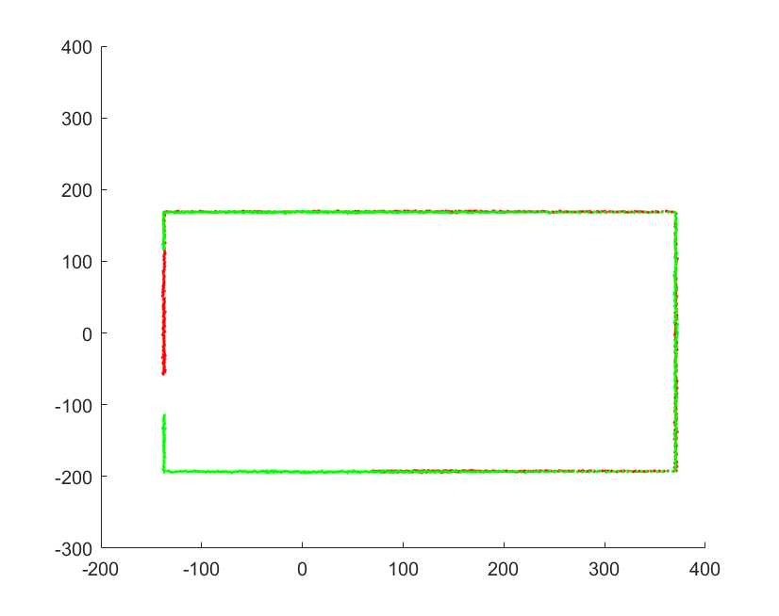
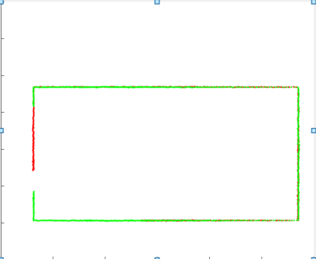
4.2 Contrast experiment based on line feature: simple environment
Holy2018 converges after about 2000 iterations, and the result is the value of 2100 iterations
真实值 | θ=35
 | T= [100,-80]
实验值 | θ=34.9919
 | T= [100.0986, -79.3386 ] MSE=9.6643 MSE1=9.6649
真实值 | θ=35
 | T= [100,-80]
实验值 | θ=34.9335
 | T= [99.5925,-79.6011] MSE=9.6108 MSE1=9.6106

Slide 18
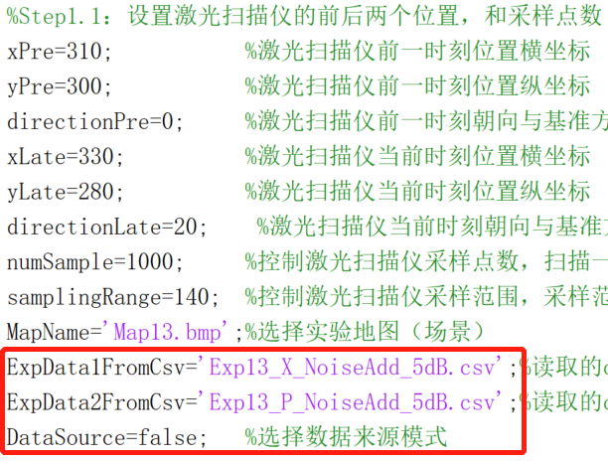
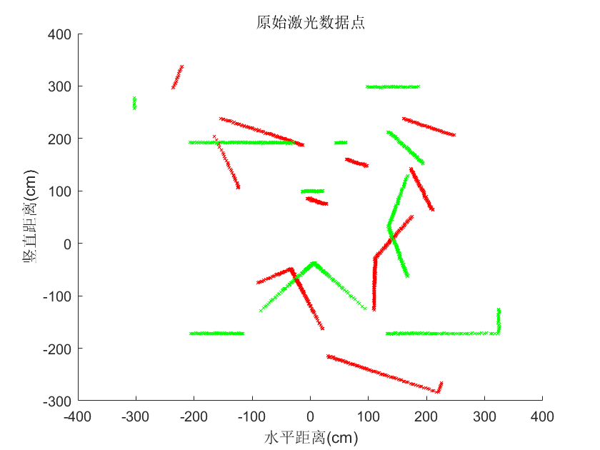
4.3 Contrast experiment based on line feature: complex environment
medium motion
sampling range:-140~+140 (add 5dB Gaussian noise)

Slide 19
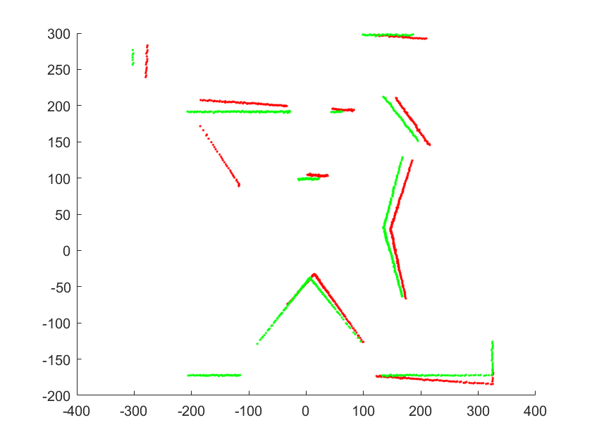
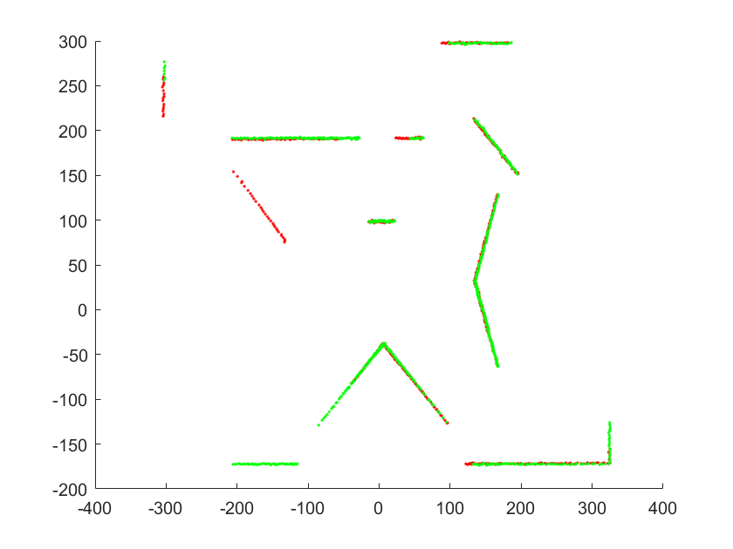
4.3 Contrast experiment based on line feature: complex environment
Holy2018 converges after about 700 iterations, and the result is the value of 2500 iterations
真实值 | θ=20
 | T= [20,20]
实验值 | θ=16.8175
 | T= [31.4357,24.2395] MSE=11.0157 MSE1=10.8630
真实值 | θ=20
 | T= [20,20]
实验值 | θ=20.2215
 | T= [19.3807,19.7836] MSE=4.8902 MSE1=4.8862

Slide 20
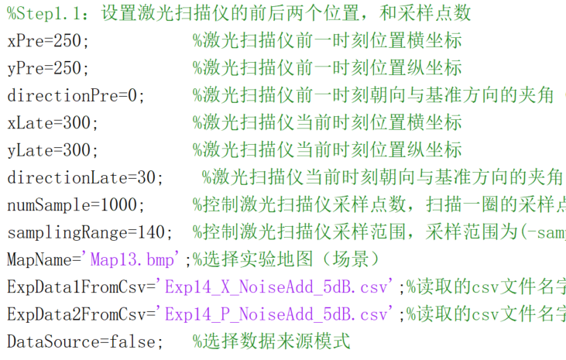
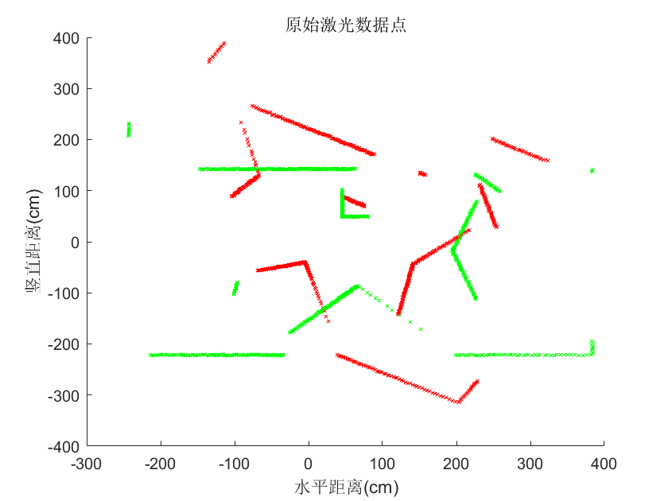
4.4 Contrast experiment based on line feature: complex environment
large motion
sampling range:-140~+140 (add 5dB Gaussian noise)

Slide 21
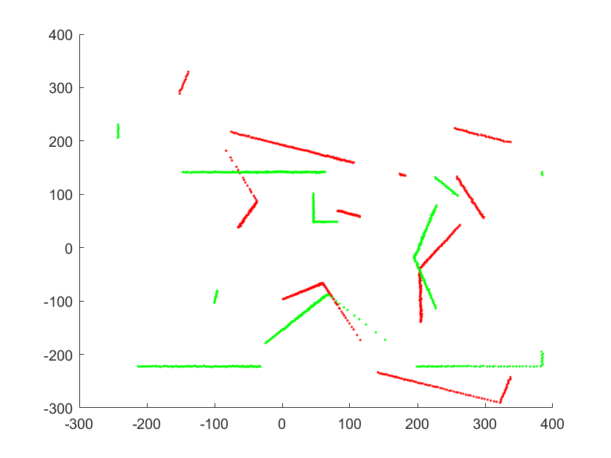
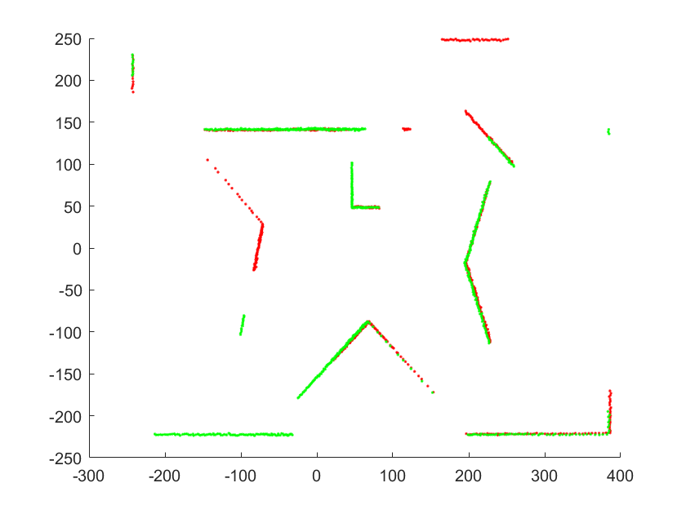
4.4 Contrast experiment based on line feature: complex environment
Holy2018 converges after about 1700 iterations, and the result is the value of 2500 iterations
真实值 | θ=30
 | T= [50,-50]
实验值 | θ=12.4217
 | T= [55.3863,-25.7186] MSE=39.3127 MSE1=28.2052
真实值 | θ=30
 | T= [50,-50]
实验值 | θ=30.2325
 | T= [51.2185,-50.0804] MSE=16.7208 MSE1=16.7180

Slide 22

