Slide 1
Understanding and Detecting Real-World Performance Bugs
Guoliang Jin, Linhai Song, Xiaoming Shi,
Joel Scherpelz and Shan Lu
University of Wisconsin–Madison

Slide 2

Software Efficiency is Critical
No one wants slow and inefficient software
Frustrate end users
Cause economic loss
Software efficiency is increasing important
Hardware is not getting faster (per-core)
Software is getting more complex
Energy saving is getting more urgent
Still Not Finished?

Slide 3

Performance Bugs
Implementation mistakes causing inefficiency
An example
many open tabs
Bookmark All Tabs…

Slide 4
Performance Bugs
Implementation mistakes causing inefficiency
An example
number of tabs
Buggy Code Snippet:
for (i = 0; i < tabs.length; i++) {
… tabs[i].doTransact();
}
Bookmark one URL

Slide 5
Performance Bugs
Implementation mistakes causing inefficiency
An example
Buggy Code Snippet:
Patch
for (i = 0; i < tabs.length; i++) {
… tabs[i].doTransact();
}
+ doAggregateTransact(tabs);

Slide 6

Need to Fight Performance Bugs
Performance bugs are severe
Escaping compiler optimization
Large speed up after fixing small code regions
E.g. “hang disappear” after fixing in the last bug
Performance bugs are common
5 to 50 Mozilla perf bugs are fixed each month

Slide 7




How to fight Performance Bugs
Bug
Detection
Bug
Avoidance
Bug Fixing
Performance
Testing

Slide 8
How to fight Performance Bugs
What are the root causes and locations of performance bugs?
How are performance bugs introduced?
Bug
Detection
Bug
Avoidance
Bug Fixing
How do performance bugs manifest?
How are performance bugs fixed?
Performance
Testing

Slide 9
Contribution
1st comprehensive study of real-world perf. Bugs
Study 109 bugs from 5 applications
Guide future performance bug research
Rule-based bug detection
Build 25 checkers
Find 332 previously unknown PPPs
Guide future performance bug detection

Slide 10
Outline
Motivation
Methodology
Characteristics Study
Rule-based Bug Detection
Conclusion

Slide 11
Outline
Motivation
Methodology
Characteristics Study
Rule-based Bug Detection
Conclusion
Motivation
Methodology
Characteristics Study
Rule-based Bug Detection
Conclusion

Slide 12
Methodology
Application and Bug Source
Threats to Validity
Application
Software Type
Language
Bug DB
History
Tags
# Bugs
MLOC
Apache
Command-line Utility +
Server + Library
C/Java
0.45
13 y
N/A
25
Chrome
GUI Application
C/C++
14.0
4 y
N/A
10
GCC
Compiler
C/C++
5.7
13 y
Compile-time-hog
10
Mozilla
GUI Application
C++/JS
4.7
14 y
perf
36
MySQL
Server Software
C/C++/C#
1.3
10 y
S5
28
Total: 109

Slide 13





Outline of Characteristics Study
Root causes and locations?
How performance bugs are introduced?
How to patch performance bugs?
How to expose performance bug?

Slide 14

Root Causes of Performance Bugs
Performance Bug Detection

Slide 15
Root Causes of Performance Bugs
Performance Bug Detection
Dominating

Slide 16
Root Causes of Performance Bugs
Mozilla Bug 490742 & Patch
Performance Bug Detection
for (i = 0; i < tabs.length; i++) {
… tabs[i].doTransact();
}
+ doAggregateTransact(tabs);

Slide 17
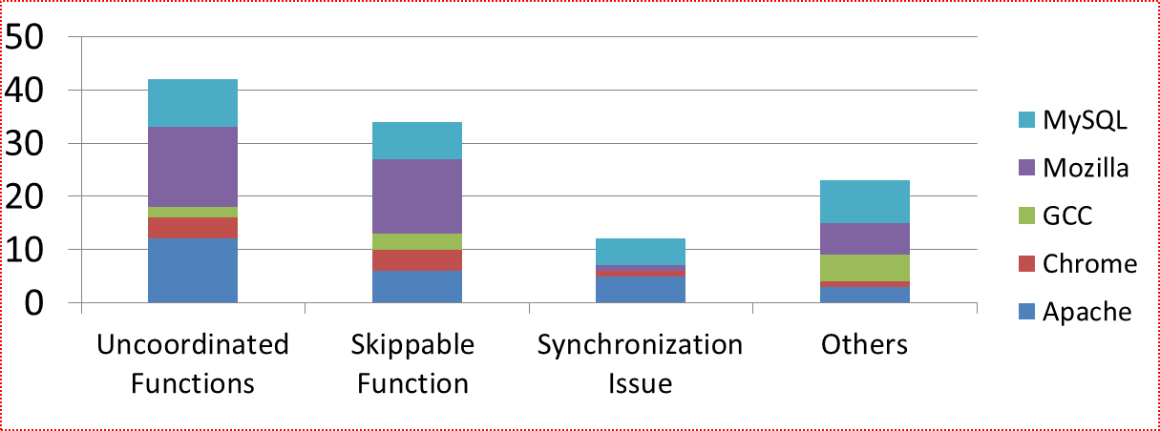
Root Causes of Performance Bugs
Performance Bug Detection
nsImage::Draw(…) {
…
}
+ if(mIsTransparent) return;
Mozilla Bug 66461

Slide 18
Root Causes of Performance Bugs
int fastmutex_lock (fmutex_t *mp){
- maxdelay += (double) random();
+ maxdelay += (double) park_rng();
…
}
Performance Bug Detection
MySQL Bug 38941 & Patch

Slide 19
Root Causes of Performance Bugs
Performance Bug Detection
Implication: Future bug detection research should focus on these common root causes.

Slide 20
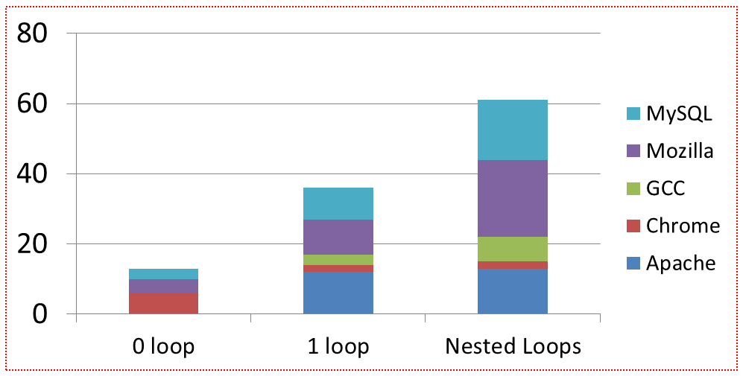
Locations of Performance Bugs
Performance Bug Detection
Implication: Detecting inefficiency in nested loops is critical.

Slide 21
How Performance Bugs are Introduced
Performance Bug Detection
Performance Bug Avoidance

Slide 22
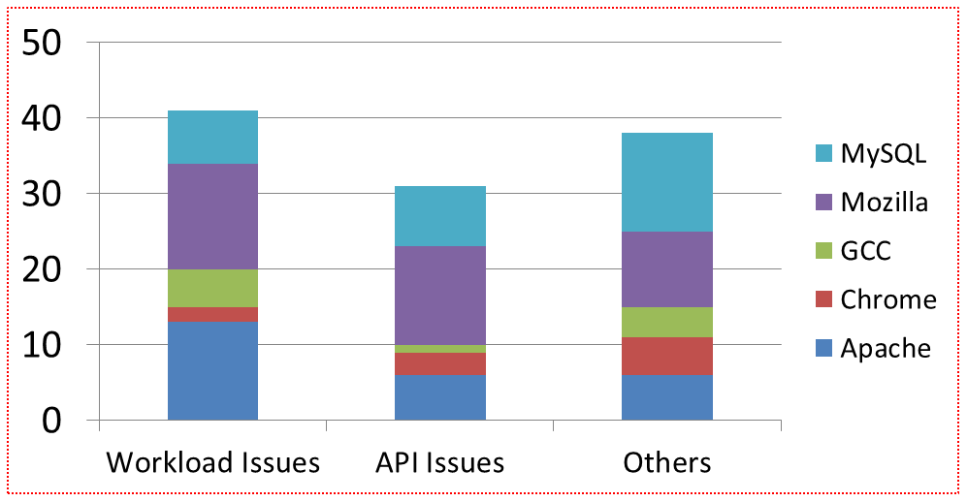
How Performance Bugs are Introduced
Performance Bug Avoidance
Dominating

Slide 23
How Performance Bugs are Introduced
int fastmutex_lock (fmutex_t *mp){
- maxdelay += (double) random();
+ maxdelay += (double) park_rng();
…
}
Performance Bug Avoidance
MySQL Bug 38941 & Patch

Slide 24
How Performance Bugs are Introduced
Performance Bug Avoidance
nsImage::Draw(…) {
…
}
+ if(mIsTransparent) return;
Not Born Buggy!
Mozilla Bug 66461

Slide 25
How Performance Bugs are Introduced
Performance Bug Avoidance
Implication: Performance aware annotation systems and change-impact analysis tools are needed.

Slide 26
How Performance Bugs Manifest
Performance Testing
Performance Bug Avoidance

Slide 27
How Performance Bugs Manifest
Performance Testing
Unique, severe

Slide 28
How Performance Bugs Manifest
Performance Testing
Special Feature
Large Scale

Slide 29
How Performance Bugs Manifest
Performance Testing
Implication: New input generation tools are needed.

Slide 30
How Performance Bugs are Fixed
Performance Testing
Performance Bug Fixing

Slide 31
How Performance Bugs are Fixed
Performance Bug Fixing
Patch sizes are small
42 patches are no larger than 5 LOC
Median patch size = 8 lines of codes
➔Fixing perf. bugs does not hurt readability

Slide 32
Other Characteristics
Performance bugs hide for a long time
Server vs. Client; Java vs. C/C++
More server bugs caused by synch. issues
Others are consistent
Correlations among characteristic categories
skippable function root cause change condition fix

Slide 33
Outline
Motivation
Methodology
Characteristics Study
Rule-based Bug Detection
Conclusion
Motivation
Methodology
Characteristics Study
Rule-based Bug Detection
Conclusion

Slide 34
Efficiency Rules
An efficiency rule includes two parts
A transformation that improves code efficiency
An applying condition of the transformation
Rules applicable to only one application
Rules applicable cross application
Mozilla Bug 490742 & Patch
int fastmutex_lock (fmutex_t *mp){
- maxdelay += (double) random();
+ maxdelay += (double) park_rng();
…
}
for (i = 0; i < tabs.length; i++) {
… tabs[i].doTransact();
}
+ doAggregateTransact(tabs);
MySQL Bug 38941 & Patch

Slide 35
Heuristics to Evaluate
Efficiency rules widely exist
Rule violations can be statically checked
Violations to efficiency rules widely exist

Slide 36
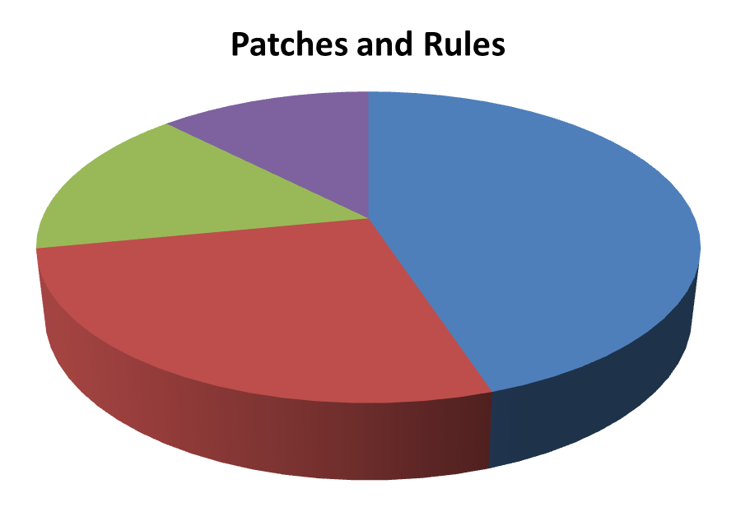
Rule Extraction and Checker Implementation
Identifying Efficiency Rules
Python Checkers
LLVM Checkers
Not Contain Rules
Dynamic Rules

Slide 37
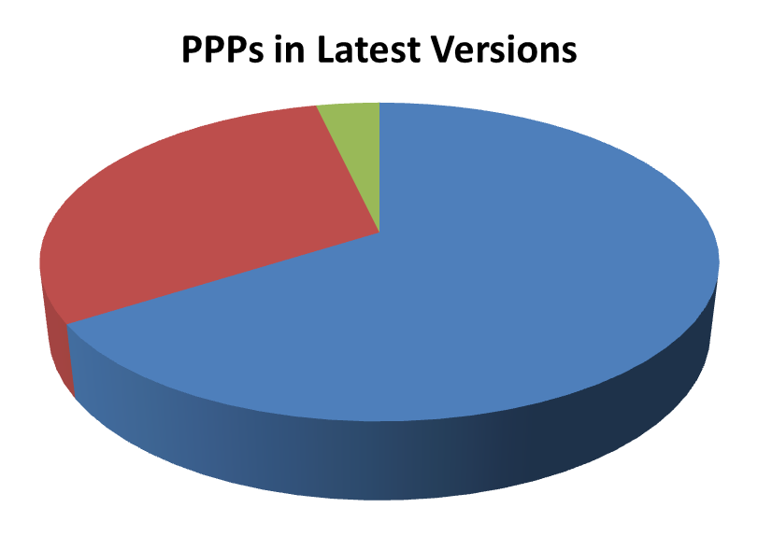
Rule-Violation Detection Results
17 checkers find PPPs in original buggy versions
13 checkers find 332 PPPs in latest versions
Found by
cross-application
checking
Introduced later
Inherits from
buggy versions
Efficiency rules and rule-based performance-bug detection is promising!
* PPP: Potential Performance Problem

Slide 38
Conclusions and Future Work
First characteristics study on performance bugs
Paper contains more details (contact us for more)
Efficiency rules are useful
Future work
Alabama: dynamically detect inefficiency in nested loops
Alabama has found severe previously unknown inefficiency

Slide 39
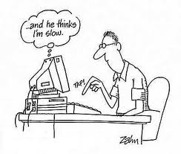
Thanks a lot!

Slide 40
Questions?
Findings
Implications
Skippable Functions and Uncoordinated Functions are most common root causes.
Inefficiency detection should focus on these common patterns.
Most bugs involve nested loops.
Most bugs are introduced by Workload Mismatch and API Misunderstanding.
Inefficiency avoidance needs performance annotations and
change-impact analysis.
29 out of 109 bugs were not born buggy.
Many bug-exposing inputs need special features and large scales.
Test-input generation should consider coverage + intensity.
Most patches are a few lines of code.
Efficiency != bad readability
Similar mistakes are made in many places by many developers in many software.
Efficiency rules are important!
Bugs involve nested loops are common and severe.
Alabama detects inefficiency in nested loops.

