Slide 1

Understanding Real-World Concurrency Bugs in Go
Tengfei Tu¹, Xiaoyu Liu², Linhai Song¹, and Yiying Zhang²
¹Pennsylvania State University
²Purdue University

Slide 2



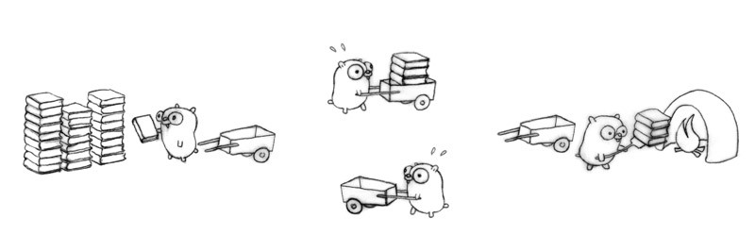

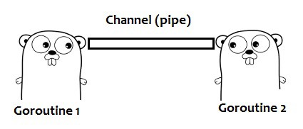
Golang
A young but widely-used programming lang.
Designed for efficient and reliable concurrency
Provide lightweight threads, called goroutines
Support both message passing and shared memory
message
Lightweight threads (goroutines)
Memory

Slide 3




Massage Passing vs. Shared Memory
Thread 1
Thread 2
Thread 1
Thread 2
Memory
Message Passing
Shared Memory
Concurrency Bug

Slide 4

Does Go Do Better?
Message passing better than shared memory?
How well does Go prevent concurrency bugs?

Slide 5




The 1st Empirical Study
Collect 171 Go concurrency bugs from 6 apps
through manually inspecting GitHub commit log
How we conduct the study?
Taxonomy based on two orthogonal dimensions
Root causes and fixing strategies
Evaluate two built-in concurrency bug detectors
Cause
BlotDB
shared
memory
×
×
message
passing
×
×
171 Real-World Go Concurrency Bugs
Behavior
blocking
non-blocking

Slide 6



Highlighted Results
Message passing can make a lot of bugs
sometimes even more than shared memory
9 observations for developers’ references
8 insights to guide future research in Go

Slide 7
Outline
Introduction
A real bug example
Go concurrency bug study
Taxonomy
Blocking Bug
Non-blocking Bug
Conclusions

Slide 8
Outline
Introduction
A real bug example
Go concurrency bug study
Taxonomy
Blocking Bug
Non-blocking Bug
Conclusions
Introduction
A real bug example
Go concurrency bug study
Taxonomy
Blocking Bug
Non-blocking Bug
Conclusions

Slide 9
Message Passing in Go
How to pass messages across goroutines?
Channel: unbuffered channel vs. buffered channel
Select: waiting for multiple channel operations
Goroutine 1
Goroutine 2
Goroutine 1
Goroutine 2
select {
case <- ch1: …
case <- ch2: …
}
Non-deterministic
ch <- m
ch <- m
m <- ch
m <- ch
unbuffered channel
buffered channel
select

Slide 10
An Example of Go Concurrency Bug
Parent Goroutine
func finishRequest(t sec) r object {
ch := make(chan object) go func() result := fn() ch <- result
}() select { case result = <- ch: return result case <- time.timeout(t): return nil }
} //Kubernetes#5316
failure

Slide 11
An Example of Go Concurrency Bug
Parent Goroutine
func finishRequest(t sec) r object {
ch := make(chan object) go func() result := fn() ch <- result
}() select { case result = <- ch: return result case <- time.timeout(t): return nil }
} //Kubernetes#5316
failure

Slide 12
An Example of Go Concurrency Bug
Parent Goroutine
Child Goroutine
func finishRequest(t sec) r object {
ch := make(chan object) go func() result := fn() ch <- result
}() select { case result = <- ch: return result case <- time.timeout(t): return nil }
} //Kubernetes#5316
go func() result := fn() ch <- result
}()
failure

Slide 13
An Example of Go Concurrency Bug
Parent Goroutine
Child Goroutine
func finishRequest(t sec) r object {
ch := make(chan object) go func() result := fn() ch <- result
}() select { case result = <- ch: return result case <- time.timeout(t): return nil }
} //Kubernetes#5316
blocking and
goroutine leak
go func() result := fn() ch <- result
}()
timeout
signal
failure

Slide 14
An Example of Go Concurrency Bug
Parent Goroutine
Child Goroutine
func finishRequest(t sec) r object {
ch := make(chan object) go func() result := fn() ch <- result
}() select { case result = <- ch: return result case <- time.timeout(t): return nil }
} //Kubernetes#5316
, 1)
go func() result := fn() ch <- result
}()
not blocking any more
failure

Slide 15
New Concurrency Features in Go
func finishRequest(t sec) r object {
ch := make(chan object) go func() result := fn() ch <- result
}() select { case result = <- ch: return result case <- time.timeout(t): return nil }
} //Kubernetes#5316
buffered channel vs. unbuffered channel
anonymous function
use select to wait for multiple channels
failure

Slide 16
New Concurrency Features in Go
func finishRequest(t sec) r object {
ch := make(chan object) go func() result := fn() ch <- result
}() select { case result = <- ch: return result case <- time.timeout(t): return nil }
} //Kubernetes#5316
buffered channel vs. unbuffered channel
anonymous function
use select to wait for multiple channels
failure

Slide 17
Outline
Introduction
A real bug example
Go concurrency bug study
Taxonomy
Blocking Bug
Non-blocking Bug
Conclusions
Introduction
A real bug example
Go concurrency bug study
Taxonomy
Blocking Bug
Non-blocking Bug
Conclusions

Slide 18
Bug Taxonomy
Categorize bugs based on two dimensions
Root cause: shared memory vs. message passing
func finishRequest(t sec) r object {
ch := make(chan object) go func() result := fn() ch <- result
}() select { case result = <- ch: return result case <- time.timeout(t): return nil }
} //Kubernetes#5316
Cause
shared
memory
channel
message
passing

Slide 19
Bug Taxonomy
Categorize bugs based on two dimensions
Root cause: shared memory vs. message passing
Behavior: blocking vs. non-blocking
func finishRequest(t sec) r object {
ch := make(chan object) go func() result := fn() ch <- result
}() select { case result = <- ch: return result case <- time.timeout(t): return nil }
} //Kubernetes#5316
Cause
shared
memory
×
×
blocking
message
passing
×
×
Behavior
blocking
non-blocking

Slide 20
Bug Taxonomy
Categorize bugs based on two dimensions
Root cause: shared memory vs. message passing
Behavior: blocking vs. non-blocking
Cause | Behavior
 | blocking | non-blocking
shared memory | 36 | 69
message passing | 49 | 17
Cause
shared
memory
×
×
105
message
passing
×
×
66
Behavior
85
86
blocking
non-blocking

Slide 21
Concurrency Usage Study
Observation: Share memory synchronizations are used more often in Go applications.

Slide 22
Outline
Introduction
A real bug example
Go concurrency bug study
Taxonomy
Blocking Bug
Non-blocking Bug
Conclusions
Introduction
A real bug example
Go concurrency bug study
Taxonomy
Blocking Bug
Non-blocking Bug
Conclusions

Slide 23
Root Causes
Conducting blocking operations
to protect shared memory accesses
to pass message across goroutines
Message Passing
Shared Memory

Slide 24
(mis)Protecting Shared Memory
Observation: Most blocking bugs caused by shared memory synchronizations have the same causes as traditional languages.

Slide 25
Misuse of Channel
Goroutine 1
Goroutine 2
ch <- m
m <- ch
blocking

Slide 26

Misuse of Channel with Lock
func goroutine1() {
m.Lock()
ch <- request
m.Unlock()
}
func goroutine2() {
for {
m.Lock()
m.Unlock()
request <- ch
}
}

Slide 27
Observation
Observation: more blocking bugs in our studied Go applications are caused by wrong message passing.
20% More

Slide 28
Implication
Implication: we call for attention to the potential danger in programming with message passing.
20% More

Slide 29
Outline
Introduction
A real bug example
Go concurrency bug study
Taxonomy
Blocking Bug
Non-blocking Bug
Conclusions
Introduction
A real bug example
Go concurrency bug study
Taxonomy
Blocking Bug
Non-blocking Bug
Conclusions

Slide 30
Root Causes
Failing to protect shared memory
Errors during message passing
Shared Memory
Message Passing

Slide 31
Traditional Bugs
> 50%

Slide 32
Misusing Channel
Thread 1
Thread 2
Thread 1
Thread 2
close(ch)
close(ch)
ch <- m
close(ch)
panic!
panic!

Slide 33
Implication
Implication: new concurrency mechanisms Go introduced can themselves be the reasons of more concurrency bugs.

Slide 34
Conclusions
1st empirical study on go concurrency bugs
shared memory vs. message passing
blocking bugs vs. non-blocking bugs
paper contains more details (contact us for more)
Future works
Statically detecting go concurrency bugs
checkers built based on identified buggy patterns
Already found concurrency bugs in real applications

Slide 35

Thanks a lot!

Slide 36
Questions?
Cause
shared
memory
×
×
BlotDB
message
passing
×
×
Behavior
171 Real-World Go Concurrency Bugs
blocking
non-blocking
Data Set: https://github.com/system-pclub/go-concurrency-bugs

