Slide 1

Artificial Intelligence and Machine learning
Prediction of Essential commodities
Name : Shiva Shankar P
SRN : PES1PG23CA128
Department of Computer Applications

Slide 2
Project Outline
Introduction
Problem Statement
Objectives
Challenges
Expected Outcomes
Potential Impact

Slide 3
Introduction
In an interconnected global economy, the prices of essential commodities such as rice, wheat, oil, and sugar significantly impact the lives of millions. These prices are subject to fluctuations that can affect stakeholders ranging from farmers and traders to policymakers and consumers. Accurate prediction of these prices is crucial for informed decision-making. By leveraging advanced data analytics and machine learning techniques, we can develop models that predict the prices of these essential commodities with a reasonable degree of accuracy.

Slide 4
Problem Statement
Develop a predictive model that forecasts the prices of essential commodities over a given time horizon. The goal is to provide accurate and timely predictions of price of each commodity to aid in decision-making for various stakeholders.

Slide 5
Objectives
Data Collection
Pre-processing
Feature Engineering
Model Development
Model Validation and Testing
Implementation and Deployment
Impact Analysis

Slide 6
Objectives - Data Collection
Gather historical price data of essential commodities.
The Data is collected from the following source : Dataset - Daily Wholesale and Retail Prices of Essential Commodities in Karnataka (dataful.in)
The Data is collected from a set of API’s of different essential commodities from different parts of Karnataka.
The data is only from Karnataka state.

Slide 7
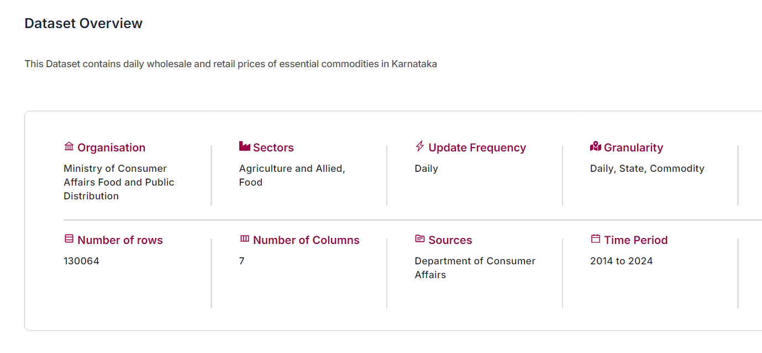
Objectives - Data Collection

Slide 8
Objectives - Data Collection
Description of each Attribute
Attribute | Details
Organization | Ministry of Consumer Affairs Food and Public Distribution
Sectors | Food, Agriculture and Allied
Update Frequency | Daily
Granularity | Daily, State, Commodity
Source | Department of Consumer Affairs
Source Link | Department of Consumer Affairs Reports
Time Period | 2014 to 2024
Units | Price in rupees per quintal Price in rupees per hundred liters Price in rupees per liter Price in rupees per kilogram
Citation | Ministry of Consumer Affairs Food and Public Distribution. Daily Wholesale and Retail Prices of Essential Commodities in Karnataka Dataful. Link to Dataful

Slide 9
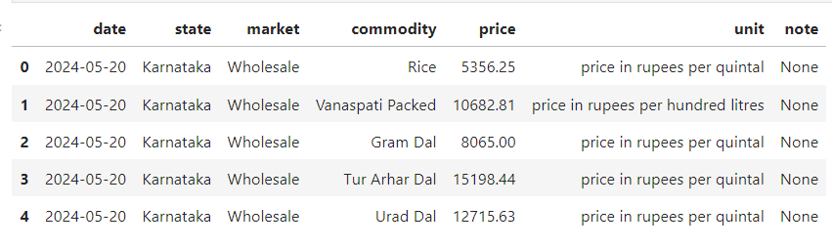
Objectives - Data Collection
First 5 Rows of the Dataset

Slide 10
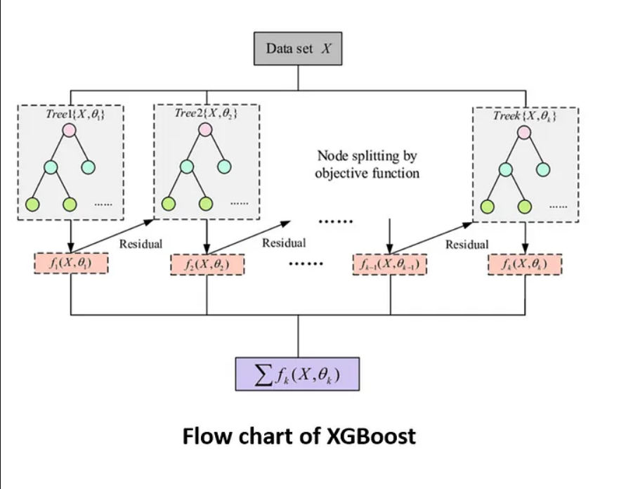
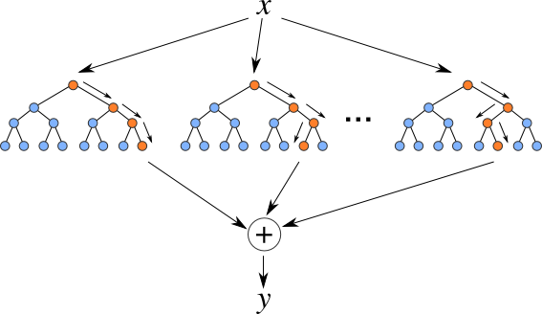
Learning Methodologies Used
Machine Learning Models are used in this project to train and predict prices
Models such as Random Forest Regressor and XGBRegressor are used for implementing machine learning models

Slide 11
Challenges
Data Quality and Availability: Ensuring the availability of high-quality, granular data across different regions and time periods.
Complex Interdependencies: Accounting for the complex interdependencies between various factors influencing commodity prices.
Dynamic Nature of Markets: Adapting the model to the dynamic nature of global commodity markets, including sudden shocks and long-term trends.

Slide 12
Expected Outcomes
A robust and accurate predictive model for essential commodity prices.
An intuitive interface for stakeholders to access and utilize price predictions.
Enhanced decision-making capabilities for farmers, traders, policymakers, and consumers.

Slide 13
Potential Impact
Accurate price predictions can help stabilize markets, optimize resource allocation, and ultimately improve the economic well-being of societies by ensuring more predictable and fair pricing of essential commodities

Slide 14

THANK YOU
Name : Shiva Shankar P
SRN : PES1PG23CA128
Department of Computer Applications

