Slide 1
On the Individual Roots of Polarization: Combining Experiments and Modeling Paweł Sobkowicz
based on What Information Drives Political Polarization?
Comparing the Effects of In-group Praise, Out-group Derogation,
and Evidence-based Communications on Polarization
by
Magdalena Wojcieszak, Paweł Sobkowicz, Xudong Yu, and Beril Bulat
The International Journal of Press/Politics, 2021
To paraphrase Stefan Thurner:
From model to data … and back

Slide 2
Motivation - general
I perceive most of opinion dynamics (OD) models to be crude at the level of individuals
People are not spinsons: we change opinions rarely and it is not clear exactly how we do it? (Incrementally? Jump-like fashion? What about changing back? Does the process of change depend on circumstances?)
What is the relation between individual opinion dynamics timescale and the frequency of social interactions? What are the consequences of different timescales? How to model them?
So, in the models we use a lot of assumptions and simplifications, often simply because we have proper toolkits available and ready to be used.
Out excuse and justification: even social sciences offer only weak and often conflicting explanations and descriptions of opinion dynamics, so there is no social sciences „gold standard” to compare models. And empirical data is hard to get.

Slide 3
Motivation – specific questions
How do we react to opinions contrary to our own (specific topics or general worldviews)? (Convergence? Repulsion? Ignoring? All have been tried in models)
But . . .
In the presence of information bubbles (by any name), do we really encounter the opposing views? How do we know them?
Or do we rely on „images” of the opposition, as portrayed by our own in-group (and media serving it)?
And such images, in addition to being selective in presenting facts, may contain negative emotional coloring („opposition bashing”), falsifications, etc.
Question: what are the effects of such filtering on OD? How to include them in OD models?

Slide 4
Model & experiment synergy
So I prepared a simple model which described a single agent receiving a stream of messages, mixing neutral random opinions and specific messages attacking one party in varying proportions.
The model showed that with increasing proportion of attacks on opposition, the agent became polarized to a high degree.
I am lucky to have as a friend prof Magdalena Wojcieszak, one of the best social scientists specializing in the field of opinions and media. When we started discussing the questions and the model, her reaction was: „why don’t we test it?”
We both expected that there would be a difference between neutral presentation of facts and emotionally laden „opposition bashing” in the real world, and had hoped to measure it.
But she pointed out my error: focusing on the out-group and enmity as the driving force. In-group relations, such as positioning oneself within the in-group, are equally (or more) important.

Slide 5
Symmetric effects
The questions then became:
How do we know what opposition believes. Directly from intergroup contacts? Or indirectly, via our in-group filtered media bubble, focused on attacking the enemy?
How do we know what our in-group members believe? Directly, from contacts with other in-group members? Or indirectly, via our in-group filtered media bubble (presenting the „party line” and glorifying our own virtues).
These two „indirect” mechanisms were the basis for the final simple single-agent OD model, in which the relative strength of the propaganda was driving the evolution of initially non-polarized opinion.

Slide 6
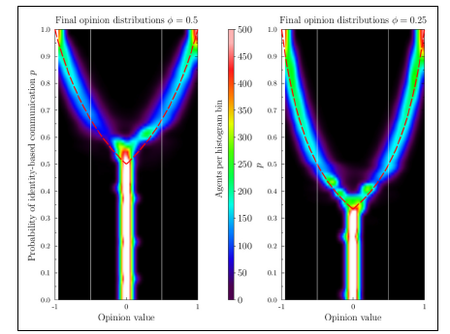
Model results
Opposition bashing (OB).
Vertical scale: ratio of OB. messages vs unbiased evidence based ones
Thin white lines: -0.5, +0.5 polarization expected from pro-attitudinal evidence based messages

Slide 7
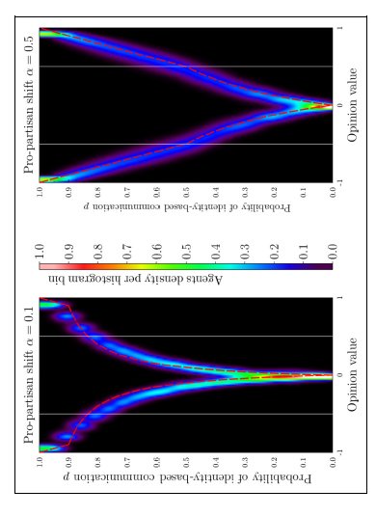
Model results
Pro-partisan (in-group) praise(PP).
Vertical scale: ratio of PP messages vs unbiased evidence based ones
Thin white lines: -0.5, +0.5 polarization expected from pro-attitudinal evidence based messages

Slide 8
Model results - summary
Simple model with clear assumptions
„Nice” results from the modeler's point of view: simulations and analytical formulas, and qualitatively different behavior of the opposition bashing and pro-partisan propaganda variants of the model.
Both effects may lead to much stronger polarization than simple effects of selective (pro-attitudinal), but evidence based (no emotional content) messaging.
But no direct way to link with real social situations (e.g. how to measure the ratio of polarizing messages?)
And . . . The reals world turned out to be much more complex and puzzling.

Slide 9
Experiment – concept
On-line, large scale, partisan sample of US society (1742 participants)
Effects of exposure to four types of simulated press articles
Posttest measures: agreement with articles, attitude strangth (pre- and post-test), self-reported polarization change and affective polarization index (based on standard measures such as feeling thermometer ratings, social distance, and trait ratings of out-party supporters)
Overall 8 different experimental conditions – four for each self-reported partizan affiliation (Democrat/Republican)

Slide 10
Experiment – results
In-group praise indeed led to stronger attitudes and greater self-reported polarization than balanced news, but did not increase out-party hostility.
However, in-group praise did not exert stronger effects than congenial evidence-based news: its effects on attitude strength, self-reported polarization, and affective polarization were indistinguishable from those of congenial news focusing on policy details.
Reading articles bashing the out-party, compared to balanced news, exacerbated attitude strength and self-reported polarization, but not affective polarization).
Again, out-party derogation did not polarize more than congenial evidence-based news in none of the measures: attitude strength; self-reported polarization; affective polarization).
There were also differences between Democrats and Republicans: in-group praise was more polarizing for the Democrats, whereas out-group derogation exacerbated attitude polarization among the Republicans.
Interesting to find similar asymmetry in Birdwatch data as reported by Emma Fraxanet here.

Slide 11
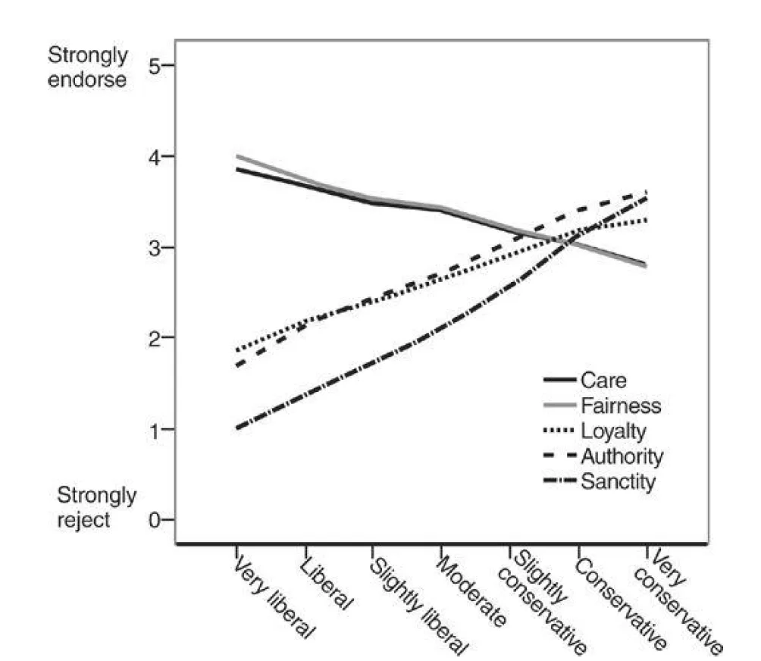
Digression: role of moral foundations?
The Moral Foundations Theory
Jonathan Haidt
Care / Harm Fairness / Cheating Loyalty / Betrayal Authority / Subversion Sanctity / Degradation
Source: The Righteous Mind, Jonathan Haidt

Slide 12
Discussion
The predictions of the model were found to be too crude: for example its emphasis on the direct emotional content of promoting the in-group or attacking the out-group was found to overestimate their effects compared to evidence-based but filtered (congenial) messaging.
The model was – as expected from the simplifications – not useful for predicting experiment results: too many unknowns and potentially important factors absent in the model (social networking, contexts, individual histories…)
But the reverse path – using the experiment to formulate a better model - also turned out to be difficult.

Slide 13
Discussion
In the experiment, we aimed to disentangle the sources of polarization. We systematically varied news that praises the in-group and news attacking the out-group, comparing them to each other and to evidence-based news that does not mention political parties. Identity-driven news polarizes attitudes more than evidence-based news covering pro and counter-issue arguments, but ...
… they do not polarize attitudes more than congenial evidence-based news presenting one-sided arguments. Simply put, congenial news (staying within the bubble) polarizes attitudes whether or not it praises one’s party or bashes the out-party. This polarization measured by a single article exposure is weak, but noticeable (statistically significant). We can only guess how this grows with the cumulative impact of continued exposure.
It may suggest that in the current polarized climate whatever is identified as a mention of politics triggers one’s political identity, thereby generating extremity and leading citizens to admit that their attitudes polarized, in line with the hot cognition hypothesis, according to which all political issues are “hot” and affectively charged.

Slide 14
Conclusions (1) – politics and policies
These results have troubling implications. Citizens often encounter information praising their in-group or attacking the out-group through partisan media, on social media, from friends and family, and in the ever more prevalent negative campaigning, information that indirectly reaches those who are not embedded in one-sided information environments.
Also, populist politicians engage in in-group praise, emphasizing that “we” are better than “them,” and combine it with an out-group derogation, noting that opponents are evil or immoral. Such media environment is likely to drive citizens further apart and may lead to more extreme political attitudes than more balanced information environment, ultimately making consensual governance more challenging.

Slide 15
Conclusions (2) – OD models
What do the results mean for the ABMs of Opinion Dynamics?
More complex models of individuals are needed/necessary: most likely multidimensional (opinions, emotions, constraints, …)
There is a lot of difference between individuals (our experiment had quite large standard deviations in the measured responses). How to prepare the simulation system to account for the initial distribution of characteristics of individuals?
Realistic model of interactions and social network filtering is needed (media, interpersonal contacts), most likely with non-uniform impact of the interactions.
Contexts are important – there might be no symmetry between spinson-up and spinson-down states (as the Democrat/Republican differences show). Or the differences between the impact of face-to-face and online contacts.

