Slide 1
Java Database Connectivity

Slide 2
Introduction to JDBC
JDBC, Java Database Connectivity, provides a Java API for updating and querying relational databases using Structured Query Language (SQL)
A Java API provides a set of classes and interfaces for database communication
  Connect to relational databases
  Send SQL commands
  Process results
  Close the connection to database
Notes:
Progrmas developed with Java programming language and JDBC are platform independent and vendor independent

Slide 3
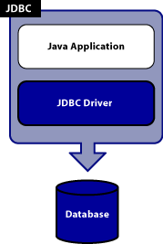
Components of JDBC
The Java application calls JDBC classes and interfaces to submit SQL statements and retrieve results.

Slide 4
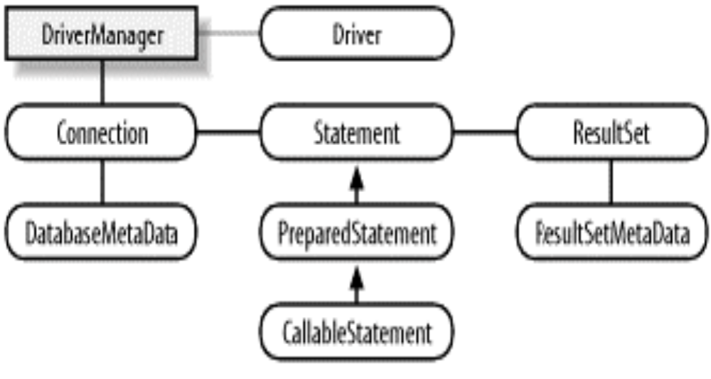
JDBC API Hierarchy
The JDBC API is based mainly on a set of interfaces, not classes.
The only concrete class is DriverManager and is used to load a JDBC Driver

Slide 5
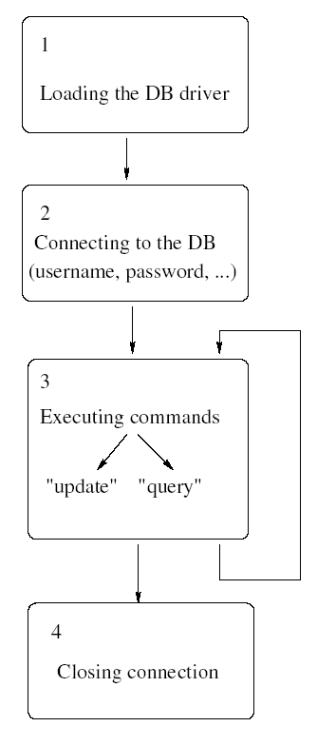
Fundamental Steps To Connect Database

Slide 6
Fundamental Steps To Connect to Database
Driver is loaded.
DriverManager is used to get a Connection.
A Connection is used to create a Statement,PreparedStatement or CallableStatement.
Statement and PreparedStatement objects are used to execute SQL statements.
CallableStatement objects are used to execute stored procedures.
The results of executing a SQL statement using a Statement or PreparedStatement are returned as a ResultSet.
A ResultSet can be used to get the actual returned data

Slide 7

Fundamental Steps : Diagram
DriveManager
creates
Connection
creates
Statement
creates
ResultSet
SQL
data
make link
to driver
Driver
SQL
data

Slide 8
Types of JDBC drivers
There are four types of JDBC drivers in use:
  JDBC to ODBC driver
  Java/Native Code driver
  Pure Java driver Network protocol
  Pure Java driver Native protocol

Slide 9
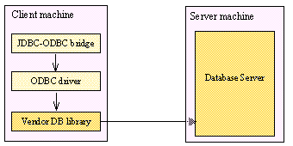
Type 1 : JDBC to ODBC driver
Translates all the JDBC calls into ODBC calls
sends them to the ODBC driver which translates the messages into a format understood by DBMS.
Performance is degraded as the JDBC call goes through the bridge to the ODBC driver, then to the native database connectivity interface.
Result comes back through the reverse process .

Slide 10
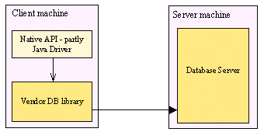
Type 2 :Java/Native Code driver
the native-API/partly Java driver -- converts JDBC calls into database-specific calls for databases
communicates directly with the database server so requires some binary code to be present on the client machine.
Vendor database library needs to be on each client machine.

Slide 11
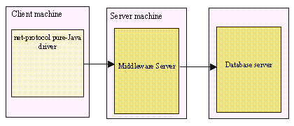
Type 3 :Pure Java driver Network protocol
Follows a three-tiered approach
JDBC database requests are passed through the network to the middle-tier server.
The middle-tier server then translates the request to the database-specific native-connectivity interface to further request to the database server.
Requires database specific coding to be done in the middle tier .

Slide 12
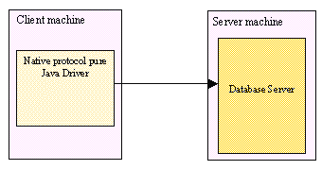
Type 4 : Pure Java driver Native protocol
Converts JDBC calls into the vendor-specific database management system (DBMS) protocol
Client applications can communicate directly with the database server.
Completely implemented in Java to achieve platform independence.
user needs a different driver for each database.

Slide 13
JDBC Application
1. Loading the Driver :
Driver is loaded before connection with DBMS.
forName() method of the java.lang.Class class is used to load the JDBC drivers.
Class.forName(“oracle.jdbc.driver.OracleDriver”);

Slide 14
JDBC Application
2. Connect to the DBMS:
getConnection() method of the DriverManager class is used to connect to the DBMS .
A call to this method creates an object instance of the java.sql.Connection class.
The getConnection() requires three input parameters,
a connect string, a username, and a password.
Connection conn = DriverManager.getConnection(URL, username, passwd);

Slide 15
JDBC Application
3.Create and Execute a SQL statement:
Creating a Statement : The createStatement() method of JDBC Connection object returns an object of the JDBC Statement class.
Statement stmt = conn.createStatement();
Executing a Statement :
The executeQuery() method of Statement object is used to query the database.
This method takes a SQL statement as input and returns a JDBC ResultSet object.
ResultSet rset = stmt.executeQuery ("SELECT ename FROM emp");

Slide 16
JDBC Application
4.Process data returned by DBMS:
After query execution, next() method of ResultSet object is used to iterate through the results obtained from DBMS.
This method steps through the result set row by row, detecting the end of the result set when it is reached.
Appropriate getXXX() methods of the ResultSet object are used to read the data , where XXX corresponds to a Java datatype.
while (rset.next())
  System.out.println (rset.getString(1));
  The next() method returns false when it reaches the end of the result set.

Slide 17
JDBC Application
5.Closing the ResultSet and Statement :
  Once the ResultSet and Statement objects have been used, they must be closed.
  Use close() method of the ResultSet and Statement classes.
  rset.close();
  stmt.close();
  6.Terminate the connection to DBMS :
  The last step is to close the database connection opened in the beginning.
  conn.close();

Slide 18
Inserting, Updating ,Deleting Records
// Connect to the database
con=DriverManager.getConnection(url,uid,pwd);
Statement s = con.createStatement(); //create sql statement
//execute sql statement
s.execute("create table table1(ename varchar2(10),sal number(10),dept varchar2(10))");
//Insert into a table
s.execute("insert into table1 values('abc',1000,'computers')");
s.execute("insert into table1 values('pqr',2000,'HR')");

Slide 19
Inserting, Updating ,Deleting Records cont..
//Update a row
String updateString = "UPDATE table1 SET sal = 20000 WHERE ename = ‘abc’”;
int i=s.executeUpdate(updateString);
//delete a row
String deleteString = "delete from table1 WHERE
ename = 'abc'";
int j=s.executeUpdate(deleteString);

Slide 20
Using Statement
Through the Statement object, SQL statements are sent to the database.
Three types of statement objects are available :
*Statements :
-for executing a simple SQL statement
*Prepared Statement:
-for executing a precompiled SQL statement passing in parameters
*Callable Statement:
-for executing a database stored procedure .

Slide 21
Useful Statement Methods
  executeQuery
  -Executes the query and returns the data in a table(ResultSet)
  -The resulting table may be empty but never null
  ResultSet results=statement.executeQuery(“select a,b from table”)
  executeUpdate
  -Used to execute for INSERT,UPDATE, or DELETE SQL statements
  -The return is the number of rows that were affected in the database
  int rows= statement.executeUpdate(“Delete from Employees where Status=0”);

Slide 22
Prepared Statements
SQL query must be compiled before it is sent to DBMS for processing.
If similar SQL statement has to executed multiple times, prepared statements can be more efficient.
Using the PreparedStatement object the query can be precompiled and executed, so the PreparedStatement object contains not just an SQL statement but an SQL statement that is precompiled .
PreparedStatement updateEmp = conn.prepareStatement
("UPDATE EMP SET EMPLOYEE_NAME = ? WHERE EMP_NO = ?");
Values to be used in place of the question mark placeholders has to be supplied before executing a PreparedStatement object.
This is done by calling one of the setXXX methods defined in the PreparedStatement class . For example , for Java int value, you call the method setInt().

Slide 23
Callable Statements
Callable statements calls stored procedures in a database
The programmer need to know only the input and output parameters for the stored procedure, not the table structure or the internal details of the stored procedure.
Syntax for invoking a stored procedure
{call procedure_name[(?, ?, ...)]}
Syntax for a procedure that returns a result parameter
{? = call procedure_name[(?, ?, ...)]}
Syntax for a stored procedure with no parameters
{call procedure_name}

Slide 24
Types of ResultSets
ResultSet objects provide access to a table
ResultSet objects maintain a cursor pointing to the current row of data
this cursor initially points before the first row and is moved to the first row by the next()method.
ResultSet rs = statement.executeQuery("SELECT NAME, PRICE FROM PRODUCT");
while ( rs.next( ) )
{
String name = rs.getString( "NAME" );
float price = rs.getFloat( "PRICE" );
System.out.println("Name: "+name+", price: "+price);
}

Slide 25
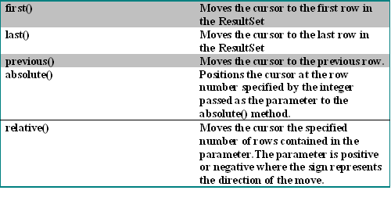
Scrollable ResultSet
Result Set's cursor can be moved backward as well as forward
There are several methods of ResultSet listed below which can be used to position the virtual cursor.

Slide 26
Scrollable ResultSet cont..
To denote a scrollable result set predefined parameter values are specified to a Connection object’s createStatement(), prepareStatement(), or prepareCall() methods.
The following are the method calls with signatures:
createStatement(int resultSetType,
int resultSetConcurrency);
prepareStatement(String SQL, int resultSetType, int resultSetConcurrency);

Slide 27
Scrollable ResultSet cont..
resultSetType, indicates how data can be scrolled.
The valid resultSetType parameter values for creating scrollable ResultSet objects should be one of three ResultSet constants as explained below :
  TYPE_FORWARD_ONLY : The result set is not scrollable
  TYPE_SCROLL_INSENSITIVE :The result set is scrollable but not sensitive to database changes
  TYPE_SCROLL_SENSITIVE : The result set is scrollable and sensitive to database changes

Slide 28
Updatable ResultSet
createStatement(int resultSetType, int resultSetConcurrency);
The first parameter resultSetType parameter is used to specify scrollable result sets.
The second parameter, resultSetConcurrency, defines the concurrency level the result should have.
resultSetConcurrency parameter has the following two options:
  CONCUR_UPDATABLE, creates an updateable result set.
  CONCUR_READ_ONLY, creates a read−only result set.
Example:
Statement sqlStmt = conn.createStatement(ResultSet.TYPE_SCROLL_INSENSITIVE ,ResultSet.CONCUR_UPDATABLE);

Slide 29
Updating a row
Updatable ResultSet objects gives the freedom to manipulate result set data directly.
rset.updateString("ename",newName);
rset.updateRow();
The ResultSet.updateXXX() method changes the data in the result set, not the data in the database.
The changes are propagated to the database and to the result set once you commit them with the ResultSet.updateRow() method.

Slide 30
Inserting a Row
This is a three step procedure:
  navigate to insert row
  update the field values in the ResultSet􀂄
  write the row to the DB
rs.moveToInsertRow();
rs.updateString("NAME", “ABC");
rs.updateString("ID", "0-201-32563-2");
rs.updateFloat("PRICE", 40.0F);
rs.insertRow();

Slide 31
Deleting a Row
This is a simple two step procedure:
  navigate to row to be deleted
  delete the row
rs.last();
rs.deleteRow();

Slide 32
ResultSetMetadata
ResultSet Metadata describes the ResultSet.
Obtained by calling getMetaData() method of the ResultSet object.
Used to get information about the types and properties of the columns in a ResultSet object.
ResultSet rs = s.executeQuery("SELECT ename,empno FROM emp");
ResultSetMetaData rsmd = rs.getMetaData();
int numberOfColumns = rsmd.getColumnCount();
String columnName=rsmd.getColumnName(1);
String columnType=rsmd.getColumnTypeName(1);
Output:2 ENAME Varchar2

Slide 33
Transactions
Normally each SQL statement will be committed automatically when it has completed executing (auto commit is on)
A group of statements can be committed together by turning auto commit off, and explicitly committing the statements ourselves
This ensures that if any of the statements fail, they all fail. We can then roll back the transaction
Notes:
JDBC Transaction modes not covered .
con.setTransactionIsolation( mode)

Slide 34
Transaction Example
try {
con.setAutoCommit( false );
s.executeUpdate("UPDATE PRODUCT SET PRICE = 40.00
WHERE ID = '0201'");
s.executeUpdate( "UPDATE REVIEW SET Price = 20.00
WHERE BOOKID ='0201" ); con.commit();
}
catch( SQLException e ) {
con.rollback();
}

Slide 35
Batch Updates
JDBC 1.0 was very inefficient for loading a lot of data into a DB -a separate SQL command had to be executed for each record changed
JDBC 2.0 allows batch updates
multiple statements can be executed as a single batch
we can roll back the whole batch if a single statement fails
We simply add statements to be batched to a Statement or PreparedStatement object using addBatch()!
We can remove the statements using clearBatch()

Slide 36
Batch Update Example
try {
con.setAutoCommit( false );
s.addBatch("INSERT INTO PRODUCT " + "VALUES(‘ABC', " + "'0201', 29.95)" );
s.addBatch("INSERT INTO PRODUCT " +
"VALUES (‘PQR'," +"'0202',29.95)");
int[ ] count = s.executeBatch( );
con.commit( );
}catch( SQLException e ) {
con.rollback( );
}

