Slide 1
Introduction
to JDBC
JDBC
Notes:
JDBC

Slide 2
Agenda
Overview of JDBC technology
JDBC drivers
Seven basic steps in using JDBC
Retrieving data from a ResultSet
Using prepared and callable statements
Handling SQL exceptions
Submitting multiple statements as a transaction
JDBC
Notes:
JDBC

Slide 3
JDBC Introduction
JDBC provides a standard library for accessing relational databases
  API standardizes
    Way to establish connection to database
    Approach to initiating queries
    Method to create stored (parameterized) queries
    The data structure of query result (table)
      Determining the number of columns
      Looking up metadata, etc.
  API does not standardize SQL syntax
  JDBC class located in java.sql package
Note: JDBC is not officially an acronym; unofficially, “Java Database Connectivity” is commonly used
JDBC

Slide 4
On-line Resources
Sun’s JDBC Site
  http://java.sun.com/products/jdbc/
JDBC Tutorial
  http://java.sun.com/docs/books/tutorial/jdbc/
List of Available JDBC Drivers
  http://industry.java.sun.com/products/jdbc/drivers/
API for java.sql
  http://java.sun.com/j2se/1.3/docs/api/java/sql/
  package-summary.html
JDBC

Slide 5
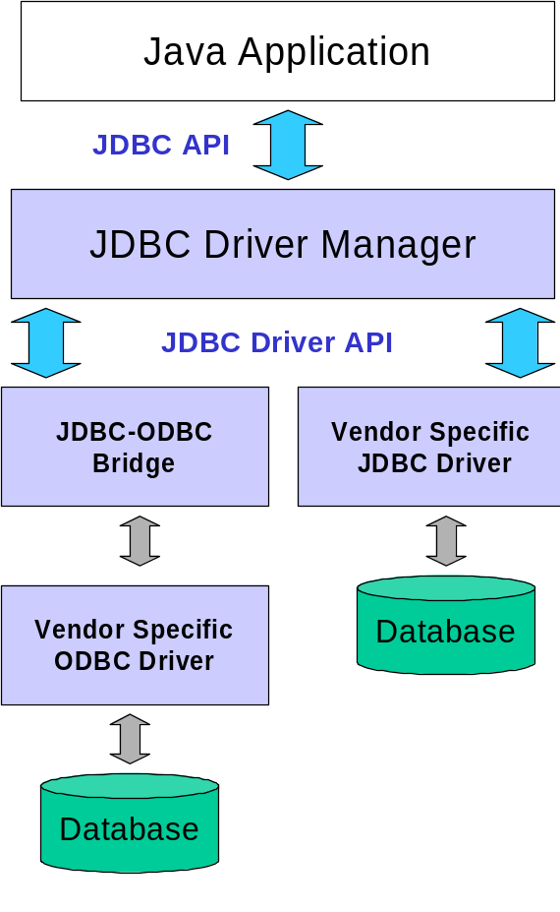
JDBC Drivers
JDBC consists of two parts:
  JDBC API, a purely
  Java-based API
  JDBC Driver Manager,which
  communicates with
  vendor-specific drivers that
  perform the real communication
  with the database.
    Point: translation to vendor
    format is performed on
    the client
      No changes needed
      to server
      Driver (translator) needed
      on client
JDBC

Slide 6
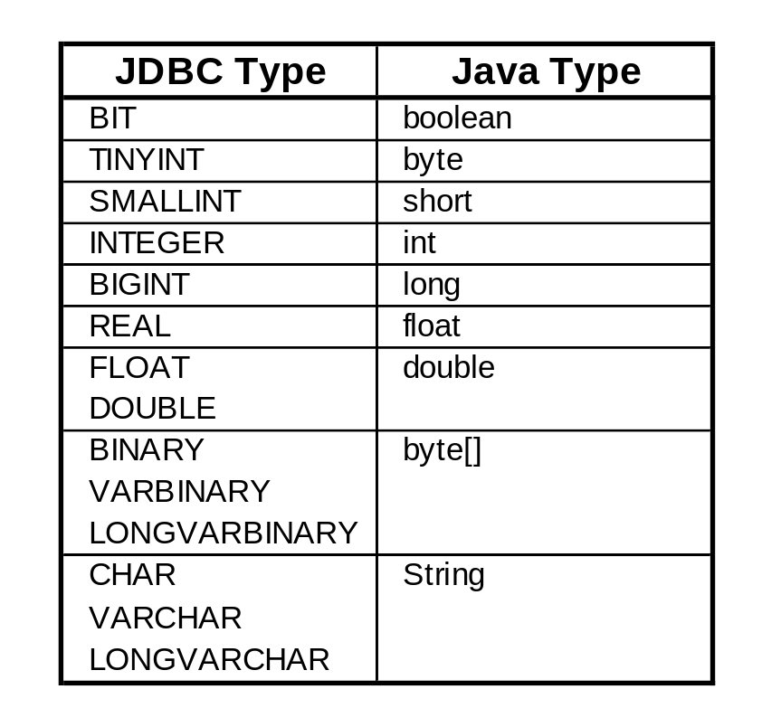
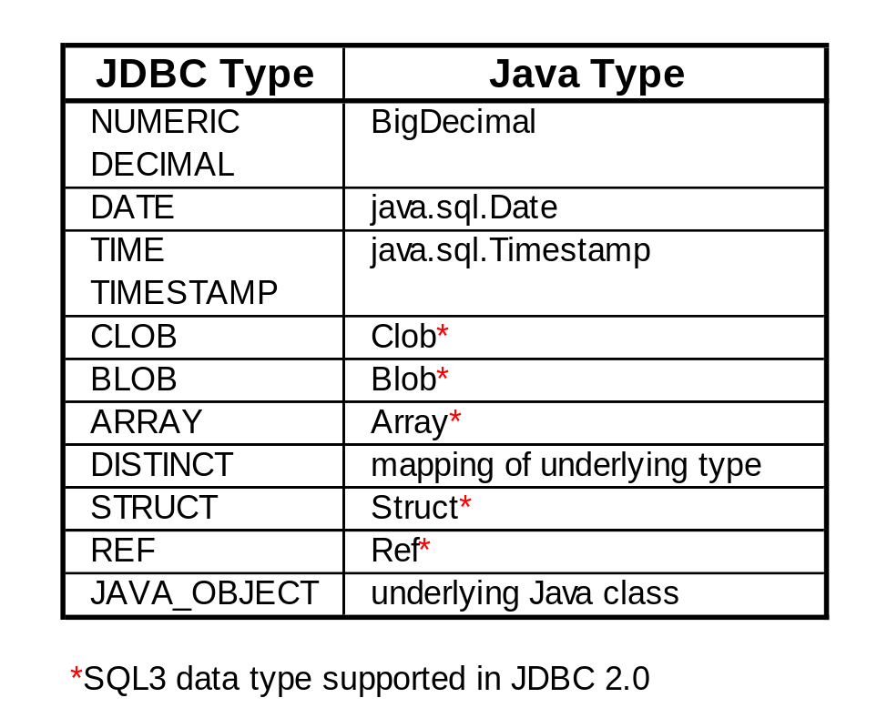
JDBC Data Types
JDBC

Slide 7
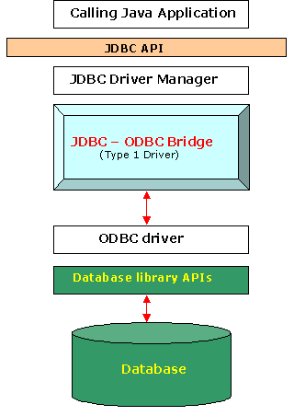
JDBC Driver Type : Type 1 Driver
The JDBC type 1 driver, also known as the JDBC-ODBC bridge is a database driver implementation that employs the ODBC driver to connect to the database. The driver converts JDBC method calls into ODBC function calls. The bridge is usually used when there is no pure-Java driver available for a particular database.
The driver is implemented in the sun.jdbc.odbc.JdbcOdbcDriver class and comes with the Java 2 SDK, Standard Edition.
The driver is platform-dependent as it makes use of ODBC which in turn depends on native libraries of the operating system. Also, using this driver has got other dependencies such as ODBC must be installed on the computer having the driver and the database which is being connected to must support an ODBC driver. Hence the use of this driver is discouraged if the alternative of a pure-Java driver is available.
Type 1 is the simplest of all but platform specific i.e only to Microsoft platform.
JDBC

Slide 8
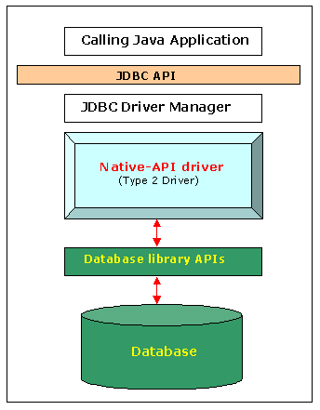
JDBC Driver Type : Type 2 Driver
The JDBC type 2 driver, also known as the Native-API driver is a database driver implementation that uses the client-side libraries of the database. The driver converts JDBC method calls into native calls of the database API.
The type 2 driver is not written entirely in Java as it interfaces with non-Java code that makes the final database calls. The driver is compiled for use with the particular operating system. For platform interoperability, the Type 4 driver, being a full-Java implementation, is preferred over this driver.
However the type 2 driver provides more functionality and performance that the type 1 driver as it does not have the overhead of the additional ODBC function calls.
JDBC

Slide 9
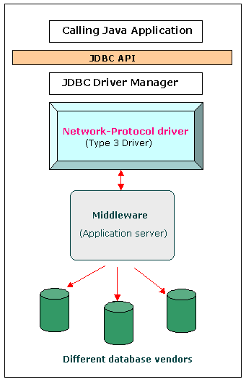
JDBC Driver Type : Type 3 Driver
The JDBC type 3 driver, also known as the network-protocol driver is a database driver implementation which makes use of a middle-tier between the calling program and the database. The middle-tier (application server) converts JDBC calls directly or indirectly into the vendor-specific database protocol.
This differs from the type 4 driver in that the protocol conversion logic resides not at the client, but in the middle-tier. However, like type 4 drivers, the type 3 driver is written entirely in Java.
The same driver can be used for multiple databases. It depends on the number of databases the middleware has been configured to support. The type 3 driver is platform-independent as the platform-related differences are taken care by the middleware. Also, making use of the middleware provides additional advantages of security and firewall access.
JDBC

Slide 10
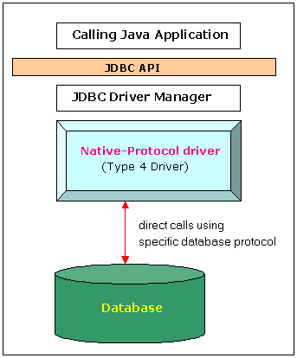
JDBC Driver Type : Type 4 Driver
The JDBC type 4 driver, also known as the native-protocol driver is a database driver implementation that converts JDBC calls directly into the vendor-specific database protocol.
The type 4 driver is written completely in Java and is hence platform independent. It provides better performance over the type 1 and 2 drivers as it does not have the overhead of conversion of calls into ODBC or database API calls. Unlike the type 1 and 2 drivers, it does not need associated software to work.
As the database protocol is vendor-specific, separate drivers, usually vendor-supplied, need to be used to connect to the database.
JDBC

Slide 11
Seven Basic Steps in
Using JDBC
Load the driver
Define the Connection URL
Establish the Connection
Create a Statement object
Execute a query
Process the results
Close the connection
JDBC

Slide 12
JDBC: Details of Process
Load the driver
try {
Class.forName("oracle.jdbc.driver.OracleDriver");
Class.forName("com.mysql.jdbc.Driver");
} catch { ClassNotFoundException cnfe) {
System.out.println("Error loading driver: " cnfe);
}
dynamically load a java class at runtime
executes newInstance() to create an object of class Driver calling the default
constructor for the class.
The constructor executes code to register the class with the DriverManager
OR Use
DriverManager.registerDriver(new oracle.jdbc.driver.OracleDriver());
JDBC

Slide 13
JDBC: Details of Process
Define the Connection URL
String host = "dbhost.yourcompany.com";
String dbName = "someName";
int port = 1234;
String oracleURL = "jdbc:oracle:thin:@" + host +
":" + port + ":" + dbName;
String mysqlURL = "jdbc:mysql://" + host +
":" + port + "/" + dbName;
JDBC

Slide 14
JDBC: Details of Process, cont.
Establish the Connection
String username = "jay_debesee";
String password = "secret";
Connection connection =
DriverManager.getConnection(oracleURL,
username,
password);
Optionally, get information about the db system
DatabaseMetaData dbMetaData = connection.getMetaData();
String productName =
dbMetaData.getDatabaseProductName();
System.out.println("Database: " + productName);
String productVersion =
dbMetaData.getDatabaseProductVersion();
System.out.println("Version: " + productVersion);
JDBC

Slide 15
JDBC: Details of Process, cont.
Create a Statement
Statement object used to send queries and commands to the database.
Statement statement = conn.createStatement();
Statements may represent:
* DDL - Data Definition Language
* DML - Data Manipulation Language
Statements allow you to:
    * Select * Insert/update/delete
    * Create table/view
    * Stored function and procedure calls
JDBC

Slide 16
JDBC: Details of Process, cont.
Create a Statement object. cont.
Statement: Interface that represents object used for executing static SQL statement and obtaining results.
PreparedStatement: Interface that represents a precompiled SQL statement.
    * May include parameters
    * More efficient if statement is executed many times
    * Subtype of Statement
CallableStatement: Interface that represents object used to execute SQL stored procedures.
    * Can process out parameters
    * Subtype of PreparedStatement
JDBC

Slide 17
JDBC: Details of Process, cont.
Execute a Query
String query = "SELECT col1, col2, col3 FROM sometable";
ResultSet resultSet = statement.executeQuery(query);
  To modify the database, use executeUpdate, supplying a string that uses UPDATE, INSERT, or DELETE
  Use statement.setQueryTimeout to specify a maximum delay to wait for results
JDBC

Slide 18
JDBC: Details of Process, cont.
Process the Result
while(resultSet.next()) {
System.out.println(resultSet.getString(1) + " " +
resultSet.getString(2) + " " +
resultSet.getString(3));
}
  First column has index 1, not 0
  ResultSet provides various getXxx methods that take a column index or name and returns the data
Close the Connection
connection.close();
  As opening a connection is expensive, postpone this step if additional database operations are expected
JDBC

Slide 19
JDBC: Details of Process, cont.
Must close in the following order:
    1. The ResultSet: rs.close();
    2. The Statement: statement.close();
    3. The Connection: conn.close();
• Overhead of opening a connection is quite large.
* Only close connections if you are completely done with database
JDBC

Slide 20
Servlet using JDBC Example
package cwp;
import java.io.*;
import java.sql.*;
import javax.servlet.*;
import javax.servlet.http.*;
public class Menagerie extends HttpServlet {
public static void main(String[] args) {
System.out.println(doQuery());
}
public void doGet(HttpServletRequest request,
HttpServletResponse response)
throws ServletException, IOException {
PrintWriter out = response.getWriter();
out.println(doQuery());
}
public static String doQuery() {
StringBuffer buffer = new StringBuffer();
try {
Class.forName("com.mysql.jdbc.Driver");
JDBC

Slide 21
Servlet using JDBC Example (Continued)
Connection connection =
DriverManager.getConnection(
"jdbc:mysql://almaak.usc.edu:3307/menagerie",
"root","xyz");
Statement statement = connection.createStatement();
String query = "SELECT * from pet";
ResultSet result = statement.executeQuery(query);
buffer.append("Pet Table from menagerie Database\n\n");
while (result.next()) {
buffer.append(result.getString(1) + " " +
result.getString(2) + " " +
result.getString(3) + " " +
result.getString(4) + " " +
result.getString(5) + "\n");
}
connection.close();
} catch (ClassNotFoundException cnfe) {
buffer.append("Couldn't find class file" + cnfe);
} catch (SQLException sqle) {
buffer.append("SQL Exception: " + sqle);
}
return buffer.toString();
}
}
JDBC

Slide 22
ResultSet
Overview
  A ResultSet contains the results of the SQL query
    Represented by a table with rows and columns
    In JDBC 1.0 you can only proceed forward through the rows using next
Useful Methods
    All methods can throw a SQLException
  close
    Releases the JDBC and database resources
    The result set is automatically closed when the associated Statement object executes a new query
  getMetaDataObject
    Returns a ResultSetMetaData object containing information about the columns in the ResultSet
JDBC

Slide 23
ResultSet (Continued)
Useful Methods
  next
    Attempts to move to the next row in the ResultSet
      If successful true is returned; otherwise, false
      The first call to next positions the cursor at the first row
      Calling next clears the SQLWarning chain
  getWarnings
    Returns the first SQLWarning or null if no warnings occurred
JDBC

Slide 24
ResultSet (Continued)
Useful Methods
  findColumn
    Returns the corresponding integer value corresponding to the specified column name
    Column numbers in the result set do not necessarily map to the same column numbers in the database
  getXxx
    Returns the value from the column specified by
    column name or column index as an Xxx Java type
    Returns 0 or null (if the value is a SQL NULL)
    Legal getXxx types:
  wasNull
    To check if the last getXxx read was a SQL NULL
double byte int Date String
float short long Time Object
JDBC

Slide 25
Using MetaData
Idea
  From a ResultSet (the return type of executeQuery), derive a ResultSetMetaData object
  Use that object to look up the number, names, and types of columns
ResultSetMetaData answers the following questions:
  How many columns are in the result set?
  What is the name of a given column?
  Are the column names case sensitive?
  What is the data type of a specific column?
  What is the maximum character size of a column?
  Can you search on a given column?
JDBC

Slide 26
Useful MetaData Methods
getColumnCount
  Returns the number of columns in the result set
getColumnDisplaySize
  Returns the maximum width of the specified column in characters
getColumnName/getColumnLabel
  The getColumnName method returns the database name of the column
  The getColumnLabel method returns the suggested column label for printouts
getColumnType
  Returns the SQL type for the column to compare against types in java.sql.Types
JDBC

Slide 27
Useful MetaData Methods (Continued)
isNullable
  Indicates whether storing a NULL in the column is legal
  Compare the return value against ResultSet constants: columnNoNulls, columnNullable, columnNullableUnknown
isSearchable
  Returns true or false if the column can be used in a WHERE clause
isReadOnly/isWritable
  The isReadOnly method indicates if the column is definitely not writable
  The isWritable method indicates whether it is possible for a write to succeed
JDBC

Slide 28
Using MetaData: Example
Connection connection =
DriverManager.getConnection(url, username, password);
// Look up info about the database as a whole.
DatabaseMetaData dbMetaData =
connection.getMetaData();
String productName =
dbMetaData.getDatabaseProductName();
System.out.println("Database: " + productName);
String productVersion =
dbMetaData.getDatabaseProductVersion();
...
Statement statement = connection.createStatement();
String query = "SELECT * FROM pet";
ResultSet resultSet = statement.executeQuery(query);
JDBC

Slide 29
Using MetaData: Example
// Look up information about a particular table.
ResultSetMetaData resultsMetaData =
resultSet.getMetaData();
int columnCount = resultsMetaData.getColumnCount();
// Column index starts at 1 (a la SQL) not 0 (a la Java).
for(int i=1; i<columnCount+1; i++) {
System.out.print(resultsMetaData.getColumnName(i) +
" ");
}
System.out.println();
// Print results.
while(resultSet.next()) {
// Quarter
System.out.print(" " + resultSet.getInt(1));
// Number of Apples
...
}
JDBC

Slide 30
Using MetaData, Result
Database: MySQL
Product Version: 3.23.52-log
Pet Table from menagerie Database
name owner species sex birth death
Puffball2 Diane hamster f 1999-03-30 0000-00-00
Puffball3 Diane hamster 1999-03-30 2000-03-30
freddy dave terrier m 1999-03-30 0000-00-00
buster jeannette cat m 1999-03-30 0000-00-00
Puffball2 Diane hamster f 1999-03-30 0000-00-00
Puffball3 Diane hamster 1999-03-30 2000-03-30
freddy dave terrier m 1999-03-30 0000-00-00
buster jeannette cat m 1999-03-30 0000-00-00
JDBC

Slide 31
Using the Statement Object
Overview
  Through the Statement object, SQL statements are sent to the database.
  Three types of statement objects are available:
    Statement
      for executing a simple SQL statements
    PreparedStatement
      for executing a precompiled SQL statement passing in parameters
    CallableStatement
      for executing a database stored procedure
JDBC

Slide 32
Useful Statement Methods
executeQuery
  Executes the SQL query and returns the data in a table (ResultSet)
  The resulting table may be empty but never null
ResultSet results =
statement.executeQuery("SELECT a, b FROM table");
executeUpdate
  statemUsed to execute for INSERT, UPDATE, or DELETE SQL ents
  The return is the number of rows that were affected in the database
  Supports Data Definition Language (DDL) statements CREATE TABLE, DROP TABLE and ALTER TABLE
int rows =
statement.executeUpdate("DELETE FROM EMPLOYEES" +
"WHERE STATUS=0");
JDBC

Slide 33
Useful Statement Methods (Continued)
getMaxRows/setMaxRows
  Determines the number of rows a ResultSet may contain
  Unless explicitly set, the number of rows are unlimited (return value of 0)
getQueryTimeout/setQueryTimeout
  Specifies the amount of a time a driver will wait for a STATEMENT to complete before throwing a SQLException
JDBC

Slide 34
Prepared Statements (Precompiled Queries)
Idea
  If you are going to execute similar SQL statements multiple times, using “prepared” (parameterized) statements can be more efficient
  Create a statement in standard form that is sent to the database for compilation before actually being used
  Each time you use it, you simply replace some of the marked parameters using the setXxx methods
PreparedStatement's execute methods have no parameters
  execute()
  executeQuery()
  executeUpdate()
JDBC

Slide 35
Prepared Statement, Example
Connection connection =
DriverManager.getConnection(url, user, password);
PreparedStatement statement =
connection.prepareStatement("UPDATE employees " +
"SET salary = ? " +
"WHERE id = ?");
float[] newSalaries = getSalaries();
int[] employeeIDs = getIDs();
for(int i=0; i<employeeIDs.length; i++) {
statement.setFloat(1, newSalaries[i]);
statement.setInt(2, employeeIDs[i]);
statement.executeUpdate();
}
JDBC

Slide 36
Useful Prepared Statement Methods
setXxx
  Sets the indicated parameter (?) in the SQL statement to the value
clearParameters
  Clears all set parameter values in the statement
Handling Servlet Data
  Query data obtained from a user through an HTML form may have SQL or special characters that may require escape sequences
  To handle the special characters, pass the string to the PreparedStatement setString method which will automatically escape the string as necessary
JDBC

Slide 37
Callable Statements
(Calling Stored procedures)
Idea
  CallableStatement is used to execute PL/SQL stored procedures directly on the database side. They also use the question mark placeholders to signify variables, and setXXX() methods to initialize those variables. In a stored procedure, the parameters may have one of three values: IN, OUT, or IN OUT, and for an argument that is either OUT or IN OUT, a registerOutParameter() method must be prepared before executing the CallableStatement. An example clarifies this:
JDBC

Slide 38
Callable Statement, Example 1
CREATE OR REPLACE PROCEDURE insert_employee
(p_eid IN CHAR
,p_fname IN VARCHAR2
,p_lname IN VARCHAR2
,p_age IN NUMBER
,p_entrydate OUT DATE
) IS
BEGIN
p_entrydate := SYSDATE;
INSERT INTO employee
(eid, fname, lname, age, entrydate) VALUES
(p_eid, p_fname, p_lname, p_age, p_entrydate);
END insert_employee;
JDBC

Slide 39
Callable Statement, Example 1
CallableStatement stmt =
con.prepareCall(
"{call insert_employee(?, ?, ?, ?, ?)}");
stmt.setString(1, "999999999");
stmt.setString(2, "John");
stmt.setString(3, "Smith");
stmt.setInt(4, 30);
stmt.registerOutParameter(5, Types.DATE);
stmt.execute();
System.out.println("entry date = " + stmt.getDate(5));
JDBC

Slide 40
Callable Statement, Example 2
CREATE OR REPLACE PROCEDURE p_highest_paid_emp
(ip_deptno NUMBER,
op_empno OUT NUMBER,
op_ename OUT VARCHAR2,
op_sal OUT NUMBER
) IS
v_empno NUMBER;
v_ename VARCHAR2(20);
v_sal NUMBER;
BEGIN
SELECT empno, ename, sal INTO v_empno, v_ename, v_sal
FROM emp e1
WHERE sal = (SELECT MAX(e2.sal) FROM emp e2
WHERE e2.deptno = e1.deptno
AND e2.deptno = ip_deptno)
AND deptno = ip_deptno;
op_empno := v_empno;
op_ename := v_ename;
op_sal := v_sal;
END;
/
JDBC

Slide 41
Callable Statement, Example 2
import java.sql.*;
public class StProcExample {
public static void main(String[] args)
throws SQLException {
int ret_code;
Connection conn = null;
try {
//Load and register Oracle driver
DriverManager.registerDriver(new oracle.jdbc.driver.OracleDriver());
//Establish a connection
conn = DriverManager.getConnection("jdbc:oracle:thin:@training:1521:
Oracle", "oratest", "oratest");
int i_deptno = 10;
JDBC

Slide 42
Callable Statement, Example 2
CallableStatement pstmt = conn.prepareCall("{call p_highest_
paid_emp(?,?,?,?)}");
pstmt.setInt(1, i_deptno);
pstmt.registerOutParameter(2, Types.INTEGER);
pstmt.registerOutParameter(3, Types.VARCHAR);
pstmt.registerOutParameter(4, Types.FLOAT);
pstmt.executeUpdate();
int o_empno = pstmt.getInt(2);
String o_ename = pstmt.getString(3);
float o_sal = pstmt.getFloat(4);
System.out.print("The highest paid employee in dept "
+i_deptno+" is: "+o_empno+" "+o_ename+" "+o_sal);
pstmt.close();
conn.close();
} catch (SQLException e) {ret_code = e.getErrorCode();
System.err.println(ret_code + e.getMessage()); conn.close();}
}
}
JDBC

Slide 43
Scrollable ResultSet
1. Creating a scrollable object is the first step to making use of this feature.
The following is a simple code fragment to create a scrollable object:
Statement stmt = conn.createStatement(ResultSet.TYPE_SCROLL_SENSITIVE, ResultSet.CONCUR_READ_ONLY);
ResultSet rset = stmt.executeQuery("select sid, name, gender,age from student");
The first argument in CreateStatement is to indicate the type of the ResultSet object :
TYPE_FORWARD_ONLY (Default)
TYPE_ SCROLL_INSENSITIVE ( A result set does not reflect changes that are made to it while it is open)
TYPE_SCROLL_SENSITIVE (Reflects the changes)
The second argument in CreateStatement is to indicate whether the result set is read-only or updatable :
CONCUR_READ_ONLY (Default)
CONCUR_UPDATABLE
JDBC

Slide 44
Scrollable ResultSet
2. Moving the cursor to a specific row
Once you have a scrollable ResultSet object, rset in the previous example, you can use it to move the cursor around in the result set. When you create a new ResultSet object, the cursor is initially positioned before the first row. You can use the following methods to access a specific row.
Rst.next() - moves the cursor forward one row;
Rst.previous() - moves the cursor backward one row;
Rst.first() - moves the cursor to the first row;
Rst.last() - moves the cursor to the last row;
Rst.afterLast() - positons the cursor after the last row;
Rst.absolute(int n) - puts the cursor on the nth row;
Rst.relative(int n) - specify how many rows (n) to move from the current row;
Rst.getRow() - obtain the current position of the cursor;
JDBC

Slide 45
Updatable ResultSet
There are two ways to modify a column value of the current row. One way is to use the executeUpdate() method in the Statement class.
For example, if we want to change the value in the age column, the code would look something like this:
Statement stmt1 = conn.createStatement();
String sqlcmd="update student set age = 30 where sid=123456";
stmt1.executeUpdate(sqlcmd);
stmt1.close();
Another way to accomplish the update is to use methods in the Java programming lauguage rather than sending SQL commands. This is illustrated in the following code fragment:
Statement stmt = conn.createStatement(ResultSet.TYPE_SCROLL_SENSITIVE, ResultSet.CONCUR_UPDATABLE);
ResultSet rset = stmt.executeQuery("select sid, name, sex,age from student");
rset.absolute(1); // move the cursor to the row you want to update. (in this case, is the first row)
rset.updateInt("age", 25); // update the current row
rset.updateRow(); //to make update effect, this method must be called
JDBC

Slide 46
Updatable ResultSet
Inserting and Deleting Rows
Besides modifying a column value, you can also insert a new row into a table or delete an existing row programmatically. In order to insert a new row into a table you need to implement the following 4 steps:
Step 1. Create the scrollable and updatable ResultSet object rset.
Statement stmt = conn.createStatement(ResultSet.TYPE_SCROLL_SENSITIVE, ResultSet.CONCUR_UPDATABLE);
ResultSet rset = stmt.executeQuery("select sid, name, sex,age from student");
Step 2. Move the cursor to the insert row, a special row associated with every ReslultSet object, by invoking the method moveToInsertRow() .
rset.moveToInsertRow();
Step 3. Set every column value by invoking the updateXXX methods. For example, if you want to set the value of the first column to 222111, the second to "Linda", the third to "M", and the forth to 19, your code would be something like this:
rset.updateInt(1, 222111);
rset.updateString(2, "Linda");
rset.updateString(3, "M");
rset.updateInt(4,19);
Here, I am using the column number to indicate the column to be set. You can use the column name as well.
JDBC

Slide 47
Updatable ResultSet
Step 4. Insert the new row into the ResultSet object and the table (in this case rset and student respectively) by calling the insertRow() method. In this example, your code would be:
rset.insertRow();
After you have called the method insertRow(), you can start building another row to be inserted.
Deleting a row programmatically is quite simple. All you do is move the cursor to the row you want to delete and then call the method deleteRow(). For example, if you want to delete the fourth row in the ResultSet rset, your code would look like this:
rset.absolute(4);
rset.deleteRow();
The fourth row has been removed from rset and also from the database.
JDBC

Slide 48
Updatable ResultSet
2. Moving the cursor to a specific row
Once you have a scrollable ResultSet object, rset in the previous example, you can use it to move the cursor around in the result set. When you create a new ResultSet object, the cursor is initially positioned before the first row. You can use the following methods to access a specific row.
Rst.next() - moves the cursor forward one row;
Rst.previous() - moves the cursor backward one row;
Rst.first() - moves the cursor to the first row;
Rst.last() - moves the cursor to the last row;
Rst.afterLast() - positons the cursor after the last row;
Rst.absolute(int n) - puts the cursor on the nth row;
Rst.relative(int n) - specify how many rows (n) to move from the current row;
Rst.getRow() - obtain the current position of the cursor;
JDBC

Slide 49
Exception Handling
SQL Exceptions
  Nearly every JDBC method can throw a SQLException in response to a data access error
  If more than one error occurs, they are chained together
  SQL exceptions contain:
    Description of the error: getMessage
    The SQLState (Open Group SQL specification) identifying the exception: getSQLState
    A vendor-specific integer error code:, getErrorCode
    A chain to the next exception: getNextException
JDBC

Slide 50
SQL Exception Example
try {
... // JDBC statement.
} catch (SQLException sqle) {
while (sqle != null) {
System.out.println("Message: " + sqle.getMessage());
System.out.println("SQLState: " + sqle.getSQLState());
System.out.println("Vendor Error: " +
sqle.getErrorCode());
sqle.printStackTrace(System.out);
sqle = sqle.getNextException();
}
}
  Don’t make assumptions about the state of a transaction after an exception occurs
  The safest best is to attempt a rollback to return to the initial state
JDBC

Slide 51
SQL Warnings
SQLWarnings are rare, but provide information about the database access warnings
Chained to object whose method produced the warning
The following objects can receive a warning:
  Connection
  Statement (also, PreparedStatement, CallableStatement)
  ResultSet
Call getWarning to obtain the warning object, and getNextWarning (on the warning object) for any additional warnings
Warnings are cleared on the object each time the statement is executed
JDBC

Slide 52
SQL Warning, Example
ResultSet results = statement.executeQuery(someQuery);
SQLWarning warning = statement.getWarnings();
while (warning != null) {
System.out.println("Message: " + warning.getMessage());
System.out.println("SQLState: " + warning.getSQLState());
System.out.println("Vendor Error: " +
warning.getErrorCode());
warning = warning.getNextWarning();
}
while (results.next()) {
int value = rs.getInt(1);
... // Call additonal methods on result set.
SQLWarning warning = results.getWarnings();
while (warning != null) {
System.out.println("Message: " + warning.getMessage());
System.out.println("SQLState: " + warning.getSQLState());
System.out.println("Vendor Error: " +
warning.getErrorCode());
warning = warning.getNextWarning();
}
}
JDBC

Slide 53
Transactions
Idea
  By default, after each SQL statement is executed the changes are automatically committed to the database
  Turn auto-commit off to group two or more statements together into a transaction
    connection.setAutoCommit(false)
  Call commit to permanently record the changes to the database after executing a group of statements
  Call rollback if an error occurs
JDBC

Slide 54
Transactions: Example
Connection connection =
DriverManager.getConnection(url, username, passwd);
connection.setAutoCommit(false);
try {
statement.executeUpdate(...);
statement.executeUpdate(...);
...
} catch (Exception e) {
try {
connection.rollback();
} catch (SQLException sqle) {
// report problem
}
} finally {
try {
connection.commit();
connection.close();
} catch (SQLException sqle) { }
}
JDBC

Slide 55
Useful Connection Methods
(for Transactions)
getAutoCommit/setAutoCommit
  By default, a connection is set to auto-commit
  Retrieves or sets the auto-commit mode
commit
  Force all changes since the last call to commit to become permanent
  Any database locks currently held by this Connection object are released
rollback
  Drops all changes since the previous call to commit
  Releases any database locks held by this Connection object
JDBC

Slide 56
Some JDBC Utilities
Idea
  Performing JDBC queries and formatting output are common tasks, so create helper classes to perform this function: DatabaseUtilities and DBResults
Class methods
  getQueryResults
    Connects to a database, executes a query, retrieves all the rows as arrays of strings, and puts them inside a DBResults object
  createTable
    Given a table name, a string denoting the column formats, and an array of strings denoting row values, this method issues a CREATE TABLE command and then sends a series of INSERT INTO commands for each row
JDBC

Slide 57
Some more JDBC Utilities
More Class methods
  printTable
    Given a table name, this method connects to the database, retrieves all the rows, and prints them on the standard output
  printTableData
    Given a DBResults object from a previous query, prints the results to standard output. Useful for debugging
JDBC

Slide 58
Using JDBC Utilities
Usage Example
DBResults results =
DatabaseUtilities.getQueryResults(driver, url,
username, password,
query, true);
out.println(results.toHTMLTable("CYAN"));
JDBC

Slide 59

Any Questions
JDBC

