Slide 1
Genetic Algorithm To solve Travelling Salesman problem
Group 1’s member:
Hoang Van An 20204864
Nguyen The An 20204865
Nguyen Phuc Truong An 20200005
Nguyen Truong Truong An 20204865

Slide 2



TABLE OF CONTENT
Problem statement
Diagram
OOP techniques
Demo and further work
Overview of TSP and Genetic algorithm
Use case diagram,
General and detailed class diagram
Explanation of OOP techniques in our design
Demo the application with GUI and some more explanation

Slide 3
Problem statement
Travelling salesman problem (TSP):
Given a set of cities and distances between every pair of cities, the problem is to find the shortest possible route that visits every city exactly once and returns to the starting point.
Minumum route!!!

Slide 4
Problem statement
Genetic Algorithm (GA) can determine the (near) optimal route.
Genetic algorithm (GA) is a metaheuristic inspired by the process of natural selection operators such as mutation, crossover and selection.

Slide 5
Problem statement
Genetic Algorithm (GA) can determine the (near) optimal route.
Genetic algorithm (GA) is a metaheuristic inspired by the process of natural selection operators such as mutation, crossover and selection.

Slide 6
Diagrams
01
02
03
Use case diagram
General Class diagram
Class diagram for packages

Slide 7
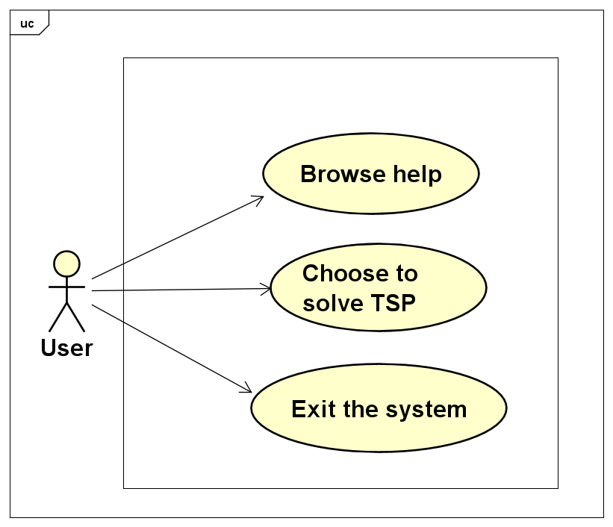
Use case
diagram
Mercury
Mercury was named after a Roman god. It’s the closest planet to the Sun in the Solar System
Jupiter
Jupiter is a gas giant as well and actually also the biggest planet in the Solar System
Saturn
Saturn is the ringed one. It is a gas giant, composed mostly of hydrogen and helium
Venus
Venus has a beautiful name, but it’s terribly hot. It is the second planet from the Sun

Slide 8
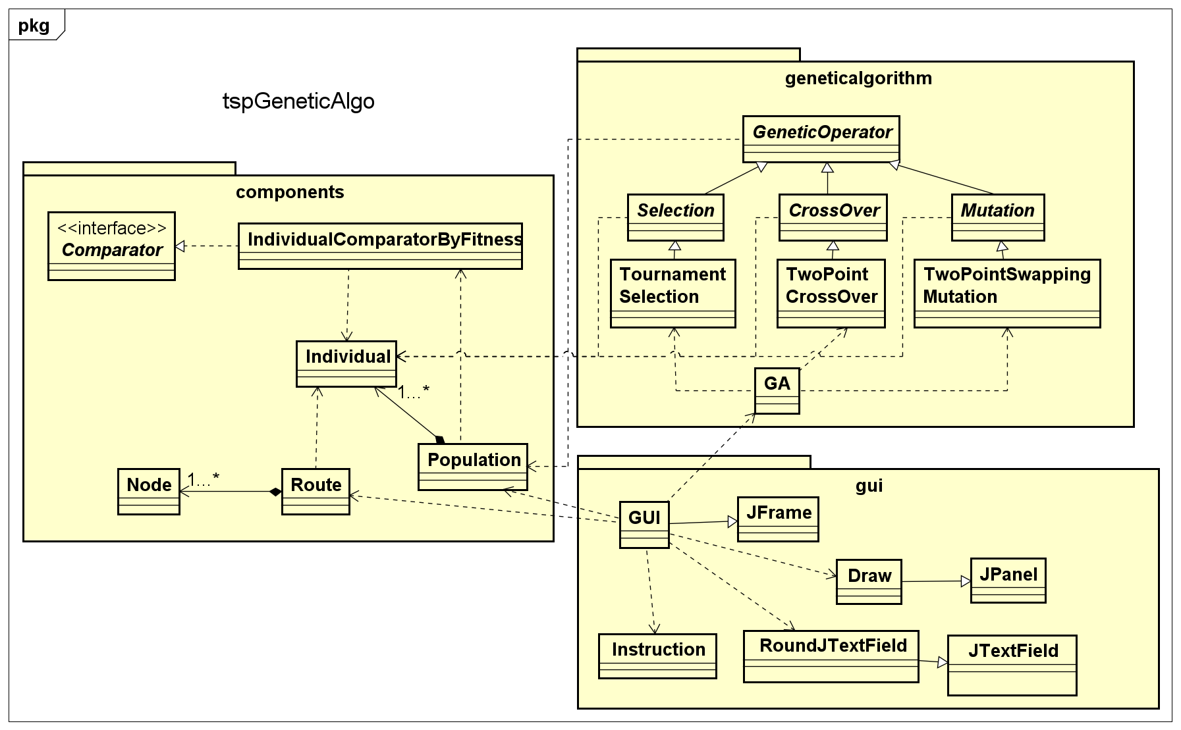
General Class diagram

Slide 9
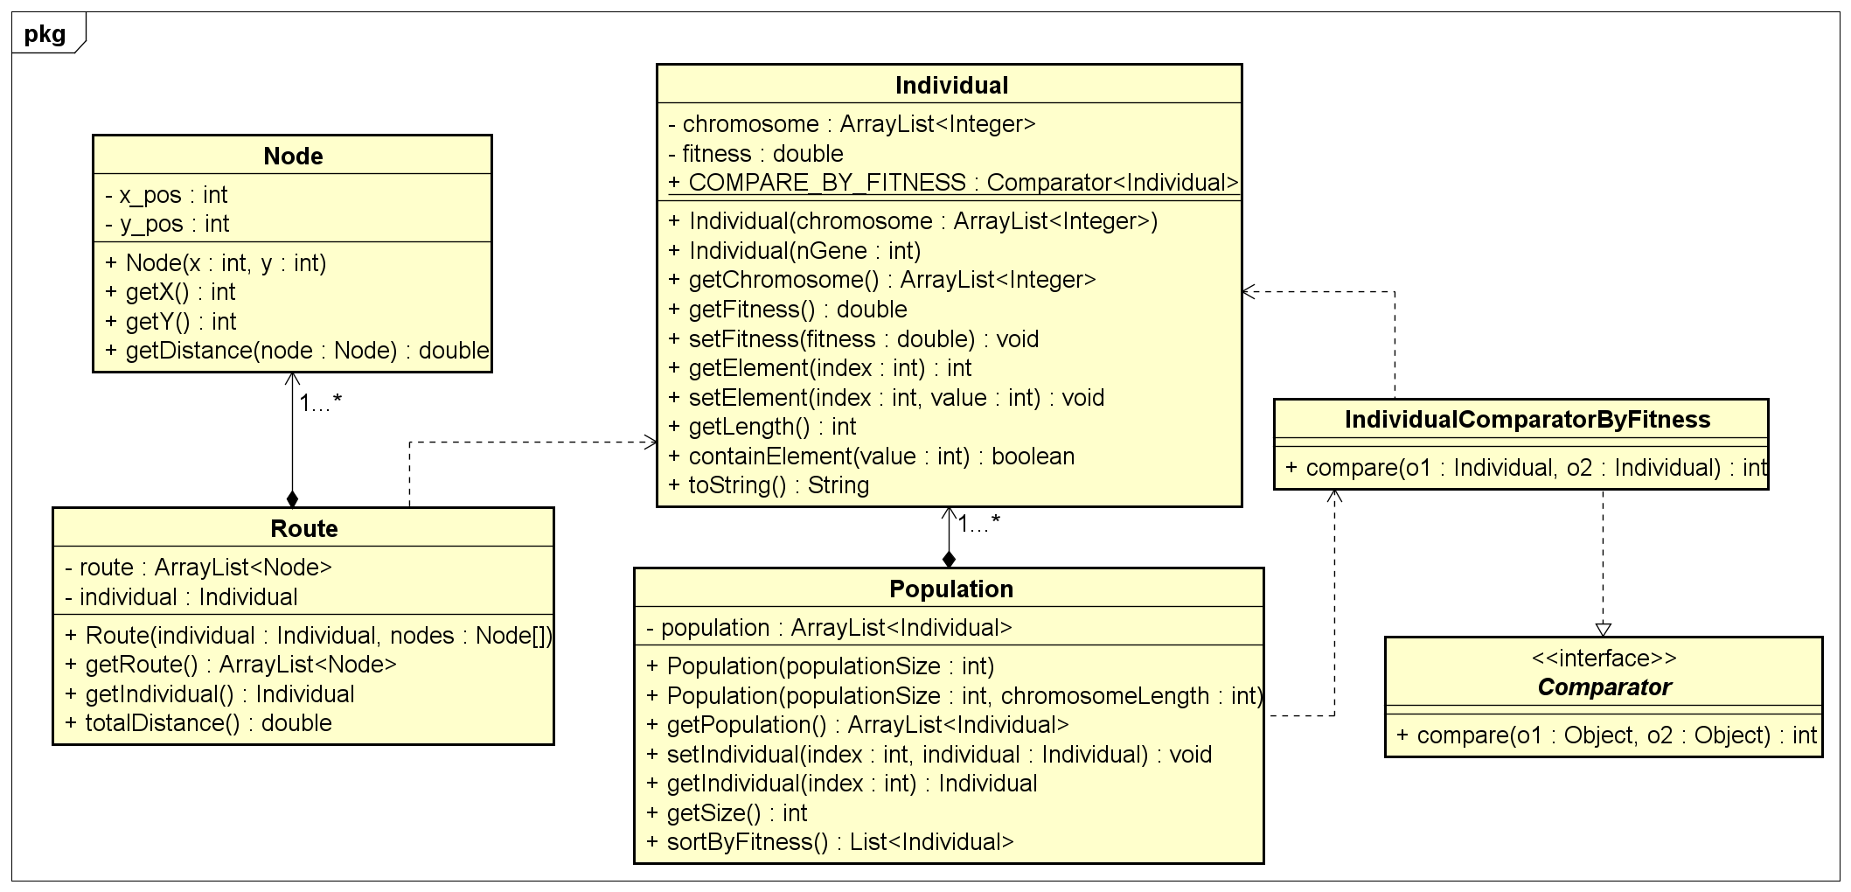
Components Class Diagram

Slide 10
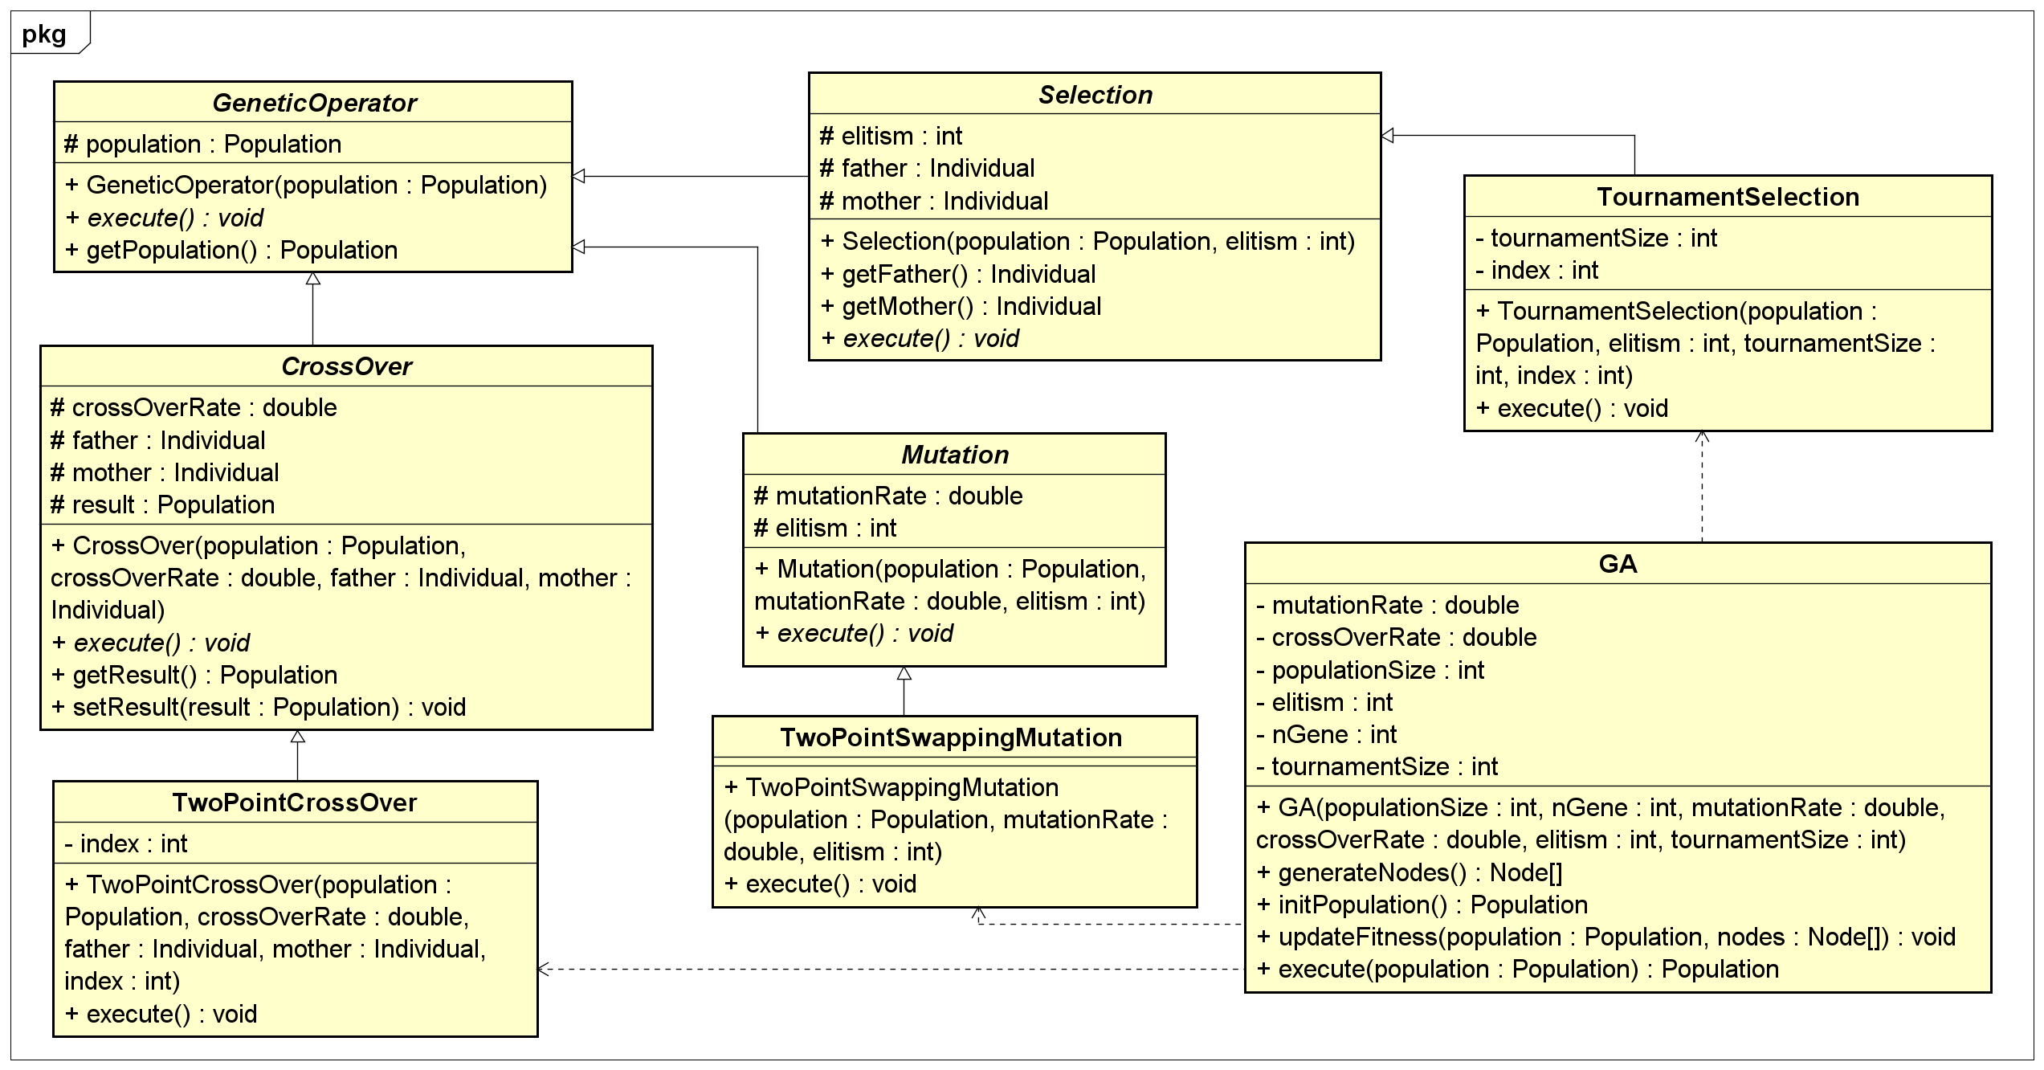
GA Class Diagram

Slide 11
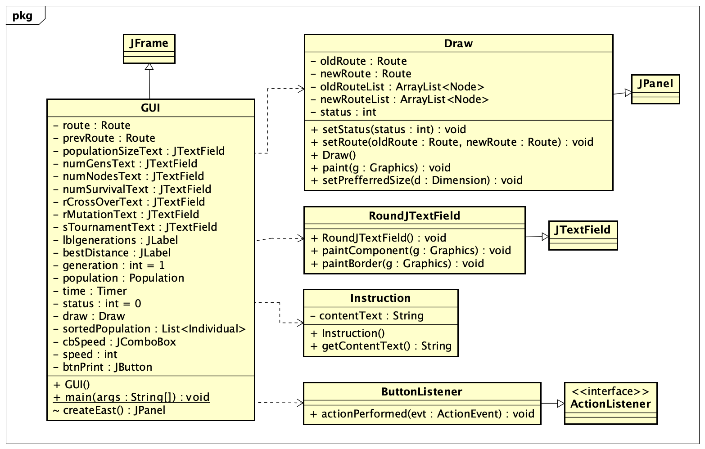
GUI Class Diagram

Slide 12
OOP TECHNIQUES EXPLANATION
Encapsulation
Polymorphism
Abstraction
Aggregation
Inheritance
Composition

Slide 13
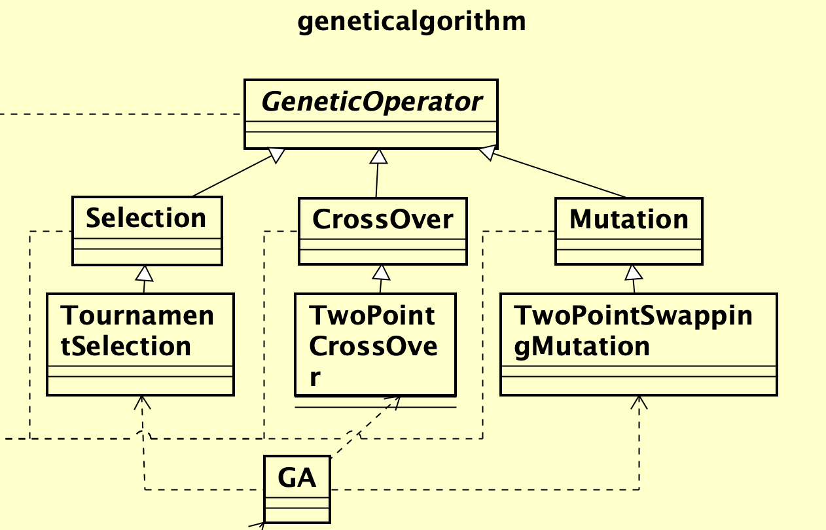
Encapsulation
&
Abstraction
GUI Class Diagram

Slide 14
Encapsulation
&
Abstraction
Genetic Algorithm Class Diagram

Slide 15
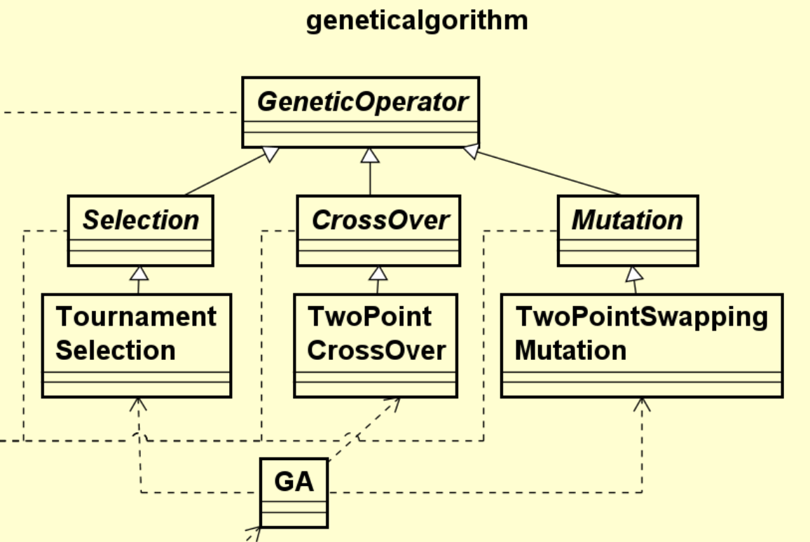
Encapsulation
&
Abstraction
Abstract class
Child classes
(not abstract)
“ga” package

Slide 16
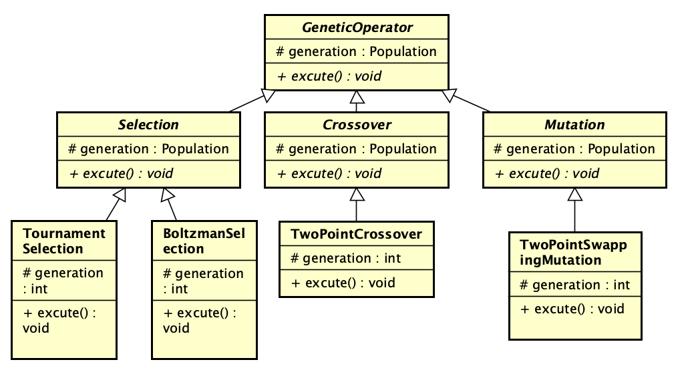
Inheritance and Polymorphism
Abstract class GeneticOperator
with a protected attribute population and public abstract method execute.
Selection, crossover,
mutation
will inherit the attribute population and method execute.
For each genetic operator, there are many strategies to do.
Example: we can do tournament selection or Boltzmann selection

Slide 17
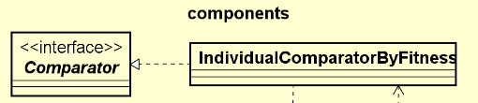
Inheritance and Polymorphism
Override compare method
Compare 2 individuals by their
fitness in selection operator and sorting the populatuion

Slide 18
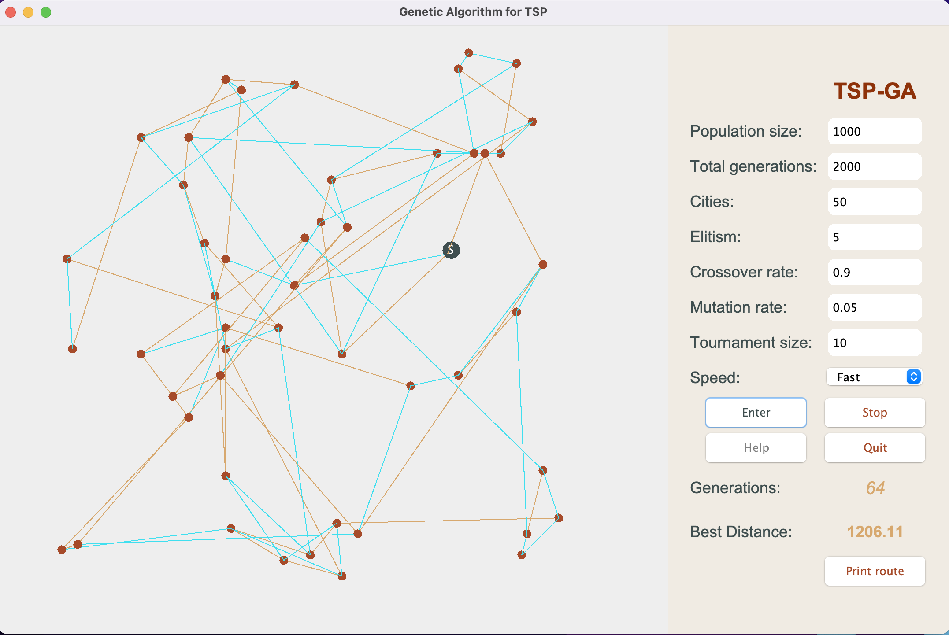
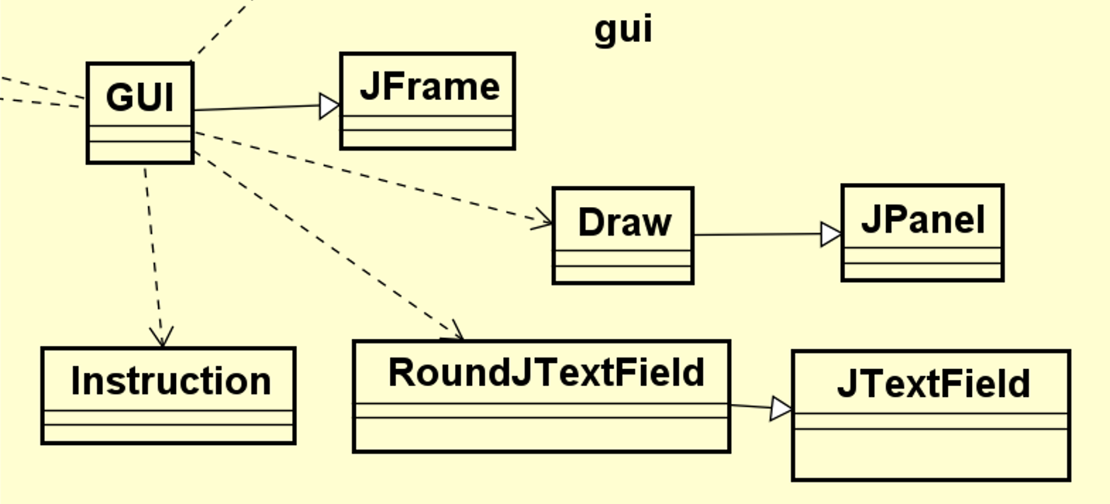
Inheritance and Polymorphism
Override paintComponent and paintBorder methods
Create a text field in shape of round border rectangle
Override paint method
Draw the process of finding the best route through nodes (cities).

Slide 19
Association, Aggregation, Composition
City 2
City 3
Route
is a composition of Nodes
2
3
Route: 0-2-1-3-0
1
0
Start: city 0
City 1
Population
is a composition of Individuals

Slide 20
GUI Demonstration
Visit link:
https://tinyurl.com/2zhh22j6

Slide 21
Thank you for listening
Group 1’s member:
Hoang Van An 20204864
Nguyen The An 20204865
Nguyen Phuc Truong An 20200005
Nguyen Truong Truong An 20204865

