Slide 1
Efficient Automatic Traveler System (EATS)
I'ts hungry for orders

Slide 2



Implementation
Accessed through Google Chrome
EX: http://192.168.2.10/...
Supervisor client
Operator client
Touch Screen Devices
Desktop
Paper trail reduced
2x4 labels identify travelers

Slide 3
How it works
Operator
Supervisor
Operator chooses traveler to run from their station queue
Run the traveler
It is timed
Submit the completed traveler
Scrap must be entered
Can partially complete travelers
Print label for new traveler (if applies)
View all stations & their travelers
Manually manipulate and move travelers
Picking list for each order

Slide 4
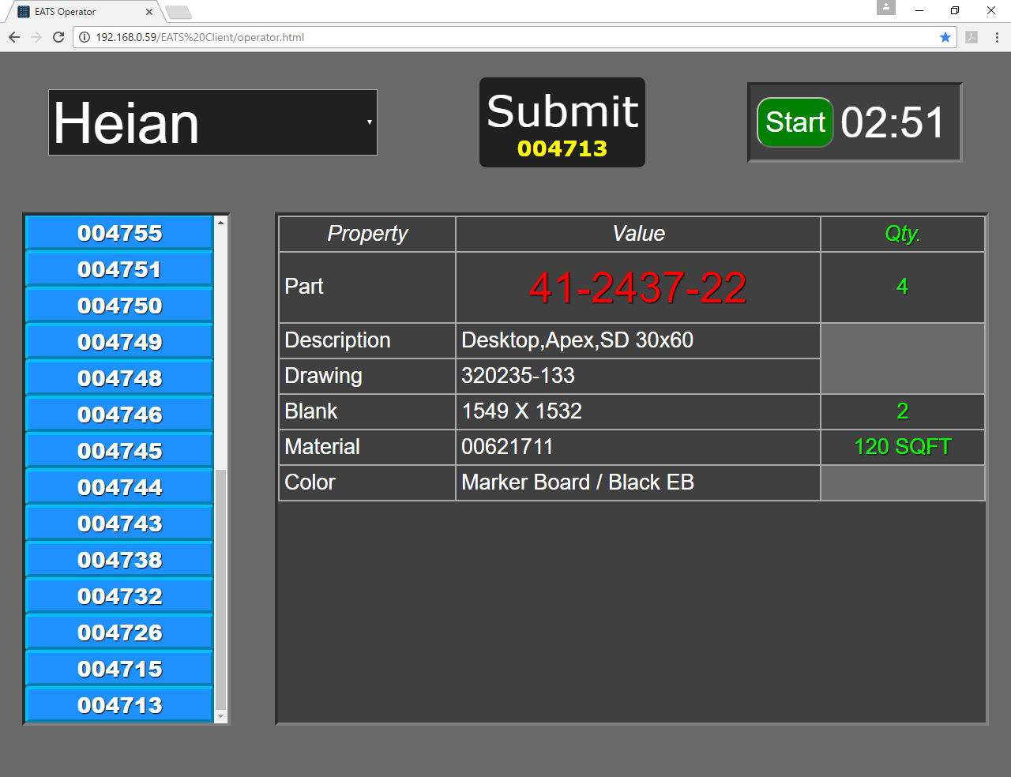

Slide 5
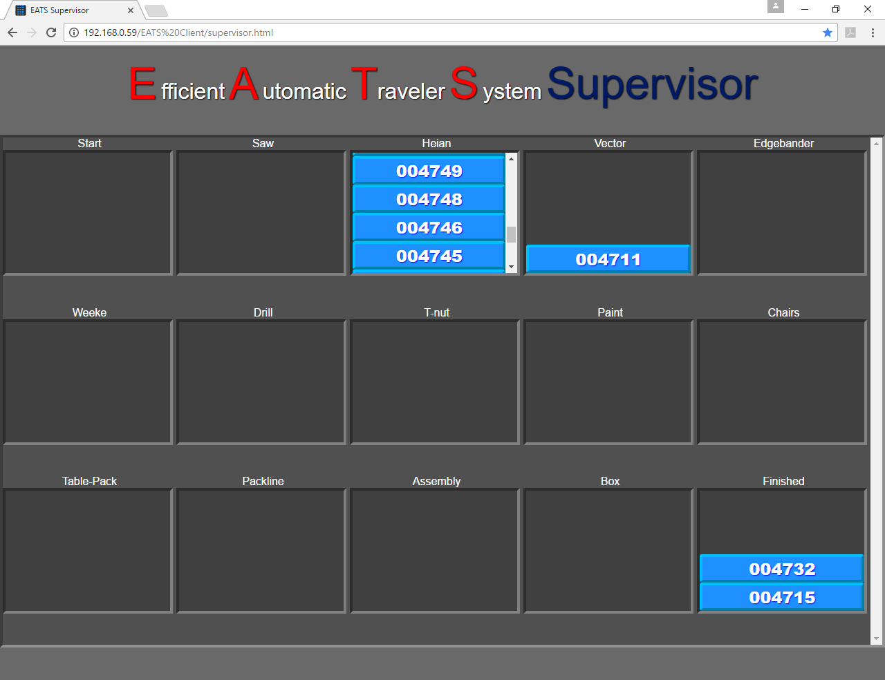

Slide 6
Features
Current
planned
Automatic traveler generation from orders
Tables
Chairs
Travelers continuously check inventory and consolidate if possible
Scrapped parts generate a new traveler
Each traveler is associated with one 2x4 label with an ID number
New traveler queues can easily be added
Possible storage queues
No software installation required
Supervisor has full control over traveler's properties
Module for displaying order picking list
Full configurability of traveler flow and operation
Kanban monitoring for any item
New traveler types
Case goods
Boxes
Blanks?
Material handler client
Drawing PDF can be viewed

Slide 7
The system
Advantages
Caveats
Its Efficient
Its Automatic
Feedback can improve it
No licensing issues
All physical actions must be mirrored in the digital representation
Numbers must be checked

