Slide 1
E C H O S P H E R E
CONTINUOUS AUDIO · SPATIAL STORYTELLING
EchoSphere
Your voice shapes
the story’s atmosphere.
An audio-first narrative experiment.
AMD
Gemma
Evolus
Developer Cloud
Open model
Agent + API
VOICE → ATMOSPHERE → STORY
AMD DEVELOPER HACKATHON ACT 3 / TRACK 4
01 / 06
Notes:
0:00–0:25 · 25 seconds
SAY
EchoSphere explores a simple idea: your voice should do more than choose the next line of a story. It should shape the world around you. We combine continuous audio feedback with a narrative guide, using an Evolus agent connected to Gemma on AMD Developer Cloud.
PRESENTER CUE (not spoken)
Open on the title. Emphasize the three technology names; no live app switch is needed.
Target total: 4:10. Hard limit: 4:30.

Slide 2
E C H O S P H E R E
WHO IT IS FOR
For the people who
bring stories to life.
01
02
03
Immersive studios
Museums & venues
Audio-first audiences
Create responsive worlds
for interactive entertainment.
Turn a visit into a story
the audience can influence.
Explore through voice, with
text and keyboard alternatives.
CREATORS / POTENTIAL CUSTOMERS
PARTICIPANTS
Proposed model: creator or venue subscription.
AMD DEVELOPER HACKATHON ACT 3 / TRACK 4
02 / 06
Notes:
0:25–0:55 · 30 seconds
SAY
We are building for immersive studios, museums, and creators of interactive audio. They create the worlds; visitors and listeners explore them. The aim is to make one story world respond differently to each participant, while offering voice, text, and keyboard controls. Our proposed business model is a creator or venue subscription. That is a customer hypothesis we still need to validate.
PRESENTER CUE (not spoken)
Point from the two creator/customer cards to the participant card.
Target total: 4:10. Hard limit: 4:30.

Slide 3
E C H O S P H E R E
THE PROBLEM IT ADDRESSES
A voice carries
more than words.
SAME WORDS
“I’m here.”
A transcript loses softness,
pauses and intensity.
SOFT DELIVERY
Waiting for a full turn can leave
the world unresponsive while we speak.
STRONGER DELIVERY
Delivery is an acoustic cue, not a diagnosis of emotion.
AMD DEVELOPER HACKATHON ACT 3 / TRACK 4
03 / 06
Notes:
0:55–1:30 · 35 seconds
SAY
A transcript captures what we say, but loses much of how we say it. The same words can arrive softly, loudly, or with long pauses. A story driven only by text has no direct signal for those differences. And if every reaction waits for a completed turn, the world can feel unresponsive while we speak. EchoSphere separates immediate acoustic feedback from slower narrative reasoning.
PRESENTER CUE (not spoken)
Use the two waveforms to illustrate delivery only. Do not assign emotions to either waveform.
Target total: 4:10. Hard limit: 4:30.

Slide 4
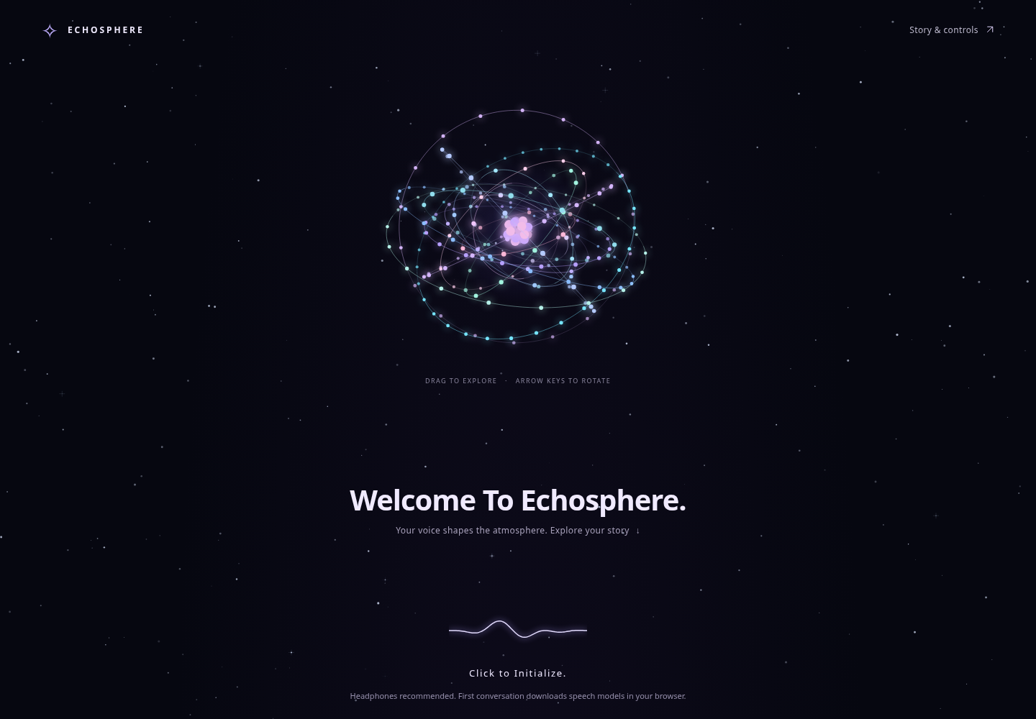
E C H O S P H E R E
WHAT IT DOES
Words move the plot.
Your delivery shapes the world.
01
As you speak
50 ms audio frames shape the atom,
waveform and ambient sound locally.
02
As the story develops
A guide leads, responds and can be interrupted.
Story cues direct a spatial voice.
16 orbits · Voice + text input · Automatic scene placement
AMD DEVELOPER HACKATHON ACT 3 / TRACK 4
04 / 06
Notes:
1:30–2:15 · 45 seconds
SAY
The experience opens in a starfield around a draggable, sixteen-orbit atom. While you speak, local audio frames change the visuals and ambience. A slower, parallel path recognizes your words and sends them, with acoustic context, to the narrative agent. The guide leads the story, and you can interrupt it. Browser-generated speech passes through spatial positioning, distance filtering, and room effects. Story cues choose the placement, while vocal delivery modulates it. Words move the plot; the way you speak shapes the atmosphere.
PRESENTER CUE (not spoken)
The screenshot is the real app interface. Describe the implemented paths; do not imply that a live speech-model acceptance test has passed.
Target total: 4:10. Hard limit: 4:30.

Slide 5
E C H O S P H E R E
THE ROLE OF TECHNOLOGY
AMD runs the narrative.
The browser shapes the moment.
AMD
Gemma
Evolus
DEVELOPER CLOUD
CONFIGURED: GEMMA 4 · 31B IT
AGENT + API
GPU compute for
narrative inference.
Generates story language
from input and context.
Connects the app to
the configured model.
REQUEST PATH
Browser → Secure backend → Evolus → Gemma on AMD
LOCAL AUDIO
Whisper: words in · Kokoro: voice out · Web Audio: spatial sound
AMD DEVELOPER HACKATHON ACT 3 / TRACK 4
05 / 06
Notes:
2:15–3:10 · 55 seconds
SAY
Each technology has a distinct role. AMD Developer Cloud hosts the meaningful compute workload: narrative inference. The configured Gemma open model generates the story language using participant input and recent context. Evolus provides the agent and API connection around that model. Our Node backend keeps the credential on the server and forwards streamed responses. In the browser, Whisper handles recognition, Kokoro generates speech, and Web Audio positions that speech in space. The detector, interface, and placement rules are our authored work; narrative prose is model generated. Render hosts the web app, while the narrative model remains on AMD.
PRESENTER CUE (not spoken)
Show the actual AMD deployment/model evidence separately with secrets hidden if available. Do not name a GPU SKU, ROCm version, or serving stack that has not been verified.
Target total: 4:10. Hard limit: 4:30.

Slide 6
E C H O S P H E R E
TWO INPUTS · TWO STORY RESPONSES
Turn listening into participation.
QUIET DISCOVERY
DISTANT ENCOUNTER
“Please stay beside me
and speak softly.”
“Let a distant voice answer
from the right.”
Guide close by
0.65 m placement preset
Voice from the far right
7 m / 55° placement preset
Real Evolus text responses + local placement decisions · Typed-input comparison
54 automated tests pass
SOURCE REPOSITORY
github.com/sg01-stack/project-zero
Next validation: speech models + public HTTPS voice demo
AMD DEVELOPER HACKATHON ACT 3 / TRACK 4
06 / 06
Notes:
3:10–4:10 · 60 seconds
SAY
We have tested two written inputs against the real Evolus agent. A quiet request produced a guide right beside the listener; a distant encounter produced a reply from the far right. The local director mapped those replies to different spatial presets. These are real text responses, not proof of microphone recognition. Fifty-four automated tests pass, including audio and backend checks. Our remaining acceptance steps are successful real Whisper and Kokoro inference, followed by the public HTTPS voice demo. Costs come from AMD compute, hosting, and any billable Evolus services; cost per session is not yet measured. EchoSphere's goal is simple: turn listening into participation.
PRESENTER CUE (not spoken)
These examples are from the documented live typed comparison. Keep the verification line visible. Finish by 4:10; the remaining 20 seconds are a buffer, not another demo segment.
Target total: 4:10. Hard limit: 4:30.

