Slide 1
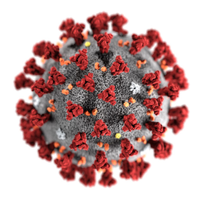
PRESENTATION ON COVID-19 NOTIFICATION SYSTEM
By – Shivam Gupta (1714310173)

Slide 2
CONTENT -
Introduction
Project Details
Technology Used
Current Status of Project
Future Timeline

Slide 3
INTRODUCTION -
Covid-19 is the virus known as corona virus and know it affected almost 215 countries of the world. World Health Organization declared Covid-19 as a pandemic on March 11th, 2020. The cases reported rapidly from all over the places impacting the day-to- day life of both organizations and individuals across the world. It is now imperative to understand how long the pandemic might last and find effective ways to flatten the progression of COVID-19 cases.
COVID-19 NOTIFICATION SYSTEM is an application that provides information of current cases of COVID-19 patients around the world using notifications using Python.

Slide 4
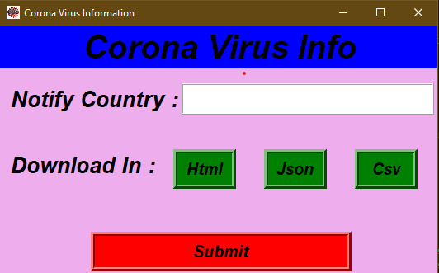
PROJECT DETAILS -
This is the starting view after running the application

Slide 5
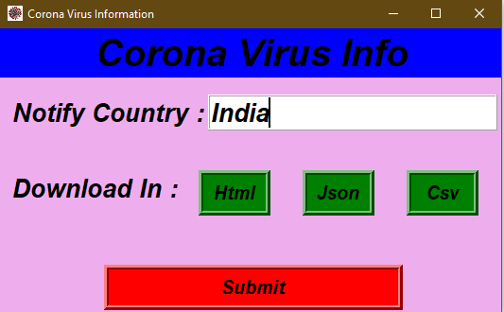
After entering the name of country in ‘Notify Country’ box click on the submit button

Slide 6
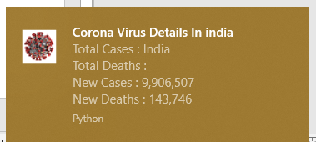
After clicking on submit button we receive a notification in the bottom right corner of the screen showing total number of COVID-19 patients and total number of deaths in that country.

Slide 7
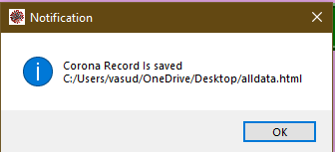
You can download the result as an HTML file, Json file or Csv file like if we want data of all the countries then just write ‘world’ in notify country box and choose one option from HTML, Json, Csv and click on submit button . After selecting the location you receive a notification like this.

Slide 8
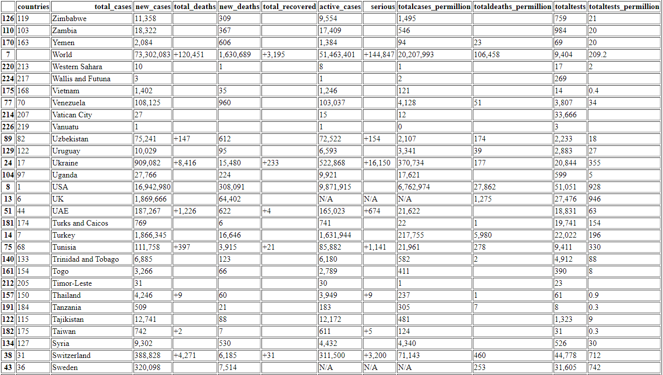
Suppose we select HTML, then a HTML file is saved with a name ‘alldata.html‘ showing all data in a tabular form like this.

Slide 9
H/W Requirement
• Processor: Intel dual core or above
• Processor Speed:1.0GHZ or above
• RAM: 1 GB RAM or above
• Hard Disk: 20 GB hard disk or above
S/W REQUIREMENTS
• Operating system : windows
• Programming Language: Python
• IDE : Visual Studio Code
• Data : 'https://www.worldometers.info/coronavirus/’

Slide 10
MODULES USED -
tkinter import messagebox, filedialog –
Tkinter is a Python’s standard GUI Framework.
Message boxes are convenient dialogs that provide messages to the user of the application.
2. Plyer –
Plyer is a Python library for accessing features of your hardware / platforms.
It is used to display the text message.

Slide 11
Notification –
Plyer has a function notification prebuilt to provide notifications.
Pandas –
pandas will help you to explore, clean and process your data.
In pandas, a data table is called a DataFrame.
4. bs4 import BeautifulSoup –
Beautiful Soup is a Python library for pulling data out of HTML and XML files. It works with your favorite parser to provide idiomatic ways of navigating, searching, and modifying the parse tree.
Request –
Request module help to send a get request to a website to fetch a website.

Slide 12
FUTURE TIMELINE -
We are trying to build a ML model for our project which will provide the probability of how redly a person is a need of COVID-19 test. It will priorities among a cluster of people that who is in more rapid need of COVID-19 test.

Slide 13
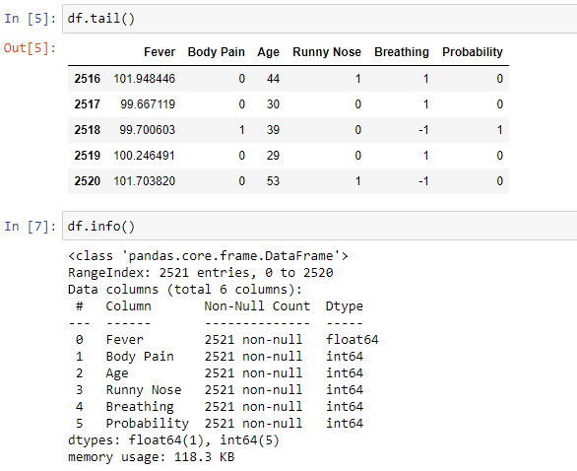
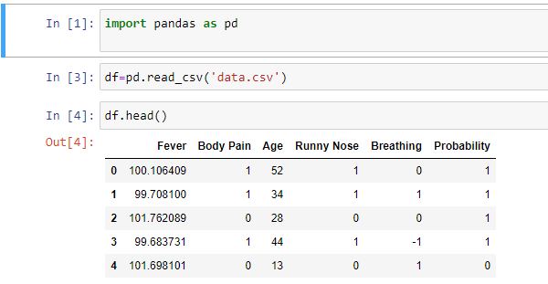
GLIMPSE OF FUTURE REFRENCE -

Slide 14
Thank You

