Slide 1
Internationalization From the Perspective of Defect Analysis
For SG16 | October 12th
Michael Kuperstein

Slide 2
Globalization
(g11n)
Localization
(l10n)
Internationalization
(i18n)
Translation
(t9n)

Slide 3
Defects in Localized Software (Jan-Jul 2011)
Notes:
Your mileage may vary.

Slide 4
World-Readiness Defect Types Analysis of 50K L10N Defects, Multi-Year, Multi-Database
Notes:
Talking Points:
Embedded strings + truncations were the numerous and vexing issues (with a very long tail of other issues).
Different types of applications result in a different distribution of issues.
I was able to clearly identify 11 defect types by using a combination of the defect type field, searching for key words in the defect descriptions, and pulling data from different defect databases.
Some of these defect types are very well understood and very crisp:
Embedded strings
Typo/spelling
Legal/branding terminology
Source spelling/ grammar
Corrupt/garbage
Other categories are extremely fuzzy and have many underlying causes:
“Other Translation Issue” – could be that we missed sending a file to translation, could be an embedded string, could be part of the translation process.
Obviously, we have two categories that we need to really work on:
“UI/Layout/Formatting”
“Other Translation Issue”
Source:
This presentation slide is originally from 2013 i18n Conference - Squashing the Top 10 Most Common World-Readiness Bugs - Michael Kuperstein.

Slide 5
Code Scans: I18N Issues by Volume
Top Issues:
Hard-coded strings: loading from string tables
Formatting strings, numbers, dates, etc. : internal vs user-visible
… long tail on the next page
* Based on I18N Code Scans of C/C++, Java, C#, JavaScript, all OS

Slide 6
I18N Issues by Volume – Honorable Mentions
Formatting dates and times internally as ISO 8601 / UTC to avoid failures.
DateTime.Now vs DateTime.UtcNow
Encodings: UTF-8 vs UTF-16, char vs wchar_t, etc.
ToUpper() and ToLower()
Turkish I problem
Understanding and correctly using language tags (BCP-47)
if (String.Compare(cultureFolder, "zh-CN", StringComparison.OrdinalIgnoreCase) == 0)
// Fails for zh-HK Windows SKU.
Spelling? 😐
Many presentations cover items in the long tail because they’re fun, unique, and news-worthy, but the long tail is not where most of the l10n/i18n effort is for most developers.

Slide 7
More than 150 string formatting functions in C/C++ on Windows
_ultot_s(addressRow.Address.Ipv4.sin_port, szField, 128, 10);
dwNumericParam = _ttol(g_szSearchParam);
swprintf(wc_buf, TEXT("%12.12e"), width);
printf("{%u,%u,%d}", state.lencode[low].op, state.lencode[low].bits,
fprintf(stderr,"incorrect gamma=(%d/100000)\n",(int)png_ptr->int_gamma);
wvsprintf(szTmp, fmt, ap);
wsprintf(time_buf, TEXT("%d %S %d %02d:%02d:%02d +0000"),
_tprintf(_T(" Status: %s\r\n"),
StringCchPrintfW(wszMonikerName, sizeof(wszMonikerName)/sizeof(wszMonikerName[0]), L"Elevation:Administrator!new:%s", wszCLSID);
StringCbVPrintf(szMessage, 2048, lpszFormat, argList);
csVersion.Format(_T("API Version: v%d.%d\n"), dwMajor, dwMinor);
_tstring strIPAddress = Format(_T("%d.%d.%d.%d"), a, b, c, d);
Problems:
Some are C++ functions from 1970’s
Some are weird Windows functions
Most are log functions, but a few may be user-visible.
Formatting numbers, dates for logs should stay language-independent for debugging (US English)
IP Addresses can be Arabic or Hindi script
All from a single driver applet!

Slide 8
Defaults: Fall into the pit of success
Developers usually reach for the most convenient tool for a task, even if it’s non-optimal for i18n:
Built-in methods in the language or SDK: printf() or String.Format()
Native OS functions
Download a package from a package manager
Copy code from StackOverflow
Discussion:
What is the developer perception of ICU?

Slide 9
Quick Intro to BCP 47 Language Tags and Fallback
language-script-region
Fallback Culture
zh
zh-Hant
zh-Hans
zh-HK
zh-MO
zh-TW
zh-SG
zh-CN
Notes:
Talking Points:
In Java and .NET, there are five regional variations of the Chinese BCP 47 tags.
We have seen ‘zh’ used in practice, usually denoting ‘zh-Hans’, but zh isn’t really very specific. We should strive to be specific enough, but not overly specific.
For these tags, we are only talking about “written” language. If we want to specify spoken Chinese, with it’s myriad dialects, how would we identify those languages with tags, and what if the script for the spoken language conflicts with the written script? This is a topic for another day...

Slide 10
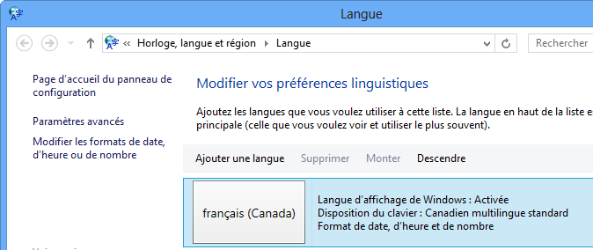
User Language Selection Choices
New PC Boot-up (Out-Of-The-Box Experience)
Install Language Packs
Browser UI Display Language
Browser Accept-Language (s) sent to server
Application can set the locale or UI language per thread
CurrentCulture / CurrentUICulture
std::setlocale
CultureInfo ci = new CultureInfo("es");
Thread.CurrentThread.CurrentCulture = ci;
Thread.CurrentThread.CurrentUICulture = ci;
LANG
LC_ALL
LC_COLLATE
LC_CTYPE
LC_MONETARY
LC_NUMERIC
LC_TIME
etc…

Slide 11
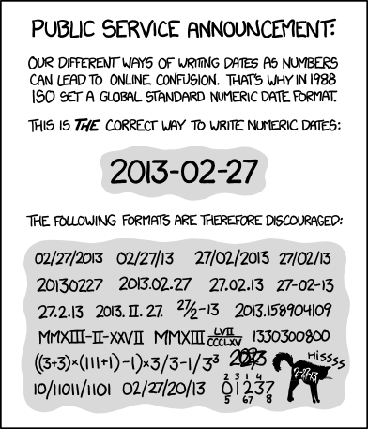
xkcd web comic Use ISO 8601 format Use UTC time zone
Notes:
Talking Points:
The popular (and geeky) xkcd web comic illustrates why we need to use a standard format for dates and times: ISO 8601.
Equally important: use the UTC time zone to avoid major functionality failures, from user confusion to outright web server failures.
Also refer to the Inside Blue thread on “UTC as the Standard”
https://soco.intel.com/message/2409092
Comic Source:
http://xkcd.com/1179/

Slide 12
The Famous Turkish “İ” Problem
"file".ToUpper()=>"FİLE"
"FILE".ToLower()=>"fıle"
string ext = Path.GetExtension("IMAGE.GIF");
if (ext.ToLower() == ".gif")
// Never true for Turkish locale!
Notes:
Talking Points:
Some issues hide in rarely used code; only surfacing when run in specific configurations, such as when run on a Turkish system.
The famous Turkish “I” problem is yet another reason why you should run a code scanning tool.
Solutions:
Solutions for comparison of paths and file names:
ToLowerInvariant(), ToUpperInvariant()
Compare() with either StringComparer.OrdinalIgnoreCase or StringComparer.InvariantCultureIgnoreCase
Snippet Compiler Sample Code:
System.Threading.Thread.CurrentThread.CurrentCulture = new CultureInfo("tr-TR"); // Turkish
string extension = ".GIF";
string ext = extension.ToLower();
if( ext == ".gif" )
Console.WriteLine("Extension: success");
else
Console.WriteLine("Extension: fail");
string argument = "EXIT";
if( argument.ToLower().EndsWith("exit"))
Console.WriteLine("exit: success");
else
Console.WriteLine("exit: fail");
Sources:
The Turkish “İ” Problem and Why You Should Care
Phil talks about configuring FxCop (free) to find these problems.
http://haacked.com/archive/2012/07/05/turkish-i-problem-and-why-you-should-care.aspx

Slide 13
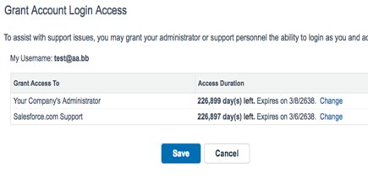
Formats (numbers, dates, etc.) are not as straightforward as they appear
Number formats
123,456,789.00, 123 456 789,00, or 12,34,56,789.00
Decimal and thousand separators
Date and Time
Convert to UTC, manipulate as UTC
Beware of messages with a short “useful life” (password reset)
Time Sync between Client and Server
Currencies
$, £, €, ₹ or USD (but also MXN and many more), GBP, EUR, INR (Rs)
How much is 100 ¥?
Single currency (€) area doesn’t overlap with EU countries
Calendars
Notes:
Does the concept of “thousand separator” even apply?
How much is 100 ¥ in USD? If JPY, less than $1. If CNY, about $14

Slide 14
Many other things can go wrong when dealing with international users
Searching and Sorting
i, ı, İ, and I, aka “the Turkish I”
Different cultures have different ways of sorting text strings
Unicode Collation Algorithm
Keyboards
QWERTY, AZERTY, etc.
Can lead to password problems…
Plural Forms
Useful to handle strings like “Found {0} result(s)”
2 options in English, not true everywhere
Comparison of plural forms
Security Issues
https://www.pаypal.com
Many different forms of security risks (spoofing, ill-formed subsequences, etc.)
Unicode Security Considerations
Notes:
See:
Unicode Technical Standard #35 – Unicode Locale Data Markup Language (LDML), XML format (used in the CLDR) for the exchange of structured locale data - https://www.unicode.org/reports/tr35/
Unicode Technical Report #36 – Unicode Security Considerations

Slide 15
JavaScript i18n Objects and Namespaces
JavaScript Built-In
Date
Number
String
Object [Intl] {
getCanonicalLocales(),
supportedValuesOf(),
DateTimeFormat(),
NumberFormat(),
Collator(),
PluralRules(),
RelativeTimeFormat(),
ListFormat(),
Locale(),
DisplayNames(),
Segmenter(),
}
i18n Namespace Types
i18n.LanguageCode
A language tag such as "en-US" or "fr".
i18n Namespace Functions
i18n.getAcceptLanguages()
Gets the accept-languages of the browser.
i18n.getMessage()
Gets the localized string for the specified message.
i18n.getUILanguage()
Gets the UI language of the browser.
i18n.detectLanguage()
Detects the language of the provided text using the Compact Language Detector.
Notes:
References:
https://developer.mozilla.org/en-US/docs/Web/JavaScript/Reference/Global_Objects/String
https://developer.mozilla.org/en-US/docs/Mozilla/Add-ons/WebExtensions/API/i18n
https://developer.mozilla.org/en-US/docs/Web/JavaScript/Reference/Global_Objects/Intl

Slide 16
.NET Culture Aware Classes and Namespaces
Namespace | Description
System.Resources | Includes information on retrieving translated resources by culture.
System.Globalization | Contains culture-related information, including calendars, format patterns for dates, currency, and numbers, and sort order for strings. System.Globalization.CultureInfo System.Globalization.CompareInfo System.Globalization.StringInfo System.Globalization.Calendar
System.Text | Encoding classes. Also System.Text.Json
System.DateTime
System.String
Notes:
https://learn.microsoft.com/en-us/dotnet/core/extensions/globalization-and-localization

Slide 17
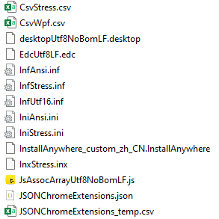
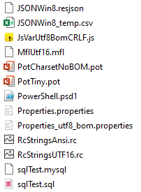
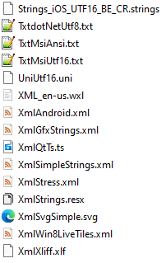
Resource File Formats

Slide 18
Read All Lines From a File
C#
foreach (string line in File.ReadAllLines(filename))
JavaScript
fs.readFileSync(resolvedFilename, 'utf-8').split(/\r?\n/).forEach((line) => {
lines.push(line);
});
C++
std::ifstream file("Read.txt");
std::string str;
while (std::getline(file, str))

Slide 19
Byte Order Mark (BOM) and Endian descriptions
Bytes | Encoding Form
00 00 FE FF | UTF-32, big-endian
FF FE 00 00 | UTF-32, little-endian
FE FF | UTF-16, big-endian
FF FE | UTF-16, little-endian
EF BB BF | UTF-8

Slide 20
Character Count vs Byte Count
Core language string.length or strlen(text) are used everywhere, all the time, for everything, until a defect is logged
Nearly always correct for byte calculations
Character counts in UTF-16 are nearly always correct for most common 15-30 languages: until we
Incorrect character counts in UTF-8 and UTF-16
Nearly all core C++ printf, strcpy, etc. functions work correctly on UTF-8, except in a very small number of cases.
Linux kernel uses UTF-8
Windows uses UTF-16 for 99% of internal text processing; convert to UTF-32 when necessary.

Slide 21
Character Encodings (Incomplete List)
Language
C/C++: char | 8 bits. Undefined encoding. Could be any native encoding or UTF-8
C/C++: wchar_t / std::wstring | 16/32 bits, non-portable types
C/C++: std::u32string | 32 bits
icu::UnicodeString | 32 bits
.NET: Char/char Object | UTF-16
Java: char Class | UTF-16
JavaScript: const letter = 'HELLO WORLD'.charAt(0); | UTF-16

Slide 22
RTL Text Detection
Bad Example:
if (Thread.CurrentThread.CurrentUICulture.TwoLetterISOLanguageName.Equals("ar", StringComparison.OrdinalIgnoreCase)
.NET Preferred:
System.Threading.Thread.CurrentThread.CurrentUICulture.TextInfo.IsRightToLeft

