Slide 1
Reviewing Wisckey: Separating Keys from Values in SSD-Conscious Storage (2016) Lanyue Lu, Thanumalayan Sankaranarayana Pillai, Andrea C. Arpaci-Dusseau, and Remzi H. Arpaci-Dusseau, University of Wisconsin—Madison
Github : sg20180546
20180546변성진

Slide 2
SQL vs NoSQL
Structured Query Language : To much Restrict
Low Performance(Btree, Random Access)
Cost issue(Oracle),OpenSource : Key value, Graph, Document..else
<number>

Slide 3
Why Key-Value Store ?
No SQL
Higher read/write Performance (100~500MB/s)
MySQL
Rocksdb(facebook),DynamoDB(Amazon), LevelDB(Google)
<number>

Slide 4
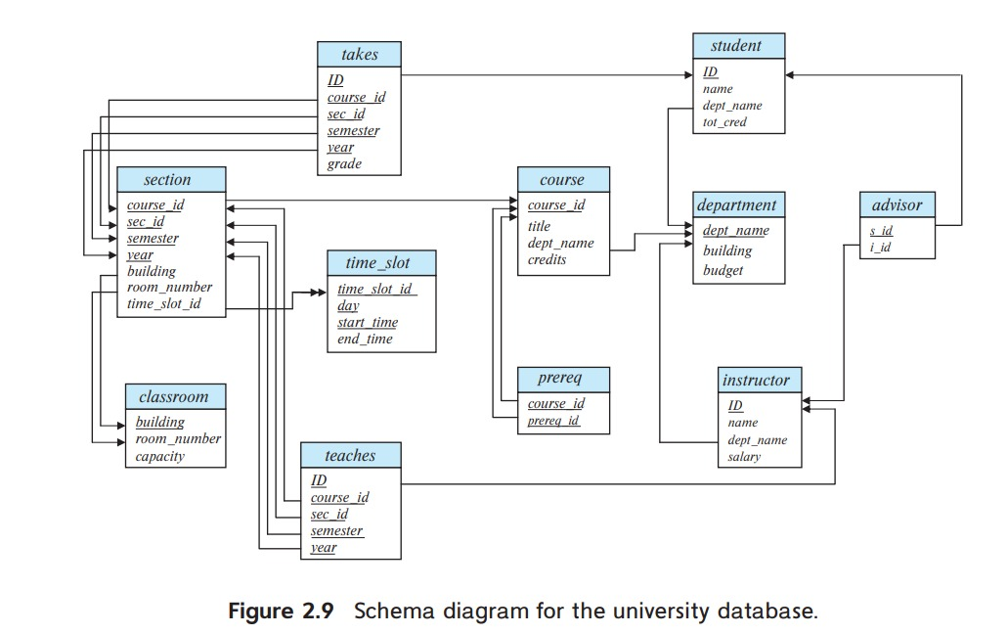
Why Key-Value Store ?
Primary Key Constraints
Referential integrity constraints(Foriegn key constraint)
<number>

Slide 5
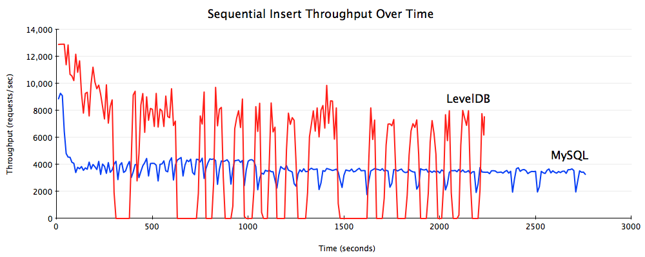
Why Key-Value Store ?
<number>

Slide 6
How Key-Value Store ?
LSM Tree
Compaction
<number>

Slide 7
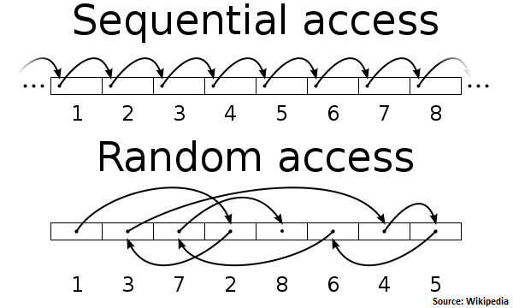
Sequential vs Random
<number>

Slide 8
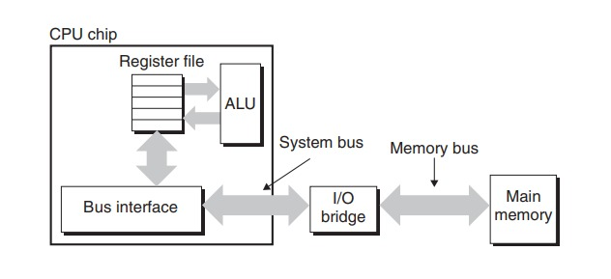
Memory Hierarchy
Reference : csapp
<number>

Slide 9
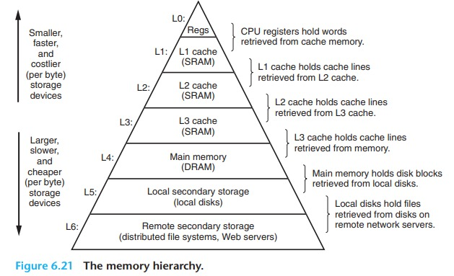
Memory Hierarchy
Reference : csapp
<number>

Slide 10
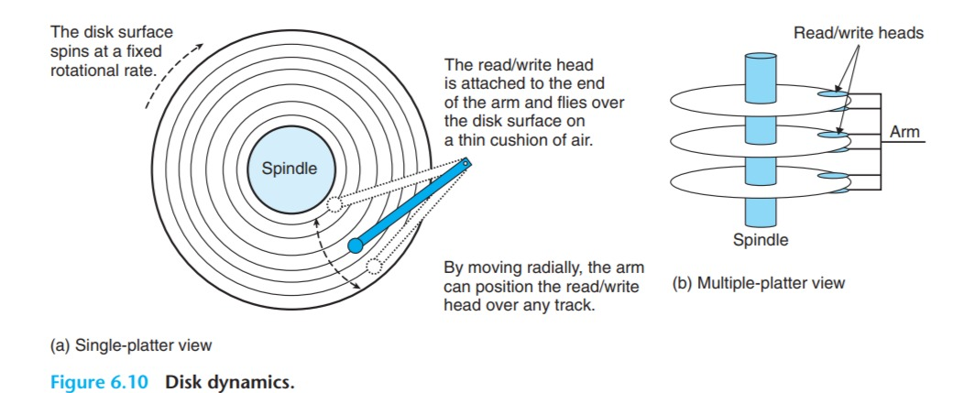
HDD
Reference : csapp
<number>

Slide 11
Sequential vs Random
Sequential I/O is faster !
<number>

Slide 12
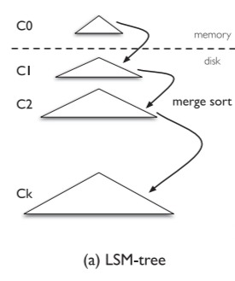
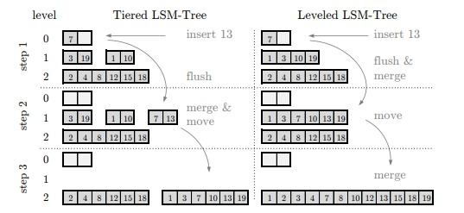
Log-Structured-Merge Tree
Reference : Monkey: Optimal Navigable Key-Value Store(2017),Niv Dayan
<number>

Slide 13
Compaction
If Level X exceed size limit, flush to X+1
Merge Sort (NlogN)
<number>

Slide 14
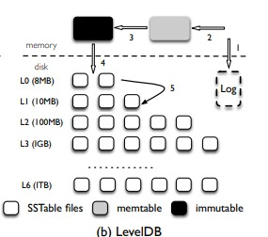
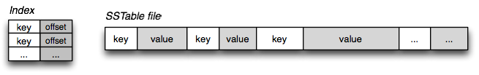
LevelDB
Reference : WiscKey: Separating Keys from Values in SSD-conscious Storage(2016),Lanyue Lu
<number>

Slide 15
Amplification
Read Amplification
(actually accessed byte on disk)/(read size)
Write amplification
(actually write in SSD)/(write size)
<number>

Slide 16
SSD-Conscious
Device Lifetime
Random Read dramatically improved (than HDD)
Internal Parallelism
<number>

Slide 17
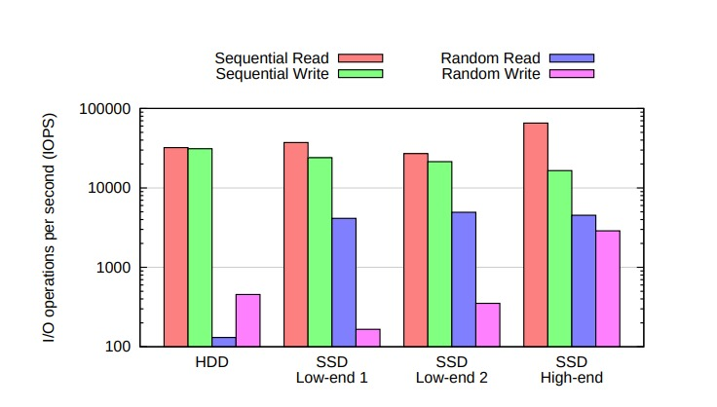
HDD vs SSD
Reference : HeteroDrive: Reshaping the Storage Access Pattern of OLTP Workload Using SSD(2015),Seungryoul Maeng
<number>

Slide 18
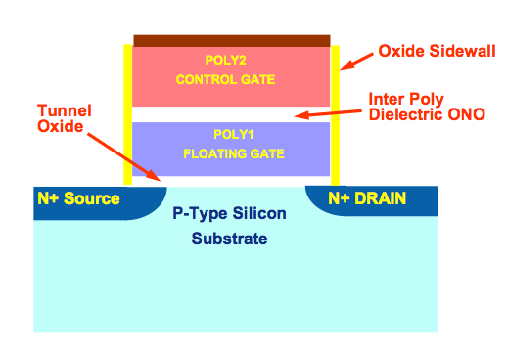
Device Lifetime
Write by page
Delete by block
150TBW / 40GB per day =10 years
Throughput : 1~500MB/s=864 0.5~2.5TB per day
→ ONLY 1500~300 days?
<number>

Slide 19
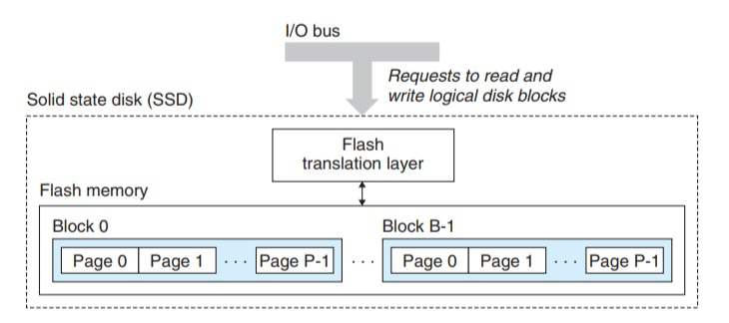
Device Lifetime
Reference : csapp
<number>

Slide 20
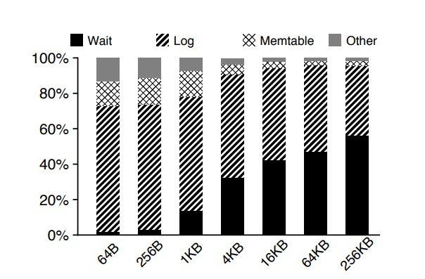
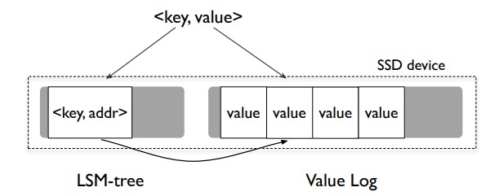
Wisckey Design Idea
Separate Key-Value !
Remove Log
Reference : WiscKey: Separating Keys from Values in SSD-conscious Storage(2016),Lanyue Lu
<number>

Slide 21
By Separating…
Read Amplification Reduced
-caching most of portion of LSM tree(key) in memory, or cache (Disk Access Reduce)
-If Cached, Only 1 Random Access I/O occurs on disk
Write Amplification Reduced
- Small LSM, less compaction, little write amplification
<number>

Slide 22
Challenge
Dealing with value-log : Garbage Collection
Range Query : Internal Parallelism
No Log : Crash Consistency
<number>

Slide 23
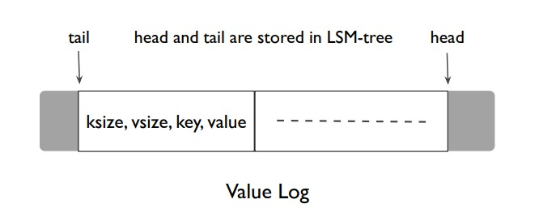
Garbage Collection
Naive : From LSM, find in vlog
Better : From vlog, find in LSM
GC starts from tail, append to head
Query to LSM : node=Get(value-log[tail].key)
if(value_log[tail].addr==node.addr)
append(data,head)
free(tail)
put(‘tail’,tail,position)
Background Job
<number>

Slide 24
Range Query
<number>

Slide 25
Range Query
(example) 32 Background Thread
32 Background Thread prefetch value from value-log
Again, SSD Random I/O dramatically Improved !
<number>

Slide 26
Crash Consistency
Since we remove log , value-log substitue
Crash after Value Written→ GC
Crash after Key Written
if(LSM.node.addr)
if(LSM.node.key!=value_log[LSM.node.addr].key)
Delete(key)
<number>

Slide 27
Optimization
Save head Position of value-log
In Memory Buffer
<number>

Slide 28
Optimizing Crash Consistency
Since we remove log, value-log substitute
Crash after Value Written→ GC
Crash after Key Written
if(LSM.node.addr)
if(LSM.node.key!=value_log[LSM.node.addr].key)
Delete(key)
Optimization : save head position
<number>

Slide 29
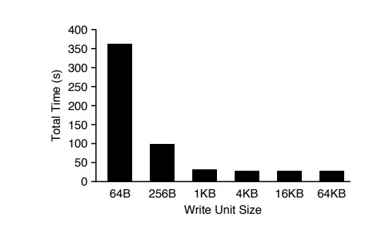
In-Memory Buffer
Reducing system call write()
Total 100MB
1MB*100 times syscall()
10MB*10 times syscall()
Latter is faster
Reference : WiscKey: Separating Keys from Values in SSD-conscious Storage(2016),Lanyue Lu
<number>

Slide 30
Benchmark Environment
Intel® Xeon® CPU E5-2667 v2 @ 3.30GHz processors
64GB Main Memory
64bit Linux 3.14
Ext4
500GB Samsung 840 EVO SSD
500MB/s read, 400MB/s write performance(sequential)
32 Background Thread to Range Query
<number>

Slide 31
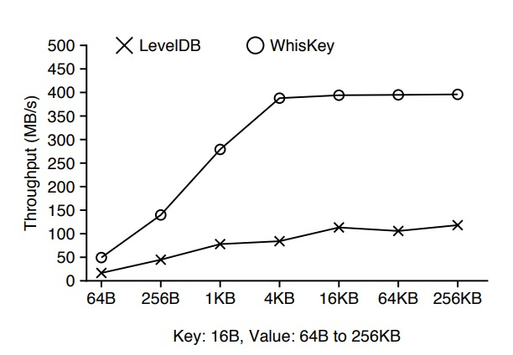
Evaluation (1) : Sequential Load
Sequential Load do not cause compaction, but Random does.
Removing log
<number>

Slide 32
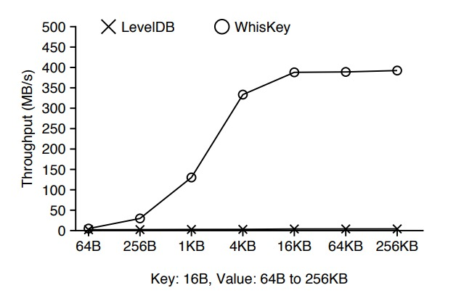
Evaluation (2) : Random Load
Compaction
Device bandwidth
small LSM,less Compaction
<number>

Slide 33
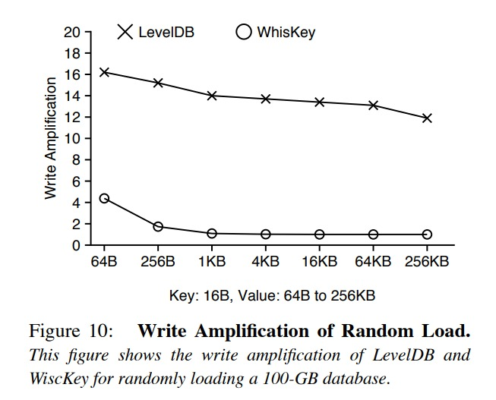
Evaluation (3) : Write Amplification
Less Compaction, Less Write Amplification
<number>

Slide 34
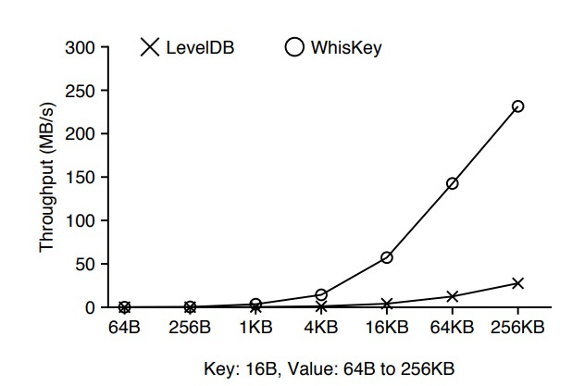
Evaluation (4) : Random Lookup
Small LSM Tree, caching efficiently
<number>

Slide 35
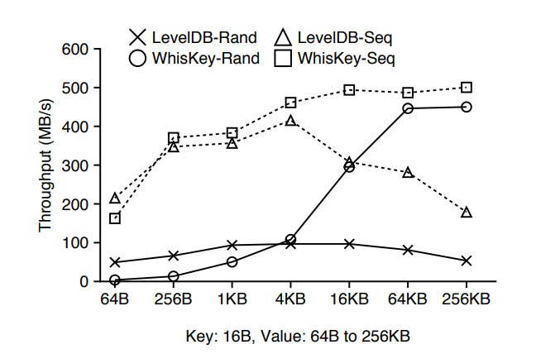
Evaluation (5) : Range Query
<number>

Slide 36
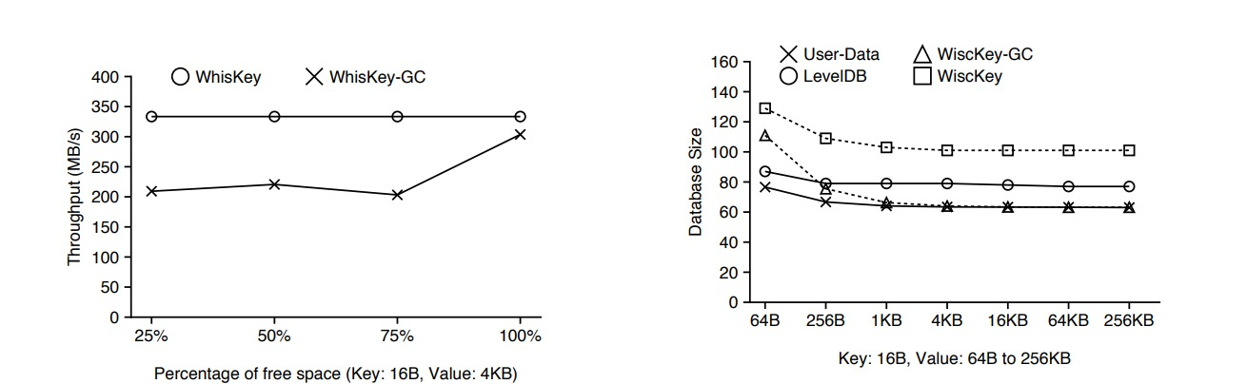
Evaluation (6) : Garbage Collection
<number>

