Slide 1
Github : sg20180546
20180546변성진
Key-Value Storage and related topics

Slide 2
SQL vs NoSQL
Structured Query Language : To much Restrict
Low Performance(Btree, Random Access)
Cost issue(Oracle),OpenSource : Key value, Graph, Document..else
<number>

Slide 3
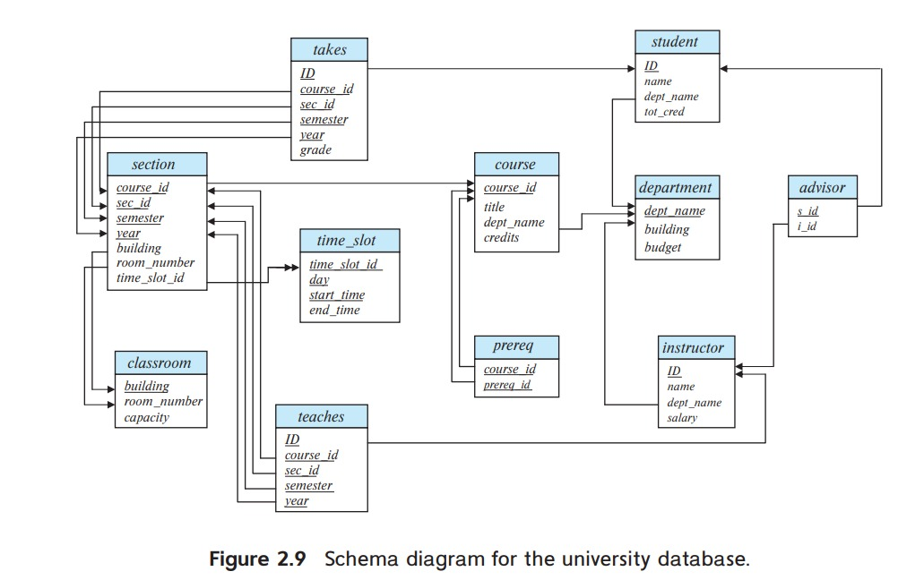
Why Key-Value Store ?
Primary Key Constraints
Referential integrity constraints(Foriegn key constraint)
<number>

Slide 4
Why Key-Value Store ?
No SQL
Higher Write Performance (100~500MB/s)
MySQL
Rocksdb(facebook),DynamoDB(Amazon), LevelDB(Google), Berkeley DB
<number>

Slide 5
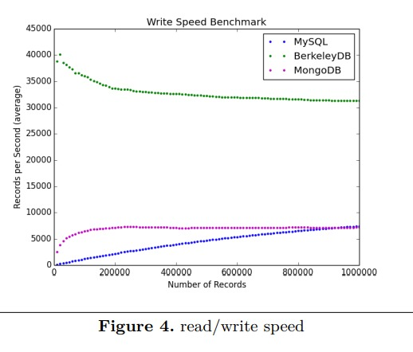
Why Key-Value Store ?
SQL vs NoSQL: A Performance Comparison (2017, Ruihan Wang
<number>

Slide 6
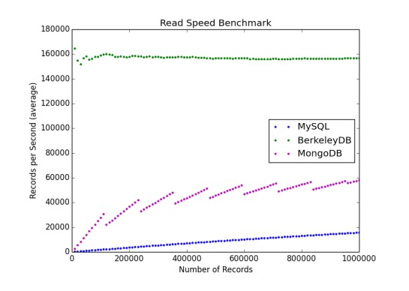
Why Key-Value Store ?
SQL vs NoSQL: A Performance Comparison (2017, Ruihan Wang
<number>

Slide 7
Why Key-Value Store ?
I7-4790 CPU 3.60Ghz Quad Core
16GB Dram, Samsung SSD 970 EVO 250GB
196.8MB/s
<number>

Slide 8
CS Review
<number>

Slide 9
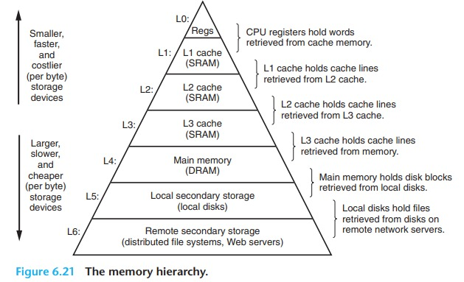
Memory Hierarchy
Reference : csapp
<number>

Slide 10
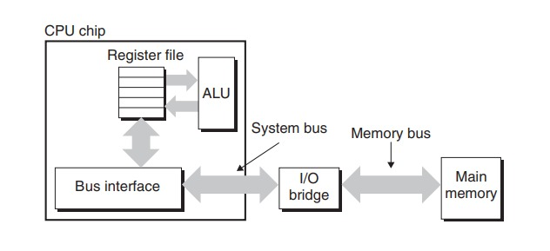
Memory Hierarchy
Reference : csapp
<number>

Slide 11
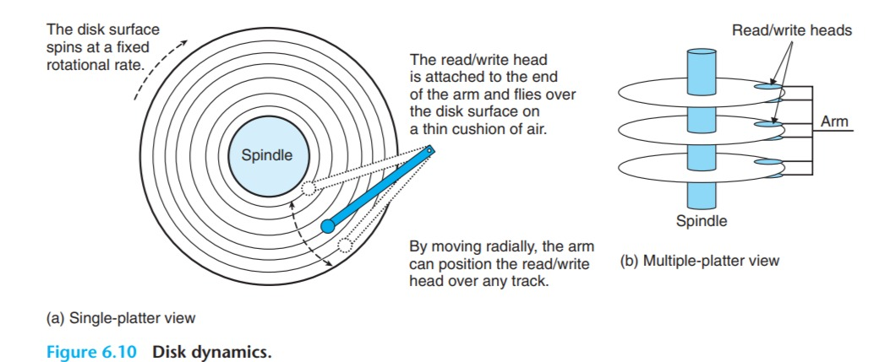
HDD
Reference : csapp
<number>

Slide 12
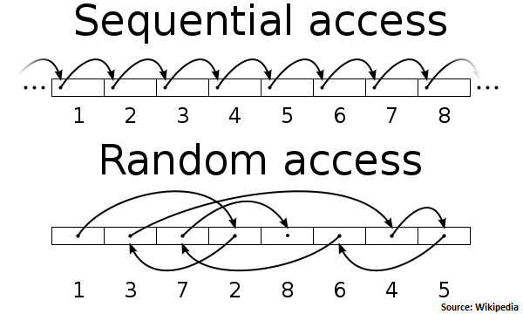
Sequential vs Random
<number>

Slide 13
Sequential vs Random
Sequential I/O is faster !
<number>

Slide 14
How Key-Value Store ?
LSM Tree
Flush
Compaction
<number>

Slide 15
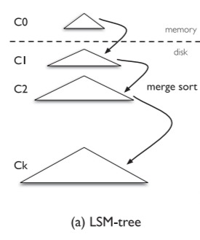
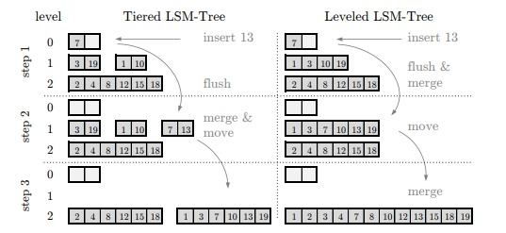
Log-Structured-Merge Tree
Reference : Monkey: Optimal Navigable Key-Value Store(2017),Niv Dayan
<number>

Slide 16
Compaction
If Memory exceed size limit, Flush to Disk
If Level X(Disk) exceed size limit, Compaction with X+1
Merge Sort (nlogn)
<number>

Slide 17
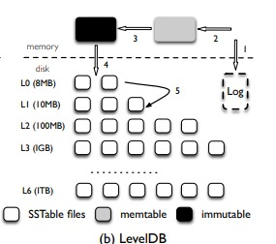
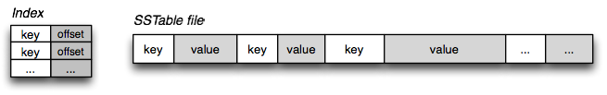
LevelDB
Reference : WiscKey: Separating Keys from Values in SSD-conscious Storage(2016),Lanyue Lu
<number>

Slide 18
Related Topic 1: SSD-Conscious
Device Lifetime : Reduce Write Amplification
Random Read dramatically improved (than HDD)
Internal Parallelism
<number>

Slide 19
Related Topic 1: SSD-Conscious
Read Amplification
(actually accessed byte on disk)/(read size)
Write amplification
(actually write in SSD)/(write size)
<number>

Slide 20
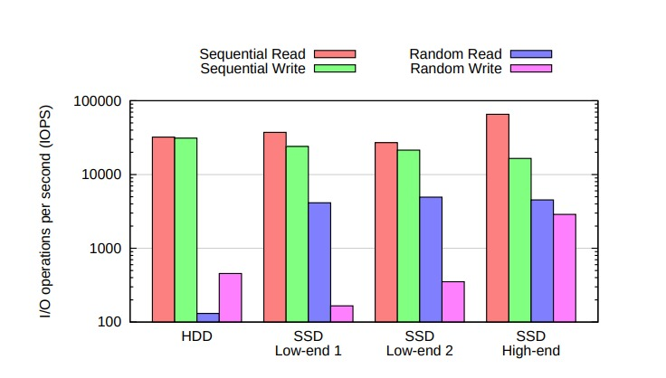
Related Topic 1: SSD-Conscious
Reference : HeteroDrive: Reshaping the Storage Access Pattern of OLTP Workload Using SSD(2015),Seungryoul Maeng
<number>

Slide 21
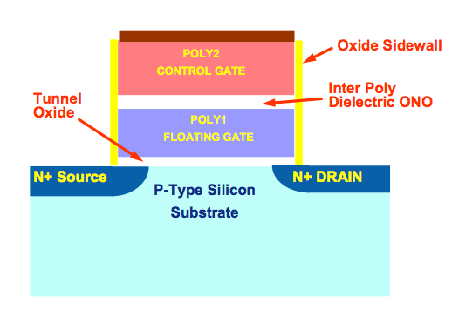
Related Topic 1: SSD-Conscious
Write by page
Delete by block
150TBW / 40GB per day =10 years
Throughput : 1~500MB/s=864 0.5~2.5TB per day
→ ONLY 1500~300 days?
<number>

Slide 22
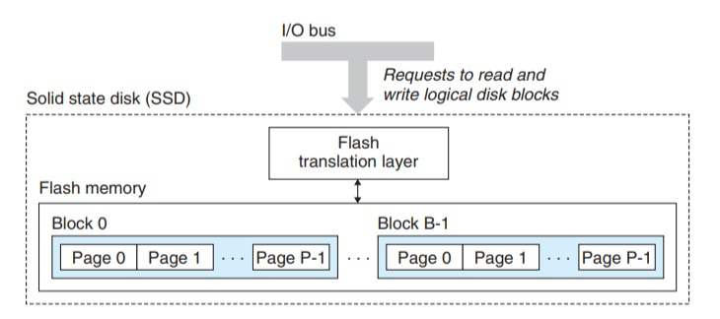
Related Topic 1: SSD-Conscious
Reference : csapp
<number>

Slide 23
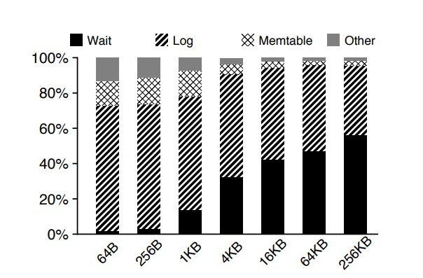
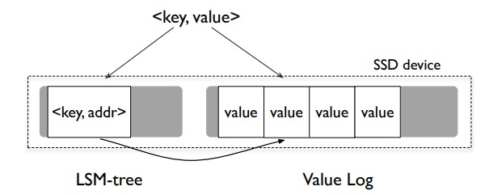
Related Topic 1: SSD-Conscious
Wisckey (2016)
Separate Key-Value !
Remove Log
Reference : WiscKey: Separating Keys from Values in SSD-conscious Storage(2016),Lanyue Lu
<number>

Slide 24
Related Topic 2: Distributed KV
Compaction Offloading
Compaction at Compaction Server
Read/Write at Region Server
Compaction Management in distributed Keyvalue datastores(2015)
<number>

Slide 25
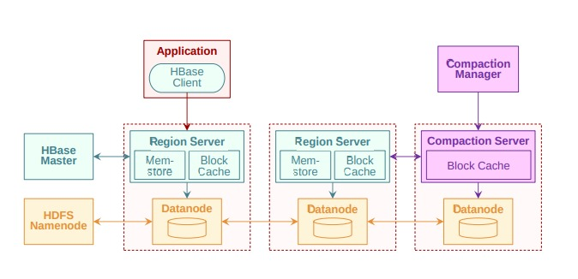
Related Topic 2: Distributed KV
<number>

Slide 26
Related Topic 3: I/O Scheduling
SILK : Preventing Latency Spikes in Log-Structured Merge Key-Value Stores(2019)
Write Faster, (Read little bit slower)
Compaction harms Latency (Slow Flush, by preempting I/O bandwidth
Compaction on lower level is more important :
If not, Flush are delayed
<number>

Slide 27
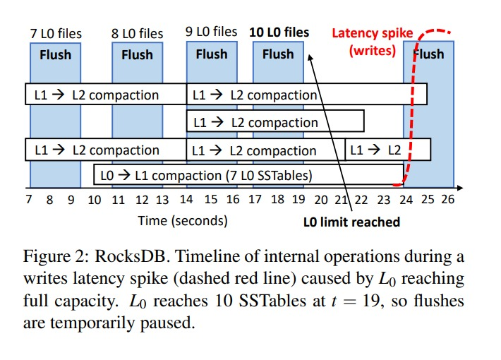
Related Topic 3: I/O Scheduling
<number>

Slide 28
Related Topic 3: I/O Scheduling
Priority Scheduling :
1. FLUSH
2. L0→L1 Compaction
3. Ln(n>0) level Compaction
<number>

Slide 29
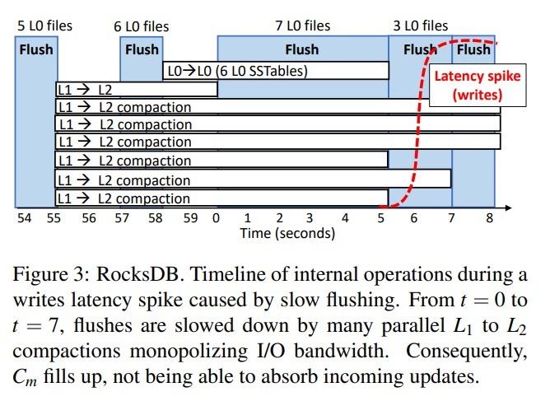
Related Topic 3: I/O Scheduling
<number>

Slide 30
Related Topic 3: I/O Scheduling
Rate Limitor
I/O Bandwidth
User operation first
Limit I/O for Internal Operation :
Ln Compaction (n>0)
<number>

Slide 31
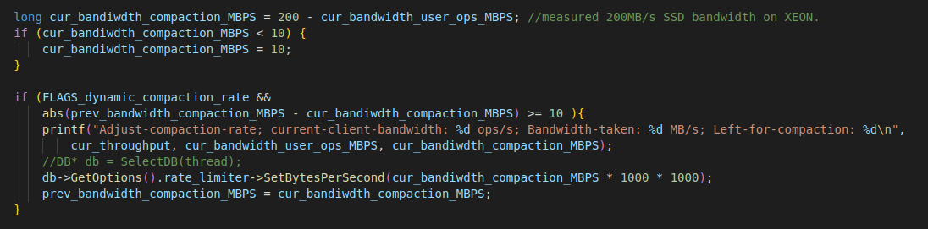
Related Topic 3: I/O Scheduling
Rate Limitor
I/O Bandwidth
User operation first
Limit I/O for Internal Operation : Ln Compaction (n>0)
<number>

Slide 32
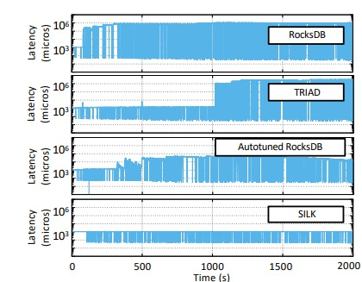
Related Topic 3: I/O Scheduling
Dynamic I/O Throttling
Rate Limitor to Ln(n>0) Compaction
<number>

Slide 33
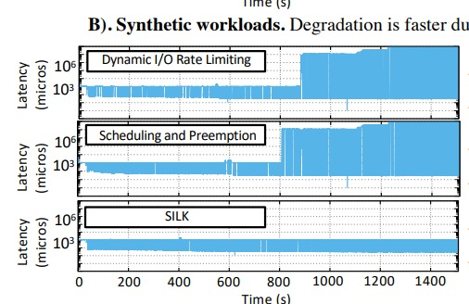
Related Topic 3: I/O Scheduling
<number>

Slide 34
Related Topic 4: CSD-Conscious
Computational Storage Drive
SSD With Tiny CPU
Newport CSD
<number>

Slide 35
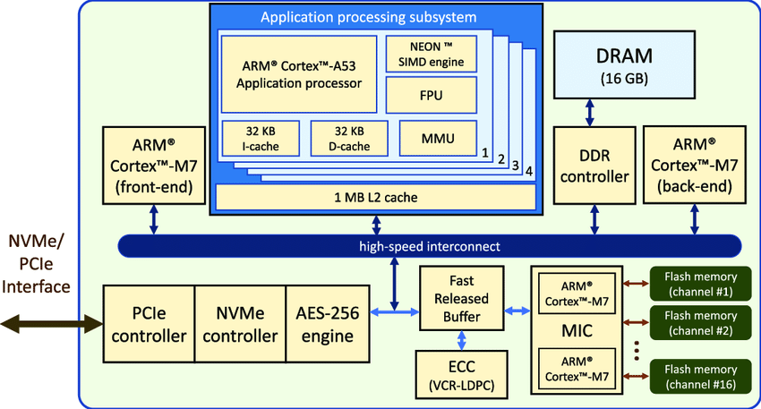
Related Topic 4: CSD-Conscious
<number>

Slide 36
Related Topic 4: CSD-Conscious
Read/Write at Host
Compaction at CSD : alleviate I/O Bandwidth
I/O Bandwidth is limited resource
Asyncronous Compaction : Write – optimized
Frequent Write, less Read
Block Chain
<number>

Slide 37
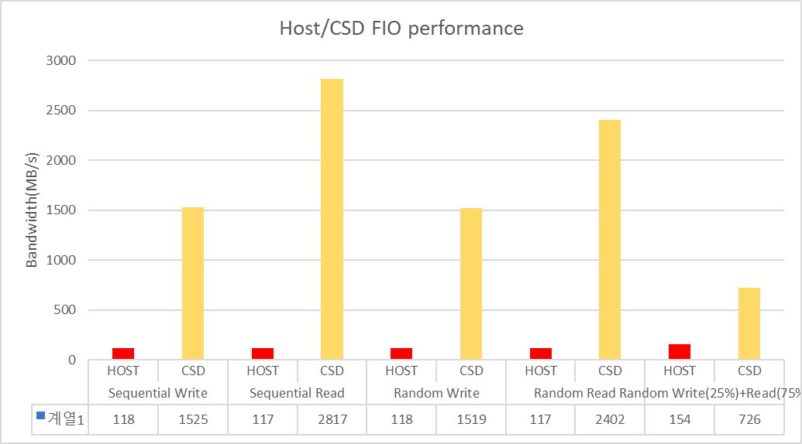
Related Topic 4: CSD-Conscious
<number>

Slide 38
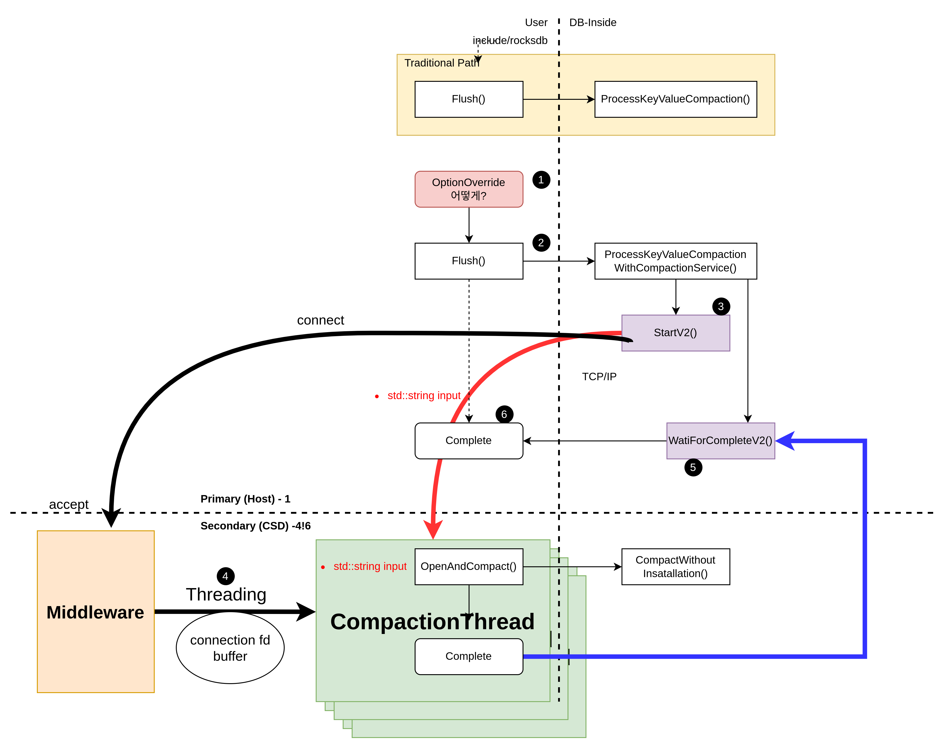
Related Topic 4: CSD-Conscious
<number>

