Slide 1


Slide 2
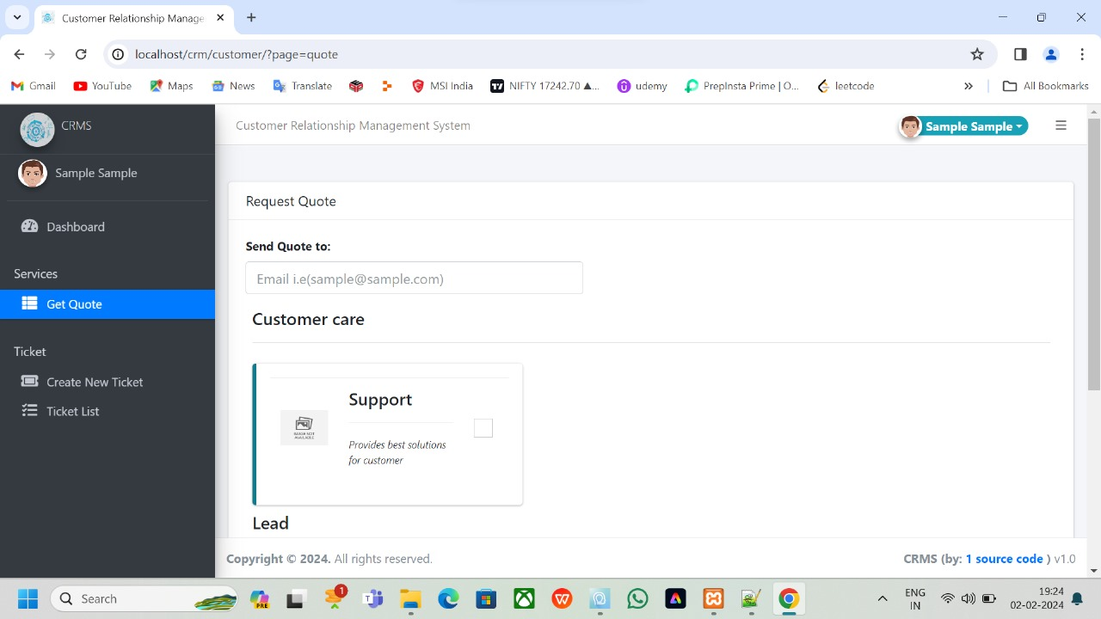
Introduction
Welcome to the presentation. We will explore building a dynamic CRM website using HTML, CSS, JavaScript, SQL, and PHP to enhance customer interactions and satisfaction.

Slide 3
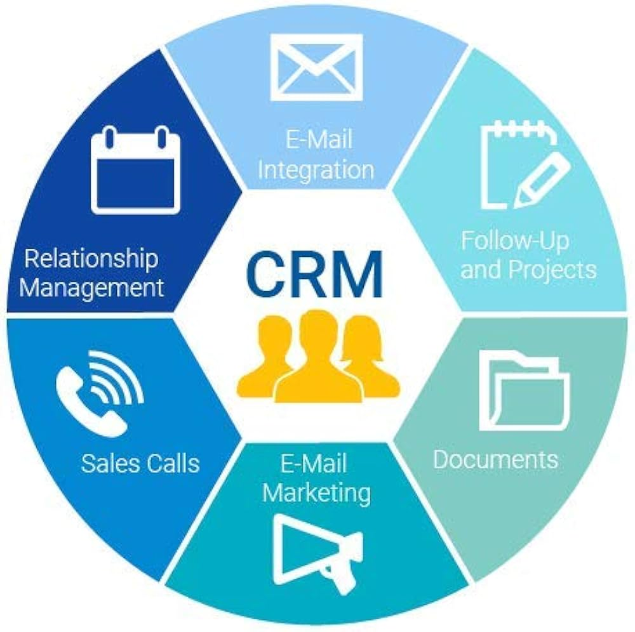
How is it usefull ?
Improved customer service through personalized interactions and the categorization of services provided will be highlighted to emphasize the customer-centric approach of CRM systems.

Slide 4

HTML and CSS Integration
Utilize HTML for structuring content and CSS for styling to create an engaging and user-friendly CRM website. Consistent design enhances brand identity and user experience.

Slide 5

Enhancing Interactivity with JavaScript
Incorporate JavaScript to add dynamic features such as form validation, interactive elements, and real-time updates, improving user engagement and overall functionality.

Slide 6
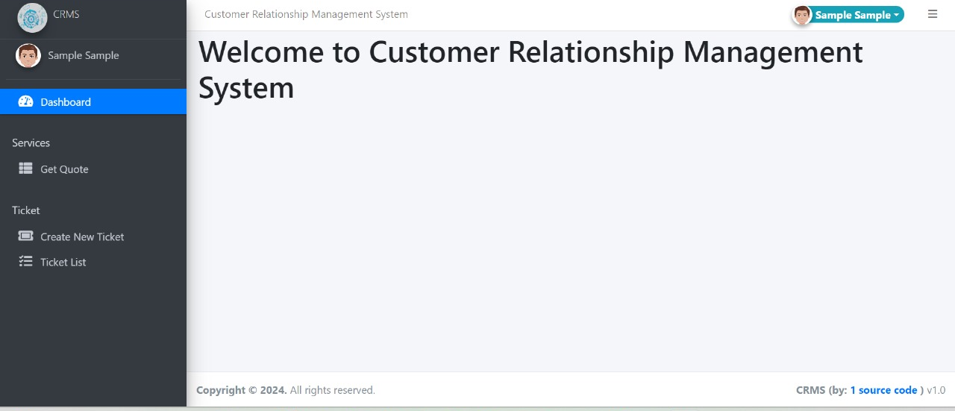
Leveraging SQL for Data
Management
Implement SQL for efﬁcient data storage, retrieval, and management. A well-designed database structure is crucial for maintaining accurate customer information and interactions.

Slide 7

Dynamic Content with PHP
Utilize PHP to create dynamic web pages, personalized content, and seamless integration with databases. Customized user experiences contribute to stronger customer relationships.

Slide 8
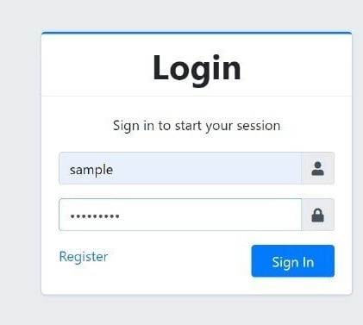
Security Considerations
Prioritize security measures to protect customer data and privacy. Implement encryption, secure authentication, and regular vulnerability assessments to build trust with customers.

Slide 9

Responsive Design for Accessibility
Adopt responsive design principles to ensure the CRM website is accessible across various devices, providing a seamless experience for customers on desktops, tablets, and smartphones.

Slide 10

Personalization and Customer Engagement
Leverage CRM capabilities to deliver personalized content, recommendations, and targeted communications, fostering stronger customer engagement and loyalty.

Slide 11

Analyzing Customer Data
Utilize CRM data to gain insights into customer behavior, preferences, and trends. Data analysis empowers informed decision-making and targeted marketing strategies.

Slide 12
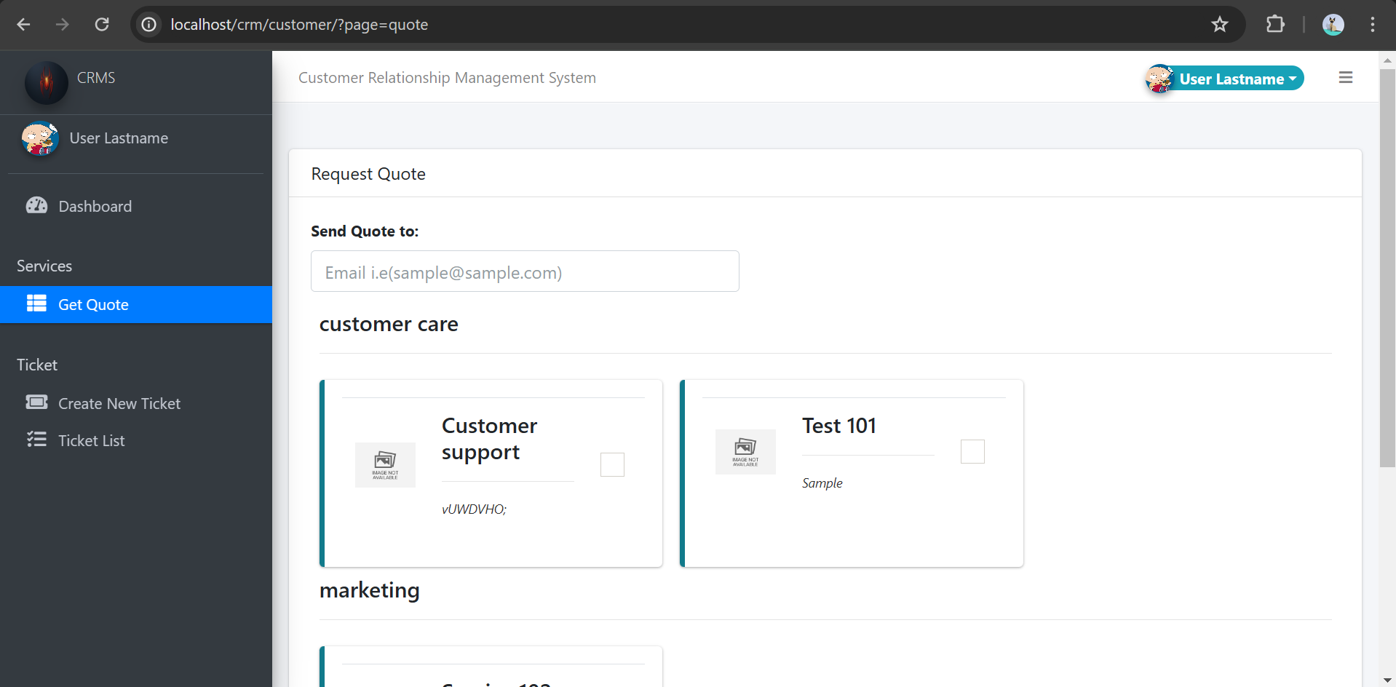
Continuous Improvement and Adaptation
Embrace a culture of continuous improvement by gathering feedback, analyzing metrics, and adapting the CRM website to evolving customer needs and market trends.

Slide 13

Conclusion
In conclusion, building a dynamic CRM website with HTML, CSS, JavaScript, SQL, and PHP is essential for optimizing customer relationships and enhancing overall business success.

