Slide 1

Building a Music Player Project Using MERN Development

Slide 2
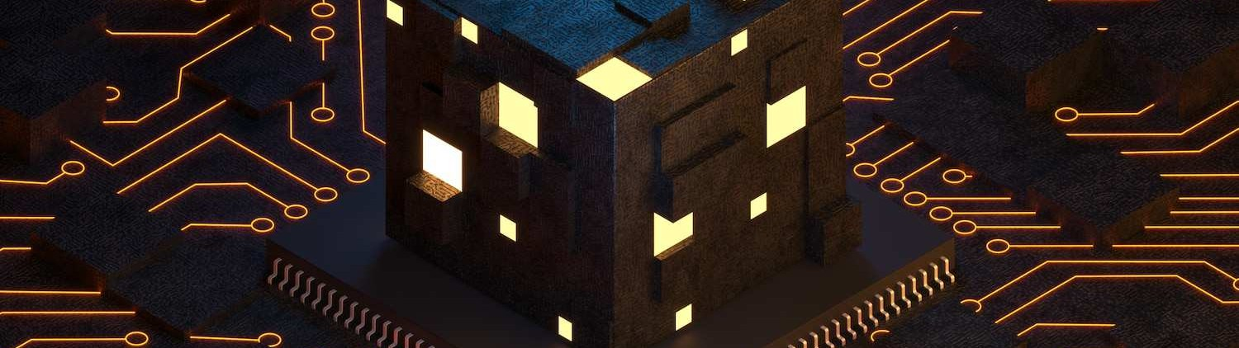
Introduction
Welcome to the presentation on Building a Music Player Project Using MERN Development. This project will showcase the integration of MongoDB, Express.js, React, and Node.js to create a powerful music player application.

Slide 3
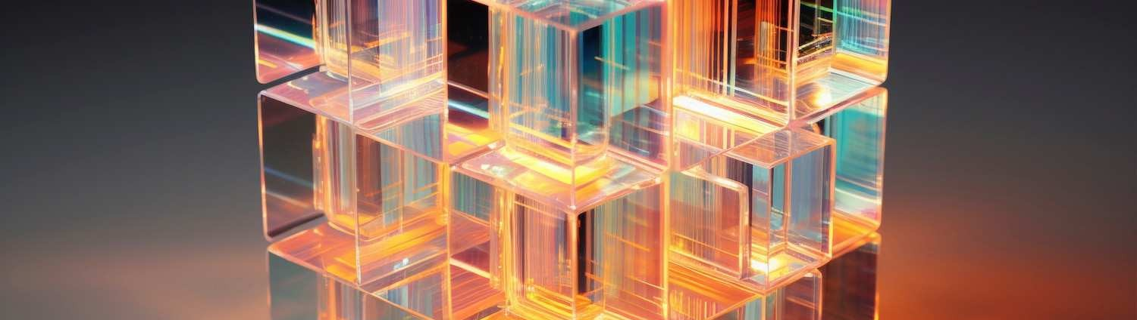
Project Overview
This project aims to demonstrate the implementation of a music player using the MERN stack. It will cover the setup of the backend with Node.js and Express.js, the database using MongoDB, and the frontend using React.

Slide 4
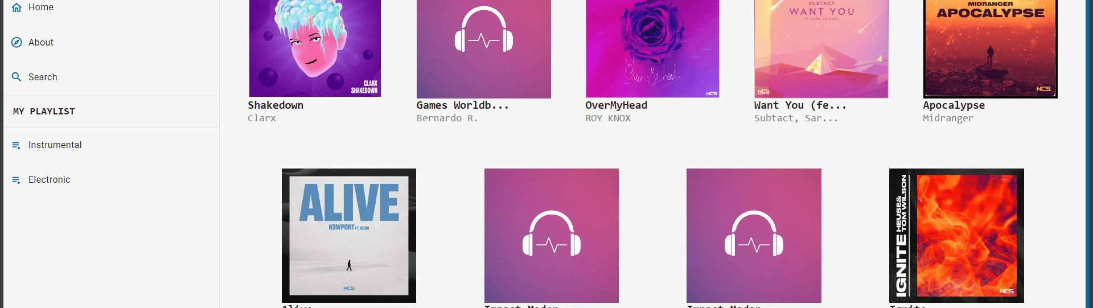
In this section, we will focus on conﬁguring and connecting MongoDB to our application. We will explore the installation process and how to establish a connection to the database using Mongoose.
Setting Up MongoDB

Slide 5
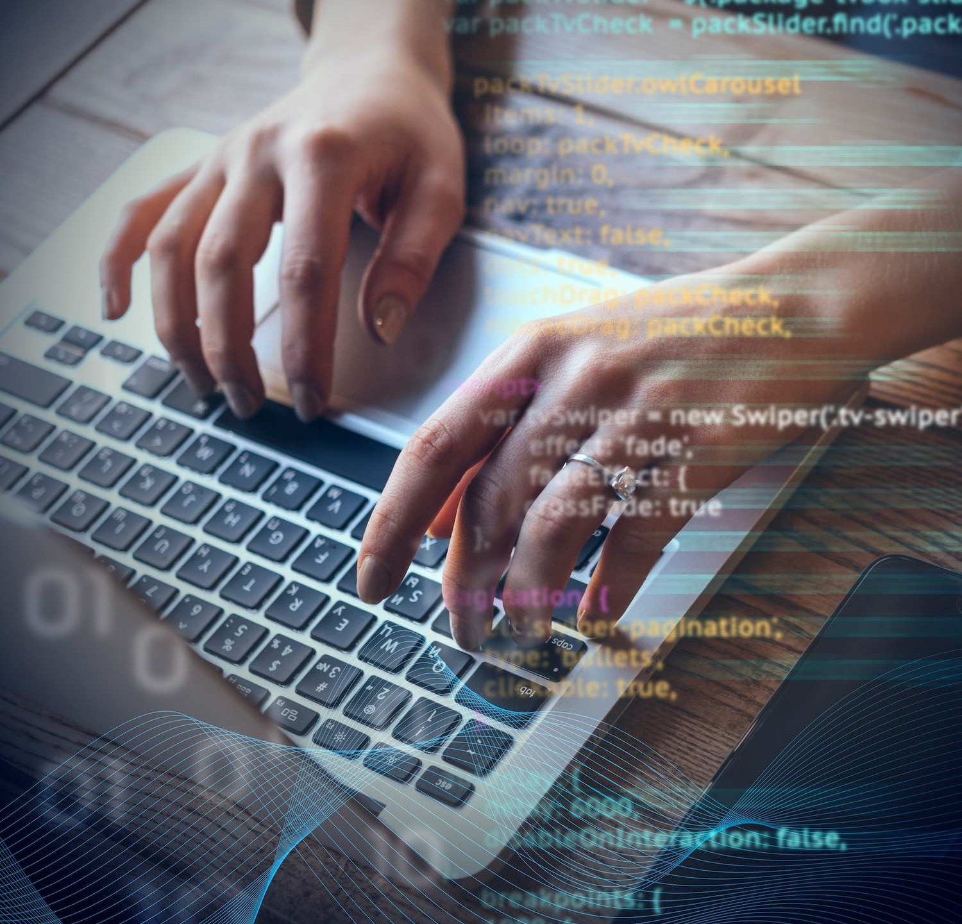
Creating the Backend with Node.js and Express.js
This slide will cover the creation of the backend using Node.js and Express.js. We will discuss setting up routes, handling requests, and integrating with the MongoDB database using Mongoose.

Slide 6
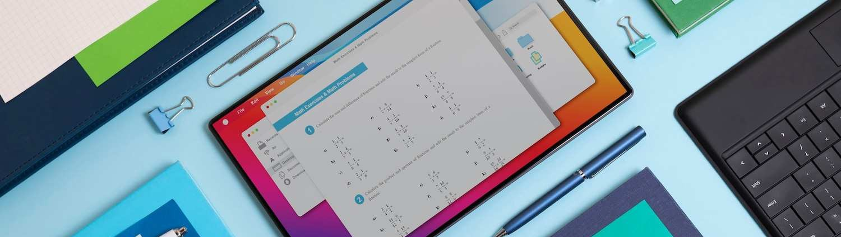
Building the Frontend with React
Here, we will dive into building the frontend of our music player application using React. We will cover the components, state management, and integrating with the backend APIs to fetch and play music.

Slide 7
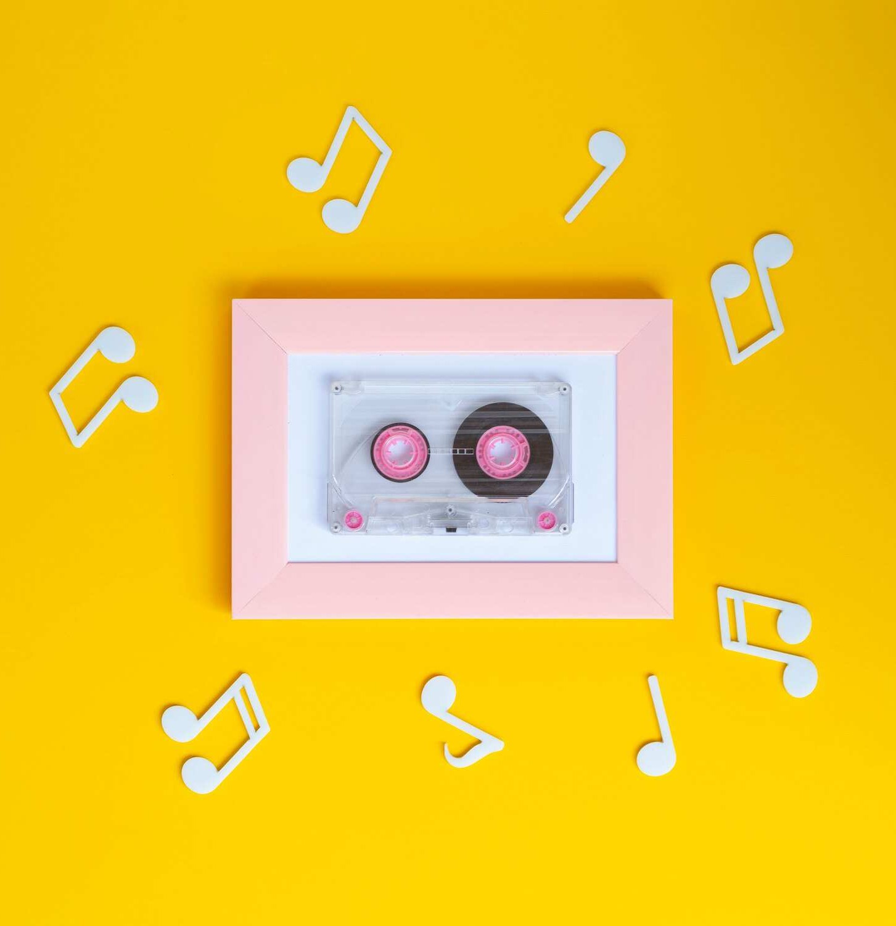
Implementing Music Player Functionality
This section will focus on implementing the music player functionality using React. We will explore features such as playing, pausing, skipping tracks, and managing the playlist.

Slide 8
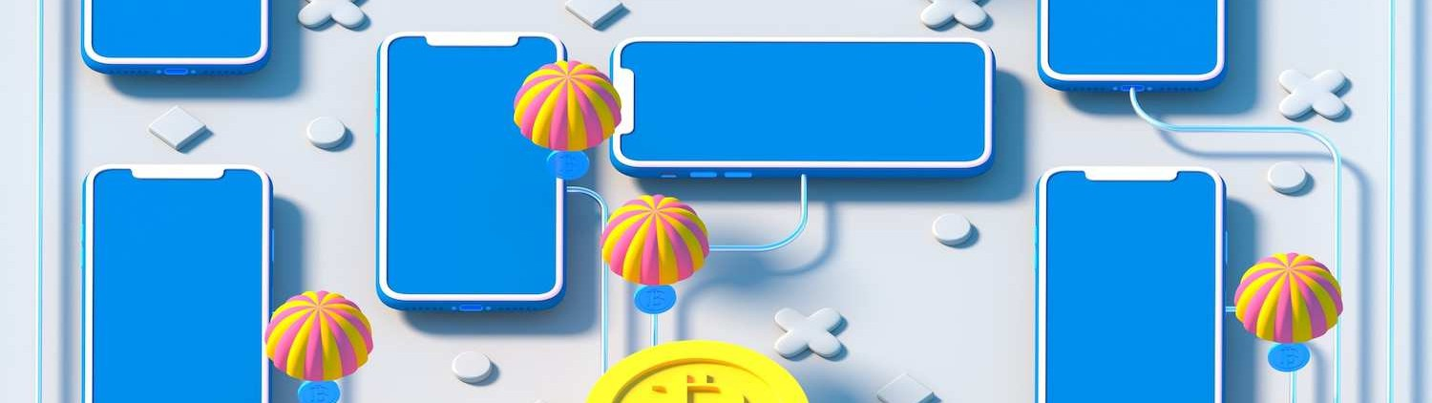
In this slide, we will discuss implementing user authentication and authorization using JWT (JSON Web Tokens) for securing the application. We will cover user login, registration, and access control.
User Authentication and Authorization

Slide 9
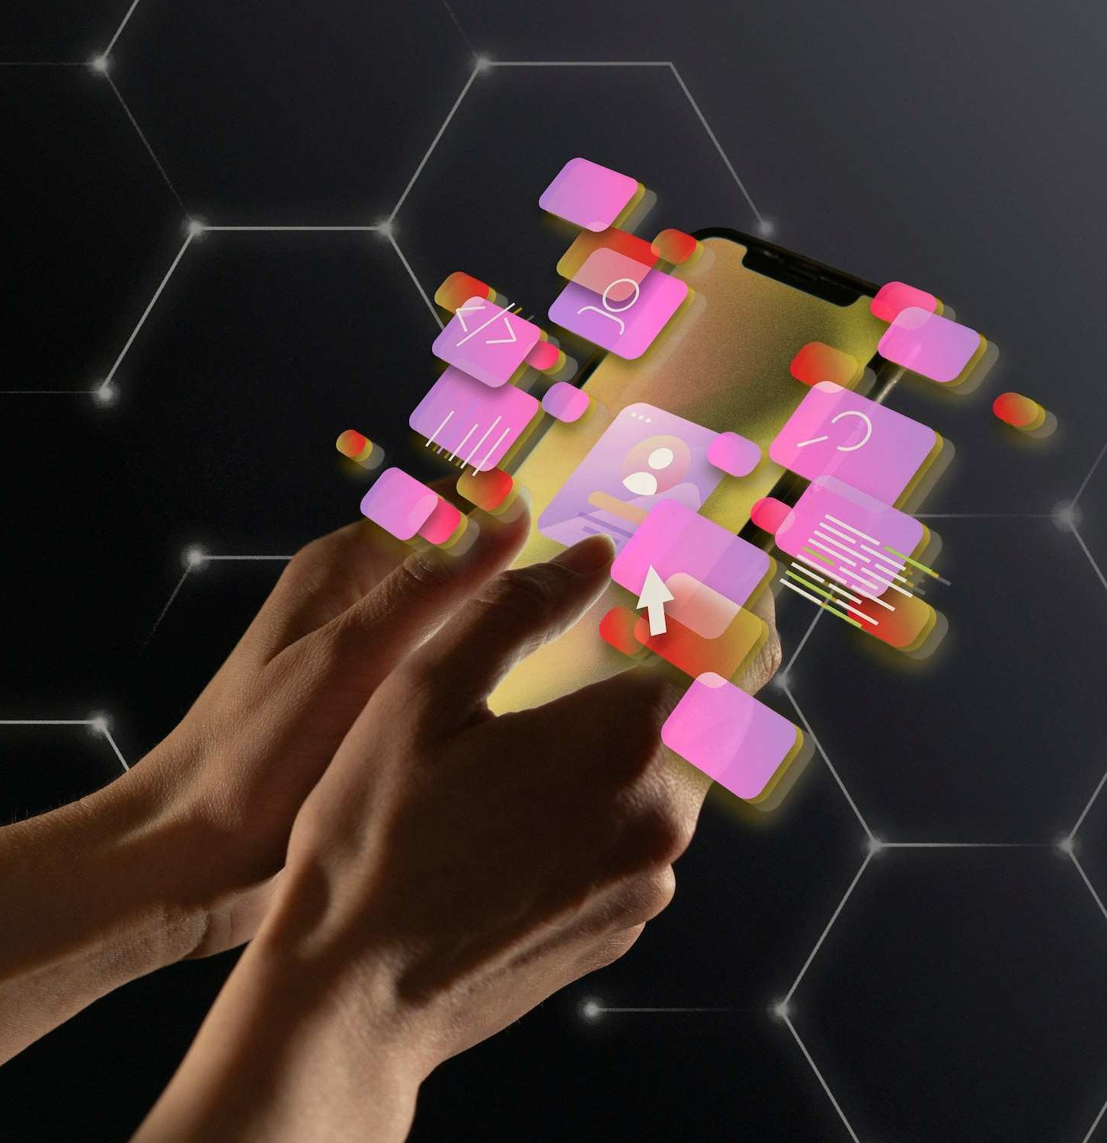
Testing and Deployment
This section will focus on testing the application and preparing for deployment. We will explore testing strategies and deployment options, including Heroku and Netlify.

Slide 10

During the development process, we encountered various challenges and gained valuable insights. This slide will highlight the key challenges faced and the learnings acquired throughout the project.
Challenges and Learnings

Slide 11

Looking ahead, there are several areas for future enhancements. We will discuss potential features and improvements to further enhance the music player application using the MERN stack.
Future Enhancements

Slide 12
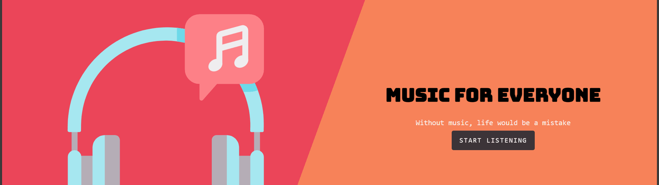
In this section, we will provide a live demo of the music player application and showcase its features. We will also invite feedback and questions from the audience.
Demo and Showcase

Slide 13
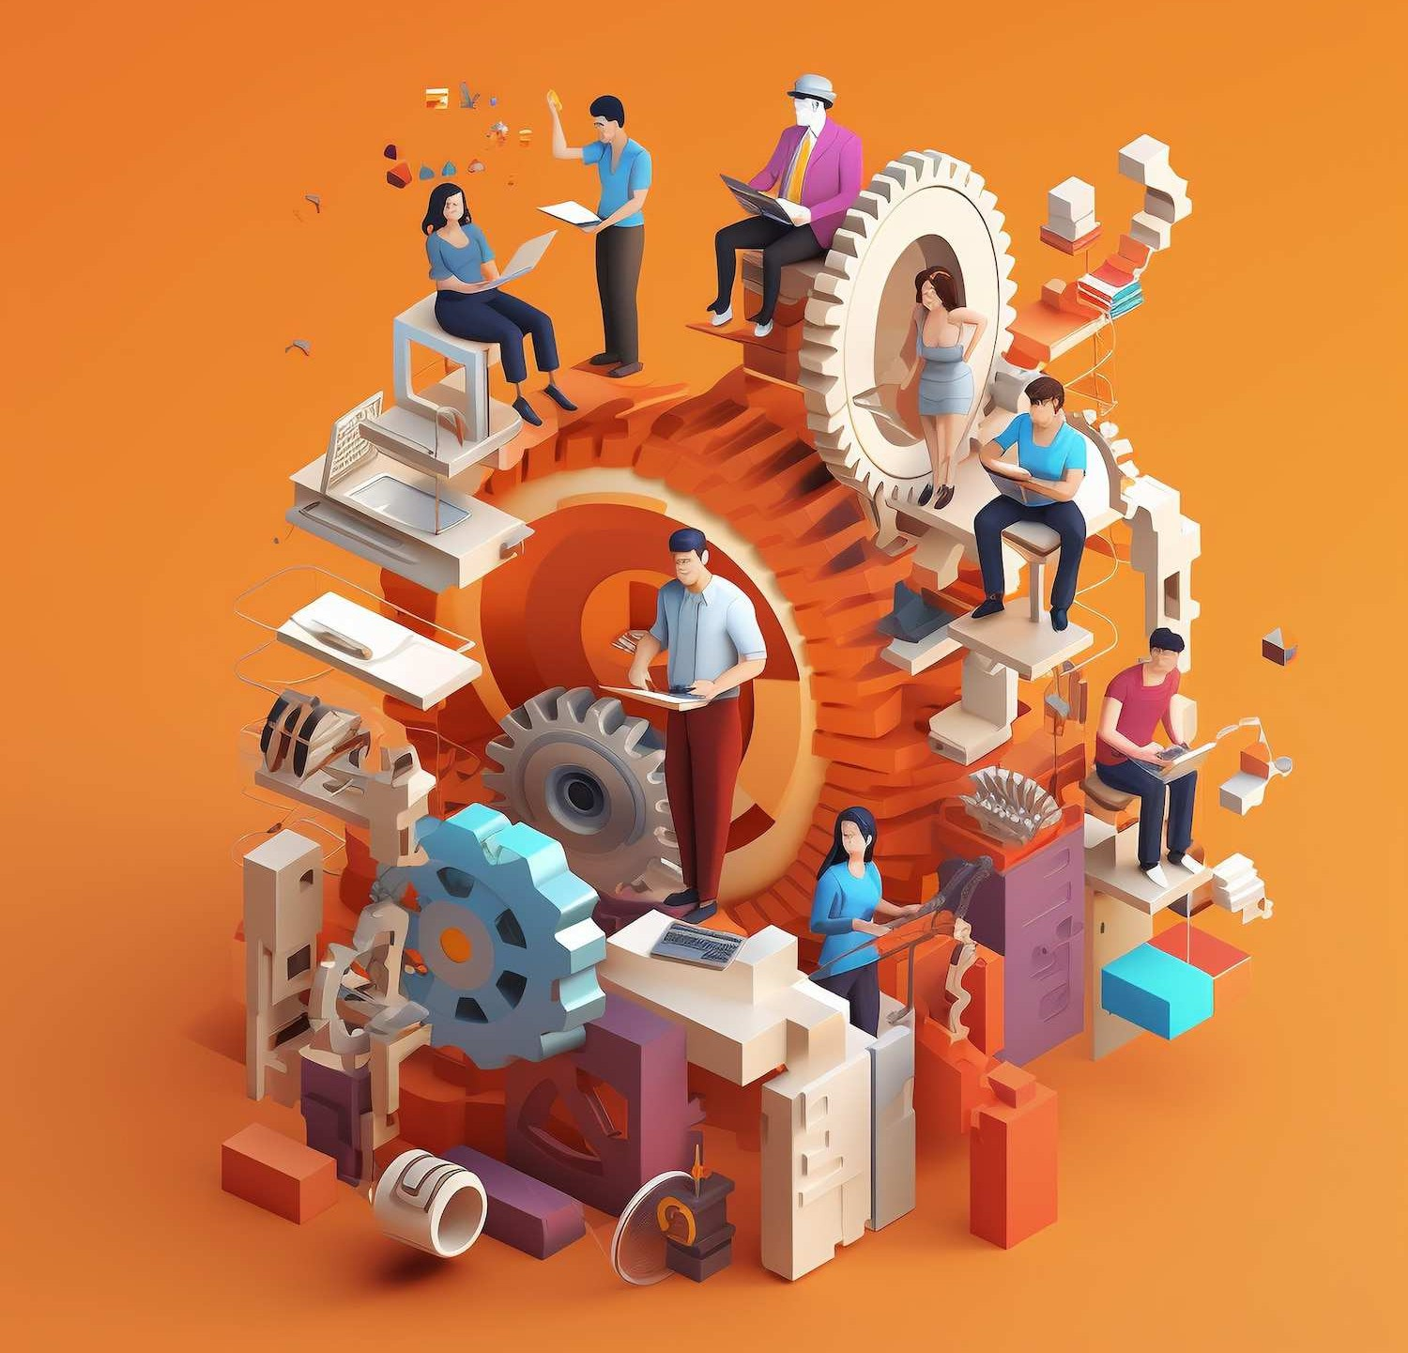
Conclusion
In conclusion, the MERN stack has enabled us to build a robust and feature-rich music player application. We have successfully integrated MongoDB, Express.js, React, and Node.js to create a seamless user experience.

Slide 14
Thanks!
Do you have any questions?
@SG20CSE019

