Slide 1
Meta Programming Ruby
概念： code that writes code.
双刃剑：
优点：可以把代码写的很优雅/漂亮/易于理解。
缺点：也可以把代码写的一团糟，难于测试。
测试：
把它看成普通代码。该怎么测试就怎么测试。(test/unit, rspec)
我们一定要掌握的理由：
深入理解RUBY的必经之路。
看懂开源项目代码的必要条件。

Slide 2
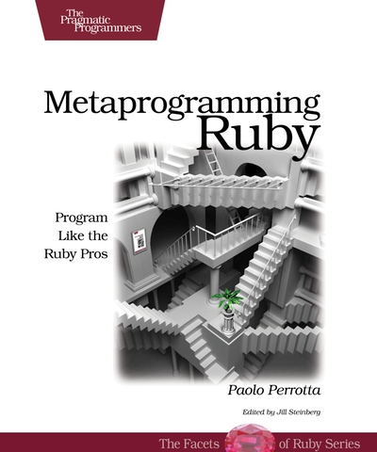
The book

Slide 3
ruby structures
class Apple
end
apple = Apple.new
apple.class # => Apple
Apple.class # => Class
Apple.ancestors # => [Apple, Object, Kernel]
Apple.superclass # => Object
Class.superclass # => Module
Module.superclass # => Object
Object.class # => Class
简言之： 所有的东西都是Object, 它们的类，都叫class.

Slide 4
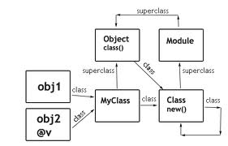
ruby structure diagram

Slide 5
method receiver
receiver: an object that you call a method on.
receiver = "some string"
receiver.reverse() # here the 'receiver' is the receiver.
irb(main):001:0> receiver = "some string"
=> "some string"
irb(main):002:0> receiver.reverse()
=> "gnirts emos"

Slide 6
what is self in Ruby
the receiver object, the current receiver
puts self # => main, an instance of Object
class Foo
puts self # => Foo
end
puts self # => main .

Slide 7
core methods
To learn about the following methods read The Book of Ruby, Chapter 20: Dynamic Programming.
1. eval, instance_eval , class_eval (aka: module_eval)
2. class_variable_set, class_variable_get, class_variables (Try it out: instance_variables), instance_variable_set (Try it out: instance_variable_get)
3. define_method, send (Try it out: method), remove_method, undef_method, method_missing
4. const_set, const_get (Try it out: constants)
5. Class.new (Try it out: Struct.new)
6. binding (Try it out: lambda)

Slide 8
refactoring:
def eat_apple
puts “apple is great!”
end
def eat_banana
puts “banana is great!”
end
[:apple, :banana].each do |fruit|
define_method “eat_#{fruit}” do
puts “#{fruit} is great!”
end
end

Slide 9
refactoring: 双刃剑
1. 一定要为动态方法加上注释，便于IDE找到。
# define methods:
# eat_apple
# eat_banana
[:apple, :banana].each do |fruit|
define_method “eat_#{fruit}” do
puts “#{fruit} is great!”
end
End
2. 不要搞得太复杂，例如2，3层嵌套。：
[:apple, :banana].each do |fruit|
People.where(:love_fruits => true).all.each do |person|
(1..5).each { |i|
define_method do “#{person}_love_#{fruit}”; puts “balbala” ; end
}
end
end

Slide 10
Basics: eval
eval mean: evaluate
string = <<-CODE
(1..5).each { puts " I love Apple! "}
CODE
eval(string)
output : =>
I love Apple!
I love Apple!
I love Apple!
I love Apple!
I love Apple!

Slide 11
Basics: class_eval
class Apple
end
Apple.class_eval(%Q{ def say_hi; puts 'hi'; end })
Apple.new.say_hi # => hi
Apple.class_eval(%Q{ def say_error; raise 'error'; end }, "apple.rb", 123)
Apple.new.say_error # =>
apple.rb:123:in `say_error': error (RuntimeError)
from ...

Slide 12
Basics: instance_eval
apple_string = "apple"
apple_string.instance_eval %Q{ def say_hi; puts 'hi, from apple'; end }
apple_string.say_hi # => 'hi, from apple'

Slide 13
Basic: class_variables
class Fruit
@@name = 'fruit'
end
class Apple < Fruit
@@color = 'red'
@@taste = 'good'
end
Fruit.class_variables.inspect # => ["@@name"]
Apple.class_variables.inspect # => ["@@taste", "@@color", "@@name"]
Apple.class_variable_defined? :@@color # => true
Apple.send(:class_variable_get,:@@color) # => 'red'
Apple.send :class_variable_set,:@@color, 'dark red'
Apple.send(:class_variable_get,:@@color) # => 'dark red'

Slide 14
Substitude Class
class Apple
def taste; puts "good"; end
end
class MockApple
def taste; puts "this is a mock apple... tastes also good!"; end
end
Apple.new.taste # => “good”
Object.send(:remove_const, "Apple")
Object.send(:const_set, "Apple", MockApple)
Apple.new.taste # => "this is a mock apple... tastes also good!"

Slide 15
Dynamic define methods
class Apple
end
a = Apple.new
a.instance_eval{ def say_hi ; puts 'hi'; end }
a.say_hi # => 'hi'
b = Apple.new
b.say_hi # NoMethodError: undefined method `say_hi' ….
Apple.class_eval {
define_method :say_goodbye do; puts "goodbye"; end
}
Apple.new.say_goodbye # => "goodbye"

Slide 16
Scope被class/module/def定义
var = "meta"
class Apple
puts var # undefined local variable or method `var' for Apple...
end
module Banana
puts var # undefined local variable or method `var' for Banana...
end
class Apple
color = 'red'
def show_color; puts color; end
end
Apple.new.show_color # undefined local variable or method `color' ...

Slide 17
Flat Scope
1. 名字固定的class.
class Apple
taste = "sweet"
define_method "taste" do ; puts "very #{taste}" ; end
end
Apple.new.taste # => “very sweet”
2. 动态名字的class name:
operation = "say"
target = "hi"
dynamic_class_name = Class.new do
define_method operation do; puts "#{operation} #{target}"; end
end
Kernel.const_set("DynamicClassName", dynamic_class_name)
DynamicClassName.new.say #=> “say hi”

Slide 18
Alias method
def say_goodbye
puts 'goodbye'
end
say_goodbye #=> 'goodbye'
alias :original_goodbye :say_goodbye
def say_goodbye
puts 'my love,'
original_goodbye
puts 'and farewell'
End
say_goodbye # => 'my love, goodbye, and farewell'

Slide 19
Mixin
就是include 多个module
module A
def say_hi; puts “hi” ; end
end
module B
def say_goodbye; puts “goodbye” ; end
end
class C
include A
include B
end
c = C.new
c.say_hi # => “hi”
c.say_goodbye # => “goodbye”

Slide 20
Hooks: include/extend
两个关键的钩子方法
module M
def self.extended(another)
puts "#{self} is extended by #{another}"
end
def self.included(another)
puts "#{self} is included by #{another}"
end
end
class C; include M end #=> M is extended by C
class D; extend M end #=> M is extended by D
（inherited 也一样，略）

Slide 21
Extension Mixin的例子
使用一个include, 就能同时实现 include/extend的功能（增加 instance / class methods )
module M
def self.included(base)
base.extend(ClassMethods)
end
module ClassMethods
def say_hi; "hi" end
end
def say_goodbye; "goodbye" end
end
class C; include M end
C.say_hi # => “hi”
C.new.say_goodbye # => “goodbye”

Slide 22
Self Yield
class Book
attr_accessor :title, :published_at
def initialize &block
yield self
end
end
book = Book.new do |b|
b.title = "diablo"
b.published_at = "2012-12-12"
end
puts book.inspect # => #<Book:0xb78d0934 @published_at="2012-12-12", @title="diablo">

Slide 23
Class Method
三种形式定义 class method. (回香豆的回字四种写法。。。 >_< )
class Apple
def self.color ; "red"; end #第一种
class << self
def size; "big"; end # 第二种
end
end
def Apple.taste; 'sweet' ; end # 第三种
Apple.color # => “red”
Apple.size # => “big”
Apple.taste # => 'sweet'

Slide 24
Eigen class
eigen /'ei dgen/ , 德语， one's own
Eigenclass, the class of a class. An object's own class.
跟 singleton class, 类似， 也叫 meta class .
跟 singleton 模式无关。

Slide 25
Eigen class
class Object
def eigenclass
class << self
self
end
end
end
class Fruit;
def sef.taste
'good'
end
end
class Apple < Fruit; end
Apple.taste # => 'good'
Apple.eigenclass # => #<Apple>
Fruit.eigenclass # => #<Fruit>
Apple.eigenclass.superclass # => 1.9 #<Fruit> , 1.8: #<Class>
Fruit.eigenclass.superclass # => 1.9 #<Object> , 1.8: #<Class>

Slide 26
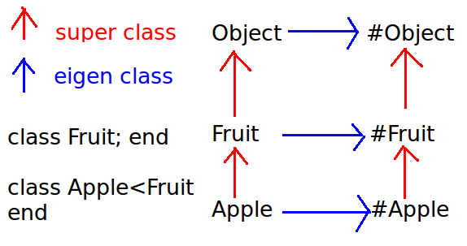
Eigen class Diagram

Slide 27
Symbol to Proc (&:method)
只适用于 receiver == 集合中element 的场合。
class String
def contains_a_or_c?
match(/a|c/)
end
end
array = ["aaa", "bbb", "ccc", "ddd"]
result1 = array.collect(&:contains_a_or_c?)
result2 = array.collect{ |element| element.contains_a_or_c? }
result: [#<MatchData "a">, nil, #<MatchData "c">, nil]
不适合：array.collect{ |element| String.contains_a_or_c?(element) }

Slide 28
rspec中的一个例子
Rpsec mock 的一个典型用法：
class Apple;
def color; 'red; end
end
red_apple = Apple.new
red_apple.color # => 'red'
green_apple = Apple.new
green_apple.stub(:color) { “green” }
green_apple.color # => “green”

Slide 29
rspec中的一个例子（代码）
lib/rspec/mocks/method_double.rb
#core method:
72 stash_original_method
73 define_proxy_method
# rename 'color', to “obfuscated_by_rspec_mocks__color”
78 def stash_original_method; end
88 def define_proxy_method
89 method_name = @method_name
90 visibility_for_method = "#{visibility} :#{method_name}"
91 object_singleton_class.class_eval(<<-EOF, __FILE__, __LINE__)
92 def #{method_name}(*args, &block)
93 __mock_proxy.message_received :#{method_name},*args,&block
94 end
95 #{visibility_for_method}
96 EOF
97 end

Slide 30
Method missing (1)
lib/active_record/attribute_methods.rb, rails 3.2.7
137 # If we haven't generated any methods yet, generate them, then
138 # see if we've created the method we're looking for.
139 def method_missing(method, *args, &block)
140 unless self.class.attribute_methods_generated?
141 self.class.define_attribute_methods
142
143 if respond_to_without_attributes?(method)
144 send(method, *args, &block)
145 else
146 super
147 end
148 else
149 super
150 end
151 end

Slide 31
Method missing (2)
35 module ClassMethods
36 # Generates all the attribute related methods for columns in the da
37 # accessors, mutators and query methods.
38 def define_attribute_methods
39 unless defined?(@attribute_methods_mutex)
40 msg = "It looks like something (probably a gem/plugin) is overr
end
61 # Use a mutex; we don't want two thread simaltaneously trying to
62 # attribute methods.
63 @attribute_methods_mutex.synchronize do
64 return if attribute_methods_generated?
65 superclass.define_attribute_methods unless self == base_class
66 super(column_names)
67 column_names.each { |name| define_external_attribute_method(..
68 @attribute_methods_generated = true
69 end
70 end

Slide 32
Method missing ( rails code)
lib/active_record/attribute_methods/read.rb
81 def define_external_attribute_method(attr_name)
82 generated_external_attribute_methods.module_eval <<-STR...
83 def __temp__(v, attributes, attributes_cache, attr_name)
84 #{external_attribute_access_code(attr_name, attribute_cas
85 end
86 alias_method '#{attr_name}', :__temp__
87 undef_method :__temp__
88 STR
89 end

Slide 33
欢迎提问
结束，欢迎提问。

Slide 34

shensiwei.com

