Slide 1


Predict House Prices
Ames / Kaggle Dataset
Sandra Gee
BA 280 Winter 2021

Slide 2
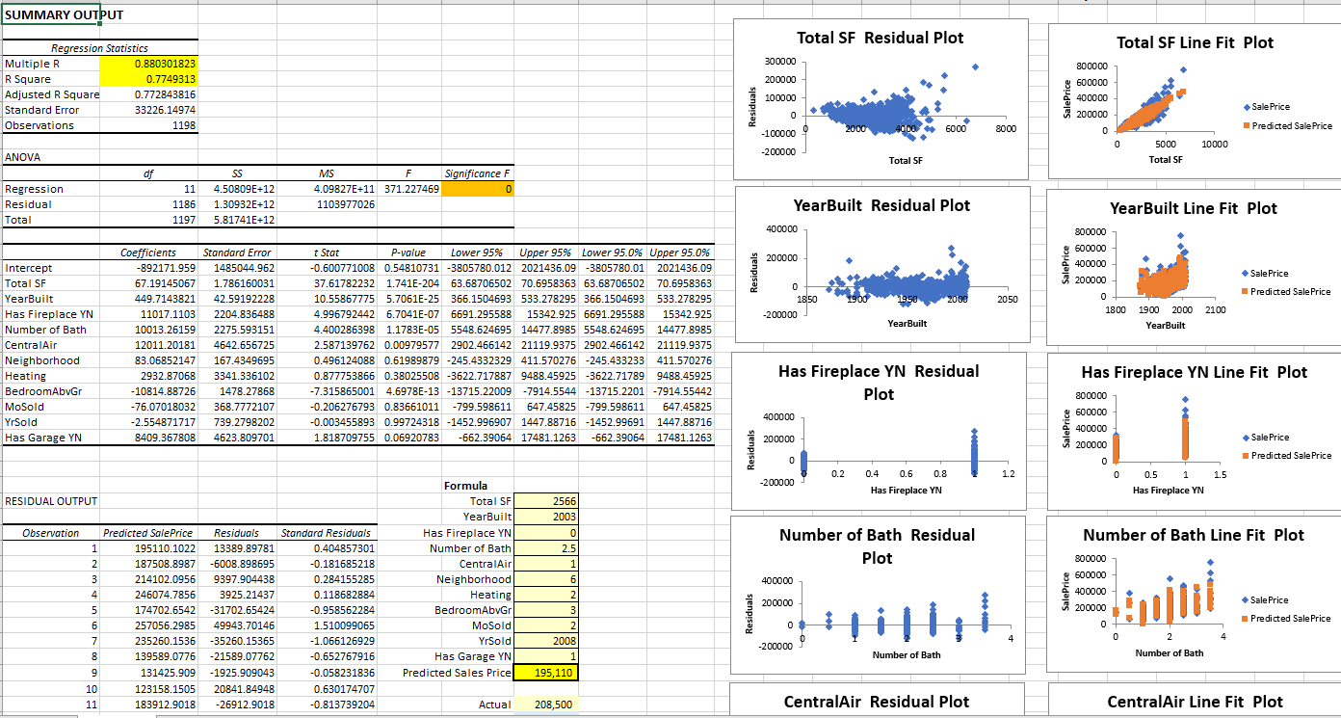
What was built and how does it work?
Power BI server AI model
Data ‘cleaned’ from original Kaggle source
Excel workbook
11 selected columns
Can be used for predictions

Slide 3

Purpose and Objective
Find the most useful independent variables for predicting house sales prices in Ames
Show relationships between certain independent variables

Slide 4
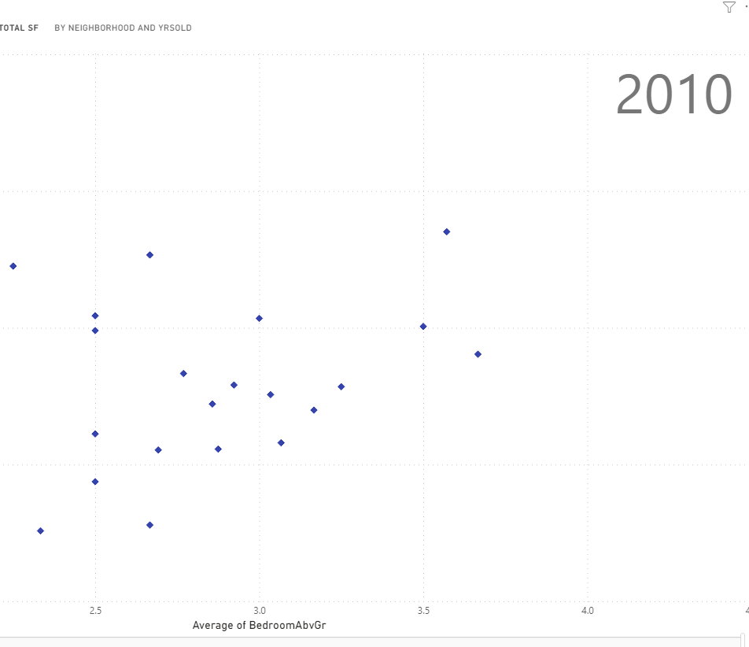
What does solution teach us?
The variables in the housing market are varied and not easy to gauge
Outliers can swing predictions
Multiple variables are interdependent

Slide 5
Thank you

