Slide 1

Kalamkari
Quality, Expertise, Answers

Slide 2

Hass Avocado Data
Analysis – February 2021

Slide 3
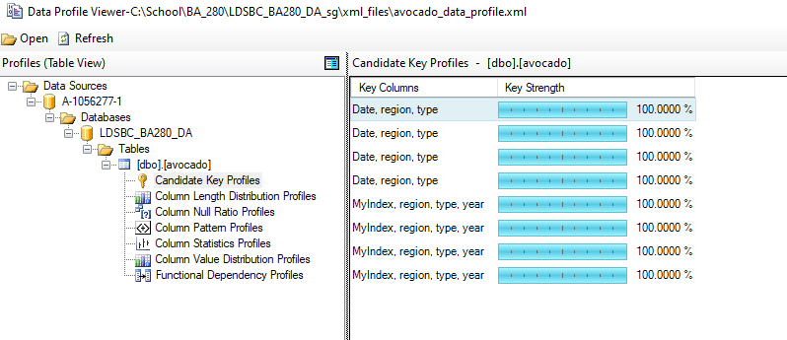
Understanding the data
The granularity was on the date, region, and type of avocado.

Slide 4
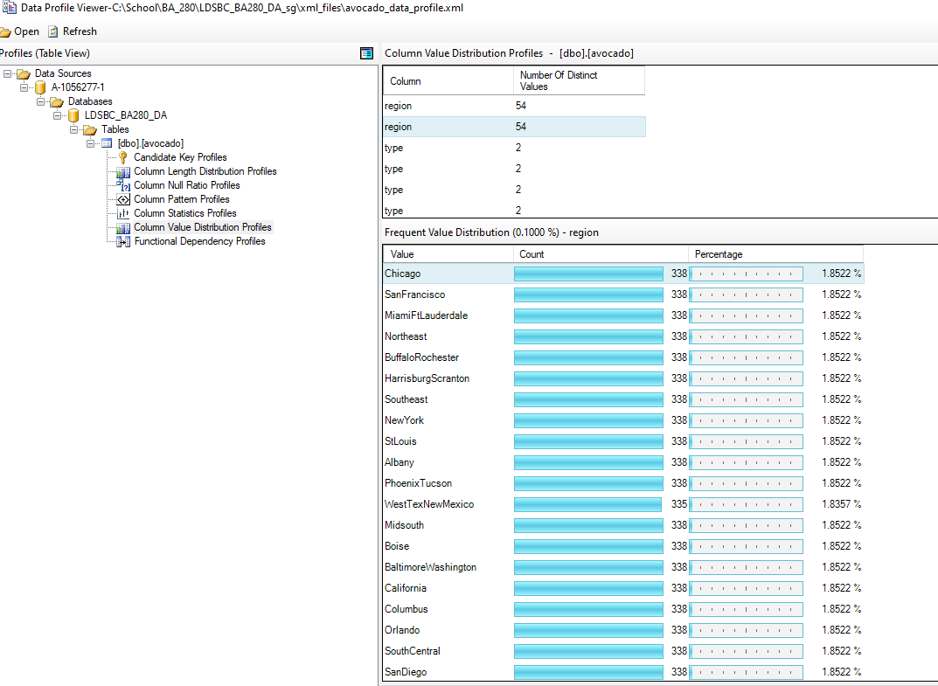
Avoiding Double Counts
The Total US was included in the data set and the main 8 regions added up to the total US.

Slide 5
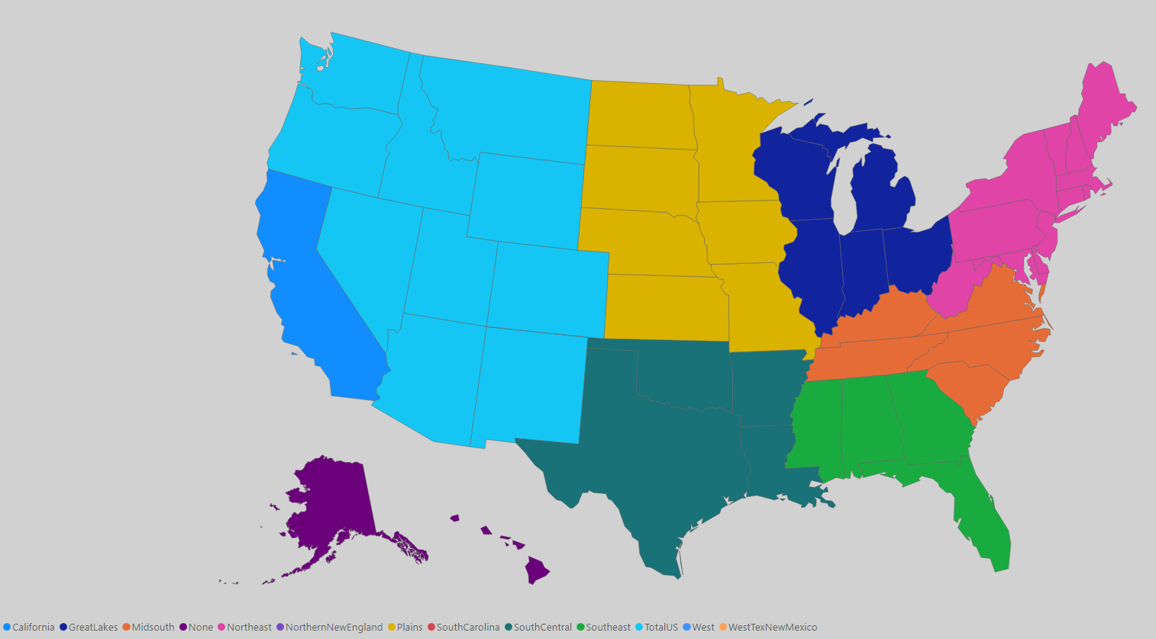
Mapping the Areas
The 8 regions added up to the total US can be found at hassavocadoboard.com/report
Adding in larger metropolitan areas made 12 regions
These were part of the 8 identified regions and did not total up
There are no sales indicated for Alaska or Hawaii

Slide 6
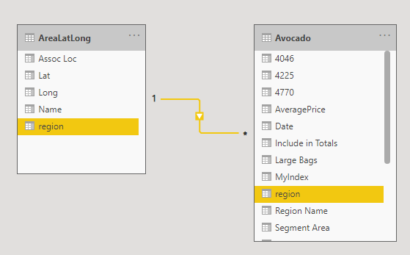
Geocode Lookup
Created Separate Excel file
Used the center of the city on Google Maps for obvious city names
Used the Google directions for metropolitan areas to see the center between cities and used that point
Used where the dot on the Hass Avocado reports map was for the same location on Google maps for region/areas

Slide 7
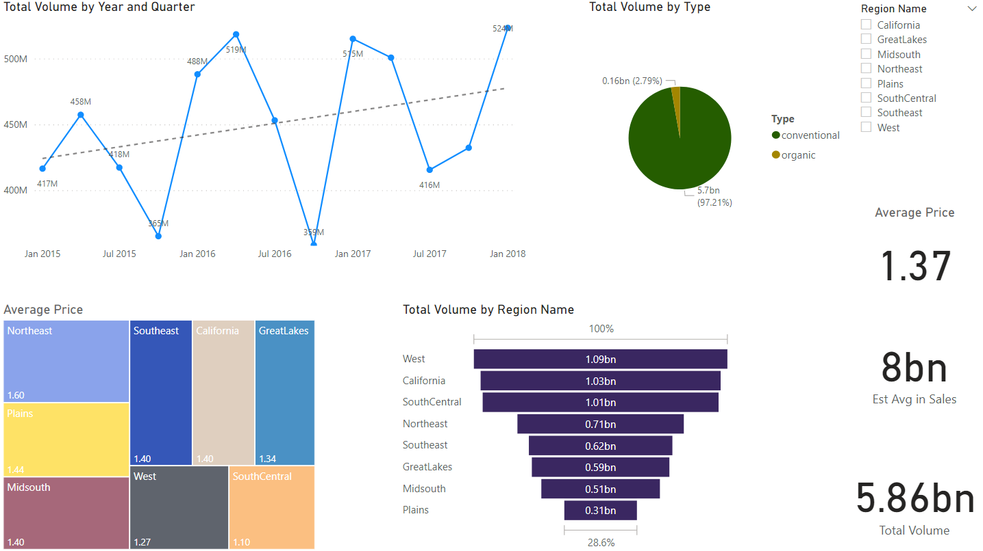
Area Review

Slide 8
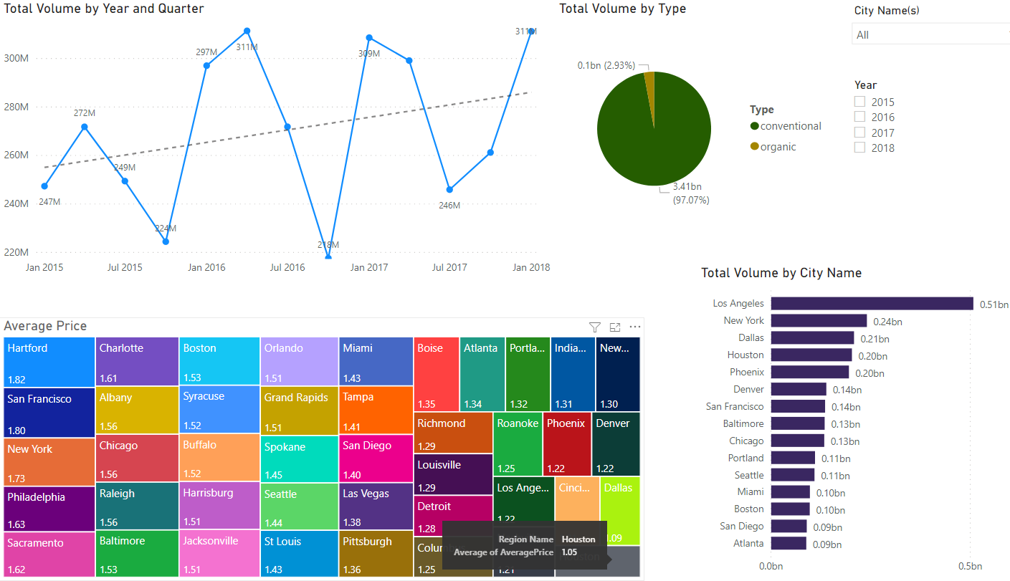
City Review

Slide 9
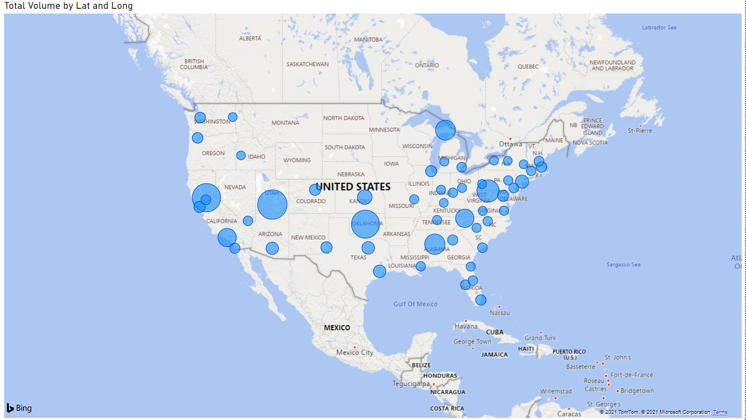

Slide 10

Thank you

