Slide 1
Manual Dropout in Neural Networks
A Reduced-Scale Reproduction and Ablation Study
Based on Srivastava et al., Journal of Machine Learning Research (2014)
Student Presenter:
Satyam Gupta | Roll No. 24CS2032
Integrated Dual Degree in Computer Science & Engineering and Artificial Intelligence
Rajiv Gandhi Institute of Petroleum Technology (RGIPT)

Slide 2
24CS2032 DEEP LEARNING — PAPER IMPLEMENTATION STUDY
Why Dropout? Addressing Co-adaptation & Overfitting
The Overfitting & Co-adaptation Problem
• Deep networks have enormous expressive capacity. When trained on finite sample sizes, training error easily approaches zero while generalization error remains high.
• Feature Co-adaptation: Neurons learn to compensate for the idiosyncratic errors of other specific neurons rather than forming robust, standalone feature representations.
• Ensemble Limitation: Training and maintaining an ensemble of hundreds of large separate networks is computationally prohibitive.
• Regularization Nuance: Dropout regularizes capacity, but excessive drop rates starve feature flow and cause underfitting.
The 3-Phase Regularization Solution
1. Standard Forward Pass
Hidden activations y = ReLU(W x + b) are computed across layers.
2. Stochastic Training Mask (d = drop probability, q = 1 - d = keep probability)
During training, units are dropped with drop probability d and retained with keep probability q. Forces each neuron to learn useful features alongside random sub-networks.
3. Deterministic Inference (Model Averaging)
At test time, the full network runs deterministically without dropping units, offering an approximate model-averaging interpretation over thinned subnetworks.

Slide 3
24CS2032 DEEP LEARNING — PAPER IMPLEMENTATION STUDY
Manual Dropout: Mathematical Formulation & PyTorch Implementation
Mathematical Formulation
Drop probability: d in [0, 1) | Keep probability: q = 1 - d
Bernoulli mask sampling: m_i ~ Bernoulli(q)
Training pass (Inverted): h̃_i = (m_i * h_i) / q
Evaluation pass: h̃_i = h_i (Identity)
Expectation Preservation Proof:
E[h̃_i | h_i] = E[(m_i * h_i) / q | h_i] = (h_i / q) * E[m_i] = (h_i / q) * q = h_i
Dividing by q keeps the expected activation magnitude unchanged during training, ensuring evaluation requires zero post-hoc weight scaling.
# run.py: ManualDropout Implementation
class ManualDropout(nn.Module):
def __init__(self, drop_rate=0.5, inverted=True):
super().__init__()
self.drop_rate = float(drop_rate)
self.inverted = inverted
def forward(self, x):
keep = 1.0 - self.drop_rate
if not self.training:
return x if self.inverted else x * keep
if self.drop_rate == 0:
return x
# Bernoulli mask sampled on same device/dtype
mask = (torch.rand_like(x) < keep).to(x.dtype)
if self.inverted:
return x * mask / keep
return x * mask
[RULES] • No nn.Dropout • Inverted scaling • Hidden layers only

Slide 4
24CS2032 DEEP LEARNING — PAPER IMPLEMENTATION STUDY
Controlled Experimental Protocol (dropout-24cs2032-v1)
Architecture & Model Specification
Network Topology: 784 -> 256 -> 256 -> 256 -> 10 Multilayer Perceptron
Hidden Activation: Rectified Linear Unit (ReLU)
Dropout Placement: Immediately after hidden ReLUs (Layers 1, 2, 3)
Input/Output Dropout: NONE (Raw pixels & logits untouched)
Parameter Count: Exactly 335,114 trainable weights & biases
Hardware Backend: Apple Silicon CPU (Native arm64)
Compute Benchmark: CPU: 0.785s / 2 eps vs MPS: 4.398s / 2 eps (>5.5x faster)
Experimental Protocol & Sweep Design
Datasets: MNIST (primary) & Fashion-MNIST (extension)
Data Splits: 10,000 train / 5,000 val / 10,000 test (Split seed: 2026)
Drop Rates Evaluated: 8 uniform rates: d in {0.0, 0.1, 0.2, 0.3, 0.4, 0.5, 0.6, 0.7}
Random Seeds: 3 seeds: 42, 43, 44 (Bitwise-identical initialization per seed)
Training Horizon: 20 fixed epochs, batch size 128
Optimizer: Adam (lr = 0.001, beta1=0.9, beta2=0.999, weight decay = 0)
Model Selection Rule: Lowest mean validation error across seeds at epoch 20
Evaluation Discipline: Official test set strictly quarantined (descriptive only)
[EXPERIMENT VOLUME] 24 runs & 480 epoch rows per dataset (48 runs total)

Slide 5
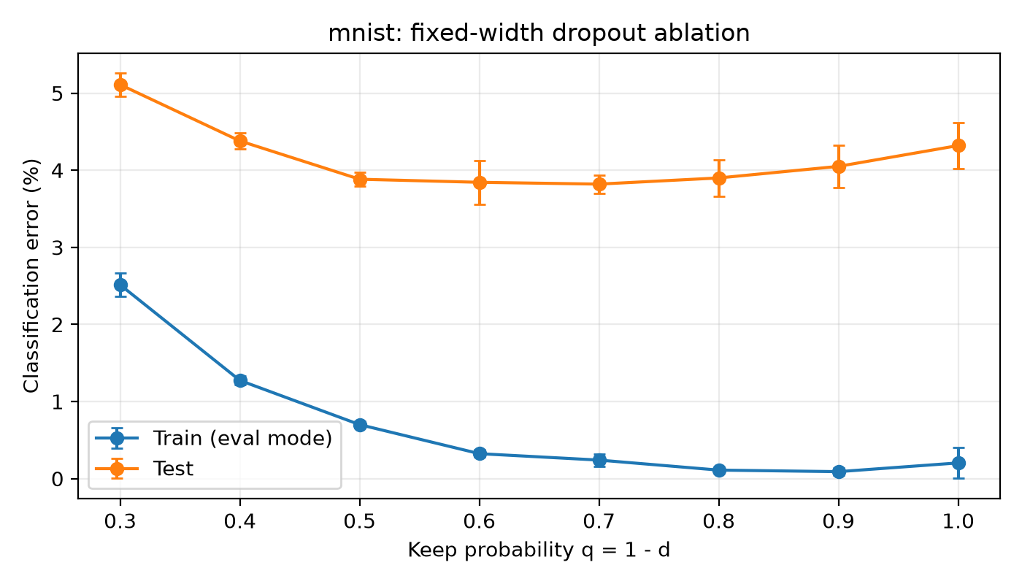
24CS2032 DEEP LEARNING — PAPER IMPLEMENTATION STUDY
MNIST: Dropout Reduced Test Error at Moderate Rates
Measured Results on MNIST (Fixed Epoch 20)
No Dropout Baseline (d = 0.0):
Train: 0.203 ± 0.200% | Val: 4.260 ± 0.533%
Test Error: 4.320 ± 0.295% | Gap: 4.117 ± 0.101 pp
Validation-Selected (d* = 0.4):
Train: 0.323 ± 0.047% | Val: 3.747 ± 0.130%
Test Error: 3.843 ± 0.282% (Accuracy: 96.157%)
Generalization Gap: 3.520 ± 0.295 pp
Net Gain over Baseline:
+0.477 pp lower test error (11.03% relative reduction)
Paper Reference Rate (d = 0.5):
Test Error: 3.883 ± 0.087% (Gap: 3.183 pp)
Model Selection Nuance:
Lowest numerical test error occurred at d=0.3 (3.820 ± 0.118%). The observed mean test-error difference between d=0.3 and d=0.4 is only 0.023 percentage points. Test performance was not used for model selection.
Negative Finding:
Higher drop rates degraded performance below baseline: d=0.6 (4.380%) and d=0.7 (5.110%).

Slide 6
24CS2032 DEEP LEARNING — PAPER IMPLEMENTATION STUDY
Historical Paper Comparison & Fashion-MNIST Extension
Comparison with Srivastava et al. (2014)
Paper Table 2 Historical Score:
Srivastava et al. report ~1.25% test error on MNIST using a 3x1024 ReLU architecture with dropout.
Our Measured Selected Score:
3.843 ± 0.282% test error (d = 0.4, 3x256 MLP).
NOT Directly Comparable:
Our experiment is not an apples-to-apples comparison:
• Architecture: 256 units vs. 1,024-8,192 units
• Training set: 10,000 subset vs. full 60,000
• Budget: 20 epochs vs. hundreds of epochs
• Optimizer: Adam vs. SGD + momentum + max-norm
Qualitative Trend:
Our reduced-scale rate sweep shows a qualitatively similar non-monotonic trend: moderate dropout performs better than very high dropout under this fixed training budget.
Fashion-MNIST Extension (Same Protocol)
No Dropout Baseline (d = 0.0):
Train: 7.130 ± 0.177% | Val: 13.127 ± 0.247%
Test Error: 14.663 ± 0.175% | Gap: 7.533 pp
Validation-Selected (d* = 0.2):
Train: 8.583 ± 0.414% | Val: 13.087 ± 0.408%
Test Error: 14.347 ± 0.253% (Accuracy: 85.653%)
Net Improvement: +0.317 pp (2.16% relative)
Critical Negative Finding:
Canonical d = 0.5 underperformed baseline:
Test error rose to 15.133 ± 0.325% (+0.47 pp worse than baseline). At d = 0.7, error spiked to 17.453%.
Key Scientific Insight:
Under the fixed 20-epoch budget, higher dropout rates produced higher train and test error on Fashion-MNIST, consistent with stronger underfitting.

Slide 7
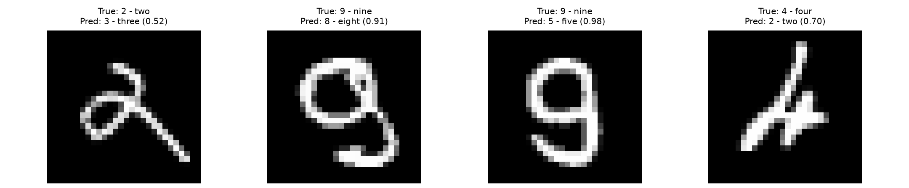
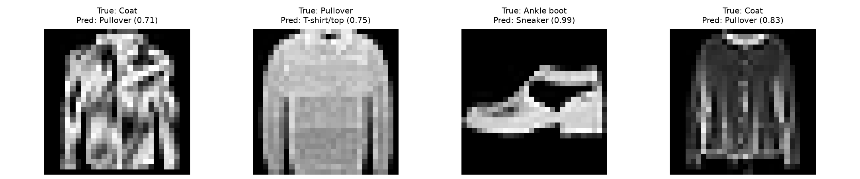
24CS2032 DEEP LEARNING — PAPER IMPLEMENTATION STUDY
Failure Case Inspection and Methodological Limitations
MNIST Failure Inspection (Selected d = 0.4):
The inspected examples include: True 2 → Pred 3 (conf 0.52) | True 9 → Pred 8 (conf 0.91)
Methodological Constraints & Scope
• 3 random seeds only:
N=3 reflects empirical sample variance but lacks statistical power for formal hypothesis testing.
• 10k training subset:
Subsampled training split magnifies regularizer sensitivity relative to the full 60,000 dataset.
• Fixed 20-epoch budget:
Higher dropout may require more optimization; this experiment intentionally keeps the same 20-epoch budget for every rate.
• Fully connected MLP:
Lacks the translational invariance of convolutional networks.
• No significance test:
Sample SD (ddof=1) reported; descriptive comparisons only without p-values.
• Fashion-MNIST is an extension:
Exploratory benchmark under the identical protocol (not present in 2014 paper).
Fashion-MNIST Failure Inspection (Selected d = 0.2):
The inspected examples include: Coat → Pullover (conf 0.71) | Ankle boot → Sneaker (conf 0.99)
Note: Inspected examples display stroke and silhouette resemblances; they do not establish category-wide concentration or individual failure causes.

Slide 8
24CS2032 DEEP LEARNING — PAPER IMPLEMENTATION STUDY
Conclusion, Live Model Demo & Resources
Key Research Conclusions
1. Mathematical Implementation: Manual inverted dropout implemented without built-in dropout primitives; standard PyTorch layers and optimizers were used.
2. Regularization Efficacy: Moderate validation-selected dropout lowered mean test error relative to the no-dropout baseline in our fixed protocol:
• MNIST: 4.320% -> 3.843% test error (11.03% relative reduction)
• Fashion-MNIST: 14.663% -> 14.347% test error (2.16% relative reduction)
3. Critical Negative Finding: Canonical d = 0.5 underperformed the no-dropout baseline on Fashion-MNIST, and high rates d >= 0.6 produced higher error consistent with stronger underfitting under the fixed training budget.
4. Methodological Lesson: Dropout strength cannot be assumed universally; it must be calibrated systematically against validation data.
Saved-Model Demonstration & Project Assets
Interactive Demo (presentation/demo.py):
• Loads saved checkpoint: mnist_d0.4_s42.pt on CPU
• First 10 MNIST test samples: 10/10 correct in the demo.
(Demo sample only — not the reported full-test accuracy.)
• Formal selected mean test accuracy remains 96.157%.
Private Project Repository:
https://github.com/sg721642/24cs2032-dropout-paper-implementation
(Contains complete source, reproducible notebook, and audited CSV data)
Verified Academic Report:
report/24CS2032_Dropout_Report.pdf (5-page IEEE conference format)
Primary Citation:
Srivastava, N., Hinton, G., Krizhevsky, A., Sutskever, I., & Salakhutdinov, R. 'Dropout: A Simple Way to Prevent Neural Networks from Overfitting.' JMLR 15.56 (2014): 1929-1958.

