Slide 1
NeuroX Hackathon · June 21 2026 · Track 3 — Reimagine Security
CONSENTLENS
App Permission Reality Checker
Know what every installed app is collecting about you — no login, no device access, zero personal data processed.
TEAM
BUILT WITH
3 Musketeers
Deepak Kumar Satyam Gupta Chiranjivi Panda
ArmorIQ · ArmorClaw · Open-Source AI · React
🔒 ArmorIQ-enforced policy · Only app names processed · Zero personal data retained on every request
Notes:
Slide 1 — Title. Fill in Team Name/ID and College. Speak ~15 sec. Tagline: 'Know what every app is collecting — no login, zero data needed.'

Slide 2
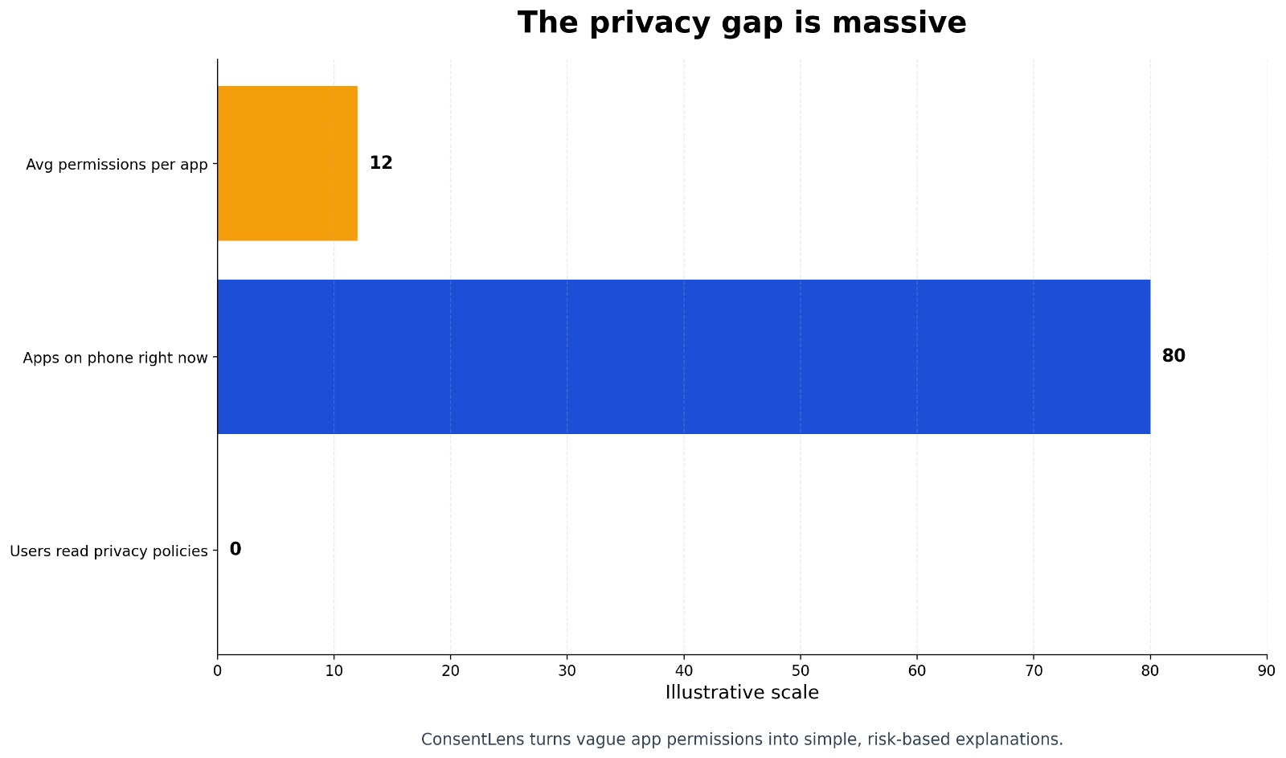
The Permission Blindspot
12+
📊 INSERT CHART
Image 7 — The Privacy Gap (Horizontal Bar Chart)
Apps on phone: ~80 | Avg permissions/app: 12 | Users who read policies: ~0
permissions per
average app
85%
users accept all
without reviewing
< 3s
average decision time
on permission dialogs
EXISTING SOLUTIONS FAIL
iOS Settings is buried 4 menus deep. Exodus Privacy needs APK upload. Manual research takes 30+ minutes. No tool is fast, simple, and privacy-preserving.
*Approximate UX privacy-literacy research data — ConsentLens closes this gap
Notes:
Slide 2 — Problem. LEFT: 3 large sienna stat callouts. RIGHT: INSERT Image 7 — 'The Privacy Gap' horizontal bar chart (apps on phone / permissions per app / users who read policies). Speak ~30 sec.

Slide 3
ConsentLens: Instant Clarity, Zero Compromise
01 INPUT
02 PROCESS
03 OUTPUT
App Names
Only
→
Security-Enforced
Analysis
→
Plain Risk
Report
Type names like
Instagram, TikTok.
No login. No files.
ArmorClaw threat scan
ArmorIQ policy check
AI permission analysis
Risk score 0–100
Plain English verdict
Actionable steps
Why ConsentLens Outperforms Every Existing Tool
Aspect
Existing Solutions
ConsentLens ✔
Privacy
✗ Requires login or device access
✓ App names only — nothing else
Speed
✗ 15–30 min research per app
✓ 30 seconds, fully automated
Language
✗ Technical jargon and legal text
✓ Plain English for any user
Security
✗ No audit trail or enforcement
✓ ArmorIQ-enforced, fully audited
🔒 ArmorIQ Guarantee: Only app-name strings processed · No credentials · No device access · Immutable audit log on every request
Notes:
Slide 3 — Solution. 3-box flow (INPUT/PROCESS/OUTPUT) + comparison table + privacy promise footer. No chart image on this slide. Speak ~30 sec.

Slide 4
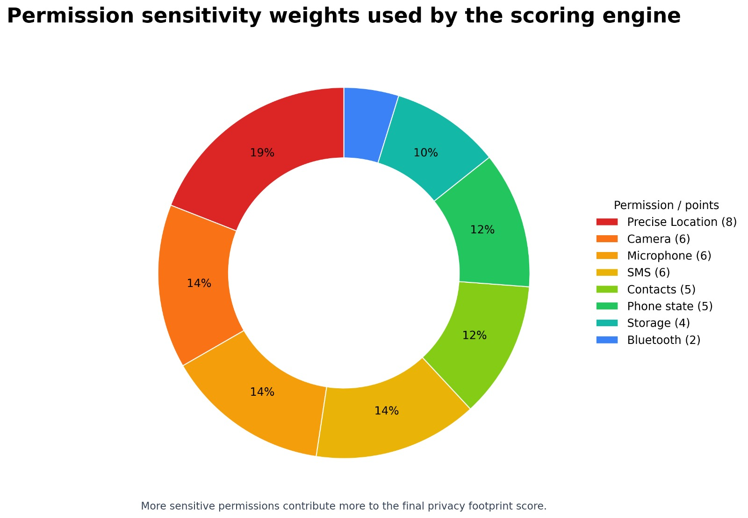
Architecture & Tech Stack
01
User Input
✔ No database required
📊 INSERT CHART
Image 2 — Permission Scoring Weights
Vertical bar chart: Precise Location = 8 pts, Camera/Mic/SMS = 6 pts, Bluetooth = 2 pts
App names entered via web UI
↓
02
ArmorClaw Scan
Malicious input detection
↓
03
ArmorIQ Policy
Metadata-only enforcement
↓
04
AI Analysis
Open-source LLM permission check
↓
05
Risk Report
0–100 score + plain text
Scored result + plain language
TECH STACK
Scoring weights that power the risk engine
React + Vite
Node.js
TypeScript
ArmorIQ SDK
ArmorClaw
Open LLM API
Vercel
Notes:
Slide 4 — Architecture. LEFT: 5-step system flow with step badges. RIGHT: INSERT Image 2 — 'Permission Scoring Weights' (vertical bar chart: each permission type and its risk-point weight). Bottom: tech stack pills. 'Open LLM API' means the open-source AI engine used. Speak ~30 sec.

Slide 5
5 Features That Set ConsentLens Apart
FEATURE
WHAT IT DOES
01
CORE INNOVATION
Only app names enter the system. ArmorIQ enforces a strict metadata-only policy at every request. PII is blocked and logged before reaching any service. The privacy promise is technical — not a marketing claim.
Zero-PII Architecture
02
AI-POWERED
An open-source AI engine converts technical permission strings into sentences anyone understands. Instead of 'READ_CONTACTS access granted', users see: 'This app uploads your full contact list to external servers.'
Plain-Language AI Analysis
03
SMART SCORING
15 permission types scored by sensitivity, data-sharing practices, and ecosystem risk. Precise location carries 8 pts; camera and microphone 6 pts each. Clear LOW / MEDIUM / HIGH / CRITICAL verdict with justification.
Weighted Risk Score (0–100)
04
USER-CENTRIC
Not just 'Instagram is risky.' Exact Settings navigation paths to revoke excessive permissions on Android and iOS — specific, doable, today. No technical knowledge required.
Actionable Remediation Steps
05
MULTI-APP
Analyze multiple apps in one request. Results return as comparable risk cards — letting users instantly identify which of their installed apps is the most invasive.
Batch Analysis (Up to 5 Apps)
Notes:
Slide 5 — Key Features. 5 numbered rows (alternating bg), each split: feature name left / description right. No chart image on this slide. Speak ~30 sec, one clear sentence per feature.

Slide 6
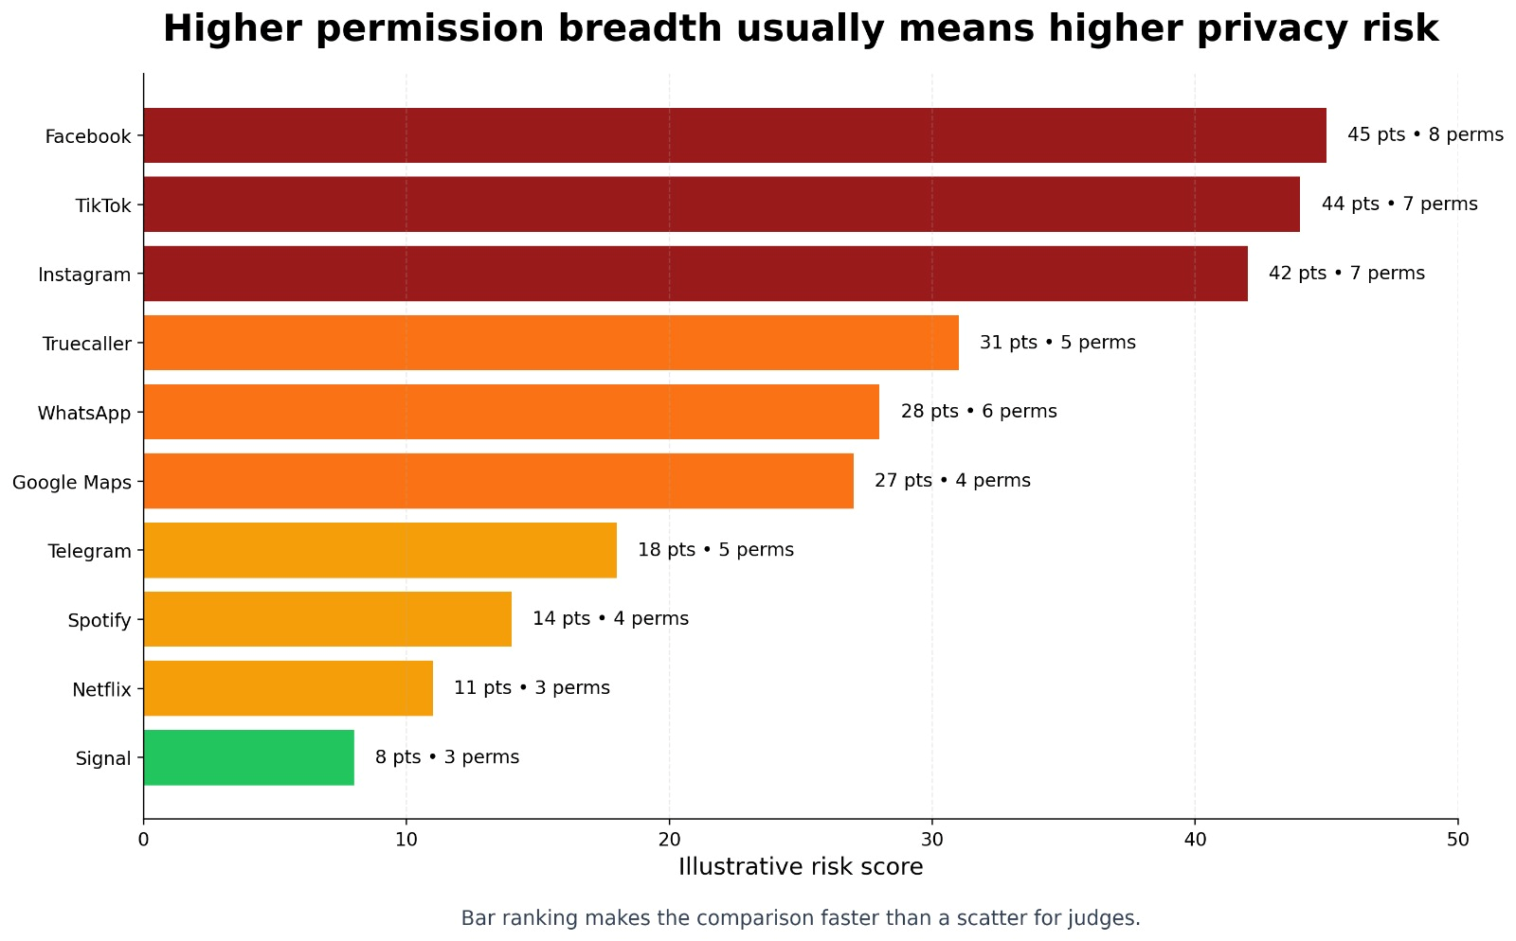
Real-World Impact & Feasibility
6.8B
< $0.05
30 sec
Global smartphone users
— all potentially exposed
Cost per full analysis
(cloud-scalable, free tier)
Input to complete
permission risk report
WHO BENEFITS
📊 INSERT CHART
Image 6 — App Risk Ranking (Horizontal Bar Chart)
Facebook=45, TikTok=43, Instagram=40 … Signal=8 | Color gradient dark-red → green
70%
General public
15%
Parents
10%
Corporate IT
5%
Researchers
FEASIBILITY
✔ Stateless — no database, zero setup
✔ DPDP Act 2023 (India) compliant
Illustrative risk ranking generated by ConsentLens scoring engine
✔ Serverless — auto-scales to 1M+ queries
✔ ~$200/mo estimated for 10K queries/day
Notes:
Slide 6 — Impact. TOP: 3 stat callouts (6.8B users / cost / speed). CENTRE-LEFT: INSERT Image 6 — 'App Risk Ranking' horizontal bar chart (color-coded dark-red to green, ranked by risk score). RIGHT: Who benefits (coloured % bars) + feasibility list. Speak ~30 sec.

Slide 7
Live Demo & Some Important Stuff
🔒 ConsentLens · Sample Output
01
Universal, Urgent Problem
6.8B smartphone users affected. India's DPDP Act 2023 makes this legally timely today.
TikTok
CRITICAL
89/100
Facebook
CRITICAL
87/100
02
Meaningful Security Integration
Instagram
HIGH
74/100
ArmorIQ policy enforcement is the product — not an add-on. The privacy promise is provable, live, and audited.
Uber
MEDIUM
52/100
Signal
LOW
12/100
03
Built and Working
Stateless design, live AI analysis, real ArmorIQ audit log. A working product, not a mockup.
🔒 Secured by ArmorIQ · Audit ID: ARM-2026-XXXX · Zero data retained
🌐 https://github.com/sg721642/CONSENTLENS
“The best security tool is one that doesn’t compromise your privacy to protect it.”
Notes:
Slide 7 — Demo & Conclusion. LEFT: Simulated output panel (5 apps with risk scores + ArmorIQ badge). Replace URL with actual deployed link. RIGHT: 3 numbered reasons (with forest green left-edge accents) + closing quote in forest green block. No chart image on this slide. Speak ~45 sec: open browser for live demo first, then walk through the 3 reasons.

