Slide 1

Data422
Analysis & Forecast of New Zealand's Unemployment Rate
Huiyuan Xie
Lin Song
Peng Dong
Song Gao

Slide 2

CONTENTS
1
BACKGROUND
2
DATA CLEANIING
3
KEY FINDINGS
4
DATA MODELLING

Slide 3
01
WHAT CAN INFLUENCE
UNEMPLOYMENT RATE?
BACKGROUND

Slide 4
FACTORS IMPACT UNEMPLOYMENT RATE
Population
Macroeconomy
THE FACTOR WE ANALYZED
Religion & Culture
Politics
……

Slide 5


BACKGROUND
WHAT CAN INFLUENCE UNEMPLOYMENT RATE?
GDP Growth
EXPORT REVENUE
FOREIGN INVESTMENT
EXCHANGE RATE
GDP
BCI
CCI
CPI
GDP is the total value of goods and services produced in a country
GDP Growth measures the rate of economic expansion
BCI assesses business confidence
CCI is a gauge of consumer confidence in the economy
CPI measures the average change in prices paid by consumers for goods and services.
Export revenue is the income from selling goods to foreign markets.
Foreign Investment represents capital invested from abroad
Exchange Rate determines the value of one currency in relation to another

Slide 6
02
OBTAIN & CLEAN DATA
DATA CLEANING

Slide 7
OBTAIN AND CLEAN DATA
ANALYTICAL APPROACH
Understanding the Unemployment Rates of Countries in the Same Region as New Zealand
Analyzing the Recent Performance of Macroeconomic Factors and Unemployment Rates in the New Zealand Region
Building Time Series Models to Forecast Unemployment Rates in New Zealand
STEP 1
STEP 2
STEP 3

Slide 8


OBTAIN AND CLEAN DATA
DATA SOURCE & TECHNIQUES
GET INDICATOR
USER-DEFINED FUNCTION
World Bank
Interest.co.nz
Obtained data on GDP, CPI, Unemployment Rate, and Foreign Investment from this website.
A valuable resource to get New Zealand exchange rate information.
OECD
NZ MacroTrends
Provided data about the BCI and CCI can be found on this website.
A simplified version of World Bank data; we utilized web scraping to directly extract the export information from this source.
DIRECT DOWNLOADS
WEB SCRAPING

Slide 9
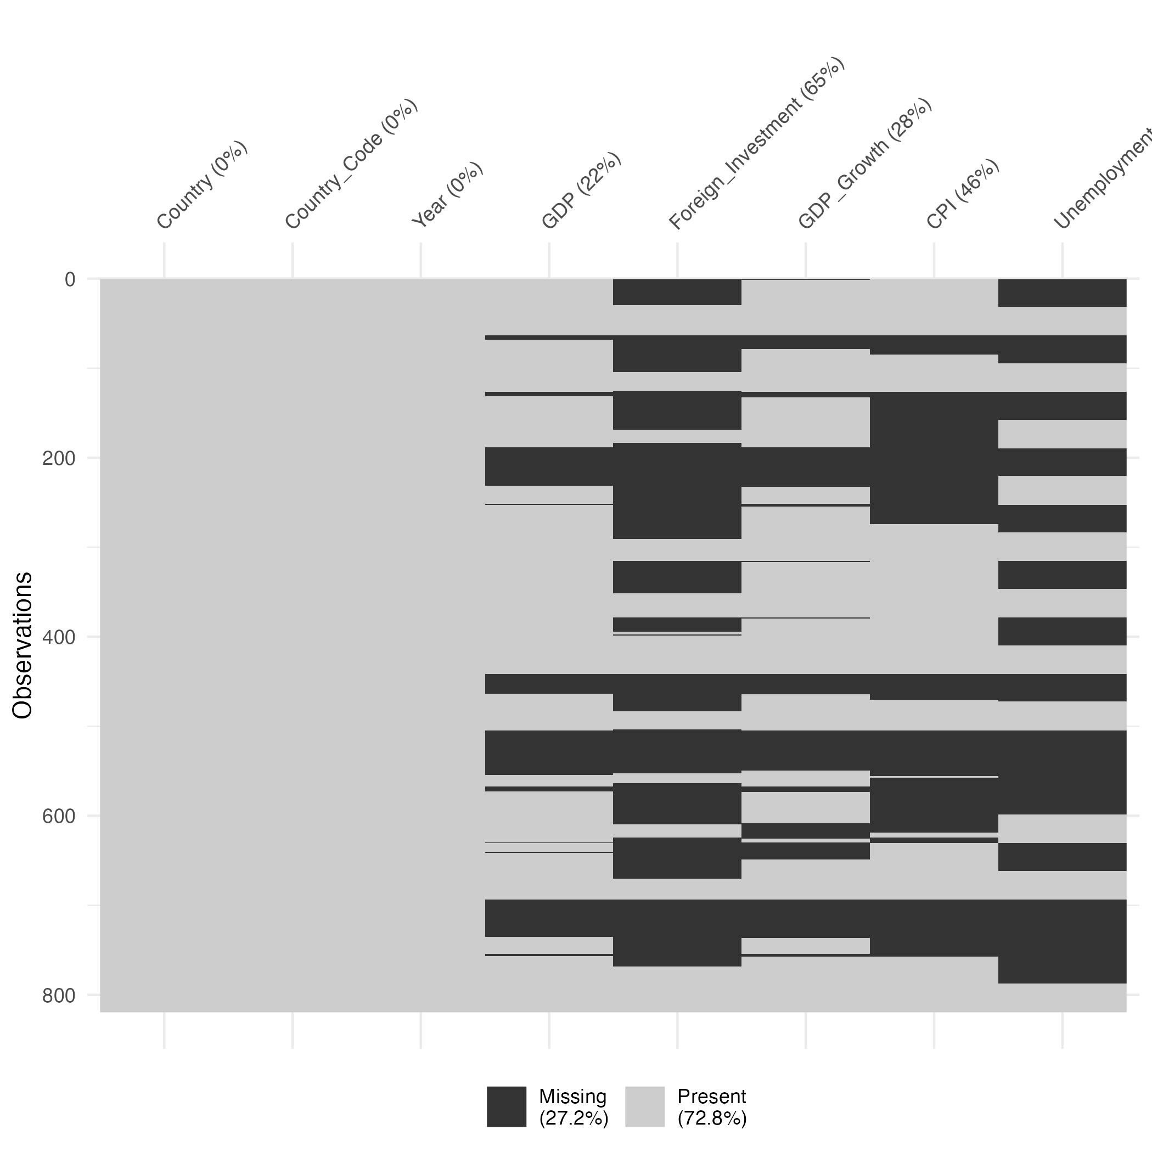
OBTAIN AND CLEAN DATA
MISSING VALUE PATTERN
COUNTRY | 1960 | 1961 | ... | 1991 | 1992 | ... | 2022
AUSTRALIA | NA | NA | NA | 9.580 | 10.730 | ... | 3.661
GUAM | NA | NA | NA | 3.510 | 3.840 | ... | 6.134
JAPAN | NA | NA | NA | 2.100 | 2.200 | ... | 2.641
NEW ZEALAND | NA | NA | NA | 10.610 | 10.670 | ... | 3.253

Slide 10
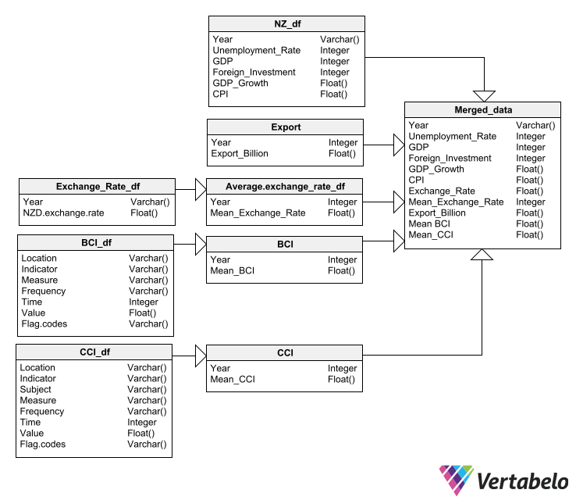
OBTAIN AND CLEAN DATA
RELATIONAL DATA

Slide 11
OBTAIN AND CLEAN DATA
CLEANED DATA
YEAR | UNEMPLOYMENT RATE | GDP | FOREIGN INVESTMENT | CPI | EXPORT | EXCHANGE RATE | CCI | BCI
1991 | 10.61 | 42744828653.3514 | NA | 2.60239285999773 | 12.46 | 1.72767460886336 | 96.8786883333333 | 99.1852841666667
1992 | 10.67 | 41649386969.5133 | NA | 1.01456027171234 | 12.99 | 1.85929624942375 | 99.4132233333333 | 103.025233333333
1993 | 9.8 | 46775038748.7573 | NA | 1.28820776574389 | 14.31 | 1.84994013781873 | 101.085166666667 | 103.5624
1994 | 8.35 | 55313381442.5437 | NA | 1.74537790773741 | 17.02 | 1.68568058209859 | 102.116308333333 | 103.182183333333

Slide 12
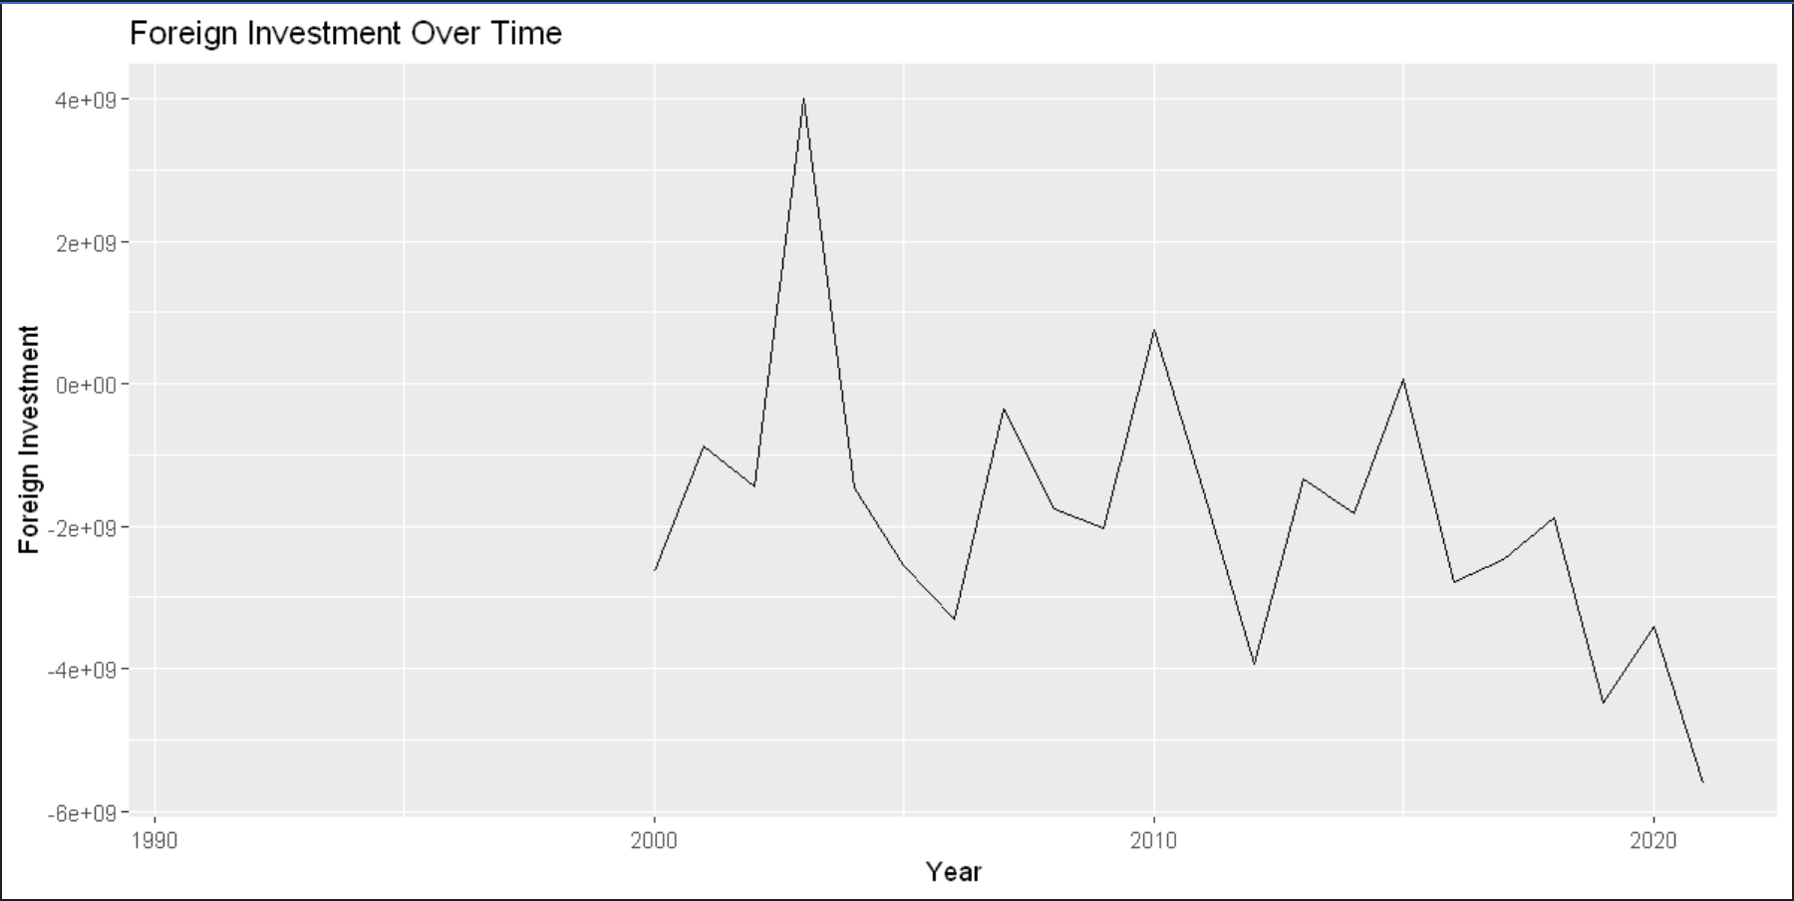
OBTAIN AND CLEAN DATA

Slide 13
03
DISCOVERING INSIGHTS
KEY FINDINGS

Slide 14
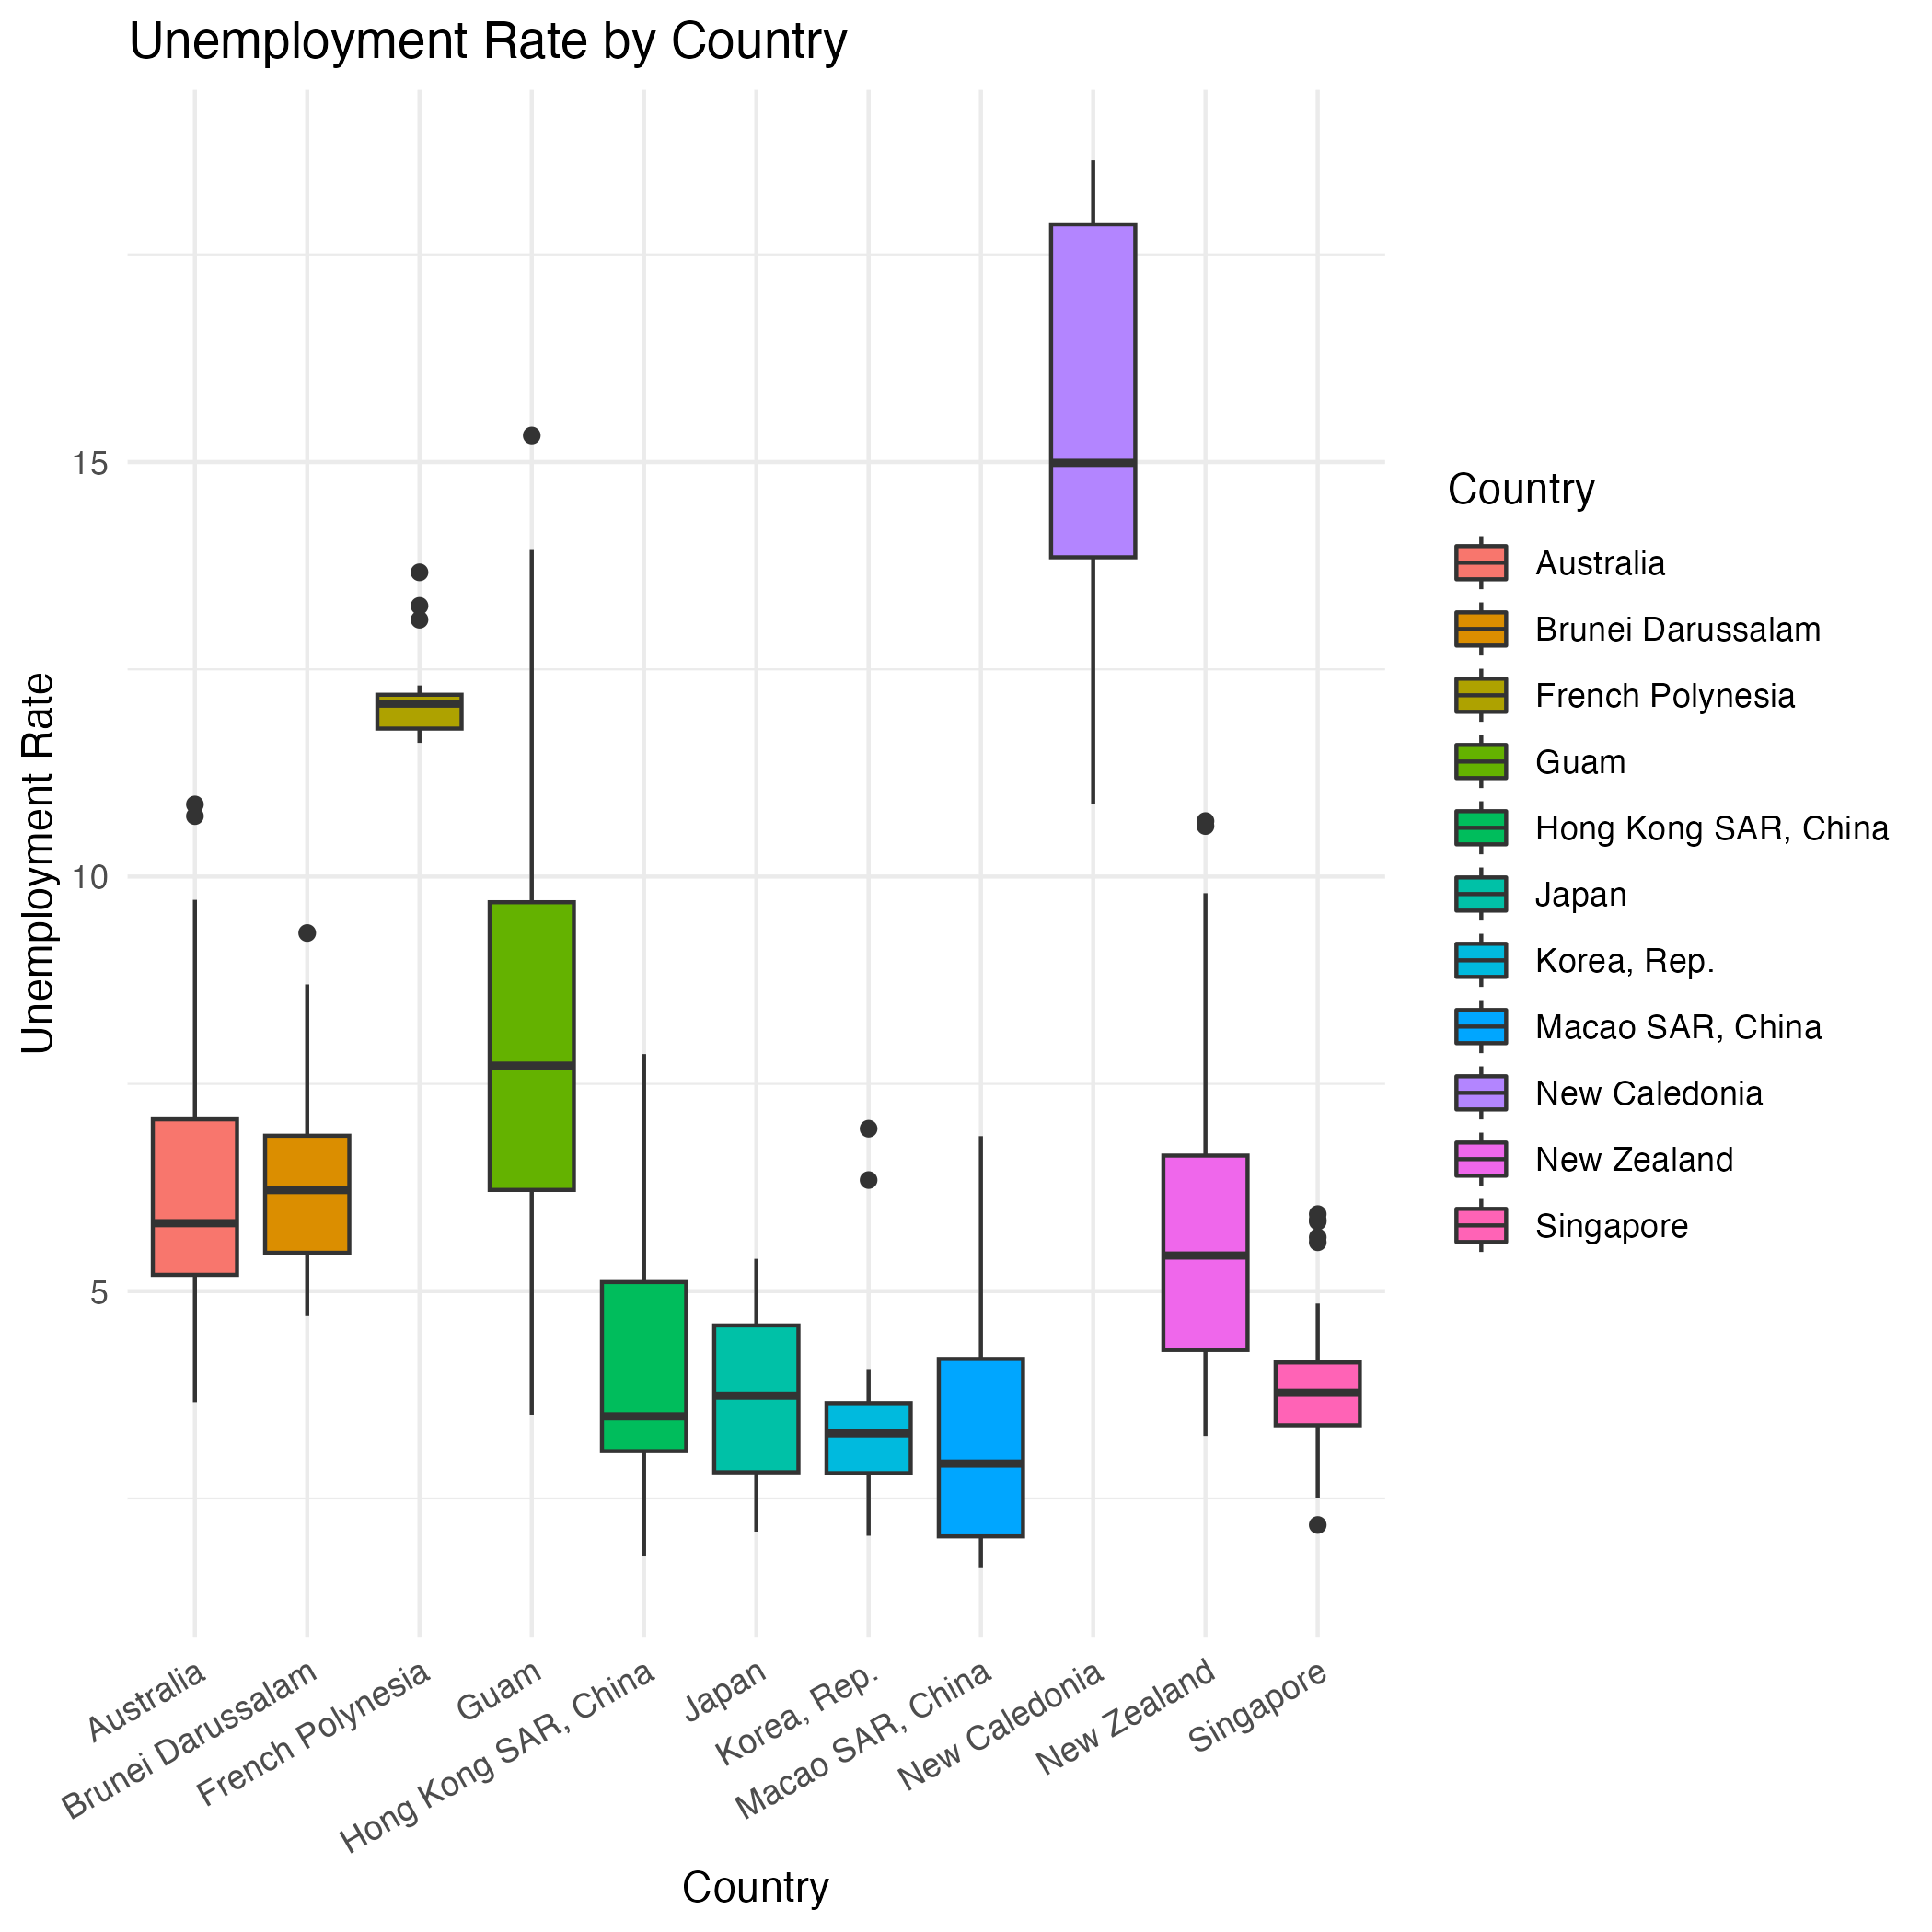
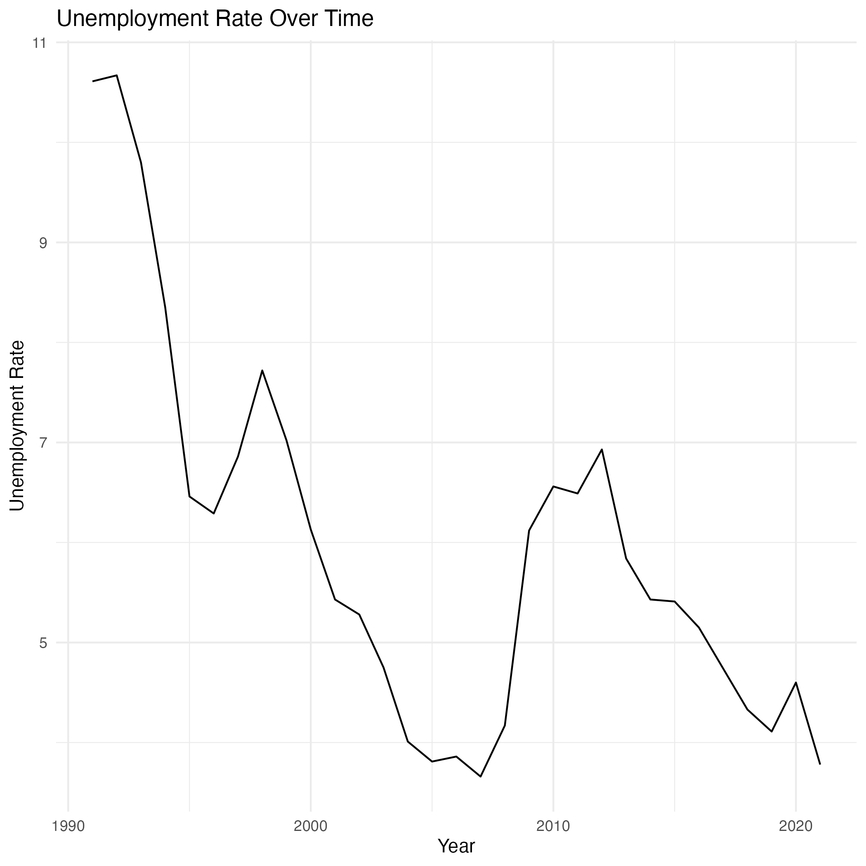
KEY FINDINGS

Slide 15
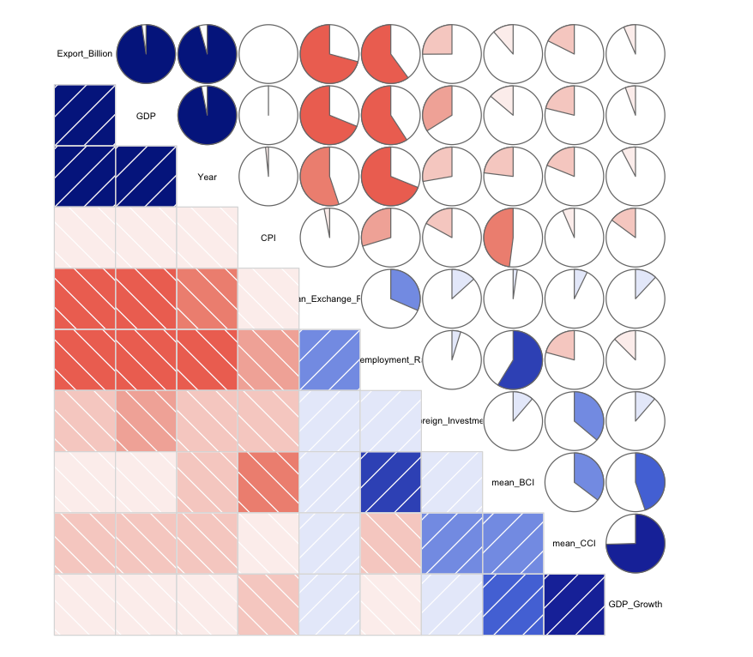
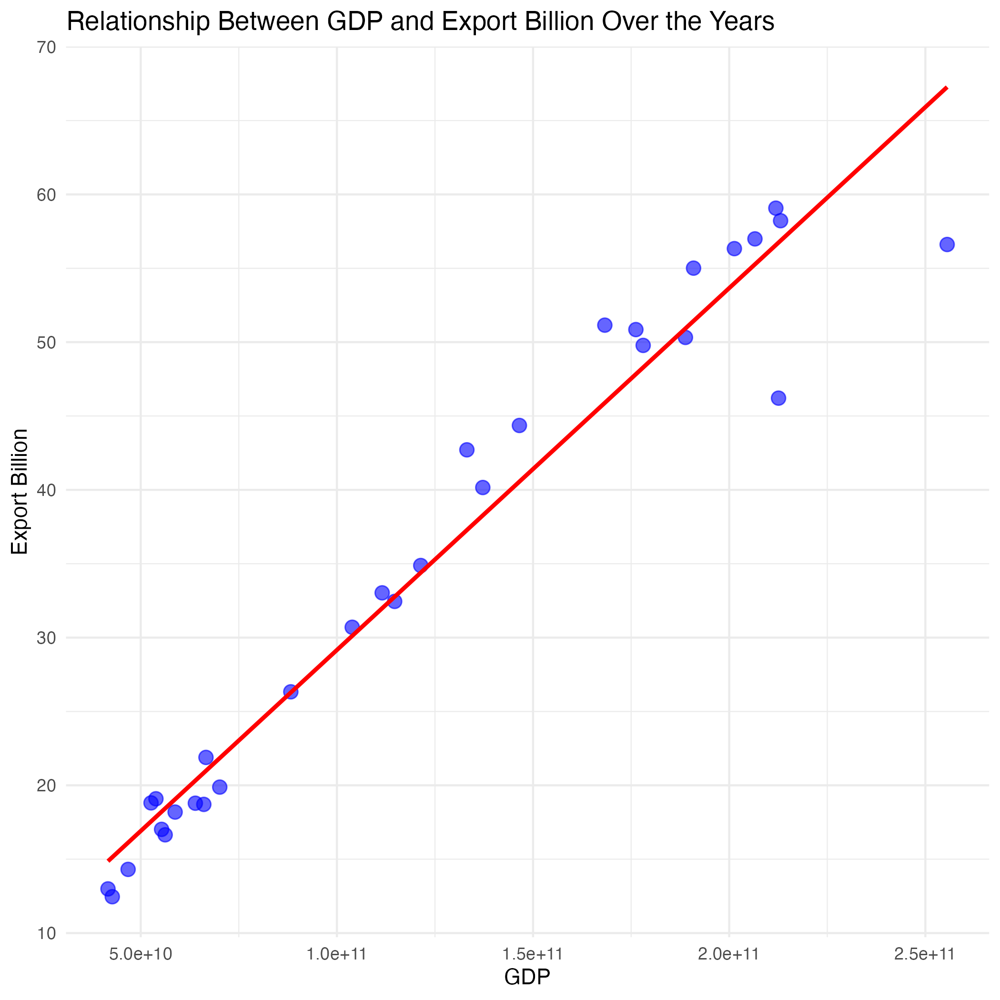
KEY FINDINGS

Slide 16
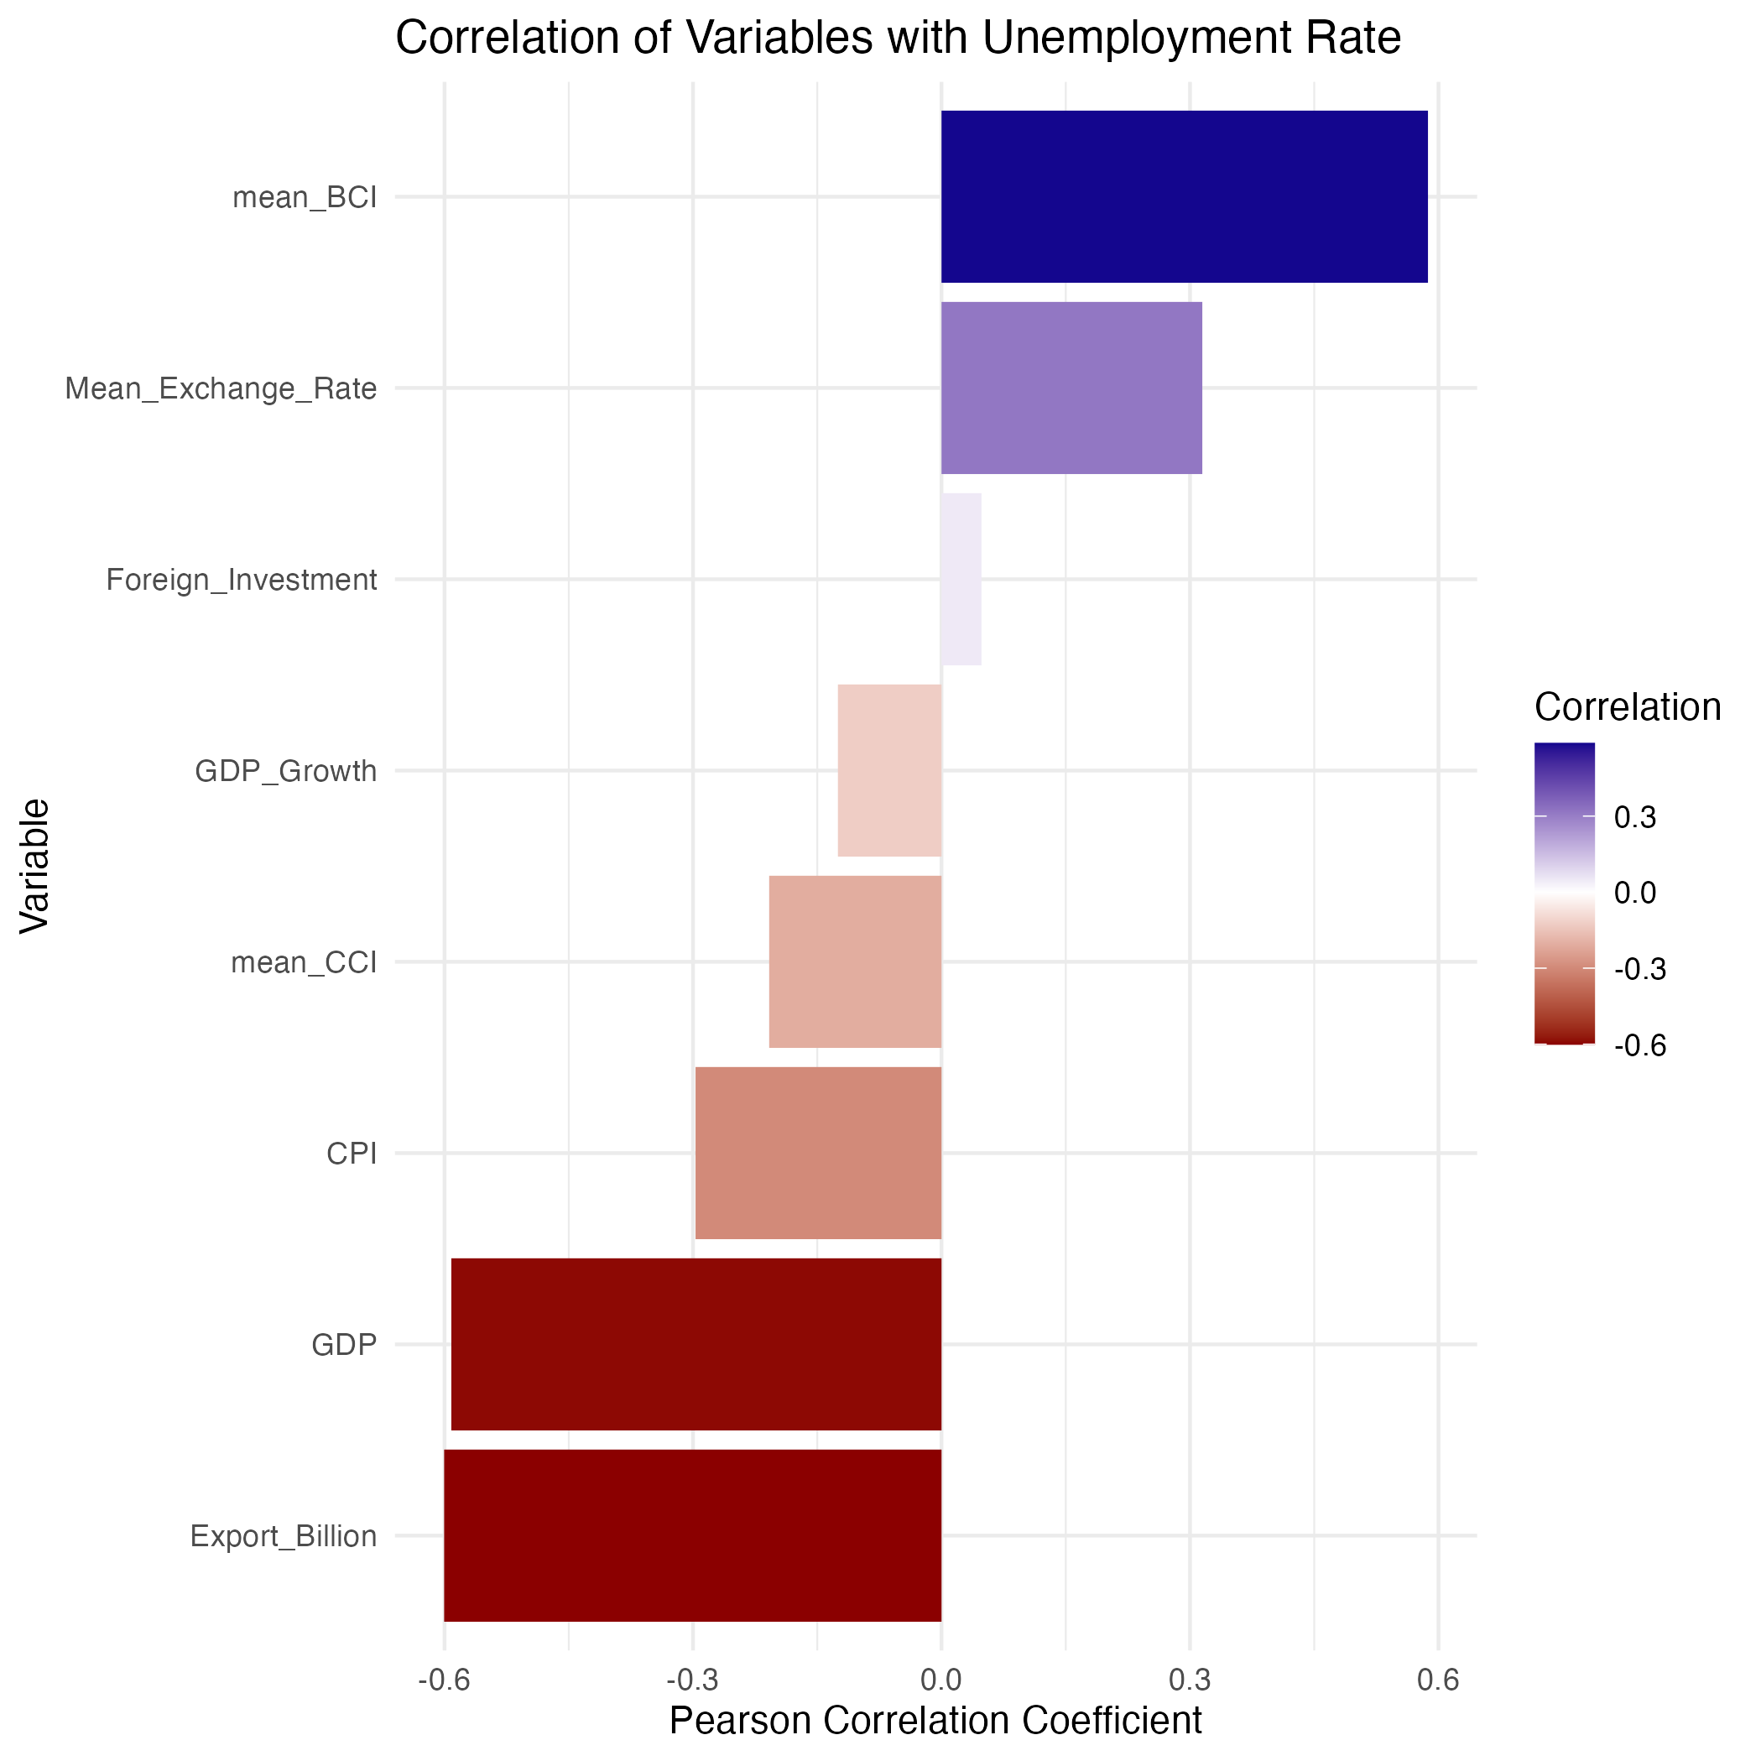
KEY FINDINGS

Slide 17
04
Data Modeling
&
Forecasting
DATA MODELLING

Slide 18
DATA MODELING
Target & Strategy
Target
Strategy
Build a ARIMA model to Fit and predict Unemployment Rate in NZ.
1
Dependent variable y:
Unemployment_Rate
2
Regression variable matrix X will contain four variables:
Export_Billion
CPI
Mean_BCI
Mean_Exchange_Rate

Slide 19
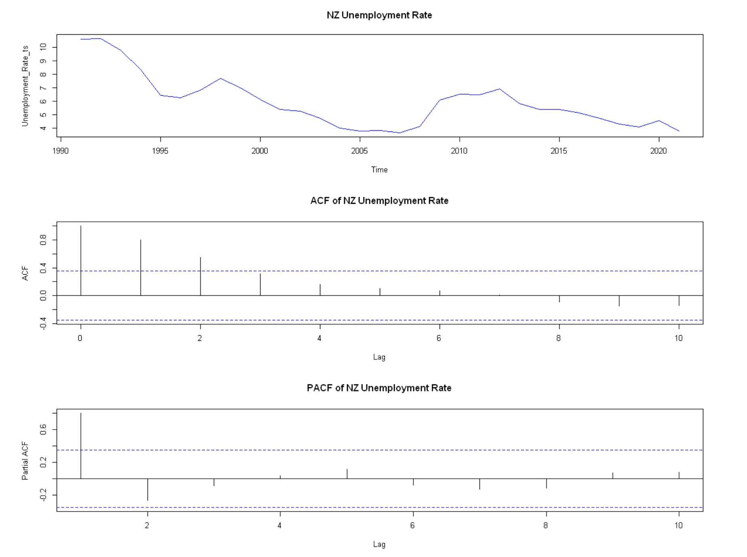
DATA MODELING
Target & Strategy
Unemployment Rate

Slide 20
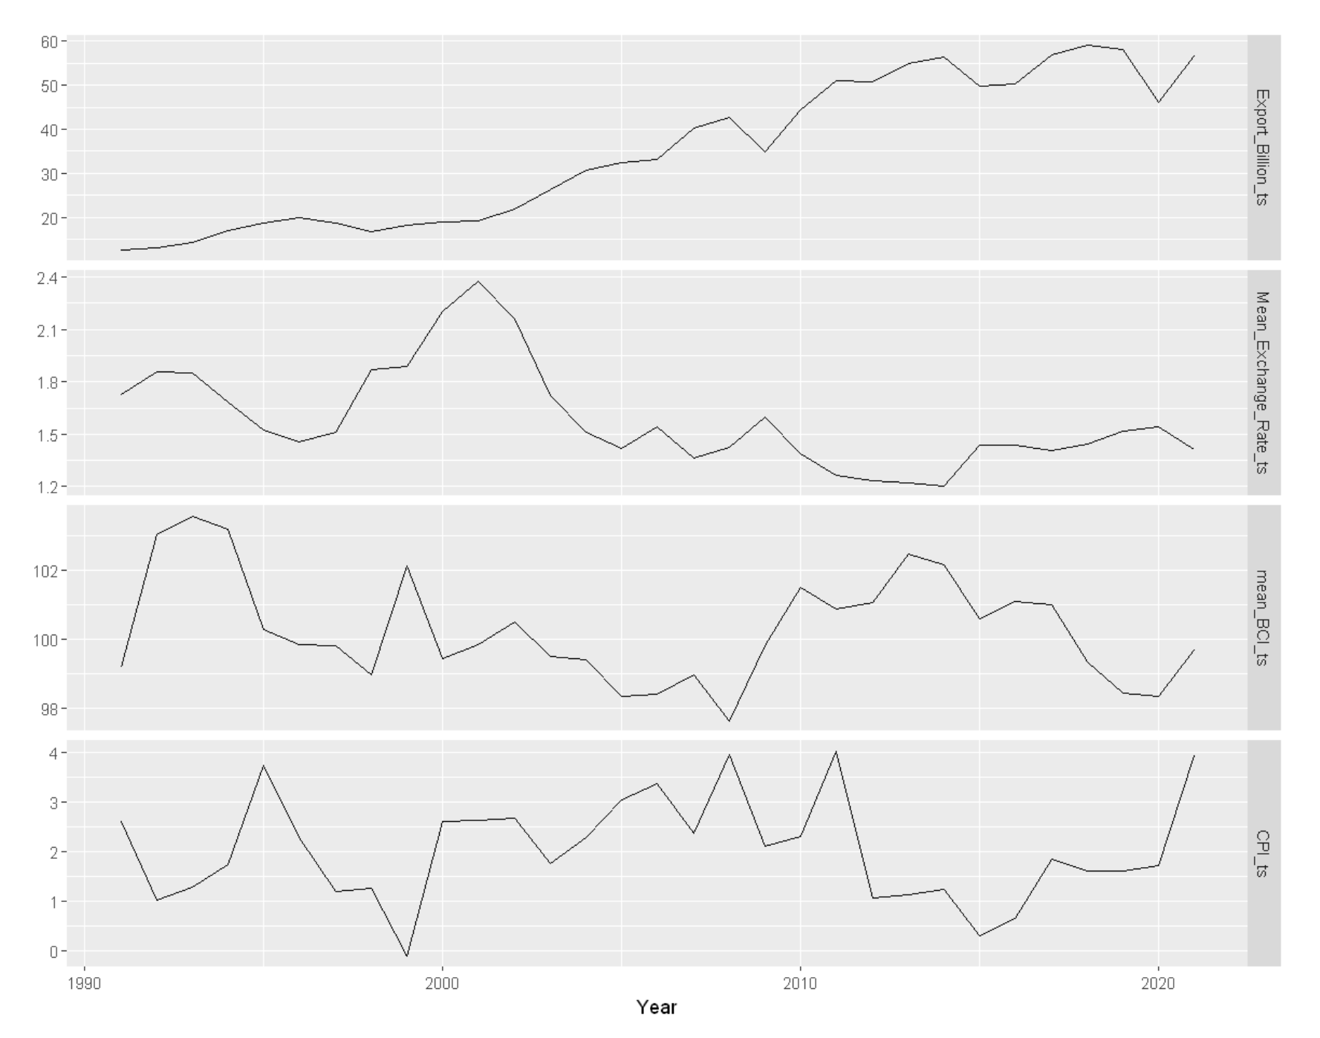

DATA MODELING
The time series of all external factors
The First Difference
&
KPSS test

Slide 21
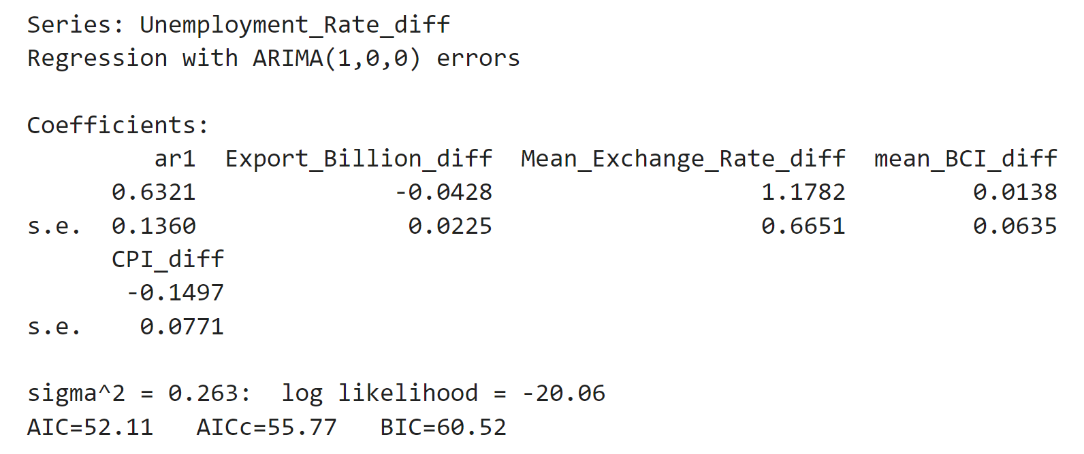
DATA MODELING
ARIMA(1,0,0)
Function: auto.arima()
AR(1) : 0.6321
Export_Billion_diff : -0.0428
Mean_Exchange_Rate_diff : 1.1782
mean_BCI_diff : 0.0138
CPI_diff : -0.1497

Slide 22
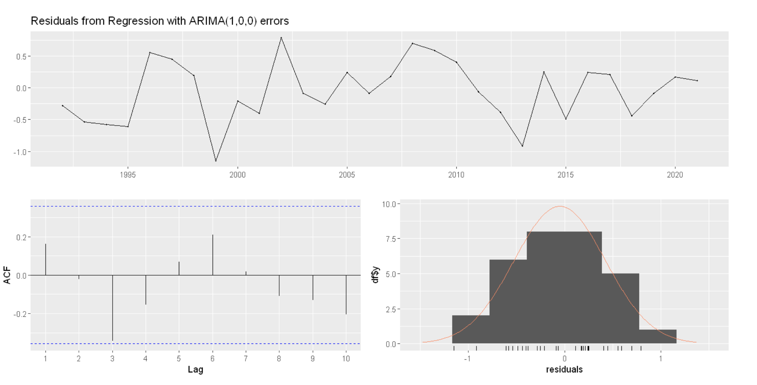
DATA MODELING
Model residual analysis

Slide 23
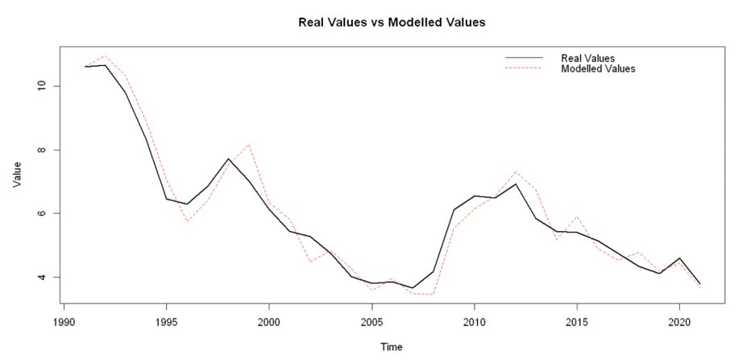
DATA MODELING
Real Values and Fitted Values

Slide 24
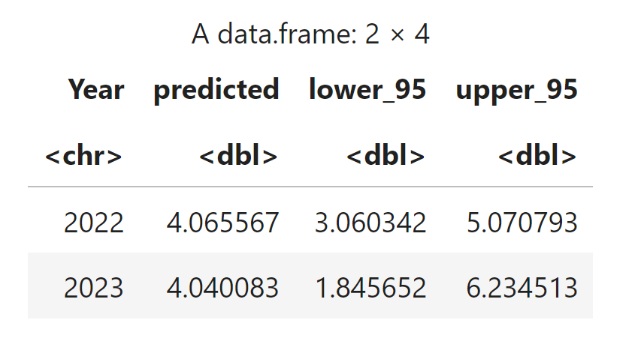
DATA MODELING
The employment rate in the next two years

Slide 25
THANK YOU!

