Slide 1
Jitter Regulation for Multiple Streams
David Hay and Gabriel Scalosub
Technion, Israel

Slide 2
Motivation
Today’s applications call for stringent QoS
  end-to-end delay, loss-ratio, jitter
Smooth traffic is essential in multimedia applications
  audio/video streaming, interactive communication
Moderating traffic throughout the network
Delay jitter measures the smoothness of a stream
  How far is the stream from being completely periodic?

Slide 3
Model Description
Abstract
Source 1
Abstract
Source 2
Regulator
Periodic streams
at rate X
Network
Non-Periodic streams
Network
Internal Buffer - B
Abstract
Source M
Periodic streams
at rate X

Slide 4
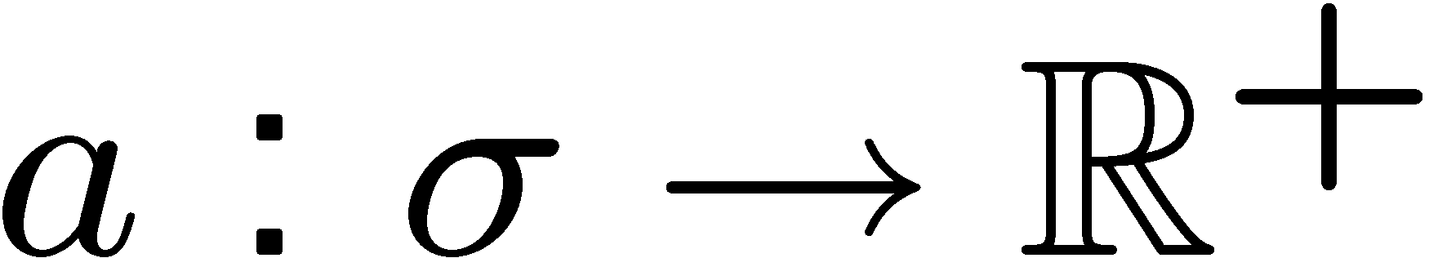
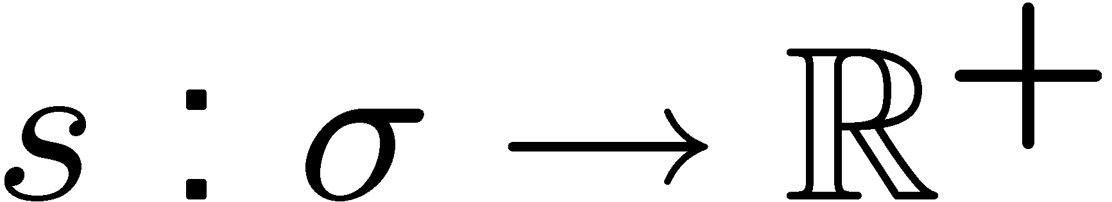
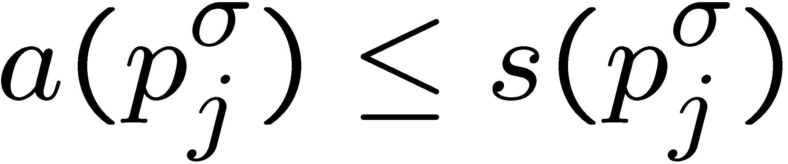
Formally… (Single Stream)
Single stream [Mansour, Patt-Shamir, 2001]
  The regulator knows the rate X, and a monotonic non-decreasing arrival sequence
  The regulator produces a release schedule that satisfies
    FIFO
    Arrival-feasibility:
    B-feasibility: at most B cells in the buffer simultaneously.
  Goal: minimize the delay jitter

Slide 5
Previous Work
Single stream regulation:
  Offline optimal algorithm.
[Mansour, Patt-Shamir, 2001]
  Online: In order to obtain the minimum
  B-feasible jitter one needs, and can do with, a buffer of size 2B.
[Mansour, Patt-Shamir, 2001]
  Offline and online settings with delay considerations.
  [Koga, 2001]

Slide 6
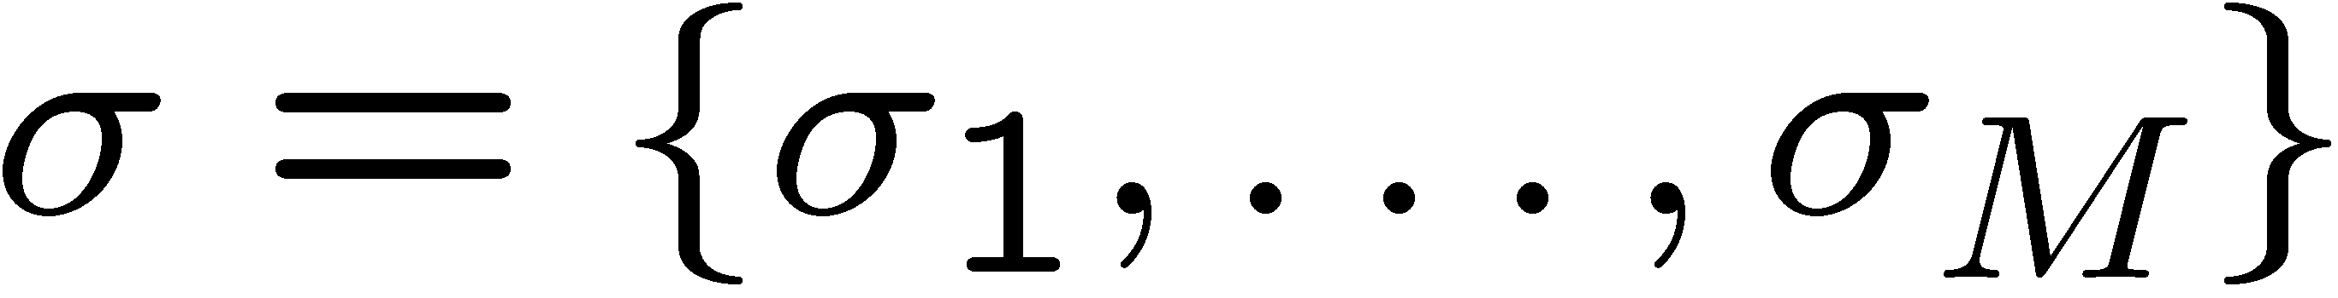
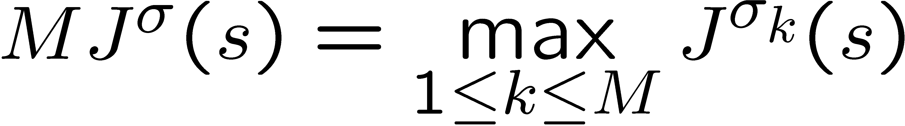
Our Model:
Multi Stream Regulation
The input is an interleaving of M streams
FIFO should be maintained in every stream
  Not necessarily between streams.
Goal: minimize the maximum delay jitter

Slide 7
Our Results
Multi stream jitter regulation:
  Offline:
    The problem of finding the minimum max-jitter is polynomially solvable.
  Online:
    In order to obtain the minimum B-feasible jitter one needs (and can do with) a buffer of size Θ(MB).
    Online jitter regulation does not scale well as the number of streams increases.

Slide 8
Geometric Intuition
(Single Stream)
Packet Number
1
2
3
5,4?
9
8
7
slope 1/x
6
5
4
3
2
1
time

Slide 9
Geometric Intuition
(Single Stream)
Packet Number
4
5
3
9
8
7
6
5
4
3
2
1
time

Slide 10
Geometric Intuition
(Single Stream)
Packet Number
6
7
8
9?
9
8
7
6
5
4
3
2
1
time

Slide 11
Geometric Intuition
(Single Stream)
Packet Number
9
7
8
9
8
left margin
7
6
5
4
right margin
3
2
1
time
The jitter

Slide 12
Multi Stream Intuition
9
1
Stream 1
8
2
1
2
7
6
Must release
5
or
4
1
1
3
2
1
1
2
3
4
5
6
7
8
9
Stream 2

Slide 13
Multi Stream Intuition
9
1
Stream 1
8
2
1
2
7
6
Case 1:
5
release
4
1
3
2
1
1
2
max-jitter
3
4
5
6
7
8
9
Stream 2

Slide 14
Multi Stream Intuition
9
1
Stream 1
8
2
1
2
7
6
Case 2:
5
release
4
1
3
2
1
1
2
max-jitter
3
4
5
6
7
8
9
Stream 2

Slide 15
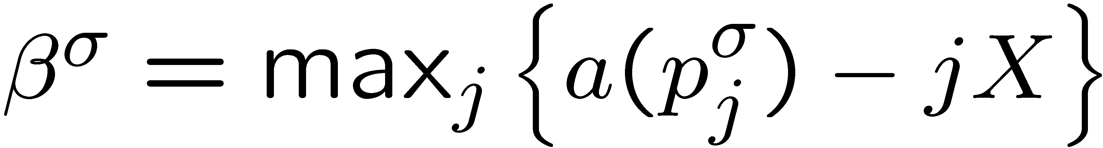
The Right Margin Property
Lemma 1:
  The right margin crosses the time axis in the point
Intuition: Try “moving” the right margin to the left
  Why not all the way to the left margin?
  We end up ‘’sending’’ some cell before it has arrived.

Slide 16
The Right Margin Property
9
8
7
6
5
4
3
2
1
time

Slide 17
The Left Margin Property
Given an optimal solution, consider all streams obtaining MJ:
  There exists one which cannot be improved;
  This is due to buffer overflow.

Slide 18
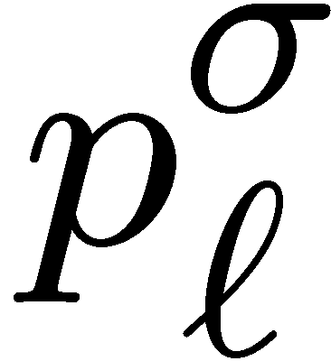
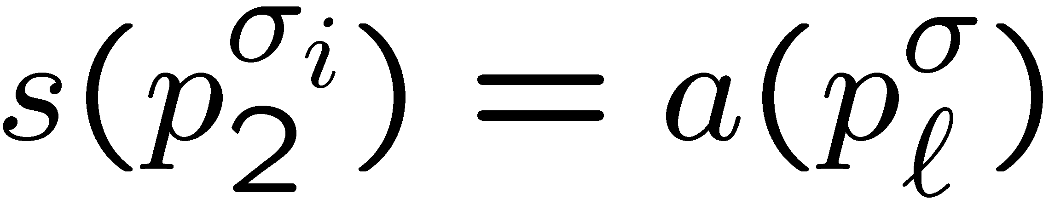
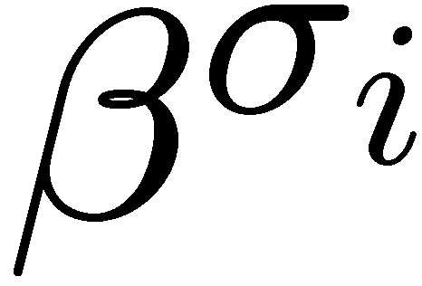
The Left Margin Property
9
8
7
6
5
4
3
2
1
time

Slide 19
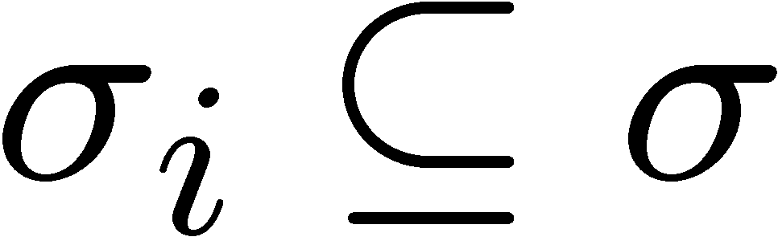
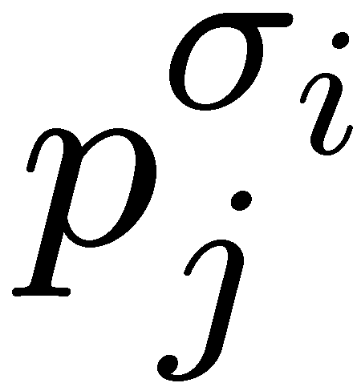
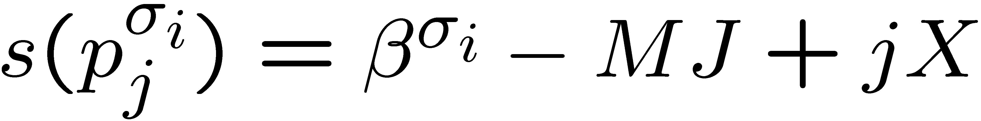
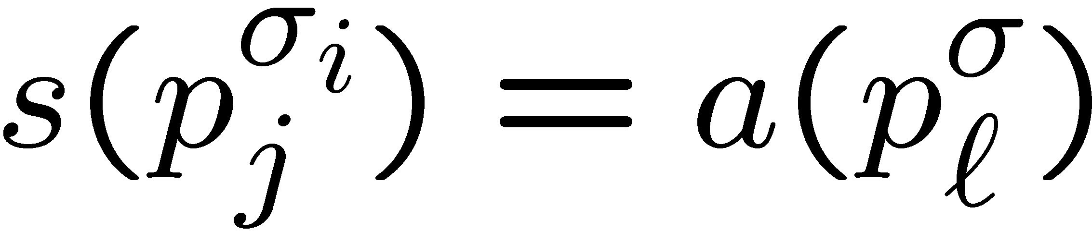
The Left Margin Property
Lemma 2
  There exists a stream that attains MJ, and a cell such that
  and for some cell
Specifically,

Slide 20
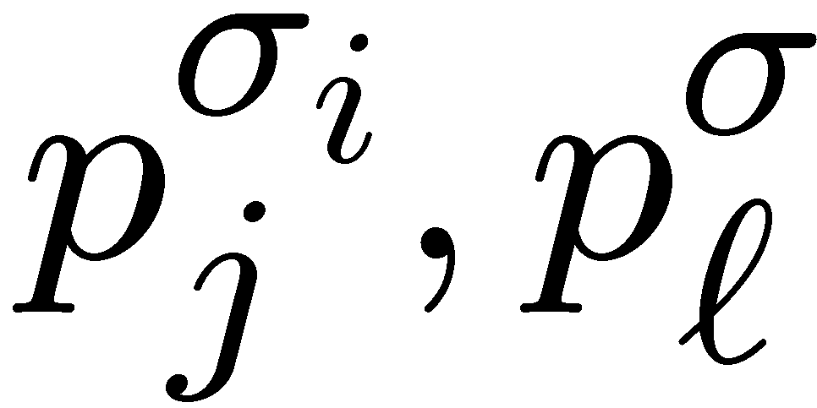
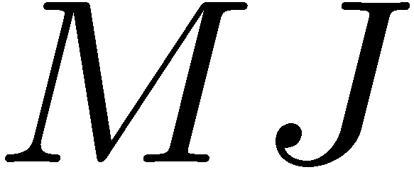
The Offline Algorithm
Enumerate over all pairs of cells :
  Try
  This defines a candidate jitter upper bound
  Try and build a feasible schedule assuming the max-jitter is
    This is easy, using a greedy scheduling policy.
Take the feasible schedule with minimum

Slide 21
Online Setting
Upper Bound: Statically partitioning a buffer of size 2MB among the M streams, one can achieve the optimal B-feasible jitter
  Using [Mansour, Patt-Shamir] online algorithm
Lower Bound: To achieve the optimal B-feasible jitter a buffer of size ≥ M(B-1)+B+1 is required
  Grows linearly with M

Slide 22
Lower Bound Proof
Adversarial Traffic: At times X,2X,…,BX one packet of each stream arrives to the buffer.
Two Cases:
  The online algorithm releases a packet
  of some stream σ_{i} at time t₁<(B+1)X.
  By time (B+1)X, the online algorithm stores all MB packets at its buffer.

Slide 23
Proof Outline
Continuation of adversarial traffic after time BX depends on the case
Case 1:
  Online algorithm achieves arbitrarily large jitter, while the offline algorithm achieves zero jitter.
Case 2:
  Online algorithm achieves jitter=X, while the offline algorithm achieves zero jitter.

Slide 24
Summary
Extended the model to multi stream
Gave a polynomial offline algorithm to find optimal solution
Proved that the online setting requires Θ(MB) buffer augmentation

Slide 25
Future Work
Jitter regulation with bounded capacity outgoing links
  Models real-life regulators
Jitter regulators that can drop a few packets
  May significantly reduce jitter
  Some applications may tolerate packets’ drops
    Video streaming

Slide 26
Thank You!

Slide 27
Sometimes Early Release Is OK
Lemma 3
  If an optimal schedule attains max-jitter J, then
  is an optimal schedule.

Slide 28
Sometimes Early Release Is OK
9
8
7
6
5
4
3
2
1
time

Slide 29
Geometric Intuition
(Single Stream – Zero Jitter)
Packet Number
9
slope 1/x
8
7
6
5
Assume B=5
4
3
2
1
t
t’
time

Slide 30
Algorithm for the Offline Setting
Main difficulty:
  Choose which cell to release
  Because there is no total order of the cells
Method:
  Identifying the left and right margins of each jitter band
  These margins are defined by some “problematic” cells

Slide 31
Lower Bound – Case 1
Online algorithm
Stream σ_{i}
9
8
7
6
5
4
3
2
1
t₁
(B+1)X
T
time
Large Jitter

Slide 32
Lower Bound – Case 1
Release all packets of streams
other than σ_{i} upon their arrival
→ zero jitter!
Optimal algorithm
Stream σ_{i}
9
8
7
6
5
4
3
2
1
Zero Jitter!
T
time

Slide 33
Lower Bound – Case 2
Online algorithm
Stream σ₁
9
8
B+1 packets
7
MB packets in the buffer
6
Online algorithm must release M+1
packets at time (B+1)X
Must release at least 2 packets of the same stream σ_{i}
Jitter of σ_{i} at least X
5
4
3
2
1
BX
(B+1)X
time

Slide 34
Lower Bound – Case 2
Optimal algorithm
Stream σ₁
9
8
B+1 packets
7
Buffer is empty
6
Release all packets of streams
other than σ₁ upon their arrival
→ zero jitter!
5
4
3
2
1
Zero Jitter!
BX
(B+1)X
time

