Slide 1
Providing Performance Guarantees in Multipass Network Processors
Isaac Keslassy | Kirill Kogan | Gabriel Scalosub | Michael Segal
EE, Technion | CISCO & CSE, BGU | CSE, BGU | CSE, BGU

Slide 2
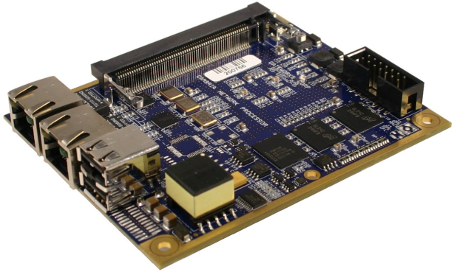
Intro to Network Processors (NPs)
Modern routers use network processors for almost everything
Forwarding
Classification
DPI
Firewalling
Traffic engineering
Homogeneous tasks and homogeneous traffic
Classical NP architectures do pretty well
Increasing heterogeneous demands
Tasks include: VPN encryption, LZS decompression, advanced QoS, …
Classical NP architectures become sluggish
What are “classical NP architectures”?

Slide 3
NPs’ Architectures
Pipelined
each processor (PPE) performs its task in sequence
main handicaps: hard to extend, synchronous, packet header copy
Parallel/multi-core
each processor (PPE) performs all tasks until all completed
main handicap: run-to-completion
Hybrid: pipeline + parallel
Multi-pass
(control!) packets recycled into the queue after each processing cycle
main benefits:
easily extendable, asynchronous
no run-to-completion (heavy-hitters do not starve light-hitters)
E.g., Xelerated X11 NP
E.g., Cavium CN68XX NP
E.g., EZChip NP-4 NP
E.g., CISCO QuantumFlow NP

Slide 4
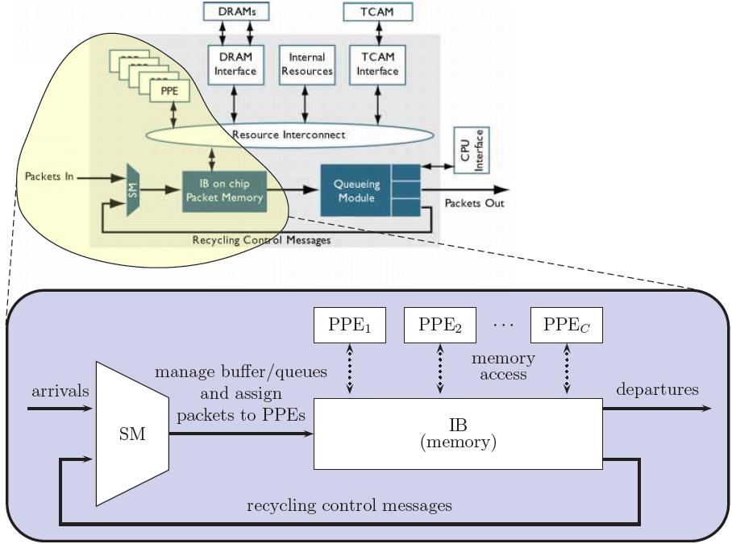
Network Model & Methodology
Abstracting a multi-pass architecture
SM: scheduler module
Buffer management policy
Overflows!!!
Assignment of packets to PPEs
Goal:
Maximize ( throughput )
Multi-core: C PPEs
In this talk: focus on C=1
Competitive approach
c-competitive: for any input sequence σ, A(σ) ≥ OPT(σ) / c
arbitrary arrival sequences (adversarial…)

Slide 5
Further Assumptions & Notation
Homogeneous packets
unit-value
unit-size
buffer capacity: B packets
Slotted time
r(p): packet p’s required passes
known upon packet arrival
max required passes: k
need not be known in advance
residual passes:
If p is processed at t,
then r_{t+1}(p) = r_{t}(p)-1

Slide 6
Further Assumptions & Notation
PQ
(less work = higher priority)
FIFO
Homogeneous packets
unit-value
unit-size
buffer capacity: B packets
Slotted time
r(p): packet p’s required passes
known upon packet arrival
max required passes: k
need not be known in advance
residual passes:
If p is processed at t,
then r_{t+1}(p) = r_{t}(p)-1
1
1
1
5
5
5
5
5
5
4
4
2
2
2
2
1
PPE
PPE
1
1

Slide 7
Our Focus and Results
Assignment: Work conserving
no slacking off
Buffer Management : Greedy
never drop if there’s still room
Assignment of packets to PPEs:
FIFO
Priority Queueing (PQ)
Buffer Management:
preemptive vs. non-preemptive
Implementation cost
preemption has its cost (e.g., copying)
Competitive Algorithms
&
Lower Bounds
(and simulations)

Slide 8
A Case for Preemption
(OR, how bad can non-preemption be when buffer overflows?)
FIFO lower bound
simple traffic pattern: competitive ratio is Ω(k)
PQ lower bound
(much) more involved
also Ω(k)
Can preemption help?
it doesn’t help OPT…
Matching O(k) upper bounds for both

Slide 9
What If We Preempt?
Preemption rule (p arriving, p_{max} in the buffer has max r_{t}):
if r(p) < r_{t}(p_{max}), drop p_{max} and accept p
else drop p
Preemption + PQ = Optimal
PQ can serve as a benchmark for optimality
very useful (stay tuned…)
Preemption + FIFO?
not optimal: Ω(log k) lower bound
sublinear(k) upper bound: still open

Slide 10
Are Preemptions Free?
New packets “cost” more than recycled packets
costly memory access
system updates (pointers, data-structures)
Copying cost
each new packet admitted incurs a cost of α∈[0,1)
Objective:
maximize ( Throughput – Cost )
Observations:
optimal offline solution never preempts: OPT_{α} = (1-α)OPT_{no-cost}

Slide 11
Algorithm PQ_{β}
Preemption rule (p arriving, p_{B} last in buffer – has max r_{t}):
if r(p) < r_{t}(p_{B}) / β, drop p_{B} and accept p
else drop p
β =1:
PQ_{β} ≡ regular preemptive PQ
β =∞:
PQ_{β} ≡ non-preemptive PQ

Slide 12
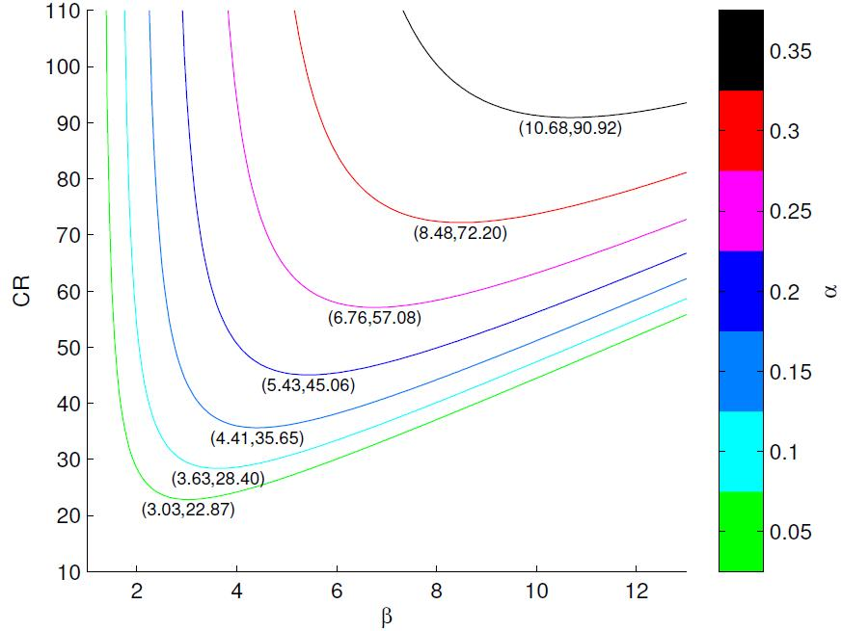
Algorithm PQ_{β}
Preemption rule (p arriving, p_{B} last in buffer – has max r_{t}):
if r(p) < r_{t}(p_{B}) / β, drop p_{B} and accept p
else drop p
Competitive ratio: f(k,α,β)
What is the best β?
for each value of k and α:
g_{k,α} (β) =f(k,α,β)
minimized for some β(k,α)
Knowing k helps… (here, k=100)
(1- α) (1 + log_{β/(β-1)}(k/2) + log_{β}(k))
1- α log_{β}(k)

Slide 13
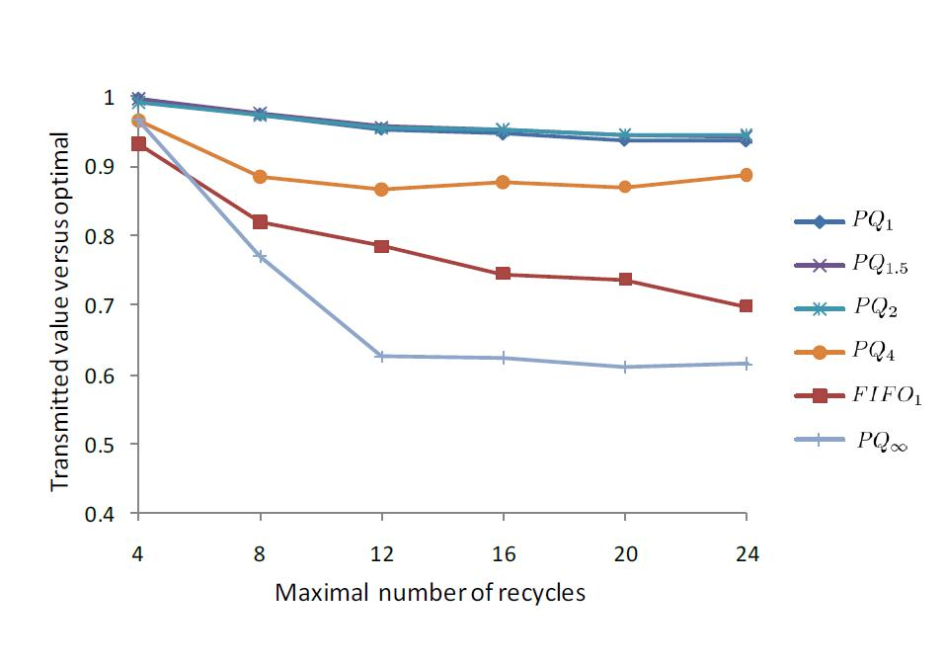
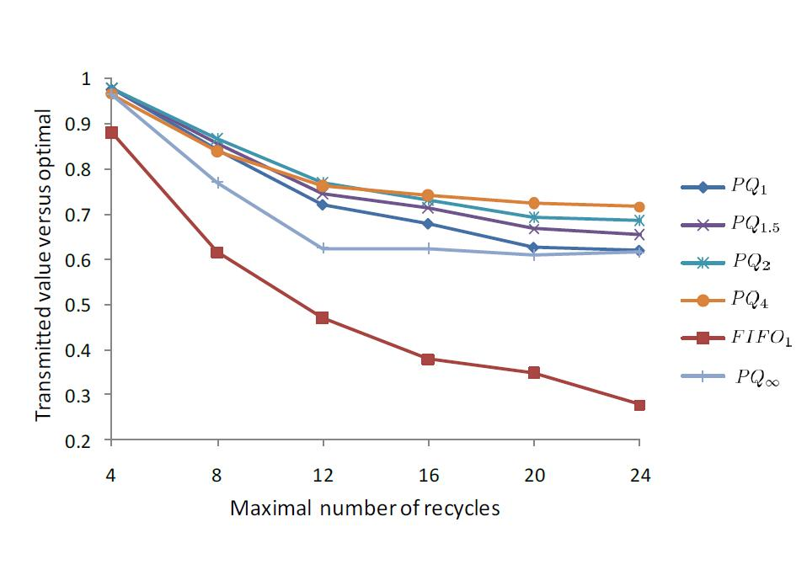
Simulation Results
Single PPE (C=1), increasing copying cost α∈{0.1,0.4}
MMPP Traffic (ON-OFF bursty), increasing pass-load
Best algorithm changes
Performance much better than worst-case guarantee

Slide 14
Summing Up
Model for multi-pass NP architectures
Competitive algorithms & lower bounds
FIFO vs. PQ
preemptive vs. non-preemptive
effect of copying cost
Simulations:
algorithmic insight is sound
perform better than worst-case guarantee
Many open questions…

Slide 15
Questions?

