Slide 1
Homogeneous Interference Game in Wireless Networks
Joseph (Seffi) Naor, Technion
Danny Raz, Technion
Gabriel Scalosub, University of Toronto

Slide 2
Collisions in Wireless Networks
The problem of multiple access:
  Decades of research
  Recent new game theoretic studies
Common assumption:
  Transmitting simultaneously causes all transmissions to fail.

Slide 3
Collisions in Wireless Networks
The problem of multiple access:
  Decades of research
  Recent new game theoretic studies
Common assumption:
  Transmitting simultaneously causes all transmissions to fail.
In real life, e.g., Wi-Mesh:
  Simultaneous transmissions
  may very well succeed.

Slide 4
In this Work
A new game-theoretical model for interferences and collisions in multiple access environments.
Analytic results for special cases:
  Analysis of Nash equilibria
  Price of Anarchy (PoA) / Price of Stability (PoS)
  The benefits of penalization

Slide 5
Warm-up: A Game of 2 Players
2 stations, A and B
B transmits while A transmits:
  Causes an interference of α 2 [0,1] to A
Utility of A in such a case: 1-α
Success probability
Effective rate
no interferences
no collisions
classic multiple
access settings
absolute interferences
transmission lost!
0
1
value of α

Slide 6
Warm-up: A Game of 2 Players
Formally,
  Assume α 2 (0,1)
  Strategy of player i : R_{i} 2 [0,1]
  Utility of player i : r_{i} = R_{i} (1 - α R_{j})
  Social welfare (value): ∑_{i} r_{i}
Unique Nash Equilibrium:
  everybody transmits
  value: 2(1 - α) ! 0
Transmission attempt probability
What if we have n players?
Transmission success probability
Expected number of
Successful transmissions
Optimum:
– at least 1

Slide 7
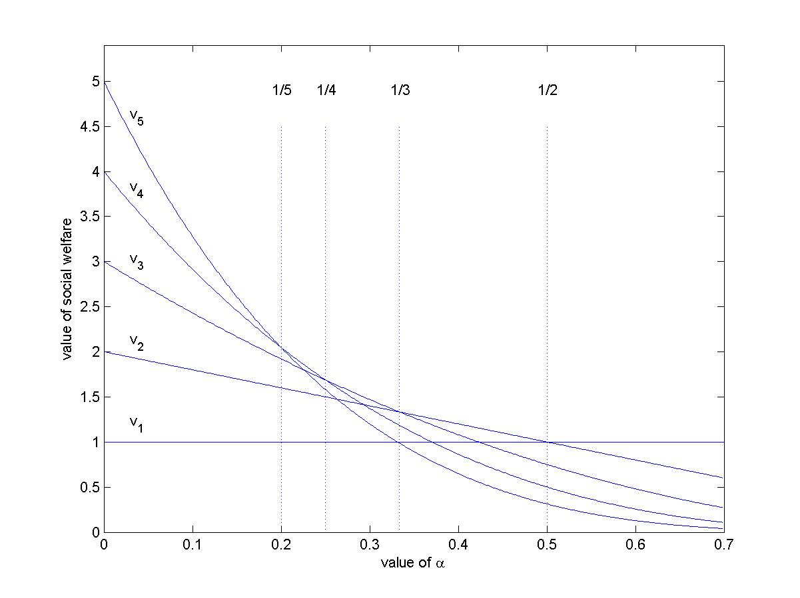
HIMA: n-player Game
Player j inflicts an interference of α_{ij} on i
Utility of player i: r_{i} = R_{i} Π_{j ≠ i} (1 - α_{ij} R_{j})
Our focus: Homogeneous Interferences
  8 i,j α_{ij}=α
Unique Nash equilibrium
  everybody transmits
  value: n (1 - α)^{n-1}
Theorem:
If 1/(k+1) · α · 1/k then
PoA = PoS =
•
Optimum:
– k=min(n,b1/αc)
transmit
– value: v_{k}=k(1 - α)^{k-1}
k
n (1 - α)^{n-k}

Slide 8
Coordinated Nash Equilibrium
Pay for being disruptive
Penalty p_{i} for being aggressive
Utility of player i : r_{i} - p_{i}
Question:
  How far can such an approach get us?

Slide 9
Take One: Exogenous Penalties
Allow penalties to depend on others
By considering
p_{i} = R_{i} (R_{i} + 1 - 2/αn) Π_{j ≠ i} (1 - α R_{j})
  Unique Nash is the uniform profile R_{i}=1/αn
  Hence, PoA = PoS · e
Goal:
  Make p_{i} independent of other players’ choices
  Put a clear “price tag” on aggressiveness

Slide 10
Take Two: Endogenous Penalties
Penalties independent of other players
Using penalty function
p_{i} = R_{i} (R_{i} + 1 - 2/αn) (1 – 1/n)^{n-1}
guarantees
  PoS · e (uniform profile R_{i}=1/αn is still Nash)
  Above Nash is unique if α < 2/e » 0.736
  ) PoA · e
This is independent of n!

Slide 11
Future Work
Analytic results for non-homogeneous interferences
  Specific interference matrices
  With/without penalties
Use results to design better MAC protocols

Slide 12
Thank You!

