Slide 1
Cell Selection in
4G Cellular Networks
David Amzallag, BT Design
Reuven Bar-Yehuda, Technion
Danny Raz, Technion
Gabriel Scalosub, Tel Aviv University

Slide 2
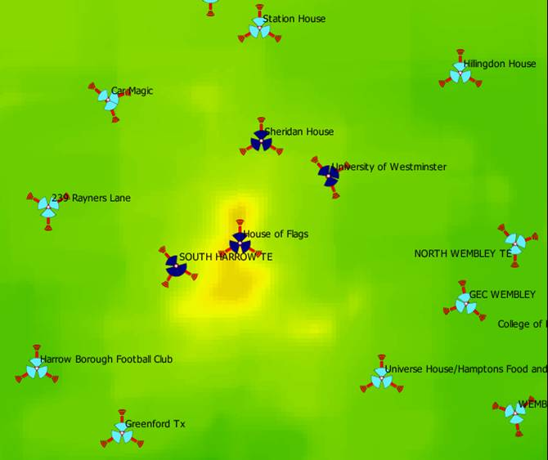

Cell Selection and
Current 3G Cellular Networks
Cell Selection:
  Which BS covers
  an MS
MSs demands <<
BSs capacities
  Mostly voice
  Data < 15Mb/s
Local SNR-based protocols are pretty good
Generally, one station servicing every client
Cover-by-One (CBO)
South Harrow area, NW London (image courtesy of Schema)

Slide 3
Future 4G Cellular Networks
High MS demand
  Video, data, …
  x10-x100 higher
  (100Mb/s-1Gb/s)
Capacities will
be an issue
  < x20 higher
  reduced costs
  missing good
  planning solutions
Technology enables having several stations cover a client
  802.16e
  MIMO
Research Goal:
Explore the potential of
Cover-by-Many (CBM)
South Harrow area, NW London (image courtesy of Schema)

Slide 4
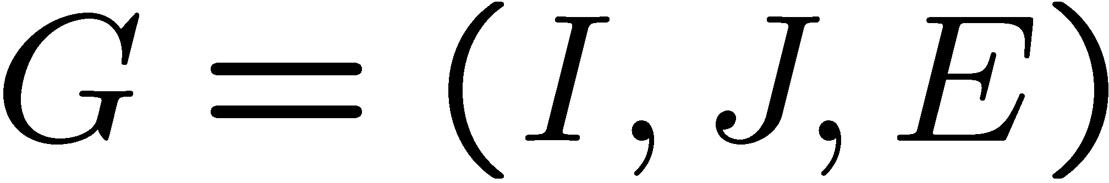
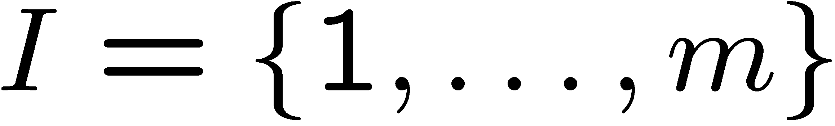
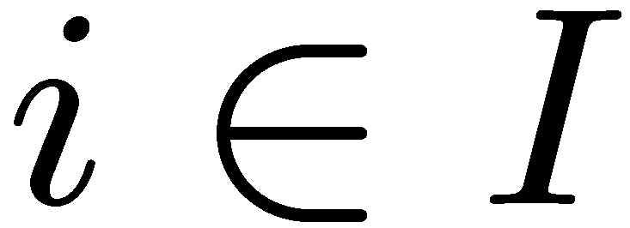
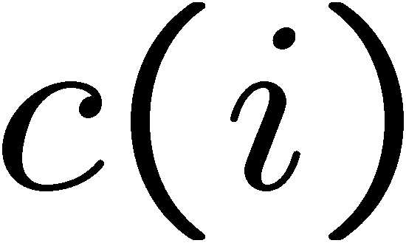
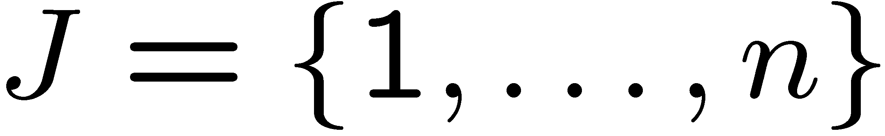
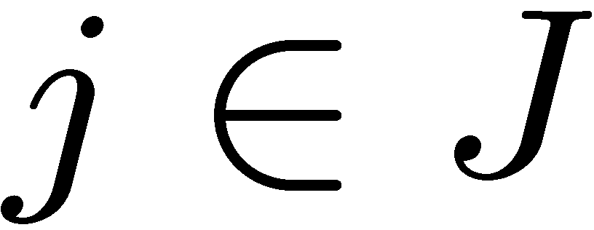
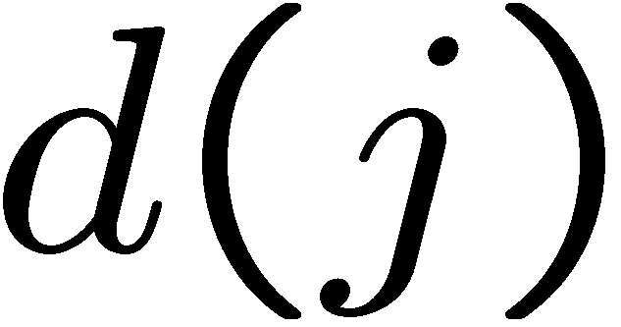
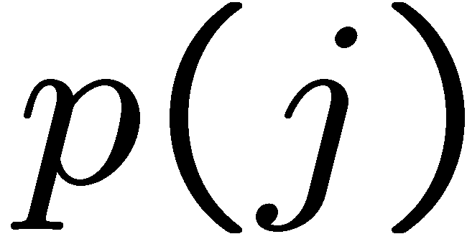
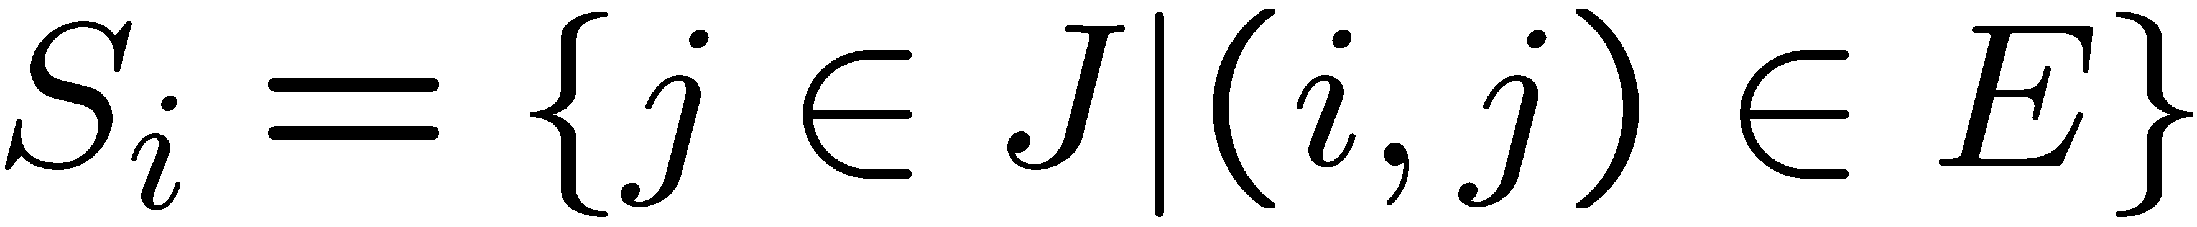
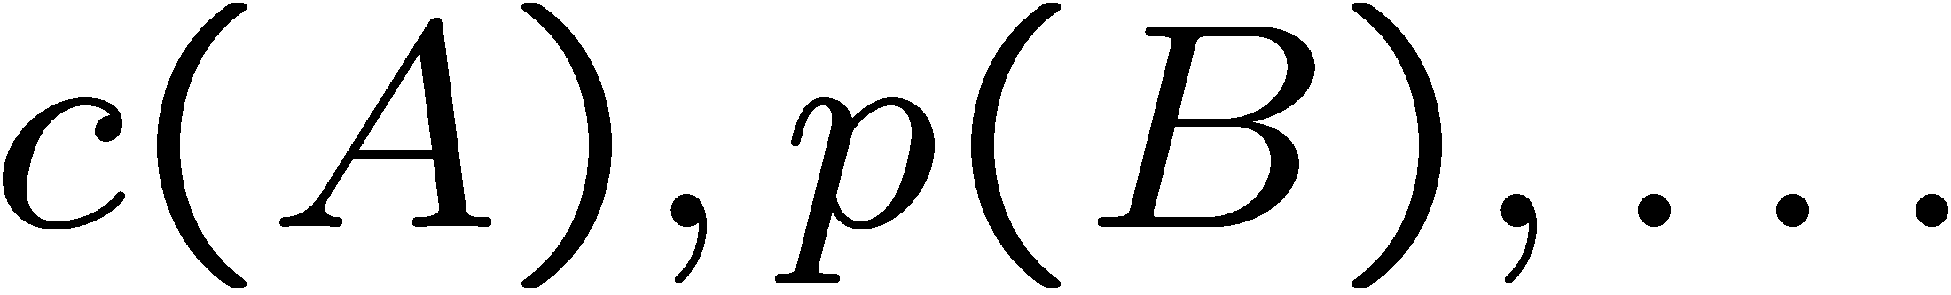
Model
Bipartite graph
(Base) Stations
  For every , capacity .
(Mobile) Clients
  For every , demand and profit .
Coverage Area
  For every ,
  For every ,
Notation extended to sets, e.g.,

Slide 5
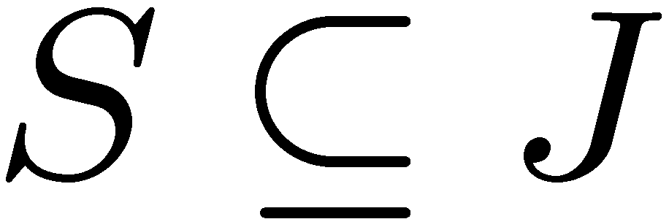
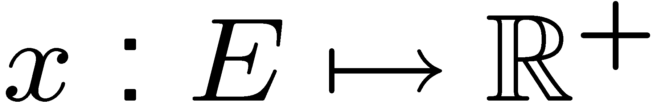
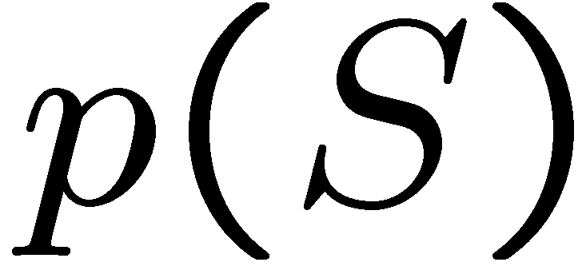
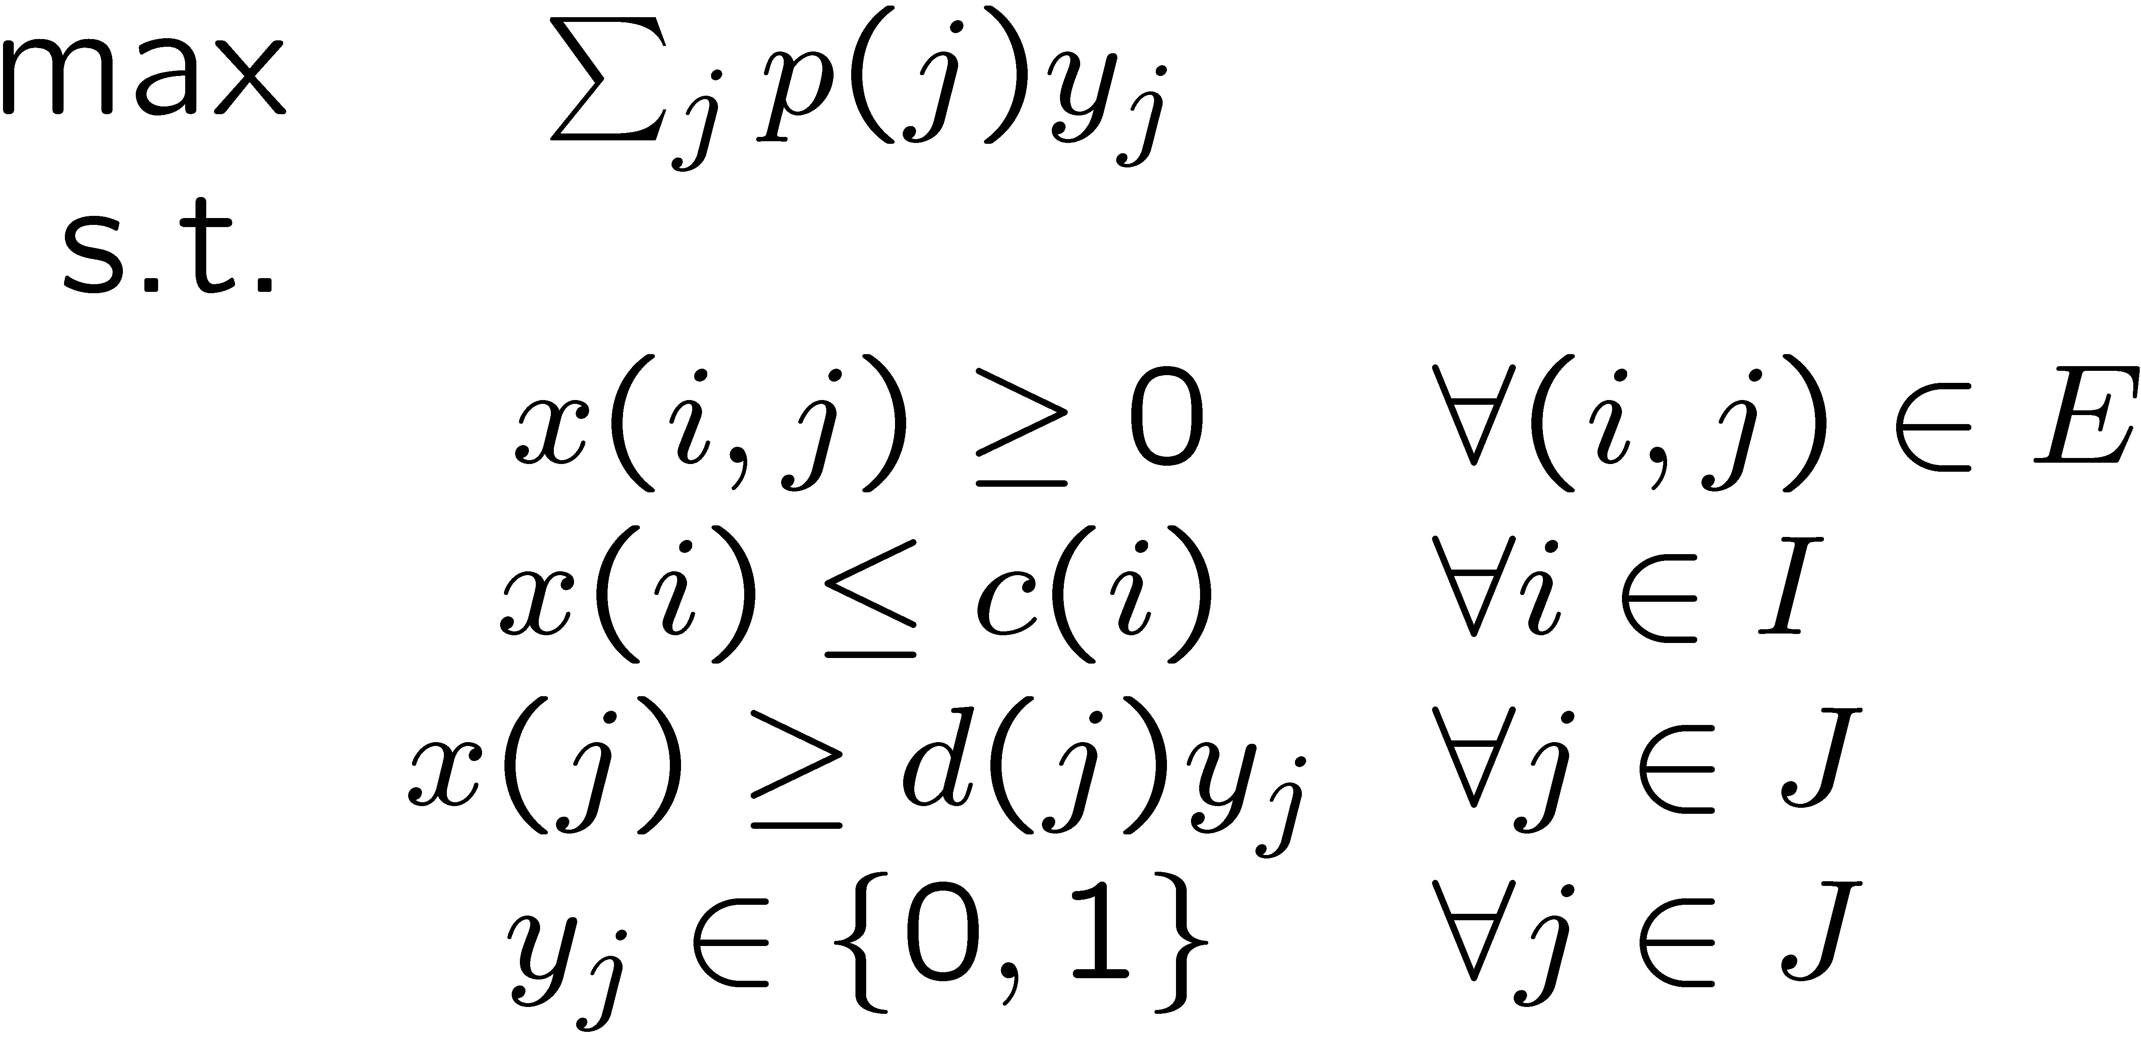
Model (cont.)
All-or-Nothing
Demand Maximization
(AoNDM)
Goal:
Find a set , and a cover plan (CP)
is maximized
All-or-Nothing (AoN)
Constraint
Capacity Constraint
Deceptively “simple” resource allocation problem
The same as previously well studied problems?

Slide 6
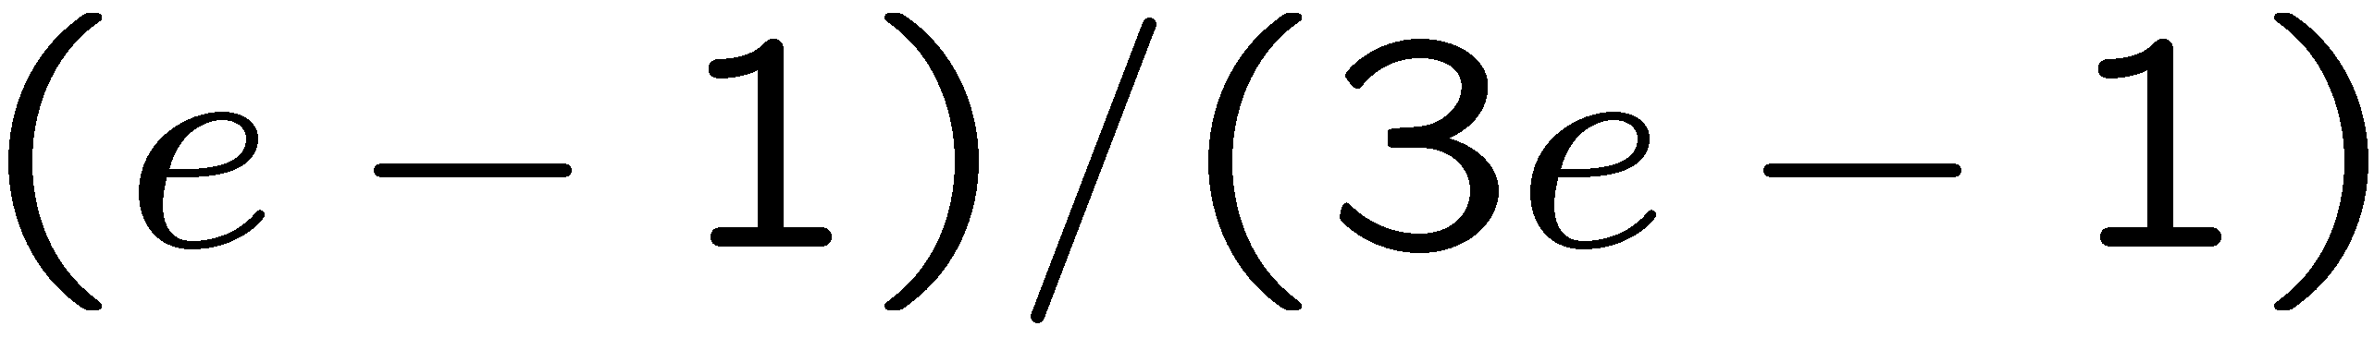
Previous Work
Cell Selection | Minimize MSs transmission power [Hanly 95] Maximize throughput (via load balancing) [Sang et al. 08]
General Assign. (GAP) | 1/2-approx. vs. APX hard [Shmoys-Tardos 93, Chekuri-Khanna 00]
Multiple Knapsack | PTAS [Chekuri-Khanna 00]
Budgeted Cell-planning | NP-hard to approximate Sufficient capacities: -approx. [Amzallag et al. 05]

Slide 7
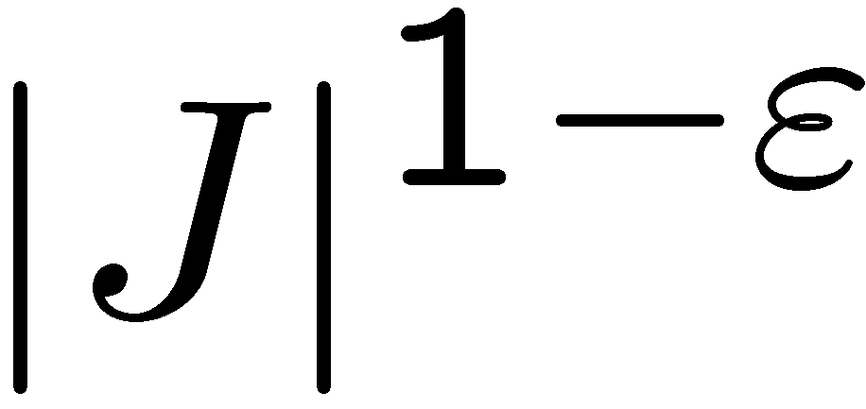

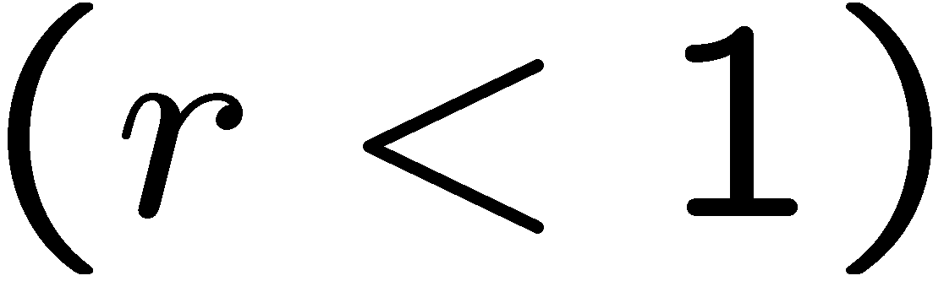
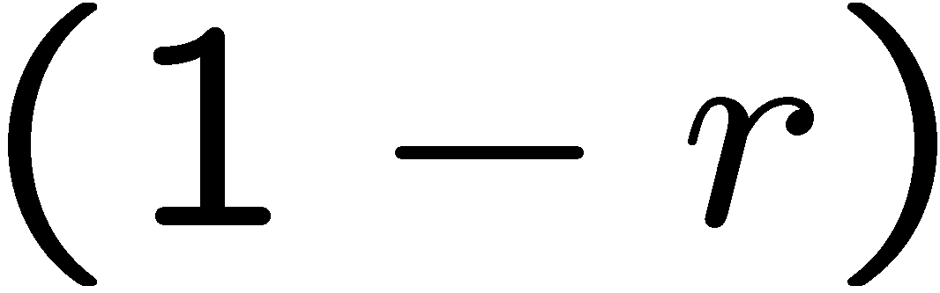
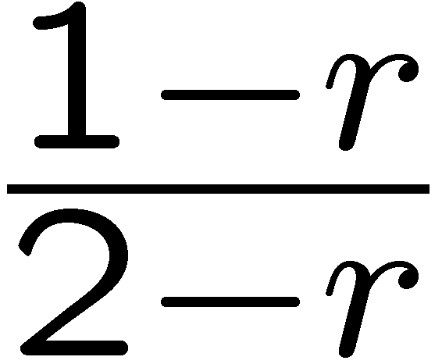
Our Results
AoNDM: Hard to approximate to within
-AoNDM: Bad News: Still NP-hard
Good News:
A -approx. CBM algorithm
Based on a simpler and faster
-approx. CBO algorithm
Simulation: CBM is up to 20% better than SNR-based
-AoNDM:

Slide 8
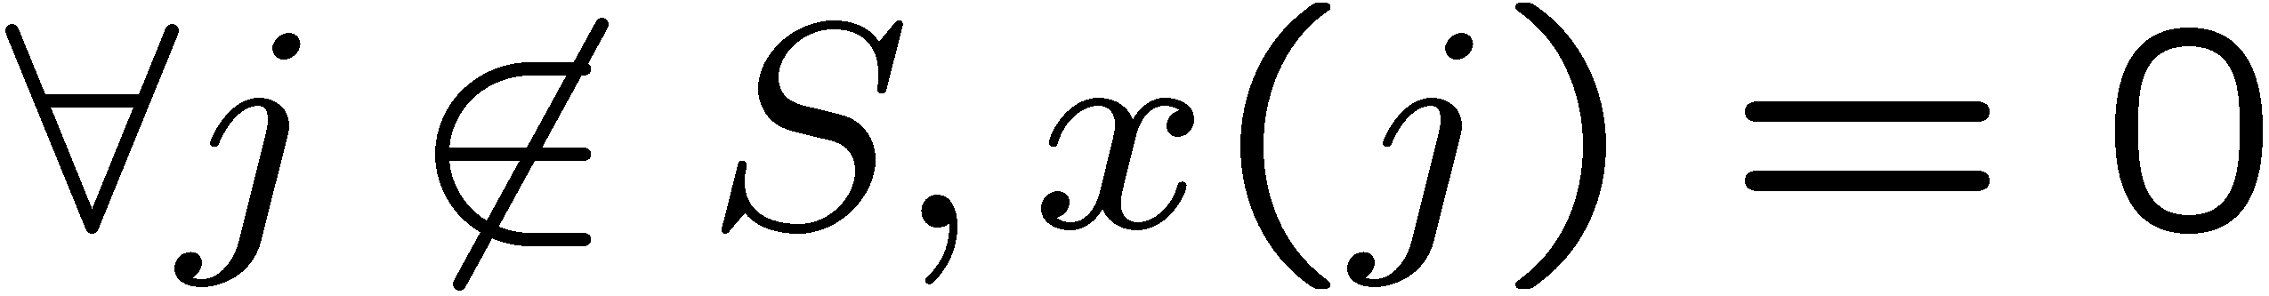
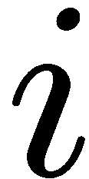
A (1-r)/(2-r)-Approx. - Intuition
A local-ratio algorithm
  Based on decomposing the profit function
Greedy approach
A CP x for S is maximal if it cannot be extended:
WLOG,
is saturated

Slide 9

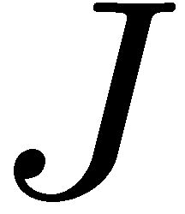
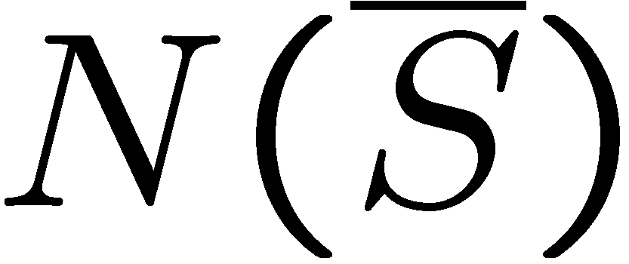
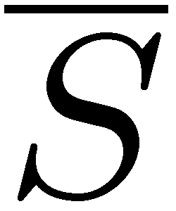
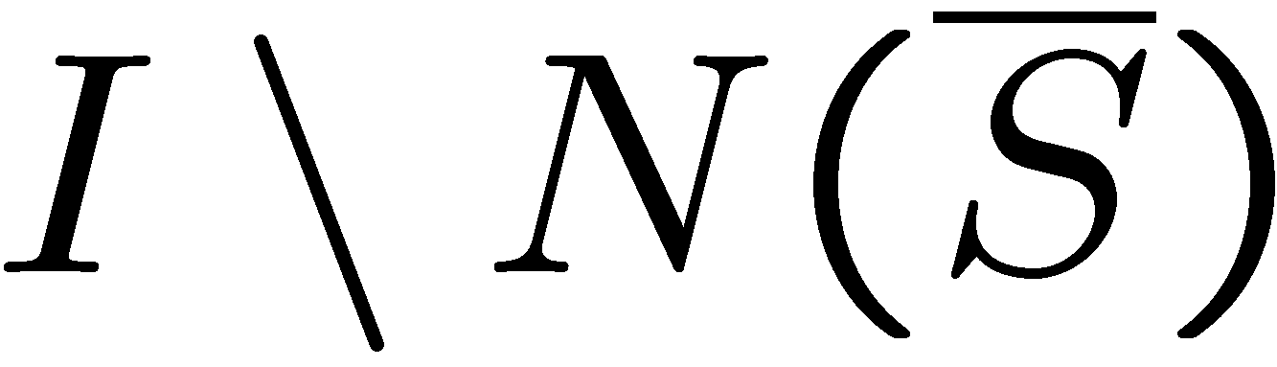
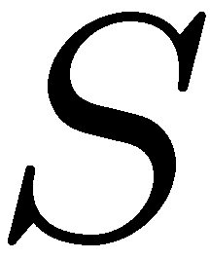
If p(j)=d(j), Maximality Suffices!
-saturated
Algorithm sketch:
  Decompose profit function:
    Demand-proportional chunks
  Recurse!
  Greedily maximize
How?
Maximal
Solution
No edge to .

Slide 10
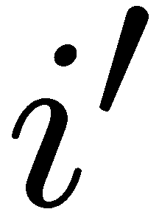
A (1-r)-Approx. – The Extra Mile
Previous algorithm might be wasteful:
Solution: Maximize usage of
A flow-based algorithm.
  Slightly increased complexity
⇒ Cover-by-Many

Slide 11
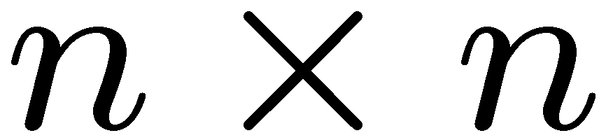
Experimental Study - Settings
-grid
A client in every node

Slide 12
Experimental Study - Settings
-grid
A client in every node
Data Clients:
Large demand
Few

Slide 13
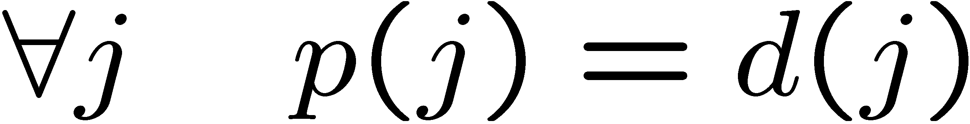
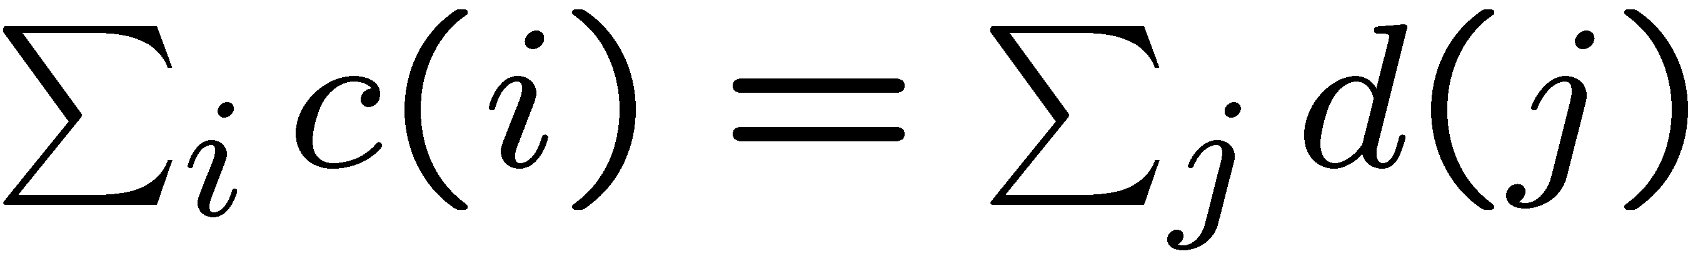
Experimental Study - Settings
-grid
A client in every node
Picocells:
Small capacity
Small radius
many
Data Clients:
Large demand
Few
Microcells:
Large capacity
Large radius
few
Voice Clients:
Small demand
Many
Profit:
High-load:

Slide 14
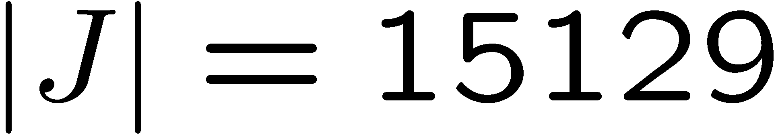
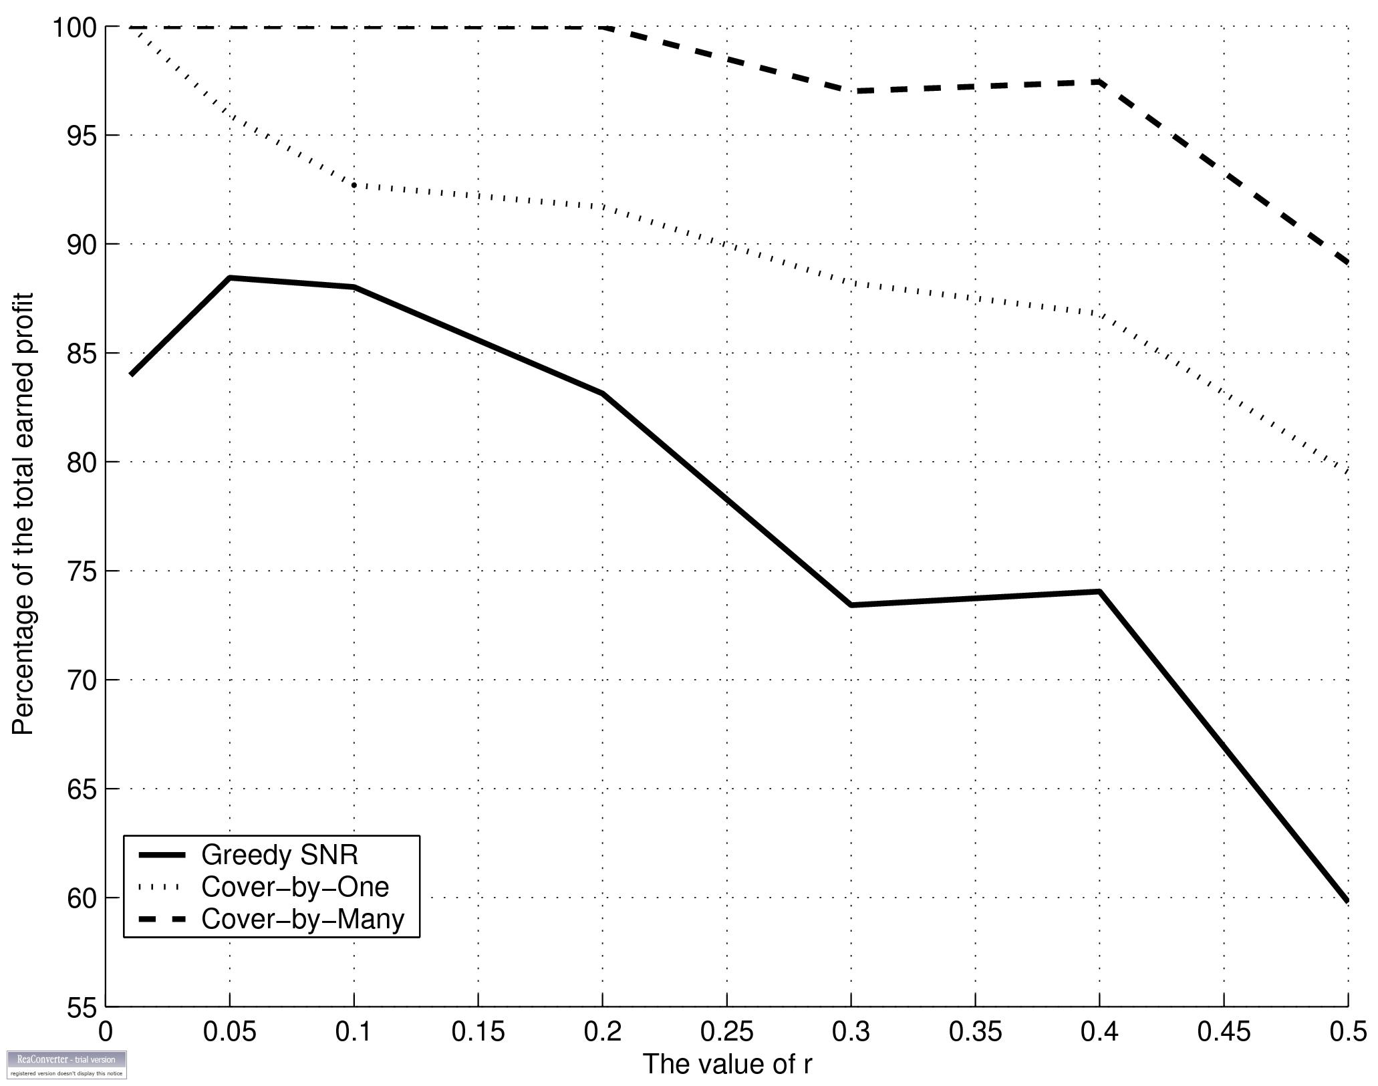
Experimental Study - Results

Slide 15
Summary
4G technology will support cover-by-many.
Good approximation algorithms for realistic scenarios.
CBM is 10%-20% better than SNR-based methods.
Future Work:
  Practical: Online & local CBM policies
  Theoretical: Approximation independent of r ?

Slide 16
Thank You!

