Slide 1
Toward Optimal Utilization of Shared Random Access Channels
Joseph (Seffi) Naor, Technion
Danny Raz, Technion
Gabriel Scalosub, University of Toronto

Slide 2
The Multiple Access Dilemma
2 access points (APs), downlink traffic
In each time slot, each AP transmits to a client
If APs are far apart: no interferences!
  Simultaneous transmissions are successful

Slide 3
The Multiple Access Dilemma
2 access points (APs), downlink traffic
In each time slot, each AP transmits to a client
If APs are overlapping: classic collision channel!
  Simultaneous transmissions are all lost

Slide 4
The Multiple Access Dilemma
2 access points (APs), downlink traffic
In each time slot, each AP transmits to a client
If APs have some partial overlap: Depends!

Slide 5
The Multiple Access Dilemma
2 access points (APs), downlink traffic
In each time slot, each AP transmits to a client
If APs have some partial overlap: Depends!

Slide 6

Settings
A finite set of backlogged access points (APs)
Downlink traffic
In each time slot:
  Each AP “chooses” a client in its range
  Each AP randomly decides if to transmit or not
APs do not know the exact location of their clients.
Non carrier-sensing environments:
  Ultra wideband (UWB) networks
  Cellular networks
Other environments might benefit too (e.g., WiFi mesh)

Slide 7
Concerns and Design Goals
Decentralized
Simple randomized protocol:
  Focus on single-parameter: transmission probability
Fairness:
  Equal share: might lead to very low utilization
  Settle for non-starvation
Throughput:
  (Expected) number of successful transmissions in a time slot
  Note: simultaneous transmission can be successful!
  (this is not a classic collision channel model)

Slide 8
Previous Work
Random access protocols
  Aloha, Multipacket Reception (MPR)
  CSMA
Restrictions of CSMA
  UWB
  Very high-load 802.11
  licensed-band inefficiency (cellular)
Selfish behavior
  Stability, throughput, convergence
Interference model
  Game theoretic analysis (special case)
Guha&Mohapatra 2007,
Jamieson et al. 2005,
Choi et al. 2006
MacKenzie&Wicker 2001,
Jin&Kesidis 2002,
and many more…
Naor et al. 2008

Slide 9


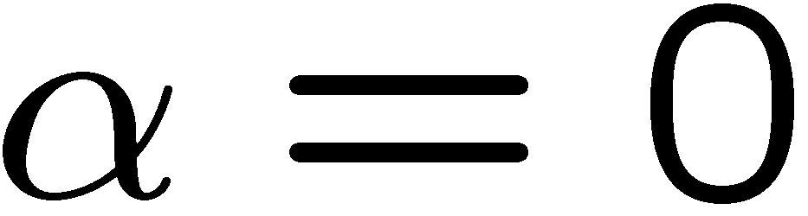


Intuition: A Case for 2 Stations
Assume for every station :
  Range is a unit disc
  Client’s location is chosen uniformly at random in range
Collision probability at ‘s client, assuming both stations transmit:
  Area of intersection: interference parameter
no interferences
“collision channel”

Slide 10
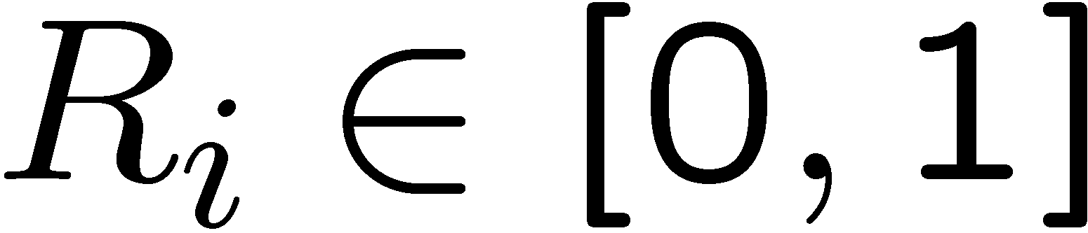
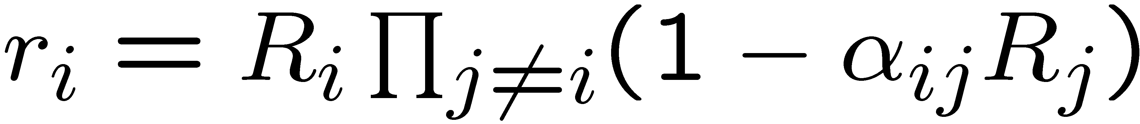


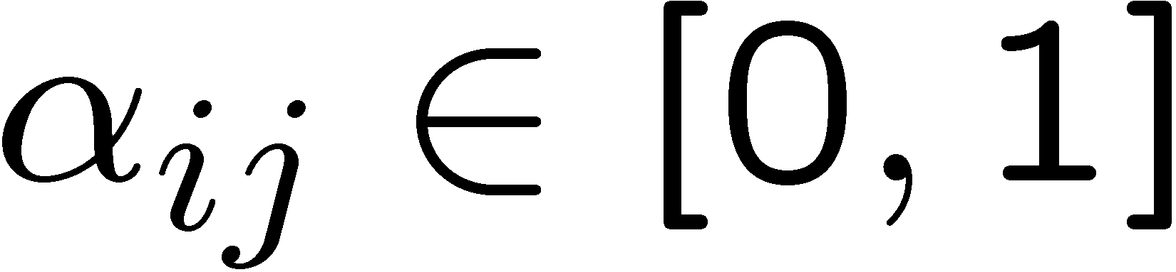
Model
Every station:
  Chooses probability of transmitting
Probability of a successful transmission:
Overall system’s expected throughput
interference inflicted by on

Slide 11
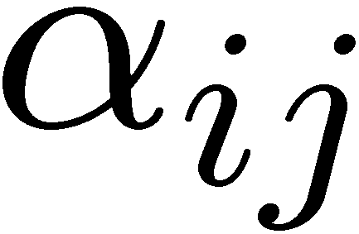
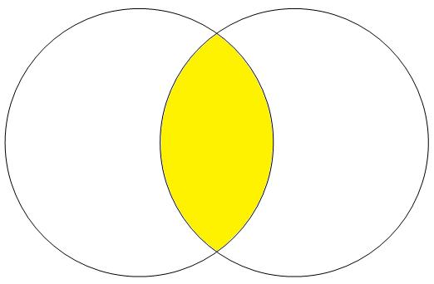
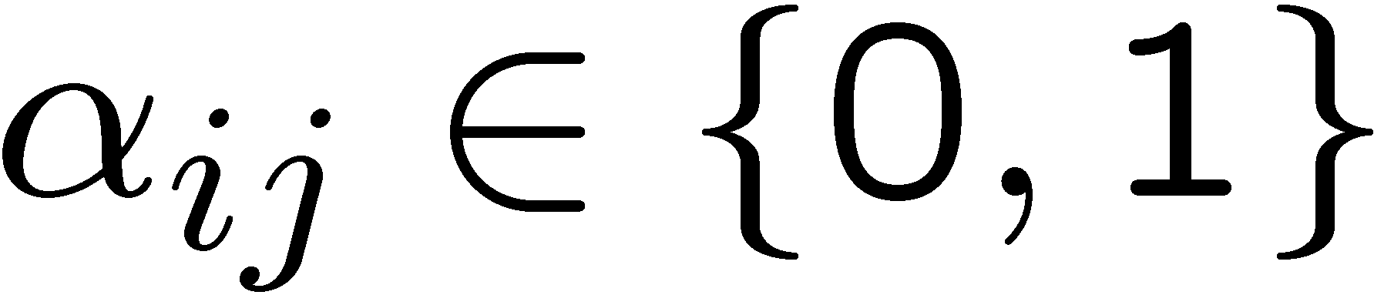
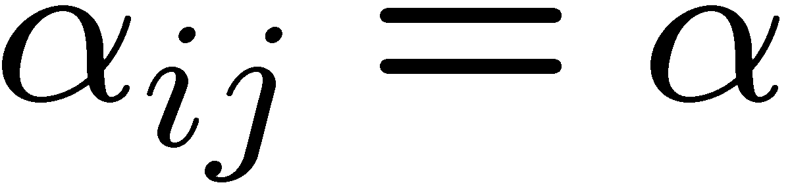
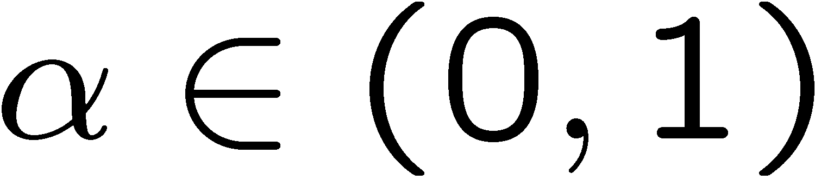
Interference Parameters
Special cases:
  are all 1: classic collision channel
  are all 0: no interferences
  and symmetric:
    Finding best subset to schedule is equivalent to MAX-IS
    NP-hard
  for some constant :
    homogeneous interferences

Slide 12
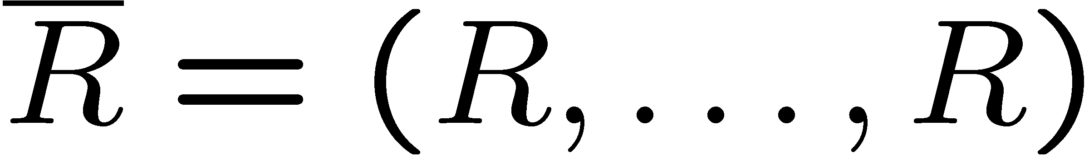
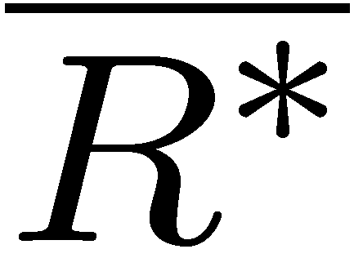

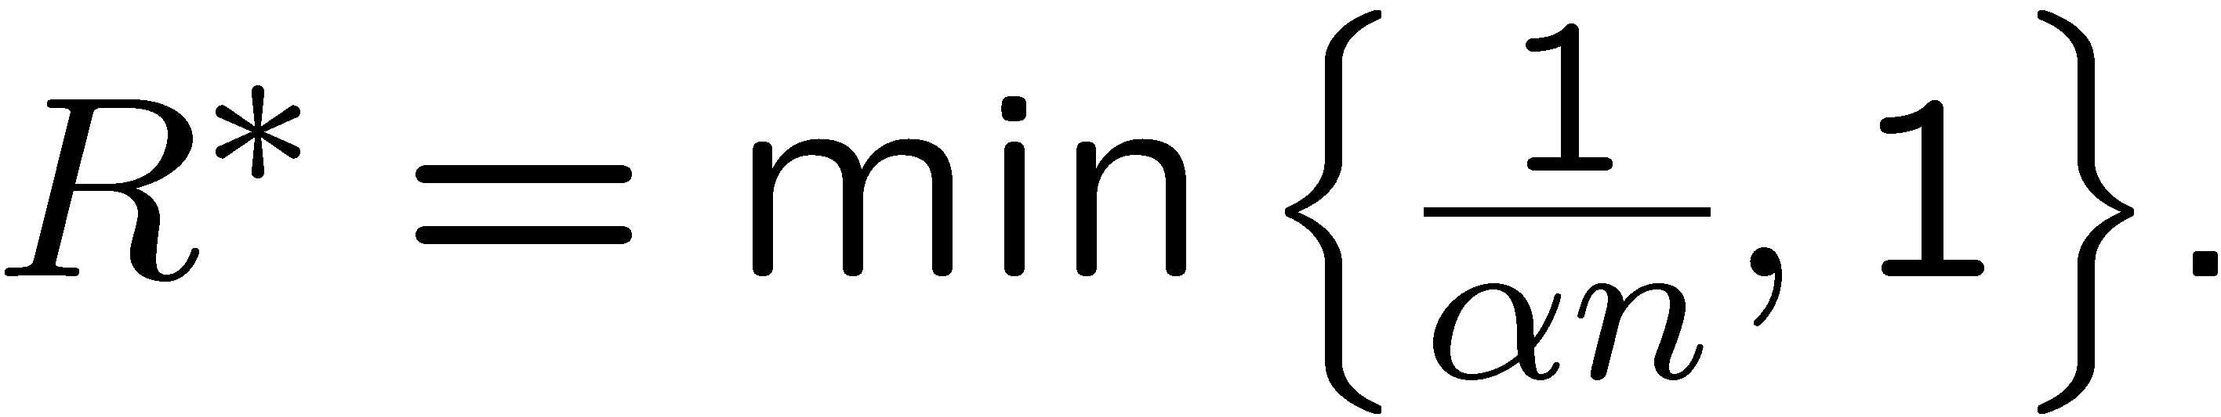
Homogeneous Interferences
Symmetry:
  A stronger sense of fairness: equiprobable channel access
  Focus on uniform random protocols:
Theorem:
The uniform random protocol that maximizes has
Question: How bad/good is a uniform protocol?

Slide 13

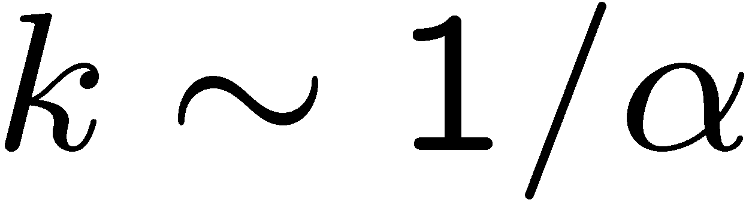
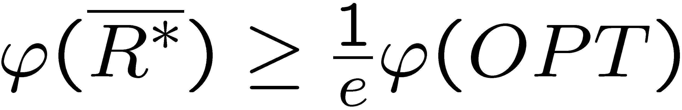
Homogeneous Interferences
Theorem [NRS 2008]:
The optimal schedule is having
stations transmit.
Corollary:
The uniform protocol satisfies
NOTE: This is not the Aloha model!

Slide 14
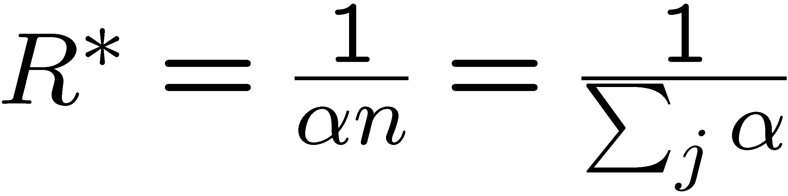
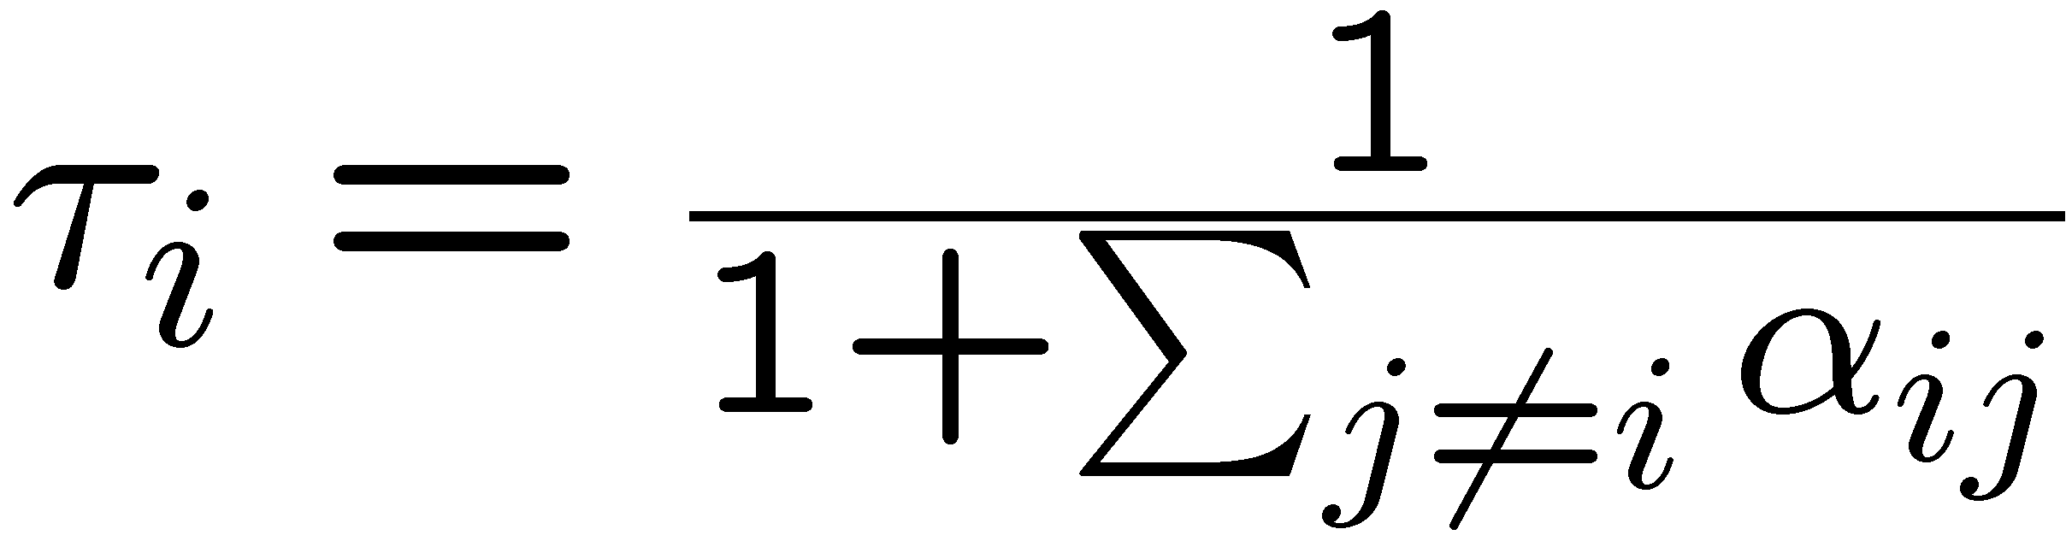
Non-homogeneous Interferences
Fairness:
  Should take into account interferences inflicted/sensed by stations
Use intuition derived from the homogeneous case:
Protocol InterferenceRand:
Every station transmits with probability
Sanity check:
  Isolated station: transmits with probability 1
  Collision channel: coincides with homogenous case

Slide 15
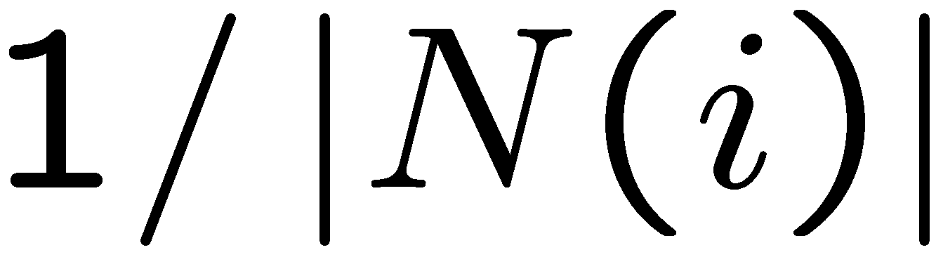
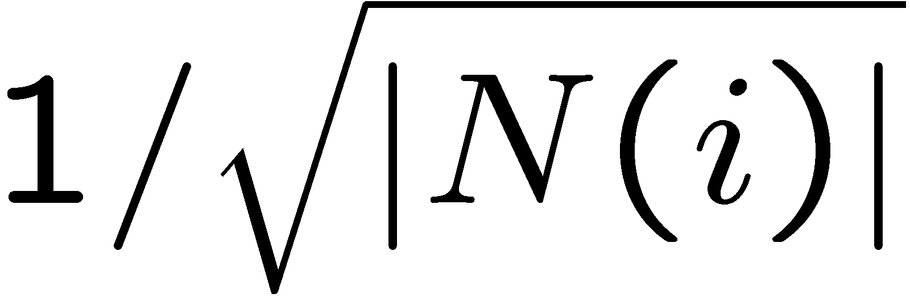
Additional Distributed Protocols
Clusterize
  Greedy local clustering heuristic (RR in every cluster)
  Collisions still possible
  Variation used in, e.g., IEEE 802.15.4 (Zigbee)
IntersectRand: transmit with probability
SqrtRand: transmit with probability
Greedy: Always transmit
HalfRand: Transmit with probability 1/2

Slide 16
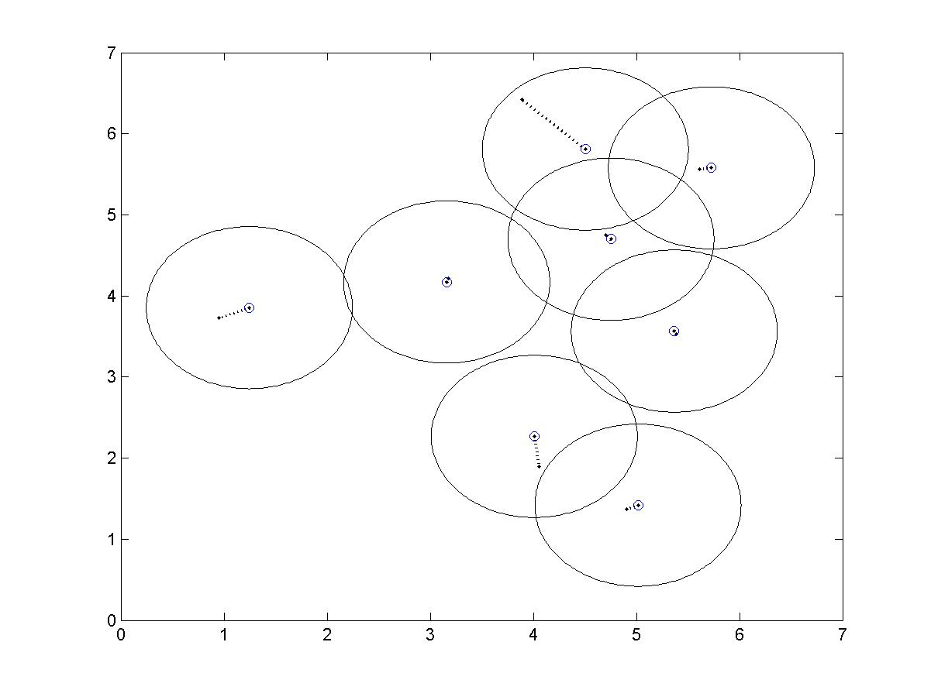
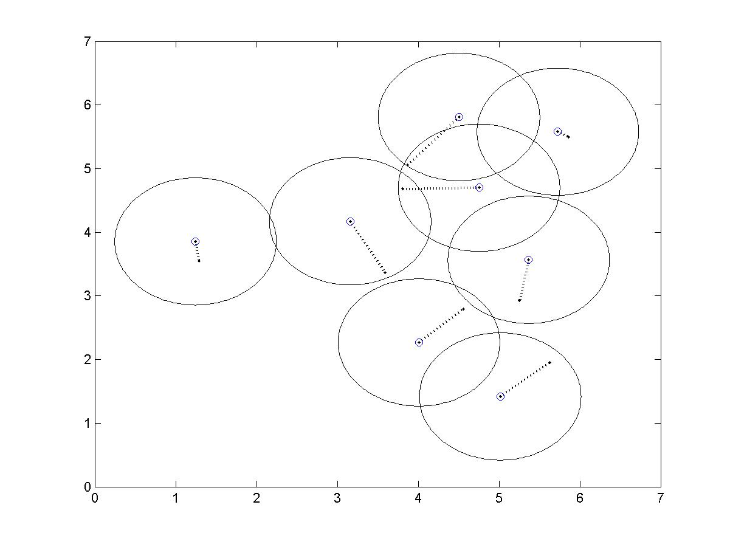
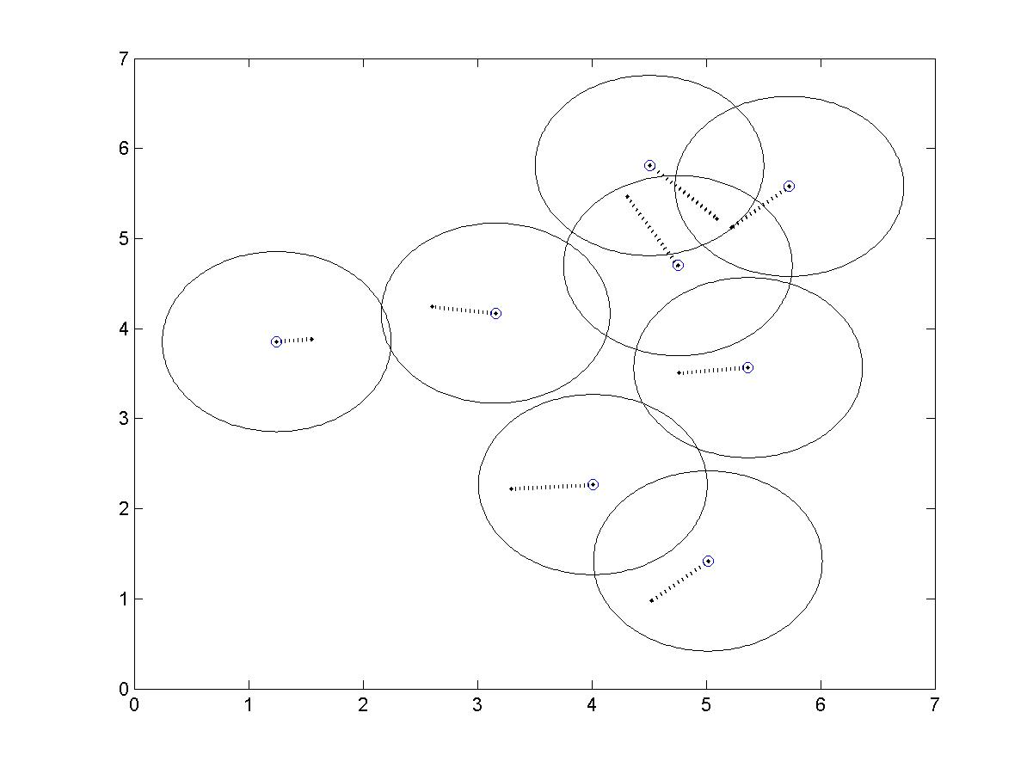
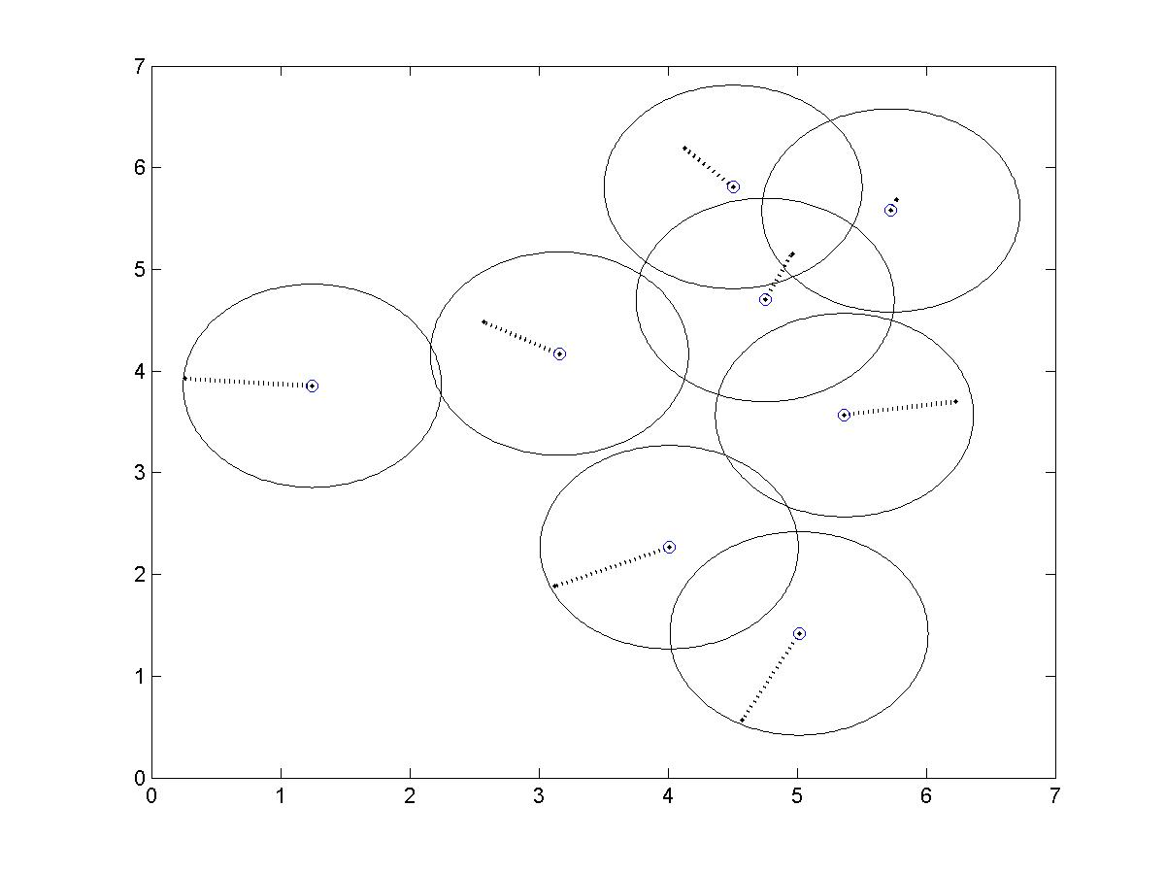
Simulation Study
Random Topologies
  WiFi mesh
Unit discs
Interference
  Area of intersection
  Symmetric
Clients
  u.a.r. in transmission area

Slide 17
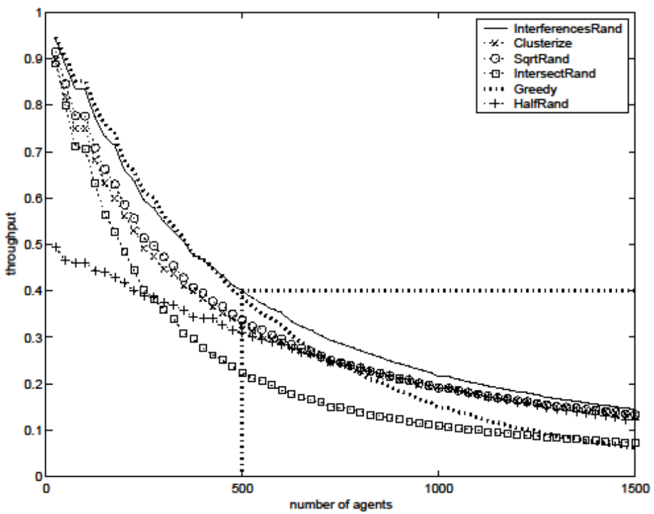
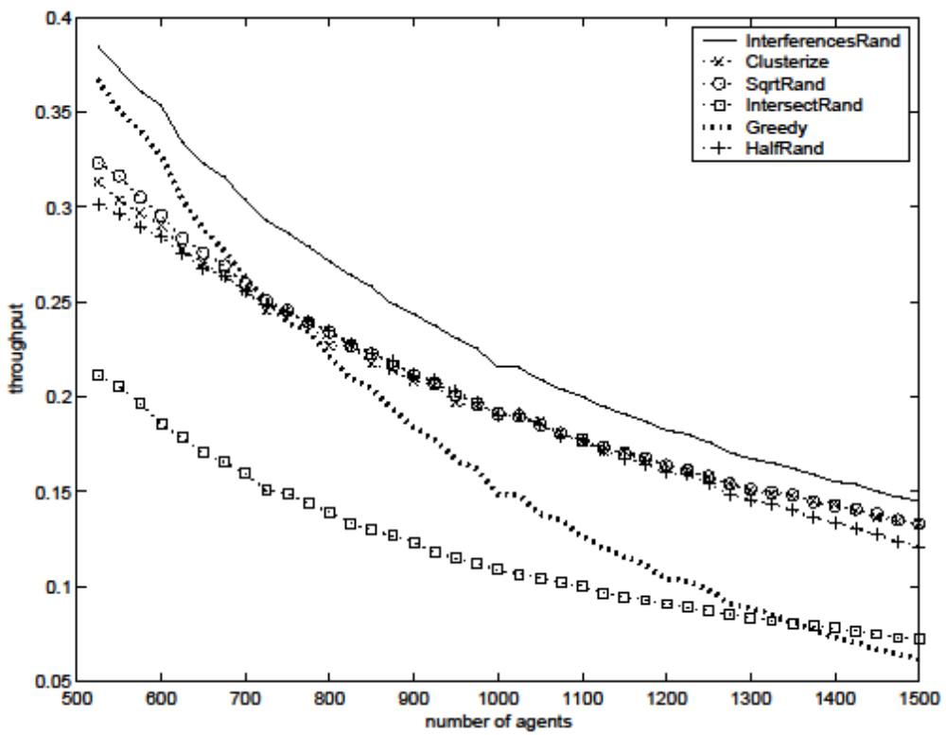
Simulation Results - Throughput

Slide 18
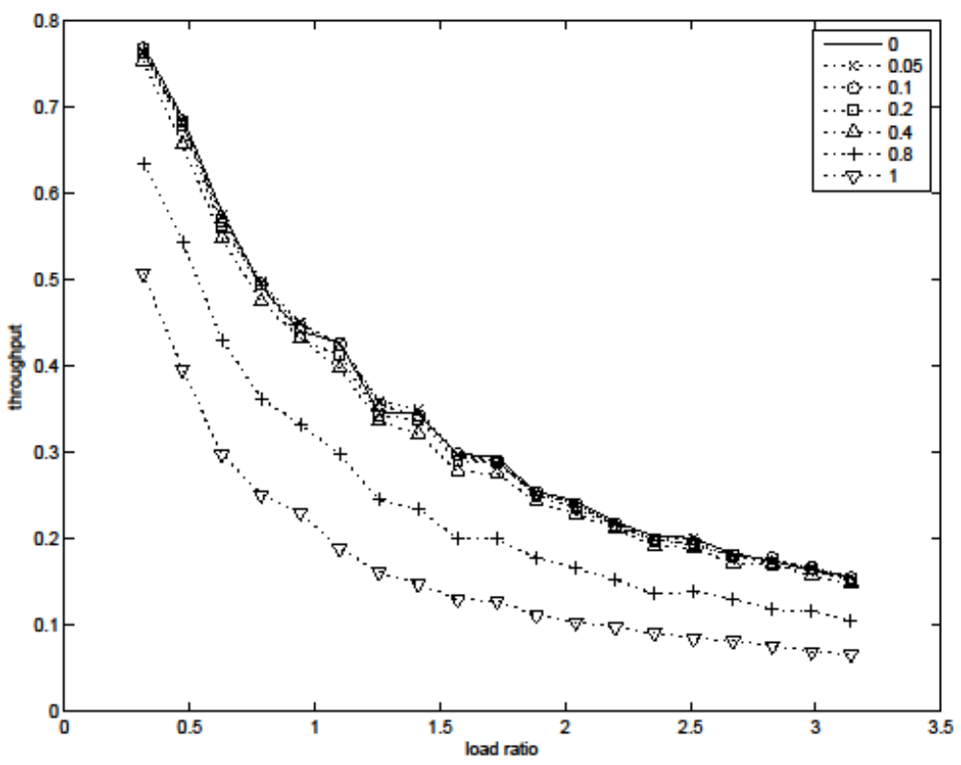
Simulation Results - Robustness

Slide 19
Summary and Open Questions
Model interferences in heterogeneous settings
  Multiple transmissions may succeed simultaneously!
Robust protocol for non-CSMA random access
  Simple, distributed
Many questions left:
  Fairness vs. Throughput
  Analytic results for non-homogeneous interferences
  High-order interferences
  Selfishness (game theoretic approach)

Slide 20
Thank You!

