Slide 1
Competitive Analysis of Buffer Policies with SLA Commitments
Boaz Patt-Shamir, Tel Aviv University
Gabriel Scalosub, University of Toronto
Yuval Shavitt, Tel Aviv University

Slide 2

Motivation
Service Level Agreements (SLA)
  ATM, DiffServ, MPLS, Metro Ethernet
  Rate meters
  Admissible traffic: Token Bucket envelope
  Additional traffic
“Show me the money!”
  SLA violation – costly!
  Forwarding “out of contract” traffic: More Money!
Issues:
  Buffer provisioning, admission control, scheduling
October 21st, 2008
Competitive Analysis of Buffer Policies with SLA Commitments

Slide 3
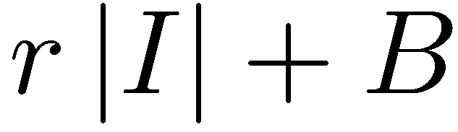

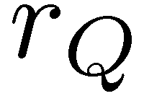
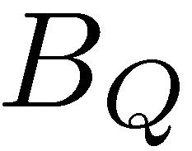
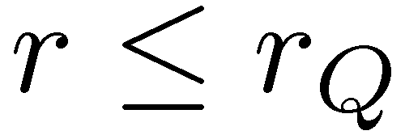
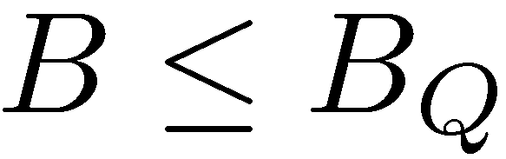
Model
Single FIFO Queue:
  Outgoing Rate
  Buffer size
Adversarial Traffic:
  Committed (green):
    Rate
    Burst size
  Excess (yellow):
    Arbitrary
Also allows best-effort / aggregate
At most
green packets in any interval
Token
Bucket
envelope
October 21st, 2008
Competitive Analysis of Buffer Policies with SLA Commitments

Slide 4
Model (cont)
Main constraint (feasibility):
  All committed traffic
  must be forwarded
Discrete time
  Delivery substep
    At most delivered
  Arrival substep
    Packets arrive
    Some yellow packets may be dropped
    Packets accommodated in the buffer
October 21st, 2008
Competitive Analysis of Buffer Policies with SLA Commitments

Slide 5



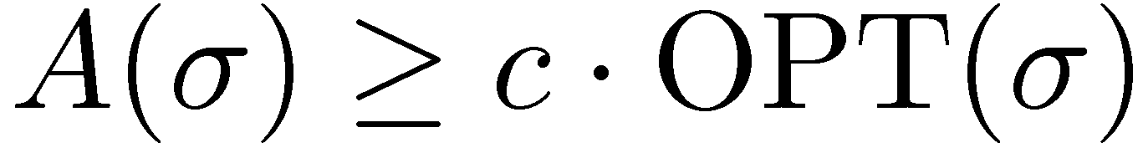


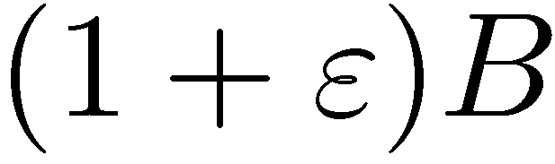

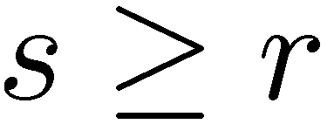
Metric and Methodology
Goal:
Competitive Analysis:
Algorithm is -competitive if for every input sequence
Resource augmentation:
  Buffer size: uses whereas uses
  Rate: uses whereas uses
Maximize the number of excess packets delivered
October 21st, 2008
Competitive Analysis of Buffer Policies with SLA Commitments

Slide 6
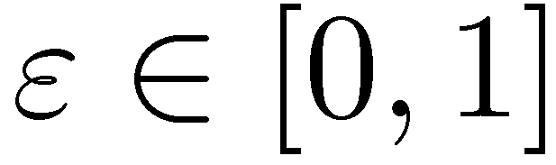

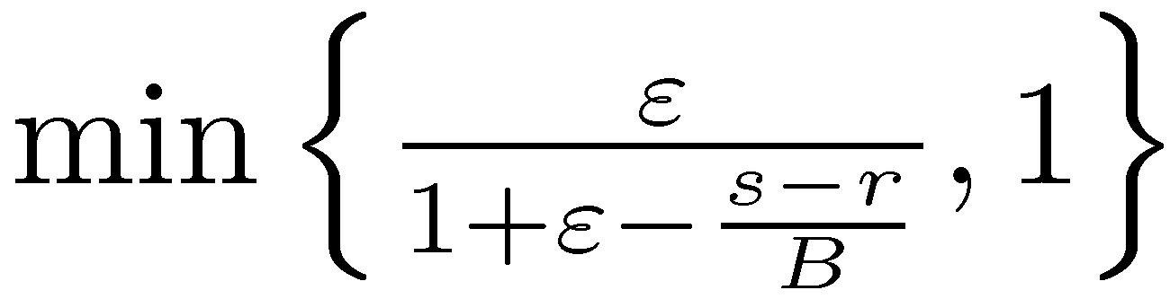
Our Results
Lower bounds:
  Buffer resource augmentation is essential
  Using times more buffer:
  cannot be better than -competitive
Online algorithm ON
  -competitive
Simulation study:
  ON is close to optimal
  Specifically, better than common policies
October 21st, 2008
Competitive Analysis of Buffer Policies with SLA Commitments

Slide 7
Previous Work
Protective buffer management
  Protective ~ feasibility
  Push-out
  Same link speed
  No analytic guarantees
Multi-valued packets
  Const. competitive for finite values
Packet color marking
  Exploiting TCP characteristics (AQM)
[Cidon et al. ‘94]
[Kesselman et al. ‘04]
[Englert&Westerman ‘06]
[Chait et al. ‘05]
October 21st, 2008
Competitive Analysis of Buffer Policies with SLA Commitments

Slide 8
Lower Bounds – A Flavor
Case 2
Case 1
If we use the same amount of buffer as we can never afford to forward excess
Infeasible
Infeasible
October 21st, 2008
Competitive Analysis of Buffer Policies with SLA Commitments

Slide 9

Upper Bounds
Lower bounds ⇒ buffer resource augmentation
  Use
Naïve approach:
  Maintain two queues
  Give priority to committed queue
Simulator
  Same buffer size and rate as
  Ignores all yellow packets
  Bounds buffer occupancy of (by feasibility…)
This is not FIFO
October 21st, 2008
Competitive Analysis of Buffer Policies with SLA Commitments

Slide 10

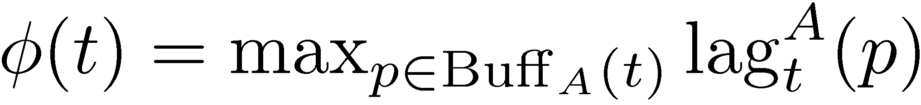
The Concept of Lag
Lag of a green packet
-lag property
  No green packet in the buffer has lag greater than
Lag of an algorithm
October 21st, 2008
Competitive Analysis of Buffer Policies with SLA Commitments

Slide 11
Algorithm
Algorithm ON
upon the arrival of a new packet:
    If yellow: accept if there’s room
    If green:
      Drop as few yellow packets from the tail such that
      the new packet will have lag at most
      Accept packet
Algorithm satisfies:
  Feasibility
  -lag property
October 21st, 2008
Competitive Analysis of Buffer Policies with SLA Commitments

Slide 12
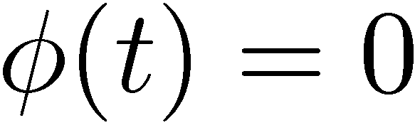
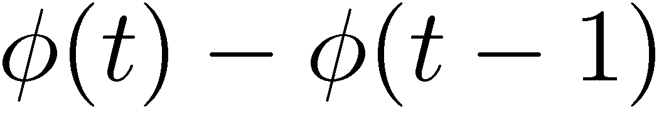
Analysis in a Nutshell
Identify “reset” events:
“Overflow” (yellow packets dropped) occurs:
  Between reset events
  At least yellow packets are “safe” since previous reset
  Many green packets accepted by :
    must deal with them as well!!
    Has “little” space/rate to deal with too many yellow
Follow algorithm’s lag-difference
October 21st, 2008
Competitive Analysis of Buffer Policies with SLA Commitments

Slide 13
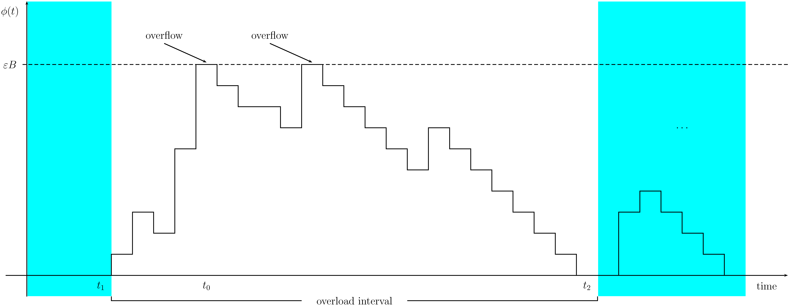
Analysis in a Nutshell (cont)
Implementation issues:
  Lag calculation is easy
  No push-out. Just tail-drop.
October 21st, 2008
Competitive Analysis of Buffer Policies with SLA Commitments

Slide 14

Simulation Study
Bursty SLA-compliant traffic
  MMPP
  Color marking (token-bucket)
Best-effort traffic
  zero-rate commitment
  Poisson
Threshold algorithm
  Accept yellow packet iff buffer occupancy is below
OPT upper bound
  The naïve 2-queue
October 21st, 2008
Competitive Analysis of Buffer Policies with SLA Commitments

Slide 15
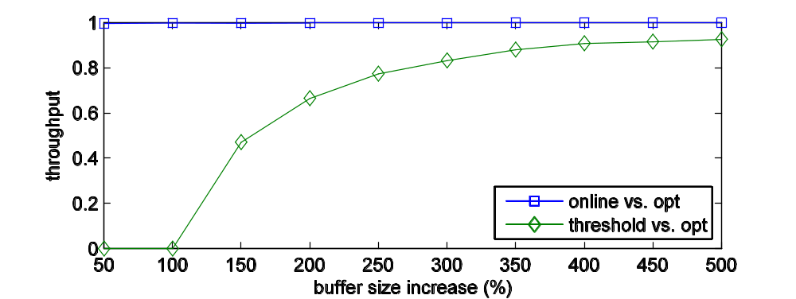
Simulation Results
Single MMPP source
Yellow packets at bursts “tail”
Yellow traffic: ~ 30% of total traffic
competitive ratio
October 21st, 2008
Competitive Analysis of Buffer Policies with SLA Commitments

Slide 16
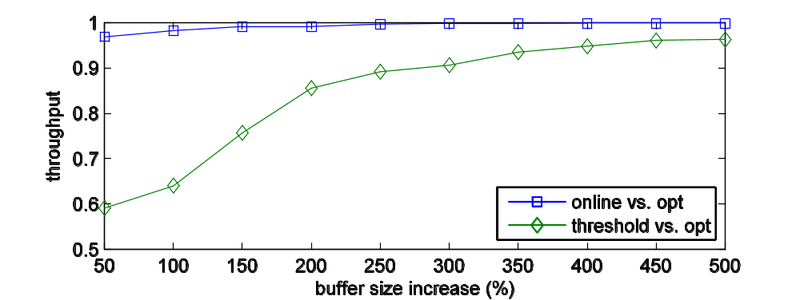
Simulation Results
MMPP + Yellow Poisson
Yellow packets also during OFF
Yellow traffic: ~ 40% of total traffic
October 21st, 2008
Competitive Analysis of Buffer Policies with SLA Commitments

Slide 17
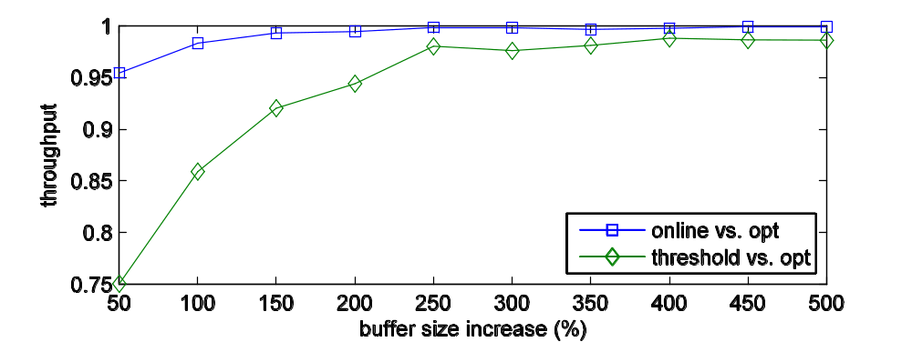
Simulation Results
MMPP + Yellow Poisson
Yellow packets also during OFF
Yellow traffic: ~ 50% of total traffic
October 21st, 2008
Competitive Analysis of Buffer Policies with SLA Commitments

Slide 18
Summary
Algorithm for managing buffers with committed traffic
Analytic performance results
  Globally applicable
  Both lower and upper bounds
  Guidelines for buffer provisioning
Simulation study
  Aggregate flows (\w best-effort)
  Outperforms common approaches
October 21st, 2008
Competitive Analysis of Buffer Policies with SLA Commitments

Slide 19
Future Work
Gaps:
  No lower bound for large .
  Lower bound vs. upper bound for small .
Multiple queues
Any guesses?
(Recommendation: read the paper first…)
October 21st, 2008
Competitive Analysis of Buffer Policies with SLA Commitments

Slide 20
Thank You!

