Slide 1
Bicriteria Approximation Tradeoff for the
Node-Cost Budget Problem
Yuval Rabani (Technion)
Gabriel Scalosub (Tel Aviv University)

Slide 2
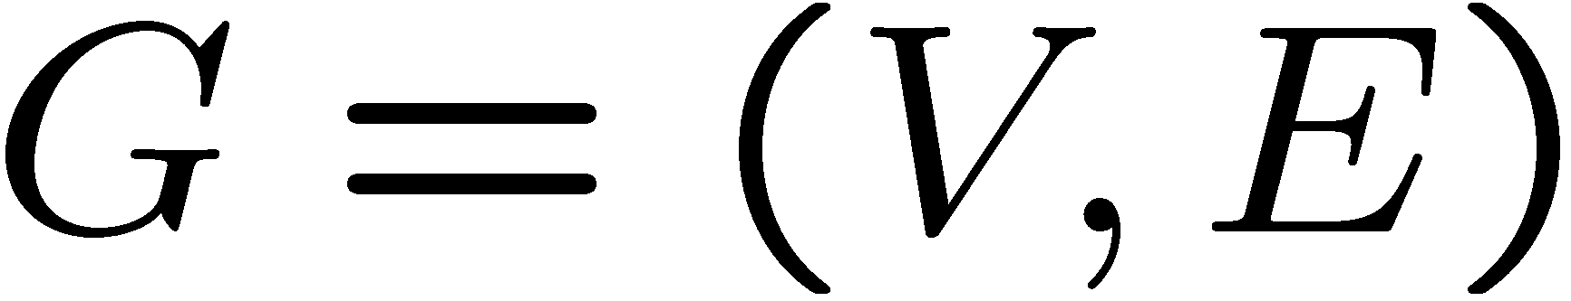
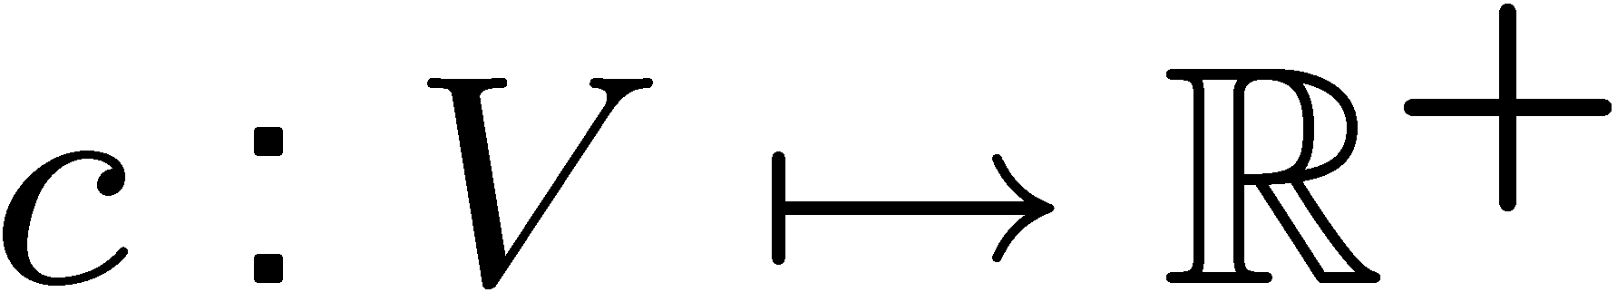
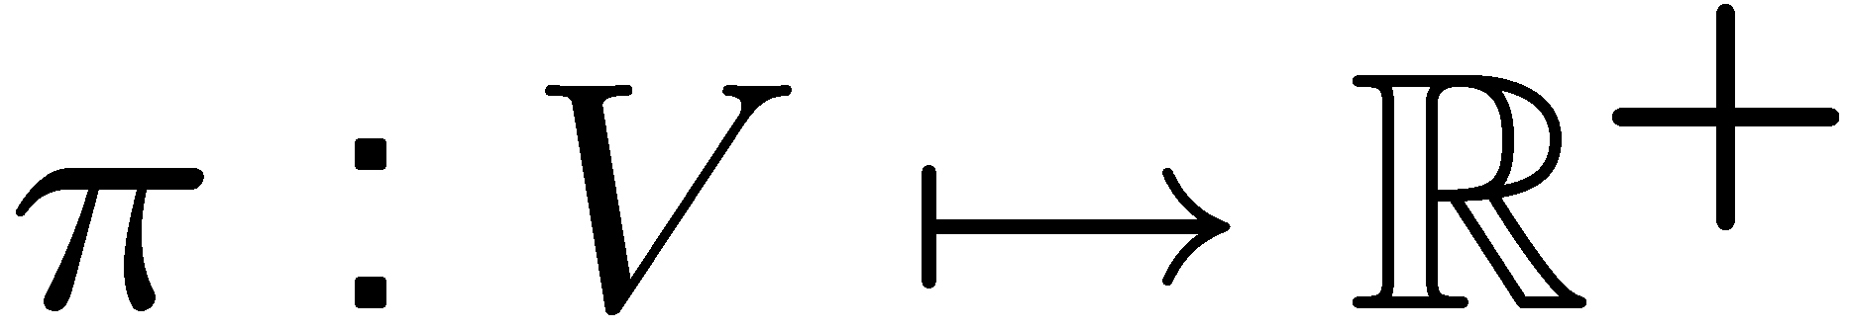
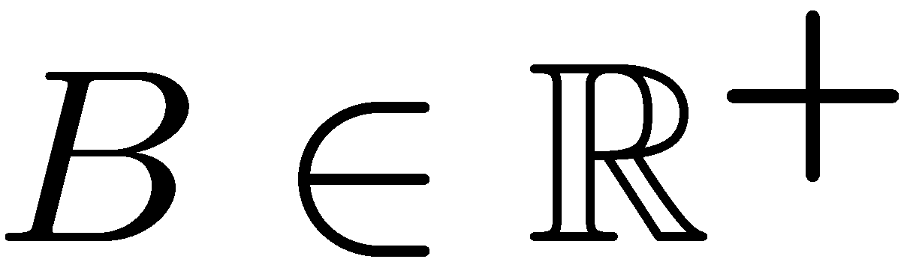
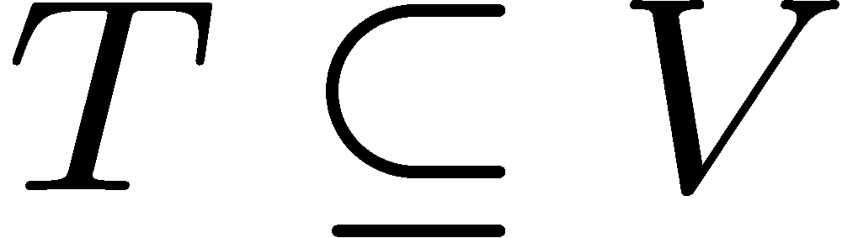
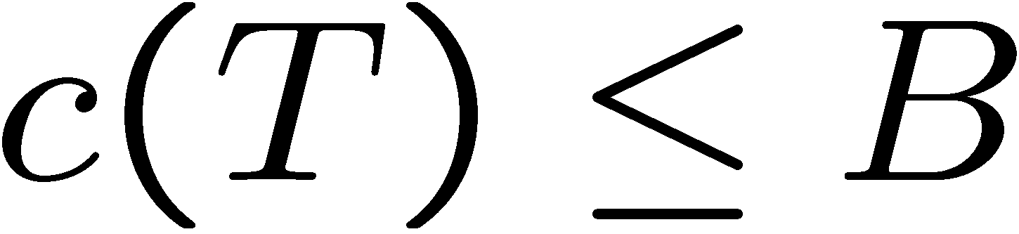
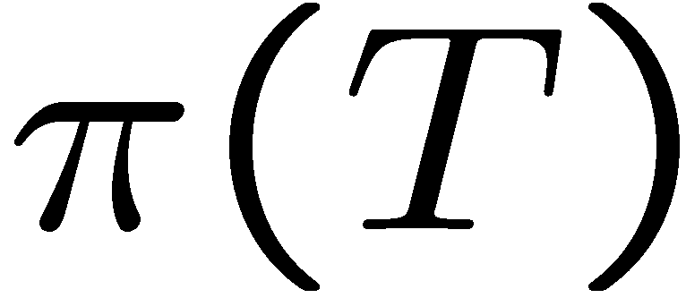
The Node-Cost Budget Problem
Input:
  Undirected graph
  Cost function
  Profit function
  Budget
Goal: Find a tree s.t.
  Budget constraint:
  is maximized
B=16
cost=16
profit=16
cost=17
profit=14

Slide 3
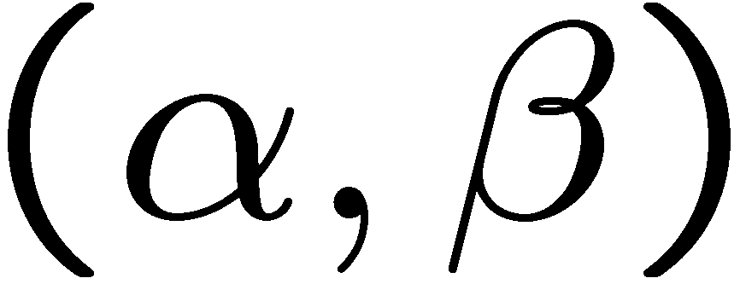

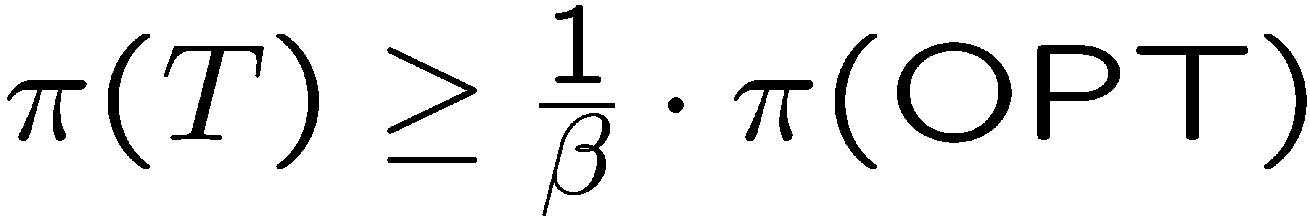
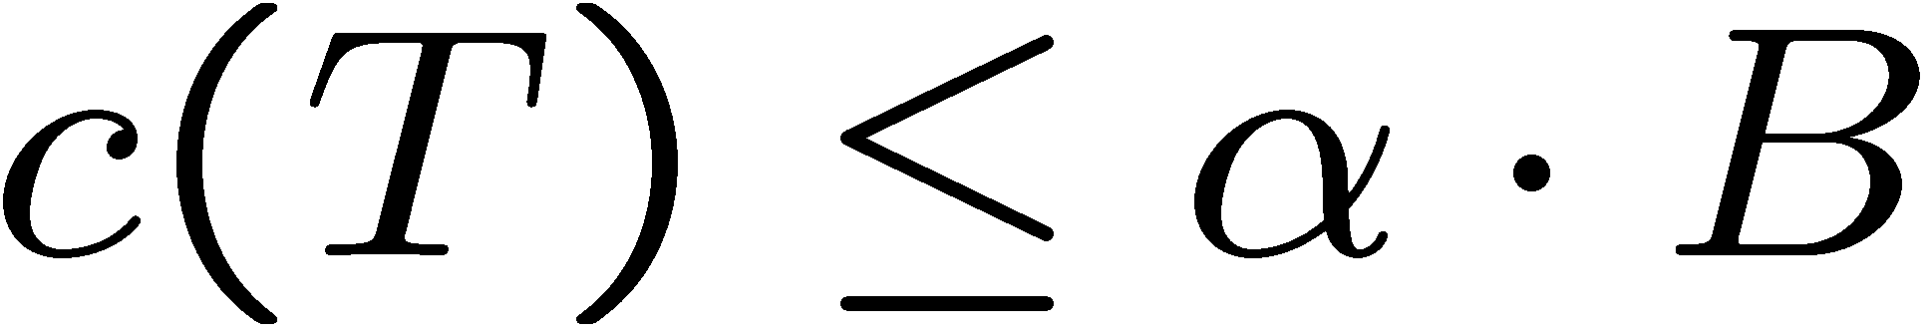
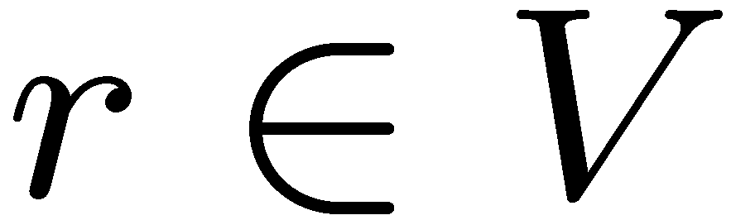
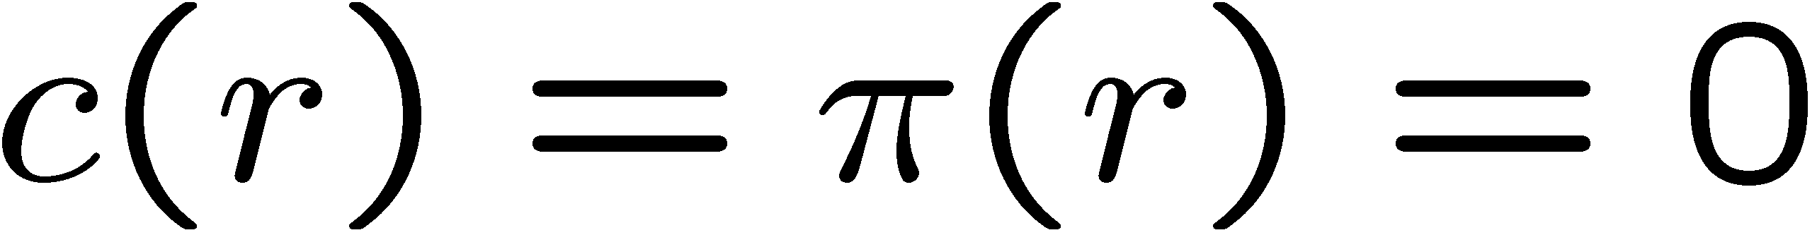
Preliminaries
An bicriteria approximate solution for the budget problem satisfies:
WLOG, assume:
  The problem is rooted:
  Some predefined must be part of the solution

Slide 4
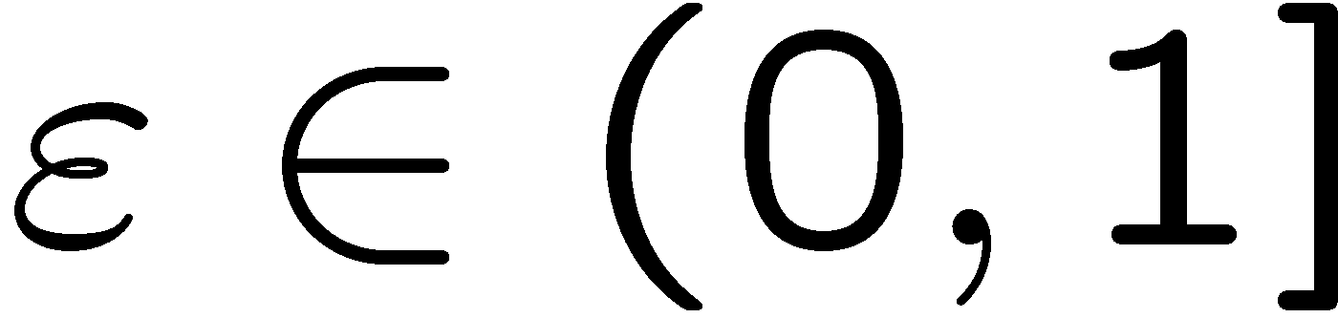
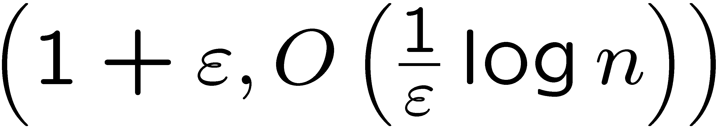
Our Results
For any ,
a -approximation algorithm
I.e., a tradeoff between the amount of budget violation, and the obtainable profit.
The first result to reduce the budget violation below 2.

Slide 5
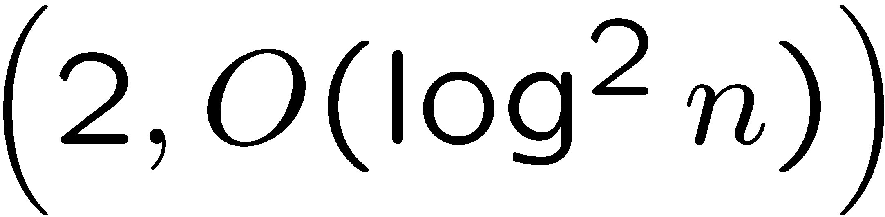
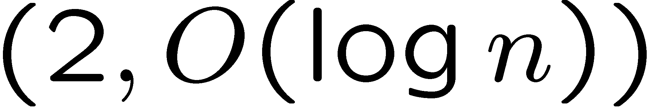
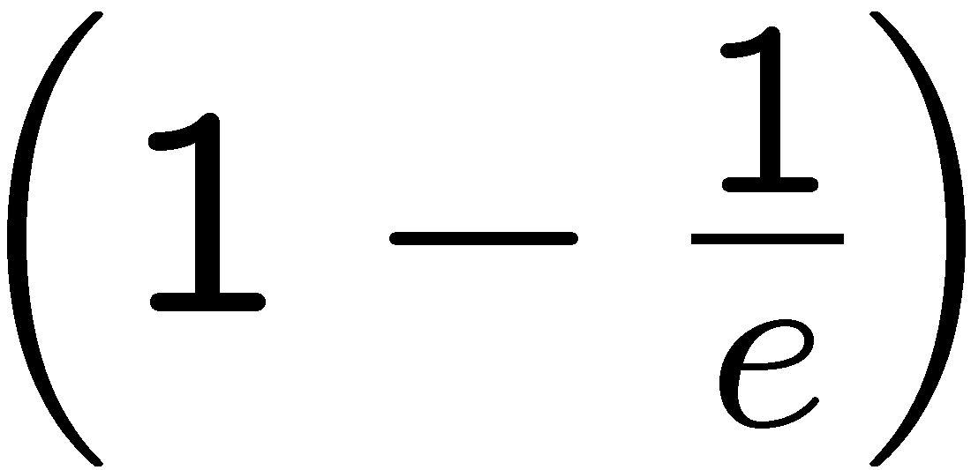
Previous Work
Upper Bounds | -approximation [Guha, Moss, Naor, Schieber 1999] -approximation [Moss, Rabani 2001]
Lower Bounds | Generalizes Budgeted Maximum Coverage Not approximable to within unless [Khuller, Moss, Naor 1999]

Slide 6
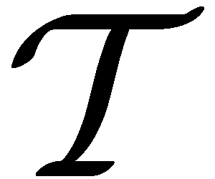

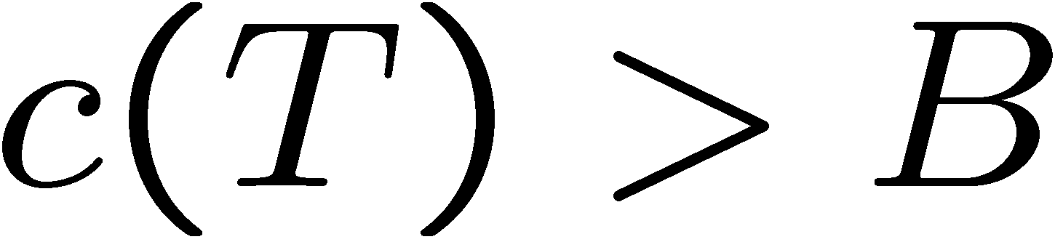
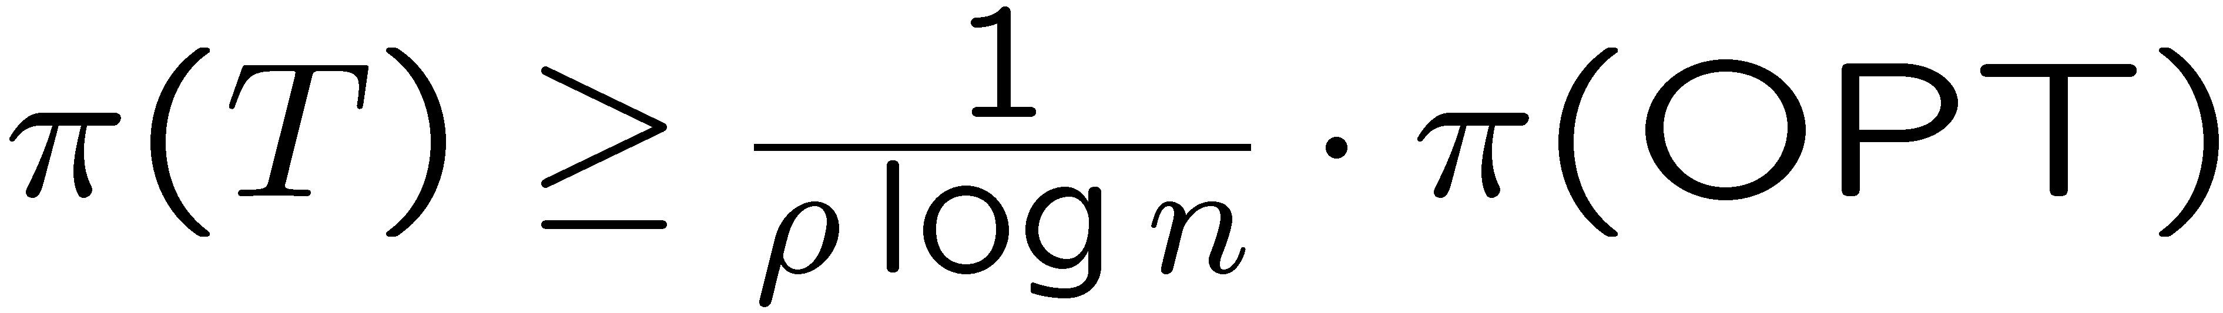
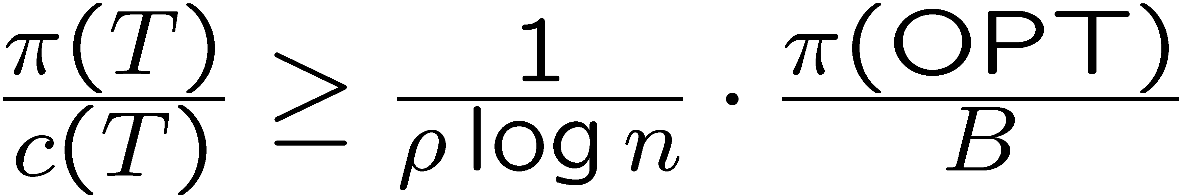
The Moss-Rabani Framework
Solve an LP relaxation of the problem
Use the solution to compute a polynomial set of trees
Show there exists a tree which satisfies:
Or
Cheap,
High profit
In this case,
we are done
Expensive,
High profit-to-cost ratio
⇒
The Hard Part

Slide 7
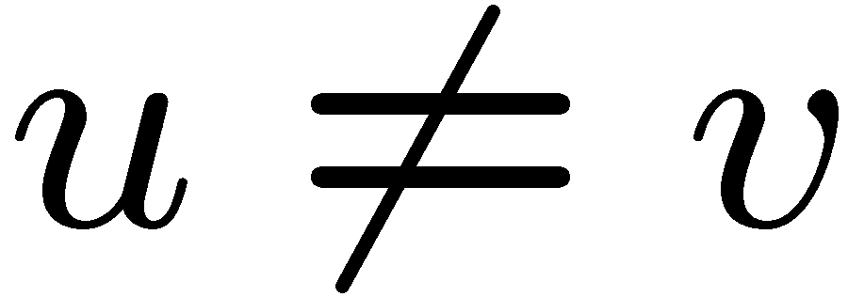
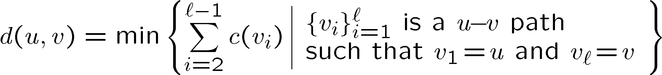
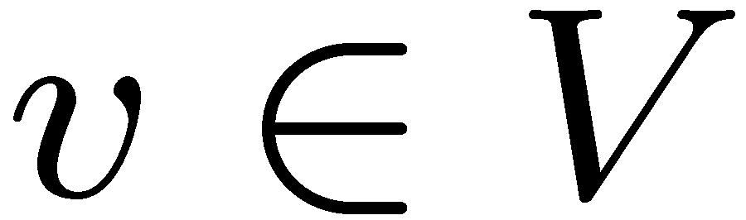
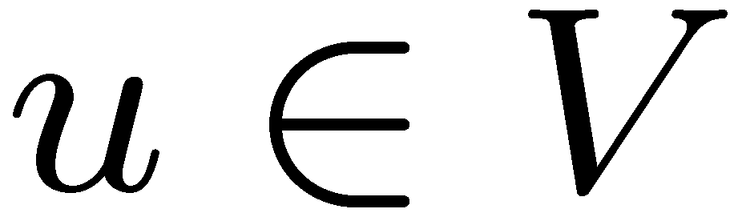

Distance and Reachability
Given two vertices , we let their distance be
We say is reachable from with cost , if

Slide 8


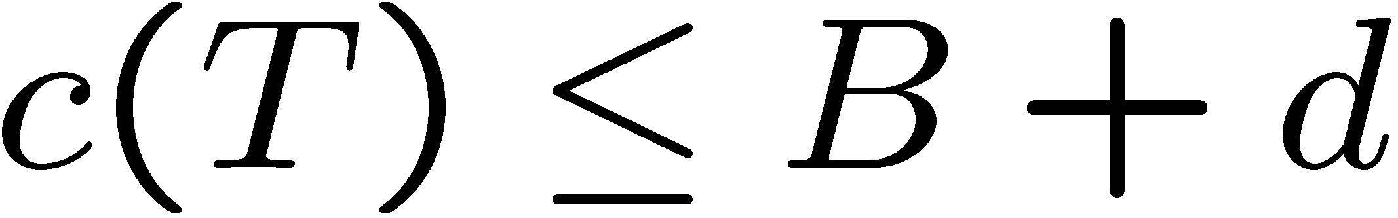
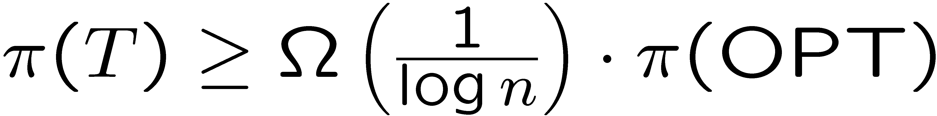
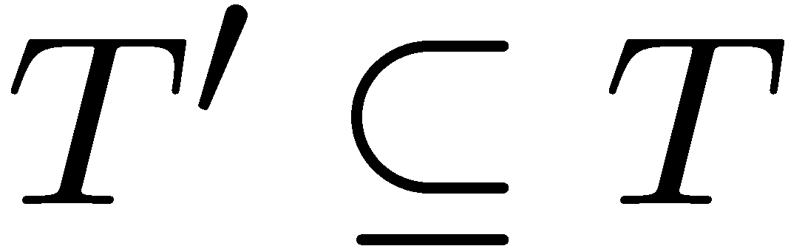

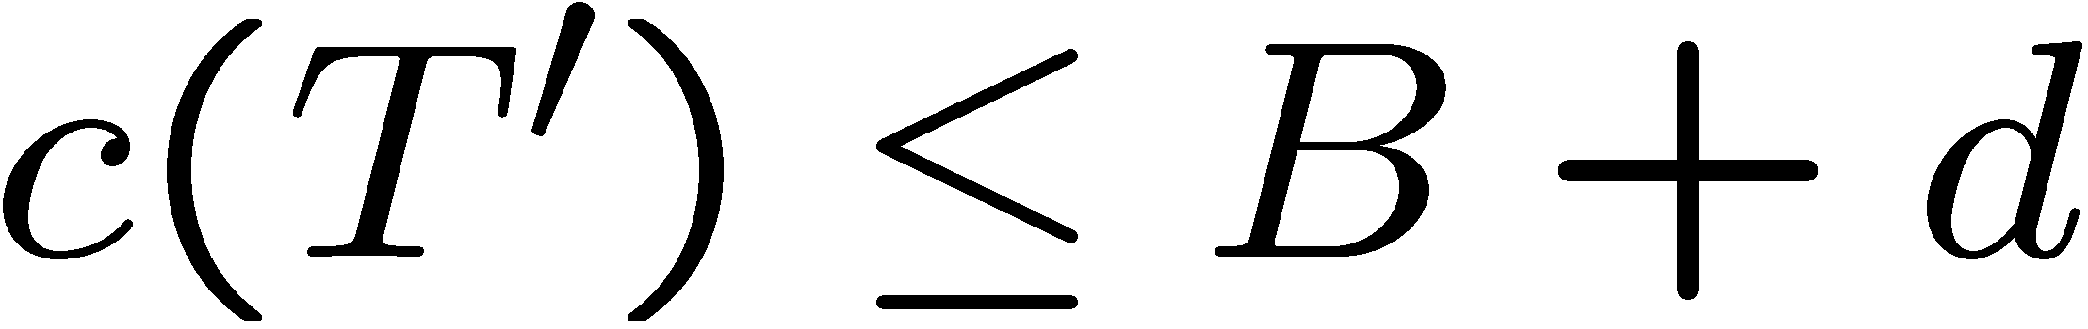
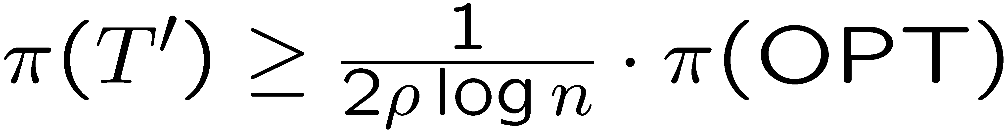
The Trimming Lemma
Assume:
  all vertices are reachable from the root with cost
  an -rooted tree satisfies
then one can find an -rooted subtree such that
Conclusion
If all vertices are reachable from the root with cost
then one can find a solution such that
MR result:

Slide 9

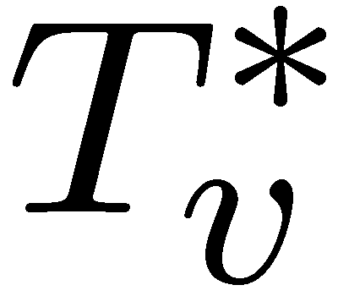
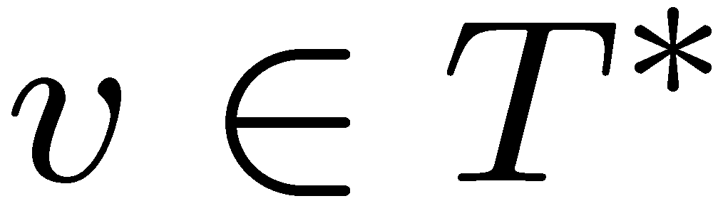
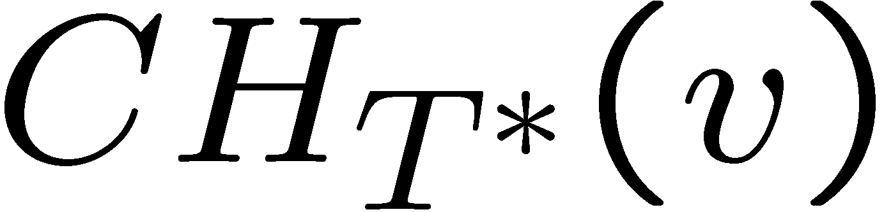

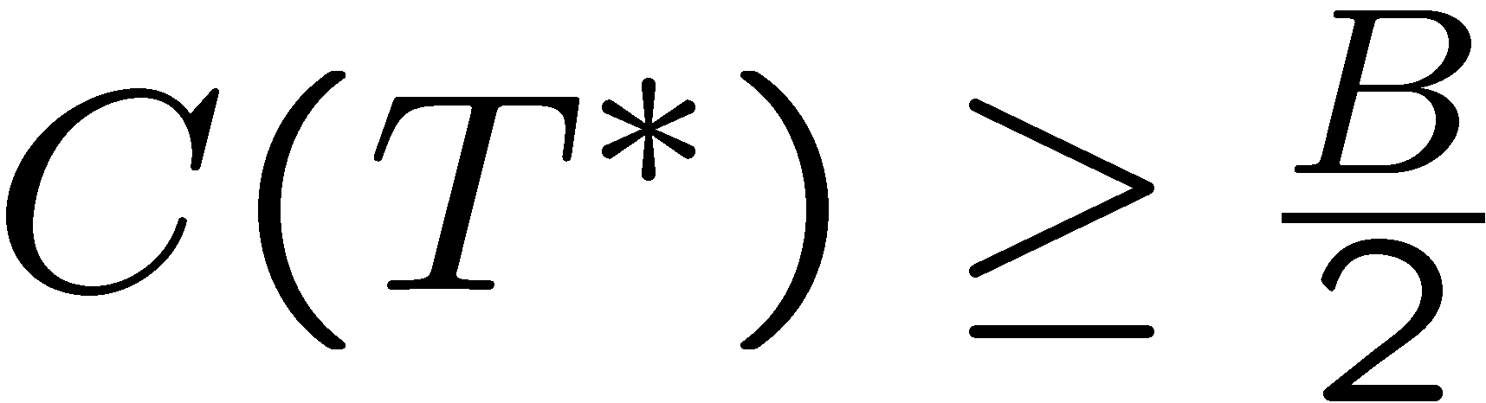
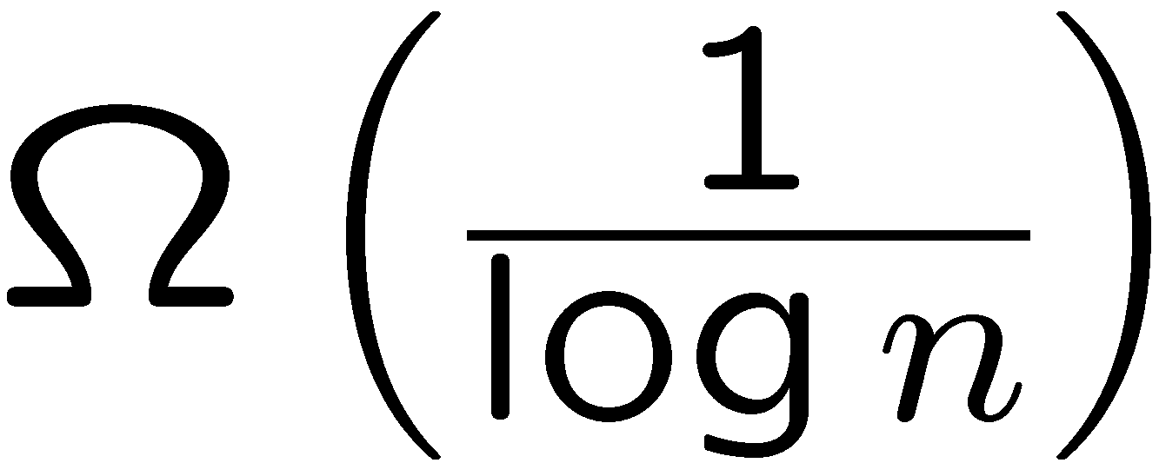

An Intermediate Goal
Some notation:
  - an optimal solution
  - a subtree of rooted at
  - the children of in
Assume WLOG,
Goal:
the optimal profit,
for the budget

Slide 10
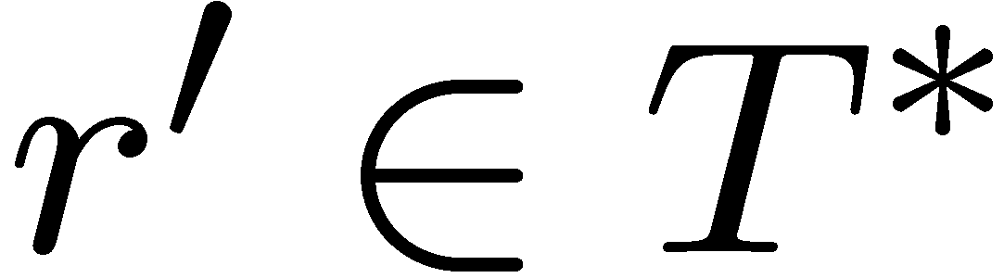



A Structural Analysis of OPT
Let be such that:
Note that

Slide 11
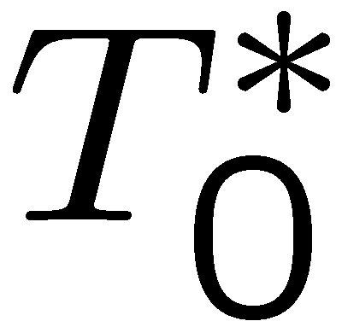

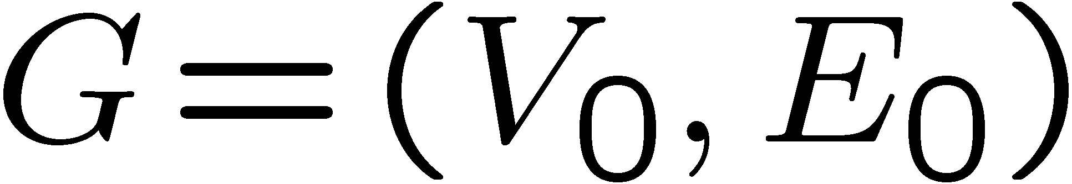
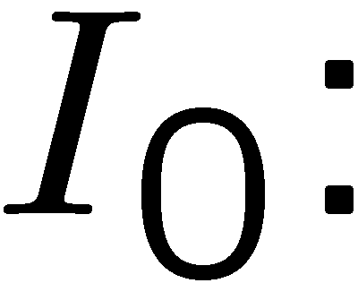
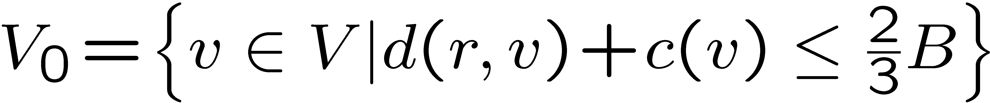
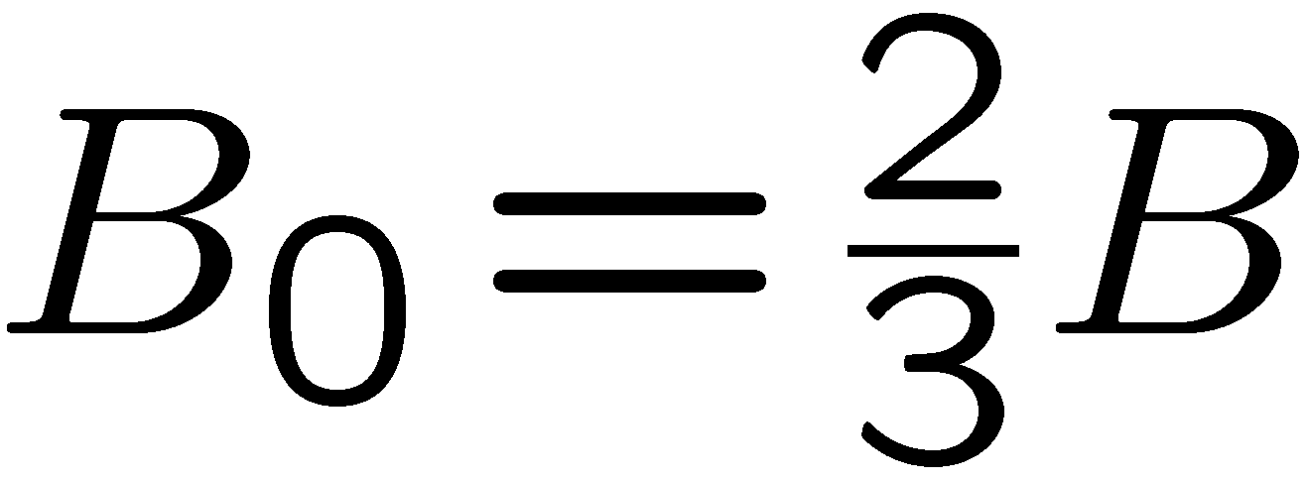
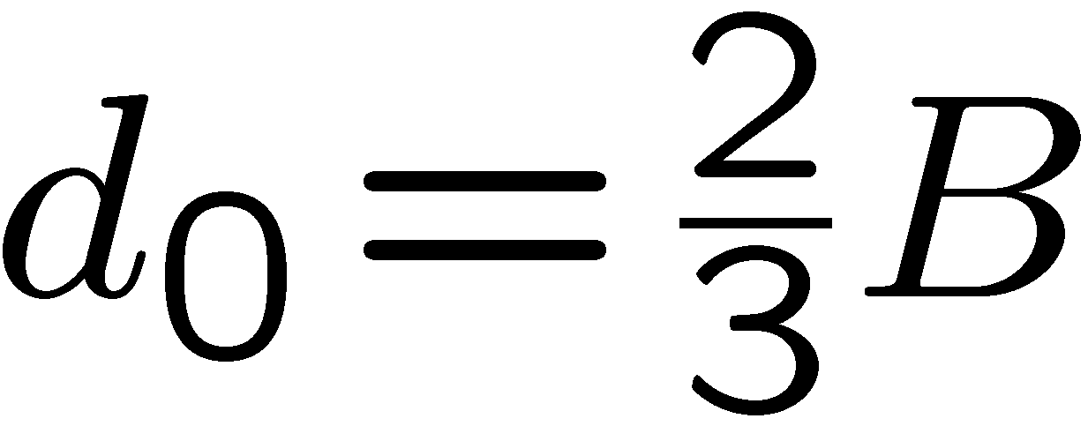
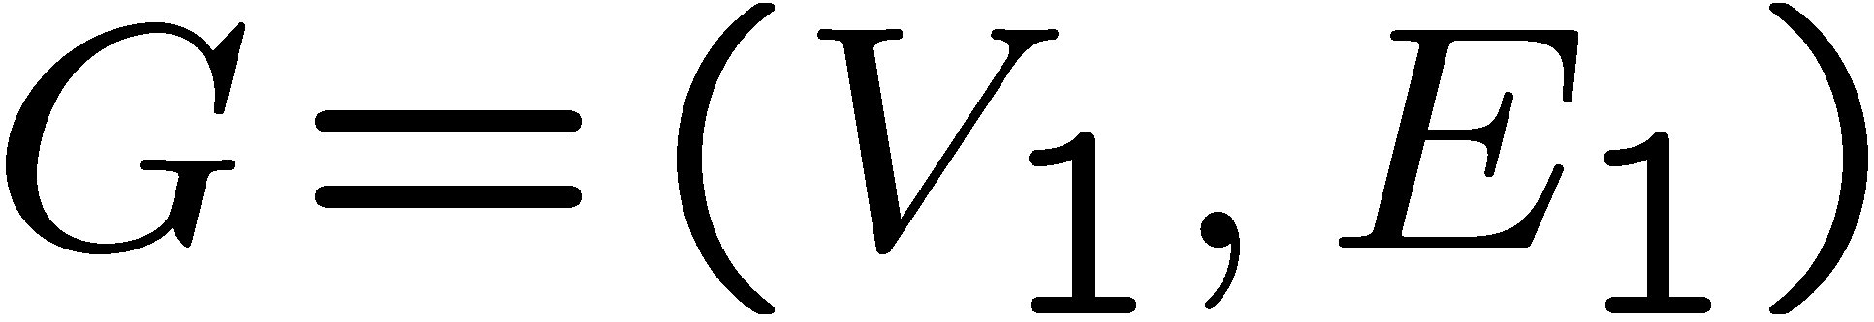

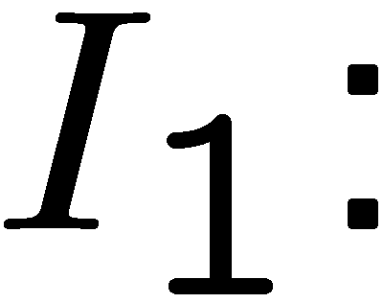
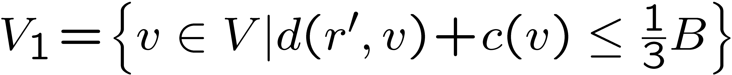
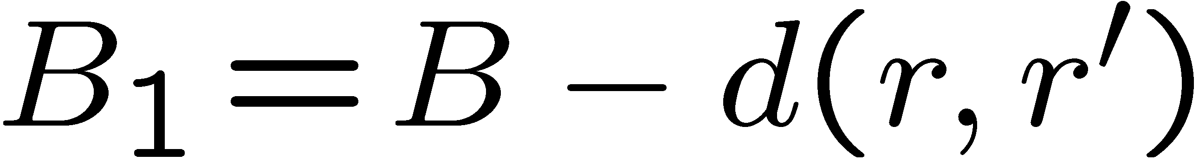
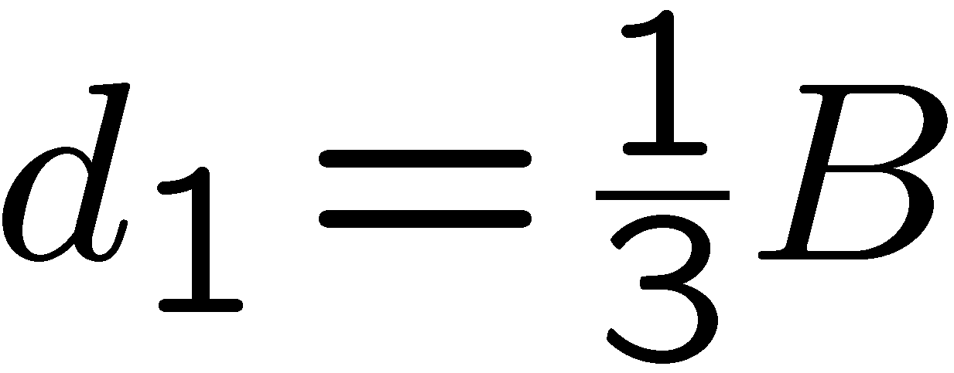
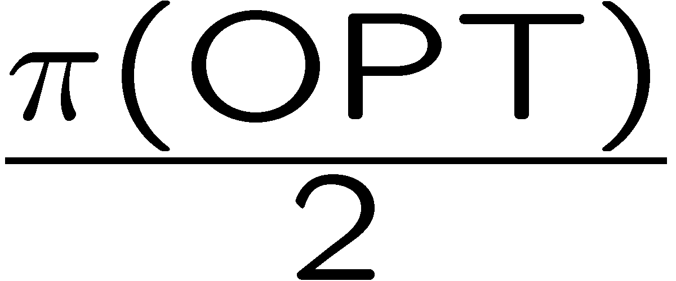
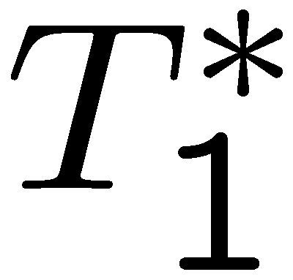
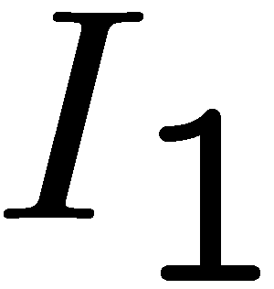
A Structural Analysis of OPT (cont)
Consider two instances:
At least one of them has value
is a feasible solution to
rooted at
rooted at
is a feasible solution to

Slide 12






Algorithm Sketch
Cand-1: MR solution with
Enumerate over all
Use the Trimming Lemma to approximate and
Let , be the solutions obtained
connect with
Cand-2:
Cand-3:
Return: best of all
rooted at
rooted at

Slide 13


Summary and Open Questions
This argument can be generalized by considering a partition into parts.
Given any , taking gives a
-approximate solution
Can one do away completely with the budget violation?
Logarithmic gap between upper and lower bound

Slide 14
Thank You!

