Slide 1
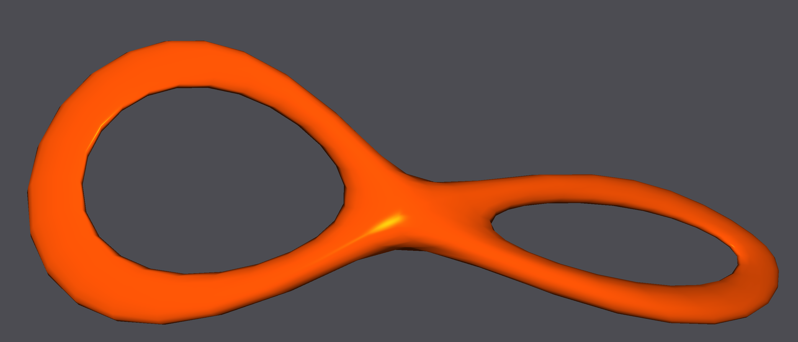
DGP 2019 Project Plasticity and explosions
Sébastien Gachoud
Ludo Hoffstetter
Simon Wicky EPFL

Slide 2
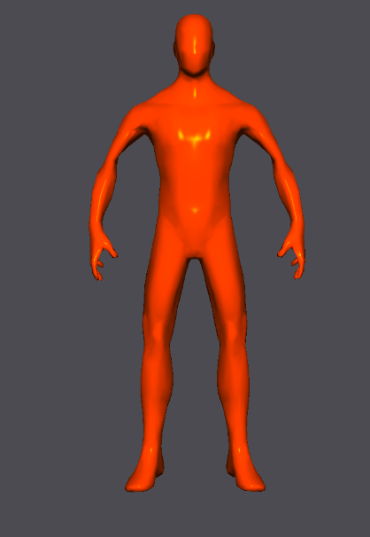
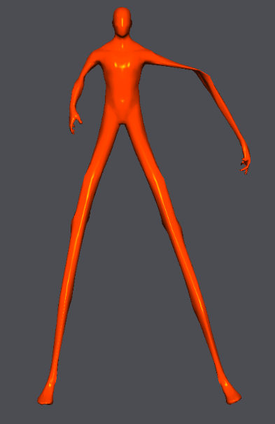
GOals
Add plasticity to the simulation
Deform the mesh if some constraint violation are too big
Explosions
Well, sort of
Point that set the vertices speed according to parameters

Slide 4
issues
You have to update the constraints
Update() methods after the local-global step.
Realism depends on the parameters of the plasticity
What is the violation threshold
How to modify the length if the constraint is violated
Conditional constraints create unwanted momentum
Cannot modify constraint weight for performance reasons
Solution: constrain to stay in place.

